Slide 1
并行程序设计
Lecture 14:
More OpenMP
Shouzhen Gu

Slide 2
Today’s Lecture
  OpenMP
  Programming Model: Loop Scheduling
  Schedule Clause
  Synchronization

Slide 3
Programming Model – Loop Scheduling
schedule clause determines how loop iterations are divided among the thread team
  static([chunk]) divides iterations statically between threads
    Each thread receives [chunk] iterations, rounding as necessary to account for all iterations
    Default [chunk] is ceil( # iterations / # threads )
  dynamic([chunk]) allocates [chunk] iterations per thread, allocating an additional [chunk] iterations when a thread finishes
    Forms a logical work queue, consisting of all loop iterations
    Default [chunk] is 1
  guided([chunk]) allocates dynamically, but [chunk] is exponentially reduced with each allocation
Notes:
Parallel for or for clause

Slide 4
More loop scheduling attributes
RUNTIME The scheduling decision is deferred until runtime by the environment variable OMP_SCHEDULE. It is illegal to specify a chunk size for this clause.
AUTO The scheduling decision is delegated to the compiler and/or runtime system.
NO WAIT / nowait: If specified, then threads do not synchronize at the end of the parallel loop.
ORDERED: Specifies that the iterations of the loop must be executed as they would be in a serial program.
COLLAPSE: Specifies how many loops in a nested loop should be collapsed into one large iteration space and divided according to the schedule clause (collapsed order corresponds to original sequential order).

Slide 5
Impact of Scheduling Decision
Load balance
  Same work in each iteration?
  Processors working at same speed?
Scheduling overhead
  Static decisions are cheap because they require no run-time coordination
  Dynamic decisions have overhead that is impacted by complexity and frequency of decisions
Data locality
  Particularly within cache lines for small chunk sizes
  Also impacts data reuse on same processor

Slide 6
A Few Words About Data Distribution
Data distribution describes how global data is partitioned across processors.
  a portion of the global address space is physically co-located with each processor
This data partitioning is implicit in OpenMP and may not match loop iteration scheduling
Compiler will try to do the right thing with static scheduling specifications

Slide 7
Common Data Distributions
Consider a 1-Dimensional array to solve the global sum problem, 16 elements, 4 threads
CYCLIC (chunk = 1):
for (i = 0; i<blocksize; i++)
… in [i*blocksize + tid];
BLOCK (chunk = 4):
for (i=tid*blocksize; i<(tid+1) *blocksize; i++)
… in[i];
BLOCK-CYCLIC (chunk = 2):
3
6
7
5
3
5
6
2
9
1
2
7
0
9
3
6
3
6
7
5
3
5
6
2
9
1
2
7
0
9
3
6
3
6
7
5
3
5
6
2
9
1
2
7
0
9
3
6

Slide 8
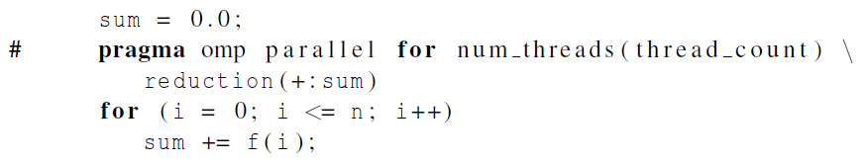
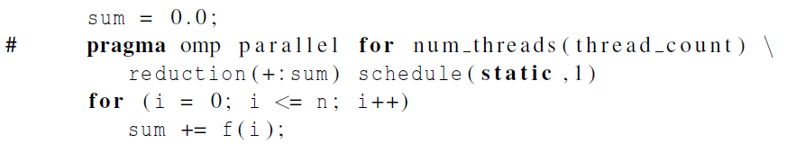
The Schedule Clause
schedule(<type> [, <chunksize>])
Default schedule:
Cyclic schedule:

Slide 9
OpenMP Synchronization
Implicit barrier
  At beginning and end of parallel constructs
  At end of all other control constructs
  Implicit synchronization can be removed with nowait clause
Explicit synchronization
  critical
  atomic (single statement)
  barrier

Slide 10
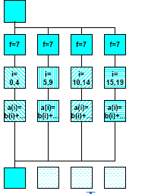
Variation: OpenMP parallel and for directives
Syntax:
#pragma omp for [ clause [ clause ] ... ] new-line
for-loop
clause can be one of the following:
shared (list)
private( list)
reduction( operator: list)
schedule( type [ , chunk ] )
nowait (C/C++: on #pragma omp for)
#pragma omp parallel private(f) {
f=7;
#pragma omp for
for (i=0; i<20; i++)
a[i] = b[i] + f * (i+1);
} /* omp end parallel */

Slide 11
Also, more control on synchronization
#pragma omp parallel shared(A,B,C)
{
tid = omp_get_thread_num();
A[tid] = big_calc1(tid);
#pragma omp barrier
#pragma omp for
for (i=0; i<N; i++) C[i] = big_calc2(tid);
#pragma omp for nowait
for (i=0; i<N; i++) B[i] = big_calc3(tid);
A[tid] = big_calc4(tid);
}

Slide 12
OpenMP environment variables
OMP_NUM_THREADS
sets the number of threads to use during execution
when dynamic adjustment of the number of threads is enabled, the value of this environment variable is the maximum number of threads to use
For example,
setenv OMP_NUM_THREADS 16 [csh, tcsh]
export OMP_NUM_THREADS=16 [sh, ksh, bash]
OMP_SCHEDULE
applies only to do/for and parallel do/for directives that have the schedule type RUNTIME
sets schedule type and chunk size for all such loops
For example,
setenv OMP_SCHEDULE GUIDED,4 [csh, tcsh]
export OMP_SCHEDULE= GUIDED,4 [sh, ksh, bash]
Notes:
Bourne Shell （即sh）是UNIX最初使用的shell，并且在每种UNIX上都可以使用。
C Shell （csh）语法与C语言很相似。Linux为喜欢使用C Shell的提供了Tcsh
Korn Shell，ash，zsh

Slide 13
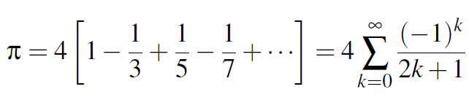
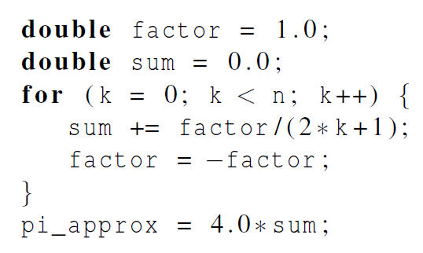
Estimating π

Slide 14
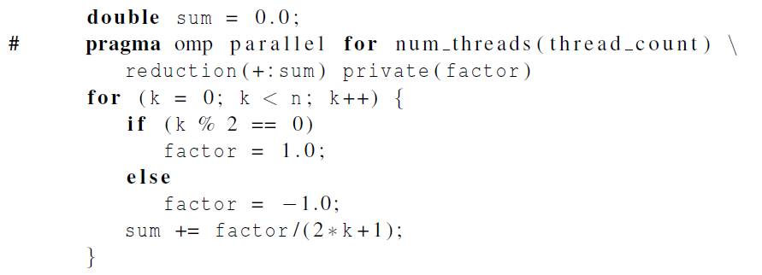
OpenMP solution
Insures factor has
private scope.

Slide 15
Conditional Parallelization
if (scalar expression)
Only execute in parallel if expression evaluates to true
Otherwise, execute serially
#pragma omp parallel if (n > threshold) \
shared(n,x,y) private(i) {
#pragma omp for
for (i=0; i<n; i++)
x[i] += y[i];
} /*-- End of parallel region --*/
Review:
parallel
for
private
shared

Slide 16
SINGLE and MASTER constructs
Only one thread in team executes code enclosed
Useful for things like I/O or initialization
No implicit barrier on entry or exit
Similarly, only master executes code
#pragma omp single {
<code-block>
}
#pragma omp master {
<code-block>
}

Slide 17
General: Task Parallelism
Recall definition:
  A task parallel computation is one in which parallelism is applied by performing distinct computations – or tasks – at the same time. Since the number of tasks is fixed, the parallelism is not scalable.
OpenMP support for task parallelism
  Parallel sections: different threads execute different code
  Tasks (NEW): tasks are created and executed at separate times
Common use of task parallelism = Producer/consumer
  A producer creates work that is then processed by the consumer
  You can think of this as a form of pipelining, like in an assembly line
  The “producer” writes data to a FIFO queue (or similar) to be accessed by the “consumer”

Slide 18
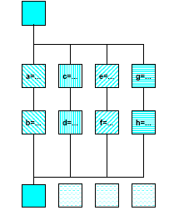
Simple: OpenMP sections directive
#pragma omp parallel
{
#pragma omp sections
#pragma omp section
{{ a=...;
b=...; }
#pragma omp section
{ c=...;
d=...; }
#pragma omp section
{ e=...;
f=...; }
#pragma omp section
{ g=...;
h=...; }
} /*omp end sections*/
} /*omp end parallel*/

Slide 19
Parallel Sections, Example
#pragma omp parallel shared(n,a,b,c,d) private(i)
{
#pragma omp sections nowait {
#pragma omp section
for (i=0; i<n; i++)
d[i] = 1.0/c[i];
#pragma omp section
for (i=0; i<n-1; i++)
b[i] = (a[i] + a[i+1])/2;
} /*-- End of sections --*/
} /*-- End of parallel region

Slide 20
Simple Producer-Consumer Example
// PRODUCER: initialize A with random data
void fill_rand(int nval, double *A) {
for (i=0; i<nval; i++) A[i] = (double) rand()/1111111111;
}
// CONSUMER: Sum the data in A
double Sum_array(int nval, double *A) {
double sum = 0.0;
for (i=0; i<nval; i++) sum = sum + A[i];
return sum;
}

Slide 21
Key Issues in Producer-Consumer Parallelism
Producer needs to tell consumer that the data is ready
Consumer needs to wait until data is ready
Producer and consumer need a way to communicate data
  output of producer is input to consumer
Producer and consumer often communicate through First-in-first-out (FIFO) queue

Slide 22
One Solution to Read/Write a FIFO
The FIFO is in global memory and is shared between the parallel threads
How do you make sure the data is updated?
Need a construct to guarantee consistent view of memory一致性
  Flush: make sure data is written all the way back to global memory
Example:
Double A;
A = compute();
Flush(A);

Slide 23
Solution to Producer/Consumer
flag = 0;
#pragma omp parallel
{
#pragma omp section
{
fillrand(N,A);
#pragma omp flush
flag = 1;
#pragma omp flush(flag)
}
#pragma omp section
{
while (!flag)
#pragma omp flush(flag)
#pragma omp flush
sum = sum_array(N,A);
}
}

Slide 24
Another Example from Textbook
Implement Message-Passing on a Shared-Memory System
A FIFO queue holds messages
A thread has explicit functions to Send and Receive
  Send a message by enqueuing on a queue in shared memory
  Receive a message by grabbing from queue
  Ensure safe access

Slide 25
Message-Passing
for (sent_msgs = 0; sent_msgs < send_max; sent_msgs++) {
Send_msg();
Try_receive();
}
while (!Done())
Try_receive();

Slide 26
Sending Messages
mesg = random();
dest = random() % thread_count;
# pragma omp critical
Enqueue(queue, dest, my_rank, mesg);
Use synchronization mechanisms to update FIFO
“Flush” happens implicitly
What is the implementation of Enqueue?

Slide 27
Receiving Messages
queue_size = enqueued-dequeued;
if (queue_size == 0) return;
else if (queue_size == 1)
# pragma omp critical
Dequeue(queue, &src, &mesg);
else
Dequeue(queue, &src, &mesg);
Print message(src, mesg);
This thread is the only one to dequeue its messages.
Other threads may only add more messages.
Messages added to end and removed from front.
Therefore, only if we are on the last entry is synchronization needed.

Slide 28
Termination Detection
Queue_size = enqueued -dequeued;
if (queue_size == 0 && done_sending == thread_count)
return TRUE;
else
return FALSE;
each thread increments this after completing its for loop
More synchronization needed on “done_sending”

Slide 29
Summary of OpenMP
OpenMP, data-parallel constructs only
  Task-parallel constructs later
What’s good?
  Small changes are required to produce a parallel program from sequential (parallel formulation)
  Avoid having to express low-level mapping details
  Portable and scalable, correct on 1 processor多线程单进程
What is missing?
  Not completely natural if want to write a parallel code from scratch
  Not always possible to express certain common parallel constructs
  Locality management
  Control of performance

