Slide 1
并行程序设计
Lecture 15:
Tree Search
Shouzhen Gu

Slide 2
Tree search problem (TSP)
An NP-complete problem.
No known solution to TSP that is better in all cases than exhaustive search.
Ex., the travelling salesperson problem, finding a minimum cost tour.
(Also called single-source shortest path)

Slide 3
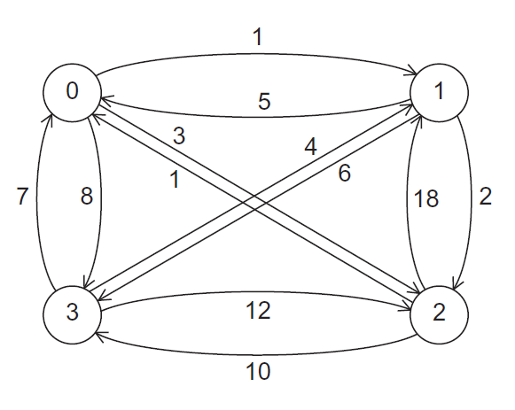

A Four-City TSP
0 is root or single source. What is the shortest path?

Slide 4
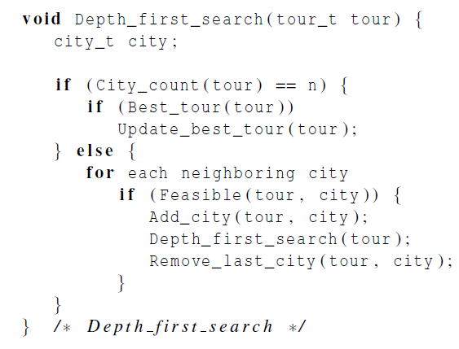
Pseudo-code for a recursive solution to TSP using depth-first search

Slide 5
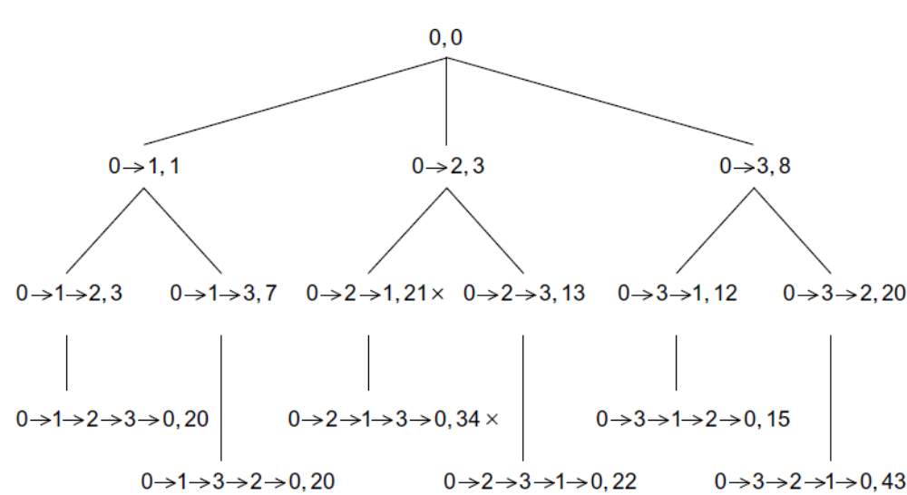
Depth-first Search

Slide 6
We’ll need to eliminate recursion
Non-recursive implementation is more flexible
  Shared data structures
  Freedom to schedule threads/processes flexibly
How to eliminate recursion
  Explicit management of “stack” data structure
  Loop instead of recursive calls

Slide 7
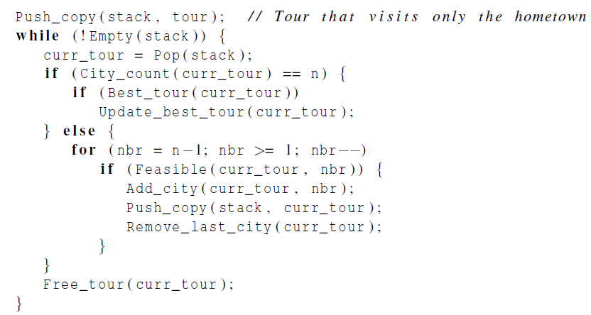
Pseudo-code for a second solution to TSP that doesn’t use recursion
Termination and find best solution
Can this city be added:
on path?
new to path?
shorter than existing paths?

Slide 8
Global variable – stores “best_tour”
How to know whether global “best_tour” value is better?
  Guarantee that any writes will be performed atomically
  Textbook suggests reading it without locking
    Value may be slightly out of date, but just increases work slightly since value is monotonically decreasing
    Cost of synchronizing read not worth it
    If the process’s value is not as good, not updated

Slide 9
Making sure we have the “best_tour”
In the case where a thread tests and decides it has a better global solution, we need to ensure two things:
  1) That the process locks the value with a mutex, preventing a race condition.
  2) In the possible event that the first check was against an old value while another process was updating, we do not put a worse value than the new one that was being written.
We handle this by locking, then testing again.

Slide 10
First scenario
global
tour value
process y
process x
local
tour value
local
tour value
27
30
22
22
27
3. test
1. test
6. lock
2. lock
7. test again
4. update
8. update
5. unlock
9. unlock

Slide 11
Second scenario
global
tour value
process y
process x
local
tour value
local
tour value
30
27
29
27
3. test
1. test
6. lock
2. lock
7. test again
4. update
8. unlock
5. unlock

Slide 12
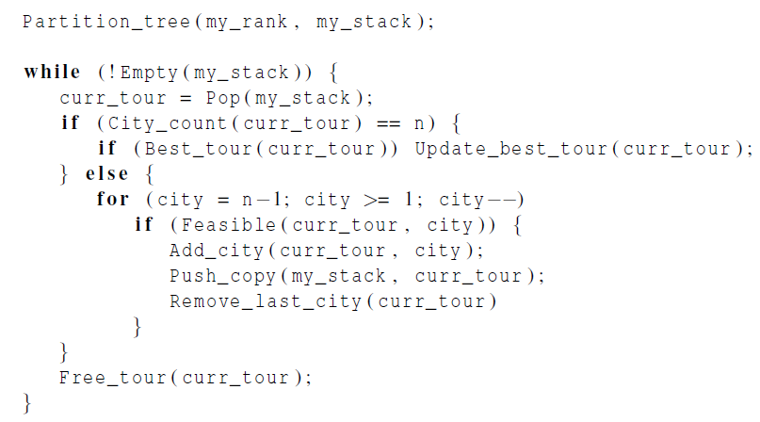
Pseudo-code for a Pthreads implementation of a statically parallelized solution to TSP
Master thread does static partitioning using breadth-first search
Thread operates on its private stack
Needs mutex (next slides)

Slide 13
A Careful Look at Load Imbalance
Load imbalance very likely
  The master thread is partitioning the work
  Some expensive paths will be pruned early
What to do?
  Schedule some work statically and some dynamically for under-utilized processors
  Minimize cost of moving work
  This could be done a lot smarter than it is
Challenges:
  Which processes are available to take on more work?
  When does execution terminate?

Slide 14
Dynamic Parallelization of Tree Search Using Pthreads
Termination issues: change the test !Empty(my_stack).
Code executed by a thread before it splits:
  It checks that it has at least two tours in its stack.
  It checks that there are threads waiting.
  It checks whether the new_stack variable is NULL.
P0
P1
While{
…
Call pthread_cond_wait to sleep;
}
While{
…
Check if there is sleep pthread;
Splitting its stack;
Call pthread_cond_signal;
}
Notes:
将while循环的终止条件改变。如果自己结束了，不跳出循环，查看一下是否有其他线程有更多的任务。

Slide 15
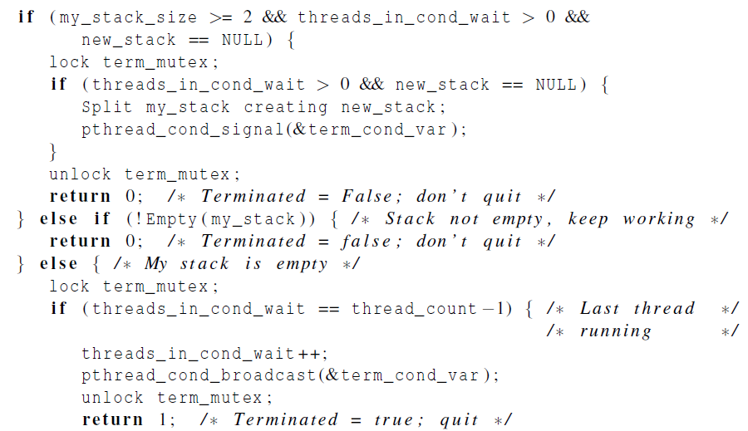
Pseudo-Code for Pthreads Terminated Function
Do I have extra work, and are there idle threads?
Wake up an idle thread
Termination test

Slide 16
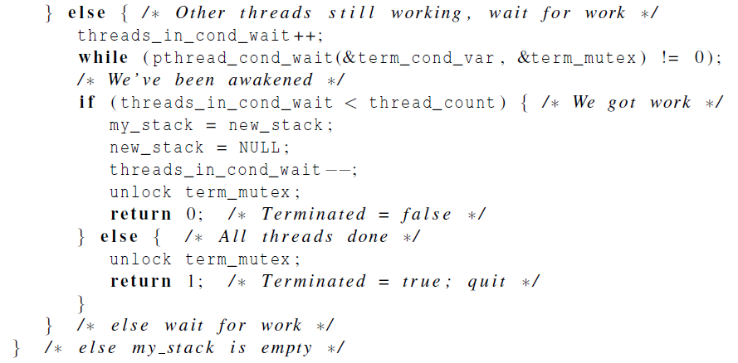
Pseudo-Code for Pthreads Terminated Function, cont.
Idle thread gets new work

Slide 17
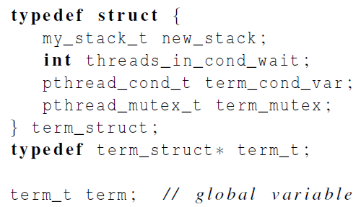
Grouping the termination variables

Slide 18


Parallelizing the Tree Search Programs Using OpenMP
Same basic issues implementing the static and dynamic parallel tree search programs as Pthreads.
A few small changes can be noted.
Pthreads
OpenMP
Notes:
单线程运行的代码，修改方式

Slide 19
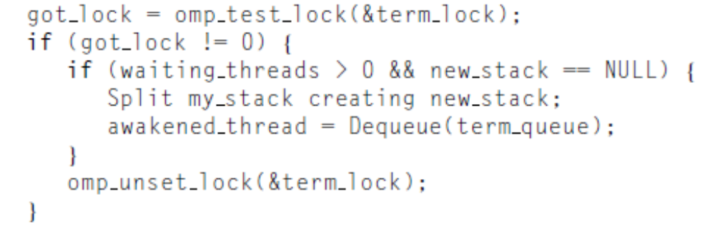
Other OpenMP changes
Use a critical section instead of a mutex to guard selection of “best tour”, but similar “optimistic” synchronization
Need a different construct for conditional wait (not clean)
  Next slide, but more in textbook to select particular idle thread
  Requires auxiliary stack of idle threads to select “awakened_thread”

Slide 20
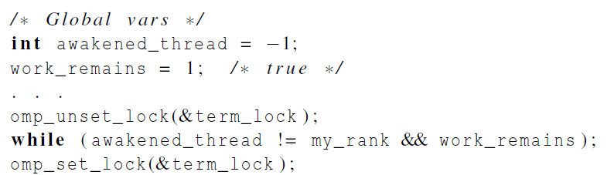
OpenMP emulated condition wait

Slide 21
MPI is similar
Static and dynamic partitioning schemes
partitioning the tree
Maintaining “best_tour” requires global synchronization, could be costly
  May be relaxed a little to improve efficiency
  Alternatively, some different communication constructs can be used to make this more asynchronous and less costly
  MPI_Iprobe checks for available message rather than actually receiving
  MPI_Bsend and other forms of send allow aggregating results of communication asynchronously

Slide 22
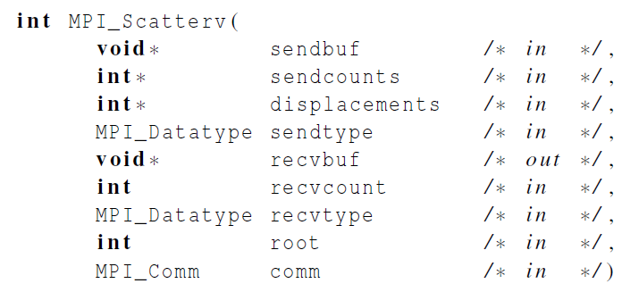
Partitioning the Tree
Sending a different number of objects to each process in the communicator to distribute initial stack

Slide 23
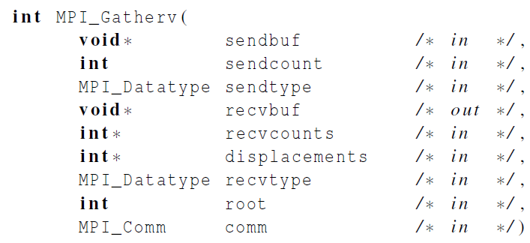
Gathering Results
Gathering a different number of objects from each process in the communicator

Slide 24
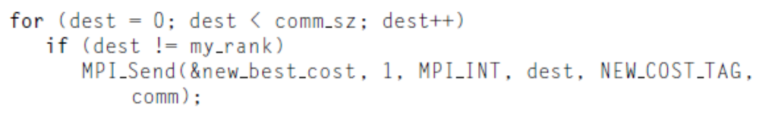
Maintaining the Best Tour
When a process finds a new best tour, it should send it to the other processes.
Tell the receiving process that the message is a new cost

Slide 25
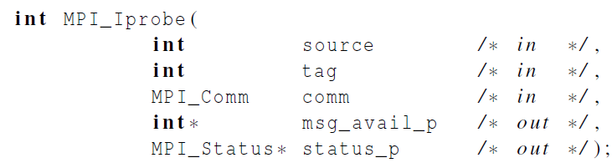
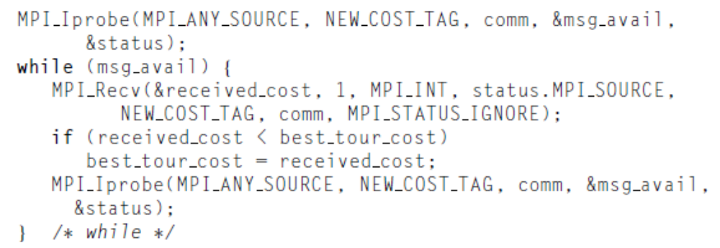
Checks for Available Message
Checking to see if a message is available
Check for new best tour costs

Slide 26
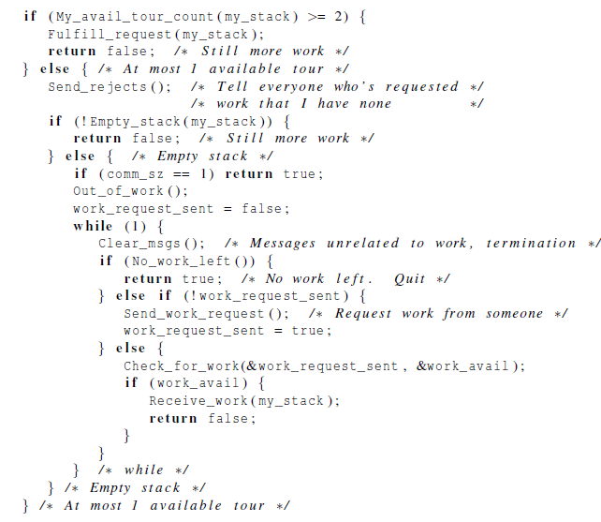
Check if there is request for work and Split work
The process announces it’s out of work
Terminated Function for a Dynamically Partitioned TSP solver that Uses MPI.
Notes:
MPI_buffer_attach

Slide 27
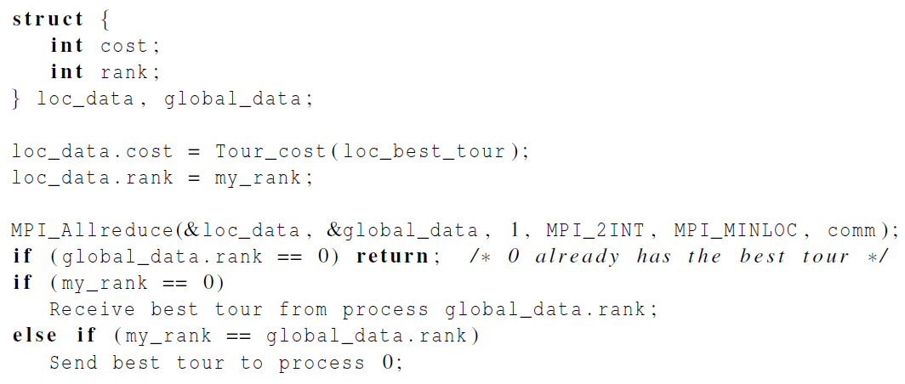
Printing the best tour

Slide 28
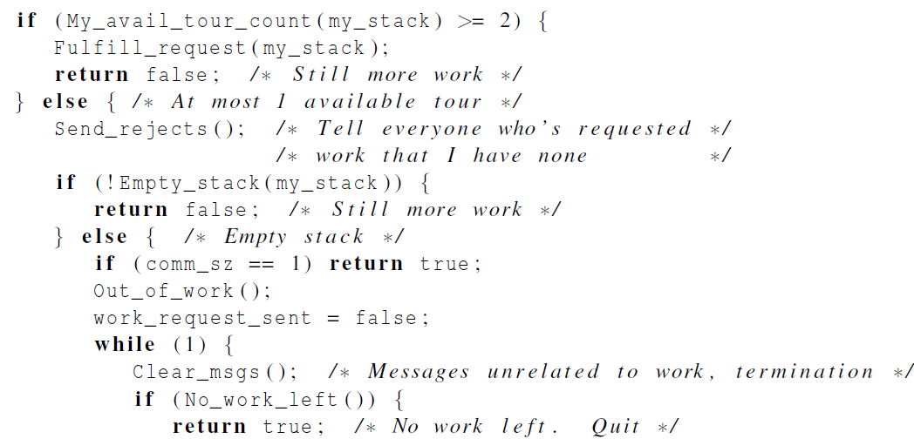
Terminated Function for a Dynamically Partitioned TSP solver with MPI (1)

Slide 29
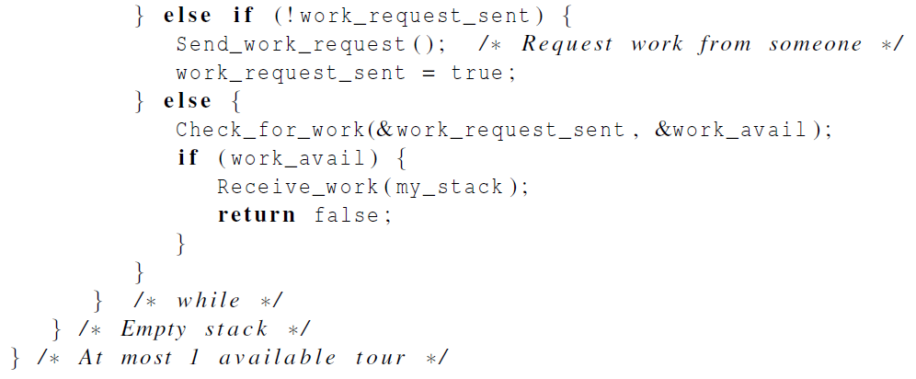
Terminated Function for a Dynamically Partitioned TSP solver with MPI (2)

Slide 30
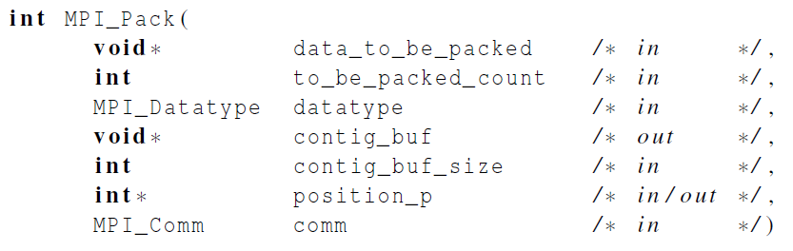
Packing data into a buffer of contiguous memory

Slide 31
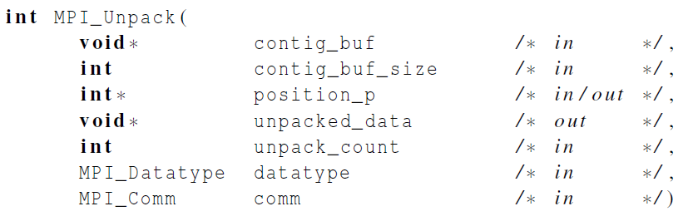
Unpacking data from a buffer of contiguous memory

Slide 32
Summary of Lecture
This “tree search” is the hardest parallel programming challenge we have studied
  Load imbalance leads to the need for dynamic scheduling, which in turn leads to termination challenges requiring elaborate synchronization and communication
  This may be too hard for an efficient OpenMP implementation and is also challenging for MPI
  We did not even talk about locality!
This chapter is dense, but getting through it is worth it
  It shows REAL parallel programming and the need for elaborate language constructs
Other “irregular” algorithms are even more difficult

