Slide 1
并行程序设计
Lecture 4:
Introduction to Parallel Architectures
Shouzhen Gu

Slide 2
Quiz
Assume there are three small cache, each consisting of four one-word blocks. One cache is fully associative, a second is two-way set-associative, and the third is direct-mapped. Find the number of misses for each cache organization given the following sequence of block addresses: 0, 8, 0, 6, and 8.

Slide 3
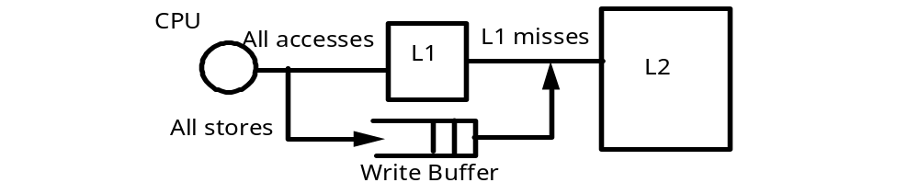
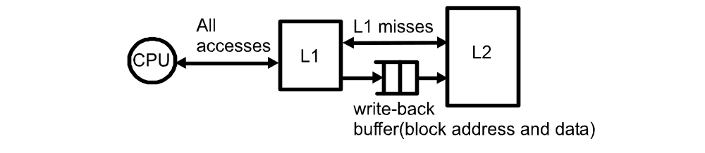
Data Inconsistent
Write through cache
  A cache line is written to main memory when it is written to the cache.
Write back cache
  The data is marked as dirty in the cache, and written back to memory when it is replaced by a new cache line.

Slide 4
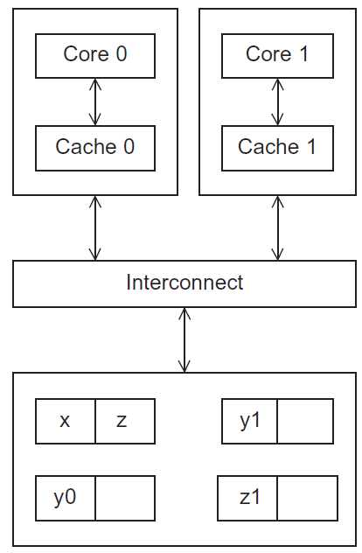
Cache coherence
Programmers have no
control over caches
and when they get updated.
A shared memory system with two cores and two caches
Figure 2.17
Copyright © 2010, Elsevier Inc. All rights Reserved

Slide 5
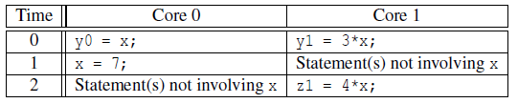
Cache coherence
y0 privately owned by Core 0
y1 and z1 privately owned by Core 1
x = 2; /* shared variable */
y0 eventually ends up = 2
y1 eventually ends up = 6
z1 = ???
Notes:
suppose the following statements are executed at the indicated times:

Slide 6
Snooping Cache Coherence
The cores share a bus.
Any signal transmitted on the bus can be “seen” by all cores connected to the bus.
When core 0 updates the copy of x stored in its cache it also broadcasts this information across the bus.
If core 1 is “snooping”监听 the bus, it will see that x has been updated and it can mark its copy of x as invalid.

Slide 7
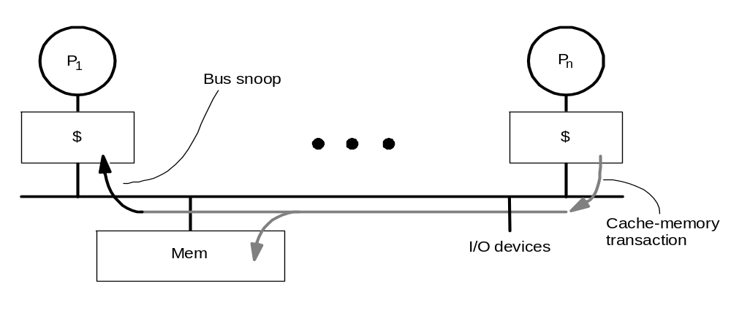
Snooping
State
Address
Data
Cache Controller “snoops” all transactions on the shared medium (bus or switch)
  transaction is relevant if it contains that block
  take action to ensure coherence
    invalidate, update, or supply value
    depends on state of the block and the protocol
Either get exclusive access before write via write invalidate or update all copies on write
Notes:
Finite state machine

Slide 8
Directory Based Cache Coherence
Uses a data structure called a directory that stores the status of each cache line.
When a variable is updated, the directory is consulted, and the cache controllers of the cores that have that variable’s cache line in their caches are invalidated.

Slide 9
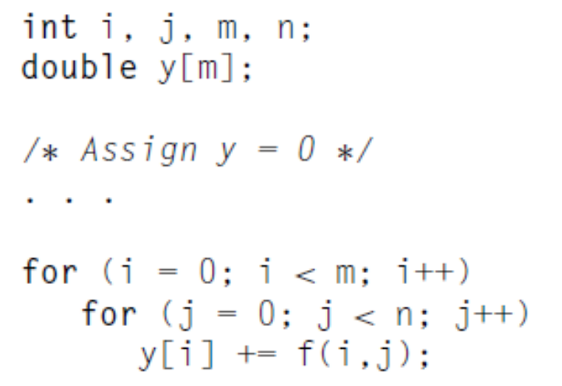
False Sharing
A cache line contains more than one machine word.
When multiple processors access the same cache line, it may look like a potential race condition, even if they access different elements.
Can cause coherence traffic.
#cores=2，m=8
Cache line：64 bytes ( 8 doubles)

Slide 10
Parallelism Definitions
Some definitions:
  Token: A group of inputs processed to produce a group of outputs
  Latency: Time for one token to pass from start to end
  Throughput: The number of tokens that can be produced per unit time
Parallelism increases throughput.

Slide 11

Parallelism Example
Ben is baking cookies. It takes 5 minutes to roll the cookies and 15 minutes to bake them. After finishing one batch he immediately starts the next batch. What is the latency and throughput if Ben doesn’t use parallelism?
Latency =
Throughput =

Slide 12
Parallelism Example
Ben is baking. It takes 5 minutes to roll the cookies and 15 minutes to bake them. After finishing one batch he immediately starts the next batch. What is the latency and throughput if Ben doesn’t use parallelism?
Latency = 5 + 15 = 20 minutes = 1/3 hour
Throughput = 1 tray/ 1/3 hour = 3 trays/hour

Slide 13
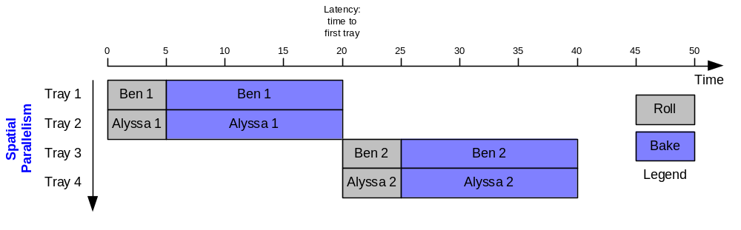
Parallelism Example
What is the latency and throughput if Ben uses parallelism?
  Spatial parallelism: Ben asks Allysa P. Hacker to help, using her own oven
Latency = 5 + 15 = 20 minutes = 1/3 hour
Throughput = 2 trays/ 1/3 hour = 6 trays/hour

Slide 14
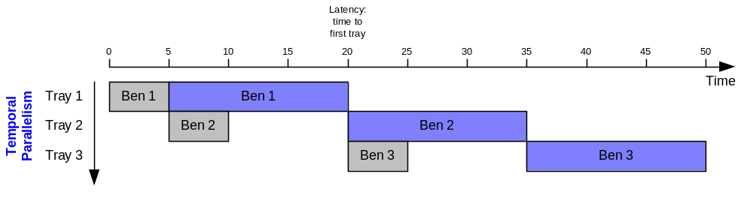
Parallelism Example
What is the latency and throughput if Ben uses parallelism?
  Spatial parallelism: Ben asks Allysa P. Hacker to help, using her own oven
  Temporal parallelism (pipelining): Ben breaks the task into two stages: roll and baking. He uses two trays. While the first batch is baking he rolls the second batch, and so on.
Latency = 5 + 15 = 20 minutes = 1/3 hour
Throughput = 1 trays/ 1/4 hour = 4 trays/hour
Using both techniques, the throughput would be 8 trays/hour

Slide 15
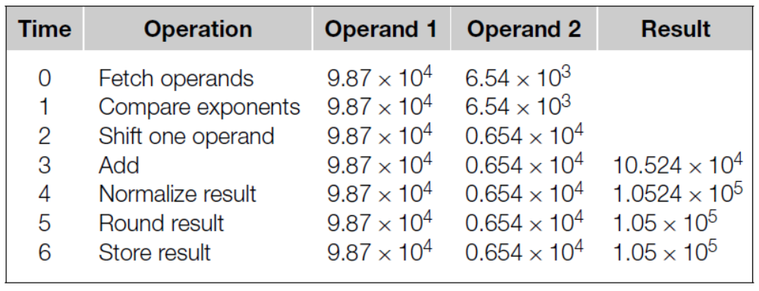
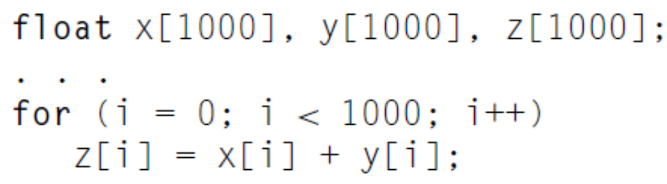
Instruction-level Parallelism: Pipelining
An addition operation can be finished by using following steps
Each step take 1 nanosecond
7000 nanoseconds

Slide 16
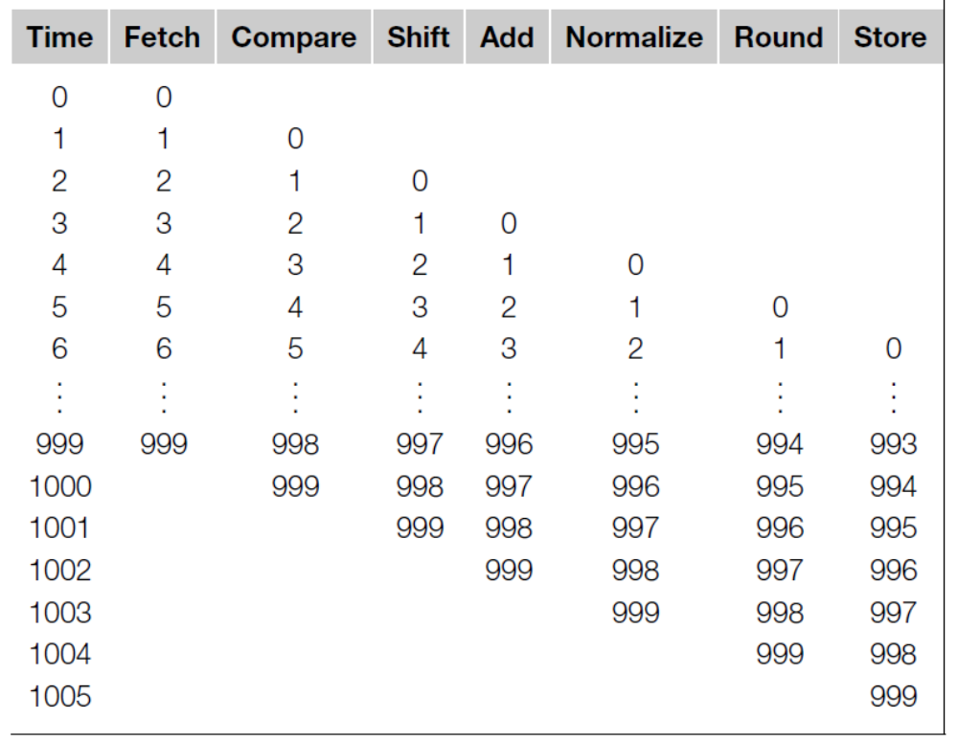
Instruction-level Parallelism: Pipelining
1006 nanoseconds < 7000 nanoseconds

Slide 17
Instruction-level Parallelism: Multiple issues
Multiple functional units
  If we have 2 complete floating point adder, then it may need 3500 nanoseconds.
Functional units schedule
  Static multiple issue
  Dynamic multiple issue → superscalar超标量技术。CpU通过内置多条流水线同时执行夺个处理。实质以空间换时间

Slide 18
Uniprocessor and Parallel Architectures
Achieve performance by addressing the von Neumann bottleneck
Reduce memory latency
  Access data from “nearby” storage: registers, caches, scratchpad memory便笺式存储器，又称从便存储器
Hide or Tolerate memory latency
  Multithreading and, when necessary, context switches while memory is being serviced
  Prefetching, predication, speculation
Uniprocessors that execute multiple instructions in parallel
  Pipelining
  Multiple issue
  SIMD multimedia extensions

Slide 19
How Does a Parallel Architecture Improve on this Further?
Computation and data partitioning focus a single processor on a subset of data that can fit in nearby storage
Can achieve performance gains with simpler processors
  Even if individual processor performance is reduced, throughput can be increased
Complements instruction-level parallelism techniques
  Multiple threads operate on distinct data
  Exploit ILP （instruction－level parallel） within a thread

Slide 20
Flynn’s Taxonomy
classic von Neumann
SISD
Single instruction stream
Single data stream
(SIMD)
Single instruction stream
Multiple data stream
MISD
Multiple instruction stream
Single data stream
(MIMD)
Multiple instruction stream
Multiple data stream
not covered
Copyright © 2010, Elsevier Inc. All rights Reserved

Slide 21
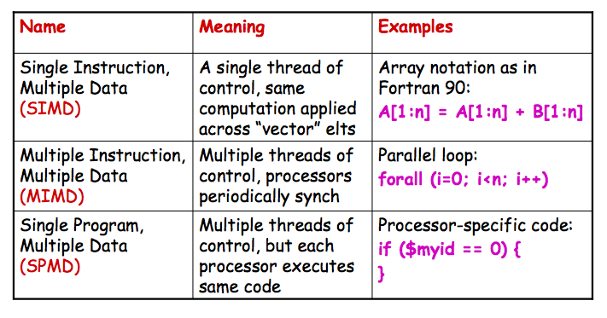
More Concrete: Parallel Control Mechanisms
SIMD: Vector processor and Graphics Processing Units (GPU)

Slide 22
Two main classes分类 of parallel architecture organizations
Shared memory multiprocessor architectures
  A collection of autonomous processors connected to a memory system.
  Supports a global address space where each processor can access each memory location.
Distributed memory architectures
  A collection of autonomous systems connected by an interconnect.
  Each system has its own distinct address space, and processors must explicitly communicate to share data.
  Clusters of PCs connected by commodity interconnect is the most common example.

Slide 23
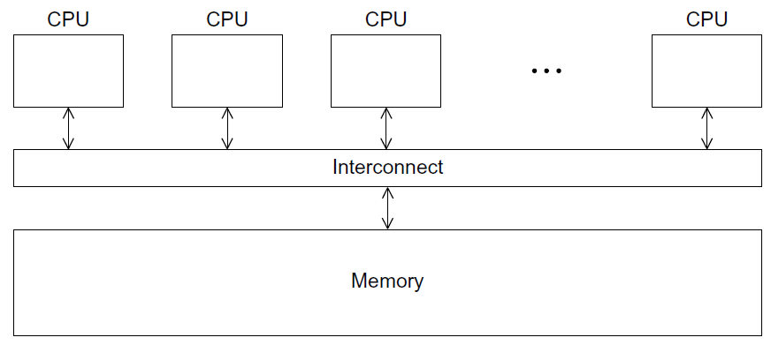
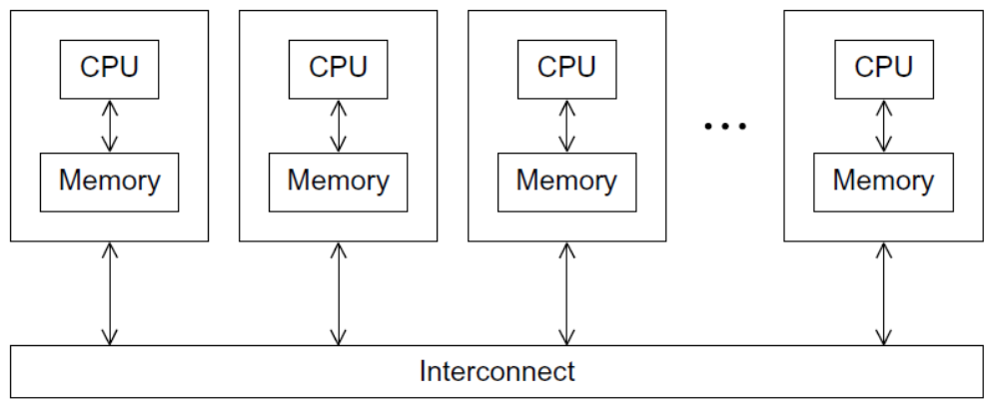
Two main classes of parallel architecture organizations
A shared-memory system
A distributed-memory system

Slide 24
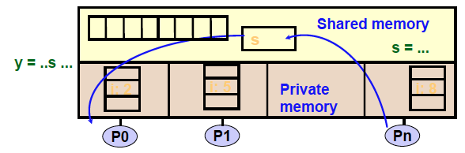
Programming Shared Memory Architectures
A shared-memory program is a collection of threads of control.
Threads are created at program start or possibly dynamically
Each thread has private variables, e.g., local stack variables
Also a set of shared variables, e.g., static variables, shared
common blocks, or global heap.
Threads communicate implicitly by writing and reading shared variables.
Threads coordinate through locks and barriers implemented using shared variables.

Slide 25
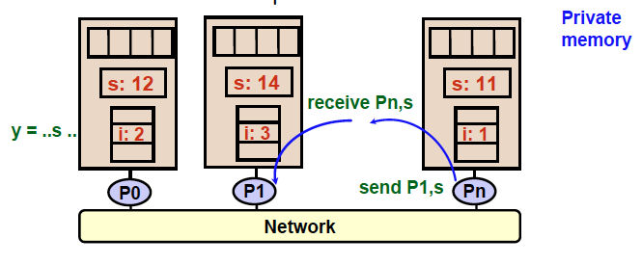
Programming Distributed Memory Architectures
A distributed-memory program consists of named processes.
• Process is a thread of control plus local address space -- NO shared data.
• Logically shared data is partitioned over local processes.
• Processes communicate by explicit send/receive pairs
• Coordination is implicit in every communication event.

Slide 26
Shared Memory Architecture 1:
Intel i7 860 Nehalem
32KB L1
Data Cache
32KB L1
Data Cache
32KB L1
Data Cache
32KB L1
Data Cache
32KB L1
Instr Cache
32KB L1
Instr Cache
32KB L1
Instr Cache
32KB L1
Instr Cache
Proc
Proc
Proc
Proc
256KB L2
Unified Cache
256KB L2
Unified Cache
256KB L2
Unified Cache
256KB L2
Unified Cache
Bus (Interconnect)
Shared 8MB L3 Cache
Up to 16 GB Main Memory (DDR3 Interface)
Notes:
Target users are general-purpose
Personal use
Games
High-end PCs in clusters
Support for SSE 4.2 SIMD instruction set
8-way hyperthreading (executes two threads per core)
multiscalar execution (4-way issue per thread)
out-of-order execution
usual branch prediction, etc.

Slide 27
Shared Memory Architecture 2:
Sun Ultrasparc T2 Niagara
Memory
Controller
Memory
Controller
Memory
Controller
Memory
Controller
512KB
L2
Cache
512KB
L2
Cache
512KB
L2
Cache
512KB
L2
Cache
512KB
L2
Cache
512KB
L2
Cache
512KB
L2
Cache
512KB
L2
Cache
Full Cross-Bar (Interconnect)
Proc
Proc
Proc
Proc
Proc
Proc
Proc
Proc
FPU
FPU
FPU
FPU
FPU
FPU
FPU
FPU
Notes:
Target applications are server-class, business operations
Characterization:
Floating point?
Array-based computation?
Support for VIS 2.0 SIMD instruction set
64-way multithreading (8-way per processor, 8 processors)

Slide 28
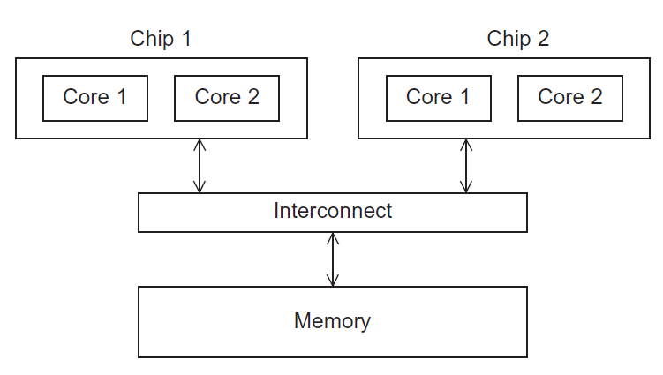
Uniform Memory Access (UMA) multicore system 均匀存储器访问
Figure 2.5
Time to access all the memory locations will be the same for all the cores.
Copyright © 2010, Elsevier Inc. All rights Reserved

Slide 29
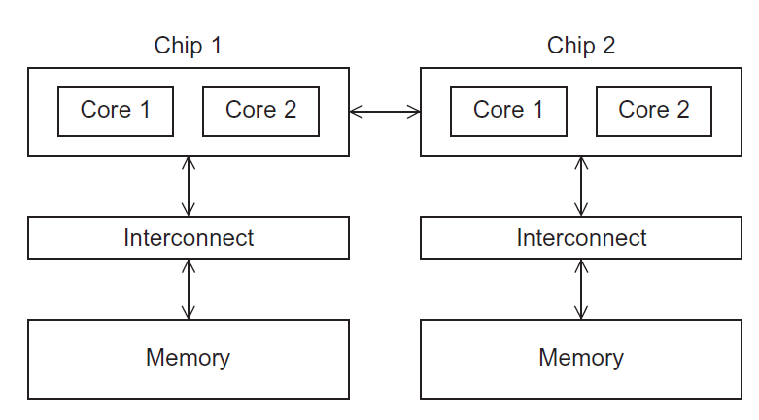
Non-uniform Memory Access (NUMA) multicore system
Figure 2.6
A memory location a core is directly connected to can be accessed faster than a memory location that must be accessed through another chip.
Copyright © 2010, Elsevier Inc. All rights Reserved

Slide 30
Shared memory interconnects
Bus interconnect
  A collection of parallel communication wires together with some hardware that controls access to the bus.
  Communication wires are shared by the devices that are connected to it.
  As the number of devices connected to the bus increases, contention for use of the bus increases, and performance decreases.
Switched interconnect
  Uses switches to control the routing of data among the connected devices.
  Crossbar –
    Allows simultaneous communication among different devices.
    Faster than buses.
    But the cost of the switches and links is relatively high.
    Crossbars grow as n² making them impractical for large n

Slide 31
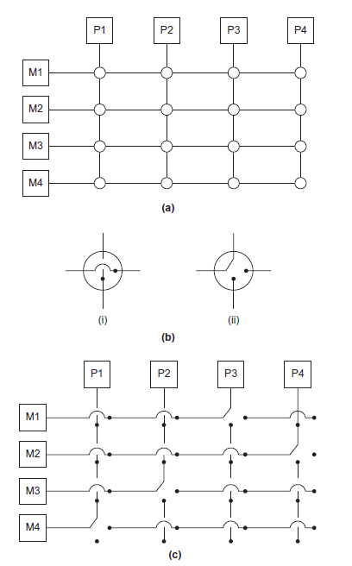
Crossbar
(a)
A crossbar switch connecting 4 processors (Pi) and 4 memory modules (Mj)
(b)
Configuration of internal switches in a crossbar
(c) Simultaneous memory accesses by the processors

Slide 32
Distributed memory interconnects
Two groups
  Direct interconnect
    Each switch is directly connected to a processor memory pair, and the switches are connected to each other.
  Indirect interconnect
    Switches may not be directly connected to a processor.
The cost of an interconnect can be a big part of a machine, governed by
  Number of links
  Number of switches
  Available bandwidth (highly optimized links are expensive)

Slide 33
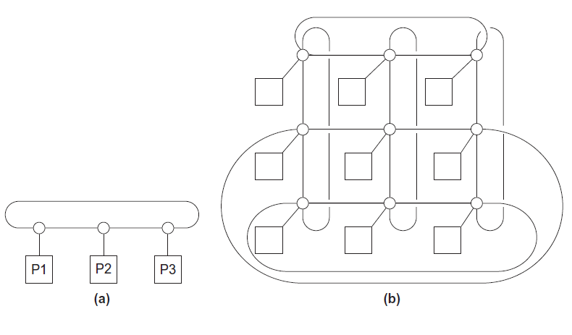
Direct interconnect
Figure 2.8
ring
toroidal mesh

Slide 34
Like memory systems, we also consider bandwidth and latency in message-passing
Message transmission time = l + n / b
latency (seconds)
length of message (bytes)
bandwidth (bytes per second)

Slide 35
Definitions
Bisection width
  A measure of “number of simultaneous communications” or “connectivity”.
  How many simultaneous communications can take place “across the divide” between the halves?
Bisection bandwidth
  A measure of network quality.
  Instead of counting the number of links joining the halves, it sums the bandwidth of the links.

Slide 36
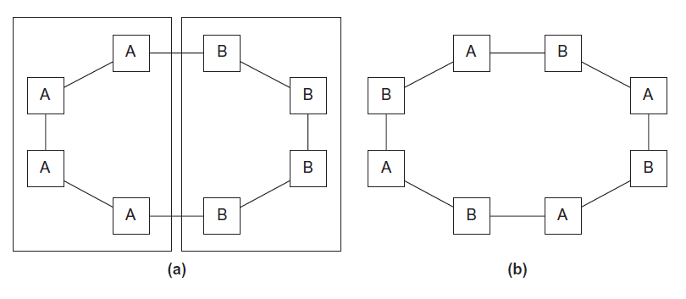
Two bisections of a ring
Figure 2.9

Slide 37
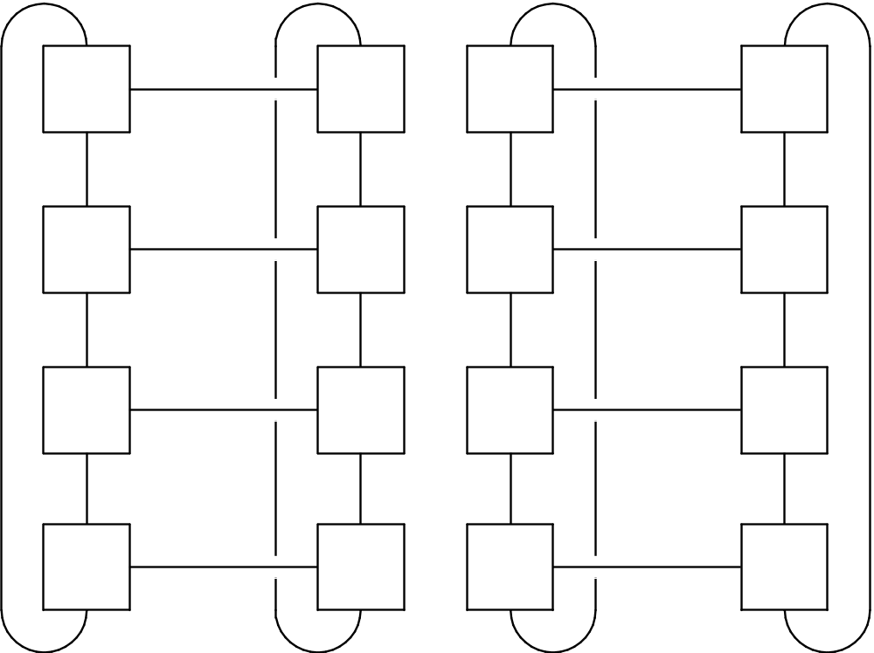
A bisection of a toroidal mesh
Figure 2.10

Slide 38
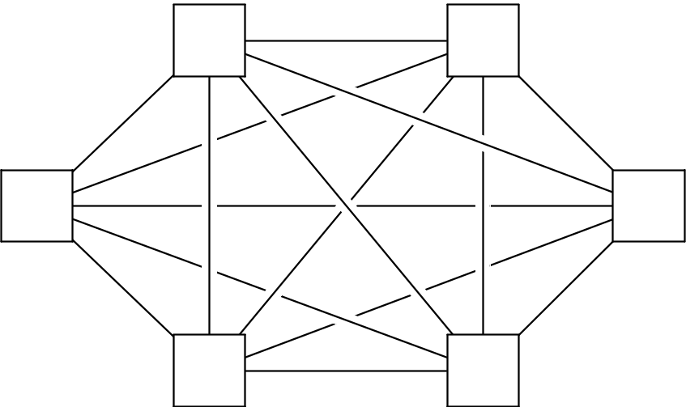
Fully connected network
Each switch is directly connected to every other switch.
impractical
bisection width = p²/4
Figure 2.11

Slide 39
Indirect interconnects
Simple examples of indirect networks:
  Crossbar
  Omega network
Often shown with unidirectional links and a collection of processors, each of which has an outgoing and an incoming link, and a switching network.

Slide 40
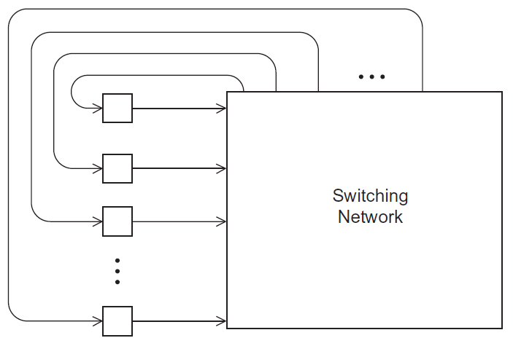
A generic indirect network
Figure 2.13

