Slide 1
并行程序设计
Lecture 3:
Introduction to Parallel Architectures
Shouzhen Gu

Slide 2

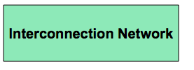

An Abstract Parallel Architecture
How is parallelism managed?
Where is the memory physically located?
Is it connected directly to processors?
What is the connectivity of the network?

Slide 3
Why are we looking at a bunch of architectures
There is no canonical权威的，典范的 parallel computer – a diversity of parallel architectures
  Hence, there is no canonical parallel programming language
Architecture has an enormous impact on performance
  And we wouldn’t write parallel code if we didn’t care about performance
Many parallel architectures fail to succeed commercially
  Can’t always tell what is going to be around in N years
Challenge is to write parallel code that abstracts away architectural features, focuses on their commonality通用性, and is therefore easily ported from one platform to another.

Slide 4
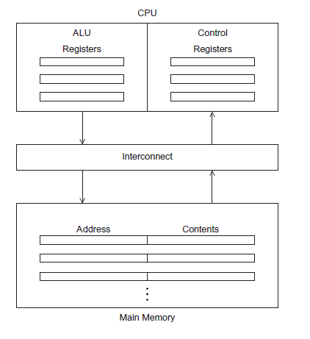
The von Neumann Architecture
Conceptually, a von Neumann architecture 冯诺伊曼executes one instruction at a time.
Cpu与内存分开。
Arithmetic and logic Unit (ALU)
Control unit
CPU速度以及内存容量的成长速率远大于双方之间的流量
Von Neumann bottleneck
Figure 2.1

Slide 5




von Neumann bottleneck

Slide 6
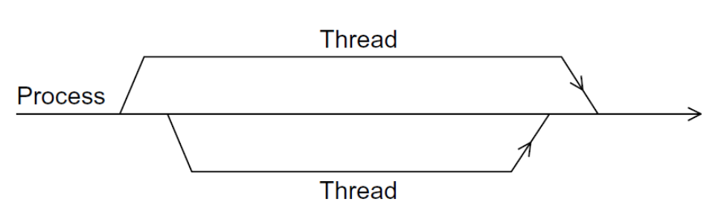
Processes, Multitasking, and threads
A process is an instance of a computer program that is being executed
  The executable machine language program, data segment, a call stack, a heap, descriptors of resources, security information, and information about the state of process.
A multitasking OS provides support for apparent 显然的simultaneous execution of multiple programs.
Threading provides a mechanism to divide programs into more or less independent tasks
  Threads are “lighter weight” than processes.轻量级
  Switching between threads much faster than switching between processes.

Slide 7
Levels of the Memory Hierarchy
Capacity
Access Time
Cost
Staging
Xfer Unit
Upper Level
CPU Registers
100s Bytes
<10s ns
Registers
faster
Instr. Operands
prog./compiler
1-8 bytes
Cache
K Bytes
10-100 ns
1-0.1 cents/bit
Cache
cache cntl
8-128 bytes
Blocks
Main Memory
M Bytes
200ns- 500ns
$.0001-.00001 cents /bit
Memory
OS
512-4K bytes
Pages
Disk
G Bytes, 10 ms
(10,000,000 ns)
10 - 10 cents/bit
Disk
-5
-6
user/operator
Mbytes
Files
Larger
Tape infinite
sec-min
10
Lower Level
-8
Tape
Notes:
PC：Program Counter；程序计数器
CPSR：Current Program Status Register；当前程序状态寄存器
SPSR：Saved Program Status Register；保存的程序状态寄存器
SP：Stack Pointer；数据栈指针
LR：Link Register；连接寄存器
SB：静态基址寄存器
SL：数据栈限制指针
FP：帧指针
IP：Intra-Procedure-call Scratch Register；内部程序调用暂存寄存器
未分组寄存器r0-r7为所有模式共用，共8个。
分组寄存器中r8-r12，快速中断模式有自己的一组寄存器，其他模式共用，所以有10个。
分组寄存器中r13，r14，除了用户模式和系统模式共用外，其他模式各一组，所以共有2*7 - 2 = 12个。
r15和CPSR共用，共2个；SPSR除了用户模式和系统模式没有外，其他模式各一个，共5个。

Slide 8
Memory Technologies
Static RAM (SRAM)
  0.5ns – 2.5ns, $2000 – $5000 per GB
Dynamic RAM (DRAM)
  50ns – 70ns, $20 – $75 per GB
Magnetic disk
  5ms – 20ms, $0.20 – $2 per GB
Ideal memory
  Access time of SRAM
  Capacity and cost/GB of disk
Solution: organize memory system into a hierarchy
  Entire memory space available in largest, slowest memory
  Incrementally smaller and faster memories, each containing a subset of the memory below it, proceed in steps up toward the processor

Slide 9
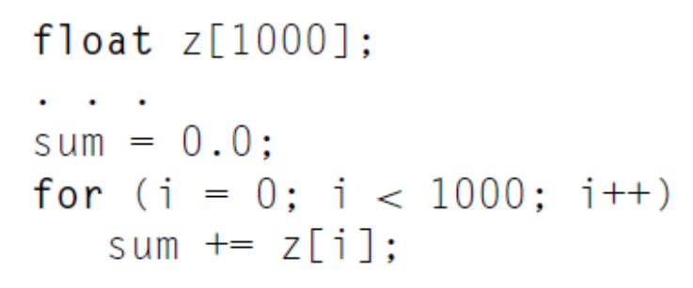
The Basics of Caching
Cache is a collection of memory locations
  It can be accessed in less time than some other memory locations.
  Locality: programs tend to use data and instructions 指令that are physically close to recently used data and instructions.
  Spatial locality and temporal locality空间局部性和时间局部性
  Cache blocks or Cache lines
Caches usually store copies of information in slower memory
Proc
Cache
L2 Cache
L3 Cache
Memory

Slide 10

Cache Line
Cache is made of directory+ data memory, one entry per cache line
  Directory stores tags and status (state) bits: valid, dirty, coherence… （这些都是状态）
Cache access has two phases
  Use index bits to fetch the tags
  and data from the set
  Check tags to detect hit/miss
Notes:
If the tag and upper 20 bits of address are equal and the valid bit is on, then the request hits in the cache.

Slide 11

Cache Access: Hit and Miss
Block (aka line): unit of copying
  May be multiple words
If accessed data is present in upper level
  Hit: access satisfied by upper level
    Time taken: hit time
If accessed data is absent
  Miss: block copied from lower level
    Time taken: miss penalty
    Miss rate: misses/accesses
  From then on accessed data supplied from upper level (until the block being replaced)
Performance measured by Average Memory Access Time (AMAT)
AMAT= hit time + miss rate x miss penalty (ns or clocks)
Sometimes people use Misses Per Instructions (MPI)
CPI = CPI₀ + MPI*miss penalty

Slide 12
Q1: Where can a block be placed in the upper level? (Block placement)
Q2: How to search for a block?
(Block identification)
Q3: Upon a miss, which block should be replaced?
(Block replacement)
Q4: What happens upon a write?
(Write strategy)

Slide 13
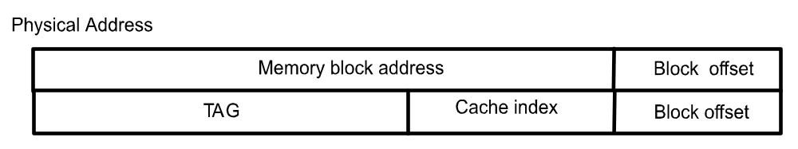
Cache Mapping
Mapping can be direct, set-associative or fully associative
  Direct-mapped: each memory block can be mapped to only one cache line
  index = block address % number of cache lines
  Set-associative: each memory block can be mapped to a set of cache lines
  index = block address % number of cache sets
  Fully associative: each memory block can be in any cache line
Full Mapped
Direct Mapped
(12 mod 8) = 4
2-Way Assoc
(12 mod 4) = 0
01234567
01234567
01234567
Cache
1111111111222222222233
01234567890123456789012345678901
Memory

Slide 14
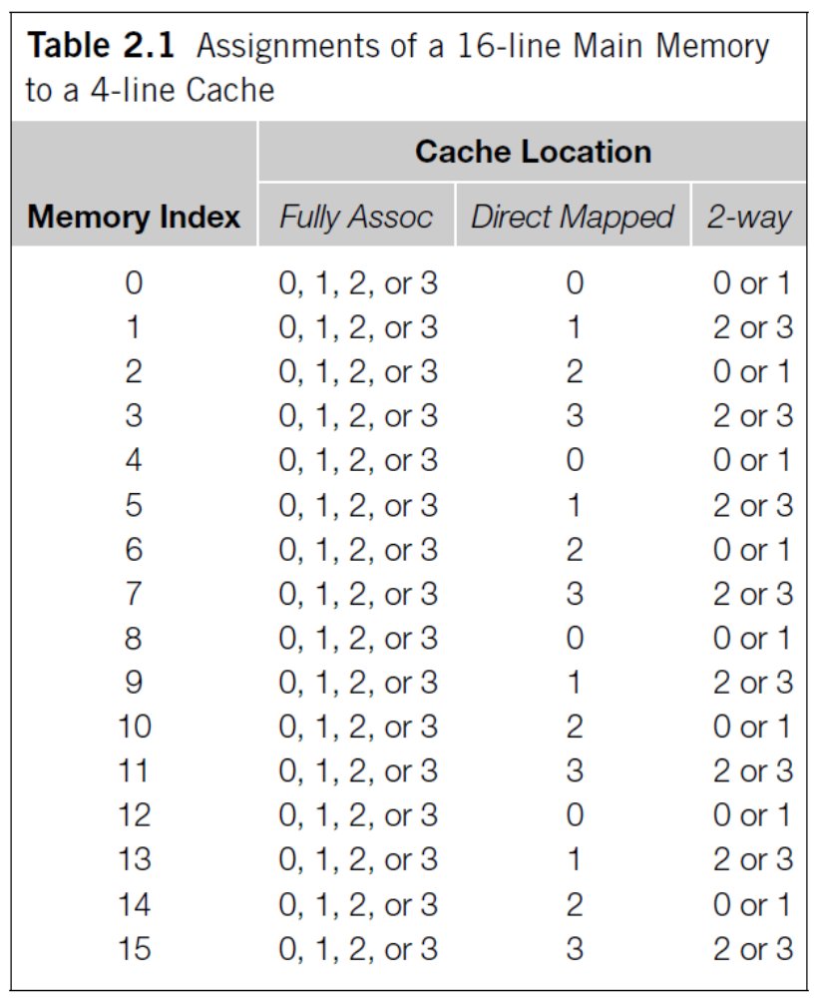
Cache Mapping：example
Fully associative
Direct mapped
N-way set associative

Slide 15
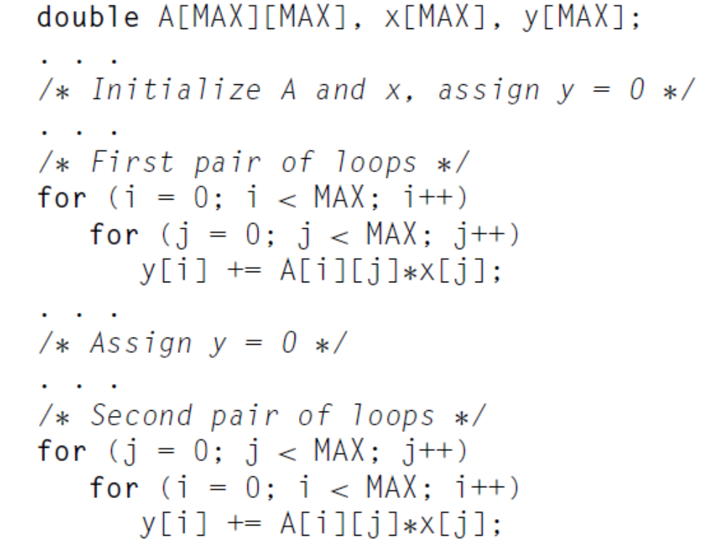
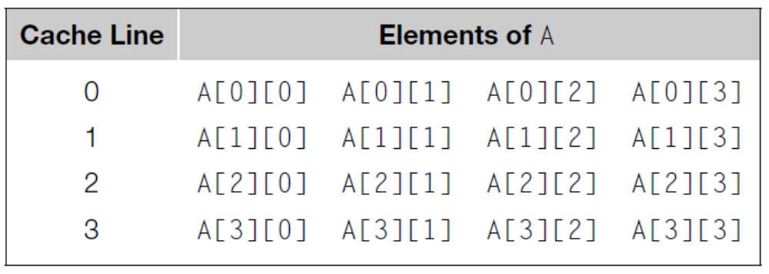
Caches and Programs
MAX=4
4-line Cache
The first pair of nested loops嵌套循环 is faster than the second pair

Slide 16
Quiz
Assume there are three small cache, each consisting of four one-word blocks. One cache is fully associative, a second is two-way set-associative, and the third is direct-mapped. Find the number of misses for each cache organization given the following sequence of block addresses: 0, 8, 0, 6, and 8.

Slide 17
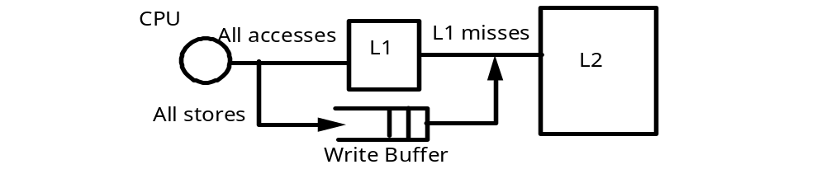
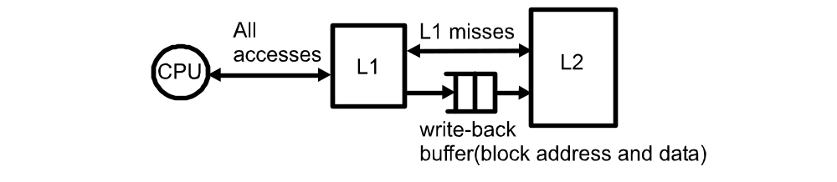
Data Inconsistent
Write through cache
  A cache line is written to main memory when it is written to the cache.
Write back cache
  The data is marked as dirty in the cache, and written back to memory when it is replaced by a new cache line.

Slide 18
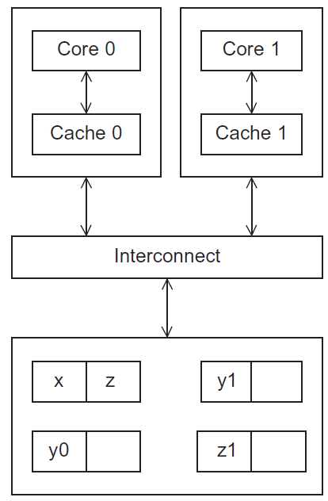
Cache coherence
Programmers have no
control over caches
and when they get updated.
A shared memory system with two cores and two caches
Figure 2.17
Copyright © 2010, Elsevier Inc. All rights Reserved

Slide 19
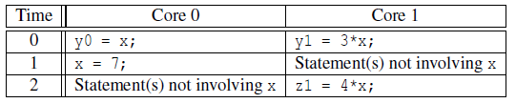
Cache coherence
y0 privately owned by Core 0
y1 and z1 privately owned by Core 1
x = 2; /* shared variable */
y0 eventually ends up = 2
y1 eventually ends up = 6
z1 = ???
Notes:
suppose the following statements are executed at the indicated times指定时间:

Slide 20
Snooping Cache Coherence
The cores share a bus总线.
Any signal transmitted on the bus can be “seen” by all cores connected to the bus.
When core 0 updates the copy of x stored in its cache it also broadcasts广播 this information across the bus.
If core 1 is “snooping”探听 the bus, it will see that x has been updated and it can mark its copy of x as invalid.

Slide 21
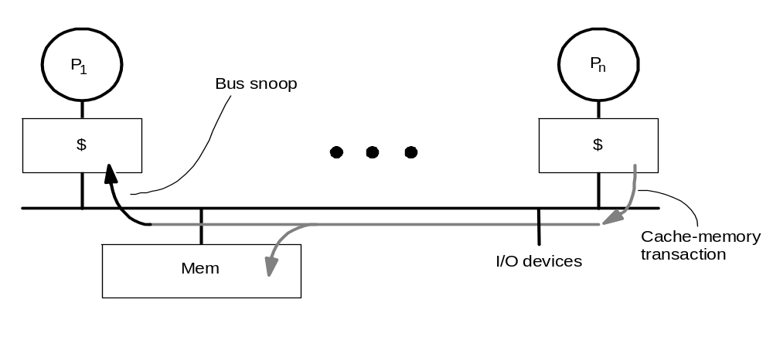
Snooping
State
Address
Data
Cache Controller “snoops” all transactions事务 on the shared medium (bus or switch)
  transaction is relevant if it contains that block
  take action to ensure coherence一致性
    invalidate, update, or supply value
    depends on state of the block and the protocol
Either get exclusive access before write via write invalidate or update all copies on write
Notes:
Finite state machine

Slide 22
Directory Based Cache Coherence
Uses a data structure called a directory that stores the status of each cache line.
When a variable is updated, the directory is consulted, and the cache controllers of the cores that have that variable’s cache line in their caches are invalidated.

Slide 23
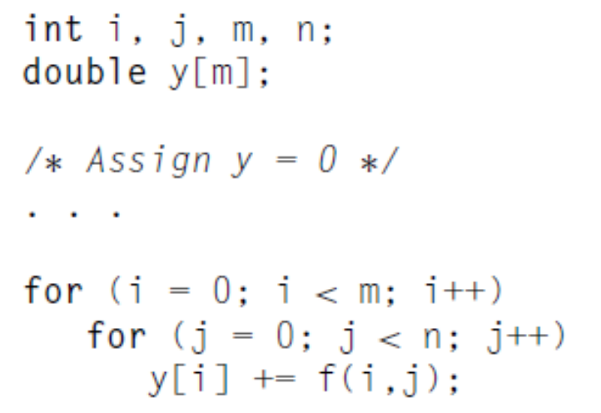
False Sharing
A cache line contains more than one machine word.
When multiple processors access the same cache line, it may look like a potential race condition, even if they access different elements.
Can cause coherence traffic.
#cores=2，m=8
Cache line：64 bytes ( 8 doubles)

Slide 24
Parallelism Definitions
Some definitions:
  Token令牌: A group of inputs processed to produce a group of outputs
  Latency反应时间: Time for one token to pass from start to end
  Throughput吞吐量: The number of tokens that can be produced per unit time
Parallelism increases throughput.

Slide 25
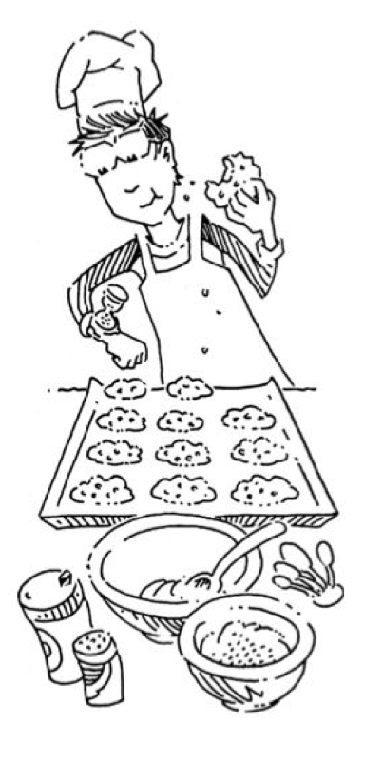
Parallelism Example
Ben is baking cookies. It takes 5 minutes to roll the cookies and 15 minutes to bake them. After finishing one batch he immediately starts the next batch. What is the latency and throughput if Ben doesn’t use parallelism?
Latency =
Throughput =

Slide 26
Parallelism Example
Ben is baking. It takes 5 minutes to roll the cookies and 15 minutes to bake them. After finishing one batch he immediately starts the next batch. What is the latency and throughput if Ben doesn’t use parallelism?
Latency = 5 + 15 = 20 minutes = 1/3 hour
Throughput = 1 tray/ 1/3 hour = 3 trays/hour

Slide 27
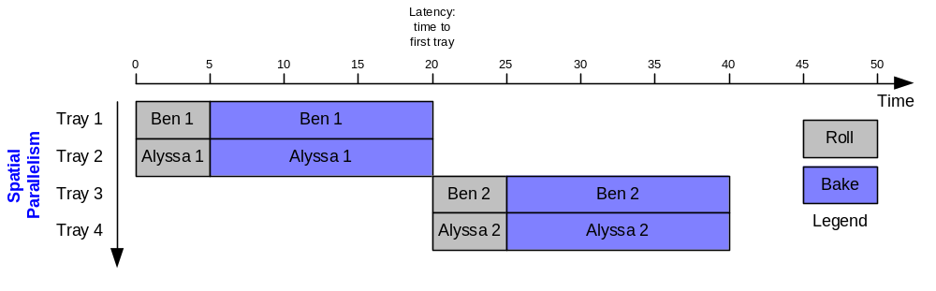
Parallelism Example
What is the latency and throughput if Ben uses parallelism?
  Spatial parallelism: Ben asks Allysa P. Hacker to help, using her own oven
Latency = 5 + 15 = 20 minutes = 1/3 hour
Throughput = 2 trays/ 1/3 hour = 6 trays/hour

Slide 28
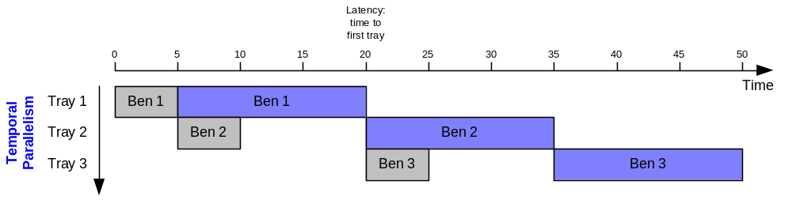
Parallelism Example
What is the latency and throughput if Ben uses parallelism?
  Spatial parallelism: Ben asks Allysa P. Hacker to help, using her own oven
  Temporal parallelism (pipelining): Ben breaks the task into two stages: roll and baking. He uses two trays. While the first batch is baking he rolls the second batch, and so on.
Latency = 5 + 15 = 20 minutes = 1/3 hour
Throughput = 1 trays/ 1/4 hour = 4 trays盘子/hour
Using both techniques, the throughput would be 8 trays/hour

Slide 29
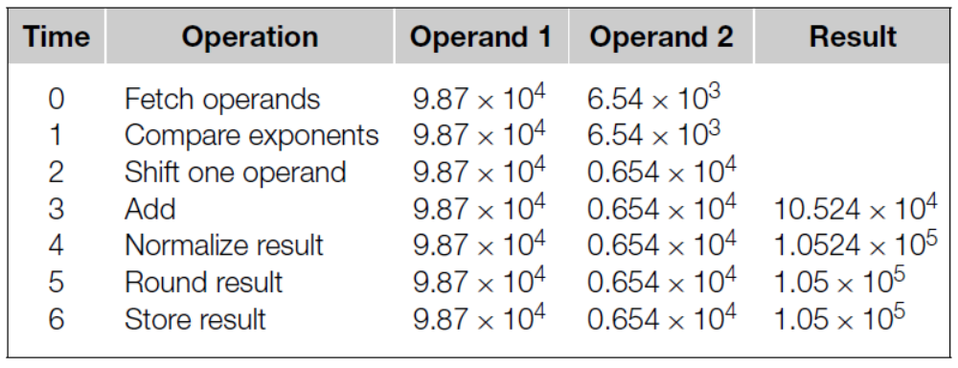
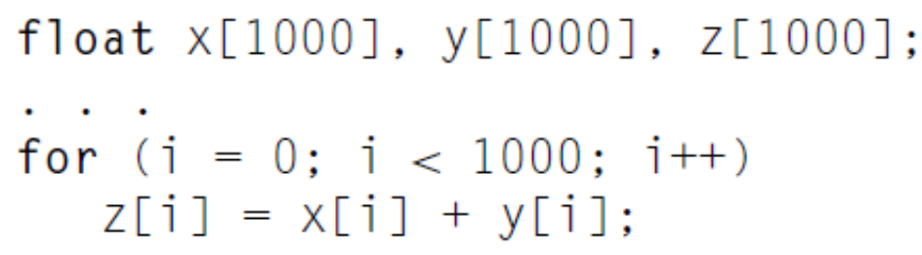
Instruction-level Parallelism: Pipelining
An addition operation can be finished by using following steps
Each step take 1 nanosecond
7000 nanoseconds

Slide 30
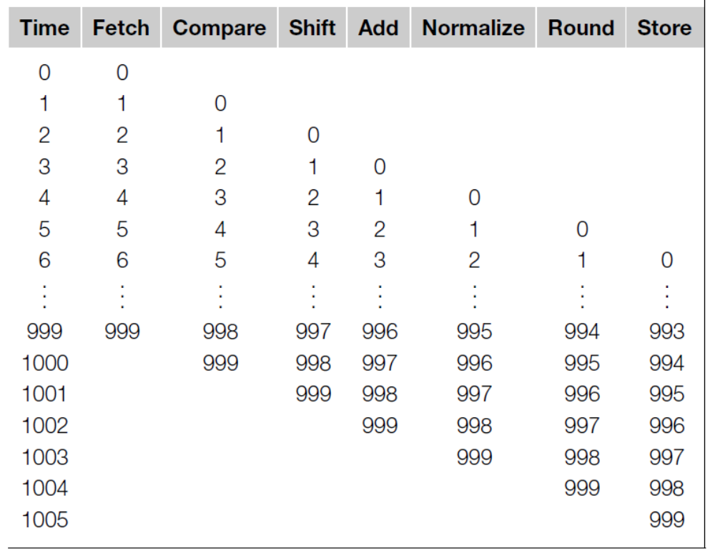
Instruction-level Parallelism: Pipelining
指令级并行 流水线技术
1006 nanoseconds < 7000 nanoseconds

Slide 31
Instruction-level Parallelism: Multiple issues
Multiple functional units
  If we have 2 complete floating point adder, then it may need 3500 nanoseconds.
Functional units schedule
  Static multiple issue
  Dynamic multiple issue→superscalar超标量

Slide 32
Uniprocessor单处理机 and Parallel Architectures
Achieve performance by addressing the von Neumann bottleneck
Reduce memory latency
  Access data from “nearby” storage: registers, caches, scratchpad memory
Hide or Tolerate memory latency
  Multithreading and, when necessary, context switches while memory is being serviced
  Prefetching, predication, speculation推断
Uniprocessors that execute multiple instructions in parallel
  Pipelining
  Multiple issue
  SIMD multimedia extensions

Slide 33
How Does a Parallel Architecture Improve on this Further?
Computation and data partitioning focus a single processor on a subset of data that can fit in nearby storage
Can achieve performance gains with simpler processors
  Even if individual processor performance is reduced, throughput can be increased
Complements instruction-level parallelism techniques
  Multiple threads operate on distinct data
  Exploit ILP within a thread

Slide 34
Flynn’s Taxonomy分类
classic von Neumann
SISD
Single instruction stream
Single data stream
(SIMD)
Single instruction stream
Multiple data stream
MISD
Multiple instruction stream
Single data stream
(MIMD)
Multiple instruction stream
Multiple data stream
not covered
Copyright © 2010, Elsevier Inc. All rights Reserved

Slide 35
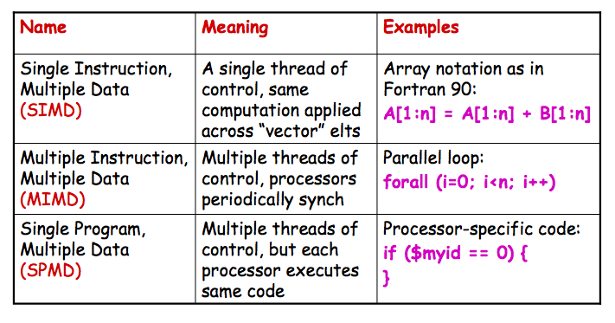
More Concrete: Parallel Control Mechanisms
SIMD: Vector processor and Graphics Processing Units (GPU)

Slide 36
Two main classes of parallel architecture organizations
Shared memory multiprocessor architectures
  A collection of autonomous独立存在的 processors connected to a memory system.
  Supports a global address space where each processor can access each memory location.
Distributed memory architectures
  A collection of autonomous systems connected by an interconnect.
  Each system has its own distinct address space, and processors must explicitly communicate to share data.
  集成cluster of PCs connected by commodity interconnect is the most common example.

Slide 37
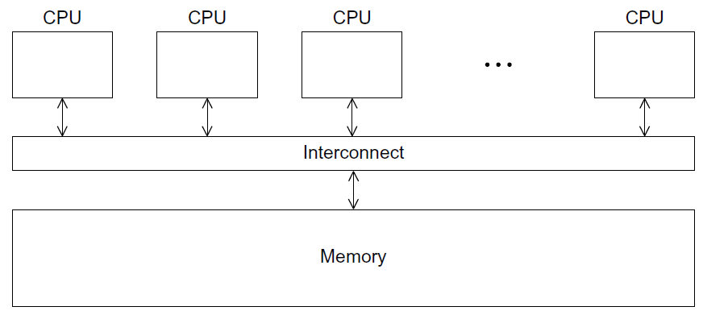
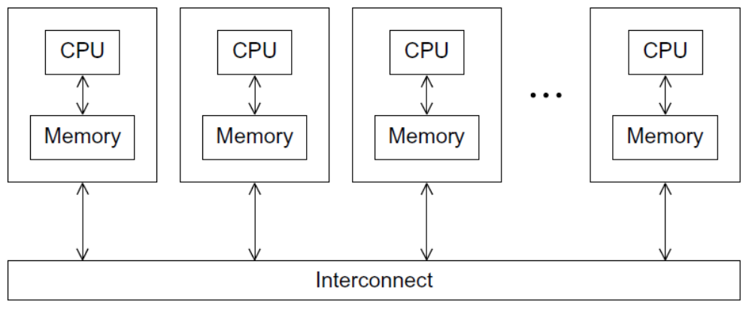
Two main classes of parallel architecture organizations
A shared-memory system
A distributed-memory system

Slide 38
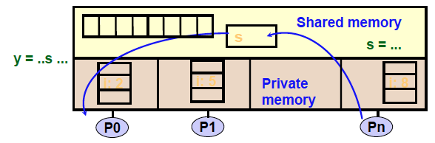
Programming Shared Memory Architectures
A shared-memory program is a collection of threads of control.
Threads are created at program start or possibly dynamically
Each thread has private variables, e.g., local stack variables
Also a set of shared variables, e.g., static variables, shared
common blocks, or global heap.
Threads communicate implicitly by writing and reading shared variables.
Threads coordinate through locks and barriers implemented using shared variables.

Slide 39
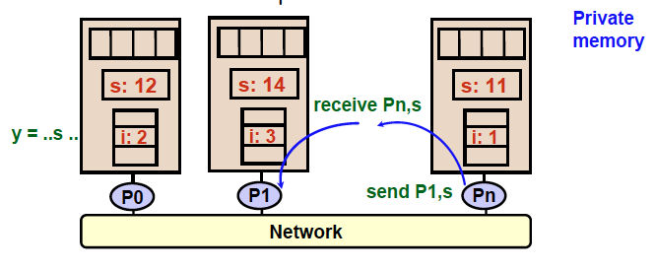
Programming Distributed Memory Architectures
A distributed-memory program consists of named processes.
• Process is a thread of control plus local address space -- NO shared data.
• Logically shared data is partitioned over local processes.
• Processes communicate by explicit send/receive pairs 显然的
• Coordination is implicit in every communication event. 内含的

Slide 40
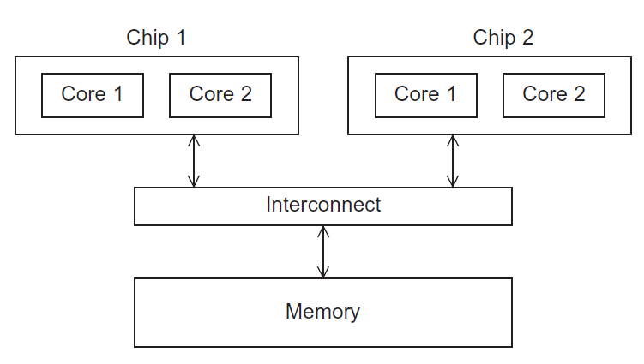
Uniform Memory Access (UMA) multicore system
Figure 2.5
Time to access all the memory locations will be the same for all the cores.
Copyright © 2010, Elsevier Inc. All rights Reserved

Slide 41
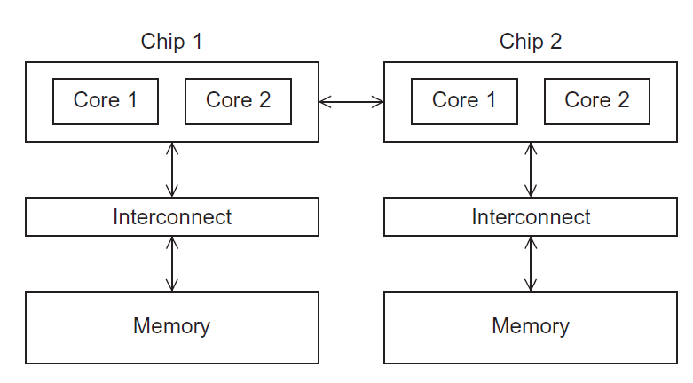
Non-uniform Memory Access (NUMA) multicore system
Figure 2.6
A memory location a core is directly connected to can be accessed faster than a memory location that must be accessed through another chip.
Copyright © 2010, Elsevier Inc. All rights Reserved

Slide 42
Shared memory interconnects互连
Bus interconnect
  A collection of parallel communication wires together with some hardware that controls access to the bus.
  Communication wires通信电线 are shared by the devices that are connected to it.
  As the number of devices connected to the bus increases, contention竞争 for use of the bus increases, and performance decreases.
Switched interconnect
  Uses switches to control the routing of data among the connected devices.
  Crossbar 交叉开关–
    Allows simultaneous communication among different devices.
    Faster than buses.
    But the cost of the switches and links is relatively high.
    Crossbars grow as n² making them impractical不实用 for large n

Slide 43
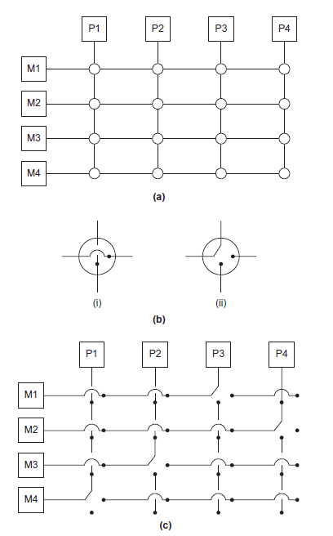
Crossbar
(a)
A crossbar switch connecting 4 processors (Pi) and 4 memory modules (Mj)
(b)
Configuration of internal switches in a crossbar
(c) Simultaneous memory accesses by the processors

Slide 44
Distributed memory interconnects
Two groups
  Direct interconnect
    Each switch is directly connected to a processor memory pair, and the switches are connected to each other.
  Indirect interconnect
    Switches may not be directly connected to a processor.
The cost of an interconnect can be a big part of a machine, governed by
  Number of links
  Number of switches
  Available bandwidth带宽 (highly optimized links are expensive)

Slide 45
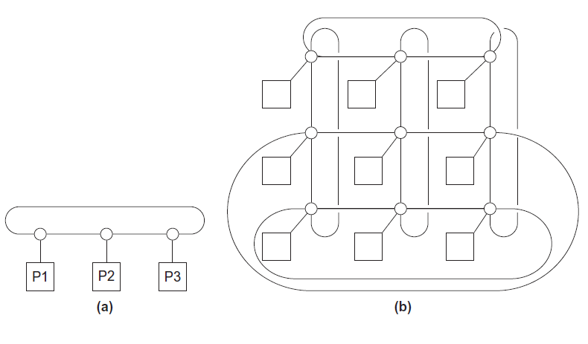
Direct interconnect
Figure 2.8
ring
toroidal mesh
环形网络

Slide 46
Like memory systems, we also consider bandwidth and latency in message-passing
Message transmission time = l + n / b
latency (seconds)
length of message (bytes)
bandwidth (bytes per second)

Slide 47
Definitions
Bisection width二部带宽
  A measure of “number of simultaneous communications” or “connectivity”.
  How many simultaneous communications can take place “across the divide” between the halves?
Bisection bandwidth对分带宽
  A measure of network quality.
  Instead of counting the number of links joining the halves, it sums the bandwidth of the links.

Slide 48
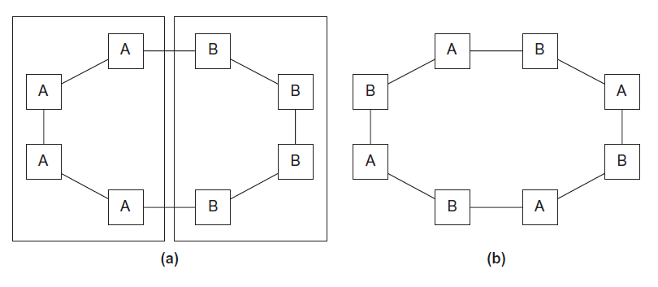
Two bisections of a ring
Figure 2.9

Slide 49
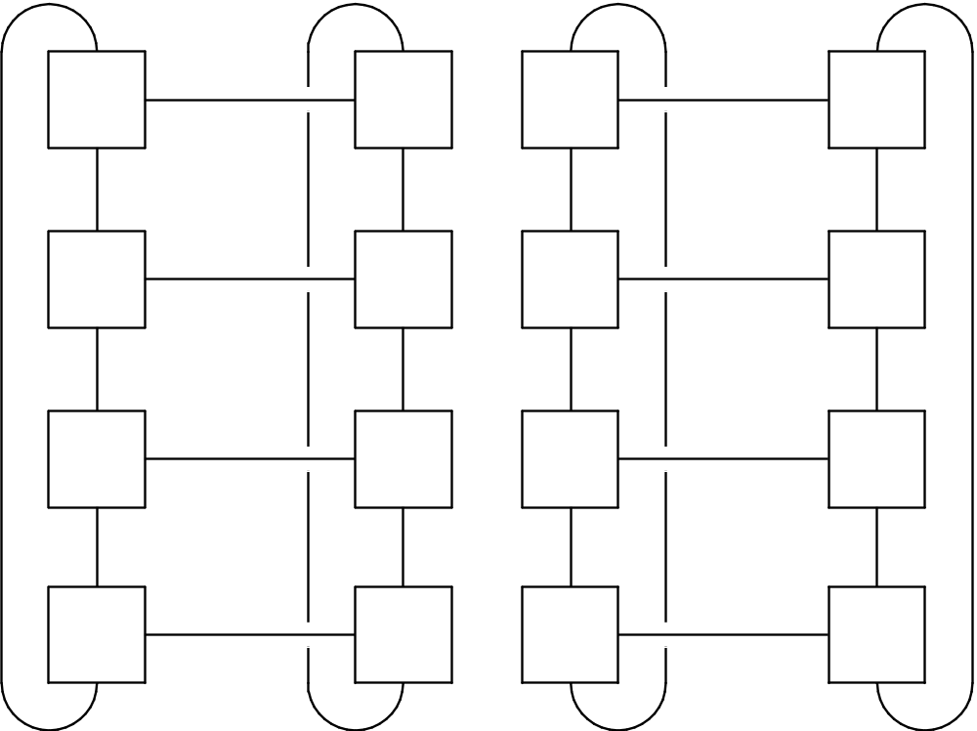
A bisection of a toroidal mesh
Figure 2.10

Slide 50
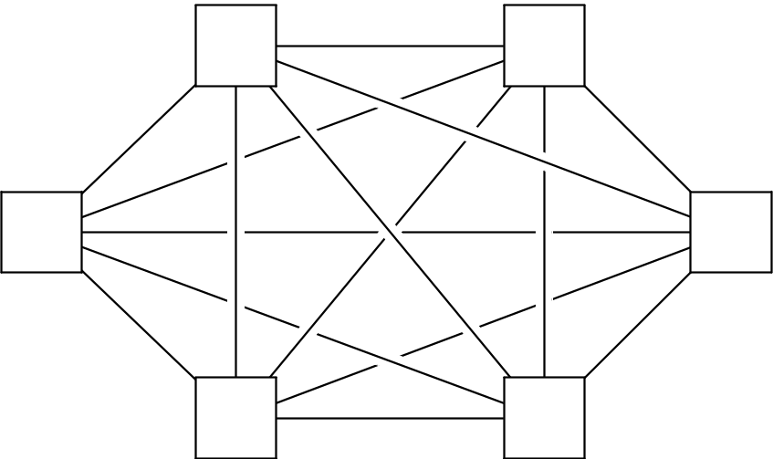
Fully connected network
Each switch is directly connected to every other switch.
impractical
bisection width = p²/4
Figure 2.11

Slide 51
Indirect interconnects
Simple examples of indirect networks:
  Crossbar
  Omega network
Often shown with unidirectional单向 links and a collection of processors, each of which has an outgoing and an incoming link, and a switching network.

Slide 52
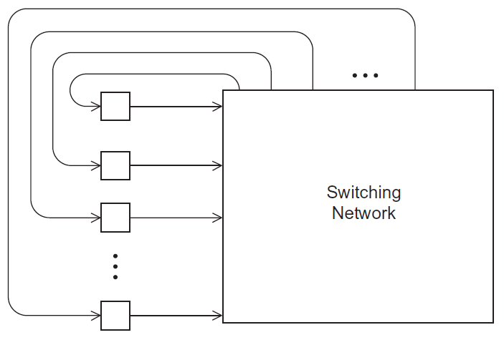
A generic indirect network
Figure 2.13

Slide 53
Summary of Lecture
The von Neumann architecture
The basics of caching
  Data Inconsistent
  Cache Mappings
Instruction-level parallelism
Parallel Hardware
  SIMD, MIMD
  Shared memory vs. Distributed memory
Memory Systems
  UMA vs. NUMA
  Cache coherence
Interconnects
  Bisection bandwidth

