Slide 1
并行程序设计
Lecture 5:
Introduction to Parallel Software
Shouzhen Gu

Slide 2
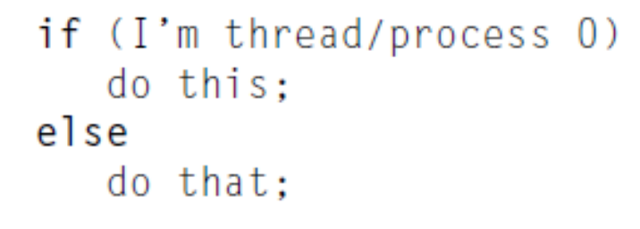
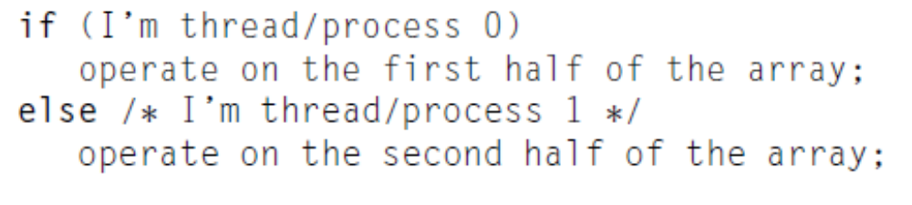
SPMD
Single Program, Multiple Data
Behave single program
Data parallel

Slide 3
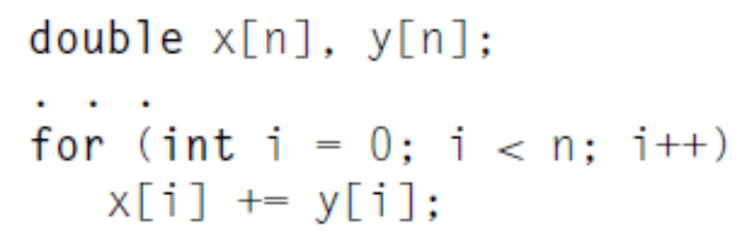
Coordinating the Processes/Threads
Divide the work among the processes/threads
Arrange for the processes/threads to synchronize
Arrange for communication among the processes/threads

Slide 4
Shared Memory vs. Distributed Memory Programs
Shared Memory Programming
  Start a single process and fork threads.
  Threads carry out work.
  Threads communicate through shared memory.
  Threads coordinate through synchronization (also through shared memory).
Distributed Memory Programming
  Start multiple processes on multiple systems.
  Processes carry out work.
  Processes communicate through message-passing.
  Processes coordinate either through message-passing or synchronization (generates messages).

Slide 5
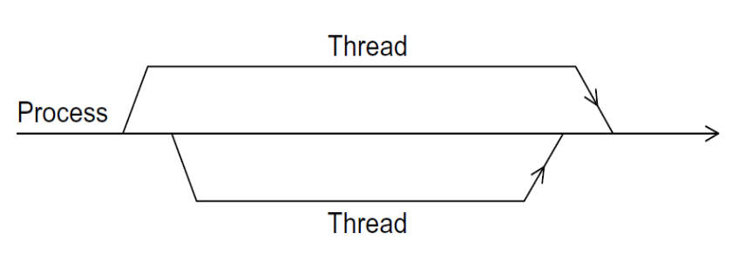
Shared Memory
Dynamic threads
  Master thread主线程 waits for work, forks new threads, and when threads are done, they terminate
  Efficient use of resources, but thread creation and termination is time consuming.
Static threads
  Pool of threads线程池 created and are allocated work, but do not terminate until cleanup.
  Better performance, but potential waste of system resources.

Slide 6
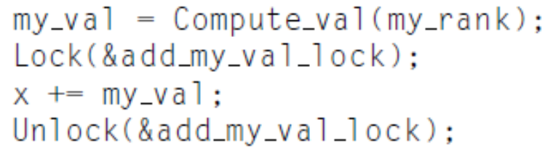
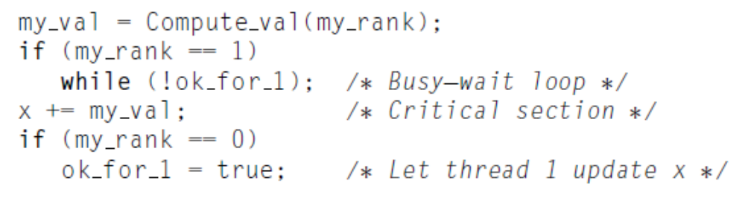
Nondeterminism不确定性主义
Some input result in different outputs
  Threads are executing independently
  Executing speed varies from run to run
  Race condition
  Mutually exclusive or Lock vs. busy- waiting

Slide 7
Quize
Suppose we have two threads, one with id 0 and the other with id 1. Suppose also that each is storing a private variable my_x, thread 0’s value for my_x is 5, and thread 1’s is 9. Further, suppose both threads execute the
following code:
printf("Thread %d > my_x = %d\n", id, my_x);
Please list all possible output.

Slide 8
Thread Safety
  A function or library is thread-safe if it operates “correctly” when called by multiple, simultaneously executing threads.
  Since multiple threads communicate and coordinate through shared memory, a thread-safe code modifies the state of shared memory using appropriate synchronization.
  Some features of sequential code that may not be thread safe?

Slide 9
Shared-Memory Programing with Pthreads
POSIX: Portable Operating System Interface for UNIX
  Interface to Operating System utilities
PThreads: The POSIX threading interface
  System calls to create and synchronize threads
  Should be relatively uniform across UNIX-like OS platforms
PThreads contain support for
  Creating parallelism
  Synchronizing
  No explicit support for communication, because shared memory is implicit; a pointer to shared data is passed to a thread

Slide 10
Forking Pthreads
Signature:
int pthread_create(pthread_t *,
const pthread_attr_t *,
void * (*)(void *),
void *);
Example call:
errcode = pthread_create(&thread_id, &thread_attribute,
&thread_fun, &fun_arg);
thread_id is the thread id or handle (used to halt, etc.)
thread_attribute various attributes
  standard default values obtained by passing a NULL pointer
thread_fun the function to be run (takes and returns void*)
fun_arg an argument can be passed to thread_fun when it starts
errorcode will be set to nonzero if the create operation fails

Slide 11
Forking Pthreads, cont.
The effect of pthread_create
  Master thread actually causes the operating system to create a new thread
  Each thread executes a specific function, thread_fun
    The same thread function is executed by all threads that are created, representing the thread’s computation decomposition
  For the program to perform different work in different threads, the arguments passed at thread creation distinguish the thread’s “id” and any other unique features of the thread.

Slide 12
Simple Threading Example
int main() {
pthread_t threads[16];
int tn;
for(tn=0; tn<16; tn++) {
pthread_create(&threads[tn], NULL, ParFun, NULL);
}
for(tn=0; tn<16 ; tn++) {
pthread_join(threads[tn], NULL);
}
return 0;
}
Compile using gcc … –lpthread
This code creates 16 threads that execute the function “ParFun”.
Note that thread creation is costly, so it is important that ParFun do a lot of work in parallel to amortize分期偿还 this cost.

Slide 13
Shared Data and Threads
Variables declared outside of main are shared
Main函数之外声明 的都是共享变量
Object allocated on the heap may be shared (if pointer is passed)
Variables on the stack are private: passing pointer to these around to other threads can cause problems
Shared data often a result of creating a large “thread data” struct
  Passed into all threads as argument
  Simple example:
    char *message = "Hello World!\n";
    pthread_create( &thread1,
    NULL,
    (void*)&print_fun,
    (void*) message);

Slide 14
“Hello World” in Pthreads
Some preliminaries准备工作
  Number of threads to create (thread_count) is set at runtime and read from command line
  Each thread prints “Hello from thread <X> of <threadcount>”
Also need another function
  int pthread_join(pthread_t *, void **value_ptr)
  From Unix specification: “suspends execution of the calling thread until the target thread terminates, unless the target thread has already terminated.”
  The second parameter allows the exiting thread to pass information back to the calling thread (often NULL).
  Returns nonzero if there is an error

Slide 15
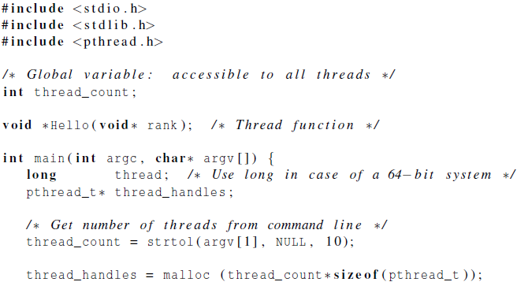
Hello World! (1)
declares the various Pthreads
functions, constants, types, etc.
pthread_t data structure
strtol function
Allocate storage for thread_t of each thread

Slide 16
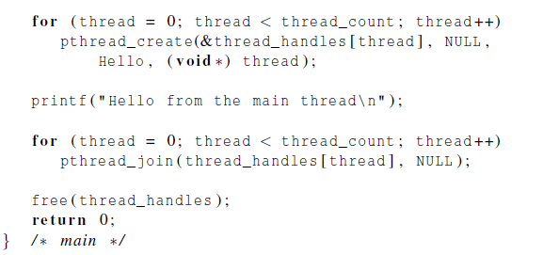
Hello World! (2)

Slide 17
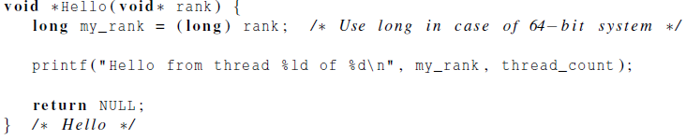
Hello World! (3)

Slide 18
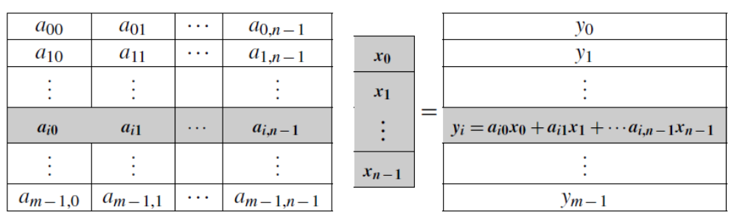

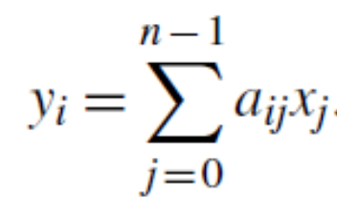
Matrix-vector multiplication
Matrix-vector multiplication:

Slide 19
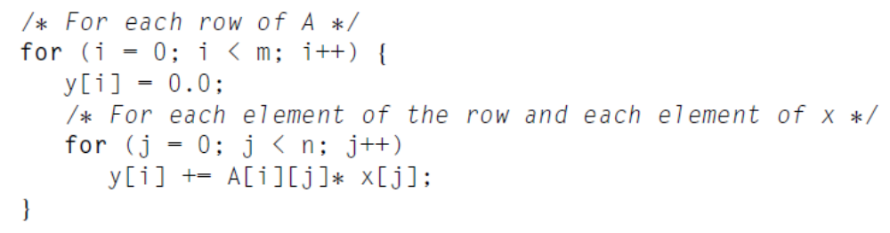
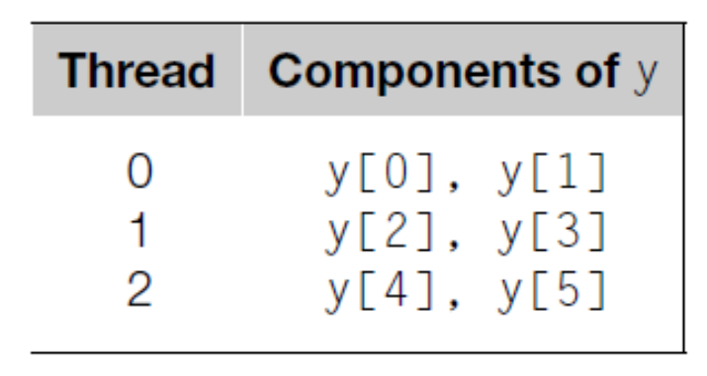
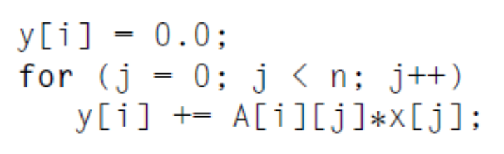
Matrix-vector multiplication
Pseudo-code for a serial program for Matrix-vector multiplication:
m=n=6, #Thread=3
X are shared

Slide 20
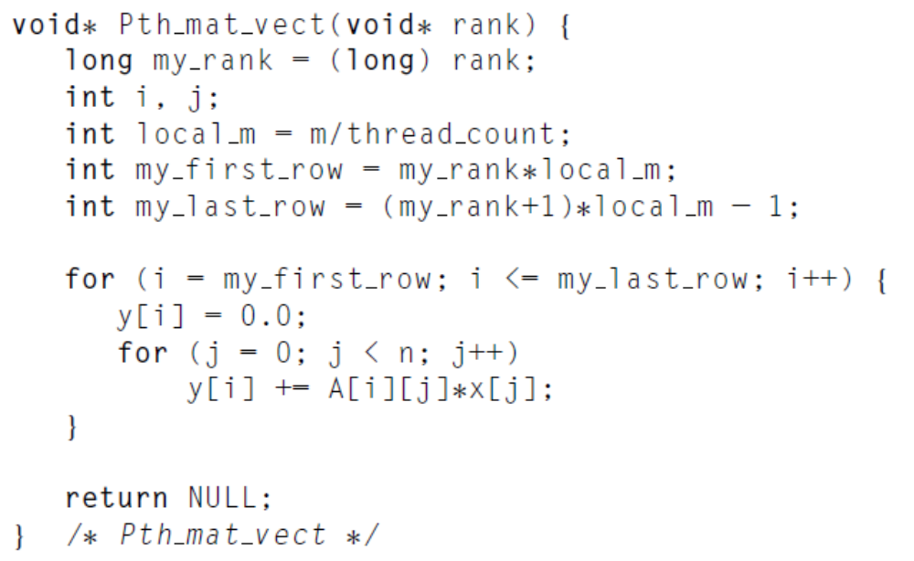
Matrix-vector multiplication

Slide 21
Homework 1:Matrix-vector multiplication
Read 4.3 Matrix-vector multiplication
When we discussed matrix-vector multiplication we assumed that both m and n, the number of rows and the number of columns, respectively, were evenly divisible by t, the number of threads. How do the formulas for the assignments change if this is not the case?
Please write a program with pthread to realize matrix-vector multiplication. Note that, matrix A, vector X, int m, int n, and int t are inputs.
Deadline: 17:00 pm, April 30
Email:735968414@qq.com（助教刘新韬邮箱）

