Slide 1
并行程序设计
Lecture 7:
Introduction to Parallel Software
Shared memory systems
Shouzhen Gu

Slide 2
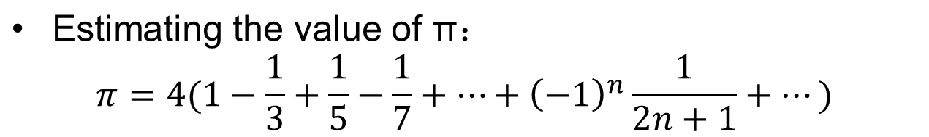
Estimating the value of π
Serial Code:
Let’s parallelize this code!
double factor = 1.0;
double sum = 0.0;
for ( i=0; i<n; i++, factor = -factor){
sum += factor/(2*i+1);
}
pi = 4.0 *sum;
General idea:
Divide up the iterations in the for loop among threads;
Make sum a shared variable
Notes:
Matrix-vector multiplication 里面的数组A与向量X相乘的问题，没有共享变量的问题。也就是race condition。
Π的计算问题。多线程会出现问题。计算结果不确定的问题。程序4.3

Slide 3
Idea
t : number of threads
n : number of terms in the formula
If m=n/t
For thread q: qm, qm+1, qm+2,…,(q+1)m-1
threads | terms
0 | Add i=0 to m-1 terms
1 | Add i=m to 2m-1 terms
2 | Add i=2m to 3m-1 terms
⁞ | ⁞

Slide 4
Estimating the value of π
Void* Thread_sum(void *rank){
long my_rank = (long)rank;
double factor;
long long i;
long long my_n = n/thread_count;
long long my_first_i = my_n * my_rank;
long long my_last_i = my_first_i + my_n;
if(my_first_i % 2 == 0) //even
factor = 1.0;
else //odd
factor = -1.0;
for(i = my_first_i; i < my_last_i; i++,factor = -factor) { sum += factor / (2 * i +1); }
return NULL;
}
Correct?
Notes:
肯定不正确。Sum是共享变量

Slide 5
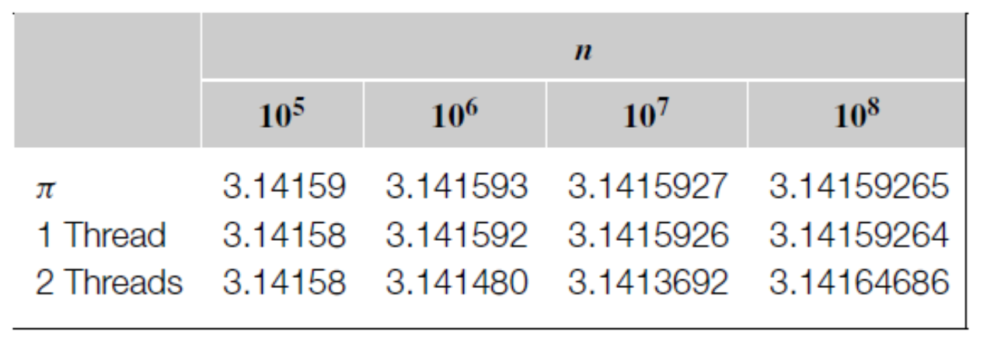
Problem
For larger values of n, the results computed by two threads actually gets worse.
The result computed by two threads changes from run to run.

Slide 6
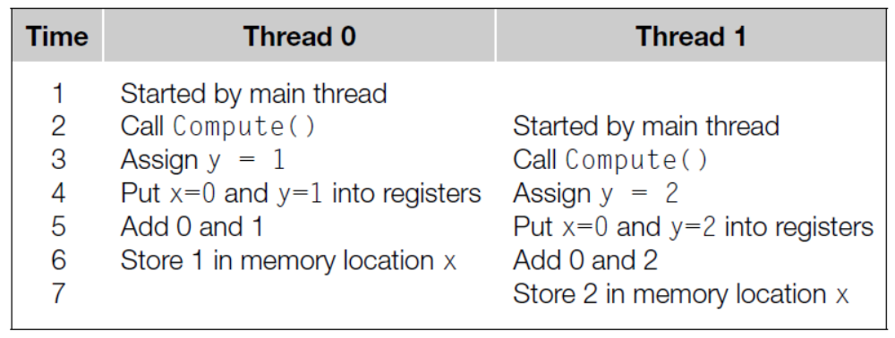
Unpredictable Results
y = Compute(my_rank);
x = x + y;
A fundamental problem in shared-memory programming: when multiple threads attempt to update a shared resource, the result may be unpredictable.
Notes:
为什么计算π的问题会出现计算结果不确定的特点？
X=X+Y，C语言指令虽然只有一条，但是编译成汇编指令后是通常由3条指令构成。
如Thread0的4，5,6三行

Slide 7
Critical Section临界区
A race condition exists when the result of an execution depends on the timing of two or more events.
A critical section is a block of code that updates a shared resource that can only be updated by one thread at a time.
y = Compute(my_rank);
x = x + y;
Critical section

Slide 8
Using Flag Variable
y = Compute(my_rank);
x = x + y;
Time | Thread 0 | Thread 1
0 | Y=0 | Y=1
1 | While() | While()
2 | x=x+y | While()
3 | Flag++ | While()
4 |  | While()
5 |  | x=x+y
6 |  | Flag++
y = Compute(my_rank);
While(flag!=my_rank);
x = x + y;
flag++;
Thread 1 cannot enter the critical section until thread 0 has completed the execution of flag++
Notes:
如何保证每次只有一个线程访问critical section。
加入flag变量 忙等

Slide 9
Busy-waiting
While loop is an example of busy-waiting.
In busy-waiting, a thread repeatedly tests a condition until the condition has the appropriate value.
Busy-waiting can be used to avoid conflicting access to critical sections with a flag variable and a while-loop with an empty body.
Note that, compiler optimizations should be turned off when we use busy-waiting,
y = Compute(my_rank);
While(flag!=my_rank);
x = x + y;
flag++;
y = Compute(my_rank);
x = x + y; While(flag!=my_rank);
flag++;

Slide 10
Estimating the value of π with BW
Void* Thread_sum(void *rank){
long my_rank = (long)rank;
double factor;
long long i;
long long my_n = n/thread_count;
long long my_first_i = my_n * my_rank;
long long my_last_i = my_first_i + my_n;
if(my_first_i % 2 == 0) //even
factor = 1.0;
else //odd
factor = -1.0;
for(i = my_first_i; i < my_last_i; i++,factor = -factor) { while(flag != my_rank):
sum += factor / (2 * i +1);
flag=(flag+1)& thread_count }
return NULL;
}
Notes:
BW busy--waiting

Slide 11
Performance of Busy-waiting
Performance degrade:
for(i = my_first_i; i < my_last_i; i++,factor = -factor) { while(flag != my_rank):
sum += factor / (2 * i +1);
flag=(flag+1)& thread_count }
One way to greatly improve the performance of the sum function is to have each thread use a private variable to store its total contribution to the sum
Notes:
Busy-waiting需要关闭compiler optimization，不然compiler会自动进行寄存器的优化。

Slide 12
Estimating the value of π with BW_2
Void* Thread_sum(void *rank){
long my_rank = (long)rank;
double factor, my_sum = 0.0;
long long i;
long long my_n = n/thread_count;
long long my_first_i = my_n * my_rank;
long long my_last_i = my_first_i + my_n;
if(my_first_i % 2 == 0) //even
factor = 1.0;
else //odd
factor = -1.0;
for(i = my_first_i; i < my_last_i; i++,factor = -factor) { my_sum+=factor/(2*i+1) }
while(flag != my_rank):
sum += my_sum;
flag=(flag+1)& thread_count
return NULL;
}
Notes:
每个线程计算自己部分的和时可以并行执行，只有最后进行总的求和时busy-waiting。
为什么这样就能加速程序？
减少critical section的访问。因为每访问一次临界区，就要好多时间

Slide 13
Pthreads Mutexes
Used to guarantee that one thread “excludes” all other threads while it executes the critical section.
The Pthreads standard includes a special type for mutexes: pthread_mutex_t.
int pthread_mutex_init(
pthread_mutex_t* mutex_p;
const pthread _mutexattr_t* attr_p;)
When a Pthreads program finishes using a mutex, it should call
int pthread_mutex_destroy(
pthread_mutex_t* mutex_p;)

Slide 14
Pthreads Mutexes
To gain access to a critical section a thread calls
int pthread_mutex_lock(
pthread_mutex_t* mutex_p;)
When a thread is finished executing the code in a critical section, it should call
int pthread_mutex_unlock(
pthread_mutex_t* mutex_p;)

Slide 15
Pthreads Mutexes
pthread_mutex_lock(&mutex);
sum+=my_sum;
pthread_mutex_unlock(&mutex);
The order in which the threads execute the code in critical section is more or less random;

Slide 16
Estimating the value of π with a mutex
Void* Thread_sum(void *rank){
long my_rank = (long)rank;
double factor, my_sum = 0.0;
long long i;
long long my_n = n/thread_count;
long long my_first_i = my_n * my_rank;
long long my_last_i = my_first_i + my_n;
if(my_first_i % 2 == 0) //even
factor = 1.0;
else //odd
factor = -1.0;
for(i = my_first_i; i < my_last_i; i++,factor = -factor) { my_sum+=factor/(2*i+1) }
pthread_mutex_lock(&mutex);
sum+=my_sum;
pthread_mutex_unlock(&mutex);
return NULL;
}

Slide 17
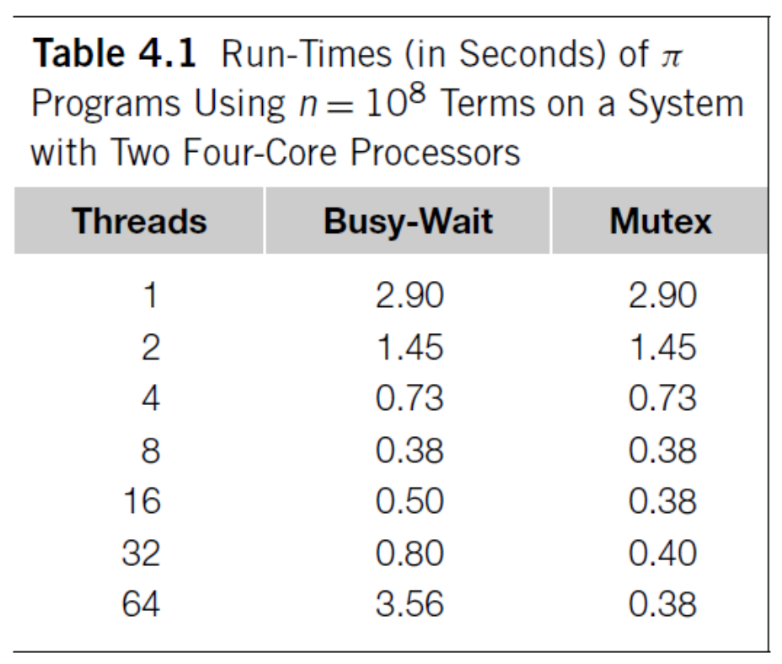
Busy-waiting vs. Mutex
Performance can degrade if there are more thread than cores.只有线程数大于进程数才会出现cpu调
The execution of threads using Busy-waiting has an order. 慎用busy-waiting

Slide 18
Producer-Consumer Synchronization and Semaphores
A semaphore is the third way to avoid conflicting access to critical sections.
It is an unsigned int together with two operations: sem_wait and sem_post. Semaphores are more powerful than mutexes since they can be initialized to any nonnegative value.
Producer-Consumer synchronization is that a thread can’t proceed until another thread has taken some action.
Notes:
Semaphore是一件可以容纳N人的房间，如果人不满就可以进去，如果人满了，就要等待有人出来。对于N=1的情况，称为binary semaphore。一般的用法是，用于限制对于某一资源的同时访问。

Slide 19
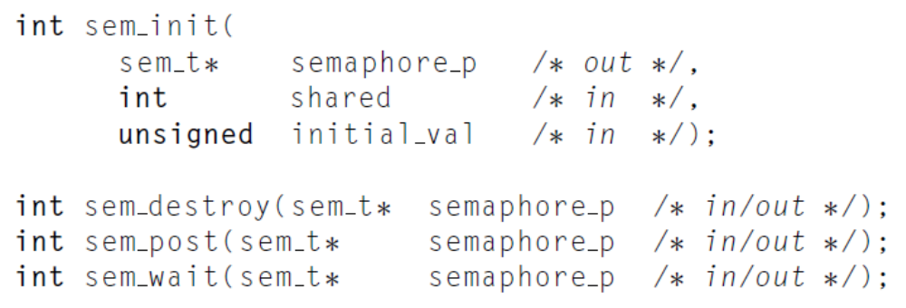

Semaphores
The syntax of various semaphore functions is:
Semaphores are not part of Pthreads.

