Slide 1
并行程序设计
Lecture 8:
Barriers, Condition Variables, and Read-Write locks
Shouzhen Gu

Slide 2
Review
Critical Section
Busy-waiting
Mutexes
Semaphores

Slide 3
Barriers
Synchronizing the threads to make sure that they all are at the same point in a program is called a barrier.
No thread can cross the barrier until all the threads have reached it.
barrier

Slide 4
Explicit Synchronization:
Creating and Initializing a Barrier
To (dynamically) initialize a barrier, use code similar to this (which sets the number of threads to 3):
  pthread_barrier_t b;
  pthread_barrier_init(&b,NULL,3);
The second argument specifies an object attribute; using NULL yields the default attributes.
To wait at a barrier, a process executes:
  pthread_barrier_wait(&b);
This barrier could have been statically initialized by assigning an initial value created using the macro
  PTHREAD_BARRIER_INITIALIZER(3)

Slide 5

Using barriers for debugging
  Point in program we want to reach;
  Barrier;
  If (my_rank==0){
  printf(“All threads reached this point\n”);
  fflush(stdout);
  }

Slide 6
Barrier: Busy-waiting and a Mutex
Implementing a barrier using busy-waiting and a mutex is straightforward.
We use a shared counter protected by the mutex.
When the counter indicates that every thread has entered the critical section, threads can leave the critical section.
  /*Barrier*/;
  pthread_mutex_lock(&barrier_mutex);
  counter++;
  pthread_mutex_unlock(&barrier_mutex);
  while(counter < thread_count);
Notes:
Waste cpu cycles.

Slide 7
Can barriers share variable counter?
  Int counter;
  Int thread_count;
  Pthread_mutex_t barrier_mutex1,barrier_mutex2;
  /*Barrier1*/;
  pthread_mutex_lock(&barrier_mutex1);
  counter++;
  pthread_mutex_unlock(&barrier_mutex1);
  while(counter < thread_count);
  /*Barrier2*/;
  pthread_mutex_lock(&barrier_mutex2);
  counter++;
  pthread_mutex_unlock(&barrier_mutex2);
  while(counter < thread_count);
?
Notes:
不能实现→如果有多个barrier，并向重复使用counter？Counter是shared。
在哪个位置将Counter设置为0，都会引起程序错误。

Slide 8
Can barriers share counter?
counter<4
counter=4
barrier1
Reset counter
barrier2

Slide 9
Barrier: semaphores
  Sem_t count_sem; /*Initialize to 1*/
  Sem_t barrier_sem; /*Initialize to 0*/
  Void* Thread_work(){
  /*Barrier*/
  Sem_wait(&count_sem);
  If(counter == thread_count){
  counter = 0;
  sem_post(&count_sem);
  for(j=0;j<thread_count-1;j++){
  sem_post(&barrier_sem);
  }else{
  counter++;
  sem_post(&count_sem);
  sem_wait(&barrier_sem);
  }
  }

Slide 10
Semaphore Reuse
1. barrier_sem = 1
blocked
barrier1
2. barrier_sem = 1
barrier2

Slide 11
Condition Variables
A condition variable is a data object that allows a thread to suspend execution until a certain event or condition occurs.
When the event or condition occurs another thread can signal the thread to “wake up.”
A condition variable is always associated with a mutex.
Notes:
直到满足特点条件之后才执行。

Slide 12
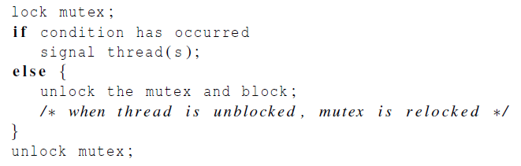
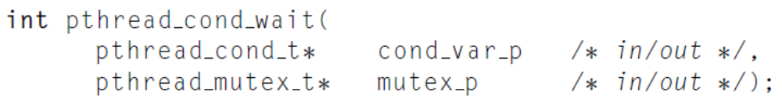
Condition Variables
The constructs in which condition variables are used:
Unlock one and all of the blocked threads:
Unlock the mutex referred to by mutex_p and cause the executing thread to block:

Slide 13
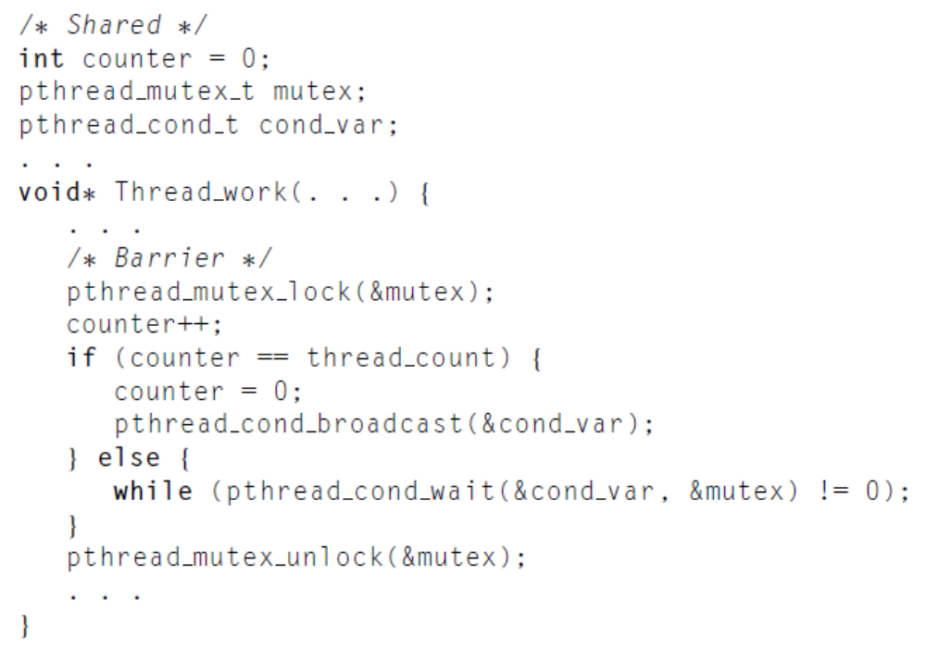
Implements a barrier with Condition Variables
Block the threads
Notes:
如果执行else语句，说明counter不等于thread_count，那么所有的thread一定是要等在barrier的，
因此要用while loop保证thread block住。

Slide 14
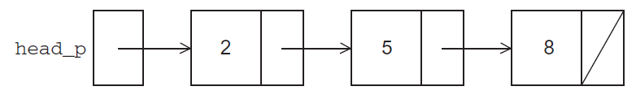
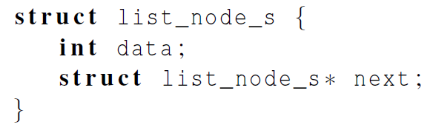
Read-Write Locks
Let’s look at an example.
Suppose the shared data structure is a sorted linked list of ints, and the operations of interest are Member, Insert, and Delete.
Notes:
List_node_s结构，head_p是list_node_s*类型，指向第一个节点。
本例是个排好序的linked list

Slide 15
Linked List Membership
Read
Read
Read

Slide 16
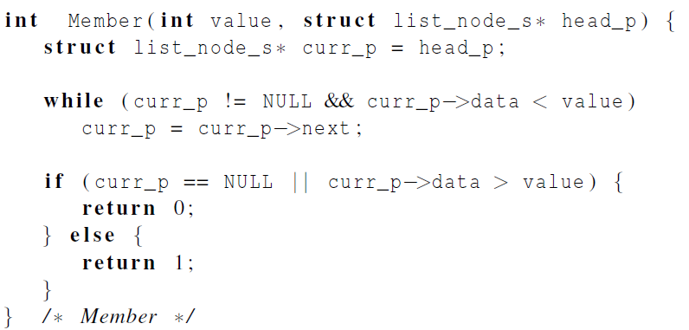
Linked List Membership
Notes:
在linked list中查找value
退出while循环时，当前data>=value

Slide 17
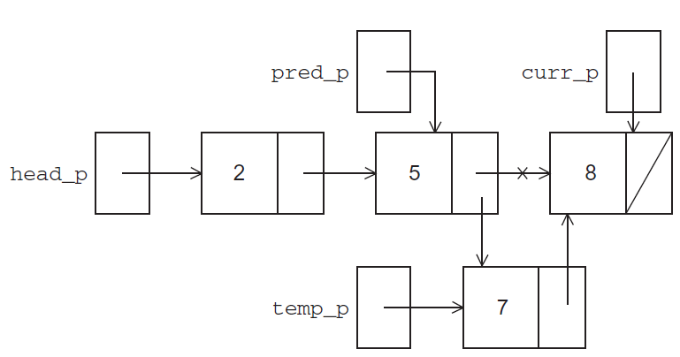
Inserting a new node into a list
Notes:
Pred_p指向当前节点的前一个节点，记录插入节点的位置。

Slide 18
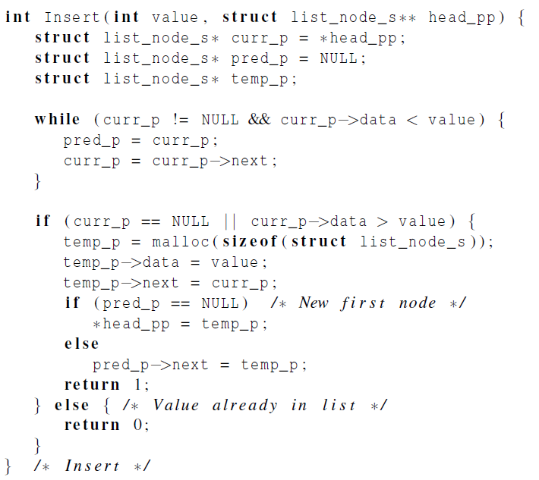
Inserting a new node into a list
Notes:
退出while循环curr_p数据项>=value

Slide 19
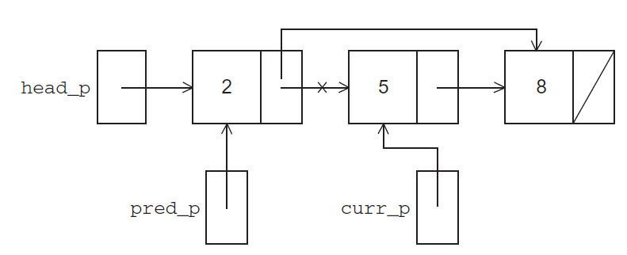
Deleting a node from a linked list
Notes:
Pred_p记录当前需要删除节点的前一个节点。

Slide 20
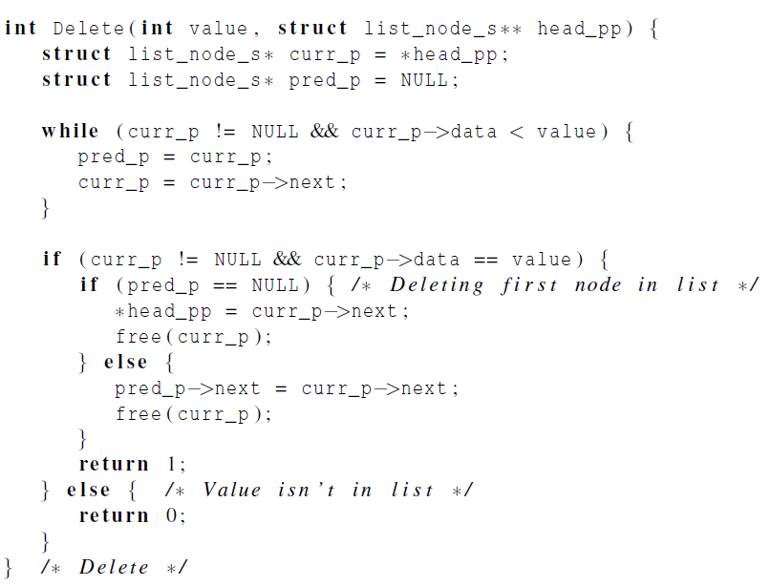
Deleting a node from a linked list

Slide 21
A Multi-Threaded Linked List
Let’s try to use these functions in a Pthreads program.
In order to share access to the list, we can define head_p to be a global (shared) variable.
Notes:
三种操作中，member只是读操作，因此可以并行执行；
但是insert和delete因为涉及到修改操作，因此不能并行执行

Slide 22
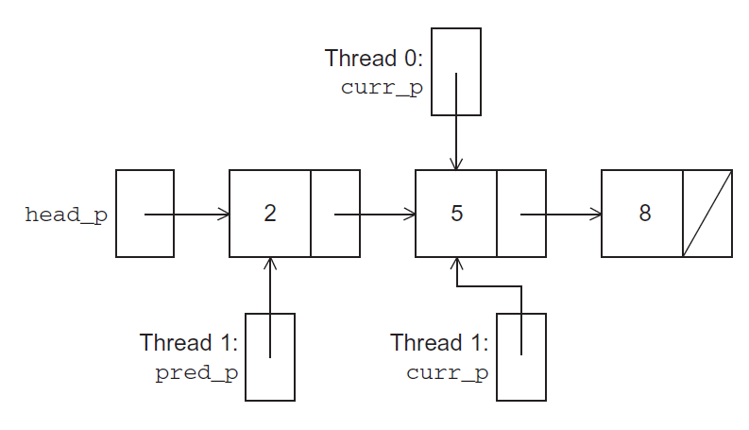
Simultaneous access by two threads
Thread 0 executing Member (5)
Thread 1 executing Delete (5)
Notes:
如果thread0要查找value等于5的节点，而thread1要删除这个节点，那么就会出现问题。

Slide 23
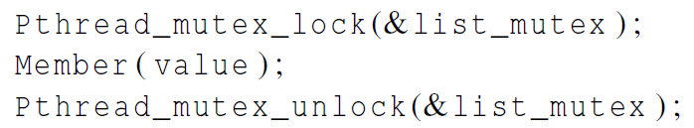
Solution #1
An obvious solution is to simply lock the list any time that a thread attempts to access it.
A call to each of the three functions can be protected by a mutex.
Good?
Notes:
用mutex保护整个linked list

Slide 24
Issues
We’re serializing access to the list.
If the vast majority of our operations are calls to Member, we’ll fail to exploit this opportunity for parallelism.
On the other hand, if most of our operations are calls to Insert and Delete, then this may be the best solution since we’ll need to serialize access to the list for most of the operations, and this solution will certainly be easy to implement.

Slide 25
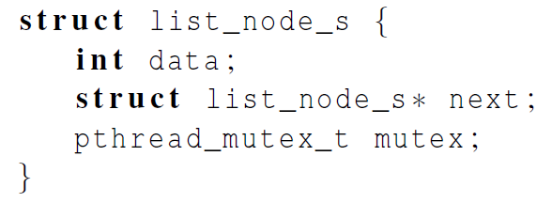
Solution #2
Instead of locking the entire list, we could try to lock individual nodes.
A “finer-grained” approach.
Good?
Notes:
每个节点加入mutex项

Slide 26
Issues
This is much more complex than the original Member function.
占时间It is also much slower, since, in general, each time a node is accessed, a mutex must be locked and unlocked.
占空间The addition of a mutex field to each node will substantially increase the amount of storage needed for the list.

Slide 27
Pthreads Read-Write Locks
Neither of our multi-threaded linked lists exploits the potential for simultaneous access to any node by threads that are executing Member.
The first solution only allows one thread to access the entire list at any instant.
The second only allows one thread to access any given node at any instant.
A read-write lock is somewhat like a mutex except that it provides two lock functions.
The first lock function locks the read-write lock for reading, while the second locks it for writing.

Slide 28
Pthreads Read-Write Locks
So multiple threads can simultaneously obtain the lock by calling the read-lock function, while only one thread can obtain the lock by calling the write-lock function.
Thus, if any threads own the lock for reading, any threads that want to obtain the lock for writing will block in the call to the write-lock function.
If any thread owns the lock for writing, any threads that want to obtain the lock for reading or writing will block in their respective locking functions.
Notes:
如果一个thread获得了读的锁，那么其他thread可以读，但是不能写；

Slide 29
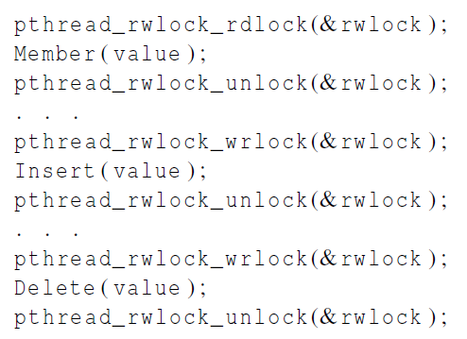
Protecting our linked list functions

Slide 30
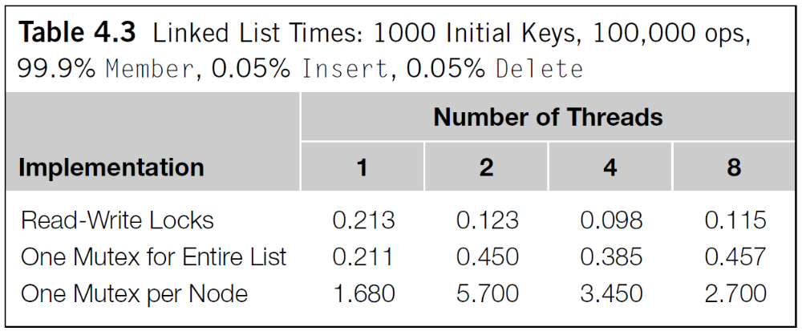
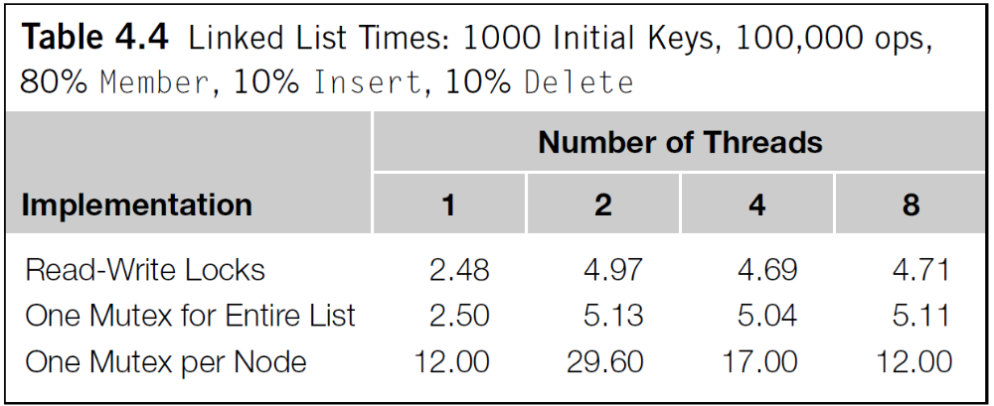
Performance

Slide 31
Summary of Programming with Threads
Pthreads are based on OS features
  Can be used from multiple languages (need appropriate header)
  Familiar language for most programmers
  Ability to shared data is convenient
Pitfalls陷阱
  Data races are difficult to find because they can be intermittent 间歇的
  Deadlocks are usually easier, but can also be intermittent

Slide 32
Some basic knowledge
A critical section is a block of code that updates a shared resource that can only be updated by one thread at a time.
Busy-waiting can be used to avoid conflicting access to critical sections with a flag variable and a while-loop with an empty body.
A mutex can be used to avoid conflicting access to critical sections as well.
A semaphore is the third way to avoid conflicting access to critical sections.
    It is an unsigned int together with two operations: sem_wait and sem_post. Semaphores are more powerful than mutexes since they can be initialized to any nonnegative value.
A barrier is a point in a program at which the threads block until all of the threads have reached it.
A read-write lock is used when it’s safe for multiple threads to simultaneously read a data structure, but if a thread needs to modify or write to the data structure, then only that thread can access the data structure during the modification.

Slide 33
Quiz
We can implement a barrier using Busy-Waiting and Mutex, Semaphores, and Condition Variables. Please explain the difference among them?

