Slide 1
并行程序设计
Lecture 9:
Introduction to Message Passing
Shouzhen Gu

Slide 2
Today’s Lecture
  Message Passing, largely for distributed memory
  Message Passing Interface (MPI): a Local View language
  Chapter 3 in textbook

Slide 3
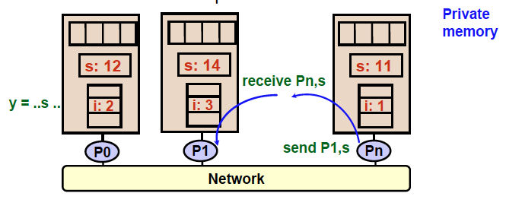
Programming Distributed Memory Architectures
A distributed-memory program consists of named processes.
• Process is a thread of control plus local address space -- NO shared data.
• Logically shared data is partitioned over local processes.
• Processes communicate by explicit send/receive pairs
• Coordination is implicit in every communication event.

Slide 4
Message Passing and MPI
Message passing is the principle alternative to shared memory parallel programming, predominant programming model for supercomputers and clusters
  Portable轻便的
  Low-level, but universal and matches earlier hardware execution model
What it is
  A library used within conventional sequential languagess (Fortran, C, C++)
  Based on Single Program, Multiple Data (SPMD)
  Isolation of separate address spaces分开的存储地址
    + no data races, but communication errors possible
    + exposes execution model and forces programmer to think about locality, both good for performance
    Complexity and code growth!
Notes:
分开的的存储地址，相互独立，因此，没有data races。
这种方式的执行模式很好分辨，需要在编程是考虑locality。
但是增加了代码的复杂度与代码量

Slide 5
Message Passing Library Features
All communication, synchronization require subroutine子程序 calls
  No shared variables
  Program runs on a single processor just like any uniprocessor program, except for calls to message passing library
Subroutines for
  Communication
    Pairwise or point-to-point: A message is sent from a specific sending process (point a) to a specific receiving process (point b).
    Collectives involving multiple processors
      Move data: Broadcast, Scatter/gather
      Compute and move: Reduce, AllReduce
  Synchronization
    Barrier
    No locks because there are no shared variables to protect
  Queries
    How many processes? Which one am I? Any messages waiting?
Notes:
交互、同步需要子程序调用，没有共享变量，不像Pthread一样能够在线程运行时完成通信与同步；
每个process都像普通的串行程序一样运行，只有调用消息传递库时，才会进行通信与同步。

Slide 6
Finding Out About the Environment
Two important questions that arise early in a parallel program are:
  How many processes are participating in this computation?
  Which one am I?
MPI provides functions to answer these questions:
  MPI_Comm_size reports the number of processes.
  MPI_Comm_rank reports the rank, a number between 0 and size-1, identifying the calling process
Notes:
进程数量？
进程编号？

Slide 7
Hello (C)
#include "mpi.h"
#include <stdio.h>
int main( int argc, char *argv[] )
{
int rank, size;
MPI_Init( &argc, &argv );
MPI_Comm_rank( MPI_COMM_WORLD, &rank );
MPI_Comm_size( MPI_COMM_WORLD, &size );
printf( ”Greetings from process %d of %d\n", rank, size );
MPI_Finalize();
return 0;
}
Communicator
The rank of process
#processes

Slide 8
Compilation
wrapper script to compile
source file
mpicc -g -Wall -o mpi_hello mpi_hello.c
produce
debugging
information
create this executable file name
(as opposed to default a.out)
turns on all warnings
Notes:
Mpicc，编译MPI库的脚本包，
-g参数指示编译器在编译时产生调试信息
-Wall

Slide 9
Execution
mpiexec -n <number of processes> <executable>
mpiexec -n 1 ./mpi_hello
run with 1 process
mpiexec -n 4 ./mpi_hello
run with 4 processes

Slide 10
Execution
mpiexec -n 1 ./mpi_hello
Greetings from process 0 of 1 !
mpiexec -n 4 ./mpi_hello
Greetings from process 0 of 4 !
Greetings from process 1 of 4 !
Greetings from process 2 of 4 !
Greetings from process 3 of 4 !

Slide 11


MPI Components
allocate storage, decide rank, define a communicator
MPI_Init
  Tells MPI to do all the necessary setup.
MPI_Finalize
  Tells MPI we’re done, so clean up anything allocated for this program.
free resources
  A communicator is a collection of processes that can send messages to each other.
Notes:
MPI_Init两个参数是指向main函数参数的指针，一般NULL；

Slide 12
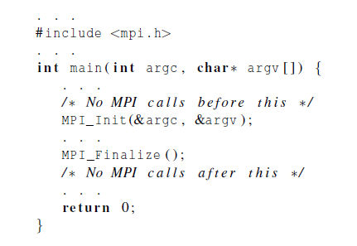
Basic Outline

Slide 13
MPI Basic Send/Receive
We need to fill in the details in
Things that need specifying:
  How will “data” be described?
  How will processes be identified?
  How will the receiver recognize/screen messages?
  What will it mean for these operations to complete?
Process 0
Process 1
Send(data)
Receive(data)
Notes:
数据如何表示？
怎么判别processes的rank？
接收方怎么识别信息？

Slide 14
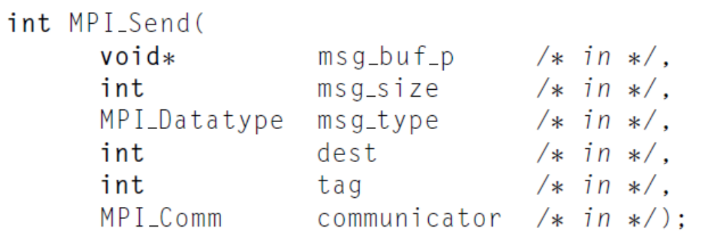
The Syntax of MPI Basic Send
msg_buf_p: a pinter to a block of memory
Msg_size and msg_type: determine the amount of data to be set.
communicator: specify communication universes.
Notes:
Tag,非负整型。
Receive里Source和tag可以用通配符。

Slide 15
MPI Basic (Blocking) Send
A(10)
B(20)
MPI_Send( A, 10, MPI_DOUBLE, 1, …)
MPI_Recv( B, 20, MPI_DOUBLE, 0, … )
MPI_SEND(buffer, size, datatype, dest, tag, comm)
The message buffer is described by (buffer,size, datatype).
The target process is specified by dest, which is the rank of the target process in the communicator specified by comm.
When this function returns, the data has been delivered to the system and the buffer can be reused. The message may not have been received by the target process.
Notes:
Tag,非负整型。

Slide 16
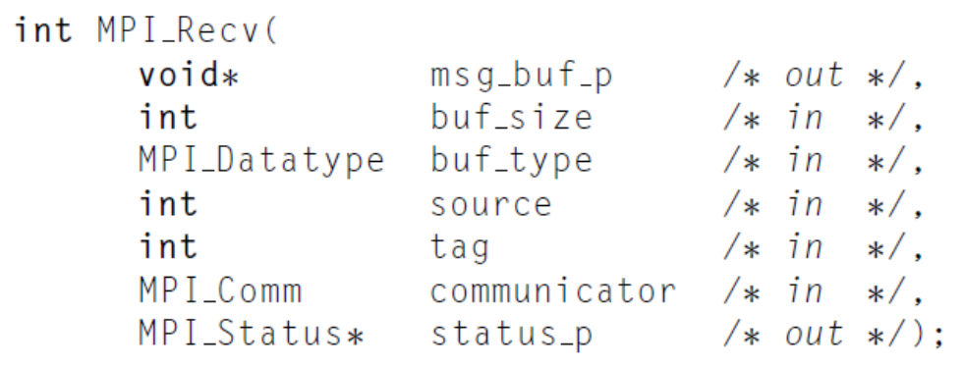
The Syntax of MPI Basic Receive
msg_buf_p: a pinter to a block of memory
Msg_size and msg_type: determine the amount of data to be set.
communicator: specify communication universes.

Slide 17
MPI Basic (Blocking) Receive
A(10)
B(20)
MPI_Send( A, 10, MPI_DOUBLE, 1, …)
MPI_Recv( B, 20, MPI_DOUBLE, 0, … )
MPI_RECV(buffer, size, datatype, source, tag, comm, status)
Waits until a matching (both source and tag) message is received from the system, and the buffer can be used
source is rank in communicator specified by comm, or MPI_ANY_SOURCE
tag is a tag to be matched on or MPI_ANY_TAG
receiving fewer than size occurrences of datatype is OK, but receiving more is an error
status contains further information (e.g. size of message)

Slide 18
Message Matching
MPI_Send(send_buf_p, send_buf_sz, send_type, dest, send_tag, send_comm);
MPI_Recv(recv_buf_p, recv_buf_sz, rece_type, src, recv_tag, recv_comm, &status)
  recv_comm=send_comm
  recv_tag=send_tag
  dest=r, and
  src=q

Slide 19
Some Basic Clarifying Concepts
How to organize processes
  Processes can be collected into groups
  Each message is sent in a context, and must be received in the same context
    Provides necessary support for libraries
  A group and context together form a communicator
  A process is identified by its rank in the group associated with a communicator
There is a default communicator whose group contains all initial processes, called MPI_COMM_WORLD

Slide 20
MPI Datatypes
The data in a message to send or receive is described by a triple (address, count, datatype), where
An MPI datatype is recursively defined as:
  predefined, corresponding to a data type from the language (e.g., MPI_INT, MPI_DOUBLE)
  a contiguous array of MPI datatypes
  a strided跨 block of datatypes
  an indexed array of blocks of datatypes
  an arbitrary structure of datatypes
There are MPI functions to construct custom datatypes, in particular ones for subarrays

Slide 21
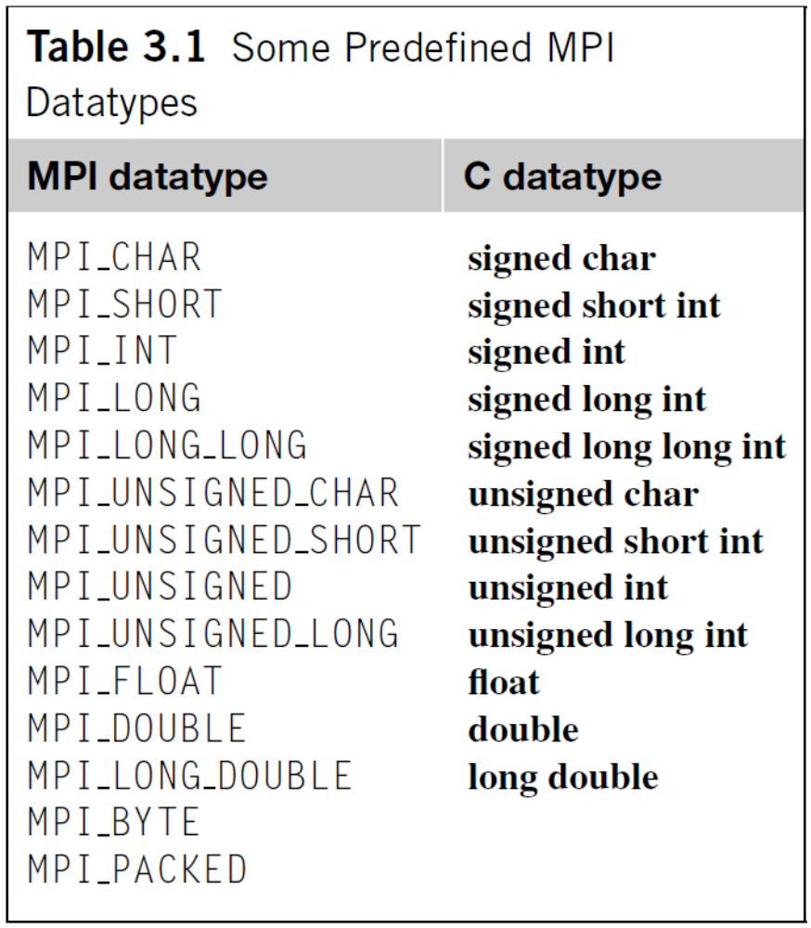
MPI Datatypes

Slide 22
MPI Tags
Messages are sent with an accompanying user-defined integer tag, to assist the receiving process in identifying the message
Messages can be screened at the receiving end by specifying a specific tag, or not screened by specifying MPI_ANY_TAG as the tag in a receive
Some non-MPI message-passing systems have called tags “message types”. MPI calls them tags to avoid confusion with datatypes

Slide 23
A Simple MPI Program
#include “mpi.h”
#include <stdio.h>
int main( int argc, char *argv[])
{
int rank, buf;
MPI_Status status;
MPI_Init(&argv, &argc);
MPI_Comm_rank( MPI_COMM_WORLD, &rank );
/* Process 0 sends and Process 1 receives */
if (rank == 0) {
buf = 123456;
MPI_Send( &buf, 1, MPI_INT, 1, 0, MPI_COMM_WORLD);
}
else if (rank == 1) {
MPI_Recv( &buf, 1, MPI_INT, 0, 0, MPI_COMM_WORLD,
&status );
printf( “Received %d\n”, buf );
}
MPI_Finalize();
return 0;
}

