Slide 1
并行程序设计
Lecture 10:
How to divide tasks or data to parallel computing
Shouzhen Gu

Slide 2
Today’s Lecture
  Recurrence
  Divide-and-Conquer
  MPI: The trapezoidal梯形 rule
  MPI_Reduce and MPI_Allreduce
  Broadcast
  Data distributions
  Scatter
  Gather
  Allgather

Slide 3
Recursion
Recursion occurs when a thing is defined in terms of itself or of its type.
The most common application of recursion is in mathematics and computer science, where a function being defined is applied within its own definition.
a class of objects or methods exhibit recursive behavior when they can be defined by two properties:
  A simple base case (or cases)—a terminating scenario that does not use recursion to produce an answer
  A set of rules that reduce all other cases toward the base case

Slide 4

Escher

Slide 5
Tower of Hanoi
The Tower of Hanoi consists of three rods and a number of disks of different sizes, which can slide onto any rod. The puzzle starts with the disks in a neat stack in ascending order of size on one rod, the smallest at the top, thus making a conical shape.
The objective of the puzzle is to move the entire stack to another rod, obeying the following simple rules:
  Only one disk can be moved at a time.
  Each move consists of taking the upper disk from one of the stacks and placing it on top of another stack i.e. a disk can only be moved if it is the uppermost disk on a stack.
  No disk may be placed on top of a smaller disk.

Slide 6
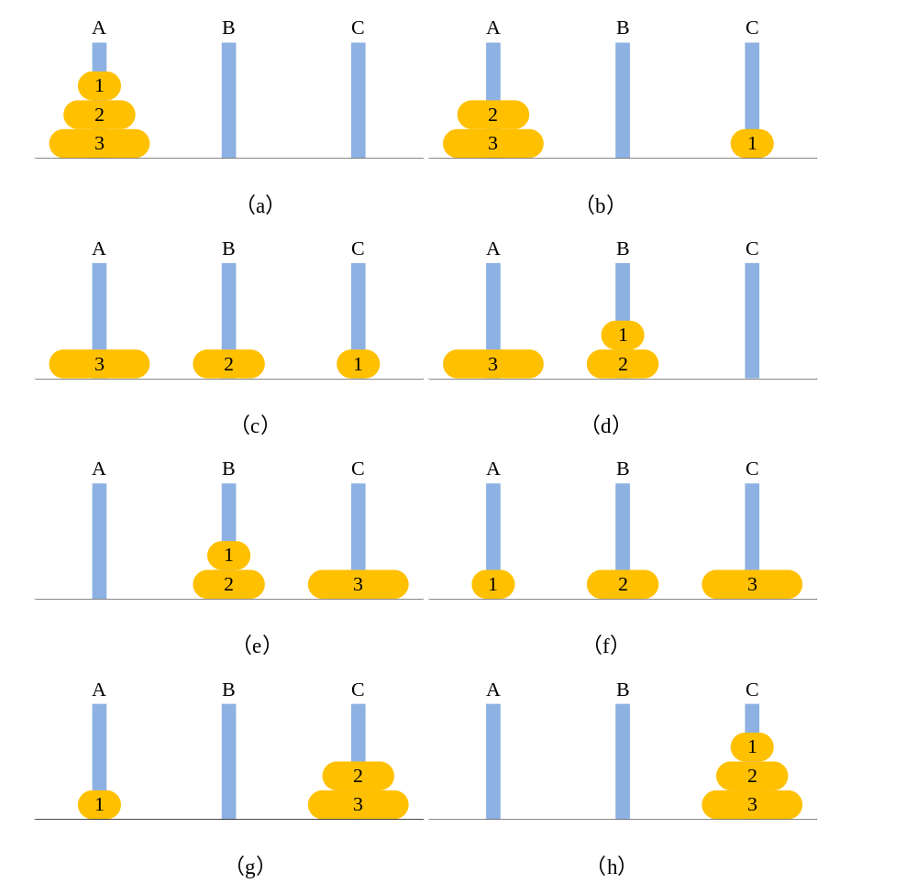
N=3
(a)~(d)
(e)~(h)

Slide 7
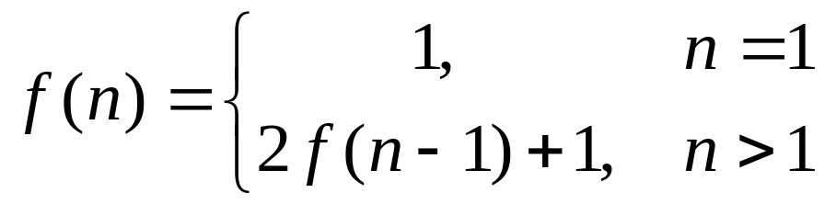
Recursive Function
f(n)=2*f(n-1)+1=2*2(f(n-2)+1)+1=4f(n-2)+2+1= 4(2f(n-3)+1) + 2 + 1 = 8f(n-3)+4 + 2 + 1=……=2^{n}-1
The recursive function of Hanoi Tower:
Terminate condition

Slide 8
Pseudo-code
#include <stdlib.h>
#include "hanoi.h"
int main(int argc, char** argv)
{
char current[] = { 'A', 'A', 'A', 'A' };
char A = 'A', B = 'B', C = 'C';
hanoi(current, 4, A, B, C);
return EXIT_SUCCESS;
}
void hanoi(char* current, int n, char A, char B, char C)
{
static int cout = 0;
int i = 0;
if (n==1)
{
i = pickTopDisk(current, A);
current[i] = C;
cout++;
printf("move %d disk %d: %c->%c\n", cout, i + 1, A, C);
return;
}
hanoi(current, n - 1, A, C, B);
current[n- 1] = C;
cout++;
printf("move %d disk %d: %c->%c\n", cout, n, A, C);
hanoi(current, n - 1, B, A, C);
}
int pickTopDisk(char* current,char x)
{
int i = 0;
while (current[i] != x)
i++;
return i;
}

Slide 9
Divide-and-Conquer
A divide and conquer algorithm (D&Q) works by recursively breaking down a problem into two or more sub-problems of the same or related type, until these become simple enough to be solved directly. The solutions to the sub-problems are then combined to give a solution to the original problem.
Divide and conquer algorithms are naturally adapted for execution in multi-processor machines, because distinct sub-problems can be executed on different processors.

Slide 10
Minimum
Finding the minimum among a1,a2,a3,…,an.
Serial program:
int m=0;
for(i=0;i<n;i++){
if(a[i]<m){
m=a[i];}
}

Slide 11
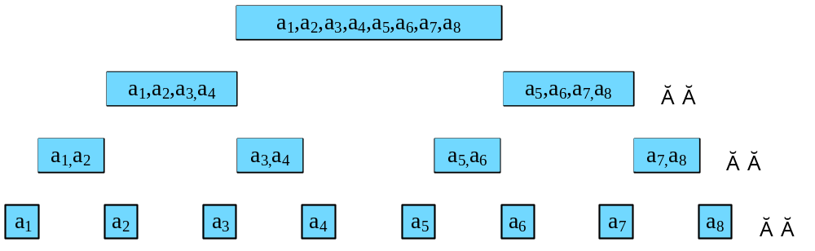
D&C: Minimum
Level: #comparison
3: n/n
2: n/4
1: n/2
0: 0
If n=8:
#comparison=0+8/2+8/4+8/8=7
If there are 4 processes and each comparison takes 1 ns. Then, in the best situation, it will take 3 ns to find the minimum.

Slide 12
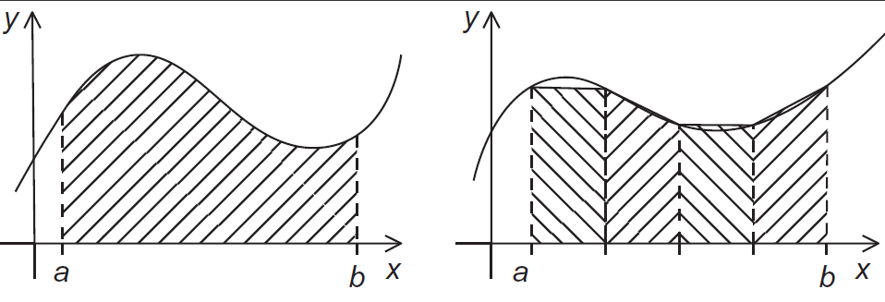
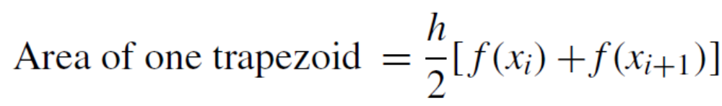
The trapezoidal rule

Slide 13
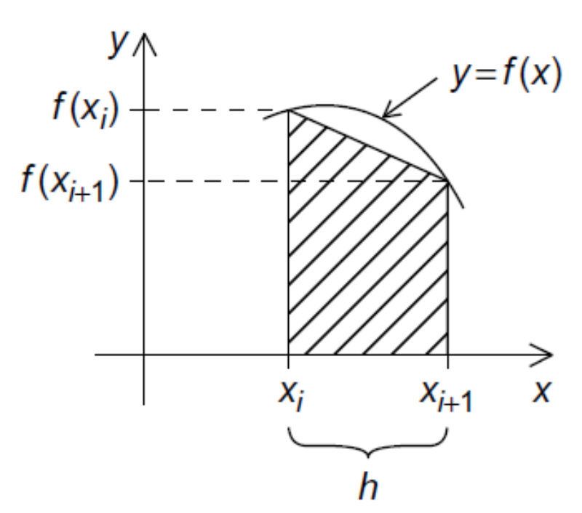
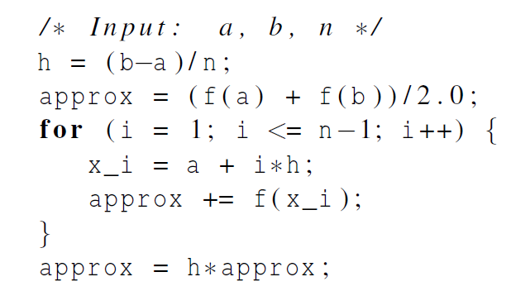
Trapezoidal Rule: Serial algorithm

Slide 14
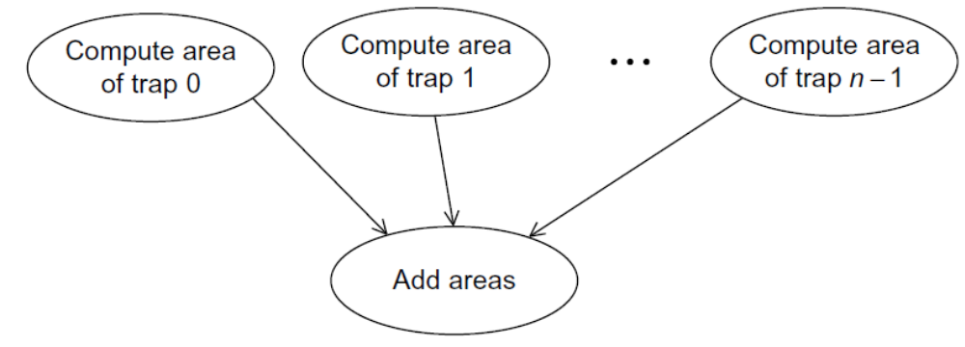
Designing a Parallel Program
Basic steps:
Partition the problem solution into tasks.
Identify the communication channels between the tasks.
Aggregate the tasks into composite tasks.
Map the composite tasks to cores.

Slide 15
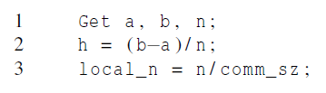
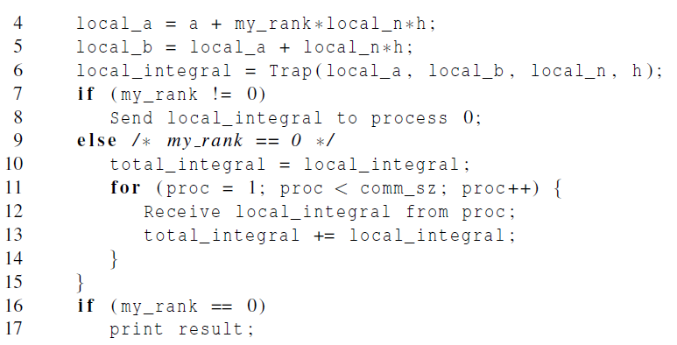
Parallel pseudo-code
#trapezoids that each process need to compute
The first trapezoid
The last trapezoid

Slide 16
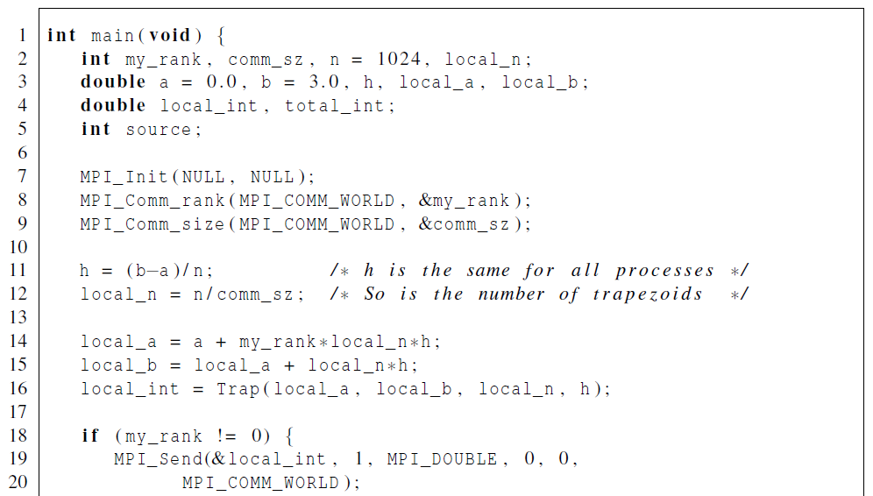
First version (1)

Slide 17
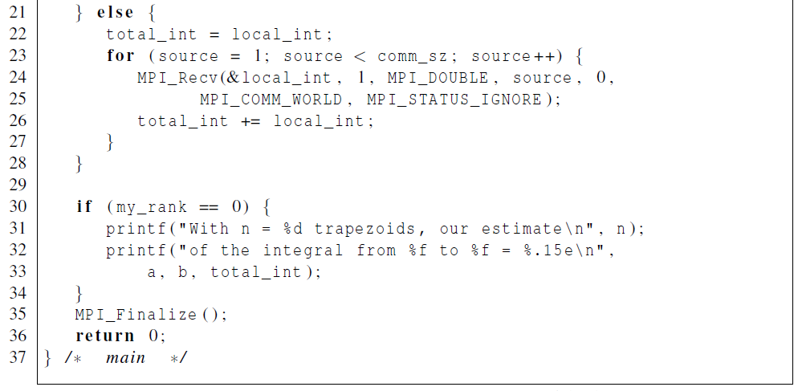
First version (2)

Slide 18
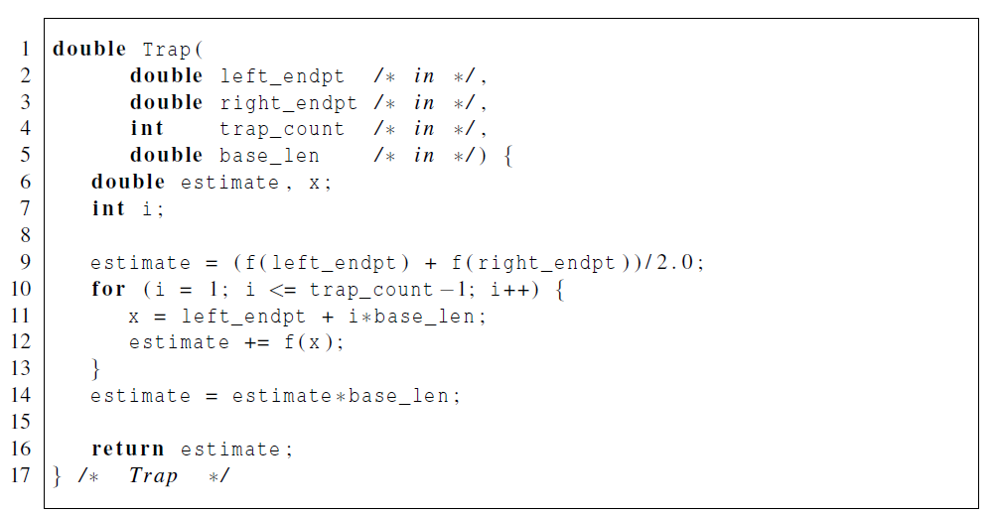
First version (3)

Slide 19
Collective communication
Collective communication is defined as communication that involves a group or groups of processes.
Several collective routines such as broadcast and gather have a single originating or receiving process. Such a process is called the root.
The type-matching conditions for the collective operations are more strict than the corresponding conditions between sender and receiver in point-to-point.
Collective communication calls may use the same communicators as point-to-point communication.
The key concept of the collective functions is to have a group or groups of participating processes.
There are two types of communicators: intra-communicators and inter-communicators.
Notes:
An intracommunicator can be thought of as an identifier for a single group of processes linked with a context.
An intercommunicator identifies two distinct groups of processes linked with a context.

Slide 20
Collective vs. Point-to-Point Communications
All the processes in the communicator must call the same collective function. For example, a program that attempts to match a call to MPI_Reduce on one process with a call to MPI_Recv on another process is erroneous, and, in all likelihood, the program will hang or crash.
The arguments passed by each process to an MPI collective communication must be “compatible.” For example, if one process passes in 0 as the dest_process and another passes in 1, then the outcome of a call to MPI_Reduce is erroneous, and, once again, the program is likely to hang or crash.
Notes:
通信器里所有的进程，必须调用同一个集合体函数。

Slide 21
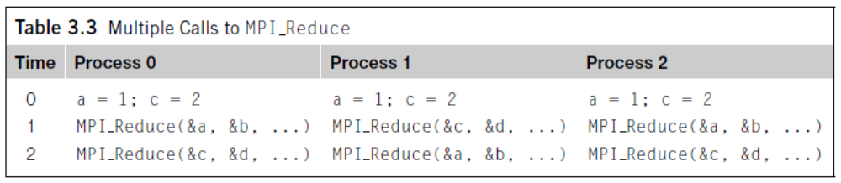
Collective vs. Point-to-Point Communications
The output_data_p argument is only used on dest_process. However, all of the processes still need to pass in an actual argument corresponding to output_data_p, even if it’s just NULL.
Point-to-point communications are matched on the basis of tags and communicators. Collective communications don’t use tags. They’re matched solely on the basis of the communicator and the order in which they’re called.
Notes:
指向接收消息的内存块的指针，这个参数只在目的进程中用。

Slide 22
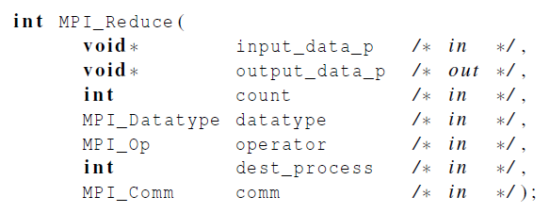
MPI_Reduce
All processes provide input buffers of the same length, with elements of the same type as the output buffer at the root.
The operator is always assumed to be associative.
Notes:
int MPI_Reduce(
void *input_data, /*指向发送消息的内存块的指针 */
void *output_data, /*指向接收（输出）消息的内存块的指针 */
int count，/*数据量*/
MPI_Datatype datatype,/*数据类型*/
MPI_Op operator,/*规约操作*/
int dest，/*要接收（输出）消息的进程的进程号*/
MPI_Comm comm);/*通信器，指定通信范围*/

Slide 23
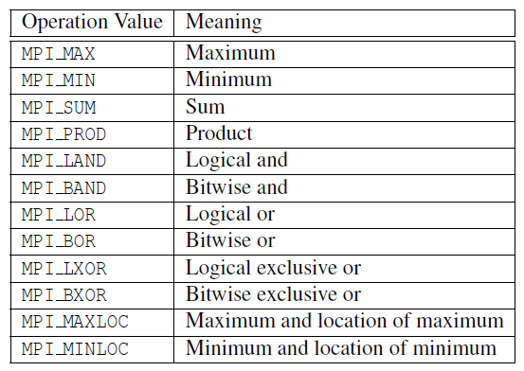
Predefined reduction operators in MPI

Slide 24
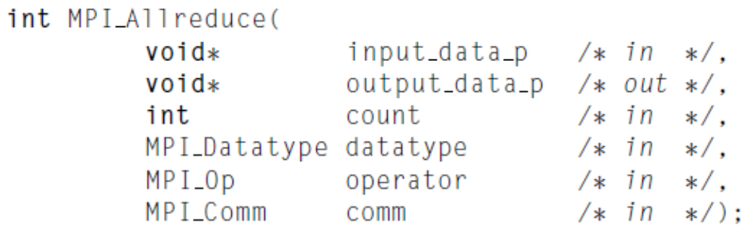
MPI_Allreduce
MPI_Allreduce behaves the same as MPI_Reduce except that the result appears in the receive buffer of all the processes.

Slide 25
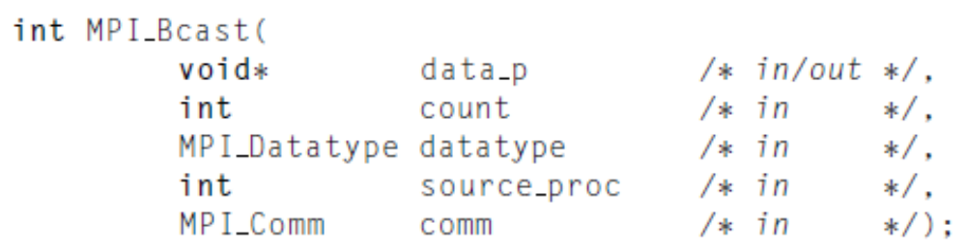
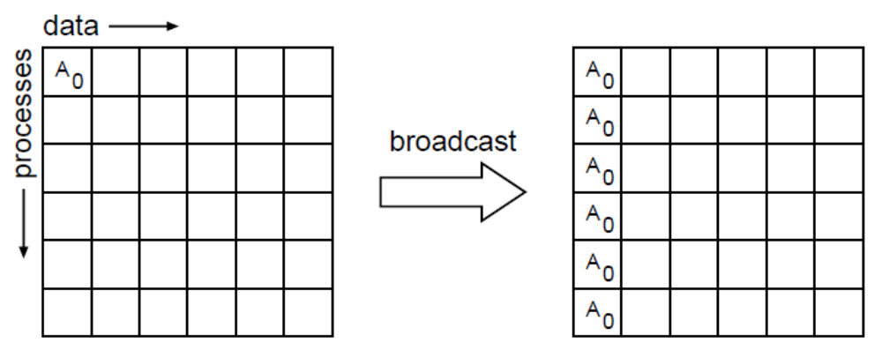
Broadcast
p0
p1
p2
p3
p4
p5
Notes:
When broadcasting, Root is included

Slide 26
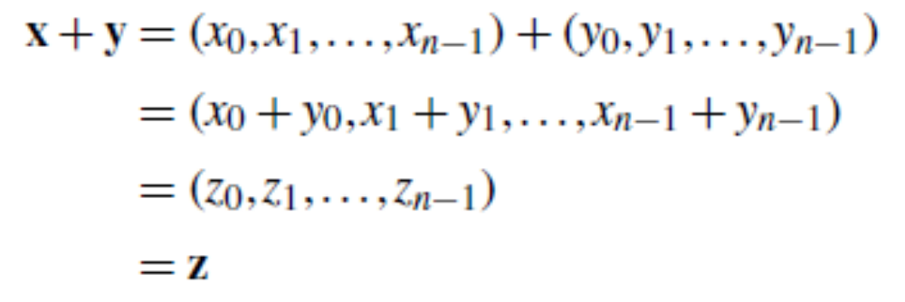
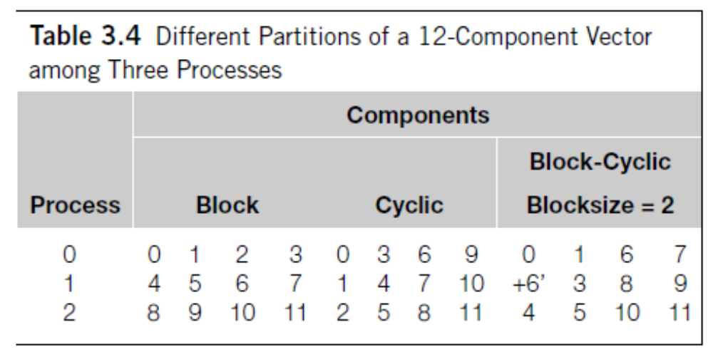
Data distributions
n=12, Comm_sz=3

Slide 27
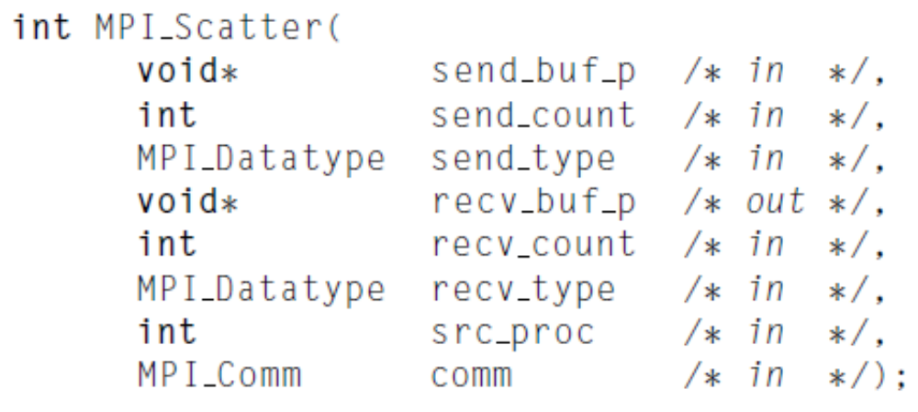
Scatter
the number of items it sends to each process
This message is split into n equal segments, the i-th segment is sent to the i-th process

Slide 28
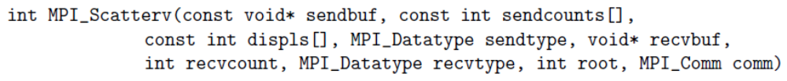
MPI_Scatterv
non-negative integer array (of length group size) containing
the number of elements that are sent to each process.
The data sent to process j is placed into sendbuf of the root process beginning at offset displs[j] elements .

Slide 29
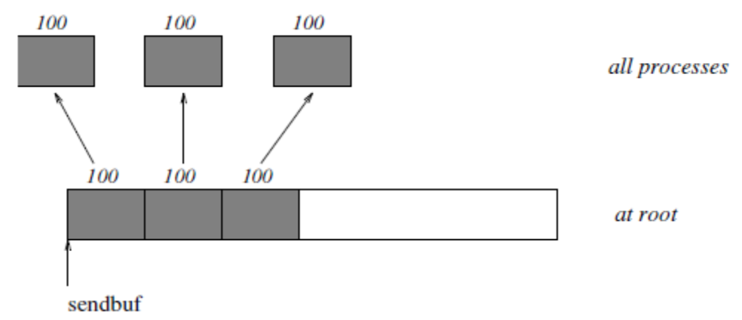
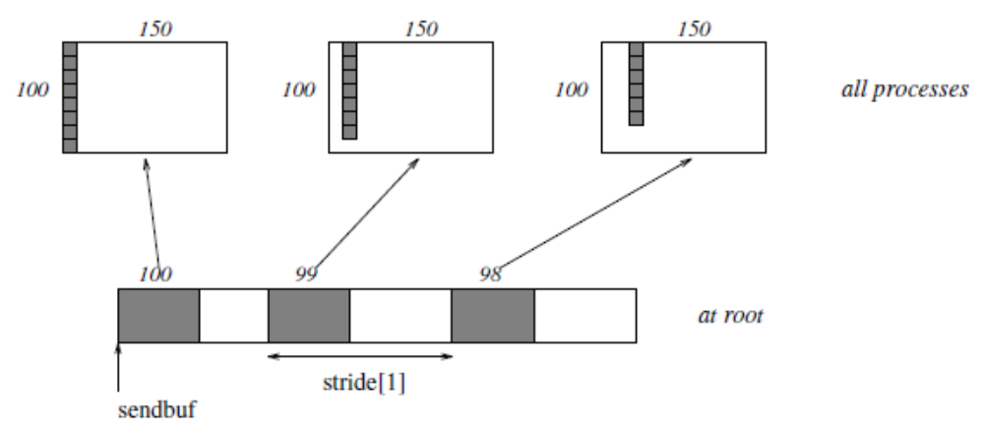
MPI_Scatter vs. MPI_Scatterv
Notes:
Scatter 将一段数组的不同部分发给不同的进程
Gather 将每个进程的数据集中到根进程中
Allgather 将所有数据聚合到每个进程中

Slide 30
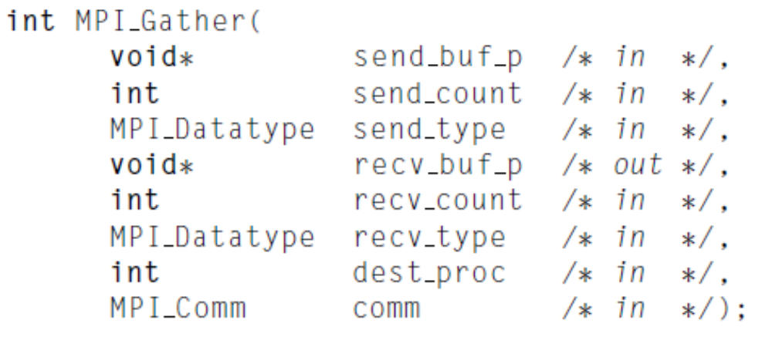
Gather
the number of items it receives from each process
All processes execute：
MPI_Send(sendbuf, sendcount, sendtype, root , ...),
The root execute:
MPI_Recv(recvbuf+i·recvcount·extent(recvtype), recvcount, recvtype, i,...),
Notes:
When gathering, Root is included

Slide 31
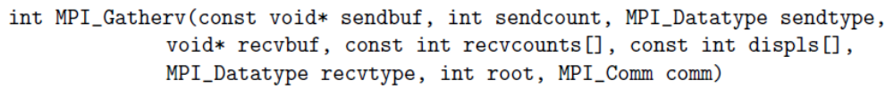
MPI_Gatherv
non-negative integer array (of length group size) containing
the number of elements that are received from each process (significant only at root)
The data received from process j is placed into recvbuf of the root process beginning at offset displs[j] elements (in terms of the recvtype).

Slide 32
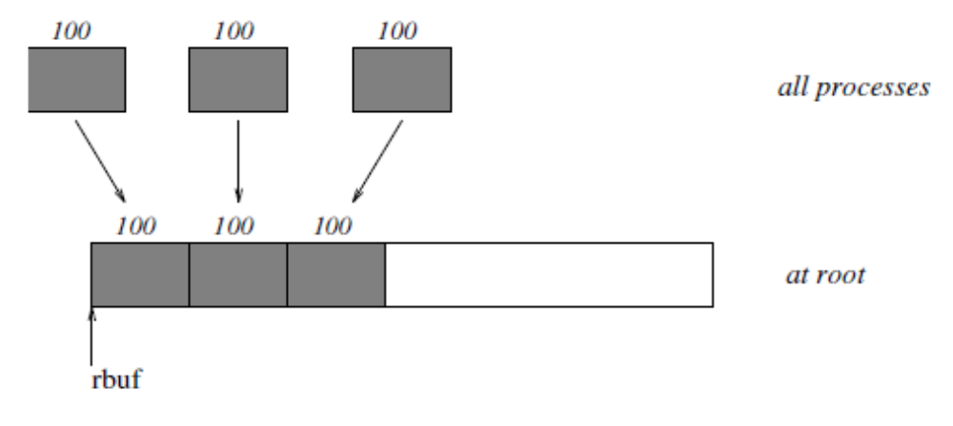
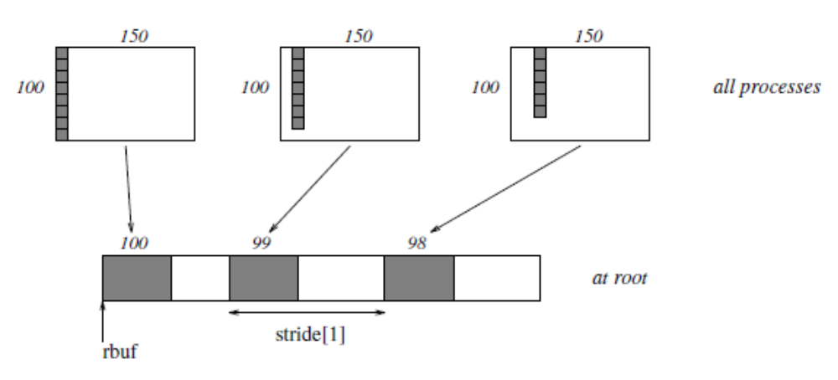
MPI_Gather vs. MPI_Gatherv

Slide 33
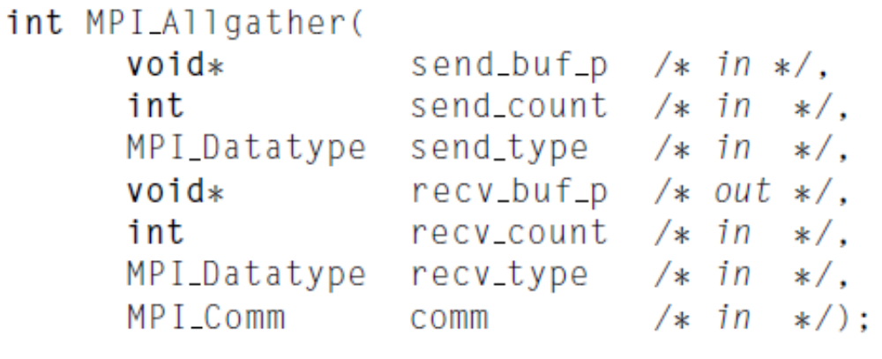
Allgather
MPI_Allgather can be thought of as MPI_Gather, but where all processes receive the result, instead of just the root.
The block of data sent from the j-th process is received by every process and placed in the j-th block of the buffer recv_buf_p.

Slide 34
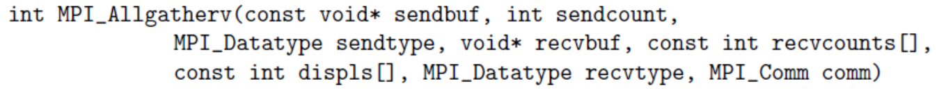
MPI_Allgatherv
MPI_ALLGATHERV can be thought of as MPI_GATHERV, but where all processes receive the result, instead of just the root.
The block of data sent from the j-th process is received by every process and placed in the j-th block of the buffer recvbuf.
These blocks need not all be the same size.

