Slide 1
Deep Multi-instance Networks with Sparse Label Assignment for Whole Mammogram Classification
汇报人：刘名桂
时间：2018年12月12号

Slide 2
背景
traditional methods do Mammogram classification need annotation，require expert domain knowledge and costly effort
our methods: classification on whole mammogram without annotate the training data.

Slide 3
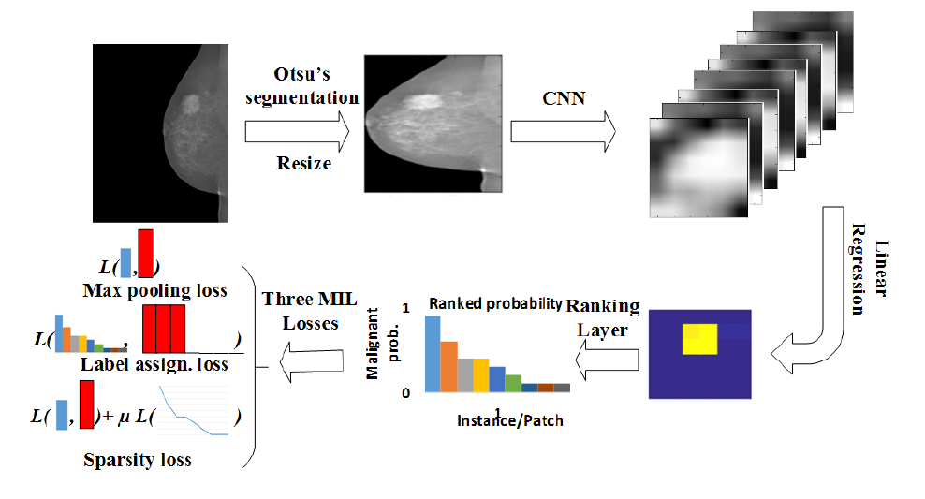
the proposed deep multi-instance network framework
6*6*256
224*224
6*6

Slide 4



Max pooling loss
takes only the largest element from ranking layer

Slide 5
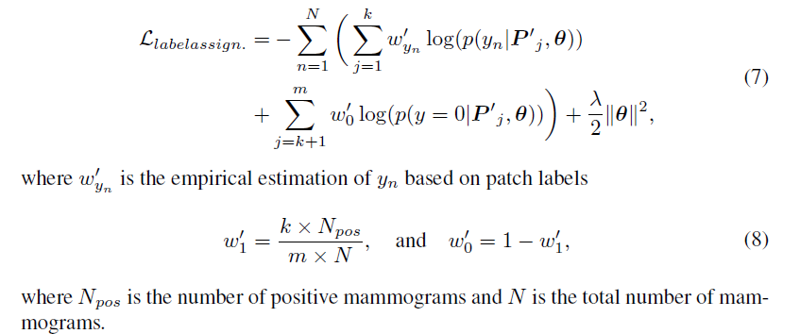
Label assign.loss

Slide 6
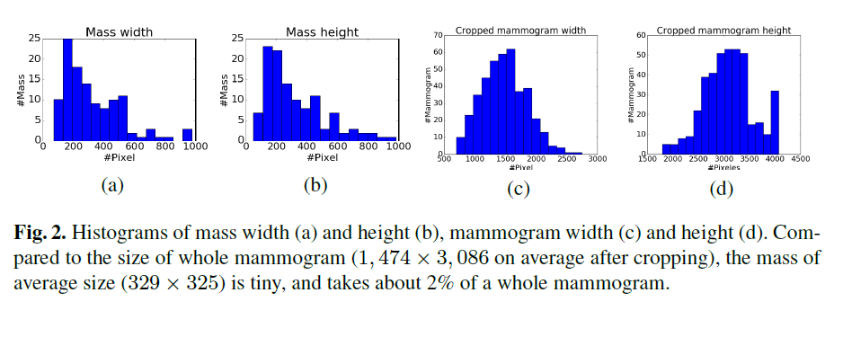


Slide 7
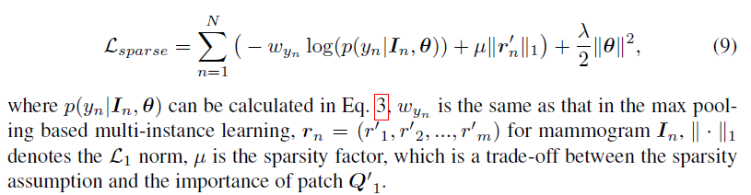
Sparsity loss

Slide 8
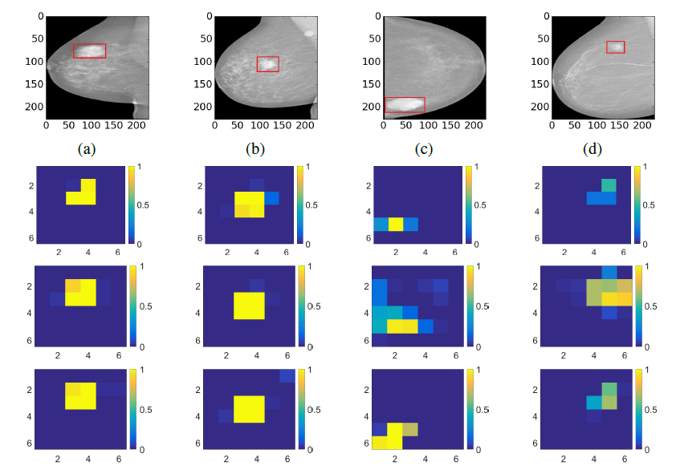
1.max pooling base miss some malignant patches in a,c,d
2.the label assign-based mis-classifies in d(设置了k)

Slide 9
