Slide 1
Simulation Flaw in a Case Study with Bayesian Model
Minzhao Liu, 2018

Slide 2
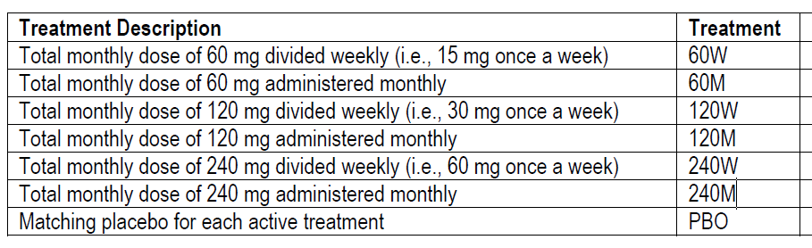
Background
Primary endpoint: response rate (RR)
Bayesian framework will be used for decision-making.
Notes:
primary efficacy objective is to select an efficacious dose level and dosing regimen as determined by the primary endpoint, response rate (RR)
A model based probability inference approach in Bayesian framework will be used for decision-making.

Slide 3
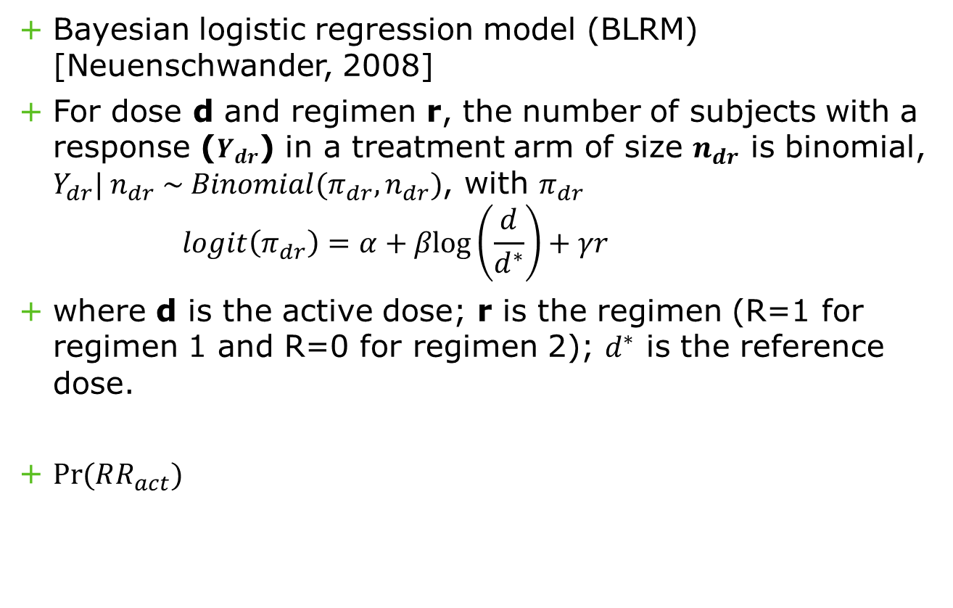
Model for Active Treatment Arm
Bayesian logistic regression model (BLRM) [Neuenschwander, 2008]
For dose d and regimen r, the number of subjects with a response ($Y_{dr}$) in a treatment arm of size $n_{dr}$ is binomial, $Y_{dr}| n_{dr} \sim Binomial(π_{dr}, n_{dr})$, with $π_{dr}$
$$logit\left(π_{dr}\right)=α+βlog\left(\frac{d}{d^{∗}}\right)+γr$$
where d is the active dose; r is the regimen (R=1 for regimen 1 and R=0 for regimen 2); $d^{∗}$ is the reference dose.
$Pr⁡(RR_{act})$

Slide 4
Model for Placebo Arm
“ Since it is not expected to have any responder in the placebo arm, posterior distribution of RRs is generated separately from a Beta distribution using uniform prior, i.e., Beta(1,1).”
Notes:
Since it is not expected to have any responder in the placebo arm, posterior distribution of
RRs is generated separately from a Beta distribution using uniform prior, i.e., Beta(1,1).
Placebo injections will be given in different dosing regimens (according to the
corresponding active treatment group) for the purpose of maintaining the blind. However,
all placebo subjects across dosing regimens will be combined in 1 group for this analysis,
since no difference in RR is expected if placebo is administered in different dosing
regimens.

Slide 5

Success Criteria
- An active treatment group will be declared efficacious if
$$\operatorname{Pr}\left( RR_{act}>RR_{pbo}\right)≥80\%$$
Notes:
An active treatment group will be declared efficacious if the posterior probability that the
difference in the RRs between that active group and the placebo is positive, is high (at
least 80%), i.e., P (RRACT > RRPBO) 80%, where RRACT is the RR in the active group,
RRPBO is the RR in the placebo group, and P is the posterior probability
A large set of posterior mean of RRs for each treatment group will be generated by using
MCMC samples from the posterior distribution using BLRM (for active) or beta
distribution (placebo). Then the difference between posterior mean of each active
treatment group and placebo (active – placebo) will be calculated for each of the MCMC
sample. The number of times the difference greater than 0 over the parameter space (i.e.
number of MCMC samples) provides the posterior probability of the difference in RRs
between that active group and the placebo group is positive.

Slide 6
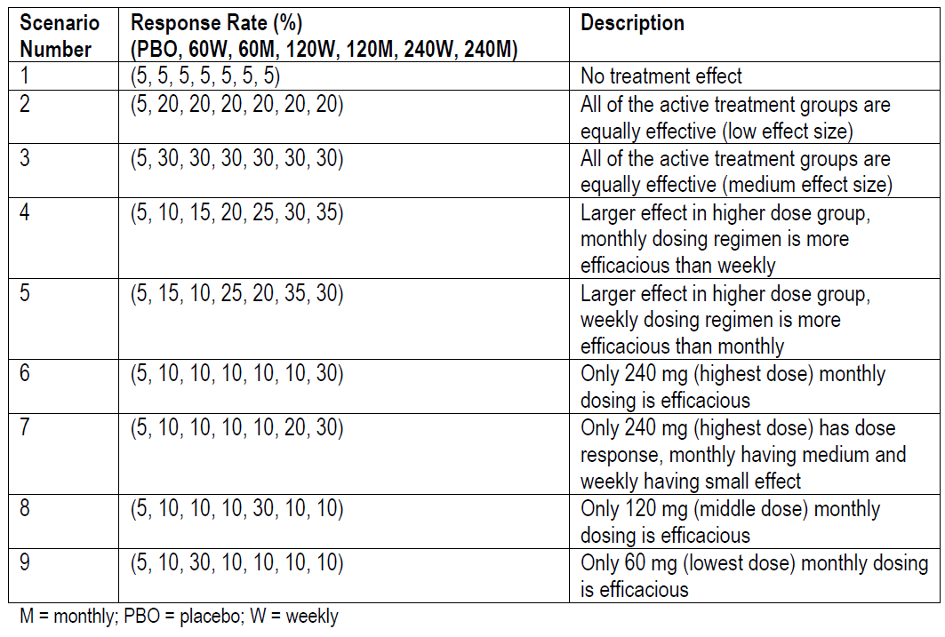
Scenarios for Simulation
Notes:
Purpose: simulations are performed to calculate the operating characteristics of this model and to
understand the model performance under each of the scenarios described
A RR of 5% or below is considered for placebo or no treatment effect. A 30% or more absolute in the RRs is considered an important treatment effect

Slide 7
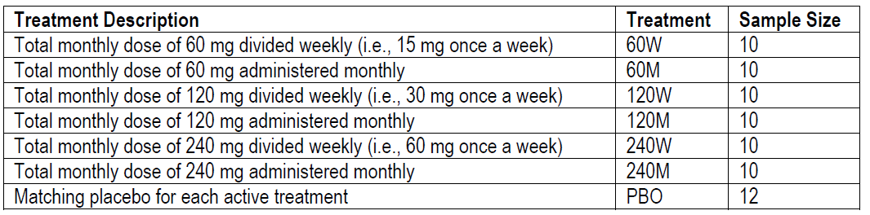
Scenarios for Simulation (Cont.)
A set of 1000 datasets were simulated for each scenario.
Average PoS, and probability of selecting a dose group
based on PoS are calculated
Testing different cutoff points for PoS (e.g. 75%, 80%, 85%
and 90%).
Notes:
probability of success (PoS)

Slide 8
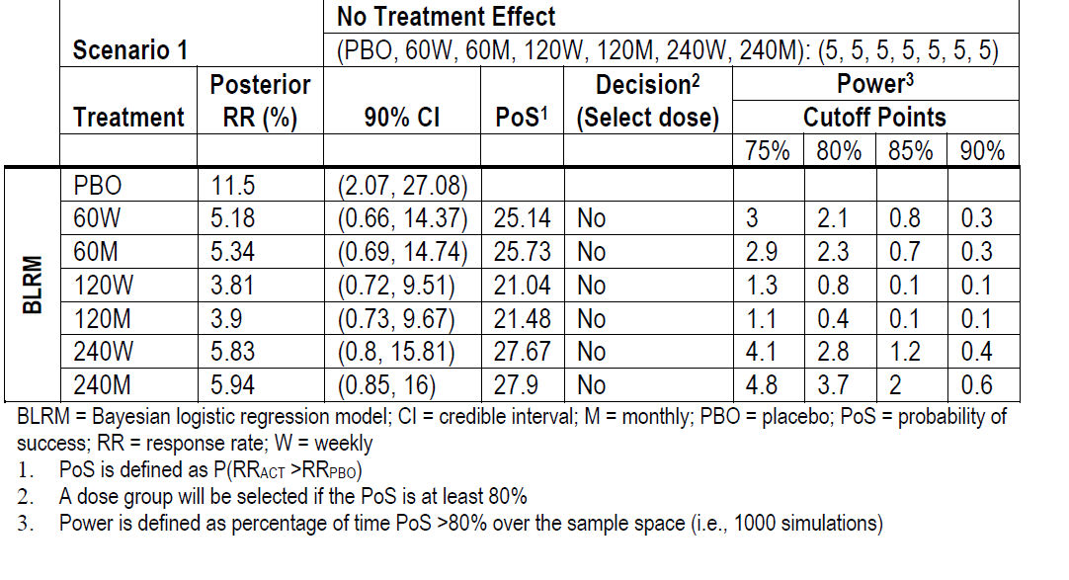
Simulation Results From Scenario 1

Slide 9
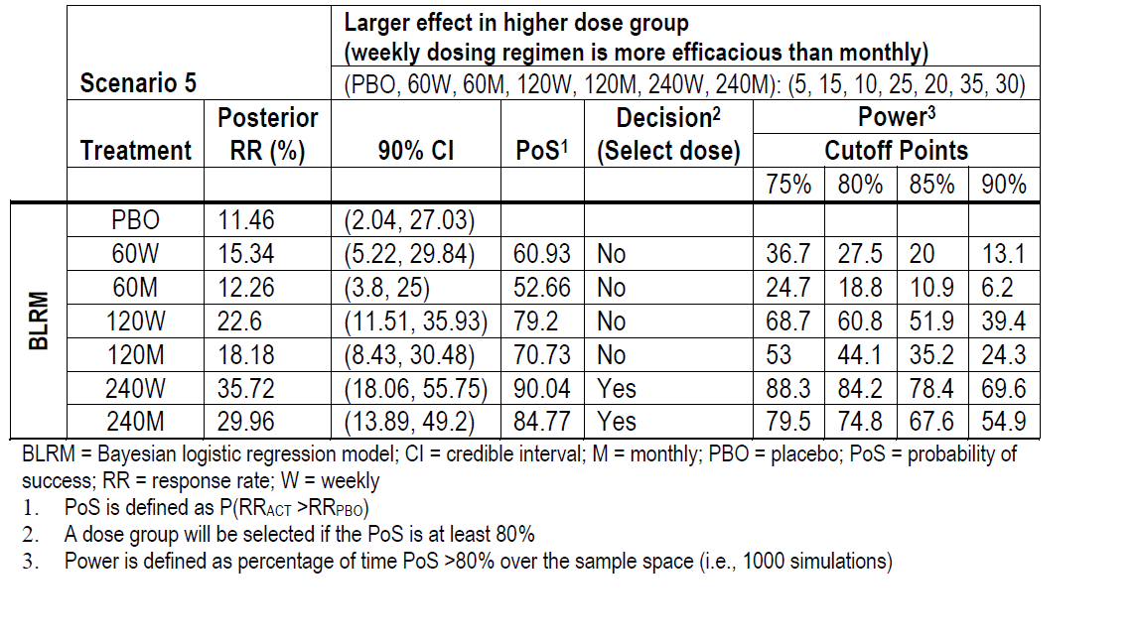
Simulation Results From Scenario 5

Slide 10
What’s Weird
“ Since it is not expected to have any responder in the placebo arm, posterior distribution of RRs is generated separately from a Beta distribution using uniform prior, i.e., Beta(1,1).”
Sample size of 10
5% of RR for Placebo in simulated data
Notes:
When true RR = 5 (for example, in Scenario 1 and PBO in all scenarios), the estimated posterior RR for PBO and PW are all around 12% which does not make sense. The model settings and code are all correct. The bias is due to extreme probability (close to 0 or 1, in our case, 0.05 close to 0).

Slide 11
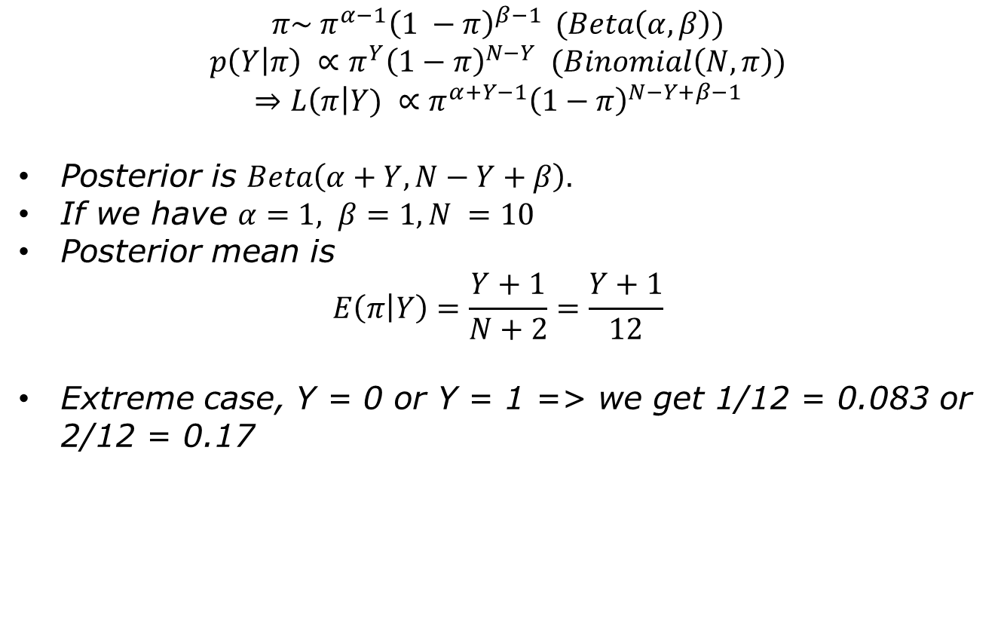
Recall for Placebo
$$π\sim π^{α−1}{\left(1 −π\right)}^{β−1 } (Beta\left(α, β\right))$$
$$p\left(Y | π\right) ∝π^{Y}{\left(1−π\right)}^{N−Y} (Binomial\left(N, π\right))$$
$$⇒L\left(π\right|Y) ∝π^{α+Y−1}{\left(1−π\right)}^{N−Y+β−1}$$
Posterior is $Beta\left(α+Y, N−Y+β\right).$
If we have $α=1, β=1, N =10$
Posterior mean is
$$E\left(π | Y\right)=\frac{Y+1}{N+2}=\frac{Y+1}{12}$$
Extreme case, Y = 0 or Y = 1 => we get 1/12 = 0.083 or 2/12 = 0.17

Slide 12

Suggestion
$$θ\sim N(0, var=100)$$
$$π=logistic\left(θ\right)$$
$$p\left(Y | π\right) ∝π^{Y}{\left(1−π\right)}^{N−Y} (Binomial\left(N, π\right))$$
May not have conjugate prior any more
But can capture extreme cases ($π$ close to 0 or 1)
Notes:
Logistic regression model with single itnercept

Slide 13
Lesson Learned
Without a firm training basis in decision theory, even the Bayesian statistician is poorly equipped to steer drug development away from the frequentist mindset & towards reasoning that could—at least theoretically—maximize expected net benefits
Be aware of sample size, prior uses, model settings when doing Bayesian analysis.

