Slide 1
EVENT PROJECTION
Minzhao Liu, 2018
Notes:
Today I am going to talk about the event projection or event prediction model I did for one of the study. It is still ongoing, but the slides were made early this year.

Slide 2
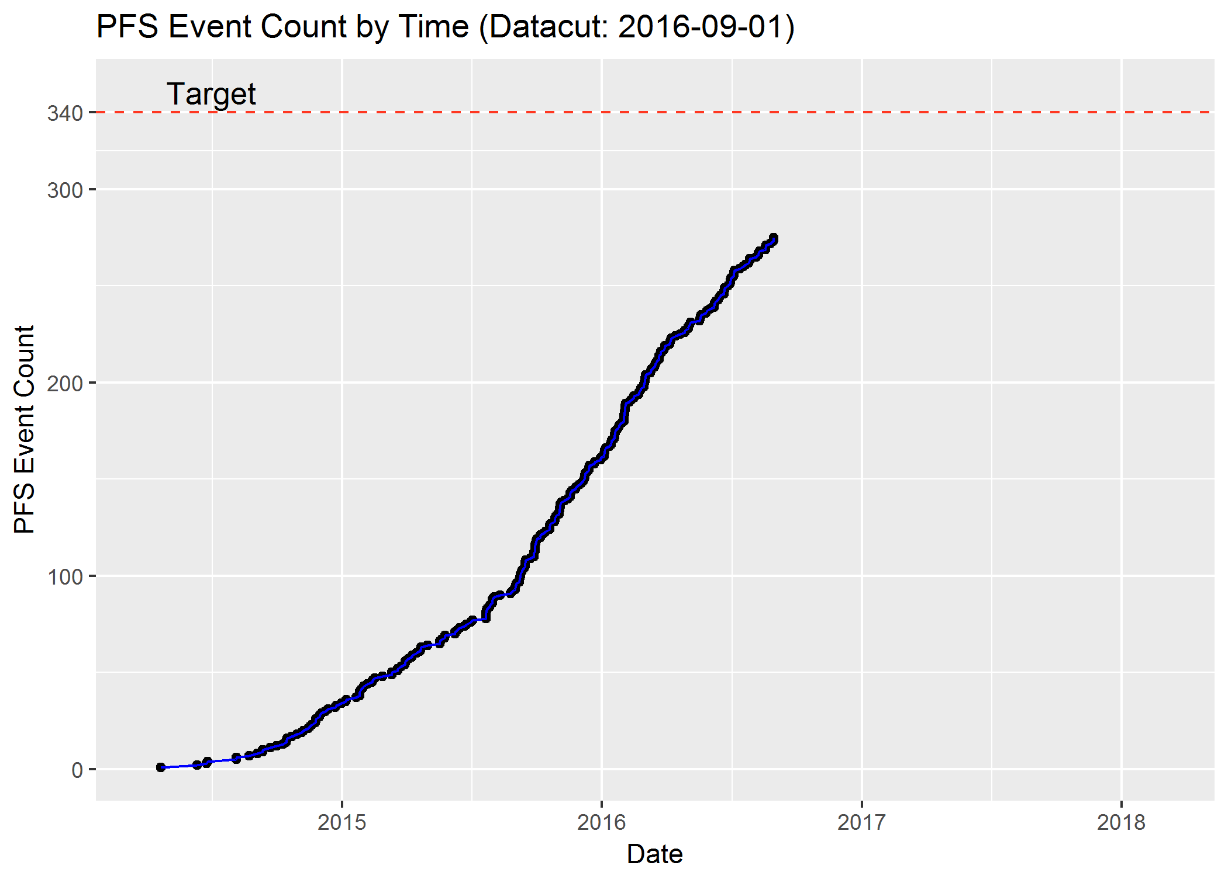
Background
Subject: 538
Goal: 340 PFS Events
Survival model:
Death
Disease Progression
LTFU
Ongoing
Notes:
Motivation come from study where deliverables are event-driven, for example, 50% interim analysis is triggered when certain number of PFS or OS events are met.
What we are going to do: is to predict when and in what probability will hit the target, i.e. when we will have the target number of events.
The Benefits are that we may have a better estimation on the timing of the final report for both business and marketing purposes. And we can use the estimation of the timing to better allocate programming and stat resources.
For example here, we have a study where we have 538 subjects. Our goal is to have final analysis once we hit 340 PFS events. It’s an oncology study where survival endpoint is of primary interest. Subjects may have reached death, PD, which will count as PFS event, or LTFU (permanent censored) or ongoing. And our major target is to predict the future event time for those ongoing subjects.

Slide 3
Results Collages
Notes:
Before moving to the detail of the process, here is the aggregated results of the our projection based on about 10 datacuts.
The dots and lines are cumulative number of PFS events count vs time, the red dotted line is the target count 340 (once we hit that, we will do final analysis). The original question is when we are going to hit that. And on the right side of the plot, is our prediction, say based on cut on 2016 June, there is 50% probability that we will get 340 PFS event in March 2018.
This is how we illustrate the results

Slide 4
Intuition
# | E/C | Date
1 | E | 2014/4/21
2 | E | 2014/6/11
 | C | 2014/6/15
3 |  | 2014/6/27
… | … | …
340 |  | 2018/1/1
… | … | …
Event
Censor
Ongoing
1. Model Fitting
2. Prediction
Notes:
Back to our method, our intuition is quite straightforward. we put subjects into 3 categories. PFS Event, permanent censored, and ongoing.
Event means subjects already had event
PC means subjects is permanent censored who won’t have event anymore in the future. (such as LTFU, taking another ATX)
Ongoing means the subject is still ongoing at the time data is cut and may have either PFS event or PC (LTFU) in the future.
Our idea is to predict for that particular group of ongoing subjects. After we predict each ongoing subjects, we stack all the predicted events by chronicle order for both observed and projected. Then find the 340th event, that corresponding date will be our projected target date to hit the goal.
Having that strategy set up, the next question come to us is how we are going to predict ongoing subject more accurately. Well, use observed information. Which lead to our next two steps: 1. fit model on observed data to capture the pattern and information. 2. using fitted parameters to predict future event time.

Slide 5
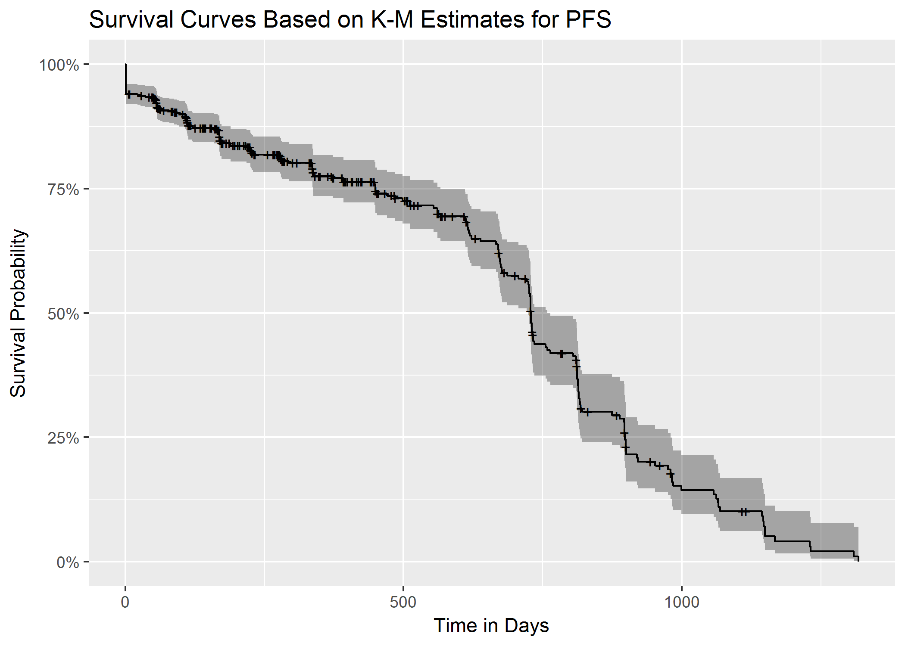
1. Model Fitting
Survival model
Parametric:
Generalized Gamma
Weibull
Exponential
Notes:
Model fitting is straightforward. We use the parametric survival model here. And fit with three distribution assumptions: generalized gamma, Weibull, exponential distribution.

Slide 6
Model Settings
proc lifereg data = pfs outset = pe1 ; class trt; model aval * cnsr(1) = trt / dist = gamma; output out = b xbeta = lp cdf = p; run;
Notes:
Here’s the code we used. We can change the statement here for different distribution assumptions.

Slide 7
Goodness of Fit
Model | -2 log likelihood (smaller is better)
Gamma | 785.303
Exponential | 819.12
Weibull | 806.211
Notes:
In terms of model fitting, or which model to use, we check the goodness of fit for each model and simple checking log likelihood help us to pick generalized gamma as our model

Slide 8
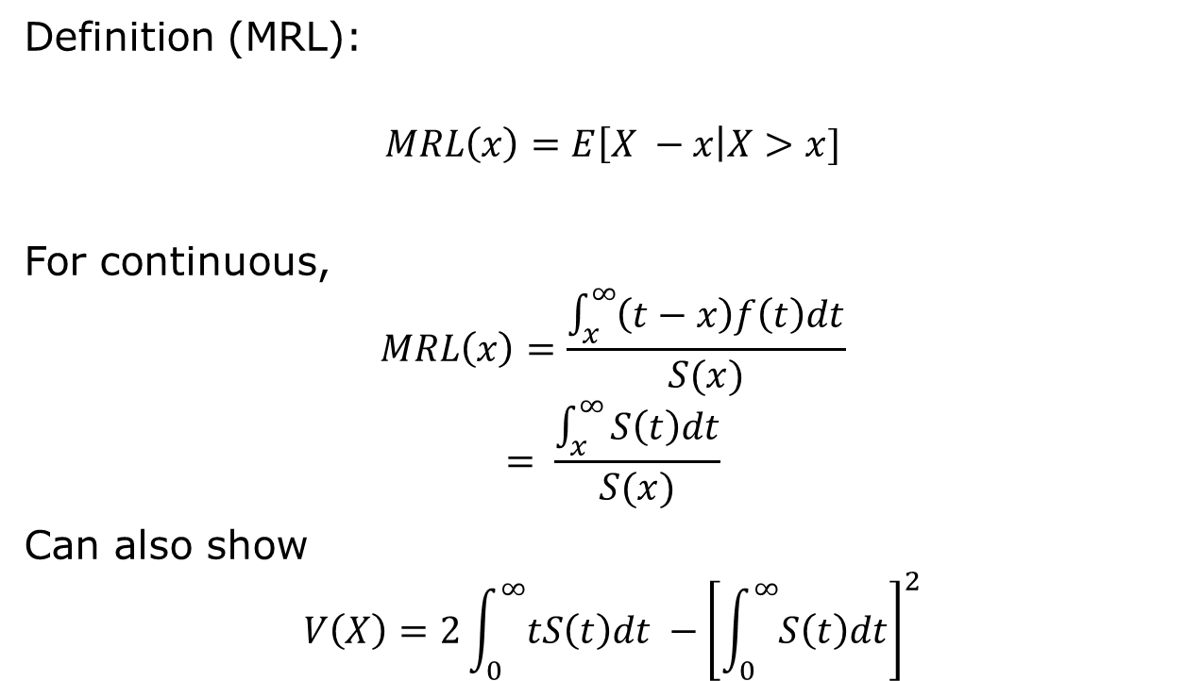
2. Prediction (Mean Residual Life)
Definition (MRL):
$$MRL\left(x\right)=E\left[X −x\right|X>x]$$
For continuous,
$$MRL\left(x\right)=\frac{\int_{x}^{∞}{\left(t−x\right)f\left(t\right)dt}}{S(x)} \\ = \frac{\int_{x}^{∞}{S\left(t\right)dt}}{S(x)}$$
Can also show
$$V\left(X\right)=2\int_{0}^{∞}{tS\left(t\right)dt −}{\left[\int_{0}^{∞}{S\left(t\right)dt}\right]}^{2}$$
Notes:
Here is the 2nd part. After we get the model estimated parameters, the next step is to predict event time for the ongoing subject.
Theoretically we can have close form for the mean and variance of the residual life, where mean residual life is defined as mean of the remaining life given what we have observed.

Slide 9
2. Prediction (Individual Sample Simulation)
Simulate generalized gamma distributed data for PROC LIFEREG
a=1/(Shape**2);
c=Scale/Shape;
b=exp(xb)/(a**c);
r=rangam(0,a);
X=b*(r**c);
where X is the generated survival time and xb can be the linear predictor
Weibull (Shape = 1)
Exponential (Shape = 1, Scale = 1)
Lognormal (Shape = 0)
Reference
Notes:
More practically, we used simulation method to simulate event time for each ongoing subjects. Which is more straightforward, and we can get a big picture when all subjects reaching number of events as a whole group.
Below is the generalized formula. It can fit Weibull, exponential and lognormal distribution as well as they are just special case of generalized gamma distribution.
The X random variable here will be the generated survival time.

Slide 10

2. Prediction (Individual Sample Simulation)
Truncated Sampling for Ongoing Subjects:
$X_{1}$: the generated survival time
Generate $X_{1}$ | $X_{1}$ > x: sample until generated survival time > current observed time
Do the similar to model Time to (Permanent Censor) independently and generate $X_{2}$time to PC
Simulation example:
Notes:
However, it’s not over yet. Since we already observed that ongoing subjects, his future event time must be beyond that observed time; therefore it is truncated distribution or conditional distribution given his observed time. It’s easy to implement within simulation, we just need to re-sampling until we get a later event time than current observed time.
Similarly we can independently do the projection for time to lost to FU.
Then For each individual, by combining his projected event time and LTFU time, which happen the earlier, we will use that as the simulated result for that subject.

Slide 11
2. Prediction (Individual Sample Simulation)
Stack simulated results
Simulation#1
# | E/C | Date
1 | E | 2014/4/21
2 | E | 2014/6/11
 | C | 2014/6/15
3 |  | 2014/6/27
… | … | …
340 |  | 2018/1/1
… | … | …
Notes:
Once we get simulated result for each individuals, just stack them together for those who have events both observed and predicted. Take the 340th event date as the projected date for the simulation iteration.

Slide 12
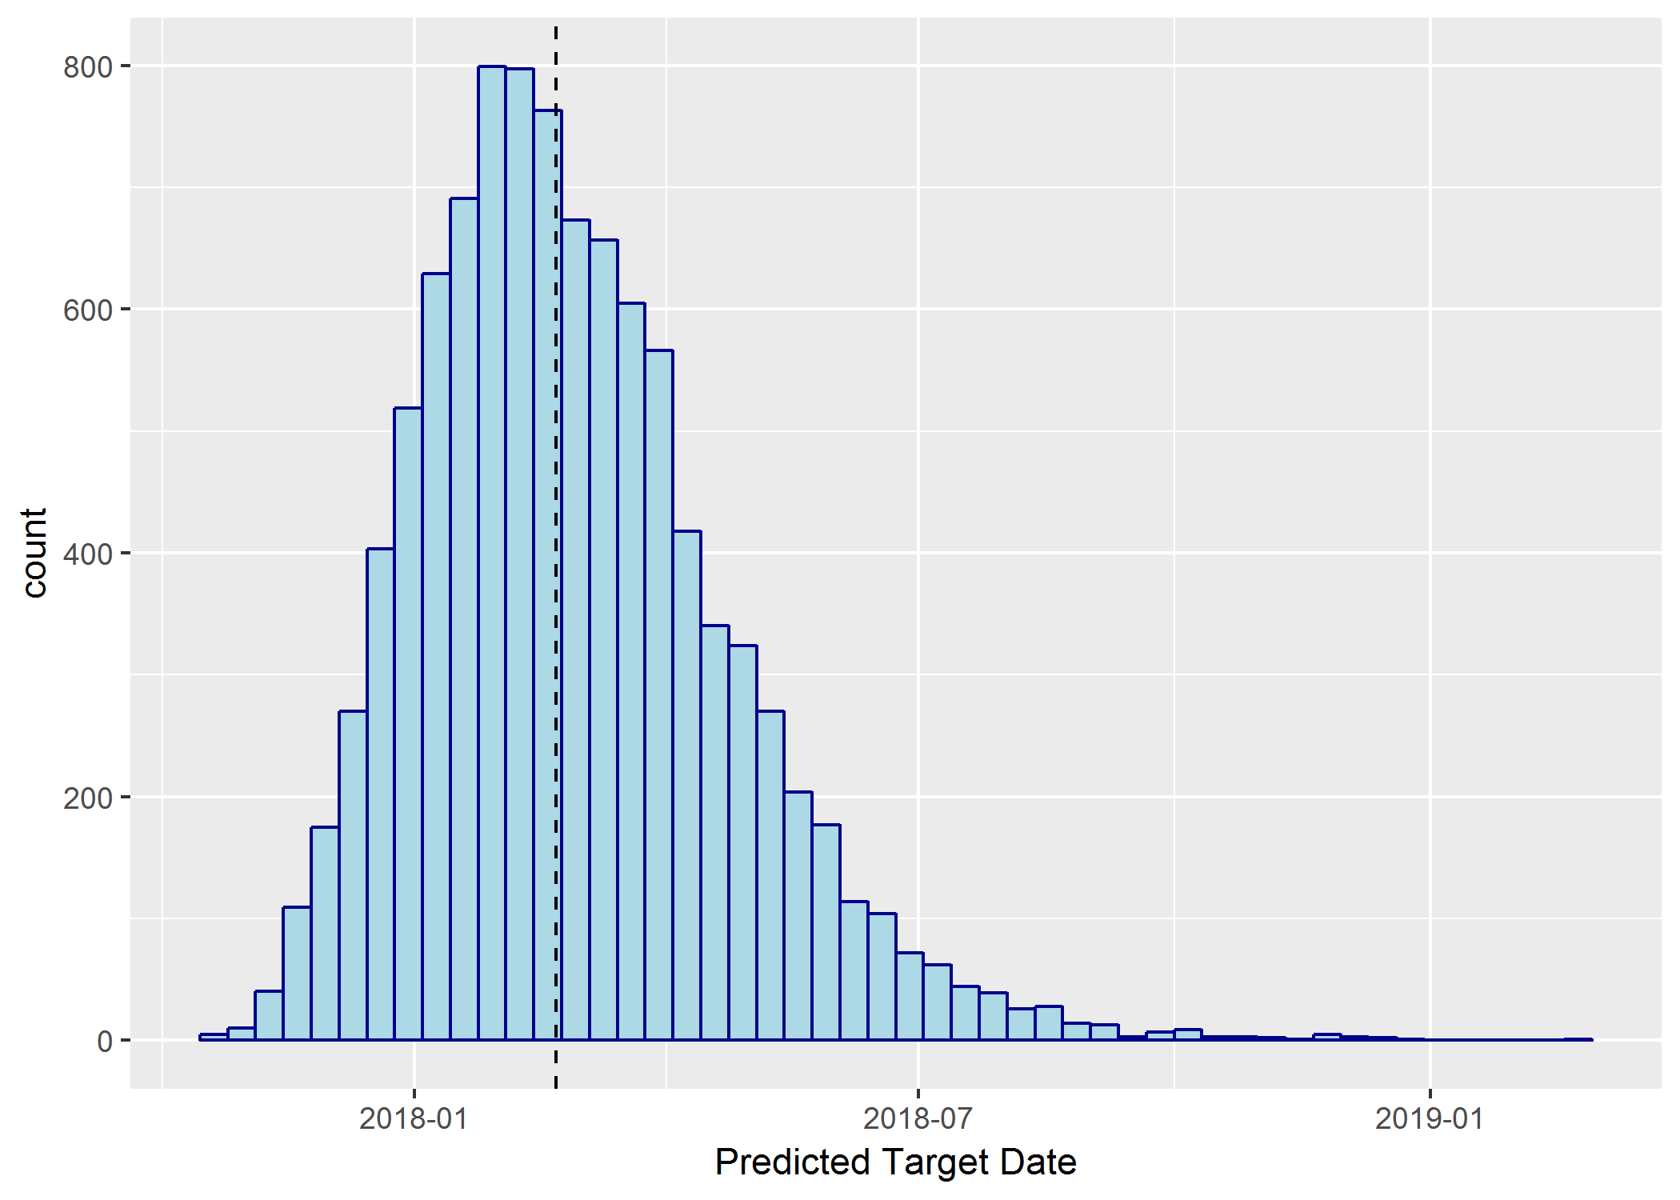
2. Prediction (Individual Sample Simulation)
Repeat Simulation 10,000 times
Histogram of the Projection Date from 10,000 Simulations
Notes:
Repeat simulation 10000 times and we will get 10000 projected dates when we hit the target. Afterwards we can do whatever we want, like picking the median, mean, 25th and 75 quantiles, or make the histogram.

Slide 13
Restrictions and Limitation
Inaccurate Censor model at early stage
Date delay
Data revert
Notes:
Limitation:
At early stage, there are only few data points for LTFU model, therefore the overall projection is over-optimistic, the model would be more likely to assume that subject is more likely to get PD/Death sooner than LTFU; but after we get more data for subject LTFU, the model changed and the prediction is more likely to get the results that ongoing subjects will LTFU first before they get PD/Death.
Data delay/change: it often happen that subjects may already have PFS event, but due to data delay, it was still showing the subjects is ongoing when we do the modeling.
It also happen to us that number of events decreased after a new datacut. It is not that subject turning alive. It turn out to be that the subject used to be PD before, but later found out he has an earlier ATX, then he become permanent censored. His PD is not counted as event any more.

Slide 14
Summary
Fit data using parametric survival models (generalized gamma/exponential/Weibull)
On both PFS and Permanent Censor (PC) outcome
Goodness of fit to pick the best model
Simulate remaining Ongoing subjects using estimated parameters:
Truncated sampling
Consider both event and PC situation
Stack simulated results and obtain predicted date to target
Replicate simulations

