Slide 1
Detection of Unusual Administrations Using a Linear Mixed Effects Model
Minzhao Liu, University of Florida
Mentors: Yi-Hsuan Lee
Alina von Davier
Notes:
Hi Good afternoon everyone. My name is Minzhao Liu, I am from university of Florida. I am working with my two mentors: Yi-Hsuan and Alina. Thank you for your help on this project. Today my topic is about using a linear mixed effects model to fit a set of TOEIC data.

Slide 2
Outline
Design of Experiment
Model and Method
Results and Interpretation
Prediction
Discussion
Notes:
Here’s the outline. First i will give a brief introduction of the dataset and the design of the experiment. Then we are gonna propose a appropriate model for this specific design. Later model selection will be adopted and interpretation of the results will be presented. After fitting the model, we will also try to derive how to predict the mean score of certain administration or subgroup in order to find if there’s something unusual with that.

Slide 3
Objectives
Detect unusual administrations based on the model we fit
Use regression model to fit the data
Hypothesis: individual scores can be explained by background predictors
Notes:
Here’s our objectives, first step, we will try to use regression model to fit the data. Second step, we wanna detect unusual administrations based on the model we just fit.

Slide 4
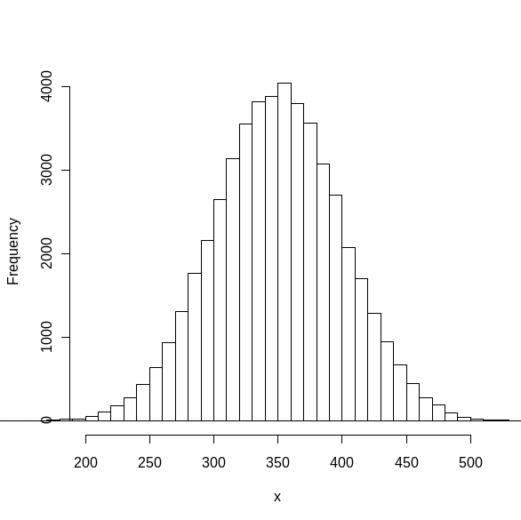

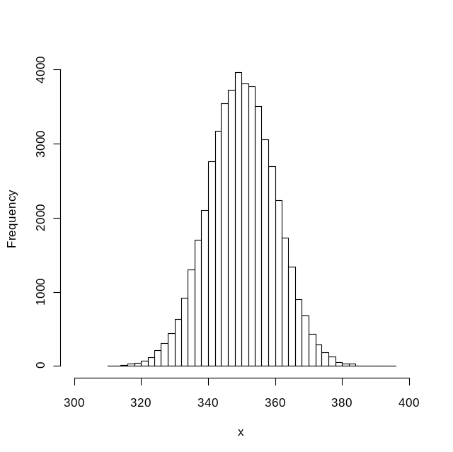


Illustration of the Hypothesis
Hypothetical Distribution
of individual score
Individual
score
Gender
Years of study
Status
Daily study time
Repeater
Level of education
Major
Country
Yrs abroad (Eng)
Distribution of subgroup
mean score
Mean score
Of subgroup
Notes:
What we wanna do is to use background variables (including demographical information and quantities about their english learning experience. ) to predict the pattern or variation of one individual’s score. We may assume every individual’s score has the normality property. And if possible, we may get those estimates, mean, and variance of interest from an appropriate model. Then based on our model, we may get the distribution for the mean score of certain subgroup or certain administration, then we can make the prediction interval for the mean score of the subgroup, thus, if the observed mean score is out of our prediction interval, then we may say, there must be something wrong with the administration, or the subgroup. That’s kind of our idea and motivation. It can also work as quality control method.

Slide 5
Data Description
TOEIC data
15 administrations
Random sample of 18,000 test-takers per administration
16 background questions
Notes:
This dataset is about TOEIC test. It includes 15 administrations (how to explain this ? Randomly sampled from a huge dataset?) and there are 18,000 test-takers randomly sampled in every administration. Every test-taker must answer a 14 background question questionnaire and their gender and nationality are the 2 extra background variables.

Slide 6
Design of Experiment
TOEIC data
15 admin
18,000 test-takers per admin
16 background variables
3 groups
Country A
Univariate responses:
Reading scores
Listening scores
Country B
Equated
An equating plan
Notes:
Here’s how the experiment was designed. Basically we can divide 15 administrations into 3 groups. 3 groups (of 5 administrations) could be considered random draws from a large pool of such groups. So we assumed Group has random effects. In each group, 5 administraions were linked in this way. The right two were taken first, and the middle one was linked to the first two. And after that, another two administrations were linked to the middle one. That’s how they were linked. In addition, among the five administrations in each group, two of them were in country a, and the other three were from country B. And there are equally 18,000 test-takers in each administraion. The responses here are the individual scores. Here we took scores as univaraite response separately.

Slide 7
Linear Mixed Effects Model
Normality assumption (checked through residual diagnostics)
Random effects can explain correlation among individuals
In general:
Notes:
Thus, the method we will use is linear mixed effects model. First of all, we assume all the individual scores are normal distributed. Fortunately this assumption was approved after our model fit , through residual diagnostics. Another benefit of the model is that the random effects term in the mixed model can explain the correlation between individuals. We will demonstrate how mixed model did that in the next slides. Here’s how the model generally looks like. The response is the summation of grand mean plus fixed effects and random effects plus an error term, which is distributed as normal distribution with unknown mean and unknown variance. The specific terms in the model will be determined through model selection.

Slide 8
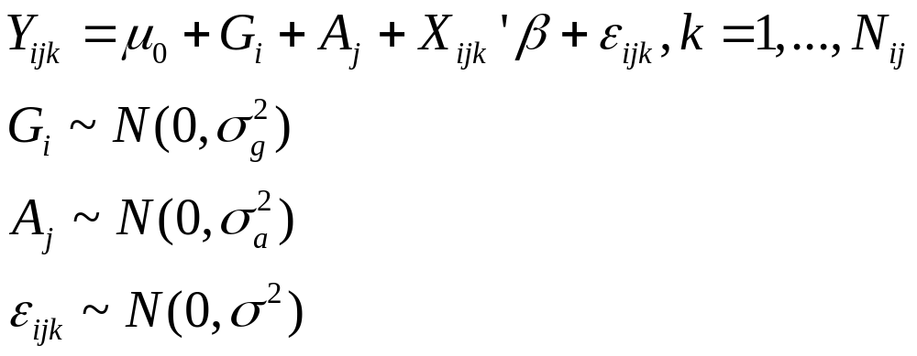
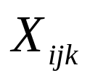
Why Mixed Model
Group random effect
Admin random effect
Individual error
Fixed effects
(background variables)
Notes:
Let’s recall the design of the experiment. we need special care of the design, the reason is that, examinees taking the same administration
had the same set of items, their scores were likely to have stronger
correlation than those taking different administrations. Similarly, it
is possible that scores in a particular group of administrations are
Also correlated since those administrations had some common
items. Therefore, we differentiated the two sources of correlation by
assigning independent variables ''group'' and ''administration'' as
random variables.

Slide 9
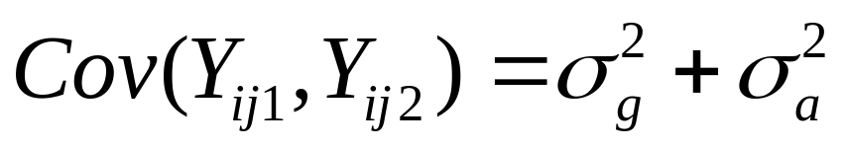
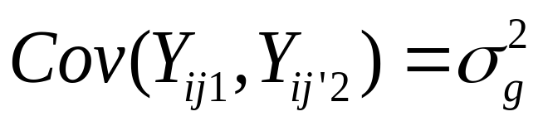
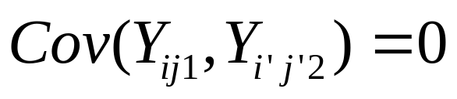
Why Mixed Model (cont’d)
Notes:
Here’s how the mixed model explained the correlation part in mathematical way. You can see from the formula, the correlation of scores from same adminsitration is strictly stronger than one from different administration but same group. (explain the above three formulas.)

Slide 10
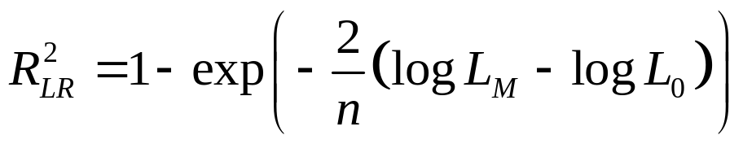

Variable Selection
Forward selection
3 steps:
Random effects
Main effects
Interactions
criteria
Notes:
So after those model setting, we wanna find the ‘best’ appropriate model . We use forward selection procedure, and the first step, we will find whether those random effects are significant or not. Then we will choose some main effects, at last, check those interactions from main effects. All the procedure criteria was based on R2 statistics in mixed model , which was introduced in this formula.

Slide 11
Final Models
Reading:
Years of study
Yrs abroad (Eng)
Repeater/First time
Level of Education
Major
Random: admin
Listening:
Years of study
Yrs abroad (Eng)
Repeater/First time
Level of Education
Major
Daily study time
Random: admin
Note: ‘group’ and ‘country’ variables did NOT turn out to be significant.
Notes:
After the model selection, we got the final model. For reading scores as response, we got those predictors as significant variables. And for listening scores, the final model is almost the same , except extra term ‘time’ predictor. Both models only includes ‘administration ‘ random effect term, which means , we did not find any significant correlation could be explained by ‘group’ variable.

Slide 12
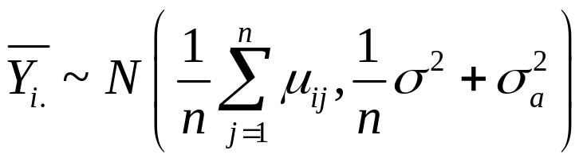
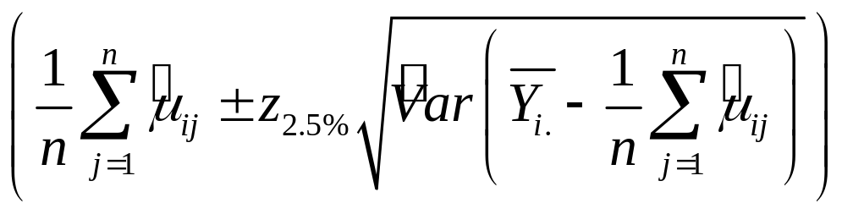
Prediction
Definition of ‘Unusual’
Distribution of mean score of certain admin
Approximate 95% prediction interval
Example: for administration 1, the observed listening mean score is 317.3, and the prediction interval is (301.7, 350.0)
Notes:
Since we finished the model fitting part, we wanna use our model to do predictions and detect unusual administrations. First of all, we need to define what is unusual. Here, we suppose if the mean score of certain subgroup is ‘statistically’ far away from its expected mean, we may call the subgroup is unusual. Then from the model, the distribution of the mean score of a certain administration would be like this. And approximate prediction interval would be this way. you can tell whether the administration is unusual or not by comparing the observed mean score with the prediction interval.

Slide 13
Discussion
Good news:
  No significant effect for ‘country’
  No significant effect for ‘group’
  Prediction interval is narrow
Limitations:
  Nonlinearity
  Few groups and administrations
  Seasonality
  Country and admin are confounded in the design
Notes:
Meanwhile, our method still has some limitations. First, it only assumes a linear canonical link. Other link functions may be tested in order to find more appropriate model. Also since we only have 3 groups, and 15 administrations, the sample size for those two variables are relatively small. If we get more groups or admins, we might have more accurate estimates for sigma and random effects variance. In addition, this also makes us difficult to get seasonality into account since we don’t have too many admins. This is a potential problem. Also in ourframework, we only define ‘unusual’ by observing wild mean score, but some one may also define ‘unusual’ as obtaining weird residual distributions such as bimodel distribution, like too many high scores and too many low scores, this can also be an unusual administration. That’s the part our model can not detect.

Slide 14

Thank You for Your Attention~
Go Gators !

