Slide 1
SigProfiler runs – ID83
For all tumors (k from 10-40, optimal=12) , each cancertype, and MSIs (k from 3-15)
Then match if hdp signatures can be found in SigProfiler runs (cosine > 0.85)
SigPro doesn’t find ID7, ID12, H_ID26,H_ID31,H_ID32, H_ID34, H_ID35, H_ID36, H_ID37, H_ID38
Then I removed PolyT peaks and re-run for MSIs
SigPro can’t find ID12 (in prostate, found one signature with low similarity to ID12), H_ID26, H_ID32,H_ID36 (only supported by one sample)

Slide 2
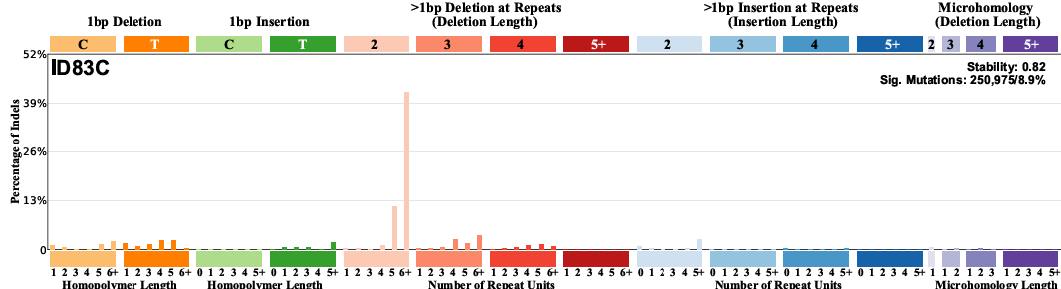
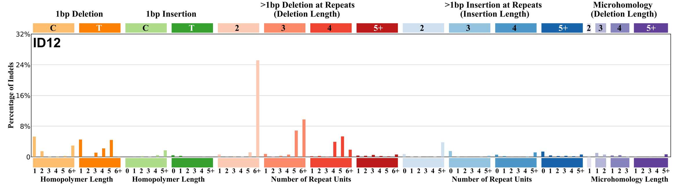
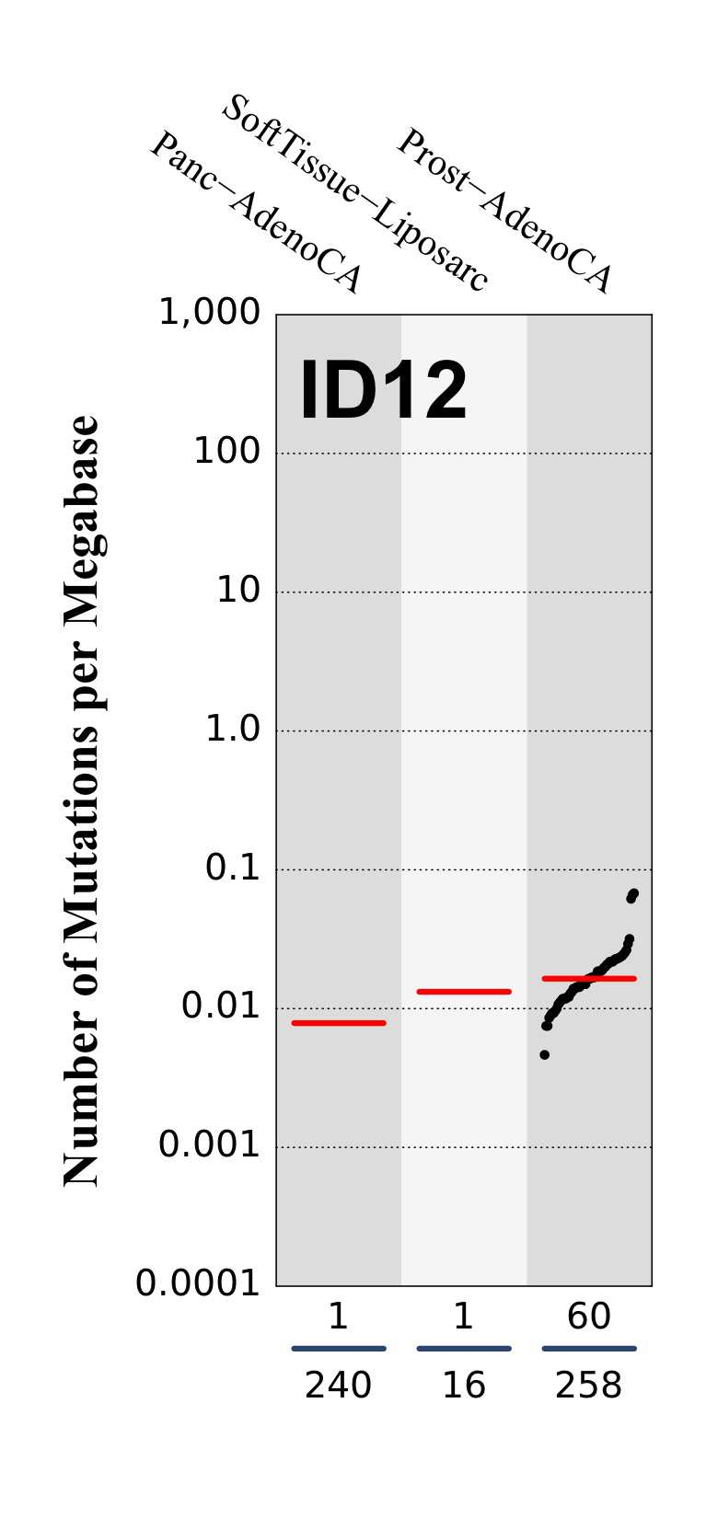
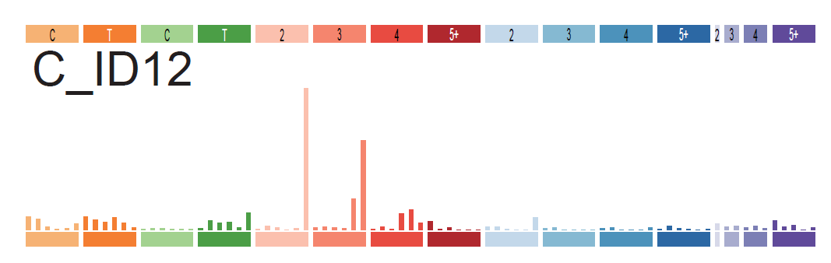
SigPro ID12-like signatures
Cosine = 0.80
Cosine = 0.95

Slide 3
SigProfiler runs – ID89
For all tumors (k from 10-50, optimal=19), each cancertype, and MSIs(k from 3-15)
SigPro doesn’t find 7 signatures: InsDel10,InsDel12, InsDel32,InsDel34a,InsDel34b, InsDel35,InsDel36,
InsDel32, InsDel36, driven by 1 sample
InsDel34a,InsDel34b are merged of SigPro signatures (reconstructed.cosine>0.9)
InsDel10, InsDel12 and InsDel35, no clue.

Slide 4
Conclusion
Nearly all HDP ID83 signatures can be reproduced in SigProfilerExtractor, with a few exceptions including ID12 and 3 signatures only driven by one sample. (29 out of 33 can be reproduced)
Nearly all HDP ID89 signatures can be reproduced in SigProfilerExtractor, with 5 signatures as exceptions: 2 only driven by one sample, InsDel12, and two other sigantures InsDel10 and 35. Probably because they are spiky? (36 out of 41 can be reproduced)
Interestingly, SigProfiler seems have problems in getting C_ID12 and InsDel12. don’t know why. Our vignette can support the signatures that not found by sigpro.
mSigAct2 done
Indel476 running (note)
Notes:
如果illumina找到了，但是BGI没找到，IGV会怎么显示？Screenshot, concordant or non-concordant，for both cases

Slide 5
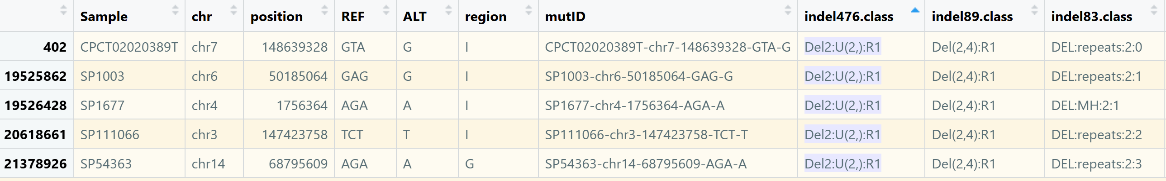
An example of one indel476 class mapped to multiple indel83 class
SP1003: GAG>G. In larger context: TATAA GAG TAA >
TATA AG TAA
TATAA G TAA. It is AGAG to AG
SP111066: TCT>T. In larger context: TCTC TCT AATA .
It seems that serena’s code only look for the repeats after the mutation site.
Deletion and insertions cause discrepancies between indel476 and indel89.

Slide 6
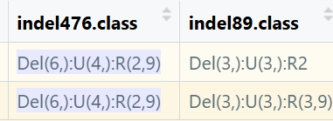
An example of one indel476 class mapped to multiple indel89 class (but this is rare)
Main differences resulted from the number of repeats

Slide 7
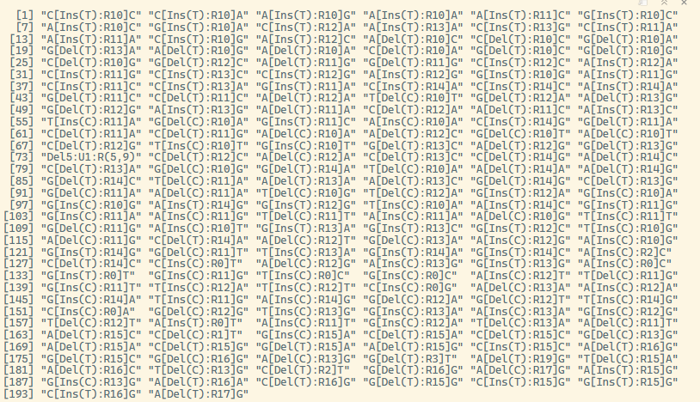
More type of indels were found due to a larger dataset. Mainly longer repeats
TTTTT
-
DEL:5+:0
TTTTTTTT
TTT

Slide 8
Indel476 signature
Finished running sigpro and mSigHdp for indel476. all tumors, each cancertype and MSI.
We provide a higher resolution of ID89 signatures.
It is difficult to use indel476 as a bridge between Koh89 and COSMIC83.
Do we have space to report indel476?

Slide 9
Indel476 extraction in mSigHdp and SigProfiler
De novo extraction aims to provide a higher resolution of the indel signatures we found in COSMIC83 and Koh89
Among 41 Koh89 signatures
mSigHdp result can be mapped to 32 signatures
SigProfiler result can be mapped 31 signatures
After mapping to Koh89 signatures, Insdel10, 23, 24b, 34a, 34b, 32, 35, 36 couldn’t be found by either
InsDel1d couldn’t be found in mSigHdp; InsDel12 and InsDel39 couldn’t be found in SigPro

Slide 10
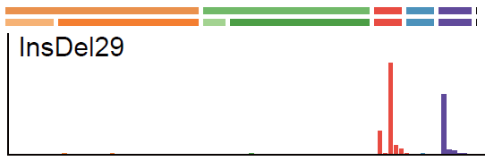
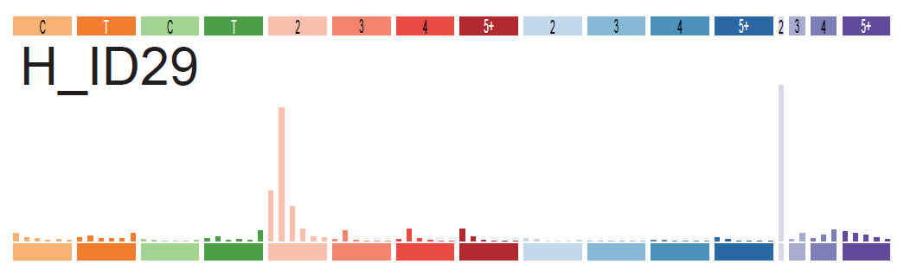
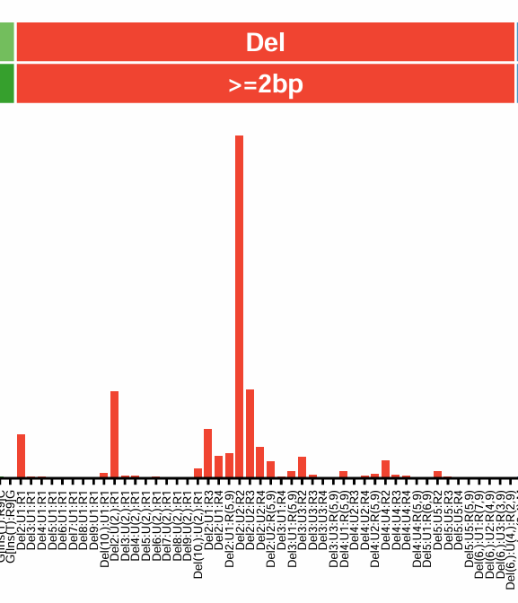
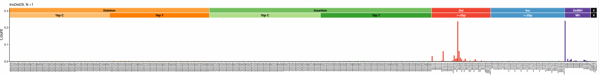
New plot

Slide 11
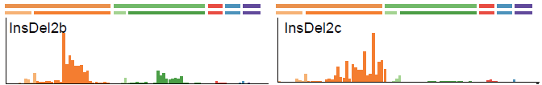

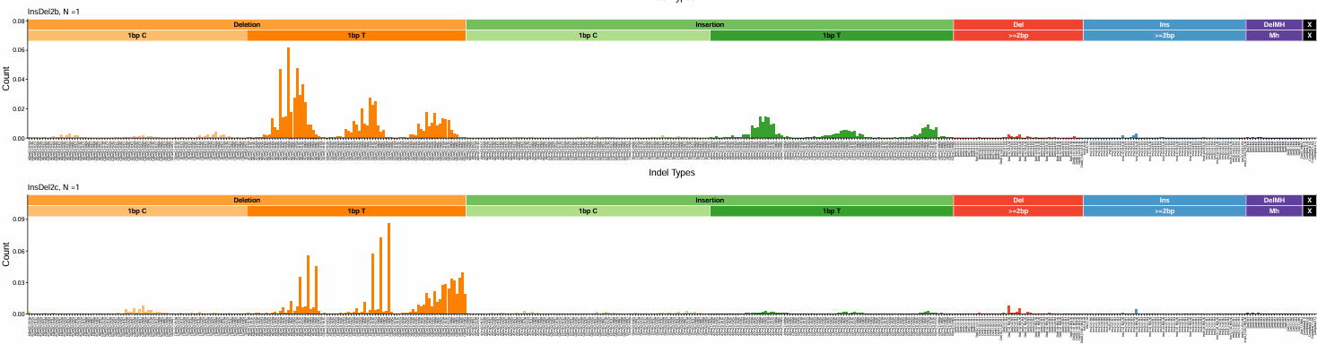
New plot

