Slide 2
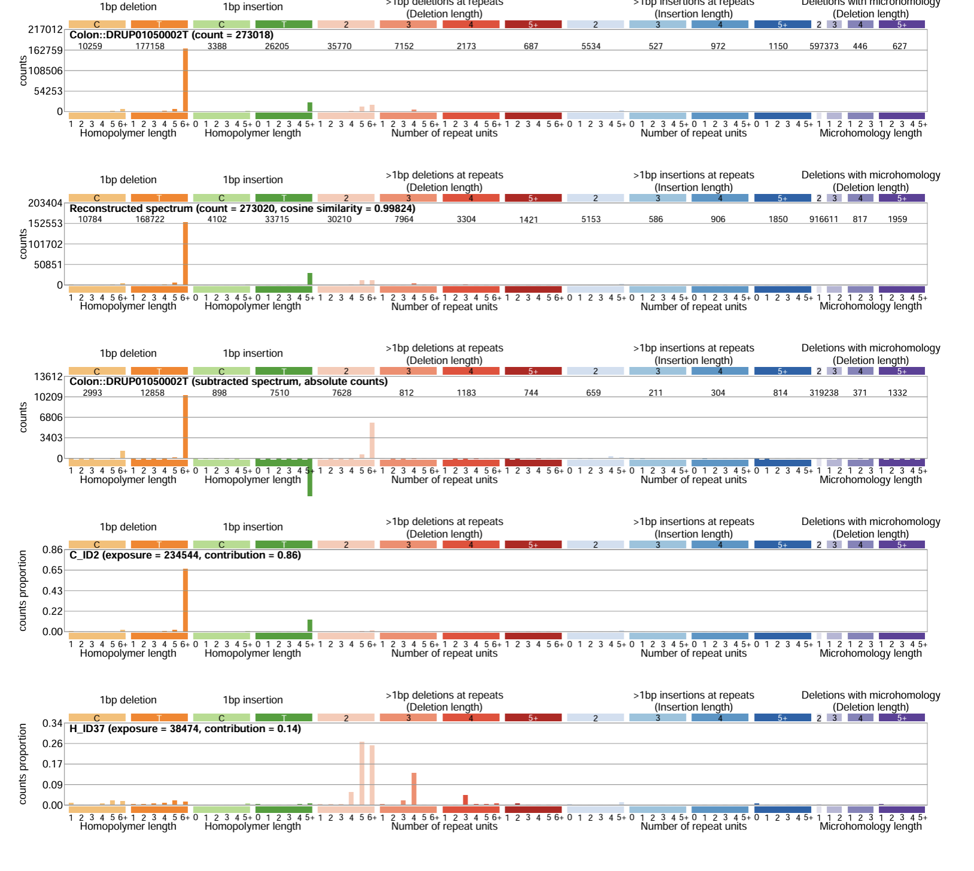
New assignment method to investigate MSI tumors- to find the signal hidden behind DEL:C:1:0 and DEL:T:1:0
Only two signatures were assigned to this tumor when doing assignment with presence test

Slide 3
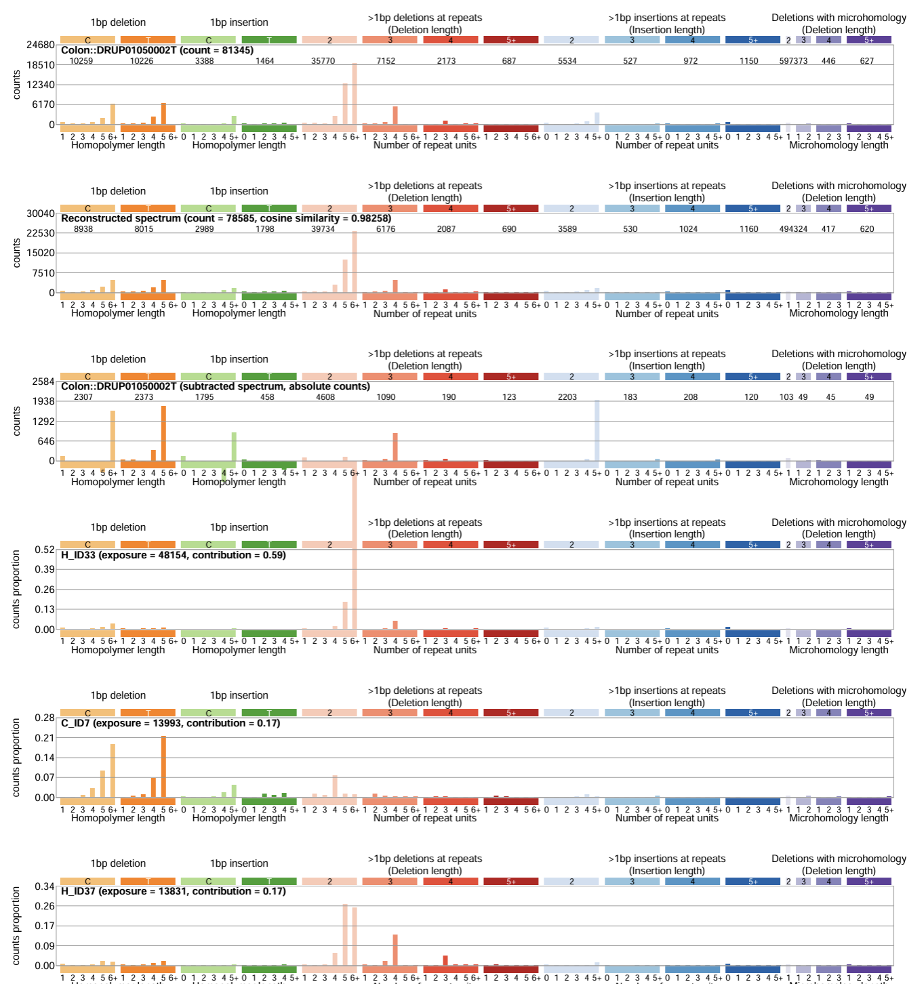
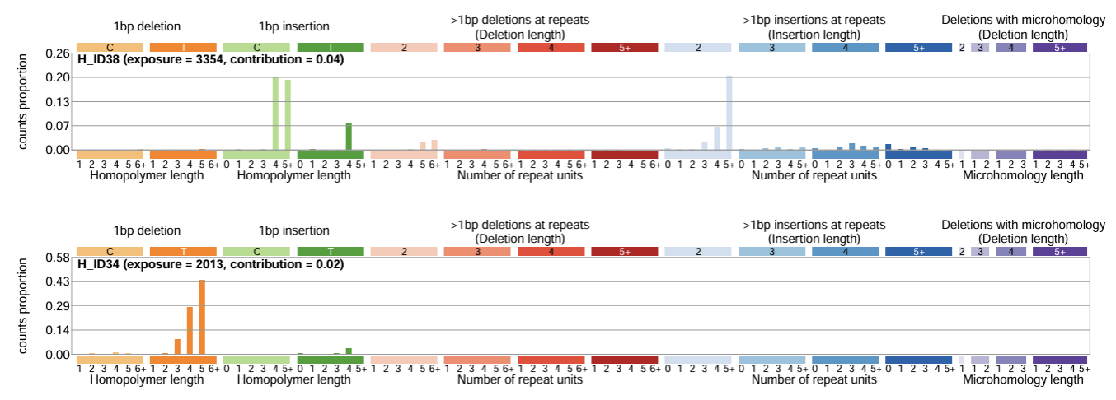
More signatures were assigned to this tumor when looking at the other channels more closely

Slide 4
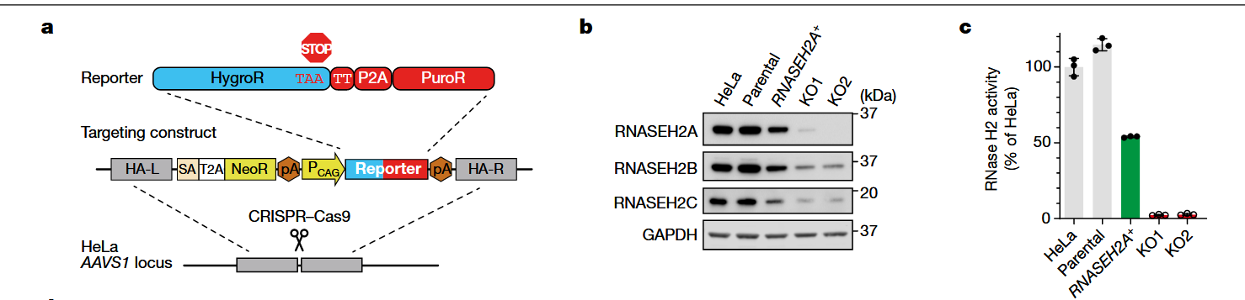
We need a figure for RNASEH2B HEK293T story

