Slide 2
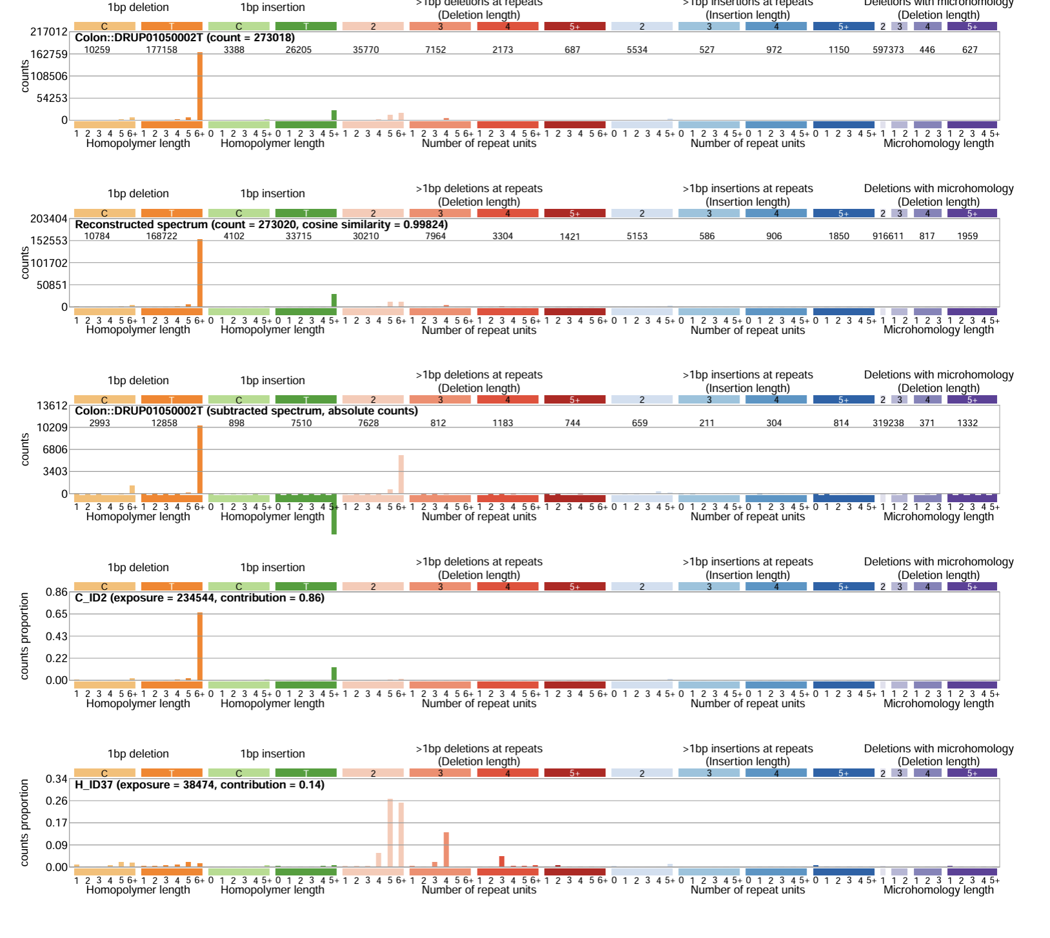
New assignment method to investigate MSI tumors- to find the signal hidden behind INS:T:1:5+ and DEL:T:1:5+
Only two signatures were assigned to this tumor when doing assignment with presence test.
Cosine similarity is misleading in MSI tumors because the INS:T:1:5+ and DEL:T:1:5+ drives the similarity

Slide 3
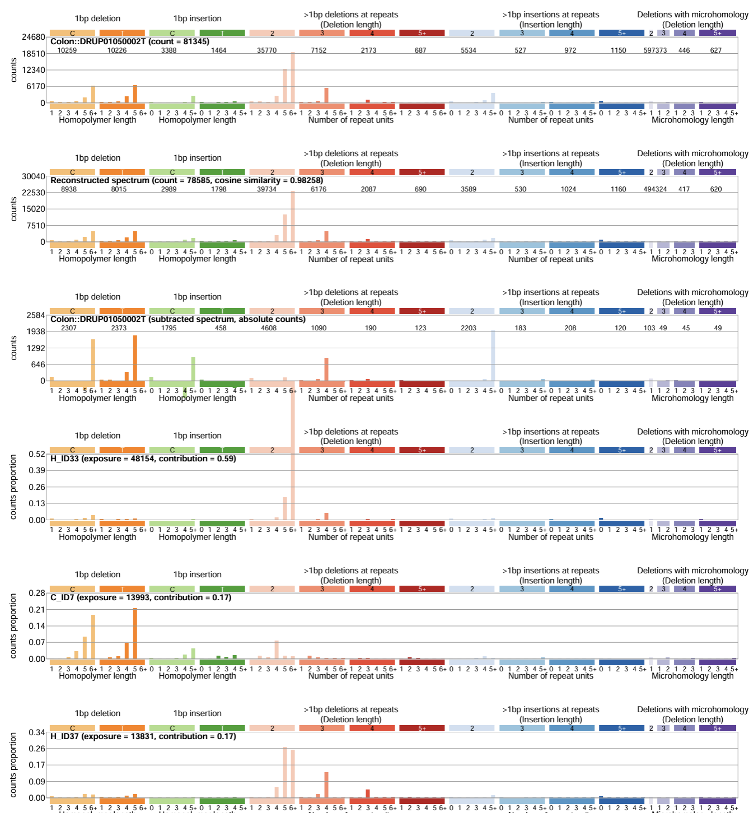
Firstly, I took out INS:T:1:5+ and DEL:T:1:5+

Slide 4
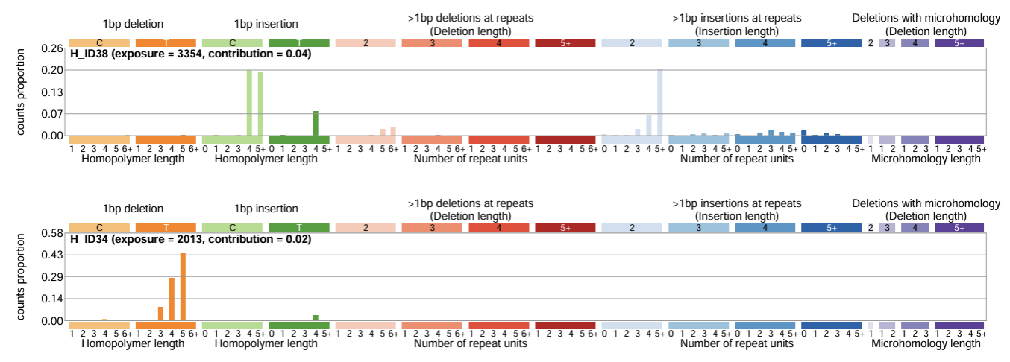
5 signatures were assigned to this tumor when looking at the other channels more closely
After this step, I used ID1 and ID2 to reconstruct the INS:T:1:5+ and DEL:T:1:5+ part which was removed previously. This results in the assignment of 7 signatures

Slide 5
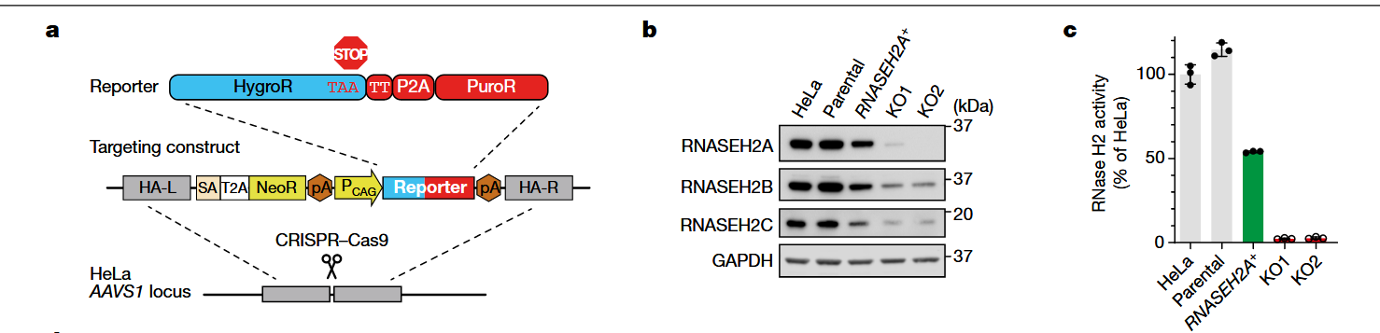
We need a figure for RNASEH2B HEK293T story. This is an example from Reijn’s et al., 2022

