Slide 1

SW Architecture and XSAL
Victor Chernetsky,
Using documents by L. Plonka, J. Roman and M. Gebolys
Kokomo, TCK
October, 2007

Slide 2

Table of Contents
Why XSAL?
XSAL Overview.
Application and Thread IDs.
XSAL startup shutdown.
Thread Management.
  Thread Synchronization.
  Typical Thread Structure.
Synchronization.
  Mutexes.
  Semaphores.
Memory management.
  Buffer Pool.
  Shared Memory.
IPC communication.
  XSAL Messages.
  Asynchronous communication
  Publish/Subscribe.
  Synchronous communication.
  Timers.
Debug Trace

Slide 3
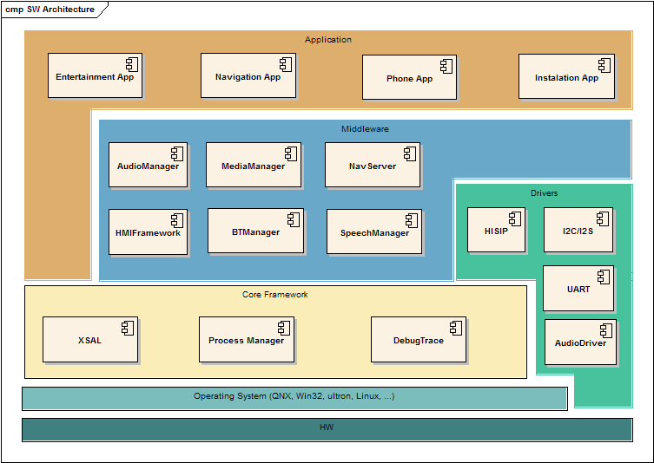
SW Architecture Overview

Slide 4
Why XSAL?

Slide 5
XSAL Overview
XSAL stands for neXt generation System Abstraction Layer
  Successor to SAL2 (GME Opel EHU4)
  Based on feedback from infotainment, reception, audio groups
XSAL is an abstraction layer located between the operating systems and applications
  Applications use only XSAL and don’t access the operating systems
  XSAL makes it easier to write multi-platform applications
Currently, XSAL is implemented on Win32, QNX, Linux, and uItron
  Applications based on XSAL can be developed on Windows and then ported to the target hardware when it becomes available
XSAL should be easy to port to other operating systems, e.g.:
  Windows CE
  OSEK
XSAL could even be implemented without an underlying OS

Slide 6
Application and Thread IDs
The application IDs are the system wide, static and defined in the global header file.
The application IDs are used by IPC as an address for events distribution.
The thread IDs are local to the process.
The thread IDs can be system generated. In this case the range of the “unknown” thread IDs need to be defined. See “Thread Management” slide.
// Application IDs
typedef enum
{
APP_FIRST_ID = 1,
APP_PROCMAN = 1, /* 01 */
APP_DESIP, /* 02 */
…
APP_SHELL_HMI, /* 05 */
APP_NAV_HMI, /* 06 */
APP_ENT_HMI, /* 07 */
…
APP_LAST_ID
} SAL_Application_Id_T;
// Thread IDs
#define TUNER_LISTENER_THREAD_ID 1
#define TUNER_SENDER_THREAD_ID 3

Slide 7
Process Manager
There are two ways to start applications with process manager.
Start process manager in “naming service” mode:
  #procman –n&
  After that the applications that build with XSAL will register with the process manager at the start time.
  # GPSDriver &
Start process manager that will launch all the necessary applications and drivers specified in the configuration file:
  #procman –f procman.cfg&
No matter how the applications were started, they will be registered with the process manager.
Example of procman.cfg file
-f GPSDriver -n"GPSDriver" -c0 -c1 -c2
-f SensorHandler -n"SH" -l9 -x5 -p15 -c0 -c1 -c2
-f AddressServer -n"AdrMgr" -c0 -a"-v0" -a"-g-1"
-f DiagnosticsManager -n"diag_mgr" -c0
-f MediaHandler -n"mh" -c0 -c1 -c2 -a"-w20" -a"-dSDC" -a"-dUSB"
-f HMIServer -n"HMIServices" -l9 -c0 -c1 -c2

Slide 8
XSAL startup shutdown.
XSAL provides default configuration.
Before initializing the XSAL following parameters are required to be set properly:
  Application ID.
  Maximum number of threads.
  First “unknown thread ID”. To make it compatible with POSIX threads, if application will not provide the thread ID, the ID will be generated by XSAL.
SAL_Init() shall be called before any XSAL use.
SAL_Run() is the message loop function.
Function SAL_Exit() terminates the application and causes SAL_Run() to exit with the provided return code.
The main thread cannot be used for anything else than SAL message loop.
If user need to have its own main thread, the SAL thread shall be started for that purpose.
int main(int argc, char* argv[])
{
SAL_Config sal_config;
/* Retrieve the default configuration parameters. */
SAL_Get_Config(&sal_config);
/* Define application ID and max number of threads. */
sal_config->app_id = 7;
sal_config->max_number_of_threads = 10;
/* Modify some other values. */
sal_config->first_unknown_thread_id = 5;
/* Initialize XSAL. */
SAL_Init(&sal_config);
/* Initialize the system, create threads, etc. */
...
return SAL_Run();
}

Slide 9
Thread Management.
#define THREAD_ID_1 1
void Thread1(void*) { /* body of thread 1 */ }
void Thread2(void*) { /* body of thread 2 */ }
int main(int argc, char* argv[])
{
SAL_Thread_Attr_T attr;
SAL_Config_T config;
SAL_Get_Config(&config);
config.first_unknown_thread_id = 5; // set first thread id for //unknown threads
SAL_Init(config.);
// Get the priority of this thread
SAL_Priority_T priority;
SAL_Get_Thread_Priority(SAL_Get_Thread_Id(), &priority);
// Create threads 1..2
attr->name = “Thread1”;
attr->id = THREAD_ID_1;
attr->priority = priority;
SAL_Create_Thread(Thread1, NULL, &attr);
attr->name = “Thread2”;
attr->id = SAL_UNKNOWN_THREAD_ID;
attr->priority = priority;
SAL_Create_Thread(Thread2, NULL, &attr);
return SAL_Run();
}
SAL_Get_Thread_Id() return the PID of the current thread.
SAL_Get_Thread_Priority() return the priority of the given thread.
To create thread the user shall provide thread ID and the priority of the new thread.
If the thread ID is unknown than SAL_UNKNOWN_THREAD_ID shall be used. The XSAL will generate the thread ID similar to POSIX thread.
The SAL_Create_Thread() will return the generated thread ID.
Even though SAL_Create_Thread() called before SAL_Run(), the actual threads will be created when SAL_Run() is called.

Slide 10
Thread Synchronization.
Often threads must be initialized in a specific order to ensure proper application initialization.
To synchronize the threads at startup XSAL provides mechanism to signal other threads within process its readiness.
The that called SAL_Wait_Ready() will be suspended until all the threads from wait_list will signal with SAL_Signal_Ready()
void Thread1(void*)
{
// This thread will wait for threads 2 and 3 to signal the completion
// of their initialization before proceeding.
static SAL_Thread_Id_T wait_list[] =
{
THREAD_ID2,
THREAD_ID3
};
SAL_Wait_Ready(wait_list, sizeof(wait_list)/sizeof(wait_list[0]));
// Now thread2 and thread3 are initialized.
...
}
void Thread2(void*) // assume thread ID == THREAD_ID2
{
... // do your initialization
SAL_Signal_Ready(); // signal “initialization done”
...
}
void Thread3(void*) // assume thread ID == THREAD_ID3
{
... // do your initialization
SAL_Signal_Ready(); // signal “initialization done”
...
}

Slide 11
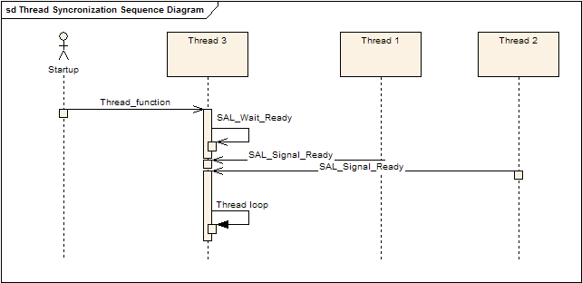
Thread Synchronization Sequence Diagram

Slide 12
Typical Thread Structure
Typically a thread needs to do the following:
  Initialize its message queue
  Subscribe to events it wants to receive
  Signal its readiness
  Wait for other threads to initialize
  Wait for and process messages/events
void Thread(void* param)
{
static SAL_Event_Id_T subscribe_list[] = {EV_E1, EV_E2}; // events to subscribe
static SAL_Thread_Id_T wait_list[] = {THREAD_ID2, THREAD_ID3}; // threads to wait for
// Create your queue. Queue size and memory allocation/deallocation functions must
// be supplied. User-defined functions might be used instead of malloc() and free().
SAL_Create_Queue(64, 0, malloc, free);
// Subscribe to events. EV_E1, EV_E2 should be defined in a global header file.
SAL_Subscribe(subscribe_list, sizeof(subscribe_list)/sizeof(subscribe_list[0]));
// Tell other threads that you’re ready to receive events.
SAL_Signal_Ready();
// Wait for other threads to initialize.
SAL_Wait_Ready(wait_list, sizeof(wait_list)/sizeof(wait_list[0]));
while (1)
{
const SAL_Message_T* msg = SAL_Receive(); // wait for a message
... // process the received message
}
}

Slide 13
Synchronization
Thread synchronization and mutual exclusion primitives comprise mutex and semaphore operations.
Mutex and semaphore APIs are similar to corresponding POSIX APIs.
Whether mutexes are recursive or not is implementation-dependent.
int SAL_Create_Mutex(SAL_Mutex_T* mutex);
int SAL_Destroy_Mutex(SAL_Mutex_T* mutex);
int SAL_Lock_Mutex(SAL_Mutex_T* mutex);
int SAL_Try_Lock_Mutex(SAL_Mutex_T* mutex);
int SAL_Unlock_Mutex(SAL_Mutex_T* mutex);
int SAL_Create_Semaphore(SAL_Semaphore_T* sem, int initial_value);
int SAL_Destroy_Semaphore(SAL_Semaphore_T* sem);
int SAL_Wait_Semaphore(SAL_Semaphore_T* sem);
int SAL_Try_Wait_Semaphore(SAL_Semaphore_T* sem);
int SAL_Signal_Semaphore(SAL_Semaphore_T* sem);

Slide 14
Buffer pool
Buffer pool management functions make it possible to allocate/free buffer pools.
int pool_id;
void* buffer;
...
// Create a pool of 32 buffers. Each buffer has a size of 256 bytes.
pool_id = SAL_Create_Buffer_Pool(32, 256);
...
// Allocate a buffer.
buffer = SAL_Alloc_Buffer(pool_id);
...
// Free the buffer.
SAL_Free_Buffer(pool_id, buffer_id);
...
// Destroy the buffer pool.
SAL_Destroy_Buffer_Pool(pool_id);

Slide 15
Shared Memory.
XSAL makes it possible to create memory areas that can be shared by applications (processes).
bool SAL_Create_Shared_Memory(
SAL_Shared_Memory_Key_T key,
SAL_Shared_Memory_Key_T subkey,
size_t size, SAL_Shared_Memory_Open_Mode_T mode, SAL_Shared_Memory_Handle_T* handle);
Parameters key and subkey identify the shared memory (note that their values must be greater than 0). Parameter mode specifies whether the shared memory will be opened in the read-only mode (when mode equals SAL_SHMEM_RDONLY) or read-write mode (when mode equals SAL_SHMEM_RDWR).
Functions SAL_Create_Shared_Memory() and SAL_Open_Shared_Memory() fill in a structure of type SAL_Shared_Memory_Handle_T which serves as a handle to the created/opened shared memory. The structure contains a data member data (of type void*) which points to the shared memory area (and must be used to access it).
Shared memory should typically be used as follows:
  Process P1 creates a shared memory area.
  Processes P2…Pn open the shared memory.
  Processes P1…Pn use the shared memory.
  Processes P2…Pn close the shared memory.
  Process P1 destroys the shared memory

Slide 16
Create Shared Memory Example
SAL_Int_T Key = 1;
SAL_Int_T Subkey = 1;
void create_shared_memory(void* param)
{
const SAL_Message_T* msg;
SAL_Shared_Memory_Handle_T handle;
Data_T dat;
if (!SAL_Create_Shared_Memory(Key, Subkey, sizeof(Data_T), SAL_SHMEM_RDWR, &handle))
{
Tr_Err("SAL_Create_Shared_Memory: Shared memory has not been created");
SAL_Exit(1);
}
dat.field1 = 30;
dat.field2 = 60;
dat.field3 = 90;
memcpy(handle.data, &dat, sizeof(Data_T));
}

Slide 17
Open Shared Memory Example
SAL_Int_T Key = 1;
SAL_Int_T Subkey = 1;
void Read_Memory_Fun(void* param)
{
SAL_Shared_Memory_Handle_T handle;
Data_T *dat;
if (!SAL_Open_Shared_Memory(Key, Subkey, SAL_SHMEM_RDONLY, &handle))
{
Tr_Err("AppId: %d, SAL_Open_Shared_Memory: Shared memory has not been opened", SAL_Get_App_Id());
SAL_Exit(1);
}
dat = (Data_T*)handle.data;
}

Slide 18
XSAL Messages.
Every XSAL message consists of two major parts
  Event ID
  Data (event attributes)
Event ID identifies the type of the message
  It can be global or local to a thread or application

Slide 19
IPC Communication
Thread can send a message to another thread “point-to-point”
  Sender must provide the address of the receiver (Application ID and thread ID)
Thread can send a message to all threads interested in a given message type at once
  This is called message publication
  Threads interested in some particular message type must subscribe to it
  Systems in which components publish messages and subscribe to them are said to follow the publish/subscribe (pub/sub) paradigm
  XSAL supports a very “lightweight” version of publish/subscribe

Slide 20
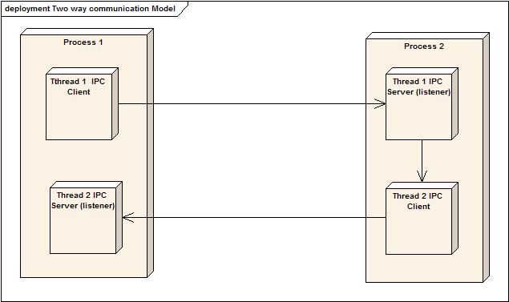
Async IPC Communication
XSAL implements Client/Server model of communication
Only the Client can send messages to the Server
Two way communication requires another Client/Server chain.

Slide 21
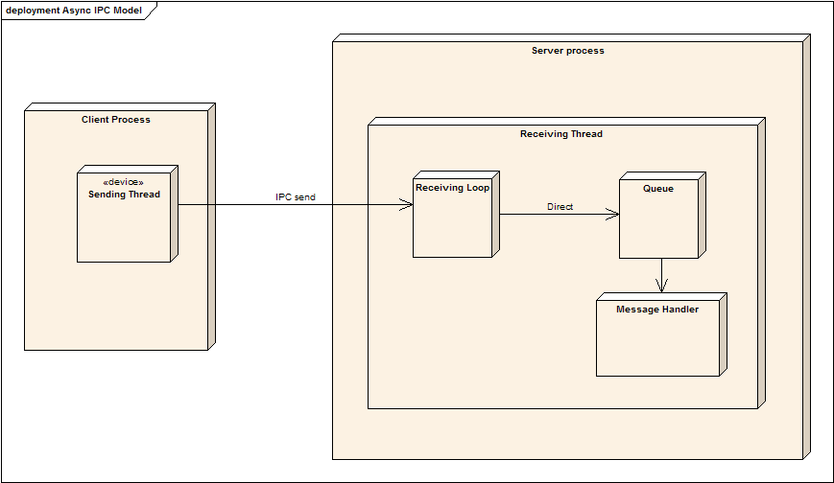
Async IPC Communication Example
Senders wishing to deliver a message/event directly to one receiver need to call function SAL_Send():
// Receiver’s application ID and thread ID
#define RECEIVER_APP_ID 7
#define RECEIVER_THREAD_ID 12
// Globally known event ID
#define EV_SAMPLE 5
// Data to send.
typedef struct
{
int field1;
int field2;
} Sample_Msg_T;
void Sender_Thread(void* param)
{
Sample_Msg_T msg;
...
// Prepare the data associated with the message/event.
msg.field1 = 123;
msg.field2 = 456;
// Send event EV_SAMPLE to selected receiver.
SAL_Send(RECEIVER_APP_ID, RECEIVER_THREAD_ID, EV_SAMPLE, &msg, sizeof(msg));
...
}
void Receiver_Thread(void* param)
{
const SAL_Message_T* msg;
Sample_Msg_T* data; // sample message from the previous example
...
msg = SAL_Receive();
printf(“Received event %d from application %d, thread %d\n”,
msg->event_id, msg->sender_app_id, msg->sender_thread_id);
data = (Sample_Msg_T*)msg->data; // get message data
printf(“Data: field1 = %d, field2 = %d\n”, data->field1, data->field2);
...
}

Slide 22
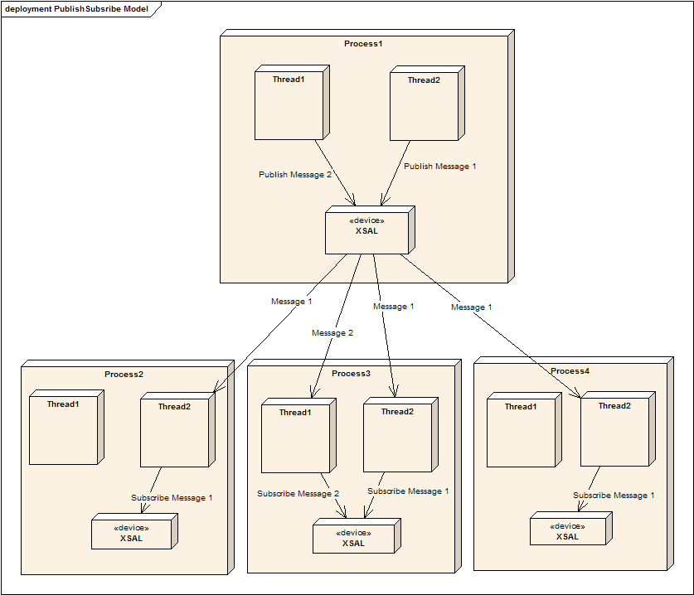
IPC Publish/Subscribe
Threads that subscribed to the Message 1, will receive it, when Thread 2 from Process 1 will publish it.
Thread 1 from Process 3 subscribed to the Message 2. This thread will not receive Message 1, but will receive Message 2 when Thread 1 from Process 1 will publish it.
Thread that publish the message does not aware about who subscribed to it.

Slide 23
Publish/Subscribe Example
Senders wishing to deliver an event to all subscribed receivers need to call function SAL_Publish():
// Globally known event ID
#define EV_SAMPLE 5
// Data to send.
typedef struct
{
int field1;
int field2;
} Sample_Msg_T;
void Sender_Thread(void* param)
{
Sample_Msg_T msg;
...
// Prepare the data associated with the event.
msg.field1 = 123;
msg.field2 = 456;
// Send the event to all threads subscribed to EV_SAMPLE.
SAL_Publish(EV_SAMPLE, &msg, sizeof(msg));
}
void Receiver_Thread(void* param)
{
const SAL_Message_T* msg;
static int subscribe_list[] = {EV_SAMPLE};
// Subscribe to events.
SAL_Subscribe(subscribe_list, sizeof(subscribe_list)/sizeof(int));
...
msg = SAL_Receive();
…
}

Slide 24
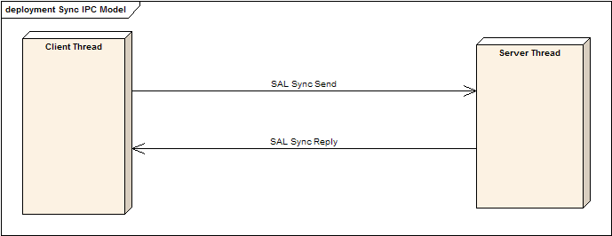
Synchronous IPC communication
Send/receive/reply communication primitives make it possible to create communication channels, connect to them, and send/receive messages (following the typical QNX send-receive-reply model).
The send/receive/reply communication primitives form the foundation on which higher-level constructs are built. Applications can also use them directly (e.g., in client/server communication).

Slide 25
Synchronous IPC communication API
The following channel, connection-management and message passing functions are provided:
int SAL_Create_Channel(SAL_Channel_T* channel);
int SAL_Destroy_Channel(SAL_Channel_T* channel);
int SAL_Bind(int app_id, int port_id, SAL_Channel_T* channel);
int SAL_Unbind(SAL_Channel_T* channel);
int SAL_Connect(int app_id, int port_id, SAL_Connection_T* connection);
int SAL_Disconnect(SAL_Connection_T* connection);
int SAL_Sync_Send( SAL_Connection_t* connection, const uint8_t* msg, int msg_size, uint8_t* reply, int reply_size, int* reply_status);
int SAL_Sync_Receive( SAL_Channel_t* channel, uint8_t* msg, int msg_buffer_size, int* msg_size, int* is_pulse, SAL_Receive_T* receive_id);
int SAL_Sync_Reply(const SAL_Receive_T* receive_id, int status,uint8_t* reply_msg, int reply_msg_size);

Slide 26
Timers
Function SAL_Create_Timer() creates a timer sending event event_id upon expiration and returns timer ID or -1 on error.
After creation, the timer is not running yet. It is started with a call to SAL_Start_Timer().
Timer interval is given in milliseconds but timer resolution depends on the underlying operating system. Parameter is_periodic defines the timer as periodic (when is_periodic = 1) or single-shot (when is_periodic = 0).
The timer is stopped with call to SAL_Stop_Timer().
void Thread(void* param)
{
int timer_id;
int is_periodic = 1;
// Create timer and start it in the periodic mode.
timer_id = SAL_Create_Timer(EV_TIMER);
SAL_Start_Timer(timer_id, 1000, is_periodic);
while (1)
{
const SAL_Message_T* msg = SAL_Receive();
// wait for a message
... // process the received message
}
}

Slide 27
Debug Trace

