Slide 1
Implementing reactive systems with XSAL
L. Plonka and J. Roman
Technical Center Krakow
29 May 2007

Slide 2
Outline
Modeling reactive systems
XSAL – neXt generation System Abstraction Layer
Developing the software design
Implementing the software design
Summary

Slide 3
Reactive systems
Reactive systems interact with the outside world
  Respond to and generate events (are event-driven)
Reactive systems often are real-time
  Not only must be functionally correct but also the results must be produced on time

Slide 4
State machines
State machines are one of the most widely used tools for modeling reactive systems
  In particular, communicating state machines
Several communicating state machine formalisms have been proposed
  E.g. statecharts (UML), SDL
State machine models have numerous advantages
  Are visual, therefore easier to understand than textual descriptions (“a picture is worth a thousand words”).
  Have well-defined syntax and semantics
    Can be verified for correctness
    Can be simulated before implementation
    Support automatic code generation

Slide 5

Introduction to statecharts
Statecharts
  State transition diagrams
  Support for AND-OR decomposition and communication
Statecharts were created by Prof. David Harel
  One of Harel’s papers
Statecharts have been adopted by UML
  Syntax and semantics was changed slightly

Slide 6
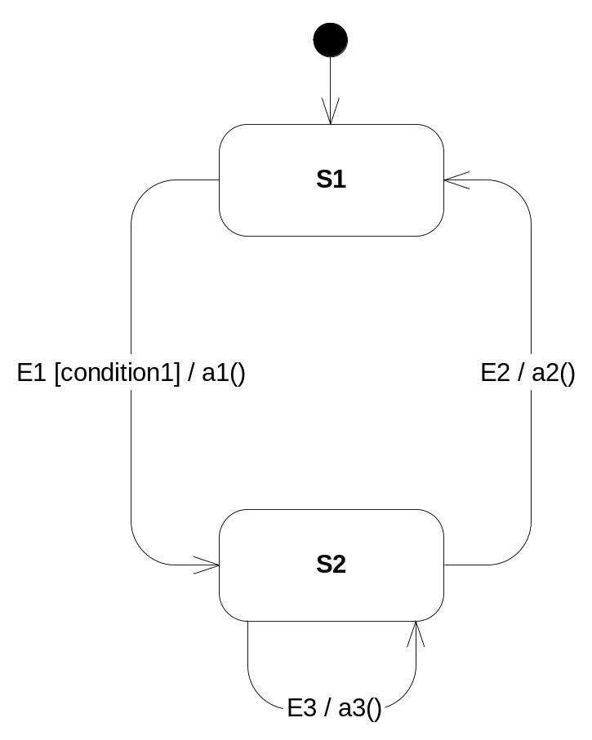
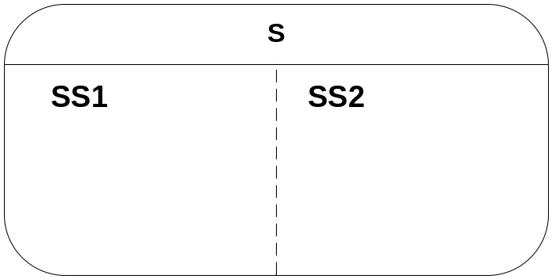
Elements of statechart syntax
S1, S2 can have nested states

Slide 7
XSAL
XSAL = neXt generation System Abstraction Layer
  Developed by TCK in co-operation with BSD and Kokomo
XSAL is an abstraction layer located between the operating systems and applications
  Applications use XSAL and typically don’t have to access the operating system
  XSAL facilitates the development of multi-platform applications
  XSAL facilitates the implementation of communicating state machine models

Slide 8
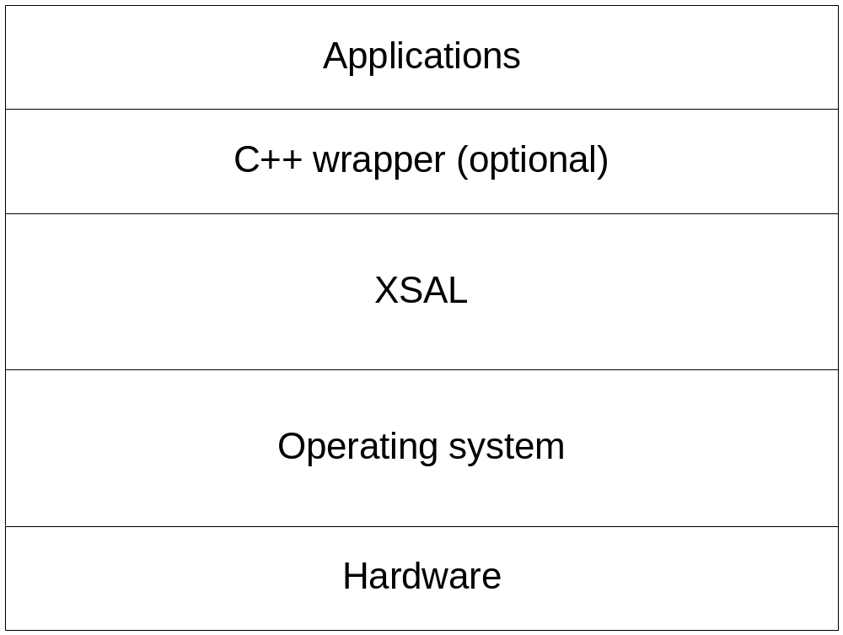
Architecture of XSAL-based systems

Slide 9
Key XSAL concepts
XSAL-based systems can be composed of any number of applications (processes, components…)
An application can consist of any number of threads (tasks)
Threads communicate by message passing

Slide 10
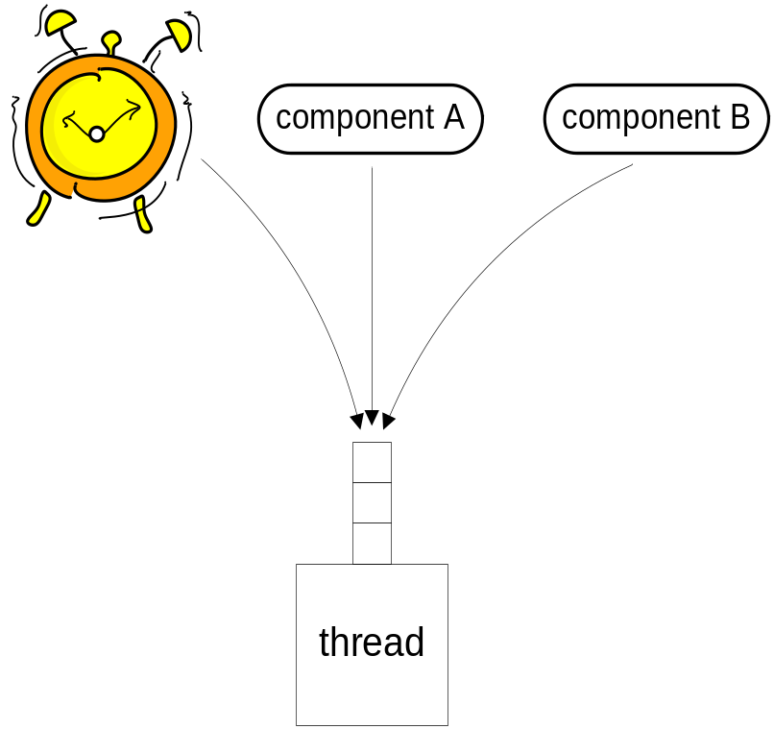
XSAL threads
Every XSAL thread can have its own message queue
  All messages sent to a thread are put into its queue
  Threads can create timers and receive messages they send just like all other messages

Slide 11
XSAL messages
Every XSAL message consists of two major parts
  Event ID
  Data (event attributes)
Event ID identifies the type of the message
  It can be global or local to a thread or application

Slide 12
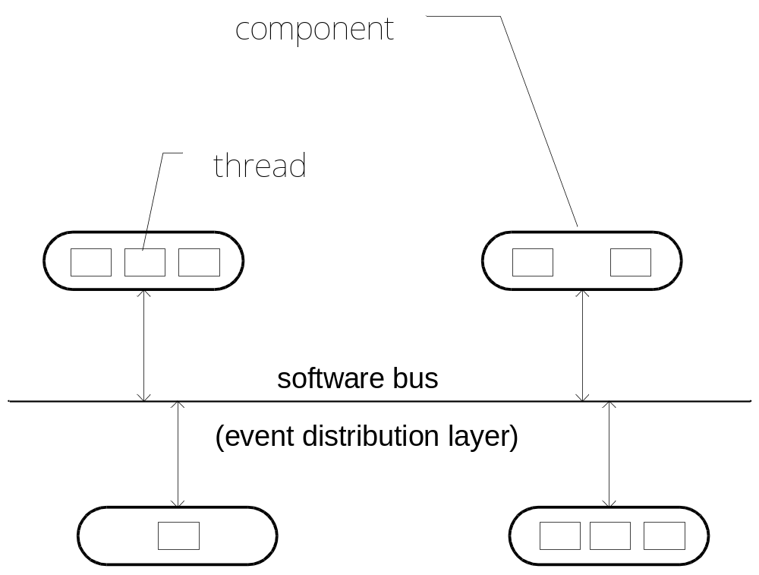
XSAL communication
Threads communicate by asynchronous message passing

Slide 13
XSAL communication
Thread can send a message to another thread “point-to-point”
  Sender must provide the address of the receiver
Thread can send a message to all threads interested in a given message type at once
  This is called message publication
  Threads interested in some particular message type must subscribe to it
  Systems in which components publish messages and subscribe to them are said to follow the publish/subscribe (pub/sub) paradigm
  XSAL supports a very “lightweight” version of publish/subscribe
Paper on pub/sub systems

Slide 14
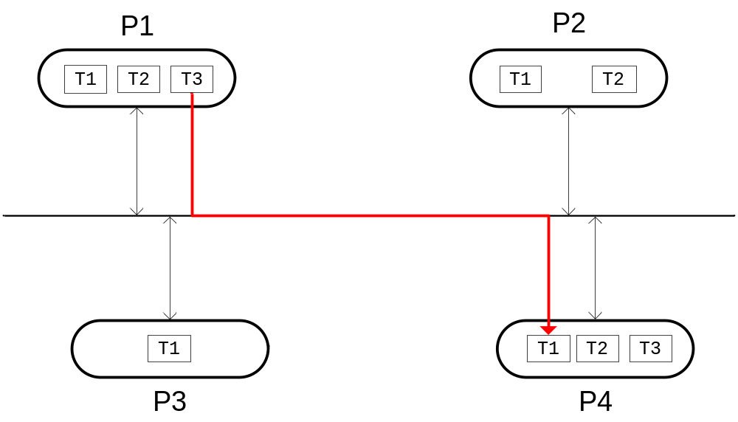
XSAL point-to-point communication

Slide 15
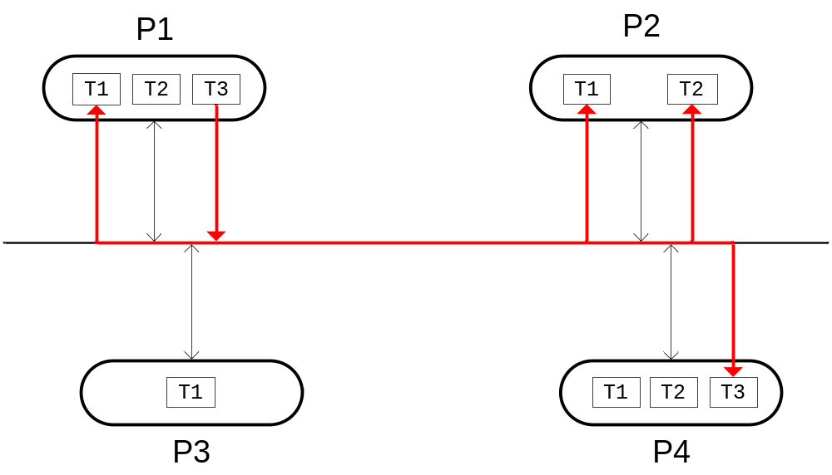
XSAL publish/subscribe

Slide 16
Software design
With SPICE, UML, state machines, and XSAL
(with a focus on detailed design)

Slide 17
Software design
SPICE ENG.5
  Architectural design
    Describes the software components and their interfaces
    Describes the dynamic behavior and interaction between the components
    Defines the resource consumption objectives
  Detailed design
    For each component, describes the software units and their interfaces
We use UML 2
  Allows us to document the design
We use Doxygen
  Generates API documentation from source code

Slide 18
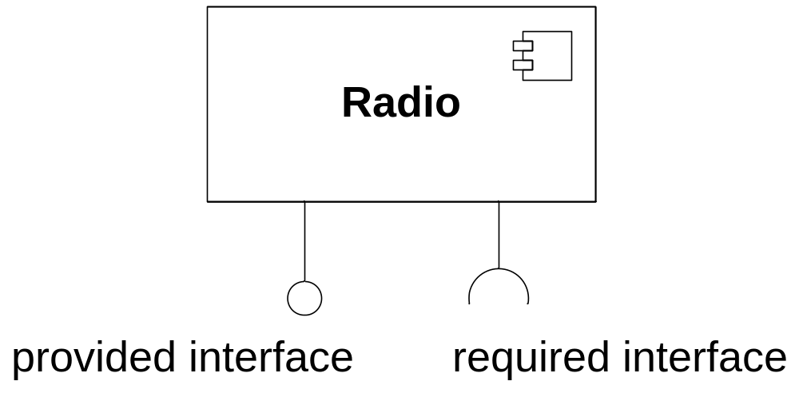
Component
Interface
  Set of messages (asynch)
    Describe in Software Detailed Design (SDD) document
  Set of functions (synch)
    Doxygen

Slide 19
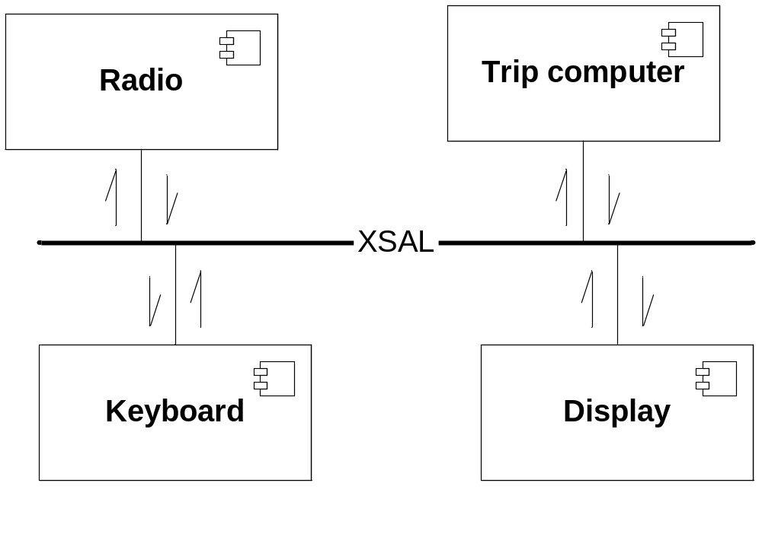
Active components
Contain at least one thread/task
Communicate (at least partially) by message passing (mainly publish/subscribe?)

Slide 20
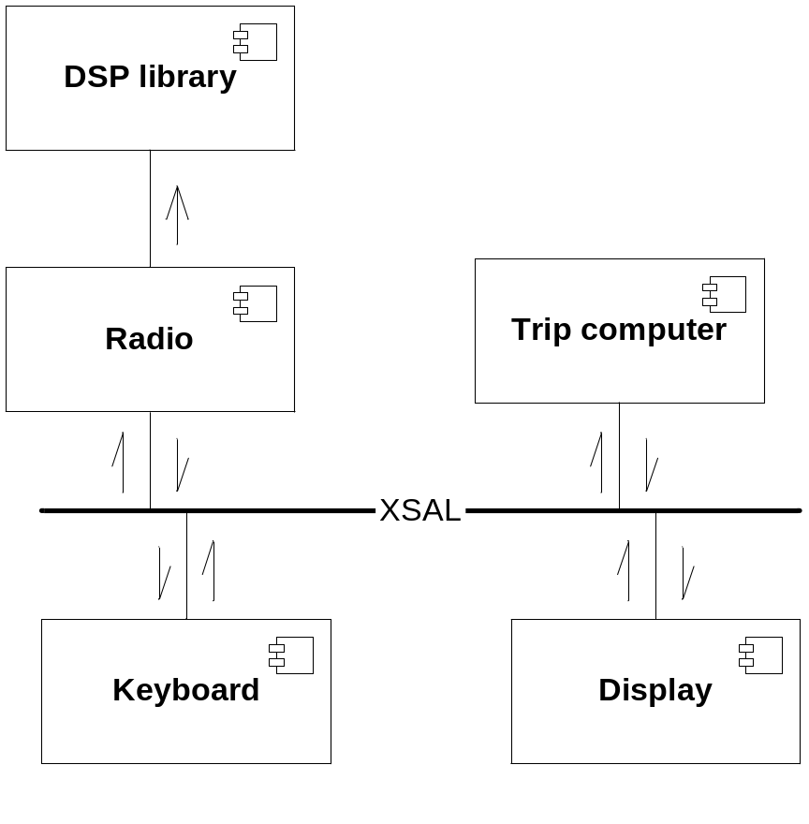
Passive components
Don’t contain threads/tasks
Have a “functional API”

Slide 21
Object modeling
Object-oriented approach
  Uses class hierarchies (inheritance)
  Requires programming language support (C++, Java…)
Object-based approach
  Doesn’t use class hierarchies
  Retains many of the benefits of the object-oriented approach
  Easier to use with the C language
  Objects = modules with a public API and private implementation

Slide 22
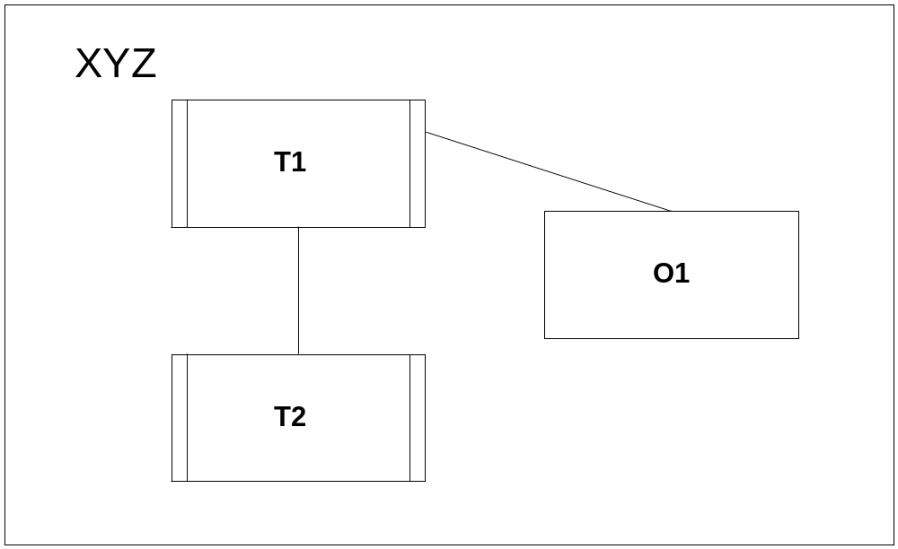
Structure of a component
Active objects
  Have a thread of control (thread/task)
  Communicate by message passing (mainly point-to-point?)
Passive objects
  Don’t have a thread of control
  E.g. modules with public functions
  Have functional API (Doxygen)

Slide 23
What should be a thread/task?
Threads are identified in the Architectural Design
Every active object has a thread
Different components have their own threads
Related functionality – one thread
Unrelated, parallel functionality – separate threads
Activities with different priorities – separate threads
Often it’s a matter of taste, simplicity, optimization concerns…

Slide 24
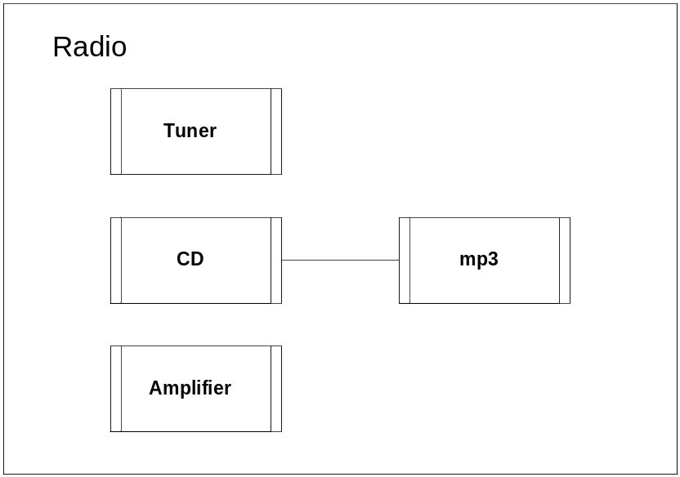
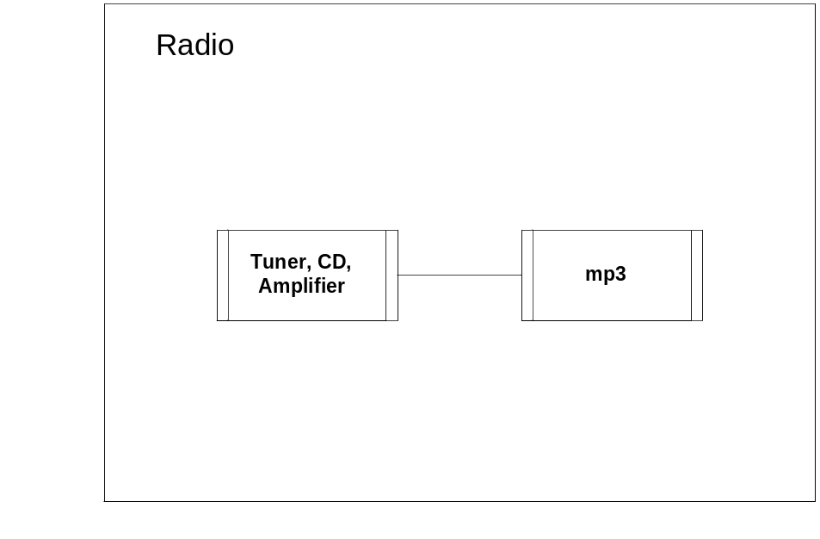
Structure of a component
For instance
OR
etc.

Slide 25
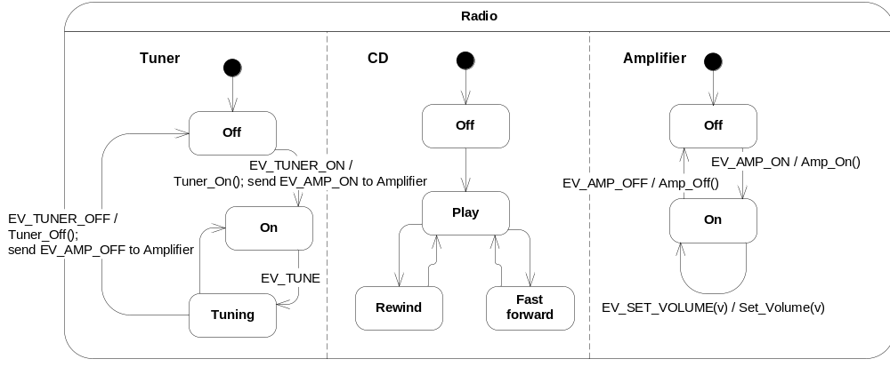
Behavior of an object
Each active object must have a state machine model
  If it’s behavior is non-trivial
  The model should be precise and complete

Slide 26
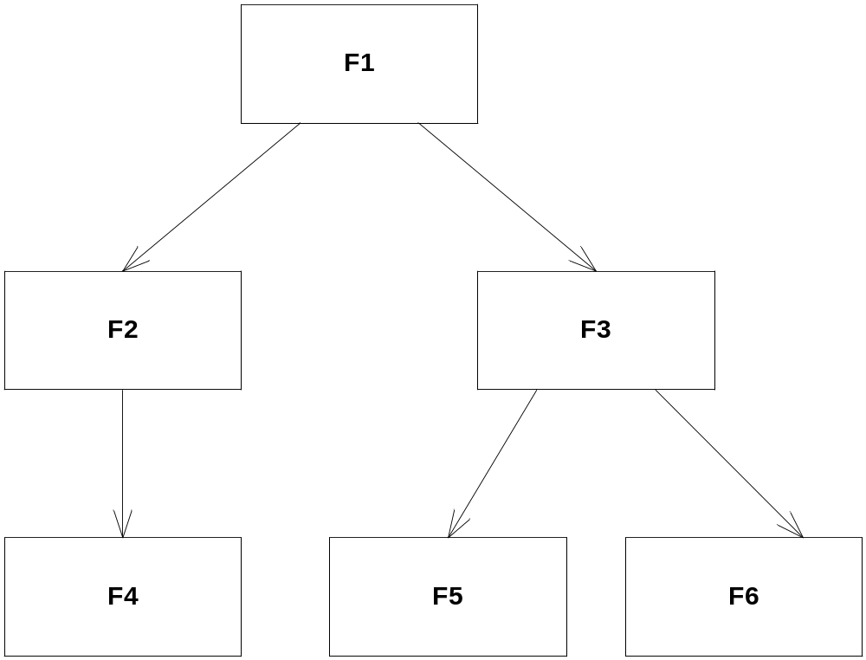
Structured design
Structure charts (deprecated, not UML)
Doxygen

Slide 27
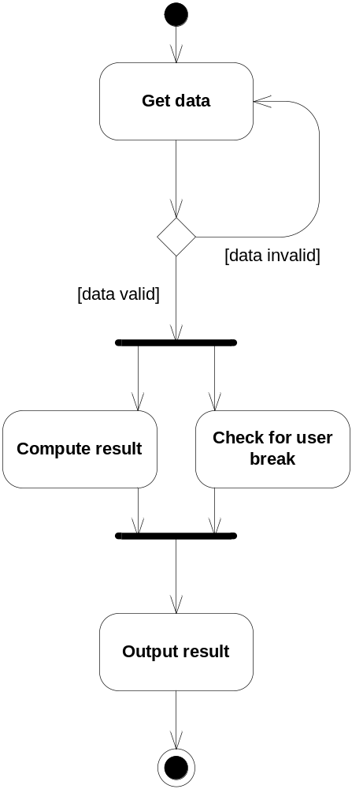
Algorithms
Activity diagrams
  Are like flowcharts
  Use for non-trivial algorithms
  Can be nested

Slide 28
Implementation

Slide 29
Typical thread structure in XSAL
void Thread(void* param)
{
static SAL_Event_Id_T subscribe_list[] = {EV_E1, EV_E2}; // events to subscribe
static SAL_Thread_Id_T wait_list[] = {THREAD_ID2, THREAD_ID3}; // threads to wait for
// Create your queue. Queue size and memory allocation/deallocation functions must
// be supplied. User-defined functions might be used instead of malloc() and free().
SAL_Create_Queue(64, 0, malloc, free);
// Subscribe to events. EV_E1, EV_E2 should be defined in a global header file.
SAL_Subscribe(subscribe_list, sizeof(subscribe_list)/sizeof(subscribe_list[0]));
// Tell other threads that you’re ready to receive events.
SAL_Signal_Ready();
// Wait for other threads to initialize.
SAL_Wait_Ready(wait_list, sizeof(wait_list)/sizeof(wait_list[0]));
while (1)
{
const SAL_Message_T* msg = SAL_Receive(); // wait for message
State_Machine(msg) // process the received message
}
}

Slide 30
Concurrent state machines
void Thread(void* param)
{
...
while (1)
{
// Receive a message
const SAL_Message_T* msg = SAL_Receive();
// Run the concurrent state machines
State_Machine1(msg);
State_Machine2(msg);
State_Machine3(msg);
...
}
}

Slide 31

Sample state machine implementation
static int state = S1;
void State_Machine(const SAL_Message_T* msg)
{
switch (state)
{
case S1:
if (msg->event_id == E1 && condition1)
{
a1();
state = S2;
}
break;
case S2:
if (msg->event_id == E2)
{
a2();
state = S1;
}
else if (msg->event_id == E3)
{
a3();
}
break;
}
}

Slide 32
Messages
Message data part is typically implemented as a structure, e.g.:
typedef struct Ev_Set_Volume_Tag
{
int32_t volume;
} Ev_Set_Volume_T;
Messages have corresponding IDs e.g.:
enum Ev_Id_Tag
{
...
EV_SET_VOLUME,
...
};

Slide 33
Helper functions/macros
Functions or macros can make using messages easier, e.g.:
// Retrieves volume from an XSAL message.
int32_t Get_Volume(const SAL_Message_T* msg)
{
return ((Ev_Set_Volume_T*)msg->data)->volume;
}
// Publishes the “EV_SET_VOLUME” message.
void Set_Volume(int32_t v)
{
Ev_Volume_T msg = {v};
SAL_Publish(EV_SET_VOLUME, &msg, sizeof(msg));
}

Slide 34

Sample SDD template
Sample SPICE-compliant Software Detailed Design (SDD) template
  Developed jointly by TCK, Delphi Grundig, and Fuba
  Tested on a customer-assessed project

Slide 35
Summary
Reactive systems
  Interact with the outside world
  Typically modeled by communicating objects, state machines, processes, threads/tasks…
XSAL as a communication-centered “virtual OS”
Architectural design – shows components and interfaces
Detailed design – shows component structure and behavior
  Structure – object models
  Behavior – statecharts, activity diagrams, sequence charts
Implementation
  One-to-one correspondence between the UML design model and the source code is best
    Imagine you have a tool that can generate code from the model

