Slide 1
Introduction to XSAL
L. Plonka, J. Roman and M. Gebolys
Technical Center Krakow
1 March 2007

Slide 2
What is XSAL?
XSAL stands for neXt generation System Abstraction Layer
  Successor to SAL2 (GME Opel EHU4)
  Based on feedback from infotainment, reception, audio groups
XSAL is an abstraction layer located between the operating systems and applications
  Applications use only XSAL and don’t access the operating systems
  XSAL makes it easier to write multi-platform applications

Slide 3
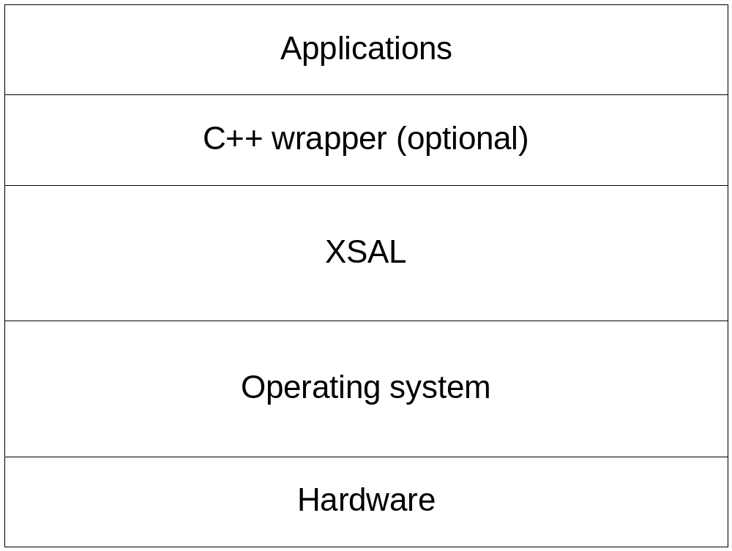
Architecture of XSAL-based systems

Slide 4
Portability
Currently, XSAL is implemented on Win32, QNX, Linux, and uItron
  Applications based on XSAL can be developed on Windows and then ported to the target hardware when it becomes available
XSAL should be easy to port to other operating systems, e.g.:
  Windows CE
  OSEK
XSAL could even be implemented without an underlying OS

Slide 5
Performance
XSAL is designed with performance in mind
  For instance, on QNX, connections between processes/threads are established only once
  Publishing a message doesn’t introduce any overhead. Time needed to publish a message to n receivers is equal to the time needed to send it n times

Slide 6
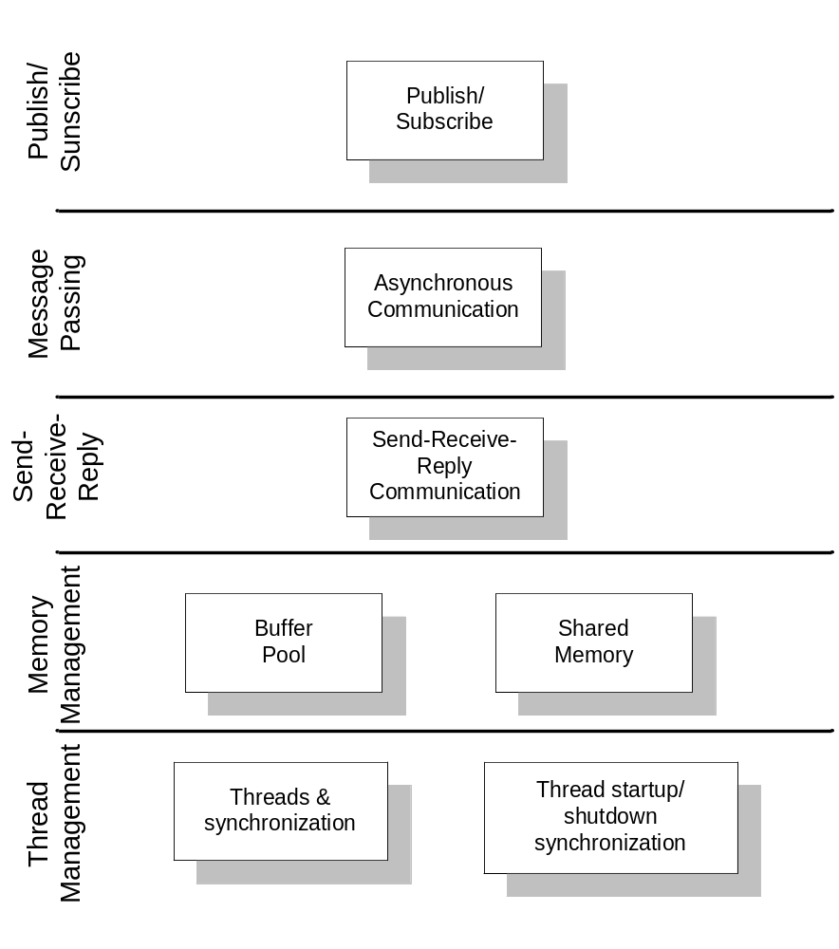
XSAL architecture

Slide 7
XSAL architecture (cont.)
Thread management & synchronization
  Thread creation
  Thread synchronization and mutual exclusion
  Thread synchronization during startup & shutdown
Memory management
  Buffer pools
  Shared memory
Send/receive/reply communiation
Message passing
  Send-receive-reply synchronous message passing
  Asynchronous message passing
  Timer management
Publish/Subscribe

Slide 8
Modularity of XSAL
The architecture of XSAL is modular
It is possible to use only the needed components
  E.g. it’s possible to use only threads and mutexes

Slide 9
Key XSAL concepts
XSAL-based systems can be composed of any number of applications (processes)
An application can consist of any number of threads
Threads communicate by message passing

Slide 10
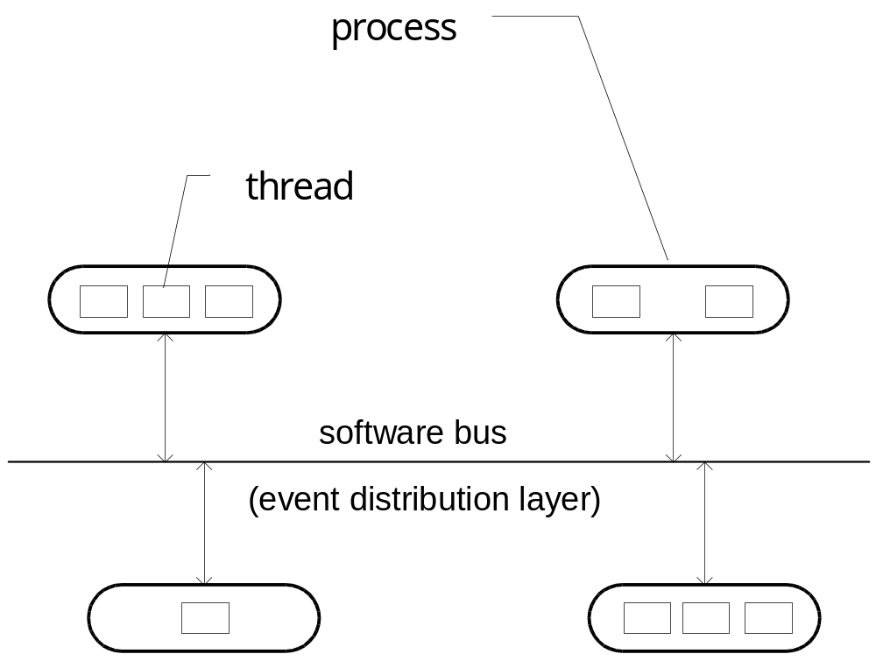
Key XSAL concepts

Slide 11
XSAL communication models
XSAL supports three communication models
  Client-server (synchronous)
  Point-to-point message passing (asynchronous)
  Publish-subscribe (asynchronous)

Slide 12
Client-server communication
Follows the typical QNX send-receive-reply model
  Sender sends a message and waits for a reply
  Receiver gets the message
  Receiver replies
  Sender gets the reply and proceeds

Slide 13
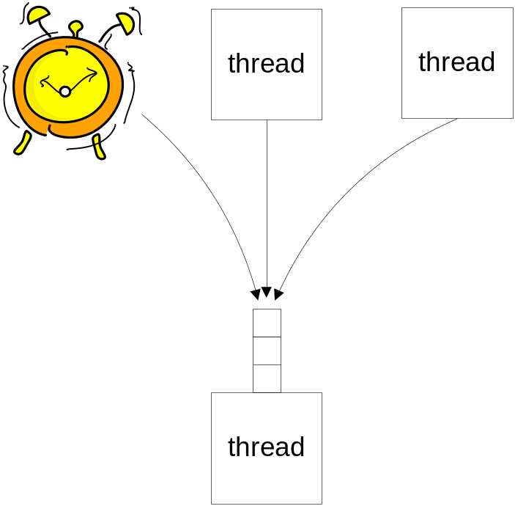
XSAL asynchronous message passing
Every XSAL thread can have a message queue
  All messages sent to a thread are put into its queue
  Note that threads can create timers and receive messages sent by them just like all other messages

Slide 14
XSAL messages
Every XSAL message consists of two major parts
  ID (integer number)
  Attributes (data of any size and structure)
Message ID identifies the type of the message
  It is system-wide
  May be set to zero if it is to be ignored
Messages with a valid event ID will also be referred to as events
  E.g. event Key_Pressed carrying key code
In addition to the ID and data, messages/events contain
  Sender application ID
  Sender thread ID
  Receiver thread ID
  Time stamp (send time)
  Data size

Slide 15
Point-to-point communication
Threads can send messages/events directly to other threads
  Sender must call function SAL_Send(),
  Sender must provide the address of the receiver thread, i.e., its application ID and thread ID

Slide 16
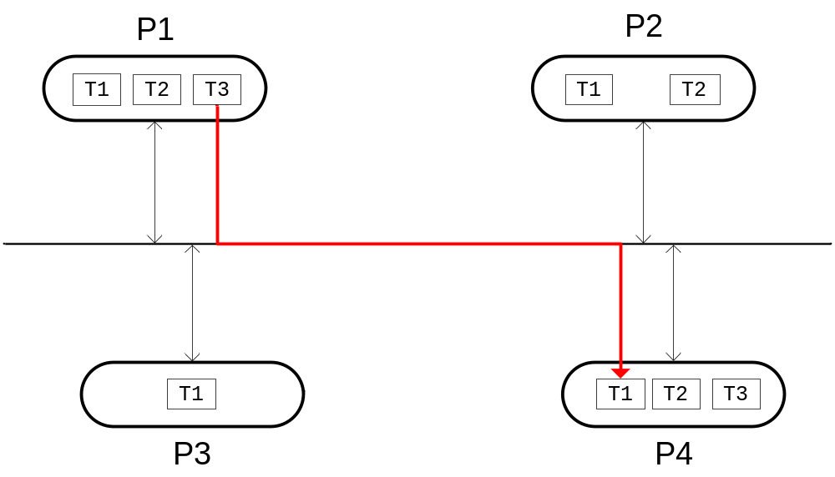
Point-to-point communication

Slide 17
Publish/subscribe
Threads can distribute events to all subscribed threads in all applications in the system with one function call
  This is called event publication
  XSAL event publication is similar to multicast/broadcast typically supported by computer networks, e.g., CAN
Threads can subscribe to events sent by other threads
  Events are global, i.e., they are distributed throughout the whole system
  It doesn’t matter whether an event was sent by a thread running in the same process/application as the subscribing thread or not -- the subscriber will always receive it
  Timer events are an exception -- they are received only by the thread that created the timer and they do not have to be subscribed to
Systems in which components publish events and subscribe to them are said to follow the publish/subscribe (pub/sub) paradigm

Slide 18
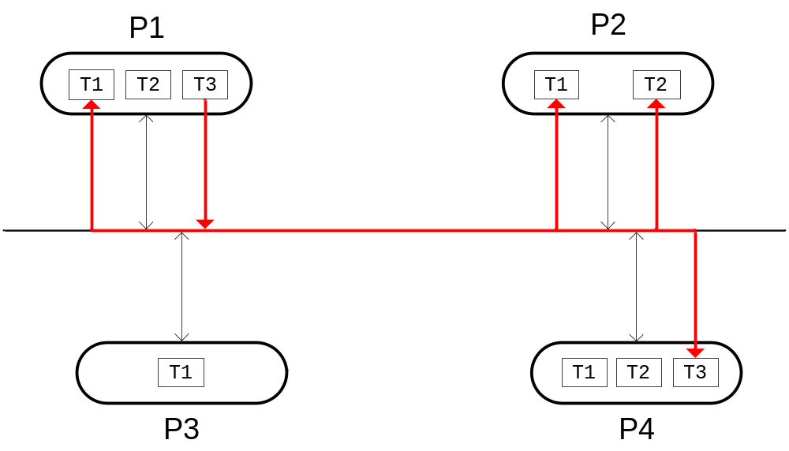
Publish/subscribe

Slide 19
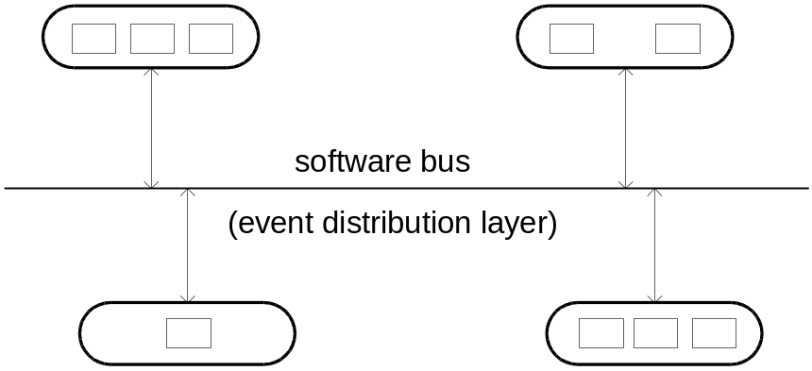
Publish/subscribe
The advantage of the pub/sub paradigm is that the sender doesn’t have to know its receivers and the receiver doesn’t have to be participating in the interaction at the same time
  It makes it easy to start and stop applications dynamically at system runtime,
  It makes it easy to implement new applications because already existing ones don’t have to be modified,
  Programmers don’t have to manually maintain the connections between senders and receivers.
Pub/sub systems are said to support space, time, and flow decoupling
process
thread

Slide 20
Other XSAL functionality
XSAL supports typical OS functionality:
  Thread management
    Creation, changing the priority, sleep etc.
  Thread synchronization and mutual exclusion
    Mutexes, semaphores
  Timers
  Buffer pools
  Shared memory
    When multiple processes are used

Slide 21
XSAL implementation
XSAL is written in the C language
  Therefore XSAL API is also C-based
  C++ is supported through a wrapper

Slide 22
Application initialization
Every XSAL application has the same basic structure:
int main(int argc, char* argv[])
{
SAL_Config sal_config;
/* Retrieve the default configuration parameters. */
SAL_Get_Config(&sal_config);
/* Define application ID and max number of threads. */
sal_config->app_id = 7;
sal_config->max_number_of_threads = 10;
/* Modify some other values. */
sal_config->first_unknown_thread_id = 5;
/* Initialize XSAL. */
SAL_Init(&sal_config);
/* Initialize the system, create threads, etc. */
...
return SAL_Run();
}

Slide 23
Thread management
User threads are created by SAL_Create_Thread():
void Thread1(void*) { /* body of thread 1 */ }
void Thread2(void*) { /* body of thread 2 */ }
int main(int argc, char* argv[])
{
SAL_Thread_Attr_T attr;
SAL_Init(/* Configuration parameters */);
// Create threads 1..2
attr->name = “Thread1”;
attr->id = 1;
attr->priority = 2;
SAL_Create_Thread(Thread1, NULL, &attr);
attr->name = “Thread2”;
attr->id = 2;
attr->priority = 5;
SAL_Create_Thread(Thread2, NULL, &attr);
return SAL_Run();
}

Slide 24
Thread synchronization at startup
Often threads must be initialized in a specific order to ensure proper application initialization. XSAL synchronization events can be used to this end.
void Thread1(void*)
{
// This thread will wait for threads 2 and 3 to signal the completion
// of their initialization before proceeding.
static SAL_Thread_Id_T wait_list[] = {THREAD_ID2, THREAD_ID3};
SAL_Wait_Ready(wait_list, sizeof(wait_list)/sizeof(wait_list[0]));
// Now thread2 and thread3 are initialized.
...
}
void Thread2(void*) // assume thread ID == THREAD_ID2
{
... // do your initialization
SAL_Signal_Ready(); // signal “initialization done”
...
}
void Thread3(void*) // assume thread ID == THREAD_ID3
{
... // do your initialization
SAL_Signal_Ready(); // signal “initialization done”
...
}

Slide 25
Typical thread structure
Typically a thread needs to do the following:
  Initialize its message queue
  Subscribe to events it wants to receive
  Signal its readiness
  Wait for other threads to initialize
  Wait for and process messages/events

Slide 26
Typical thread structure
Example demonstrates the key steps in thread operation
void Thread(void* param)
{
static SAL_Event_Id_T subscribe_list[] = {EV_E1, EV_E2}; // events to subscribe
static SAL_Thread_Id_T wait_list[] = {THREAD_ID2, THREAD_ID3}; // threads to wait for
// Create your queue. Queue size and memory allocation/deallocation functions must
// be supplied. User-defined functions might be used instead of malloc() and free().
SAL_Create_Queue(64, 0, malloc, free);
// Subscribe to events. EV_E1, EV_E2 should be defined in a global header file.
SAL_Subscribe(subscribe_list, sizeof(subscribe_list)/sizeof(subscribe_list[0]));
// Tell other threads that you’re ready to receive events.
SAL_Signal_Ready();
// Wait for other threads to initialize.
SAL_Wait_Ready(wait_list, sizeof(wait_list)/sizeof(wait_list[0]));
while (1)
{
const SAL_Message_T* msg = SAL_Receive(); // wait for a message
... // process the received message
}
}

Slide 27
Event distribution
If a sender thread wants to deliver an event to all subscribed receivers, it needs to call SAL_Publish()
// Globally known event ID.
#define EV_SAMPLE 5
// Event data structure.
typedef struct Ev_Sample_Tag
{
int32_t field1;
int32_t field2;
} Ev_Sample_T;
void Sender_Thread(void*)
{
...
// Prepare the data associated with the event.
Ev_ Sample_T e;
e.field1 = 123;
e.field2 = 456;
// Send the event to all threads subscribed to EV_SAMPLE.
SAL_Publish(EV_SAMPLE, &e, sizeof(e));
...
}

Slide 28
Point-to-point message passing
If a sender thread wants to send a message/event to a selected receiver, it needs to call SAL_Send()
// Globally known app ID, thread ID, and event ID.
#define RECEIVER_APP_ID 2
#define RECEIVER_THREAD_D 3
#define EV_SAMPLE 5
// Event data structure.
typedef struct Ev_Sample_Tag
{
int32_t field1;
int32_t field2;
} Ev_Sample_T;
void Sender_Thread(void*)
{
...
// Prepare the data associated with the event.
Ev_Sample_T e;
e.field1 = 123;
e.field2 = 456;
// Send the event to all threads subscribed to EV_SAMPLE.
SAL_Send(RECEIVER_APP_ID, RECEIVER_THREAD_ID, EV_SAMPLE, &e, sizeof(e));
...
}

Slide 29
Timers
Threads can create timers
Timers can be single-shot or periodic
Timers send events to threads that created them
  Timer events are delivered only to the thread that created the timer
  Timer events are sent when the timer expires
  Timer events do not carry any data, only event ID
  Timer events do not have to be subscribed to

Slide 30
Timers
Example from slide “Typical thread structure” with a timer
void Thread(void* param)
{
SAL_Timer_Id_T timer_id;
static SAL_Event_Id_T subscribe_list[] = {EV_E1, EV_E2};
static SAL_Thread_id_T wait_list[] = {THREAD_ID2, THREAD_ID3}; // threads to wait for
// Create your message queue.
SAL_Create_Queue(64, 0, malloc, free);
// Subscribe to events.
SAL_Subscribe(subscribe_list, sizeof(subscribe_list)/sizeof(subscribe_list[0]));
// Tell other threads that you’re ready to receive events.
SAL_Signal_Ready();
// Wait for other threads to initialize.
SAL_Wait_Ready(wait_list, sizeof(wait_list)/sizeof(wait_list[0]));
// Create a timer and start it in the periodic mode.
// It will send event EV_TIMER every 1000 ms to this thread.
SAL_Create_Timer(EV_TIMER, &timer_id);
SAL_Start_Timer(timer_id, 1000, true);
while (1)
{
const SAL_Message_T* msg = SAL_Receive(); // wait for a message
... // process the received message (including the timer event)
}
}

Slide 31
Thread synchronization
Threads can create and use mutexes and semaphores
bool SAL_Create_Mutex(SAL_Mutex_T* mutex, const SAL_Mutex_Attr_T* attr);
bool SAL_Lock_Mutex(SAL_Mutex_T* mutex);
bool SAL_Lock_Mutex_Timeout(SAL_Mutex* mutex, uint32_t timeout_msec);
bool SAL_Try_Lock_Mutex(SAL_Mutex_T* mutex);
bool SAL_Unlock_Mutex(SAL_Mutex_T* mutex);
bool SAL_Destroy_Mutex(SAL_Mutex_T* mutex);
bool SAL_Create_Semaphore(SAL_Semaphore_T* sem, const SAL_Semaphore_Attr_T* attr);
bool SAL_Destroy_Semaphore(SAL_Semaphore_T* sem);
bool SAL_Wait_Semaphore(SAL_Semaphore_T* sem);
bool SAL_Wait_Semaphore_Timeout(SAL_Semaphore_T* sem, uint32_t timeout_msec);
bool SAL_Try_Wait_Semaphore(SAL_Semaphore_T* sem);
bool SAL_Signal_Semaphore(SAL_Semaphore_T* sem);

Slide 32
XSAL vs. XSAL Light
XSAL is available in two versions
  XSAL
  XSAL Light
XSAL Light is targeted at low-end systems
  Simpler
The API of XSAL Light is a proper subset of the XSAL API
  XSAL Light applications can be run on XSAL platforms
  If you want two-way portability, use XSAL Light

Slide 33
Efficiency concerns
The following rules should be followed to reduce XSAL memory requirements:
  All event IDs in the system should be contiguous The lowest event ID should have the value of 2 (0 and 1 are reserved for XSAL).
  All application IDs in the system should be contiguous. The lowest application ID should have the value of 2 (0 and 1 are reserved for XSAL).
  All thread IDs in the system should be contiguous. The lowest thread ID should have the value of 1 (0 is reserved for XSAL).

Slide 34
Building XSAL-based applications
Dependencies during compilation
  Globals
  DebugTrace
During the compilation of XSAL-based applications (as well as XSAL lib), macro XSAL_TYPE=XSAL (or XSAL_Light) must be defined
Dependencies during runtime (not for XSAL_Light)
  Process Manager must be running (procman)

Slide 35
Starting XSAL Application
XSAL-based applications can be started
  By the ProcessManager
  Manually
An example of starting an application by the Process Manager:
  Create config file: config.cfg
    -f desip –n“desip” –c0 –a”param1” –a”param2”
  Start the Process Manager: procman –f config.cfg
  String desip after –n option is defined in xsal_application_id.h file (see the next slide)
Starting manually:
  Run the Process Manager with option –n (NameServer only)
  Start application(s)
    procman –n &
    desip param1 param2 &

Slide 36
Sample xsal_application_id.h file
typedef enum SAL_Application_Id_Tag
{
  APP_FIRST_ID = 1,
  APP_PROCMAN = 1, /* 01 */
  APP_DESIP, /* 02 */
  . . .
  APP_LAST_ID
} SAL_Application_Id_T;
typedef struct
{
int app_id;
char* app_name;
} Application_Name_T;
#define APP_NAMES \
{ \
{ 0, „” }, \
{ APP_PROCMAN, „procman” }, \
{ APP_DESIP, „desip” }, \
. . . \
}

Slide 37
Summary
Key points to remember:
  XSAL is a multi-platform “virtual operating system.”
  XSAL is implemented in C and has a C++ wrapper.
  XSAL is based on (asynchronous) message passing.
    Point-to-point
    Publish-subscribe
  XSAL supports the typical operating system concepts like threads, timers, mutexes, semaphores, and real-time memory management.
    Some of these haven’t been covered in detail in this introductory presentation -- please refer to the user manual.

