Slide 1
Class imbalance classification
2018.03.09(Friday)

Slide 2
Paper
CUSBoost: Cluster-based Under-sampling with Boosting for Imbalanced Classification (arXiv:1712.04356)
MEBoost: Mixing Estimators with Boosting for Imbalanced Data Classification (arXiv:1712.06658)

Slide 3
Introduction - Problems
Most of real-life datasets are often imbalanced in nature.
Existing learning algorithms often correctly classify the majority class, but misclassify the minority class.
We are more interested in the minority class instances.

Slide 4
Introduction – Existing Methods
Dealing with class imbalance problems
Data balancing methods
External methods
Reducing their sensitiveness to the class imbalance
Internal methods

Slide 5
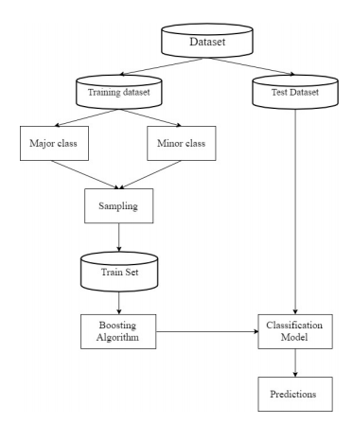
Introduction – Overview of Process
Process of classifying imbalanced data using sampling with boosting approach:

Slide 6
Introduction – Details of External Methods
Sampling Techniques: Get balanced class instances
Under-sampling: the removal of some majority class instances;
Over-sampling : increase the number of minority class instances.
But random under-sampling or over-sampling methods may result in:
huge loss of information from the majority class instances;
high probability of overfitting due to the same instances occurring multiple times.

Slide 7
Introduction – Details of External Methods
Sampling Techniques: Get balanced class instances
Under-sampling: the removal of some majority class instances;
Over-sampling : increase the number of minority class instances.
Under-sampling techniques:
Neighborhood cleaning rule.
Near miss.
One sided selection.
Random under-sampling.
Over-sampling techniques:
AdaSyn.
SMOTE: Synthetic Minority class Oversampling Technique.
Random over-sampling.

Slide 8
Introduction – Details of Internal Methods
Cost-sensitive learning: More misclassification cost to minority class instances
Modify cost function
Weighted minority classes
Greatest challenge : assigning the costs as they are difficult to be derived from datasets.

Slide 9
Proposed : CUSBoost Algorithm
Features: sampling technique
Cluster-based Under-sampling(基于聚类的欠采样)
Adaboost algorithm(weak classifier : C4.5 decision tree)
How to under-sampling ?
Clusters the majority class instances into k clusters using k-means clustering algorithm.
For each of the created clusters, randomly selecting 50% of the instances.
Balanced datasets: Selected representative instances, the minority class instances.

Slide 10
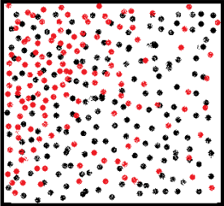
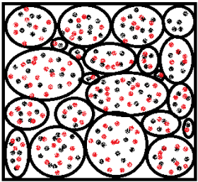
Proposed : CUSBoost Algorithm
Features: sampling technique
Cluster-based Under-sampling(基于聚类的欠采样)
Adaboost algorithm(weak classifier : C4.5 decision tree)

Slide 11
Proposed : CUSBoost Algorithm
Features: sampling technique
Cluster-based Under-sampling(基于聚类的欠采样)
Adaboost algorithm(weak classifier : C4.5 decision tree)
Strength:
It considers examples from all subspaces of the majority class(for applying k-means clustering);
Selecting proper representatives of the majority class.

Slide 12
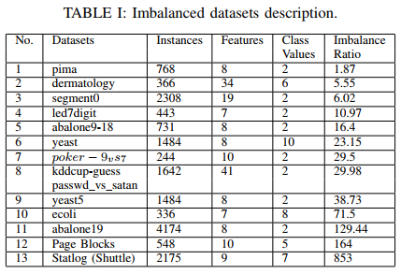
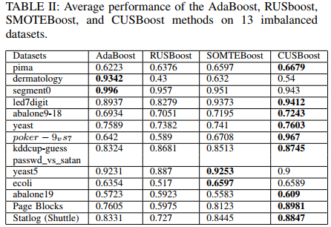
Result : CUSBoost Algorithm
AUC as metric for classifier performance

Slide 13
Proposed : MEBoost Algorithm
Mixing Estimators with Boosting for Imbalanced Data Classification:
Use two different weak estimators(Decision Tree and Extra Tree) alternately in Adaboost.
Discarding learners with poor performance.
Early Stopping.
No sampling on train set.
Intuition : Each tree algorithms will generate different trees in different ways and cover different sub-spaces of the total dataset.

Slide 14
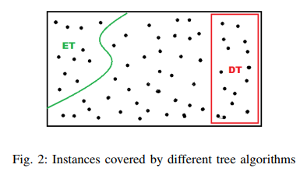
Proposed : MEBoost Algorithm
Intuition : Each tree algorithms will generate different trees in different ways and cover different sub-spaces of the total dataset.

Slide 15
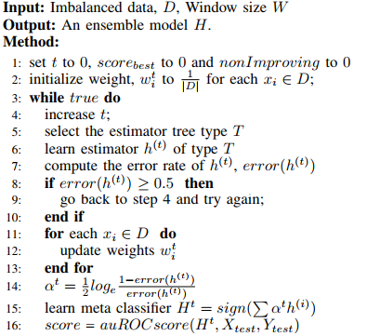
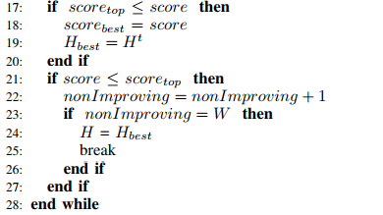
Proposed : MEBoost Algorithm
Pseudo-code :

Slide 16
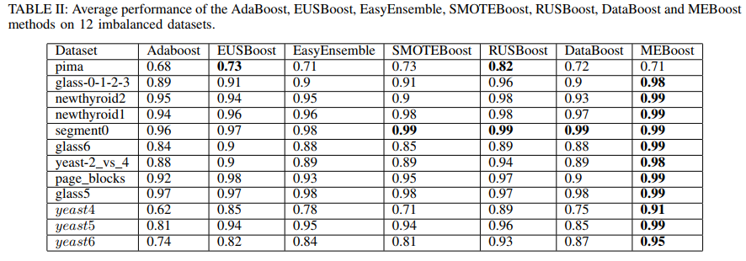
Result : MEBoost Algorithm
the performance of the MEBoost algorithm

