Slide 1
APEX

Slide 2
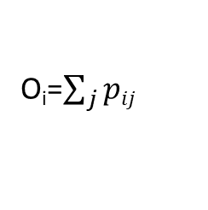
Predict the p_{ij} for each peptitide
Peng L et.al 2007
Training data
4023 peptides from 40 proteins of yeast proteome
714 observed in shortgun, 3309 not observed
Parameters of Classifier: Peptide length, molecular weight, percentage of each amino acid
ML
Bagging
SVM
Logistic regression
Instance based learners
Cross-validation
Testing data
All yeast or E. coli proteins
For each peptide, the probability p_{ij} of being observed in a shortgun proteomics experiment is predicted
Classifier
10 fold cross validation
86% accuracy
69% true positive rate
90% true negative rate
O_{i}=$\sum_{j}{pij}$

Slide 3
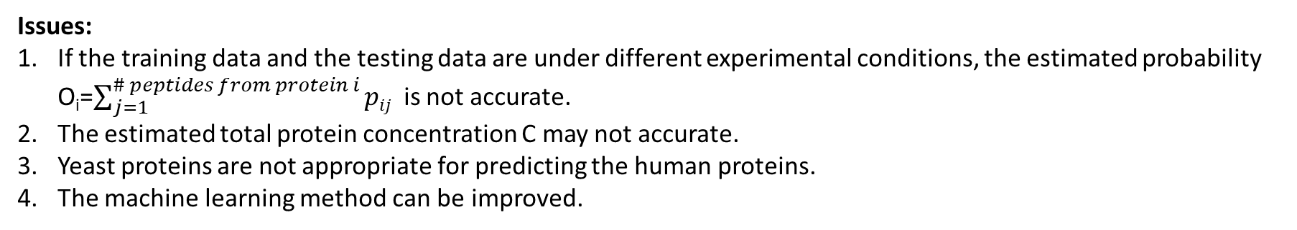
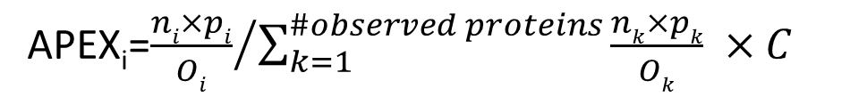
Calcuate the absolute protein expression index APEX_{i}
proteins i
Sum of all observed proteins
Estimated total protein concentration
APEX_{i}=${\frac{ni×pi}{Oi}}/{\sum_{k=1}^{\#observed proteins}{\frac{nk×pk}{Ok}}} ×C$
Issues:
If the training data and the testing data are under different experimental conditions, the estimated probability O_{i}=$\sum_{j=1}^{\# peptides from protein i}{pij}$ is not accurate.
The estimated total protein concentration C may not accurate.
Yeast proteins are not appropriate for predicting the human proteins.
The machine learning method can be improved.
John B et.al (2008) implemented the APEX into a Java tool. They used random forest, and claimed random forest ML algorithm outperforms bagging.

Slide 4
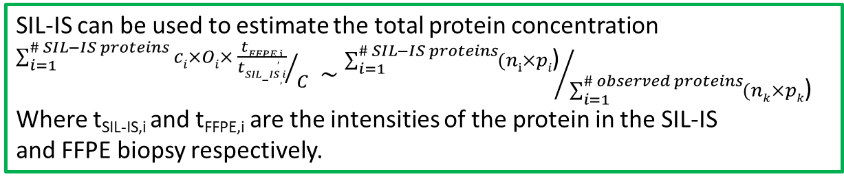
Calcuate the absolute protein expression index APEX_{i}
proteins i
Sum of all observed proteins
Estimated total protein concentration
APEX_{i}=${\frac{ni×pi}{Oi}}/{\sum_{k=1}^{\#observed proteins}{\frac{nk×pk}{Ok}}} ×C$
SIL-IS can be used to estimate the total protein concentration
${\sum_{i=1}^{\# SIL−IS proteins}{ci×Oi× \frac{tFFPE,i}{tSIL−IS,i}}}/C$ $\sim$ ${\sum_{i=1}^{\# SIL−IS proteins}{(ni}×pi\text{)}}/{\sum_{i=1}^{\# observed proteins}{(n}k×pk\text{)}}$
Where t_{SIL-IS,i} and t_{FFPE,i} are the intensities of the protein in the SIL-IS
and FFPE biopsy respectively.
O_{i} is experiment-wise. Use SILAC data to predict p_{ij}
Our method
Use SILAC data to train a model for predicting the probability of proteins been observed (p_{ij}) in FFPE kidney biopsies under the same experimental environment.
Use the SIL-IS data to estimate the total protein concentration more accurately.

Slide 5
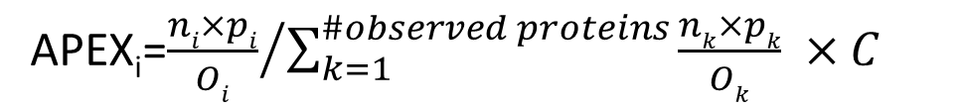
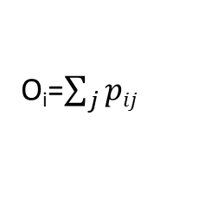
Workflow of our method
Training data
Proteins and peptides list (40 proteins??)
Classifers: Peptide length, molecular weight, percentage of each amino acid, etc
Get the observed/unobserved information from SILAC data
ML
Random forest
LDA
Deep learning
SILAC
Cross-validation
FFPE kidney biopsies
O_{i}=$\sum_{j}{pij}$
Classifier
APEX_{i}=${\frac{ni×pi}{Oi}}/{\sum_{k=1}^{\#observed proteins}{\frac{nk×pk}{Ok}}} ×C$
SIL-IS

Slide 6
Other things…
Performance evaluation
Evaluate the reproducibility of our method
Evaluate the accuracy of our method
What are the true/reference protein concentrations?
How to compare with the original APEX method?
Real data application
Apply to kidney disease proteomic data

Slide 7
Use SALIC normalize the total proteins from FFPE bioposies.

