Slide 1
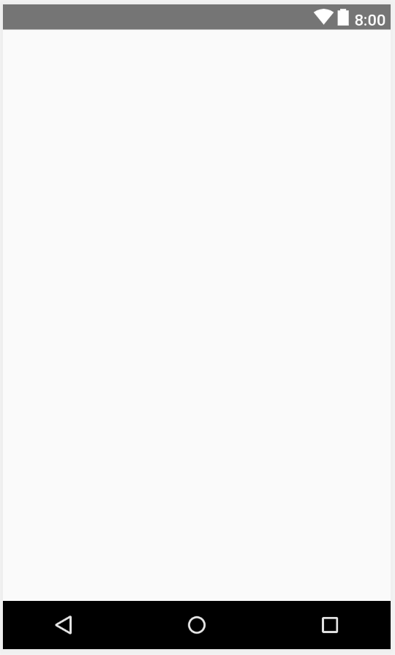
Home Activity (Phone/Tablet)
Primary Layout = Constraint Layout
0 dp
Frame Layout:
Width = match parent
Height = match parent
0 dp
0 dp
0 dp

Slide 2
Main Activity (Phone)
Frame Layout:
Width = match parent
Height = 100 dp
Primary Layout = Constraint Layout
8 dp
8 dp
8 dp
Frame Layout:
Width = match parent
Height = match constraint
8 dp
8 dp
8 dp
Frame Layout:
Width = match parent
Height = 100dp
8 dp
8 dp
8 dp
8 dp

Slide 3
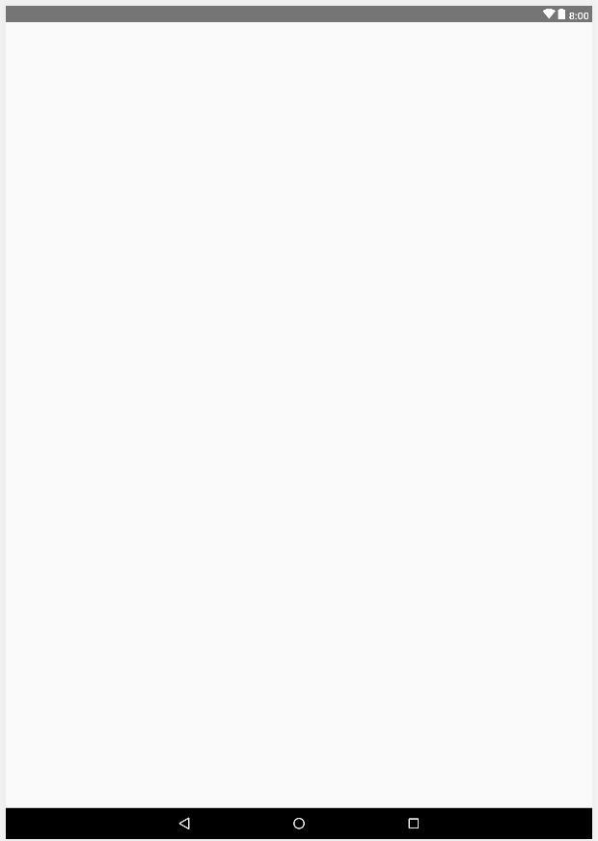
Main Activity (Tablet)
Primary Layout = Constraint Layout
8 dp
8 dp
8 dp
Frame Layout:
Width = match parent
Height = match constraint
Frame Layout:
Width = match parent
Height = 200 dp
8 dp
8 dp
8 dp
8 dp

Slide 4
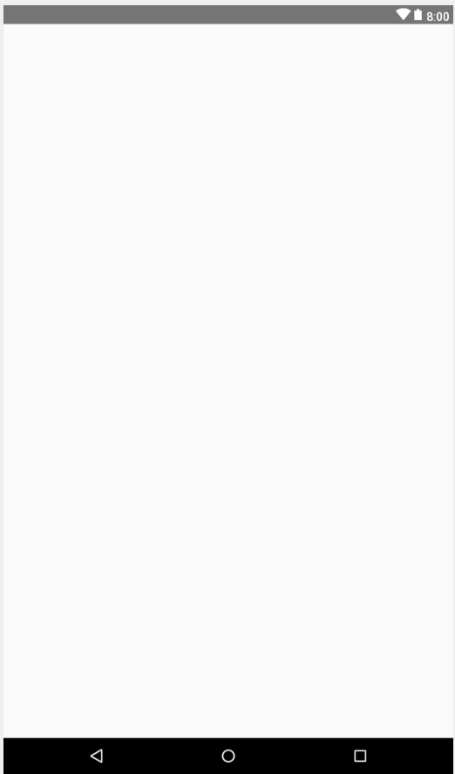
New User Activity (Phone/Tablet)
Frame Layout:
Width = match parent
Height = 210 dp
8 dp
Primary Layout = Constraint Layout
8 dp
8 dp
Frame Layout:
Width = match parent
Height = wrap content
0 dp
8 dp
8 dp
8 dp

Slide 5
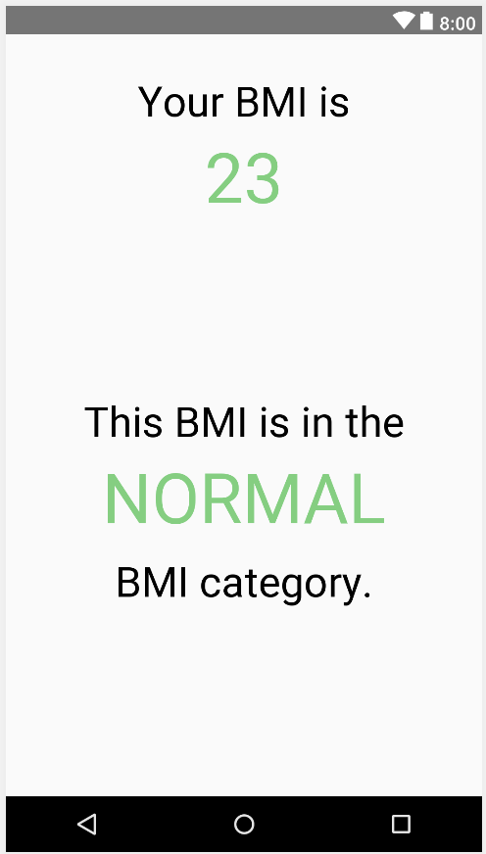
BMI Fragment (Phone)
Textview:
Width = wrap content
Height = wrap content
Font size = 36sp
Color = black (000000)
Primary Layout = Constraint Layout
32 dp
Textview:
Width = match constraint
Height = wrap content
Font size = 36sp
Color = black (000000)
8 dp
8 dp
0 dp
8 dp
8 dp
Textview:
Width = wrap content
Height = wrap content
Font size = 60sp
Color = green (6BD178)
Textview:
Width = match constraint
Height = wrap content
Font size = 60sp
Color = green (6BD178)
16 dp
8 dp
8 dp
0 dp
8 dp
8 dp
8 dp
0 dp
8 dp
8 dp
Textview:
Width = match constraint
Height = wrap content
Font size = 36sp
Color = black (000000)
32 dp

Slide 6
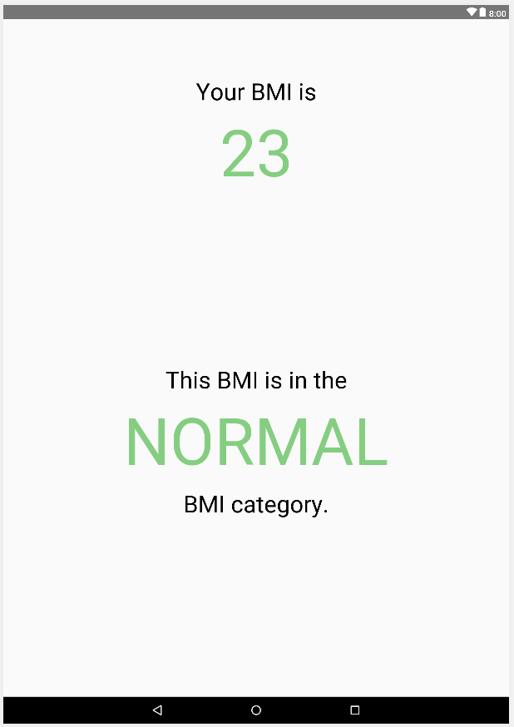
BMI Fragment (Tablet)
Textview:
Width = wrap content
Height = wrap content
Font size = 42sp
Color = black (000000)
Primary Layout = Constraint Layout
100 dp
Textview:
Width = match constraint
Height = wrap content
Font size = 42sp
Color = black (000000)
8 dp
8 dp
0 dp
8 dp
8 dp
Textview:
Width = wrap content
Height = wrap content
Font size = 116sp
Color = green (6BD178)
Textview:
Width = match constraint
Height = wrap content
Font size = 116sp
Color = green (6BD178)
16 dp
8 dp
8 dp
0 dp
8 dp
8 dp
8 dp
0 dp
8 dp
Textview:
Width = match constraint
Height = wrap content
Font size = 42sp
Color = black (000000)
8 dp
32 dp

Slide 7
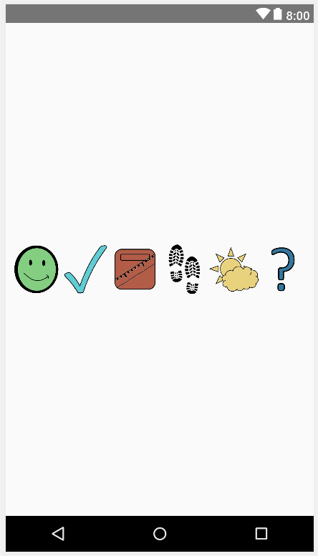
Bottom Buttons Fragment (Phone)
Primary Layout = Linear Layout (Horizontal)
Imagebuttons:
Width = match parent
Height = match parent
Weight = 1
Scaletype = fitCenter

Slide 8
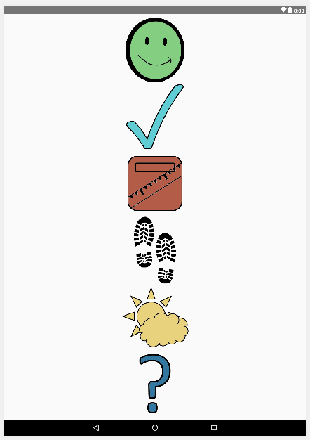
Bottom Buttons Fragment (Tablet)
Primary Layout = Linear Layout (Vertical)
Imagebuttons:
Width = match parent
Height = match parent
Weight = 1
Scaletype = fitCenter

Slide 9
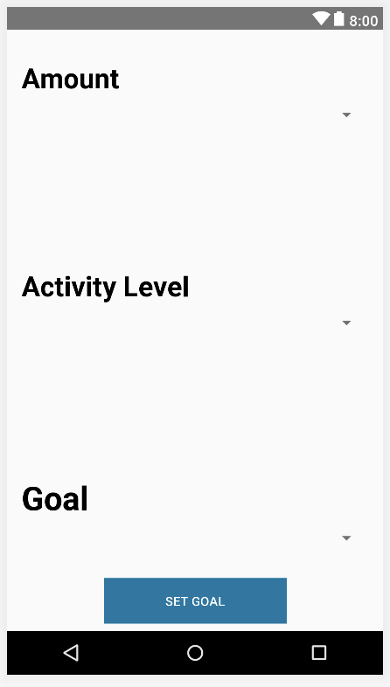
Change Goals Fragment (Phone)
Primary Layout = Constraint Layout
Linear Layouts:
Width = match parent
Height = wrap content
32 dp
TextView:
Width = match parent
Height = wrap content
Font size = 30sp
Color = black (000000)
Style = bold
8 dp
8 dp
8 dp
8 dp
8 dp
Spinner:
Width = match parent
Height = wrap content
8 dp
8 dp
8 dp
32 dp
8 dp
8 dp
Button:
Width = 200 dp
Height = 50 dp
8 dp

Slide 10
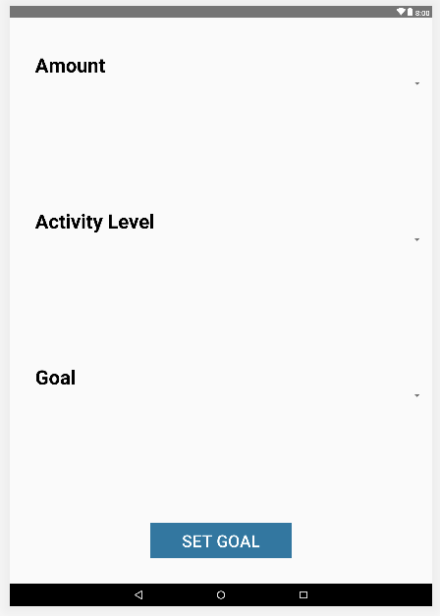
Change Goals Fragment (Tablet)
Primary Layout = Constraint Layout
72 dp
Linear Layouts:
Width = match parent
Height = wrap content
TextView:
Width = match parent
Height = wrap content
Font size = 30sp
Color = black (000000)
Style = bold
54 dp
8 dp
Spinner:
Width = match parent
Height = wrap content
8 dp
8 dp
8 dp
Button:
Width = 200 dp
Height = 50 dp
8 dp

Slide 11
Change Profile Fragment (Phone)

Slide 12
Change ProfileFragment (Tablet)

Slide 13
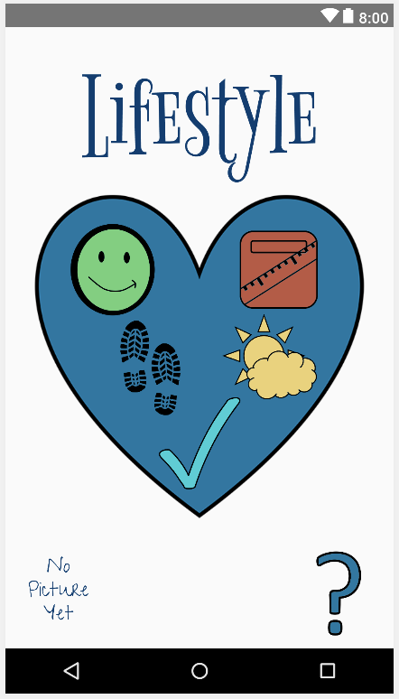
Choices Designed Fragment (Phone)
Textview:
Width = match constraint
Height = match constraint
Font size = 125sp
Color = dark blue (003D73)
8 dp
8 dp
72 dp
8 dp
0 dp
Constraint layout:
Width = 300 dp
Height = 300 dp
Imageview:
Width = match constraint
Height = match constraint
8 dp
8 dp
8 dp
16 dp
8 dp
8 dp
32 dp
8 dp
48 dp
8 dp
8 dp
Imagebutton:
Width = 100 dp
Height = 100 dp
0 dp
0 dp
Imagebutton:
Width = 100 dp
Height = 100 dp
8 dp
8 dp
8 dp
8 dp
8 dp
8 dp
0 dp
8 dp
8 dp
32 dp
8 dp

Slide 14
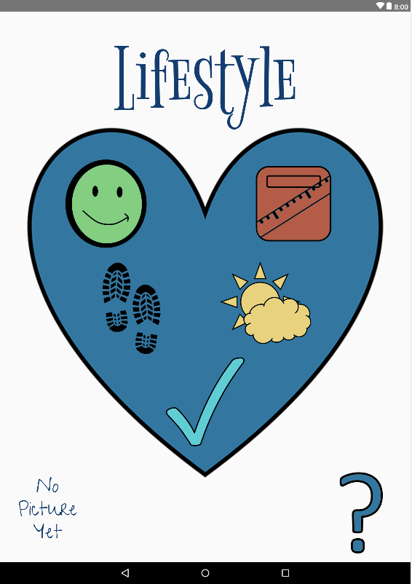
Choices Designed Fragment (Tablet)
Textview:
Width = match constraint
Height = match constraint
Font size = 200sp
Color = dark blue (003D73)
Primary Layout = Constraint Layout
8 dp
8 dp
102 dp
8 dp
0 dp
Imageview:
Width = match constraint
Height = match constraint
Constraint layout:
Width = 650 dp
Height = 650 dp
8 dp
8 dp
8 dp
8 dp
8 dp
32 dp
8 dp
8 dp
32 dp
8 dp
Imagebutton:
Width = 200 dp
Height = 200 dp
0 dp
8 dp
0 dp
Imagebutton:
Width = 200 dp
Height = 200 dp
8 dp
8 dp
8 dp
8 dp
8 dp
8 dp
8 dp
0 dp
8 dp
32 dp
8 dp

Slide 15
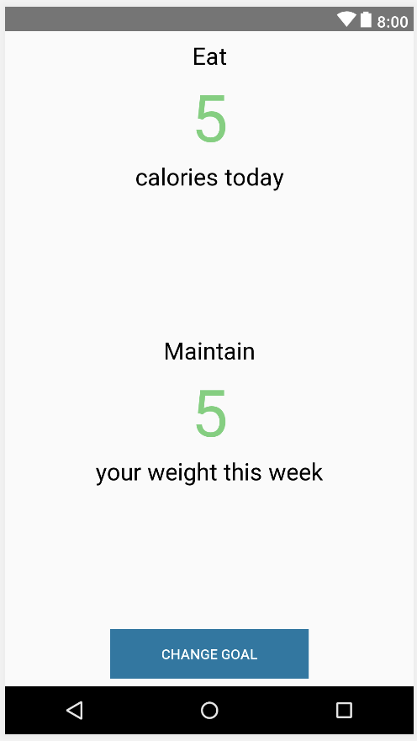
Goals Fragment (Phone)
Primary Layout = Constraint Layout
8 dp
8 dp
8 dp
0 dp
8 dp
8 dp
0 dp
Textview:
Width = match constraint
Height = wrap content
Font size = 24sp
Color = black (000000)
8 dp
8 dp
Textview:
Width = match parent
Height = wrap content
Font size = 66sp
Color = green (6BD178)
8 dp
8 dp
0 dp
8 dp
0 dp
8 dp
8 dp
0 dp
0 dp
8 dp
8 dp
32 dp
Button:
Width = 200 dp
Height = 50 dp
8 dp
8 dp
8 dp

Slide 16
Goals Fragment (Tablet)

Slide 17
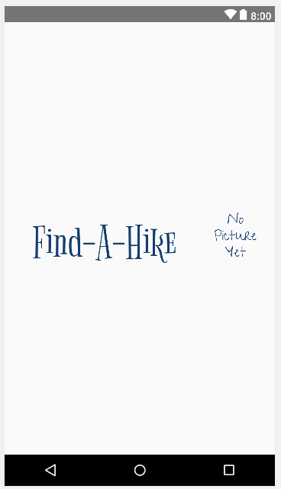
Header Fragment (Phone)
Primary Layout = Constraint Layout
Textview:
Width = match constraint
Height = wrap content
Font size = 72sp
Color = dark blue (003D73)
8 dp
8 dp
8 dp
8 dp
0 dp
8 dp
Imagebutton:
Width = 100 dp
Height = 100 dp
8 dp

Slide 18
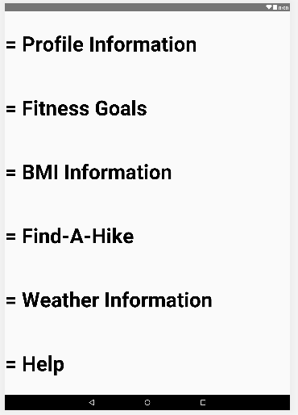
Help Fragment (Tablet)
Primary Layout = Linear Layout
TextView:
Width = match parent
Height = match parent
Font size = 65sp
Color = black (000000)
Style = bold
Gravity = center_vertical
Weight = 1

Slide 19
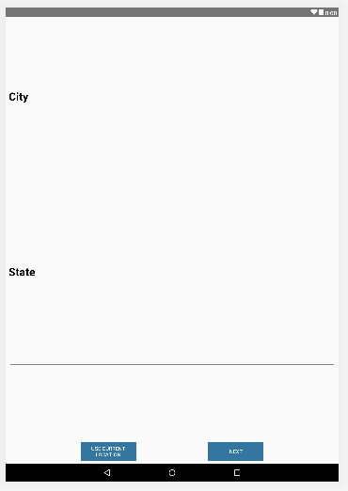
Location Fragment (Phone/Tablet)

Slide 20
Name Age Fragment (Phone/Tablet)

Slide 21
Phys Details Fragment (Phone/Tablet)

Slide 22
Profile Pic Fragment (Phone/Tablet)

Slide 23
Review Fragment (Phone)

Slide 24
Review Fragment (Tablet)

Slide 25
Title Fragment (Phone/Tablet)

Slide 26
Weather Fragment (Phone)

Slide 27
Weather Fragment (Tablet)

Slide 28
Primary Layout = Constraint Layout
textview
8 dp
8 dp
102 dp
8 dp
0 dp
constraint layout
8 dp
8 dp
imageview
8 dp
8 dp
8 dp
32 dp
8 dp
8 dp
32 dp
8 dp
imagebutton
0 dp
8 dp
0 dp
imagebutton
8 dp
8 dp
8 dp
8 dp
8 dp
8 dp
8 dp
0 dp
8 dp
32 dp
8 dp
imagebutton

