Slide 1
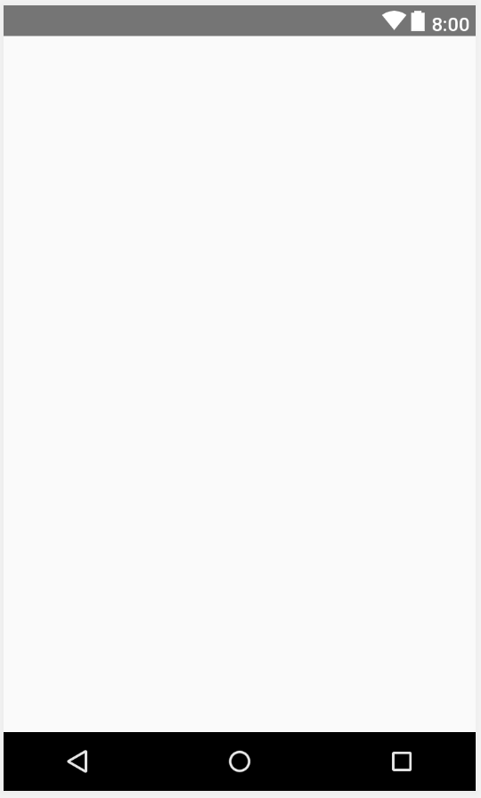
Home Activity (Phone/Tablet)
Primary Layout = Constraint Layout
0 dp
Frame Layout:
Width = match parent
Height = match parent
0 dp
0 dp
0 dp

Slide 2
Main Activity (Phone)
Frame Layout:
Width = match parent
Height = 100 dp
Primary Layout = Constraint Layout
8 dp
8 dp
8 dp
Frame Layout:
Width = match parent
Height = match constraint
8 dp
8 dp
8 dp
Frame Layout:
Width = match parent
Height = 100dp
8 dp
8 dp
8 dp
8 dp

Slide 3
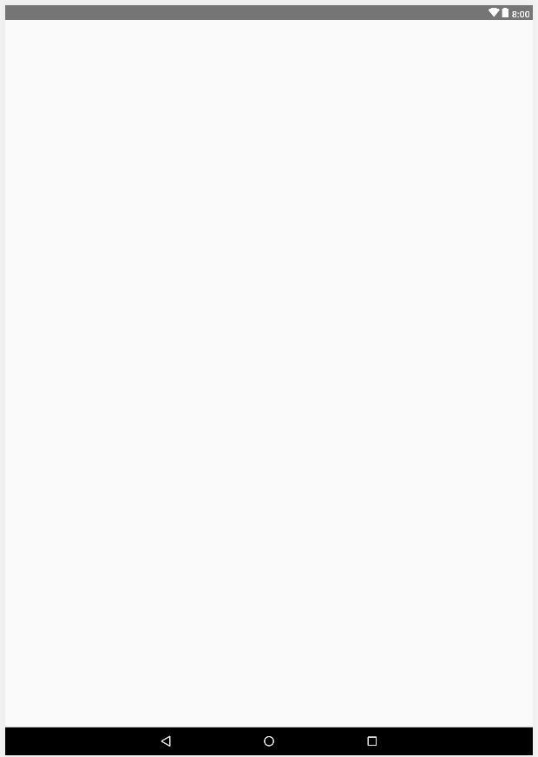
Main Activity (Tablet)
Primary Layout = Constraint Layout
8 dp
8 dp
8 dp
Frame Layout:
Width = match parent
Height = match constraint
Frame Layout:
Width = match parent
Height = 200 dp
8 dp
8 dp
8 dp
8 dp

Slide 4
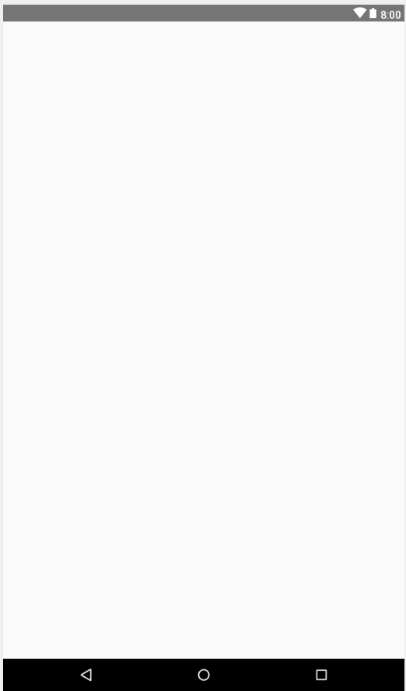
New User Activity (Phone/Tablet)
Frame Layout:
Width = match parent
Height = 210 dp
8 dp
Primary Layout = Constraint Layout
8 dp
8 dp
Frame Layout:
Width = match parent
Height = wrap content
0 dp
8 dp
8 dp
8 dp

Slide 5
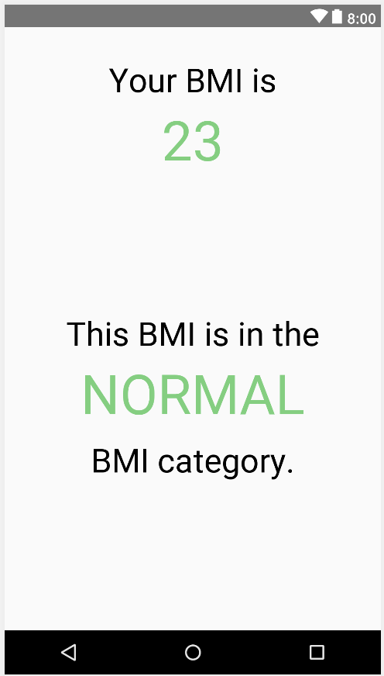
BMI Fragment (Phone)
Textview:
Width = wrap content
Height = wrap content
Font size = 36sp
Color = black (000000)
Primary Layout = Constraint Layout
32 dp
Textview:
Width = match constraint
Height = wrap content
Font size = 36sp
Color = black (000000)
8 dp
8 dp
0 dp
8 dp
8 dp
Textview:
Width = wrap content
Height = wrap content
Font size = 60sp
Color = green (6BD178)
Textview:
Width = match constraint
Height = wrap content
Font size = 60sp
Color = green (6BD178)
16 dp
8 dp
8 dp
0 dp
8 dp
8 dp
8 dp
0 dp
8 dp
8 dp
Textview:
Width = match constraint
Height = wrap content
Font size = 36sp
Color = black (000000)
32 dp

Slide 6
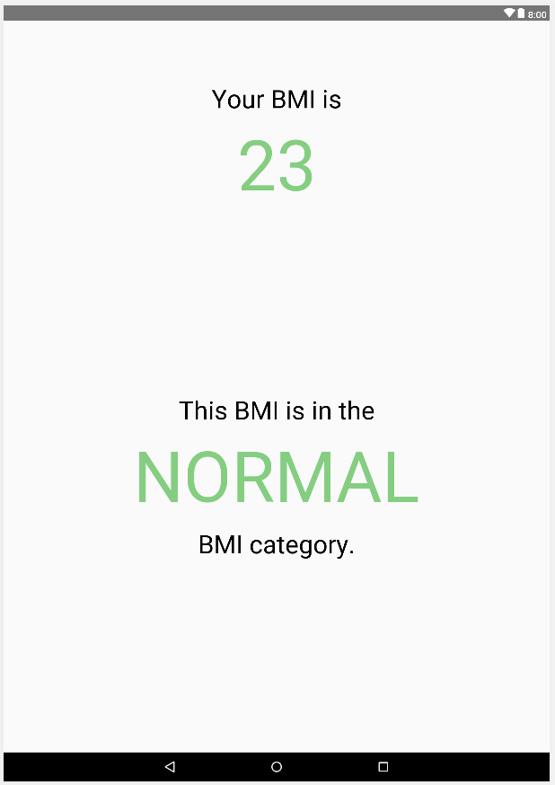
BMI Fragment (Tablet)
Textview:
Width = wrap content
Height = wrap content
Font size = 42sp
Color = black (000000)
Primary Layout = Constraint Layout
100 dp
Textview:
Width = match constraint
Height = wrap content
Font size = 42sp
Color = black (000000)
8 dp
8 dp
0 dp
8 dp
8 dp
Textview:
Width = wrap content
Height = wrap content
Font size = 116sp
Color = green (6BD178)
Textview:
Width = match constraint
Height = wrap content
Font size = 116sp
Color = green (6BD178)
16 dp
8 dp
8 dp
0 dp
8 dp
8 dp
8 dp
0 dp
8 dp
Textview:
Width = match constraint
Height = wrap content
Font size = 42sp
Color = black (000000)
8 dp
32 dp

Slide 7
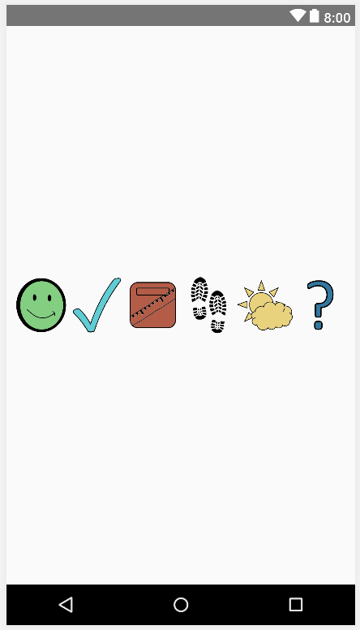
Bottom Buttons Fragment (Phone)
Primary Layout = Linear Layout (Horizontal)
Imagebuttons:
Width = match parent
Height = match parent
Weight = 1
Scaletype = fitCenter

Slide 8
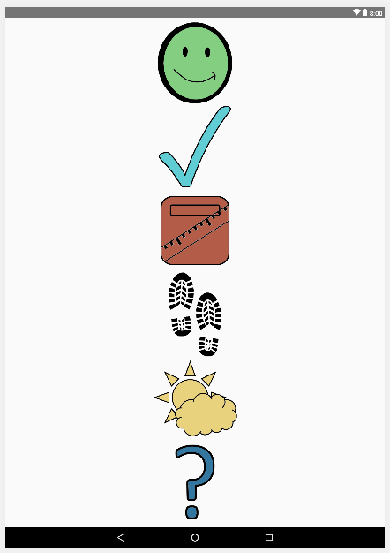
Bottom Buttons Fragment (Tablet)
Primary Layout = Linear Layout (Vertical)
Imagebuttons:
Width = match parent
Height = match parent
Weight = 1
Scaletype = fitCenter

Slide 9
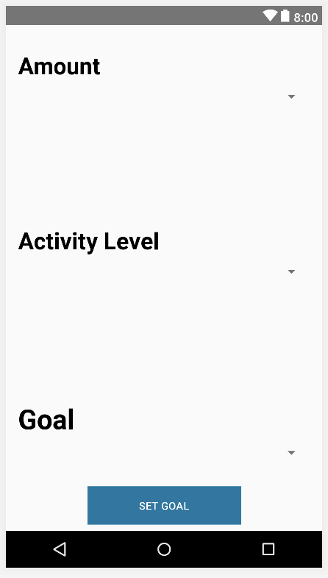
Change Goals Fragment (Phone)
Primary Layout = Constraint Layout
Linear Layouts:
Width = match parent
Height = wrap content
32 dp
TextView:
Width = match parent
Height = wrap content
Font size = 30sp
Color = black (000000)
Style = bold
8 dp
8 dp
8 dp
8 dp
8 dp
Spinner:
Width = match parent
Height = wrap content
8 dp
8 dp
8 dp
32 dp
Button:
Width = 200 dp
Height = 50 dp
Color = medium blue (0878A4)
8 dp
8 dp
8 dp

Slide 10
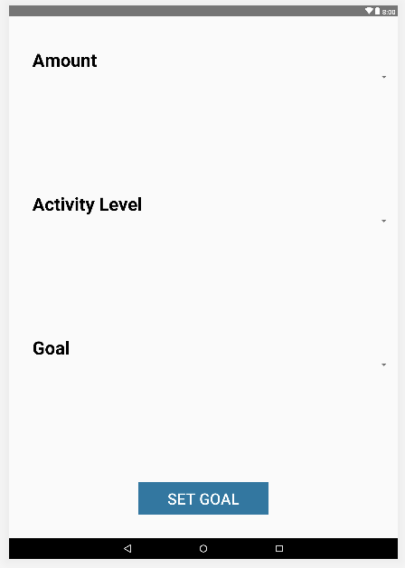
Change Goals Fragment (Tablet)
Primary Layout = Constraint Layout
72 dp
Linear Layouts:
Width = match parent
Height = wrap content
TextView:
Width = match parent
Height = wrap content
Font size = 30sp
Color = black (000000)
Style = bold
54 dp
8 dp
Spinner:
Width = match parent
Height = wrap content
8 dp
Button:
Width = 200 dp
Height = 50 dp
Color = medium blue (0878A4)
8 dp
8 dp
8 dp

Slide 11
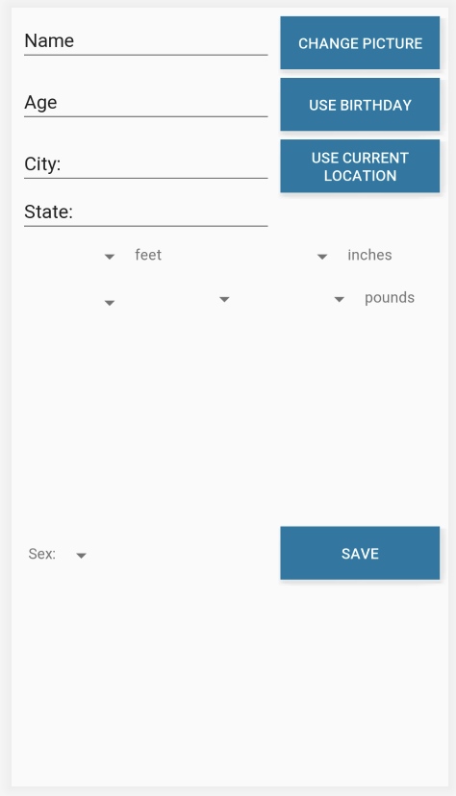
Change Profile Fragment (Phone)
Primary Layout = Constraint Layout
8 dp
8 dp
8 dp
8 dp
8 dp
EditTexts:
Width = match constraint
Height = wrap content
8 dp
Buttons:
Width = 150 dp
Height = 50 dp
Color = medium blue (0878A4)
8 dp
8 dp
8 dp
8 dp
8 dp
8 dp
8 dp
8 dp
EditTexts:
Width = match parent
Height = wrap content
Weight = 1
8 dp
8 dp
8 dp
8 dp
8 dp
8 dp
8 dp
Linear Layouts:
Width = match constraint
Height = wrap content
8 dp
TextViews:
Width = wrap content
Height = wrap content
Font size = 36sp
Color = black (000000)
8 dp
8 dp
8 dp
Spinners:
Width = wrap content
Height = wrap content
8 dp
8 dp
8 dp

Slide 12
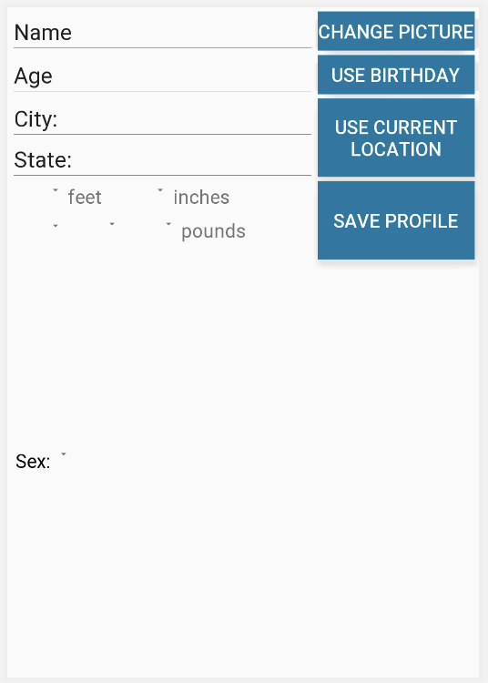
Change ProfileFragment (Tablet)
Buttons:
Width = 300 dp
Height = 75 dp
Color = medium blue (0878A4)
Primary Layout = Constraint Layout
8 dp
8 dp
8 dp
8 dp
8 dp
EditTexts:
Width = match constraint
Height = wrap content
8 dp
8 dp
8 dp
8 dp
8 dp
8 dp
8 dp
8 dp
8 dp
Buttons:
Width = 300 dp
Height = 150 dp
Color = medium blue (0878A4)
8 dp
8 dp
8 dp
EditTexts:
Width = match parent
Height = wrap content
Weight = 1
8 dp
8 dp
8 dp
8 dp
8 dp
8 dp
8 dp
Linear Layouts:
Width = match constraint
Height = wrap content
TextViews:
Width = wrap content
Height = wrap content
Font size = 36sp
Color = black (000000)
8 dp
8 dp
8 dp
Spinners:
Width = wrap content
Height = wrap content
8 dp

Slide 13
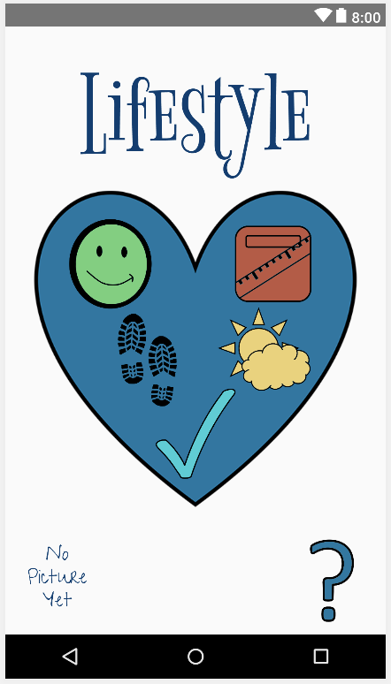
Choices Designed Fragment (Phone)
Textview:
Width = match constraint
Height = match constraint
Font size = 125sp
Color = dark blue (003D73)
8 dp
8 dp
72 dp
8 dp
0 dp
Constraint layout:
Width = 300 dp
Height = 300 dp
Imageview:
Width = match constraint
Height = match constraint
8 dp
8 dp
8 dp
16 dp
8 dp
8 dp
32 dp
8 dp
48 dp
8 dp
8 dp
Imagebutton:
Width = 100 dp
Height = 100 dp
0 dp
0 dp
Imagebutton:
Width = 100 dp
Height = 100 dp
8 dp
8 dp
8 dp
8 dp
8 dp
8 dp
0 dp
8 dp
8 dp
32 dp
8 dp

Slide 14
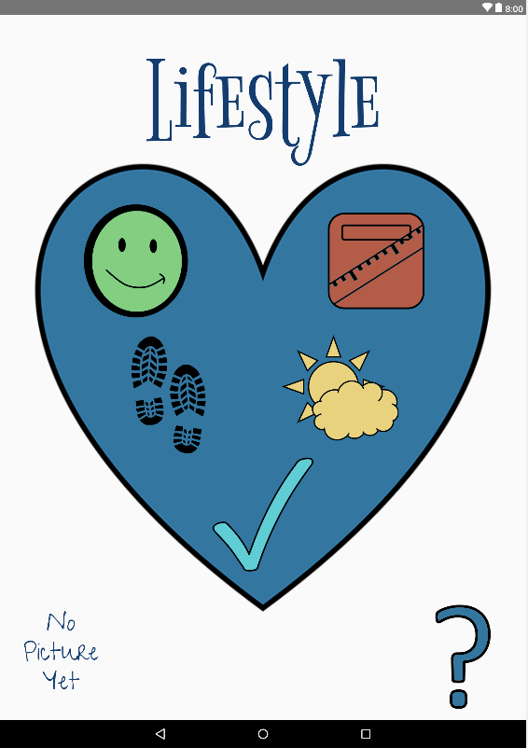
Choices Designed Fragment (Tablet)
Textview:
Width = match constraint
Height = match constraint
Font size = 200sp
Color = dark blue (003D73)
Primary Layout = Constraint Layout
8 dp
8 dp
102 dp
8 dp
0 dp
Imageview:
Width = match constraint
Height = match constraint
Constraint layout:
Width = 650 dp
Height = 650 dp
8 dp
8 dp
8 dp
8 dp
8 dp
32 dp
8 dp
8 dp
32 dp
8 dp
Imagebutton:
Width = 200 dp
Height = 200 dp
0 dp
8 dp
0 dp
Imagebutton:
Width = 200 dp
Height = 200 dp
8 dp
8 dp
8 dp
8 dp
8 dp
8 dp
8 dp
0 dp
8 dp
32 dp
8 dp

Slide 15
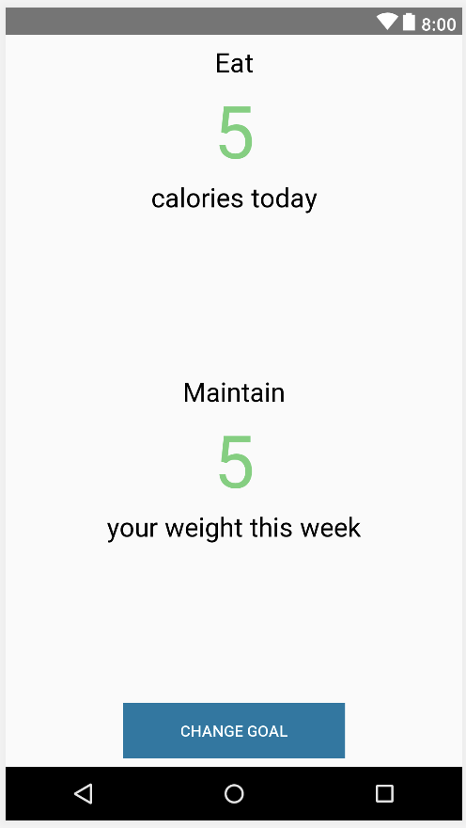
Goals Fragment (Phone)
Primary Layout = Constraint Layout
8 dp
8 dp
8 dp
0 dp
8 dp
8 dp
0 dp
Textview:
Width = match constraint
Height = wrap content
Font size = 24sp
Color = black (000000)
8 dp
8 dp
Textview:
Width = match parent
Height = wrap content
Font size = 66sp
Color = green (6BD178)
8 dp
8 dp
0 dp
8 dp
0 dp
8 dp
8 dp
0 dp
0 dp
8 dp
8 dp
Button:
Width = 200 dp
Height = 50 dp
Color = medium blue (0878A4)
32 dp
8 dp
8 dp
8 dp

Slide 16
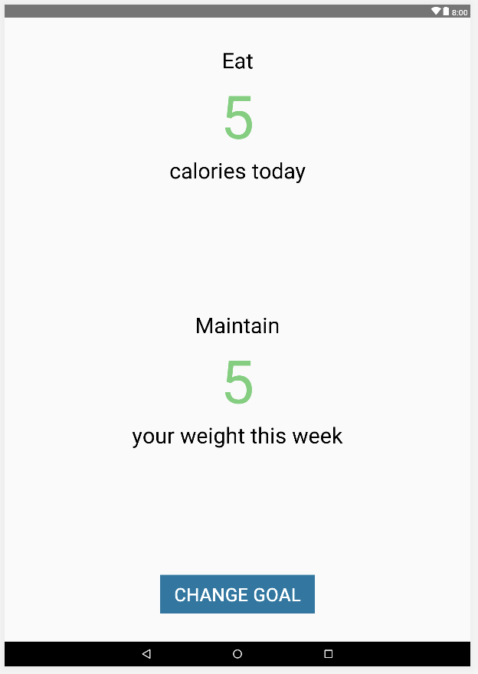
Goals Fragment (Tablet)
Primary Layout = Constraint Layout
8 dp
54 dp
8 dp
0 dp
8 dp
8 dp
0 dp
Textview:
Width = match constraint
Height = wrap content
Font size = 42sp
Color = black (000000)
8 dp
8 dp
Textview:
Width = match parent
Height = wrap content
Font size = 116sp
Color = green (6BD178)
8 dp
8 dp
0 dp
8 dp
0 dp
8 dp
8 dp
0 dp
0 dp
8 dp
8 dp
32 dp
Button:
Width = 300 dp
Height = 75 dp
Color = medium blue (0878A4)
8 dp
8 dp
54 dp

Slide 17
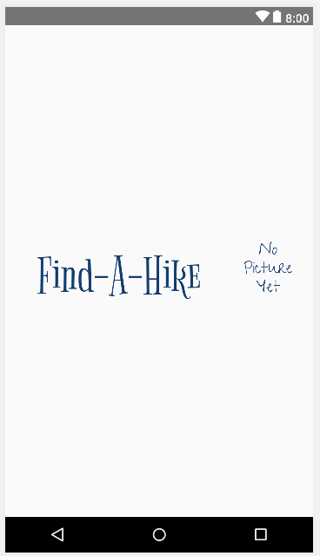
Header Fragment (Phone)
Primary Layout = Constraint Layout
Textview:
Width = match constraint
Height = wrap content
Font size = 72sp
Color = dark blue (003D73)
8 dp
8 dp
8 dp
8 dp
0 dp
8 dp
Imagebutton:
Width = 100 dp
Height = 100 dp
8 dp

Slide 18
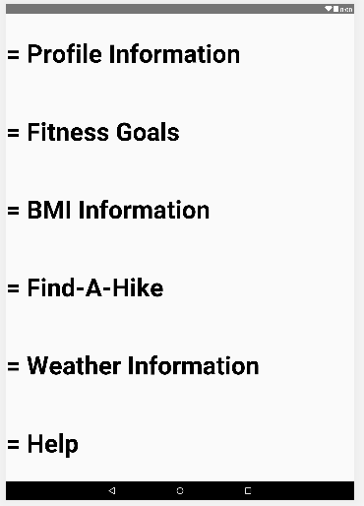
Help Fragment (Tablet)
Primary Layout = Linear Layout
TextView:
Width = match parent
Height = match parent
Font size = 65sp
Color = black (000000)
Style = bold
Gravity = center_vertical
Weight = 1

Slide 19
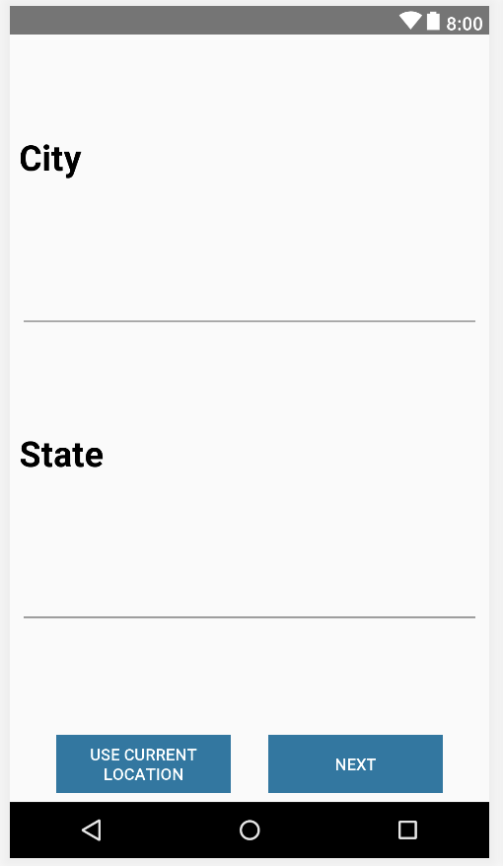
Location Fragment (Phone)
Primary Layout = Constraint Layout
TextView:
Width = match parent
Height = wrap content
Font size = 30sp
Color = black (000000)
Style = bold
8 dp
0 dp
8 dp
0 dp
0 dp
8 dp
8 dp
0 dp
8 dp
0dp
0 dp
EditText:
Width = match parent
Height = wrap content
8 dp
Buttons:
Width = 150dp
Height = 50dp
Color = medium blue (0878A4)
0 dp
8 dp
8 dp
8 dp
8 dp
0 dp
0 dp
8 dp
8 dp
8 dp

Slide 20
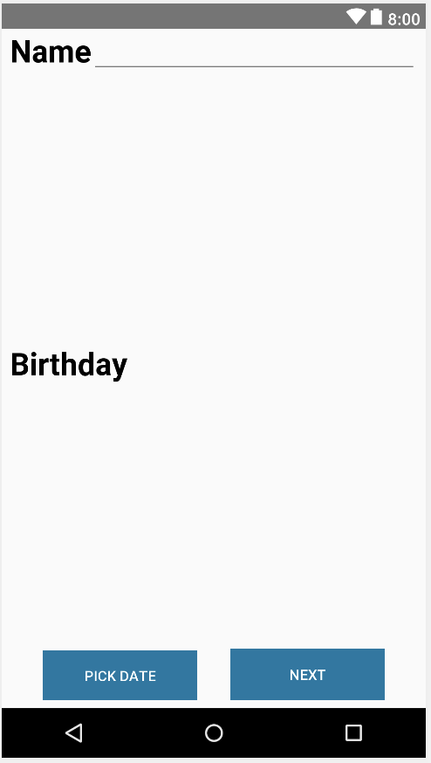
Name Age Fragment (Phone)
Primary Layout = Constraint Layout
8 dp
0 dp
0 dp
0 dp
8 dp
EditText:
Width = match parent
Height = wrap content
TextView:
Width = match parent
Height = wrap content
Font size = 30sp
Color = black (000000)
Style = bold
16 dp
16 dp
TextView:
Width = match parent
Height = wrap content
Font size = 30sp
Color = black (000000)
Style = normal
16 dp
8 dp
8 dp
16 dp
16 dp
Buttons:
Width = 150dp
Height = 50dp
Color = medium blue (0878A4)
8 dp
0 dp
0 dp
8 dp
8 dp
8 dp

Slide 21
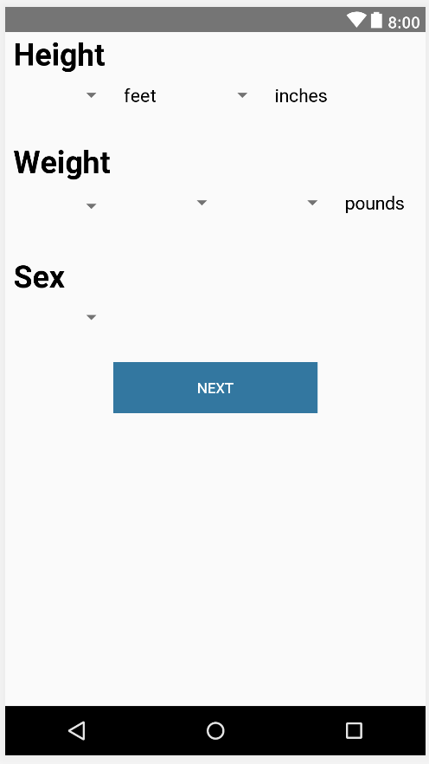
Phys Details Fragment (Phone)
TextViews:
Width = wrap content
Height = wrap content
Font size = 18sp
Color = black (000000)
Style = normal
Primary Layout = Constraint Layout
8 dp
0 dp
8 dp
8 dp
8 dp
TextViews:
Width = wrap content
Height = wrap content
Font size = 30sp
Color = black (000000)
Style = bold
8 dp
8 dp
8 dp
8 dp
8 dp
8 dp
32 dp
8 dp
8 dp
8 dp
8 dp
8 dp
8 dp
8 dp
8 dp
32 dp
Spinners:
Width = 100 dp
Height = wrap content
8 dp
8 dp
8 dp
32 dp
8 dp
8 dp
Button:
Width = 200dp
Height = 50dp
Color = medium blue (0878A4)

Slide 22
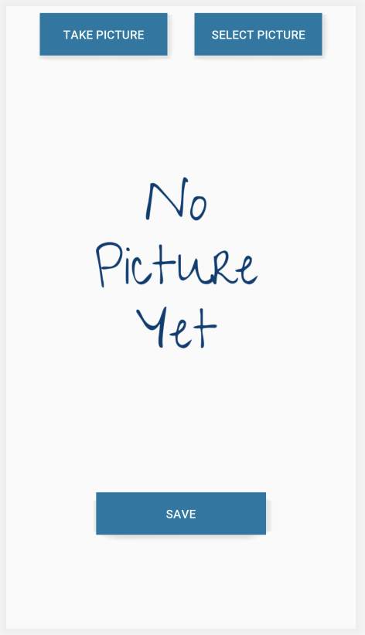
Profile Pic Fragment (Phone/Tablet)
Primary Layout = Constraint Layout
8 dp
8 dp
8 dp
8 dp
0 dp
0 dp
Buttons:
Width = 150 dp
Height = 50 dp
Color = medium blue (0878A4)
8 dp
ImageView:
Width = 300 dp
Height = 300 dp
8 dp
8 dp
0 dp
Button:
Width = 200 dp
Height = 50 dp
Color = medium blue (0878A4)
8 dp
0 dp
8 dp
8 dp

Slide 23
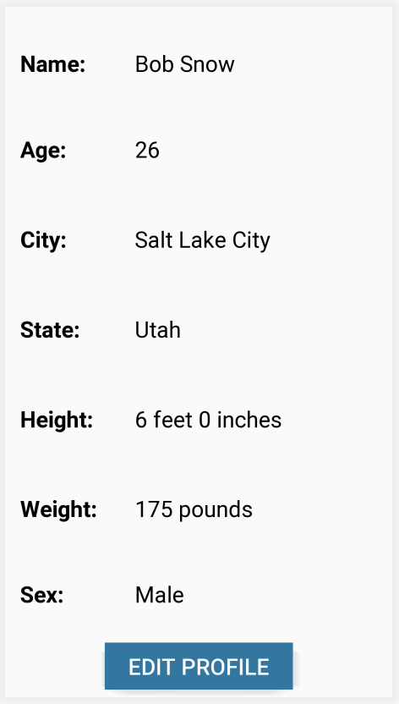
Review Fragment (Phone)
Primary Layout = Constraint Layout
Linear Layout:
Width = match parent
Height = match parent
Weight = 1
Linear Layout:
Width = match parent
Height = match constraint
8 dp
8 dp
8 dp
TextView:
Width = match parent
Height = match parent
Font size = 24 sp
Color = black (000000)
Style = normal
Gravity = center_vertical
Weight = 1
TextView:
Width = 600 dp
Height = match parent
Font size = 24 sp
Color = black (000000)
Style = bold
Gravity = center_vertical
Weight = 4
Button:
Width = 200 dp
Height = 50 dp
Color = medium blue (0878A4)
0 dp
8 dp
8 dp
8 dp

Slide 24
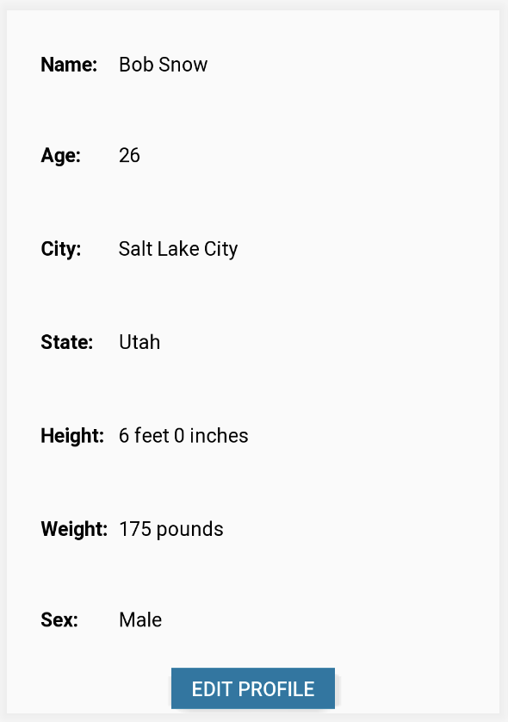
Review Fragment (Tablet)
Primary Layout = Constraint Layout
Linear Layout:
Width = match parent
Height = match parent
Weight = 1
Linear Layout:
Width = match parent
Height = match constraint
8 dp
8 dp
8 dp
TextView:
Width = match parent
Height = match parent
Font size = 36 sp
Color = black (000000)
Style = normal
Gravity = center_vertical
Weight = 1
TextView:
Width = 600 dp
Height = match parent
Font size = 36 sp
Color = black (000000)
Style = bold
Gravity = center_vertical
Weight = 4
Button:
Width = 200 dp
Height = 50 dp
Color = medium blue (0878A4)
0 dp
8 dp
8 dp
8 dp

Slide 25

Title Fragment (Phone/Tablet)
Primary Layout = Constraint Layout
0 dp
8 dp
8 dp
TextView:
Width = match parent
Height = wrap content
EditText:
Width = match constraint
Height = wrap content
8 dp
8 dp
8 dp
8 dp

Slide 26
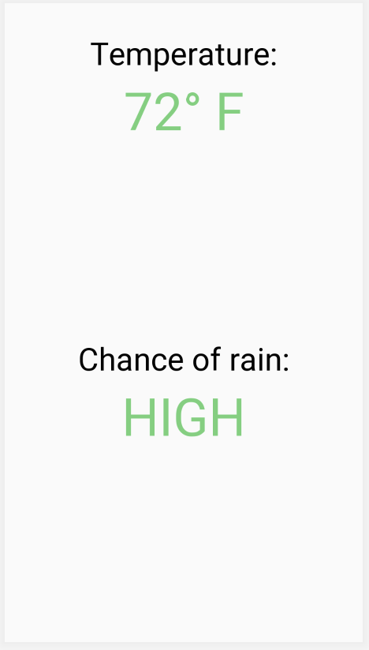
Weather Fragment (Phone)
Textview:
Width = wrap content
Height = wrap content
Font size = 36sp
Color = black (000000)
Primary Layout = Constraint Layout
32 dp
8 dp
8 dp
0 dp
8 dp
8 dp
Textview:
Width = match constraint
Height = wrap content
Font size = 60sp
Color = green (6BD178)
0 dp
8 dp
8 dp
0 dp
0 dp
8 dp
8 dp
0 dp

Slide 27
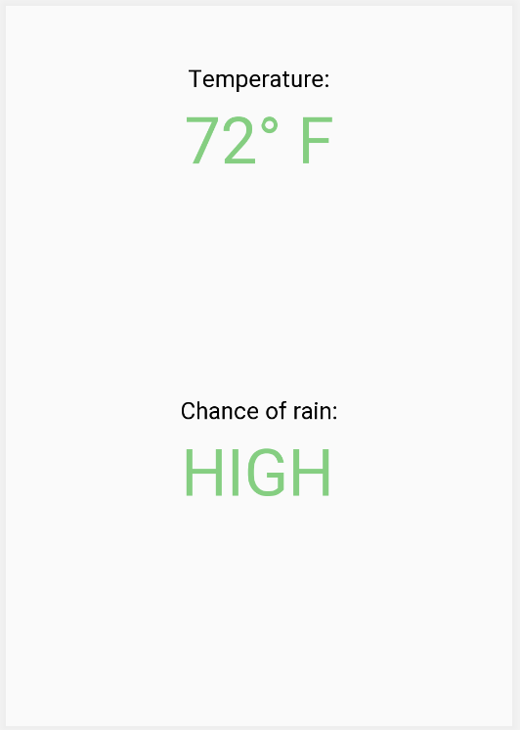
Weather Fragment (Tablet)
Textview:
Width = wrap content
Height = wrap content
Font size = 42sp
Color = black (000000)
Primary Layout = Constraint Layout
0 dp
8 dp
8 dp
0 dp
8 dp
8 dp
Textview:
Width = match constraint
Height = wrap content
Font size = 116sp
Color = green (6BD178)
0 dp
8 dp
0 dp
8 dp
0 dp
8 dp
8 dp
0 dp

