Slide 1
CS 5764 Information Visualization TweetLion Team Final Presentation
Presenters:
Tong Zhang, Liuqing Li
{ztong, liuqing} @vt.edu
Instructor:
Dr. Chris North
Virginia Polytechnic Institute and State University
Blacksburg, VA, 24061
December 7, 2016

Slide 2
Outline
Motivation
Dataset
Architecture
Demo

Slide 3
Motivation
Conclude what we learned
Focus on social media (e.g. twitter)
Temporal Distribution
Spatial Distribution
Sentiment Distribution
Hot-spot Issues
Key Users
Extensibility
Dataset
Algorithm

Slide 4
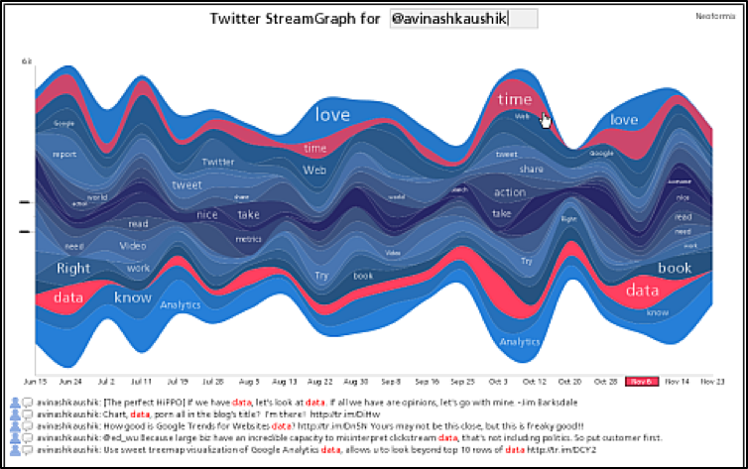
Motivation
Conclude what we learned
Focus on social media (e.g. twitter)
Temporal Distribution
Spatial Distribution
Sentiment Distribution
Hot-spot Issues
Key Users
Extensibility
Dataset
Algorithm

Slide 5
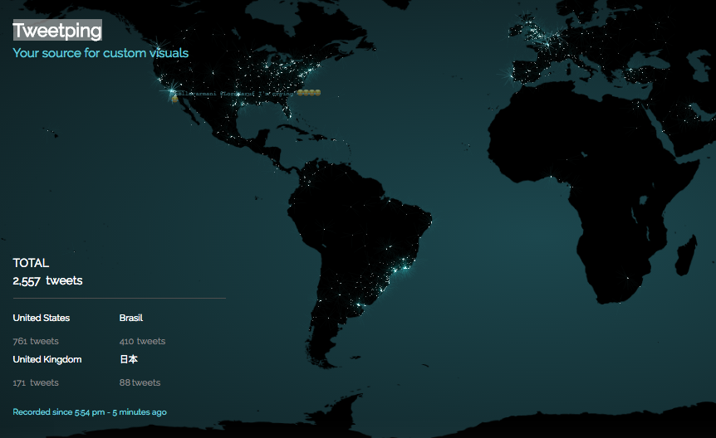
Motivation
Conclude what we learned
Focus on social media (e.g. twitter)
Temporal Distribution
Spatial Distribution
Sentiment Distribution
Hot-spot Issues
Key Users
Extensibility
Dataset
Algorithm

Slide 6
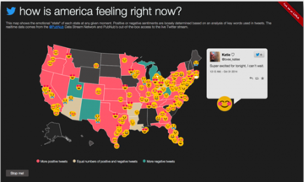
Motivation
Conclude what we learned
Focus on social media (e.g. twitter)
Temporal Distribution
Spatial Distribution
Sentiment Distribution
Hot-spot Issues
Key Users
Extensibility
Dataset
Algorithm

Slide 7

Motivation
Conclude what we learned
Focus on social media (e.g. twitter)
Temporal Distribution
Spatial Distribution
Sentiment Distribution
Hot-spot Issues
Key Users
Extensibility
Dataset
Algorithm

Slide 8
Motivation
Conclude what we learned
Focus on social media (e.g. twitter)
Temporal Distribution
Spatial Distribution
Sentiment Distribution
Hot-spot Issues
Key Users
Extensibility
Dataset
Algorithm

Slide 9
Dataset
Description
Tweet Collection (Keyword: flood)
Duration: 10/01/2016 – 10/05/2016
# of records: 75,432 records
Table
Relevant Attributes
created_time (temporal distribution)
location (spatial distribution, fake data)
neg_value, neu_value, pos_value (sentiment distribution)
text (hot-spot Issues)
screen_name, mention_name (key users)

Slide 10
Dataset
Data Fragment
ID | created_time | user_id | screen_name | follower_count | friends_count | retweet_count | hashtag | mention_name | location
1 | 10/5/16 4:00 | 783517294861422593 | CatherineDeWald | 575 | 330 | 1009 |  |  | NH
2 | 10/5/16 4:00 | 783517237256814592 | bethums | 9 | 55 | 0 |  | _trapdoorspider | AZ
3 | 10/5/16 4:00 | 783517218307006464 | AlisahDW93_ | 553 | 203 | 23 |  |  | KS
4 | 10/5/16 4:00 | 783517210002227204 | tgten | 7881 | 72 | 0 | telangana, flood |  | OR
5 | 10/5/16 4:00 | 783517189932474368 | AJStream | 196522 | 1918 | 5 |  |  | VA
6 | 10/5/16 4:00 | 783517177198575617 | KellyBoyWonder | 1261 | 3375 | 0 |  |  | MP
7 | 10/5/16 4:00 | 783517176485515265 | _Lauren_Kinard_ | 344 | 237 | 1009 |  |  | AK
8 | 10/5/16 4:00 | 783517176028340228 | liss_flood | 1093 | 1496 | 3923 |  |  | TX
9 | 10/5/16 4:00 | 783517154129940480 | maceyharrill | 355 | 271 | 1009 |  |  | PA
10 | 10/5/16 4:00 | 783517121716314114 | kelsay_say | 596 | 659 | 1009 |  |  | AR
11 | 10/5/16 4:00 | 783517117542981632 | lcecluther | 9 | 45 | 0 |  | jillytowns | NJ
12 | 10/5/16 4:00 | 783517068679344128 | cmhwillis1 | 384 | 395 | 1 |  |  | MT
13 | 10/5/16 3:59 | 783517047854596097 | aristway27 | 1238 | 2104 | 3 |  |  | CA
14 | 10/5/16 3:59 | 783517046046879745 | liss_flood | 1093 | 1496 | 1884 |  |  | PW
15 | 10/5/16 3:59 | 783517032646074370 | aristway27 | 1238 | 2104 | 3 |  |  | MH
16 | 10/5/16 3:59 | 783517026249764865 | alexand94767631 | 753 | 972 | 5 |  |  | WI
17 | 10/5/16 3:59 | 783517013461311490 | gabrielmartinez | 844 | 1990 | 0 | NowPlaying, SRV |  | IL
18 | 10/5/16 3:59 | 783517005274091521 | ciawaabea | 458 | 322 | 137 |  |  | OK
19 | 10/5/16 3:59 | 783516997334204416 | The_One242 | 564 | 2004 | 71 |  |  | AS
20 | 10/5/16 3:59 | 783516987976773632 | CountyofMaui | 8325 | 453 | 0 |  |  | SD

Slide 11









Architecture
Raw
Data
vaderSentiment API
Google Geocoding API
Processed
Data
SQL Query
Server
Side
Results
HTTP Request
HTTP Response
Client
Side

Slide 12
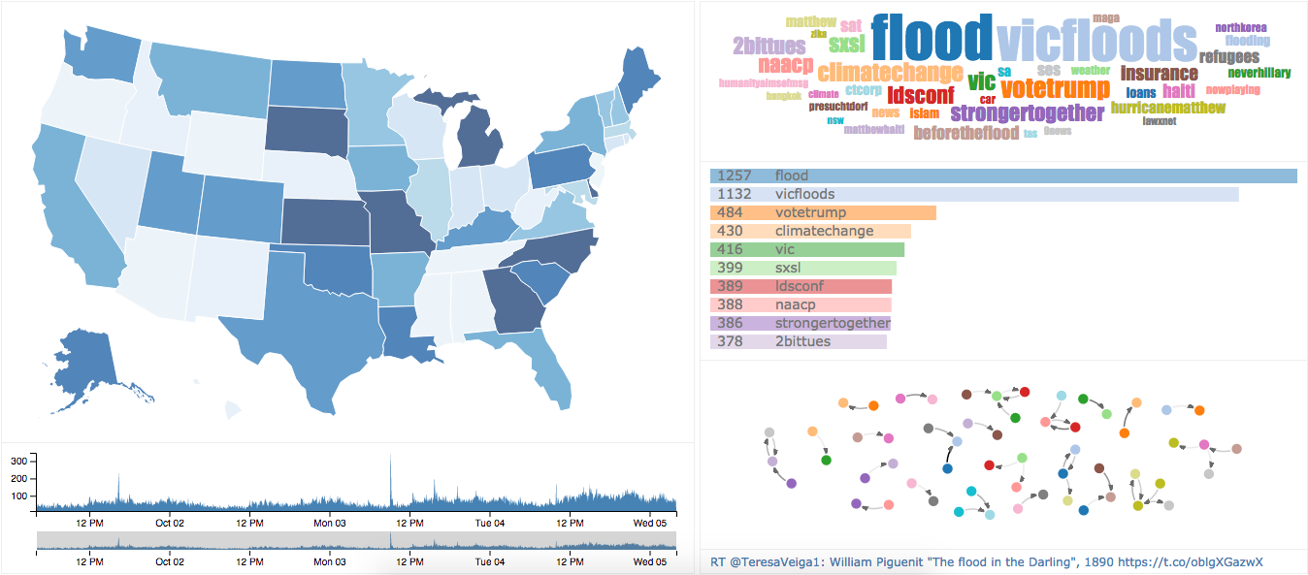
Demo
Timeline (Zoom & Pan)
WordCloud + Word Frequency
Geo-infomation + Sentiment
Social Network
Detail Display

