Slide 1
Detecting Wheat Leaf Rust using Deep Learning
A Deep Learning Approach for Agricultural Diagnosis
Ziqing Cheng, Ruiying Liu

Slide 2

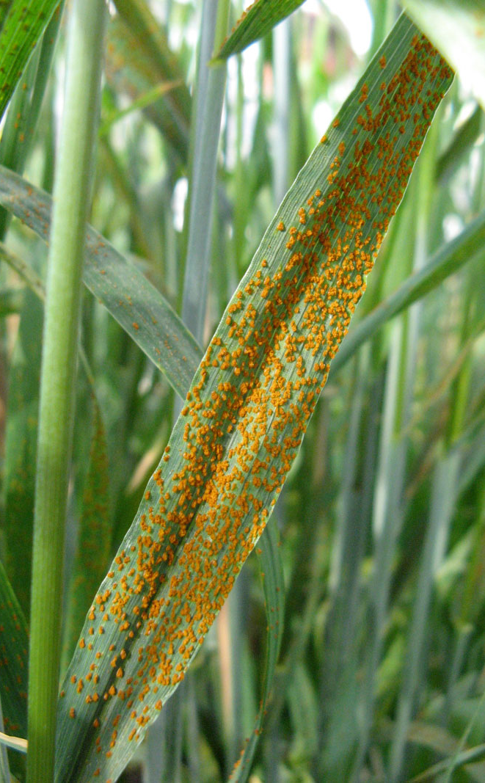
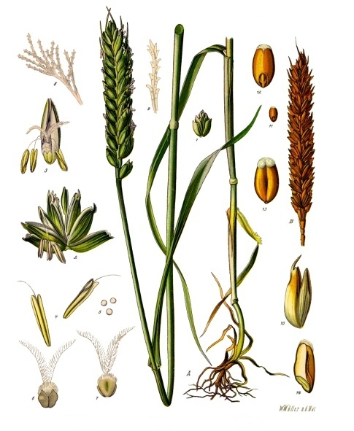
Introduction
Wheat is a worldwide staple food of mankind.
Wheat leaf rust (Latin name: Puccinia triticina) is a fungal disease that affects wheat leaves, leading up up to 20% yield loss every year in most wheat growing region.
Symptoms: Small brown pustules (Formal name: Uredinia) develop on the leaf blades in a random scatter distribution.

Slide 3
Introduction
Early diagnosis of leaf rust during wheat growing season reduces its damage to wheat yield.
Problem: traditional disease diagnostic were performed by farmers or experts with their naked eyes, which requires detailed knowledge and experience actual disease identification and is laborious and time-consuming. And manual methods is not feasible for larger fields.
Convolutional Neural Networks(CNN) is widely used in portrait recognition and other imagine recognition. Imaging wheat leaf and using CNN model to identify the healthy and diseased leaf is a good way to approach this problem.

Slide 4
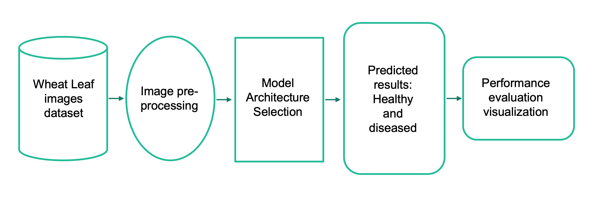
Architecture of Detection System
Predicted results:
Healthy and diseased
Wheat Leaf images dataset
Model Architecture Selection
Performance evaluation
visualization
Image pre-processing

Slide 5
Data Collection and Preparation
The dataset was generated by Biswabiplab et al.(2020, https://data.mendeley.com/datasets/th422bg4yd/1)
The data was collected with an RGB camera from a wheat crop sown in the winter 2019 and harvested in 2020 at the Indian Agriculture Research Institute field.
Total 491 1159 images
Three categories:
Control(healthy)
Deficiency(Nitrogen deficient)
Diseased(leaf rust infected)
Split ratio: 70:15:15
 | Control | Deficiency | Diseased
Train | 343 | 210 | 258
Validation | 74 | 45 | 55
Test | 74 | 45 | 55

Slide 6
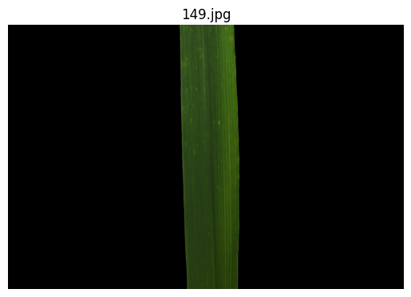
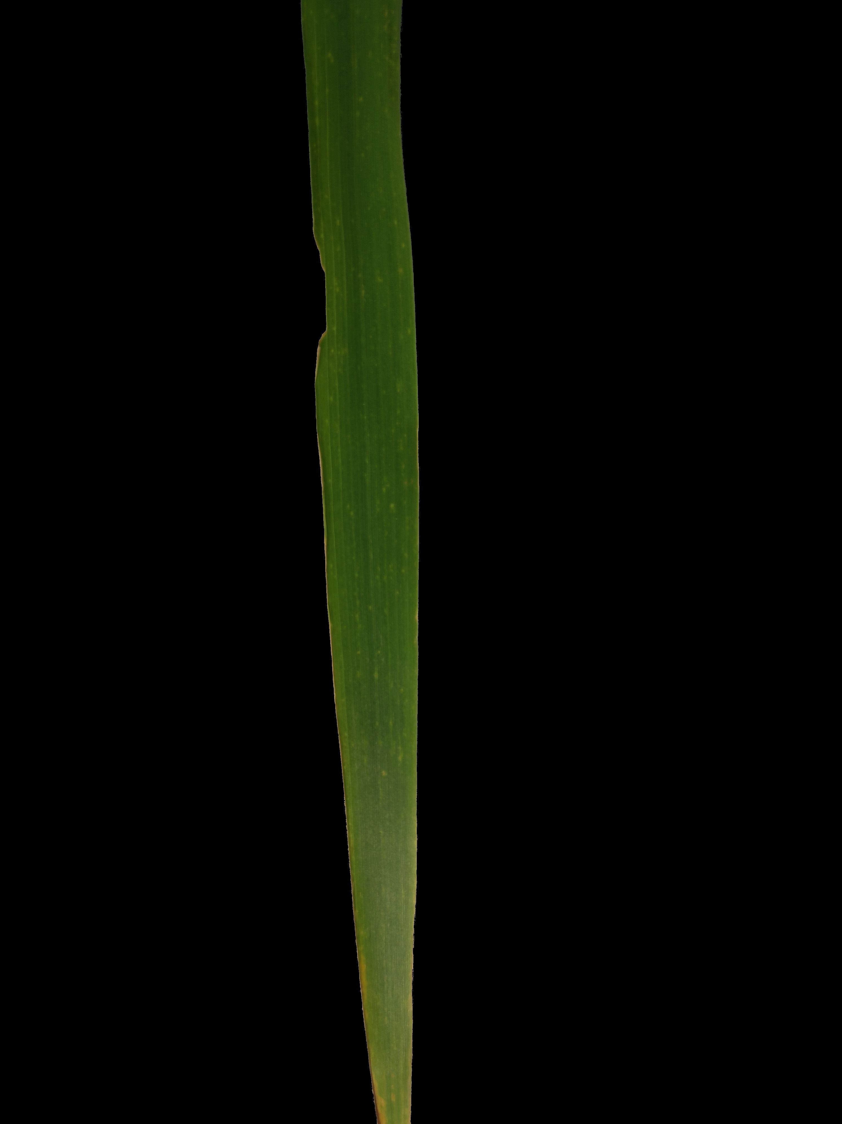
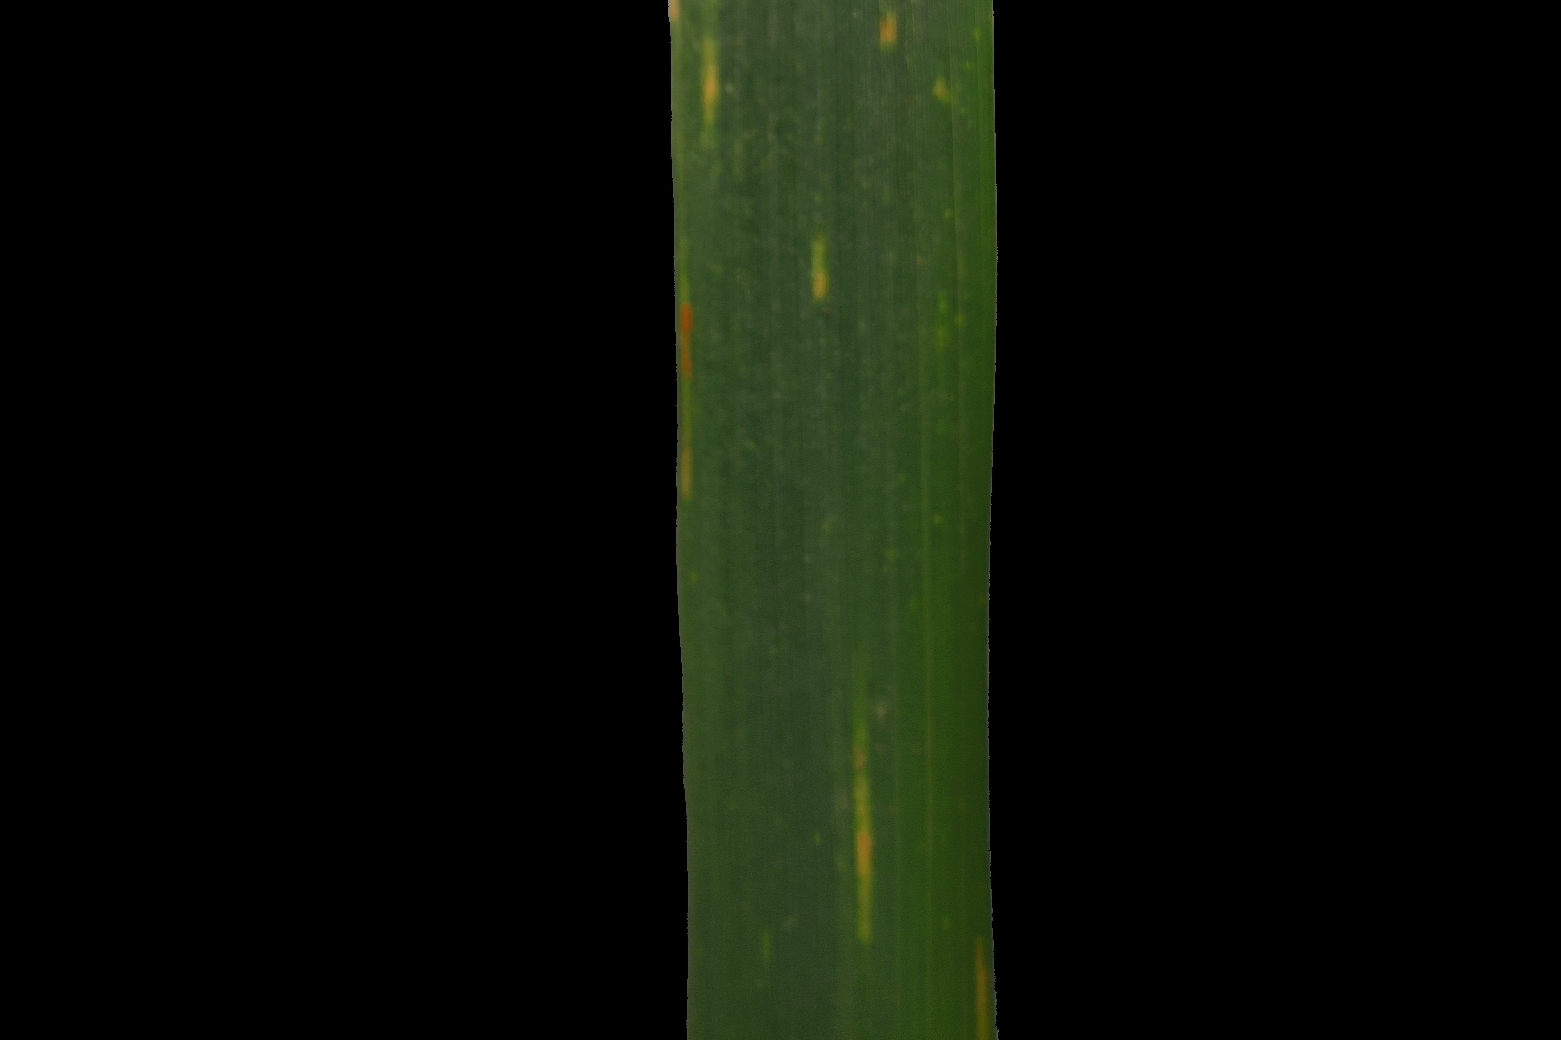
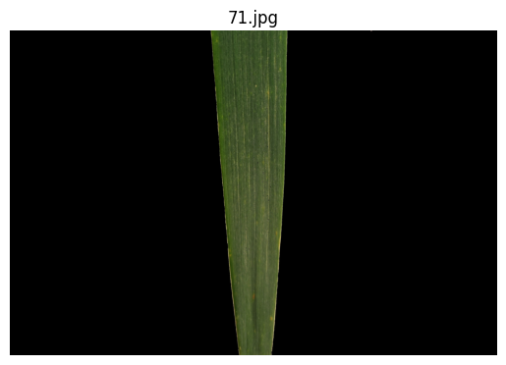
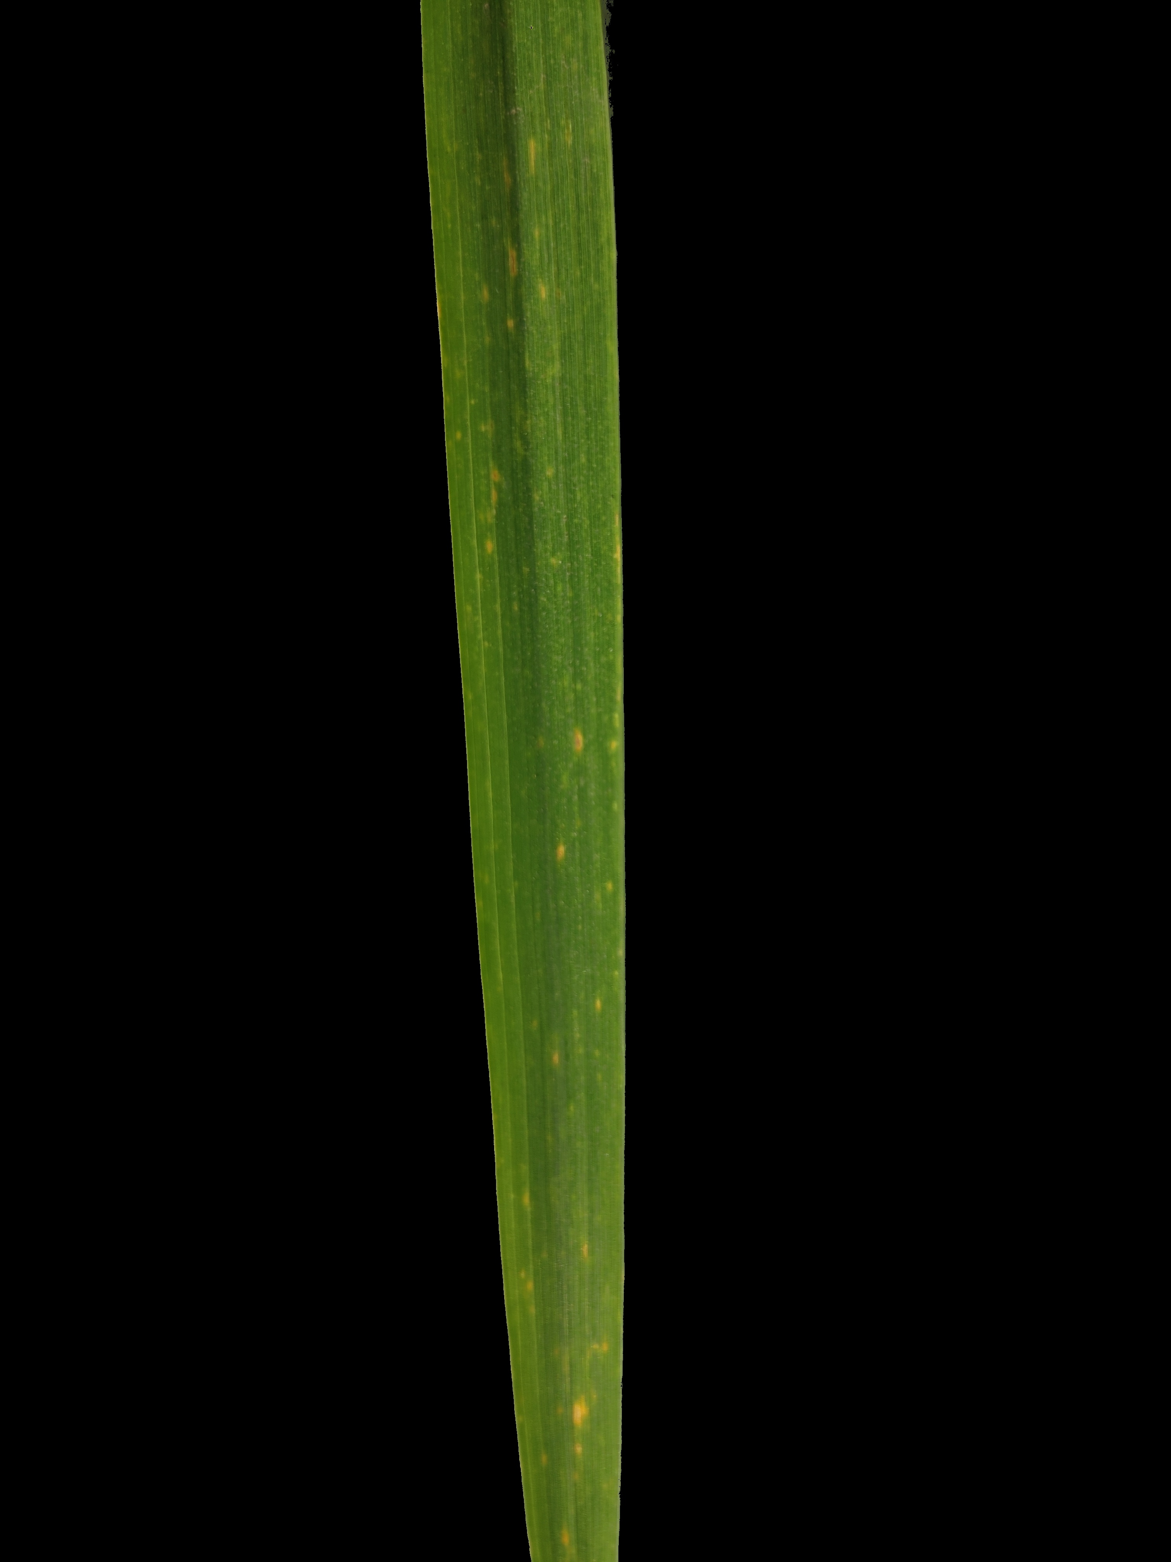
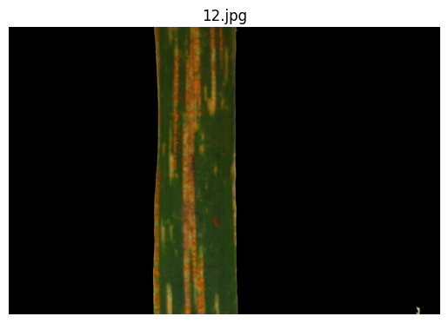
Data Collection and Preparation
Control
Deficiency
Diseased
The leaf images were acquired at the booting stage of a wheat crop. After the pictures were taken, the images were segmented from the background using Otsu-based masking.

Slide 7
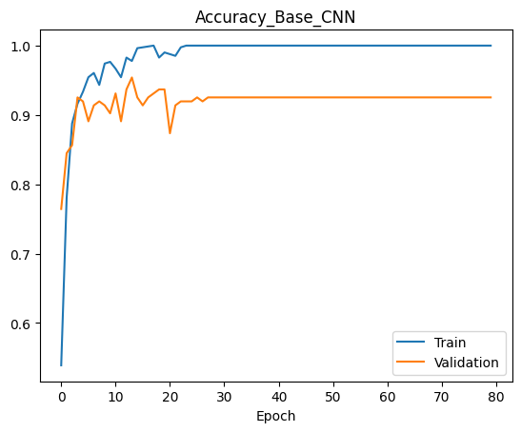
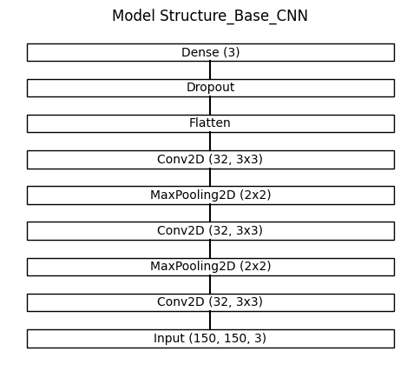
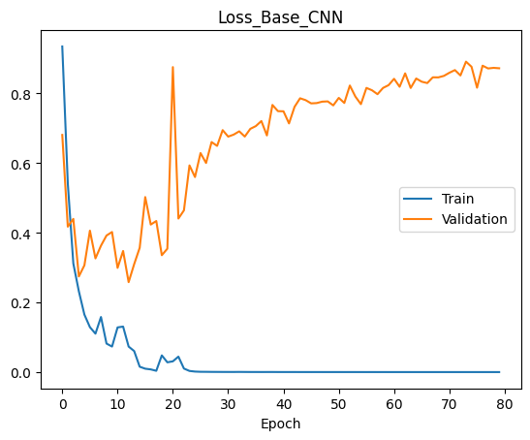
Baseline Model
Image Preprocessing:
rescale = 1./255
image_size = (150, 150)
batch_size = 32
Convolutional Neural Networks
(CNN)
Train_accuracy : 99.99%
Val_accuracy : 87.35%
Support vector machine(SVM)
Notes:
Discuss the choice of deep learning architecture for image classification and the rationale behind it.

Slide 8
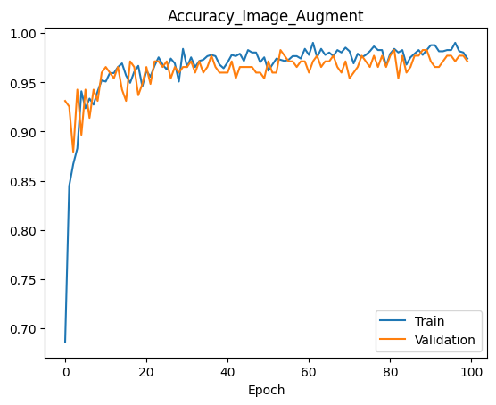
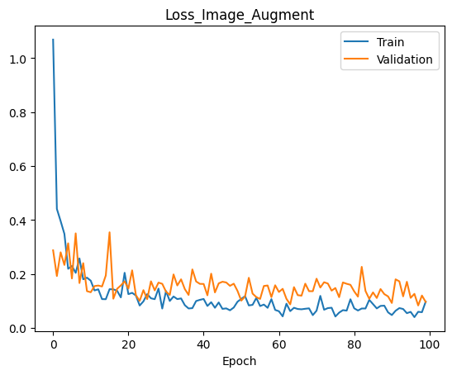
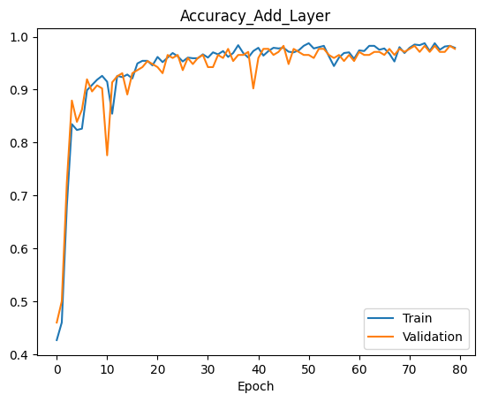
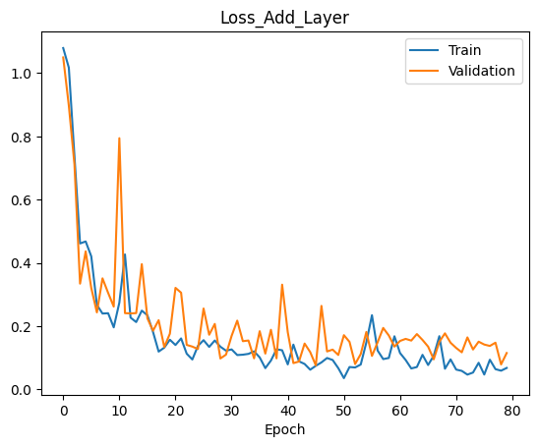
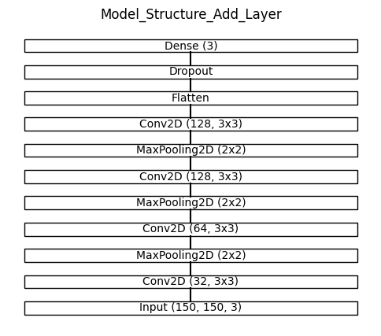
Model Improvement
Step1:Image Data Augmentation
Step2: Add More Layers
Notes:
Discuss the choice of deep learning architecture for image classification and the rationale behind it.

Slide 9
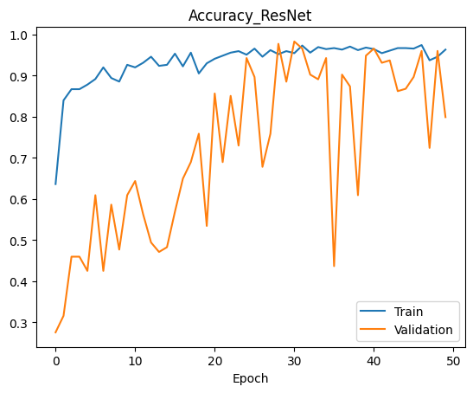
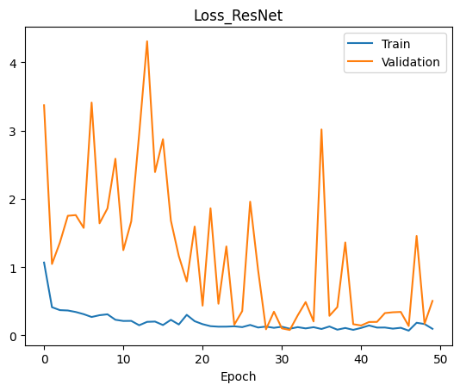
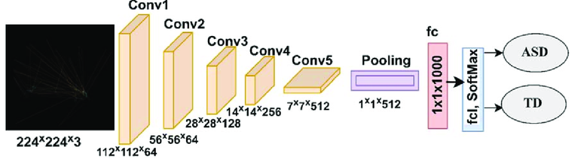
Pre-trained Model Application
Model for plant diseases detection:
AlexNet, VGG, ResNet, et al.
Ahmed,I.A. et al., 2022
Notes:
Discuss the choice of deep learning architecture for image classification and the rationale behind it.

Slide 10
Summary
 | Train Accuracy | Val Accuracy | Train Loss | Val Loss
SVM | 0.9999 | 0.8735
Base_CNN | 0.9999 | 0.9253 | 2.9933e-05 | 0.8721
CNN_Ima_Aug | 0.9741 | 0.9713 | 0.0970 | 0.0957
CNN_Add_Layer | 0.9827 | 0.9655 | 0.0675 | 0.1091
CNN_ResNet | 0.9630 | 0.7989 | 0.0947 | 0.5037

