Slide 1
Linear Relationship Between Body Fat Percentage and Body Part Circumference
Ruiying Liu

Slide 2
Research Question
Is it possible to use the circumference of body parts as a proxy for estimating body fat percentage?
Is there a linear relationship between body fat and circumference measurements?

Slide 3
Importance
Body fat percentage(BFP) is a very important indicator for maintaining health, improving body composition, and optimizing athletic performance.
Accurate measurements of BFP by equipment are inconvenient and costly.
The well-known BMI-BFP estimation, which needs to consider many infectors, such as weight, height, and gender, is difficult to understand and memorized.
Building a new model to simply and easily explain the relationship between circumference measurements and BFP can be used in the daily life as a roughly assessment of health.
Notes:
Body fat percentage is a measure of the proportion of fat tissue in the human body. Its importance lies in several factors:
Health risk assessment: High body fat percentage is closely linked to many chronic diseases such as cardiovascular disease, diabetes, and hypertension. Therefore, knowing one's body fat percentage can help assess health risks and take appropriate measures to reduce disease risk.
Body composition assessment: Body fat percentage can help assess body composition, that is, the proportion of fat tissue and non-fat tissue. This is important for weight management, exercise training, and nutrition planning.
Optimize athletic performance: For athletes and fitness enthusiasts, knowing their body fat percentage can help optimize performance. Low body fat percentage is closely related to better muscle definition and higher athletic performance.
In summary, understanding and monitoring body fat percentage is important for maintaining health, improving body composition, and optimizing athletic performance.

Slide 4
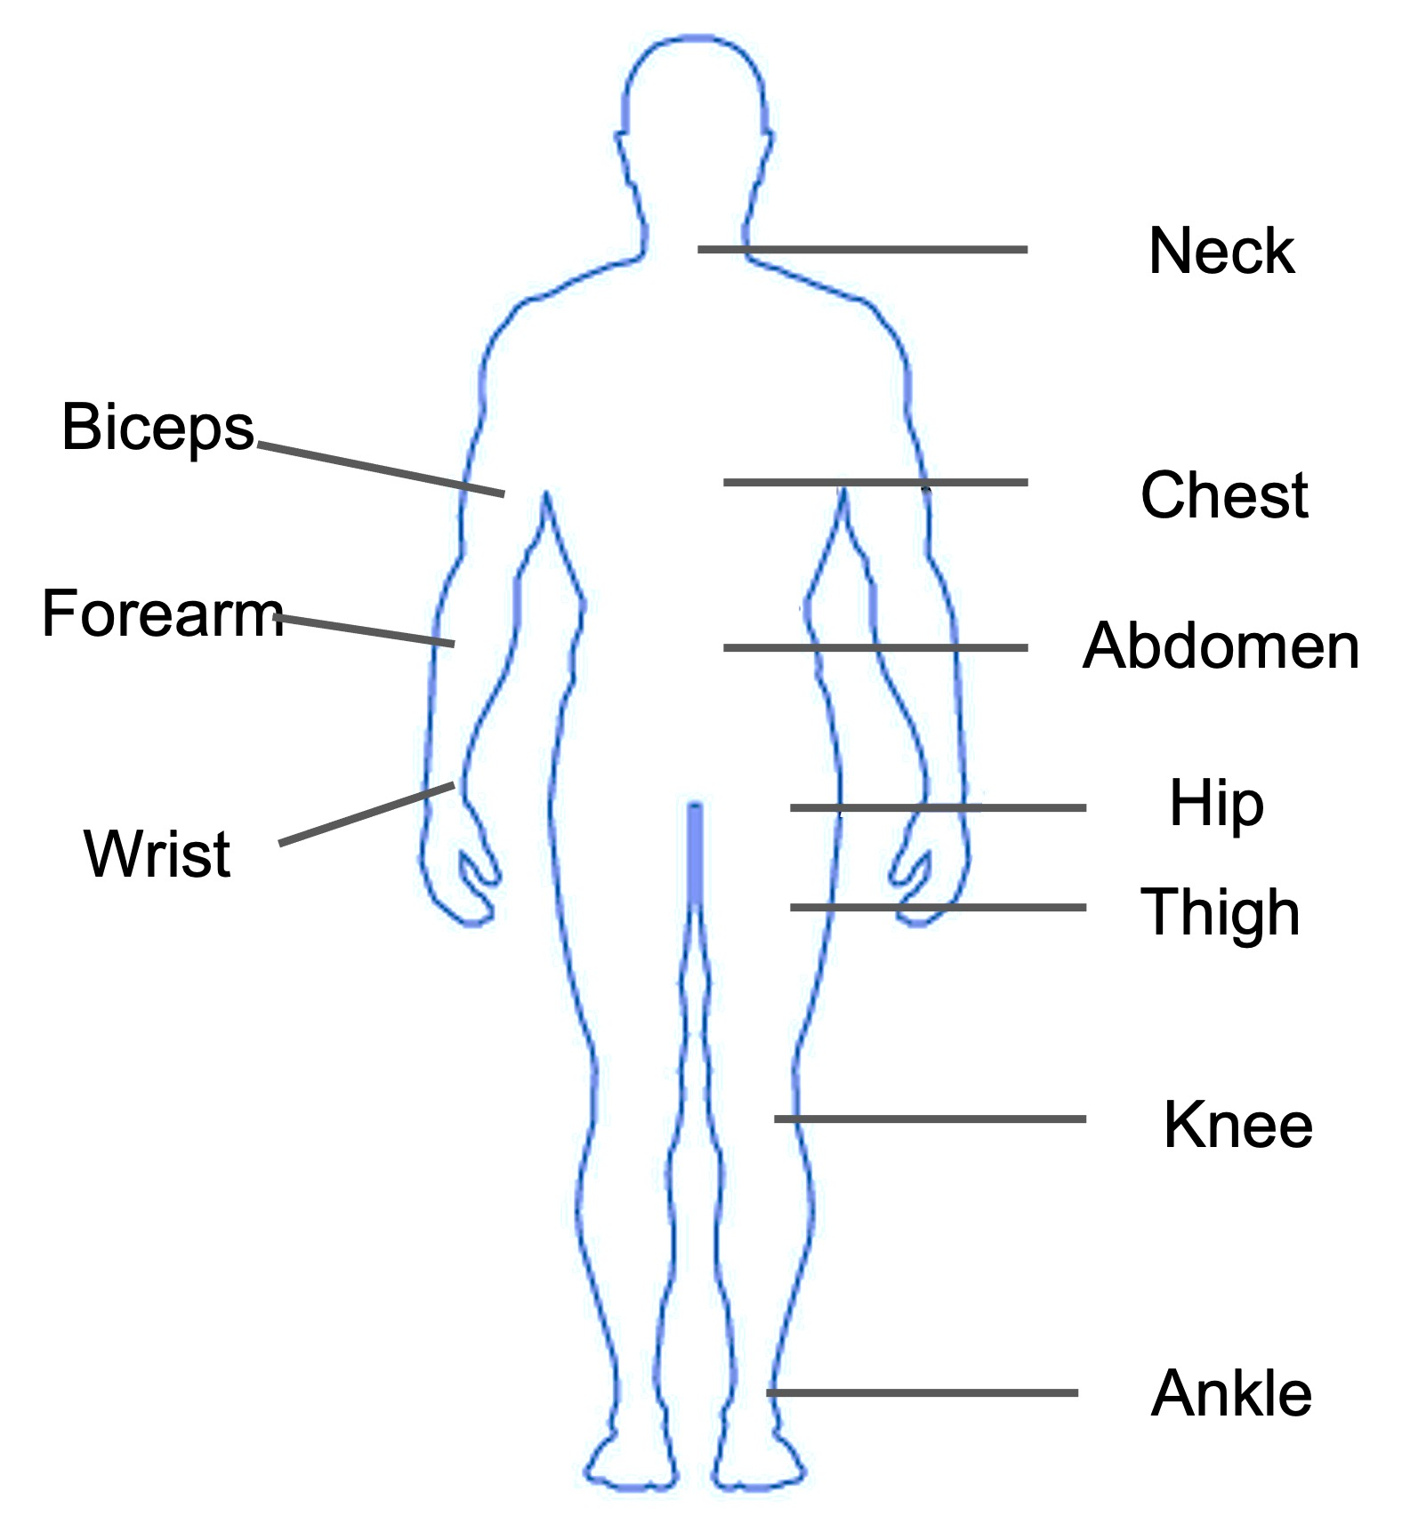
General Description of the Data
Source: http://lib.stat.cmu.edu/datasets/bodyfat
Data was collected from 252 male adults aged from 22 to 81
BFP listed in this data was accurately estimated using underwater weighing method.
13 variables were included in this data: age, height, weight and the circumference of different body parts

Slide 5
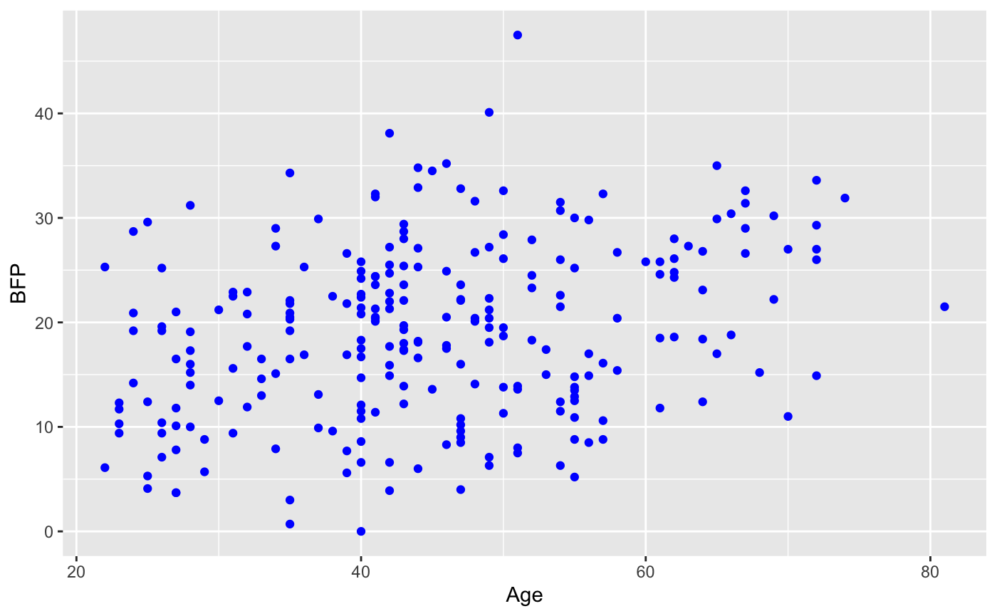
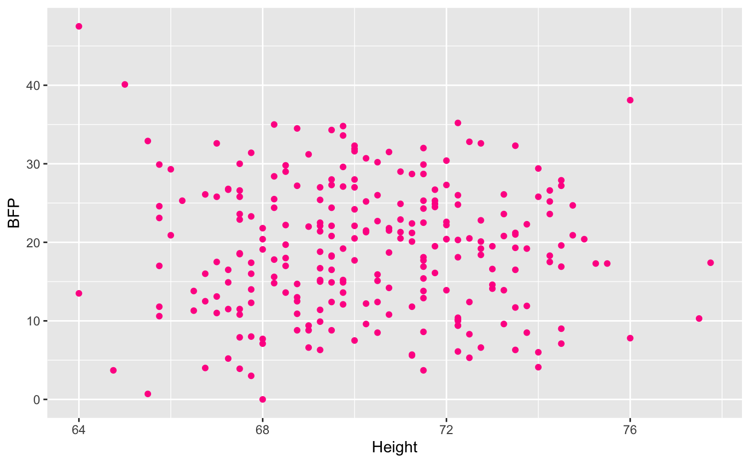
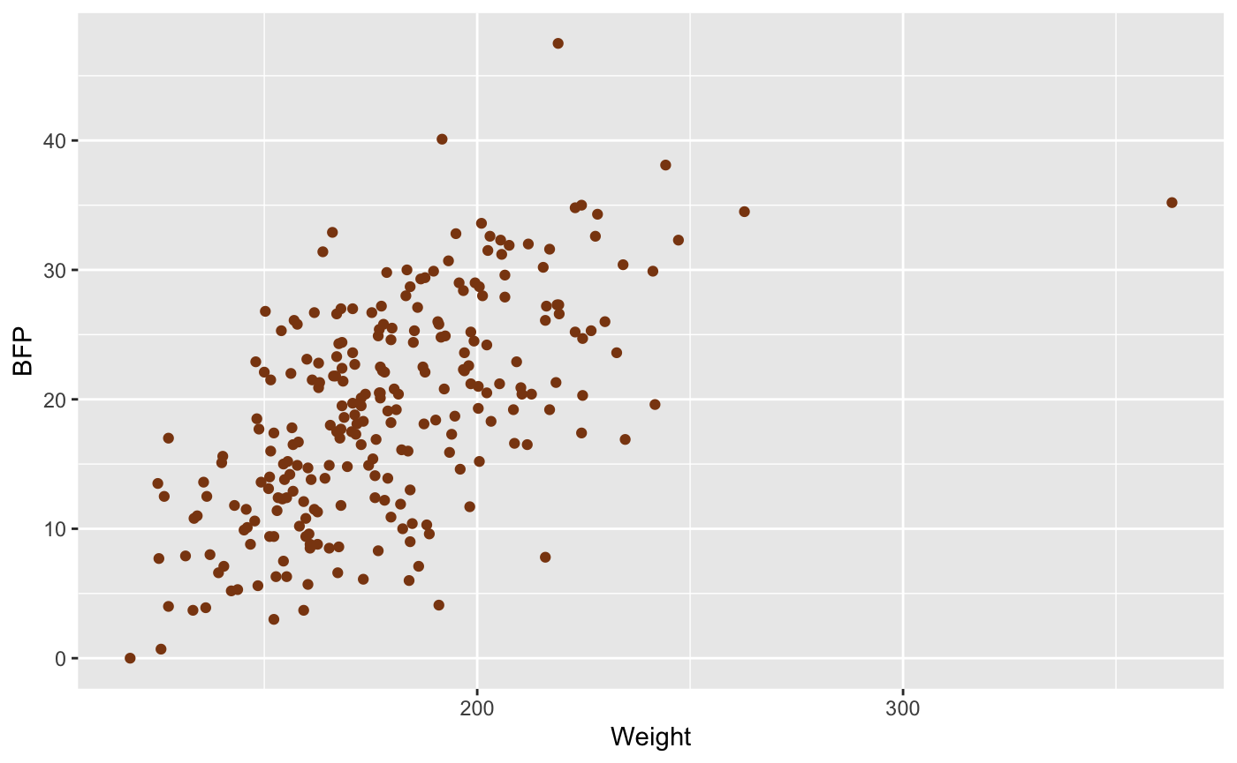
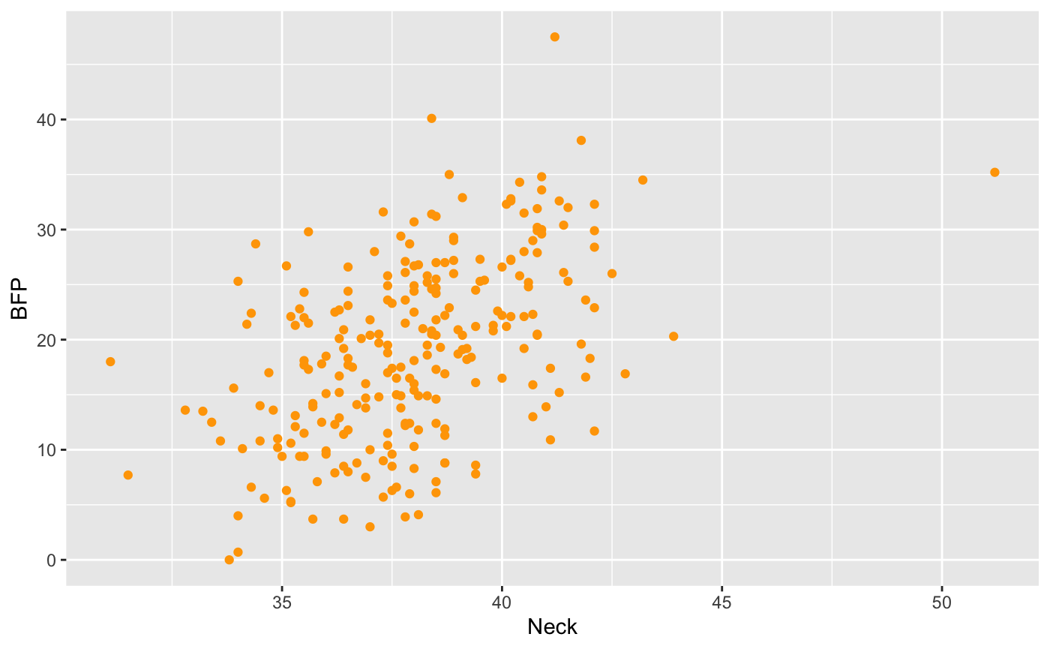
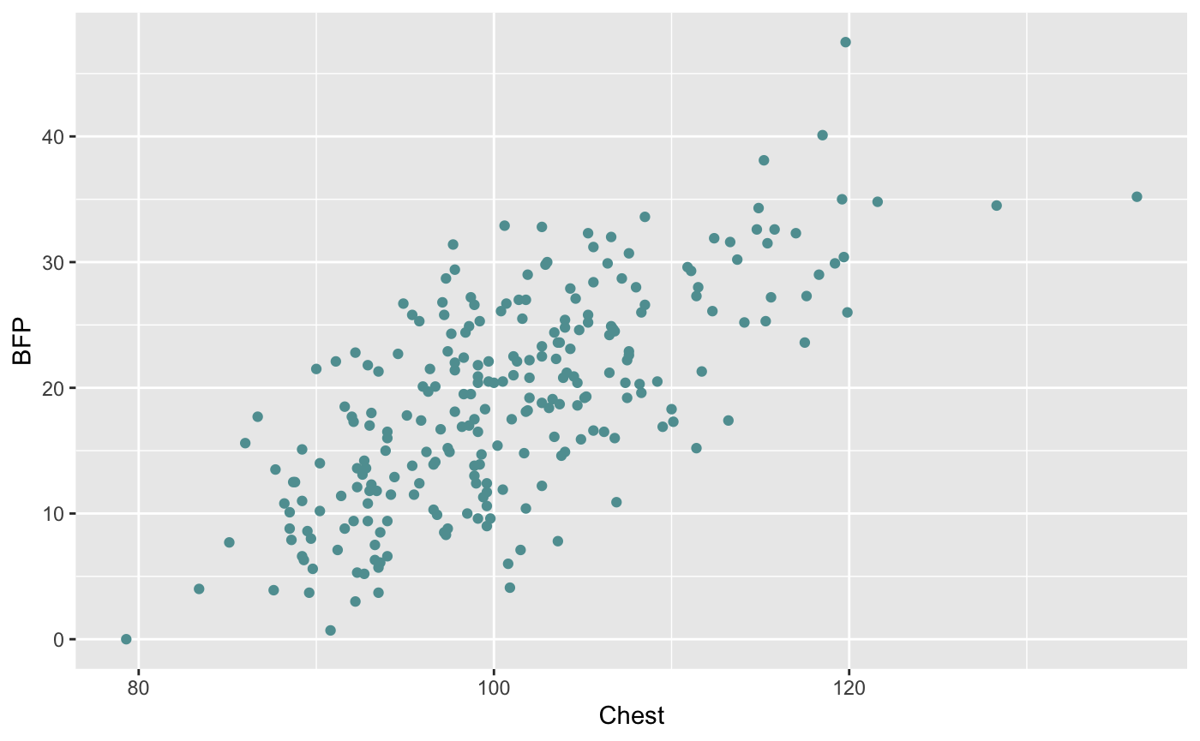
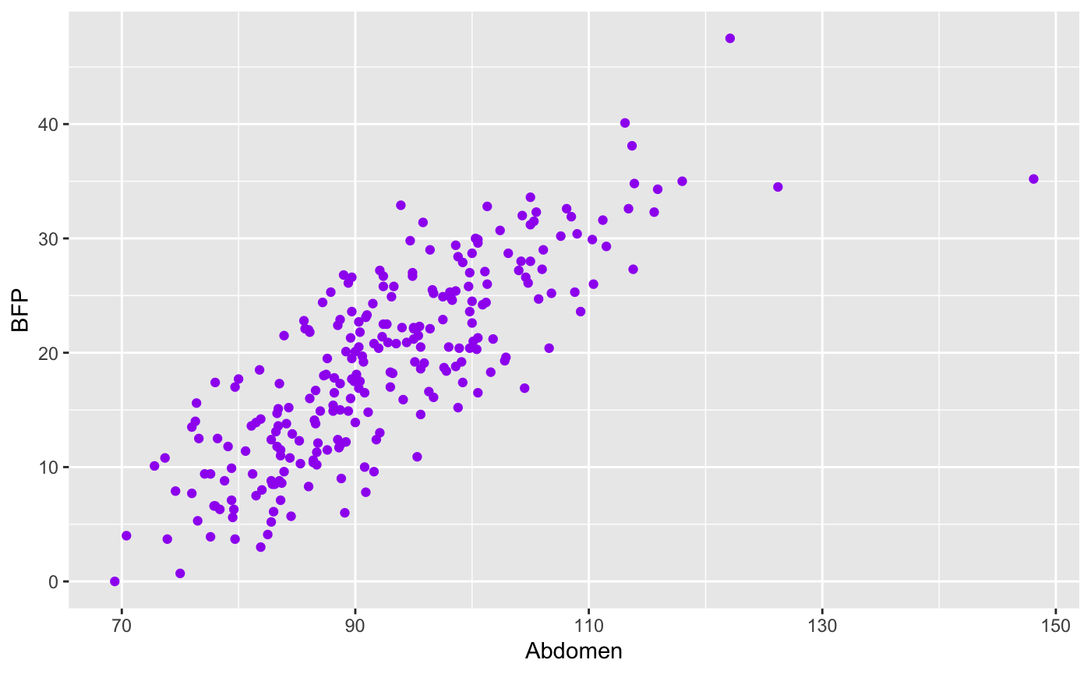
Data Preparation
BFP
BFP
BFP
Age
Height
Weight
BFP
BFP
BFP
Neck
Chest
Abdomen
Notes:
Data Preparation: data cleaning and munging, removal of outliers, data transformation, feature extraction, feature selection, etc.

Slide 6
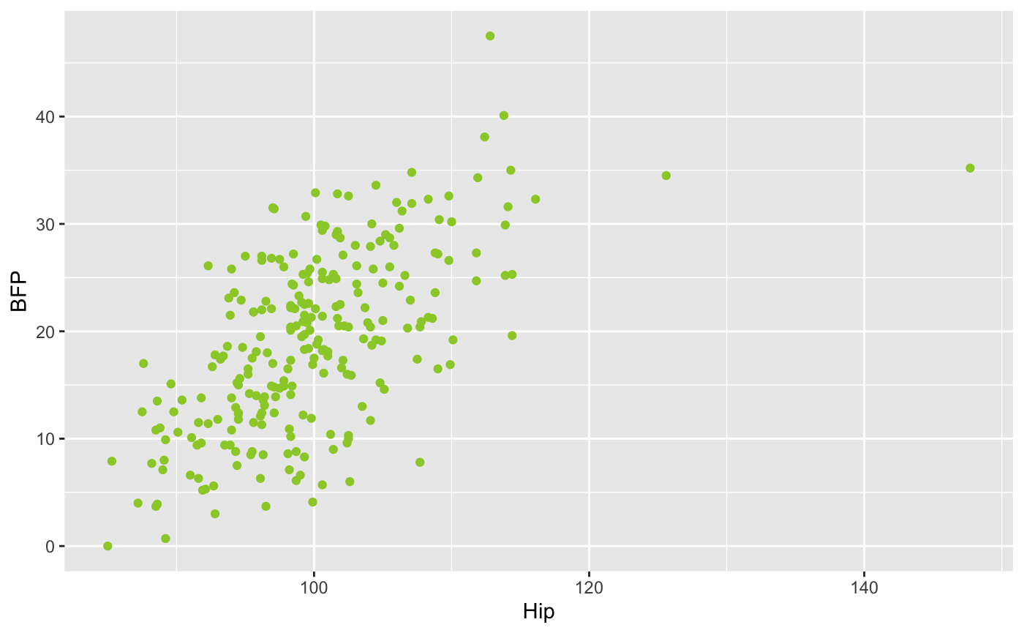
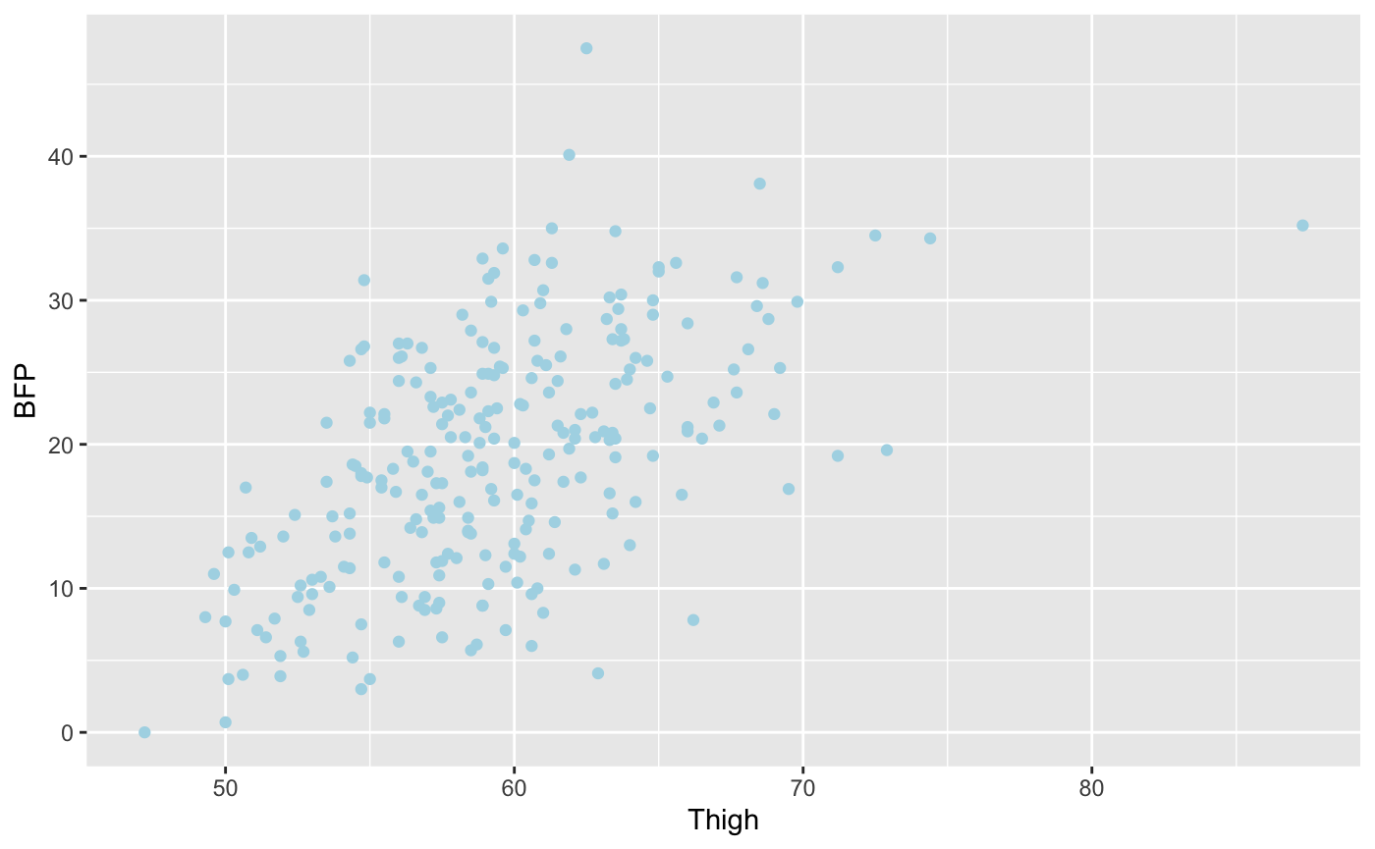
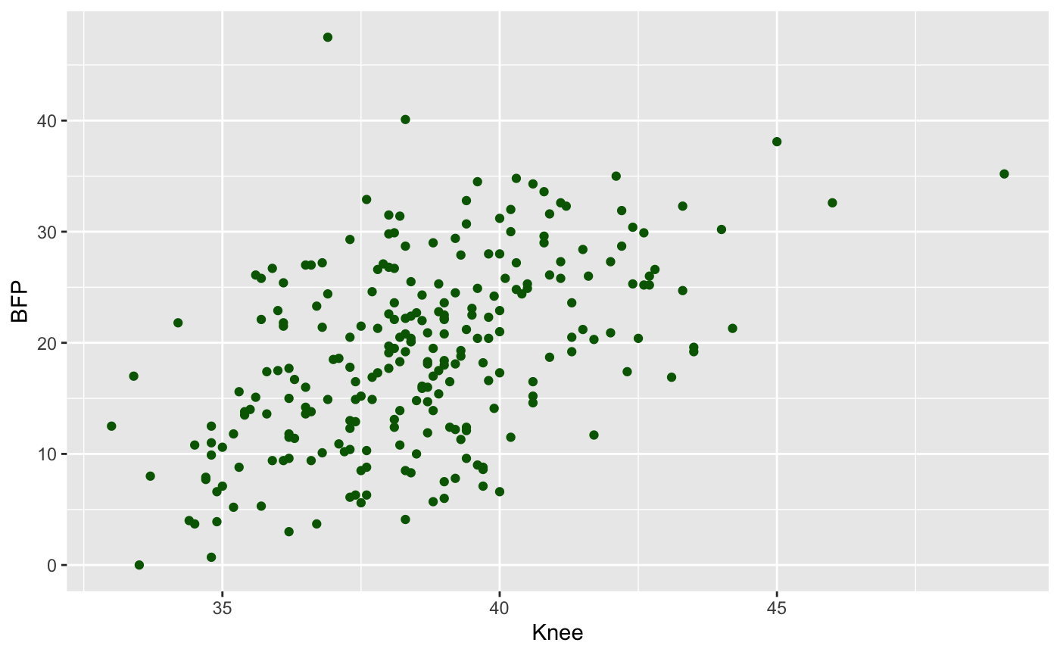
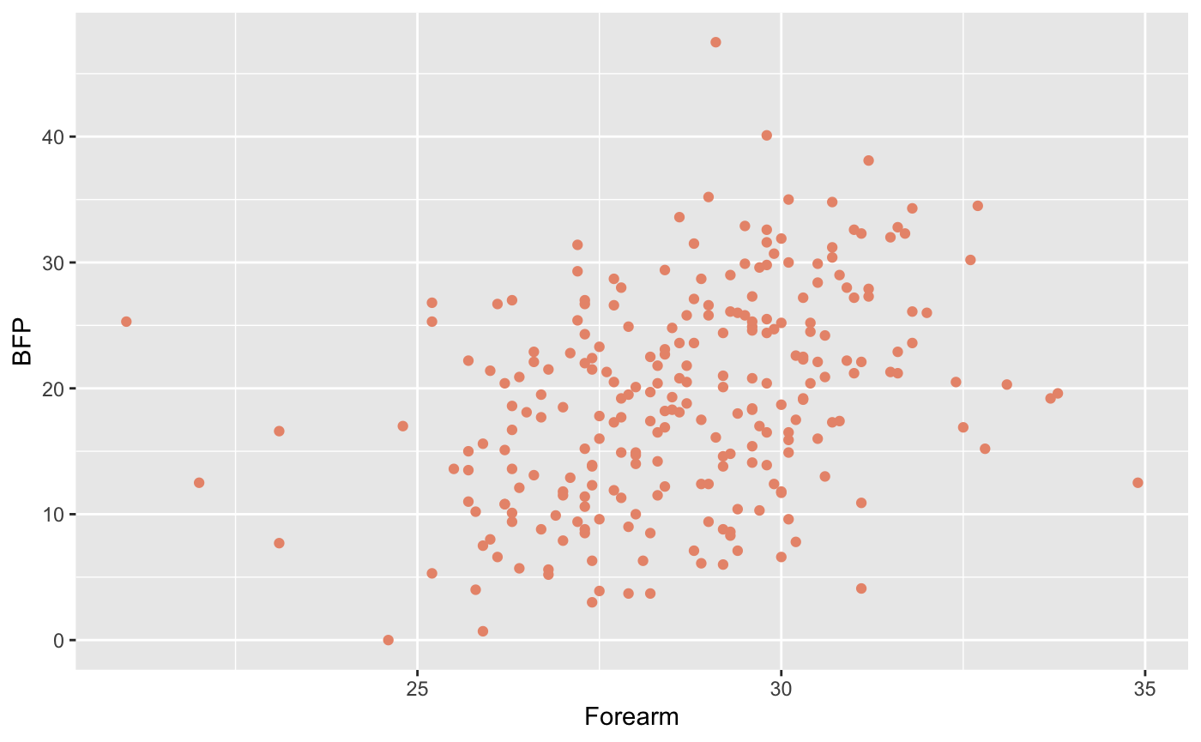
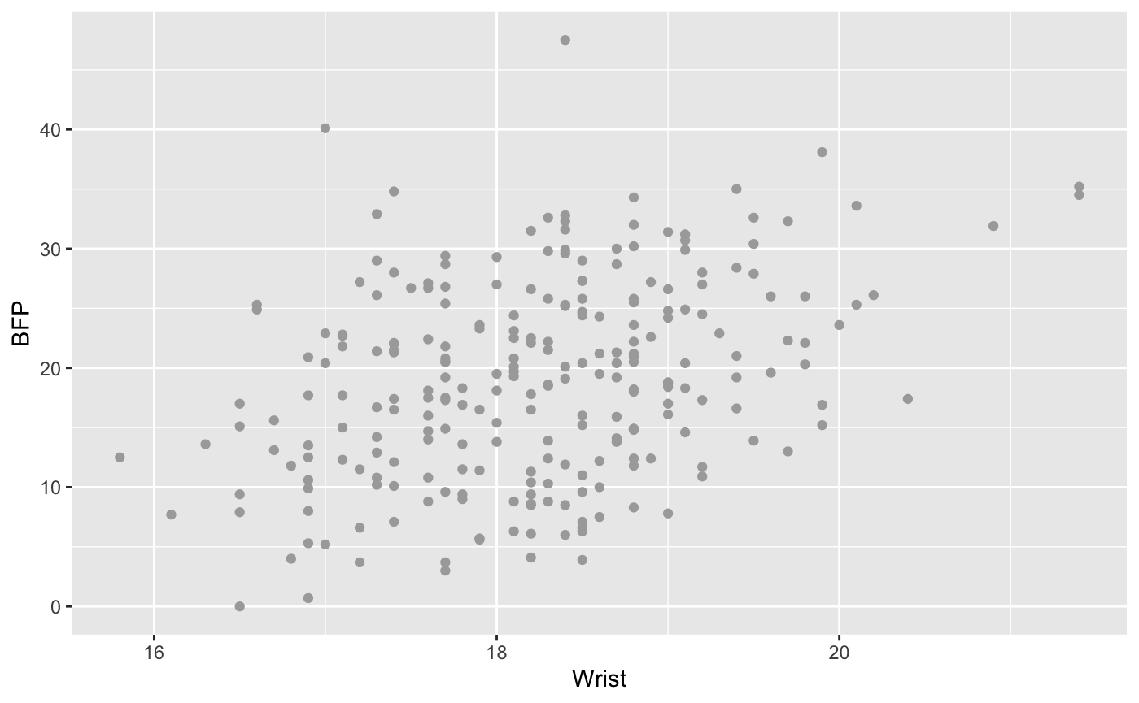
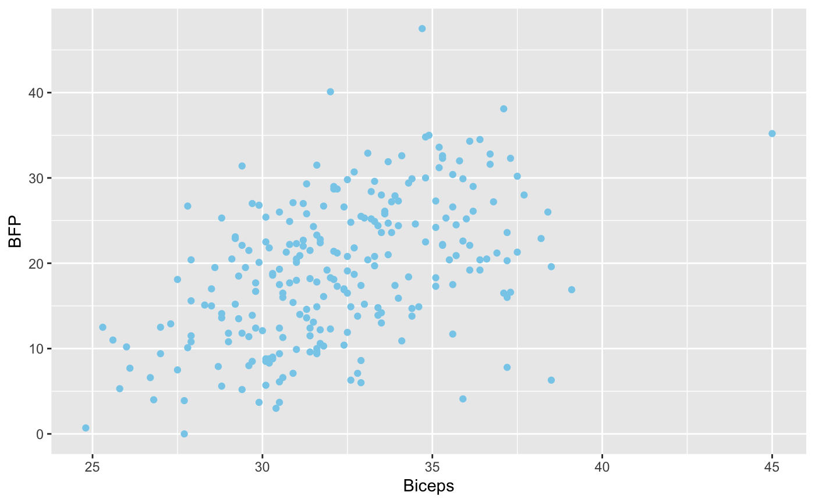
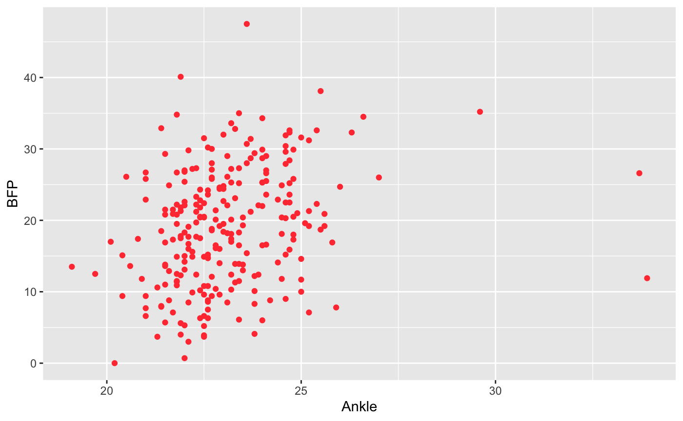
Data Preparation
BFP
BFP
BFP
Hip
Thigh
Knee
BFP
BFP
BFP
BFP
Forearm
Wrist
Biceps
Ankle

Slide 7
Data Preparation
Some of the features show obviously linear relationship with BFP, Weight, Neck, Chest, Abdomen, Hip, Thigh, etc.
To reduce features which are not important and make model easier and simpler to understand, factor analysis is performed here.
 | R² |  | R²
Age | 0.086 | Thigh | 0.31
Weight | 0.37 | Knee | 0.25
Height | 0.00054 | Ankle | 0.07
Neck | 0.25 | Biceps | 0.24
Chest | 0.49 | Forearm | 0.13
Abdomen | 0.66 | Wrist | 0.126
Hip | 0.38
Notes:
Data Preparation: data cleaning and munging, removal of outliers, data transformation, feature extraction, feature selection, etc.

Slide 8
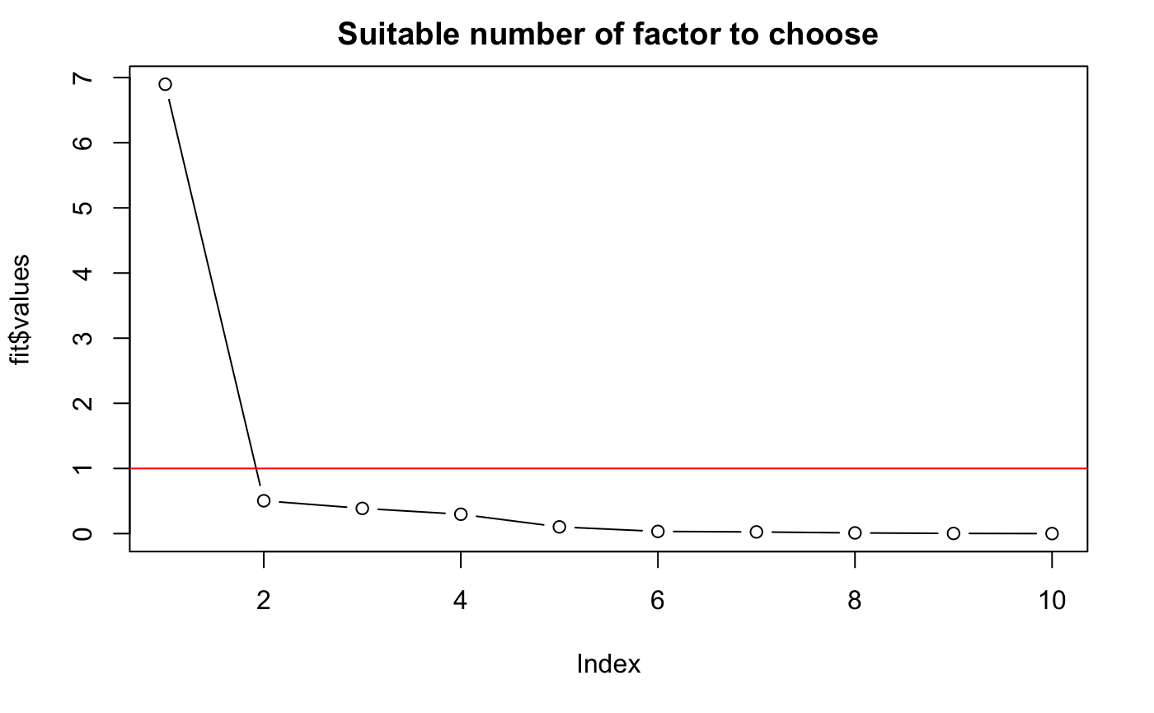
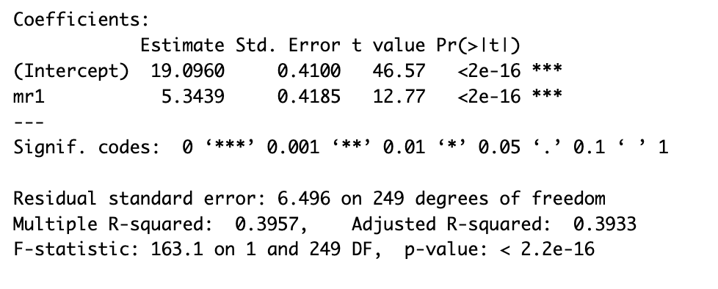
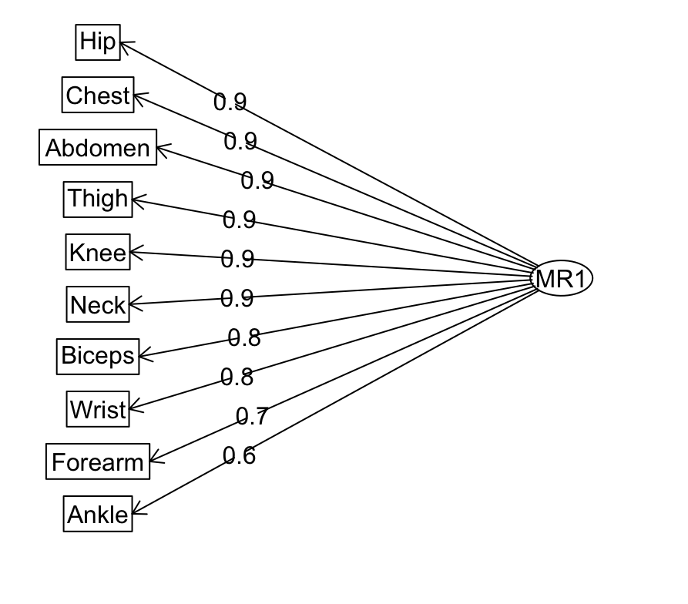
Factor analysis
R²= 0.3957 <R²(Abdomen)
So I decide to only use the variable “Abdomen” for the linearization

Slide 9
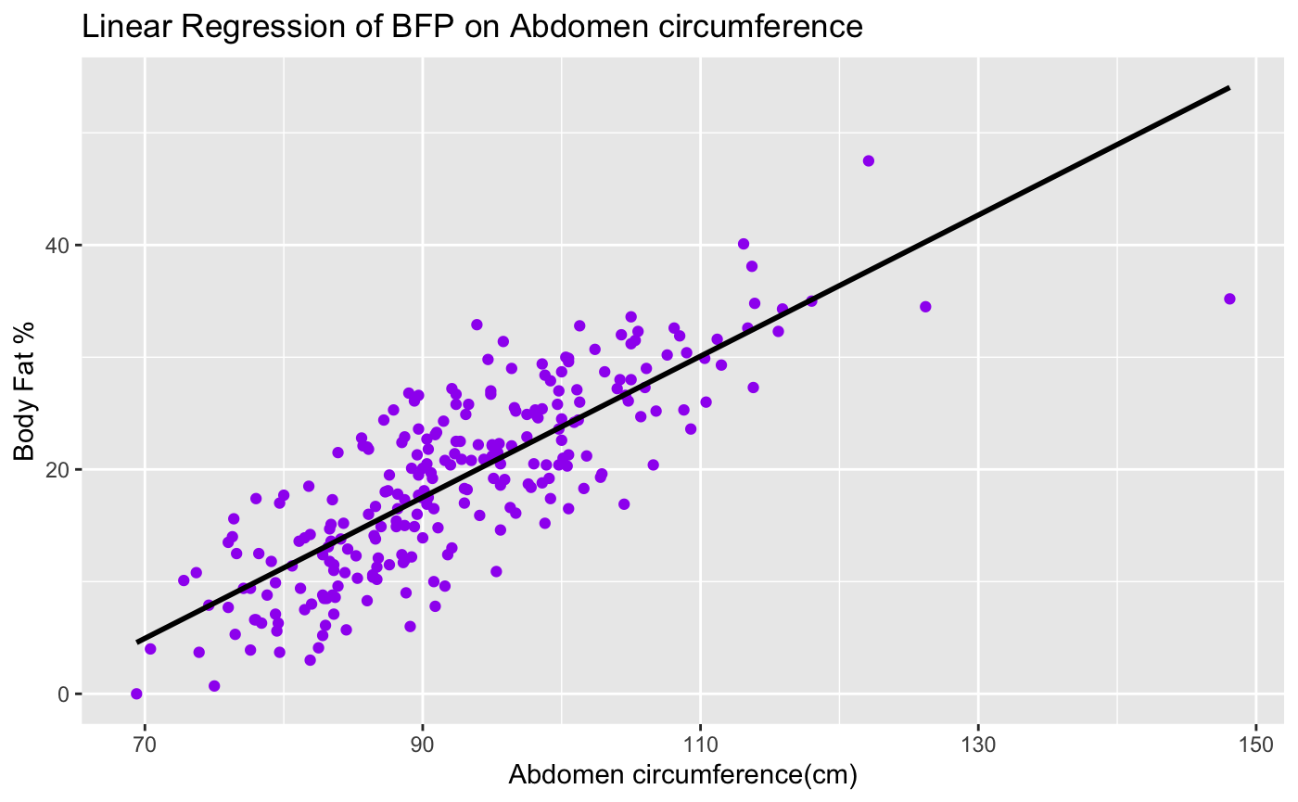
Data Visualization

Slide 10
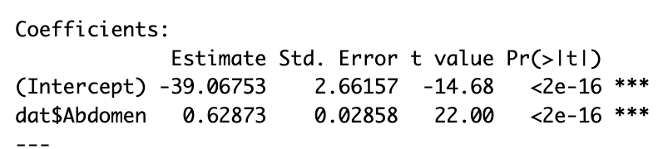
Fitted Model
BFP = 0.63 * Abdomen_ circumference – 39.07

Slide 11
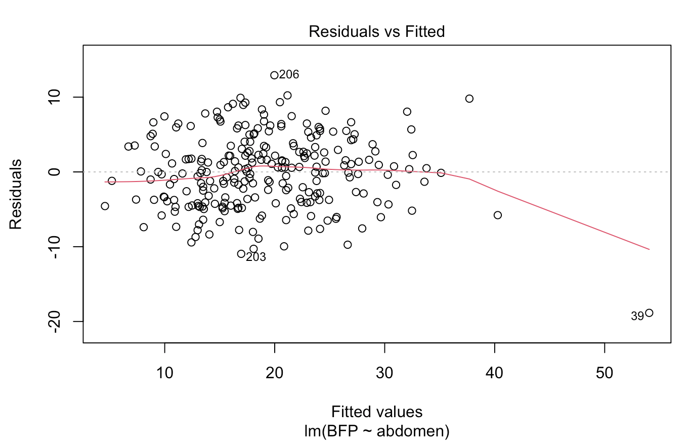
Model Evaluation

Slide 12
Conclusion
BFP and Abdomen circumference have a linear relationship.
A coefficient of 0.63, suggesting a positive association between the two variables.
The fitted model has a very low p-value of 2e-16, indicating strong evidence to reject the null hypothesis that the true slope is 0.

