Slide 1

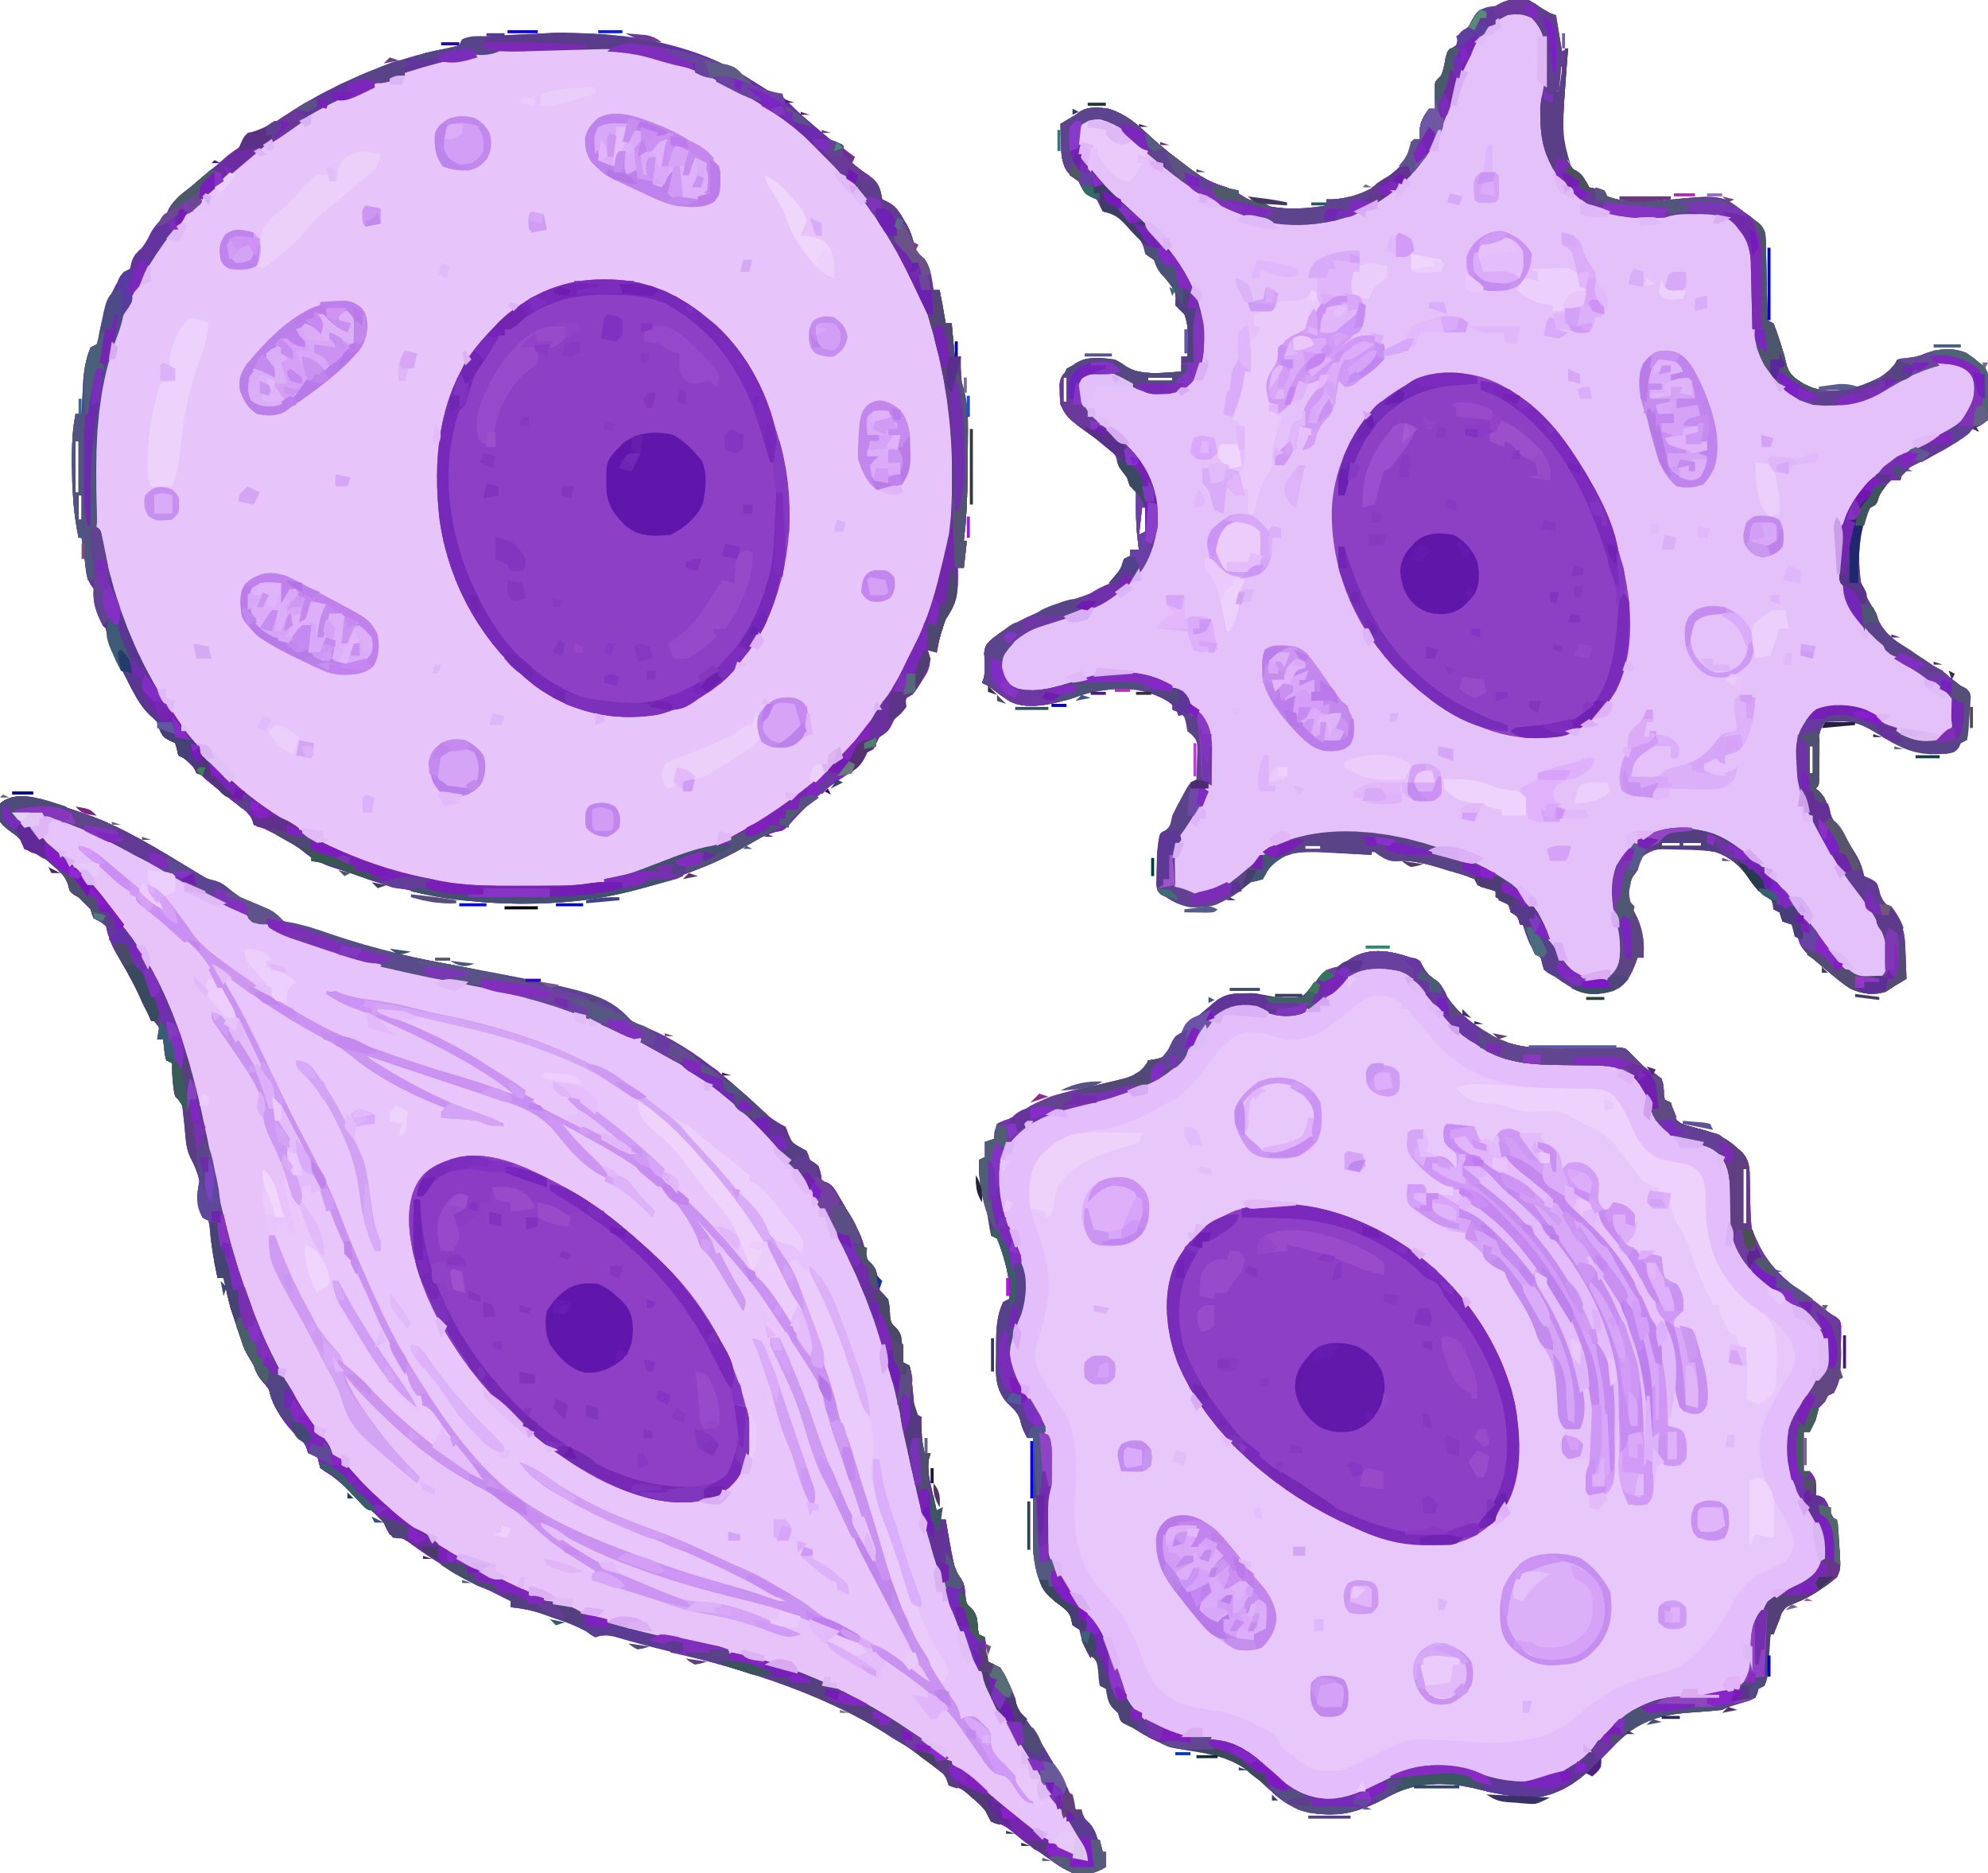
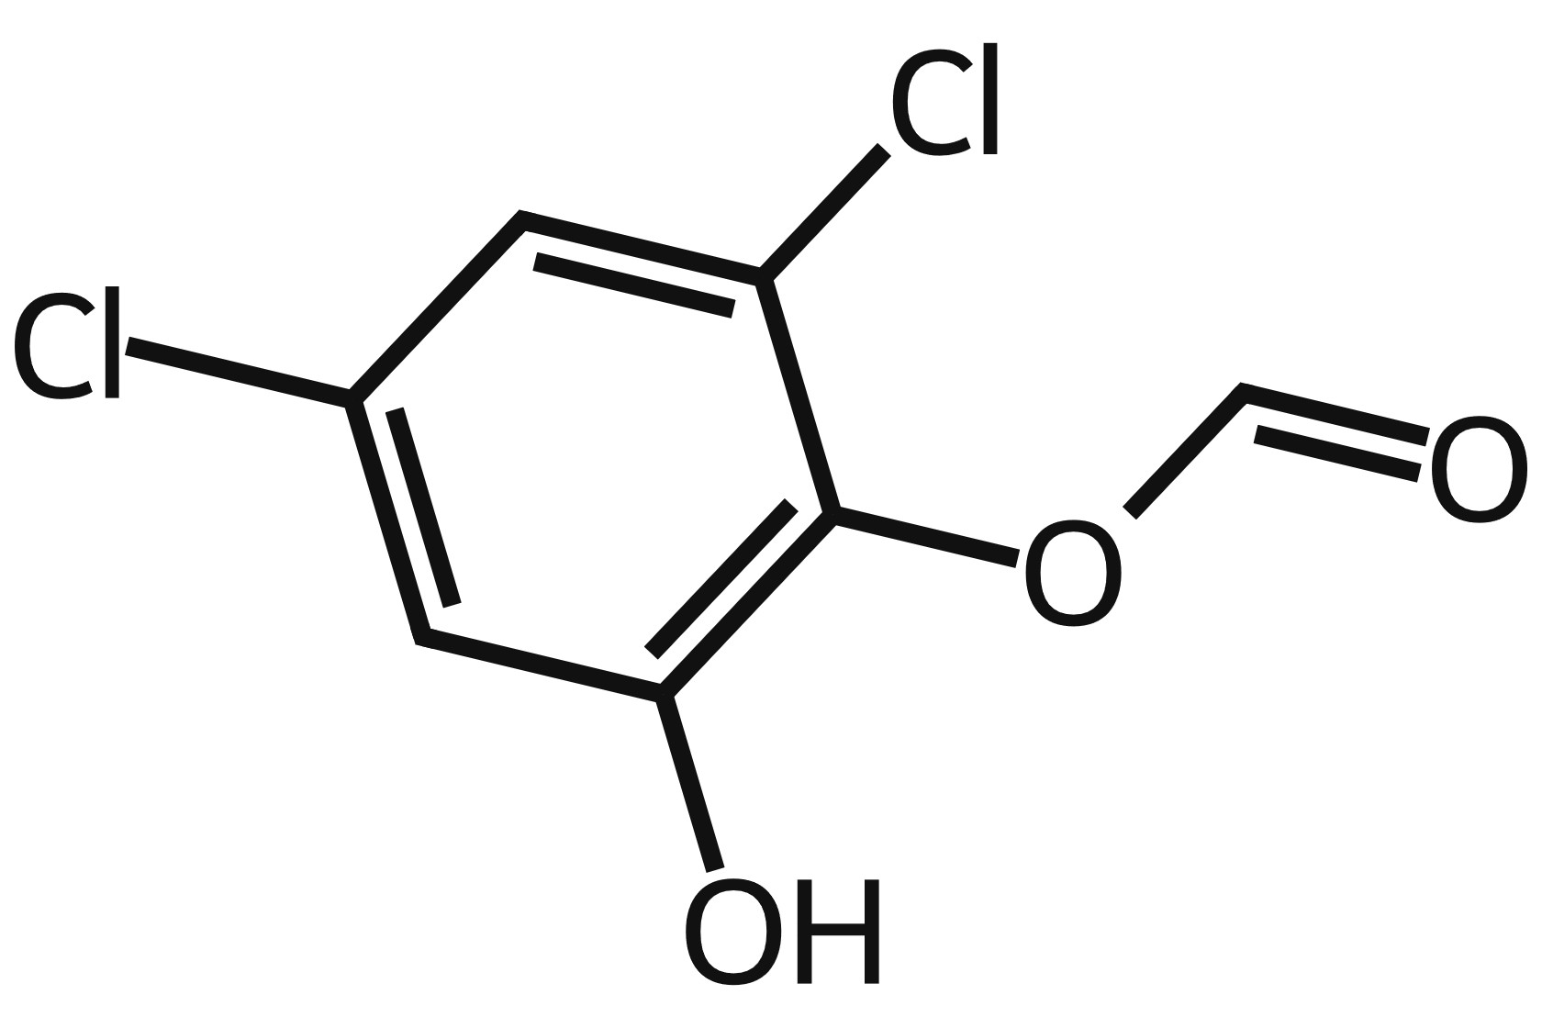
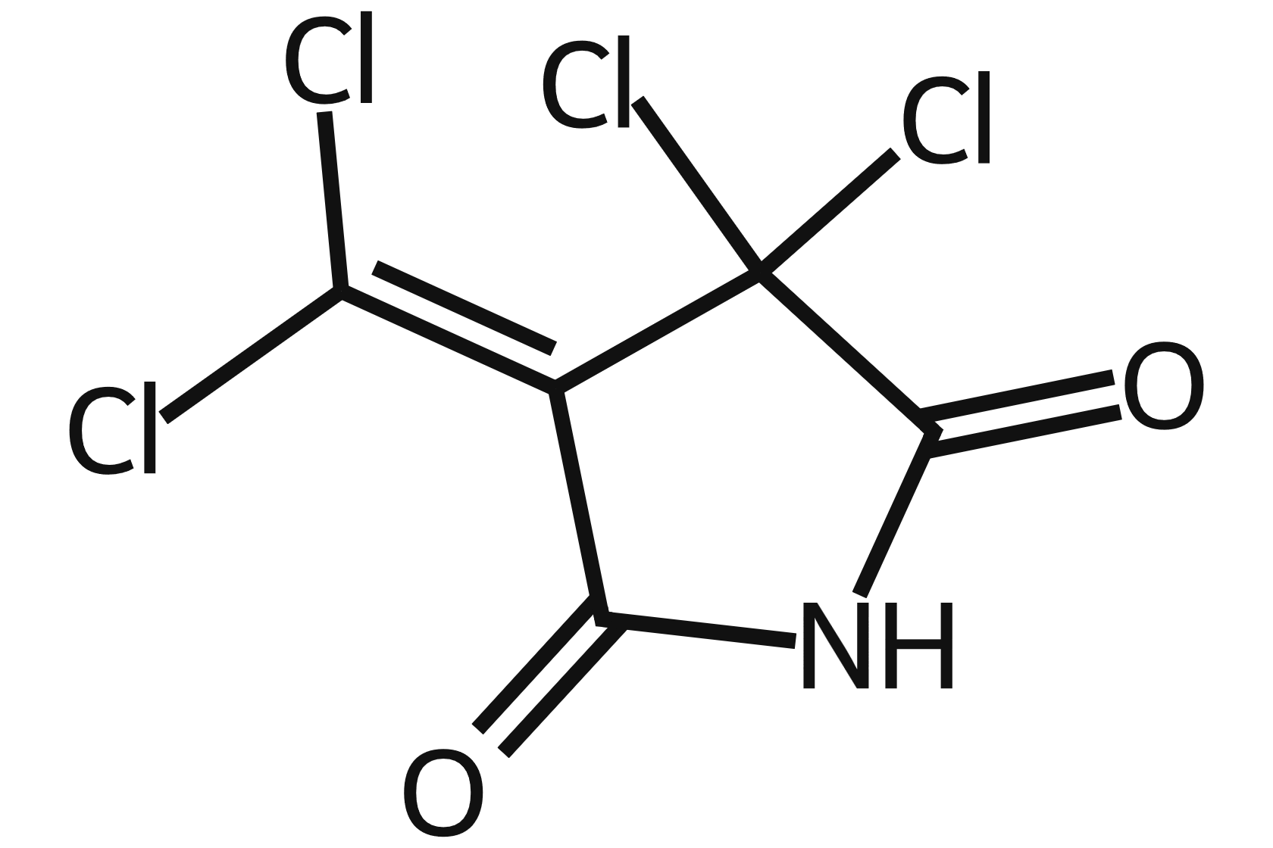
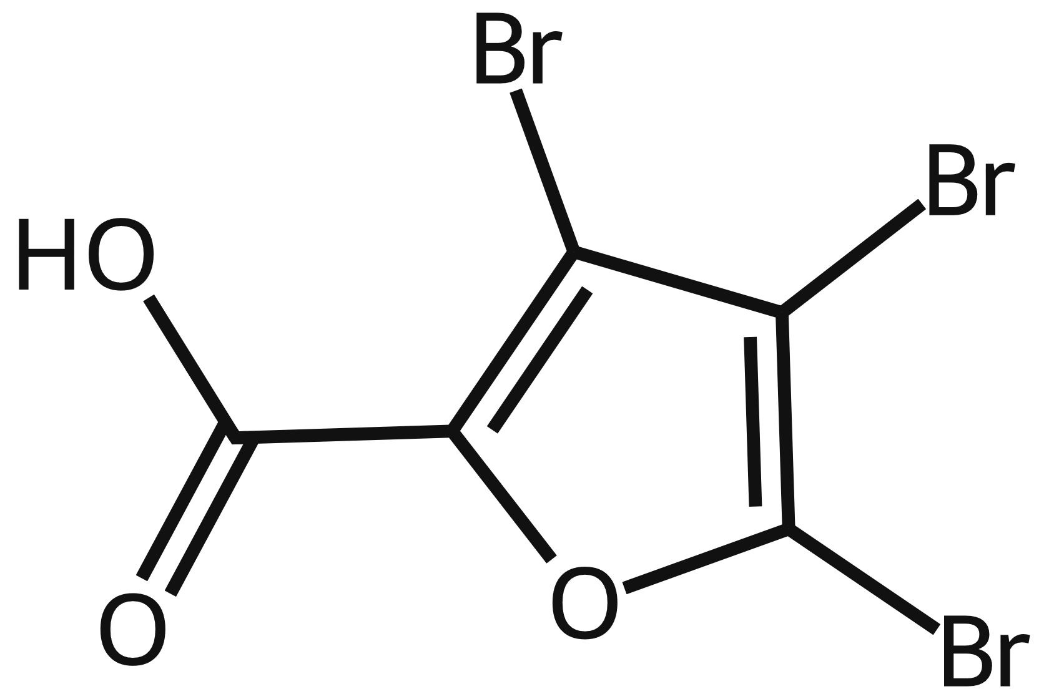
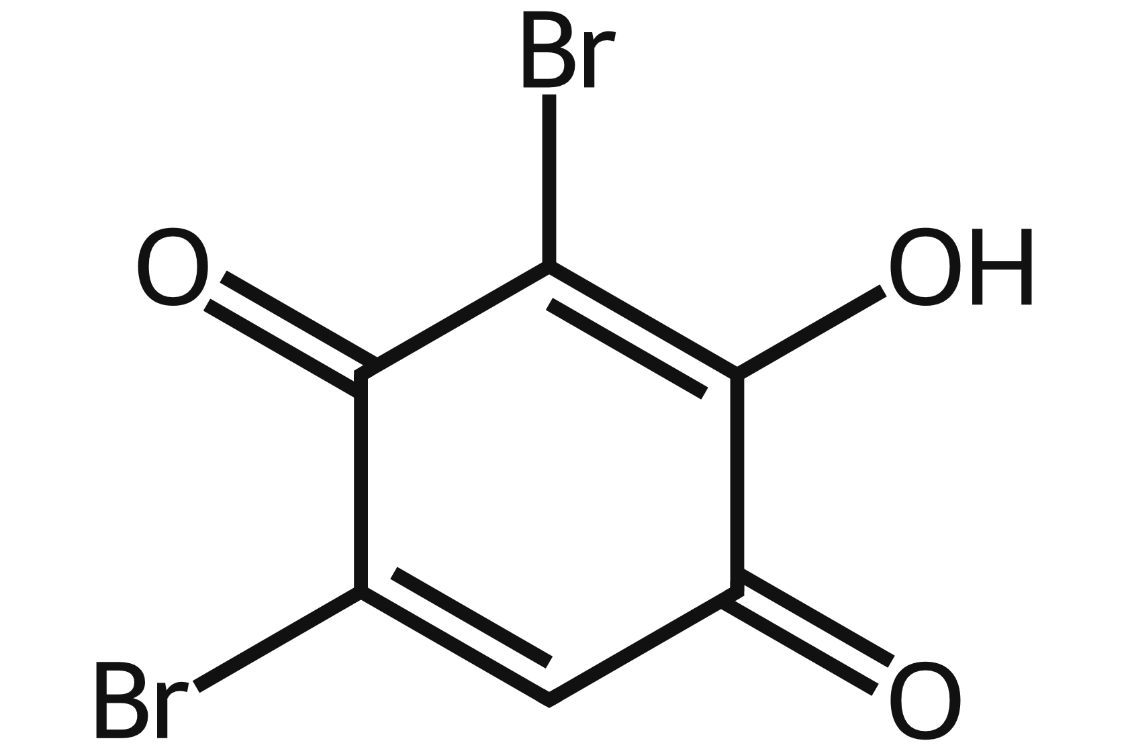
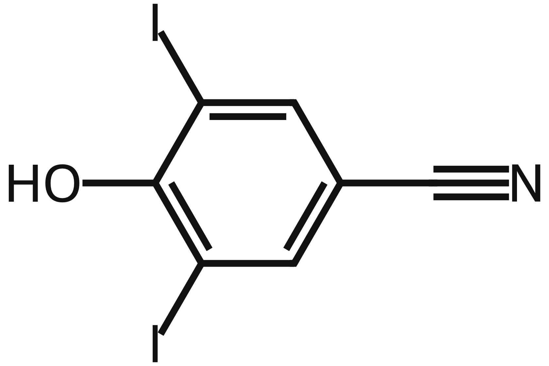
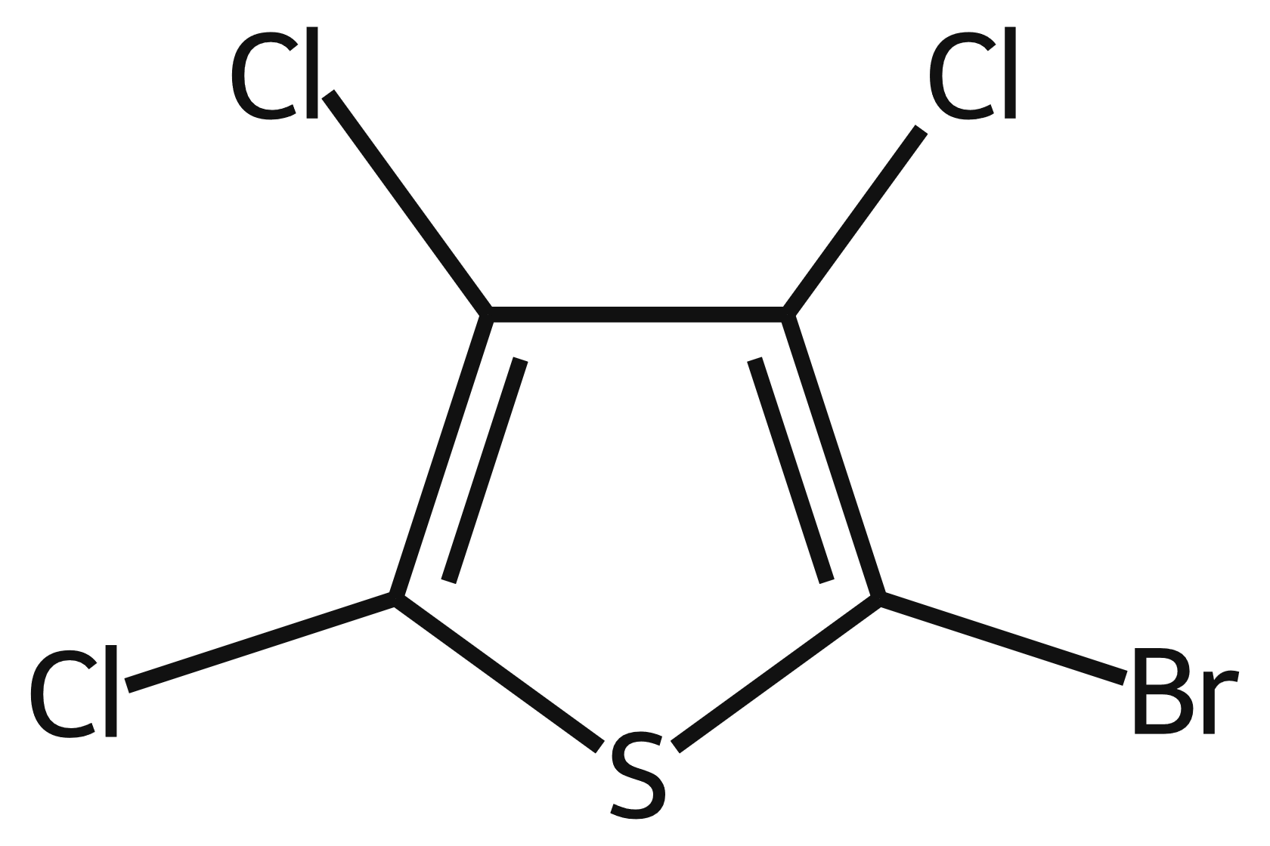
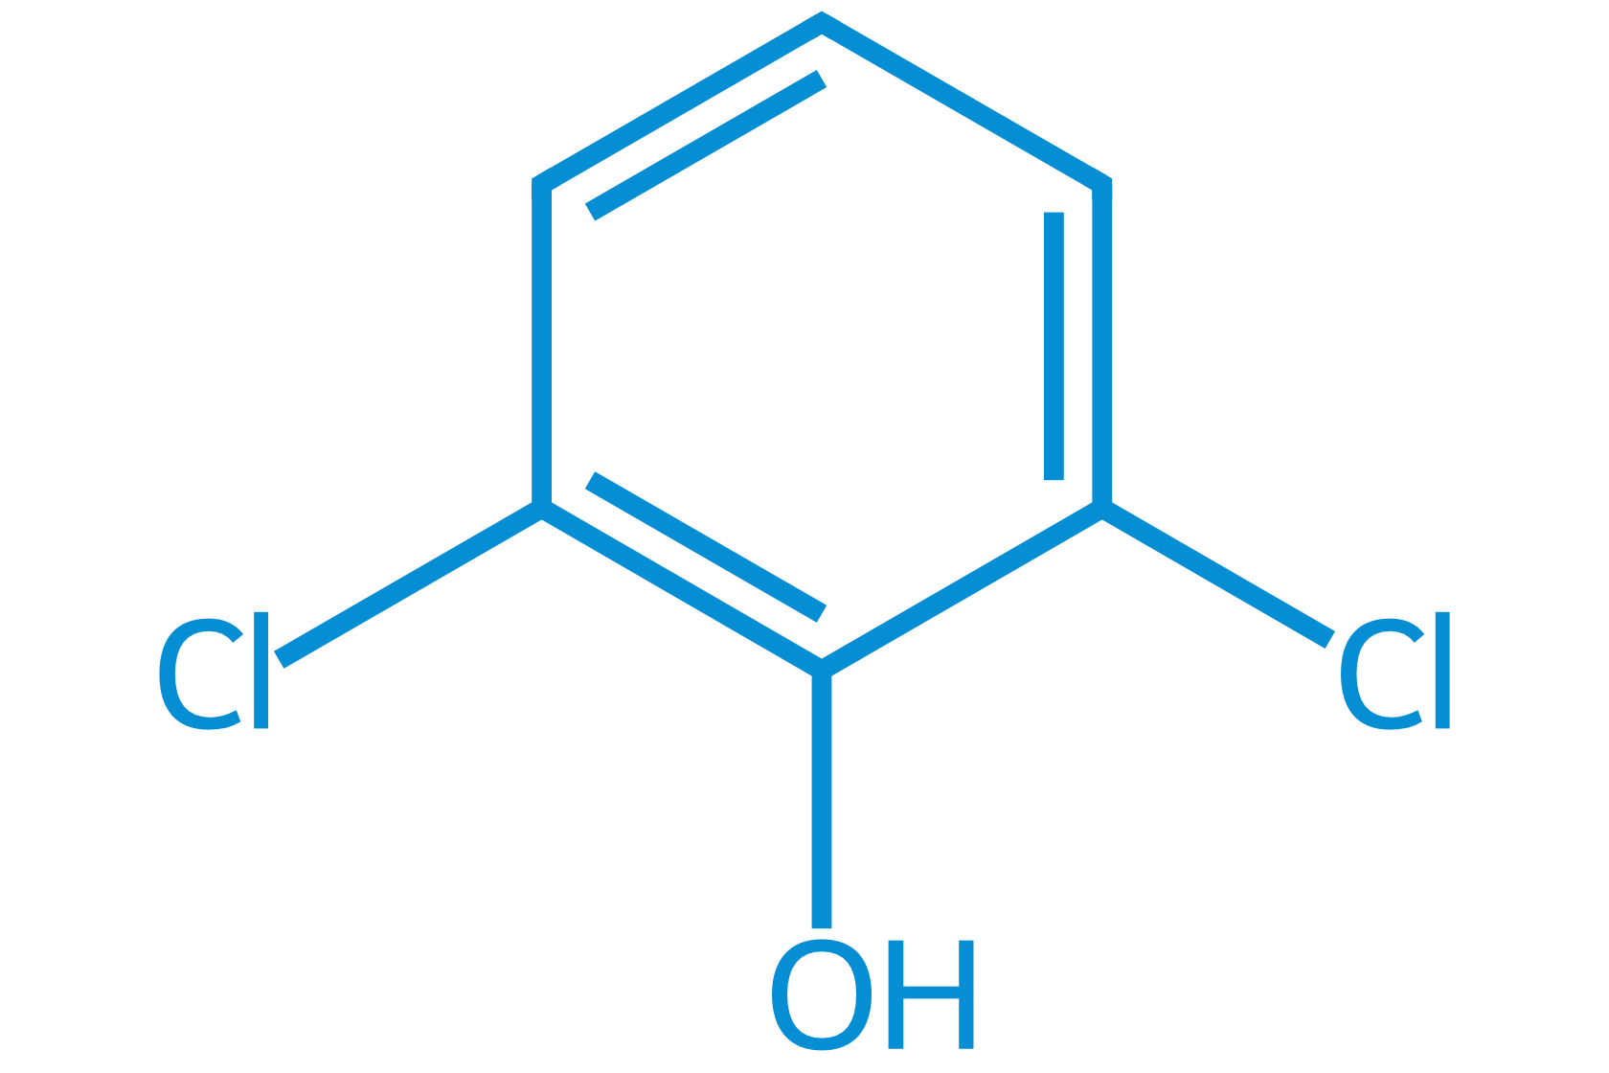
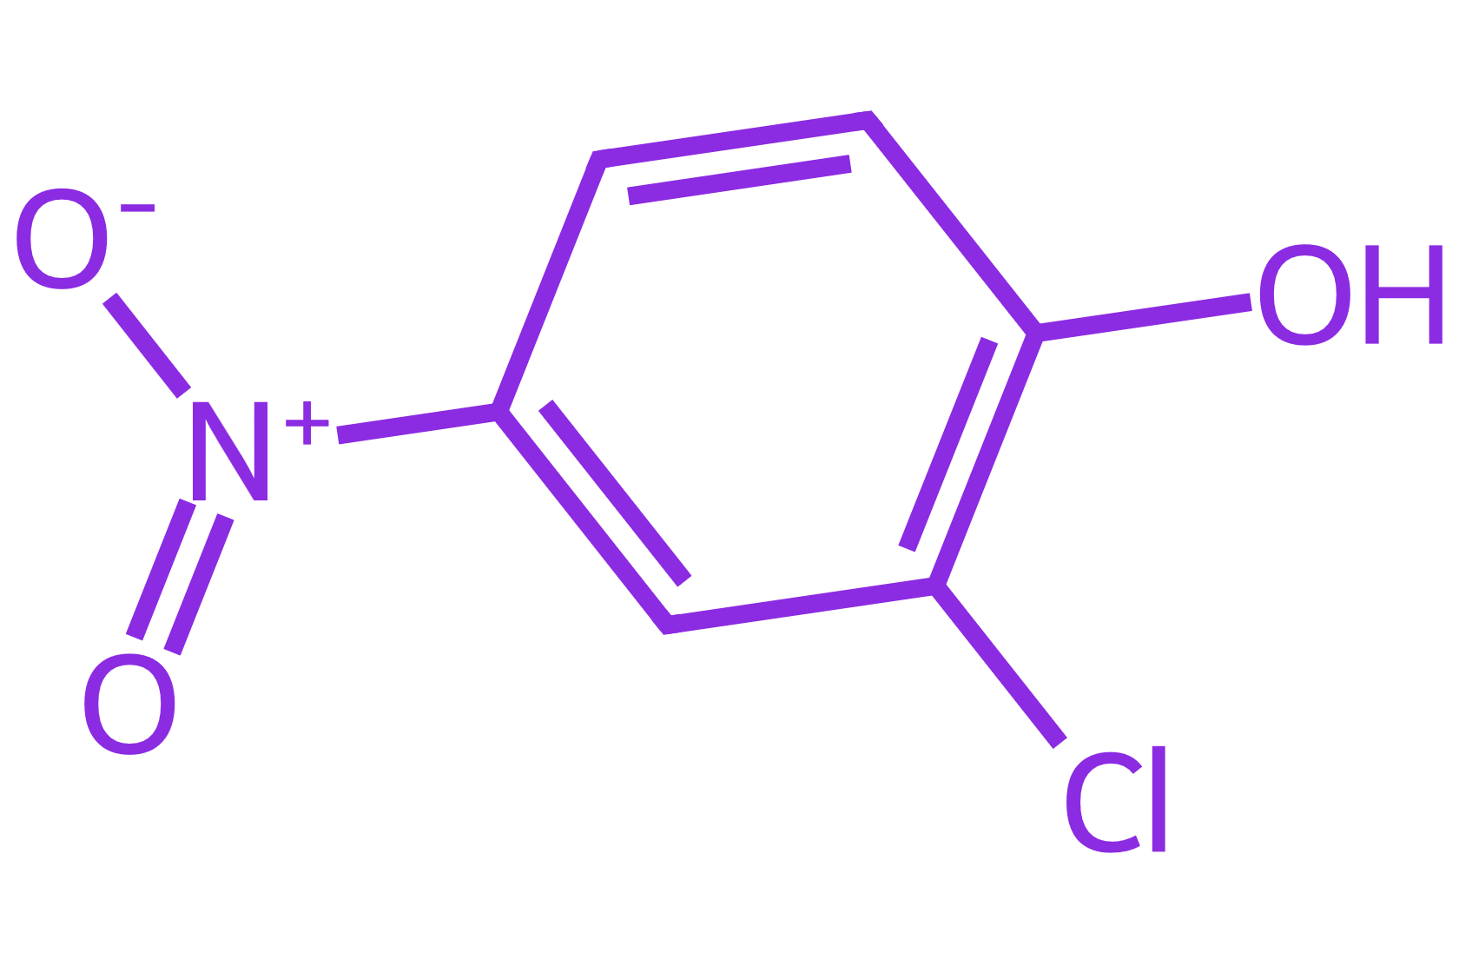
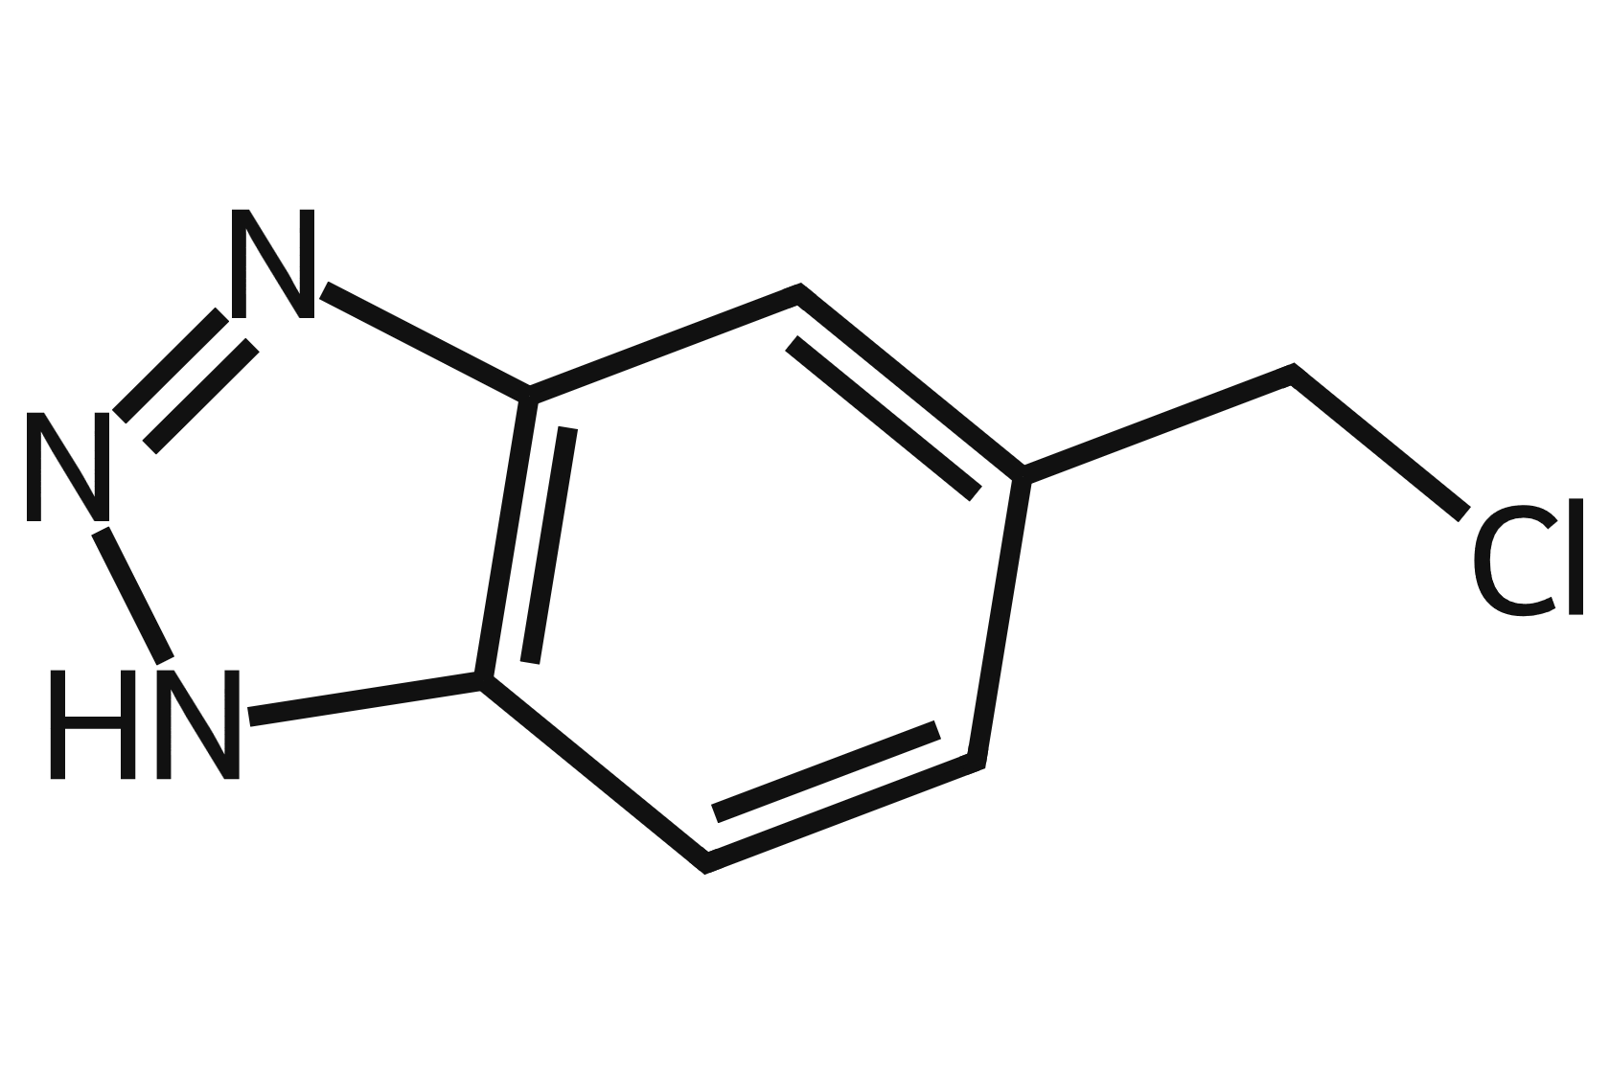
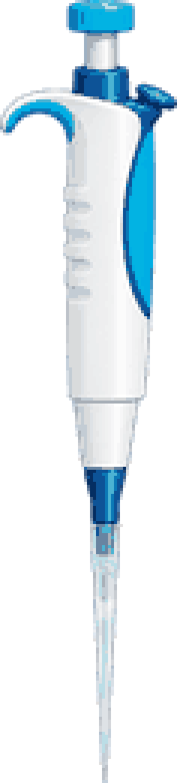

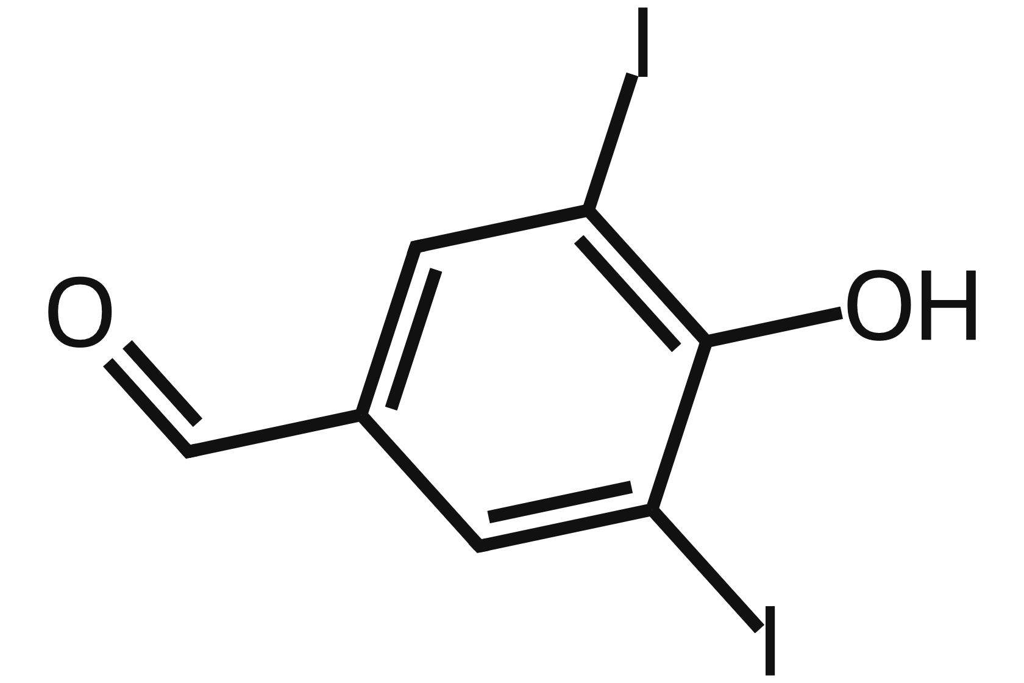
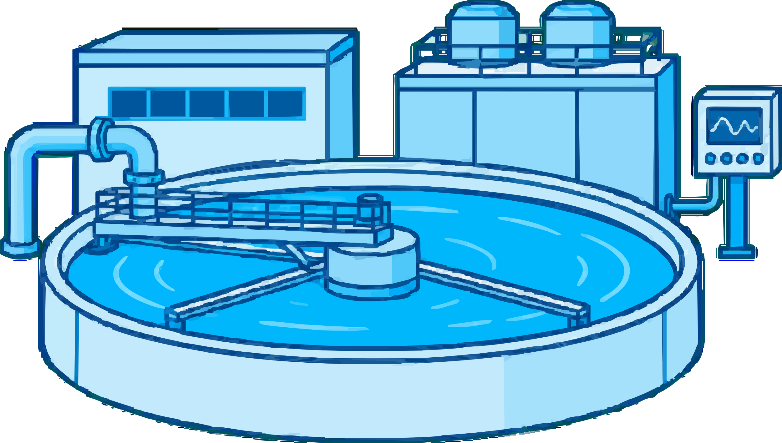
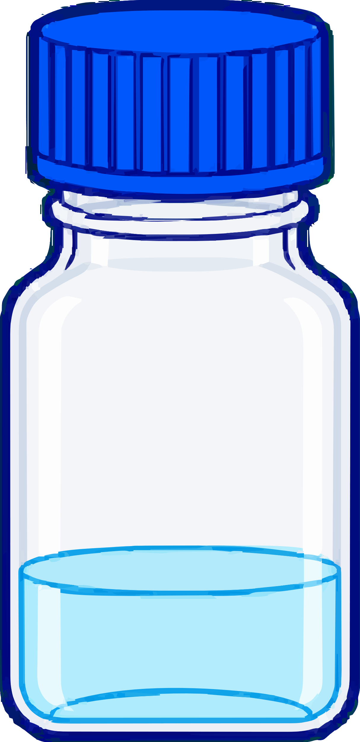
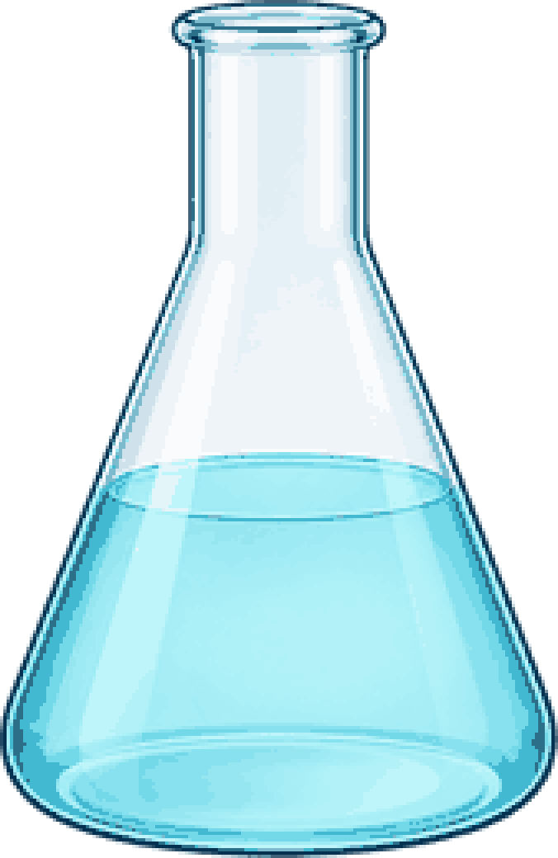
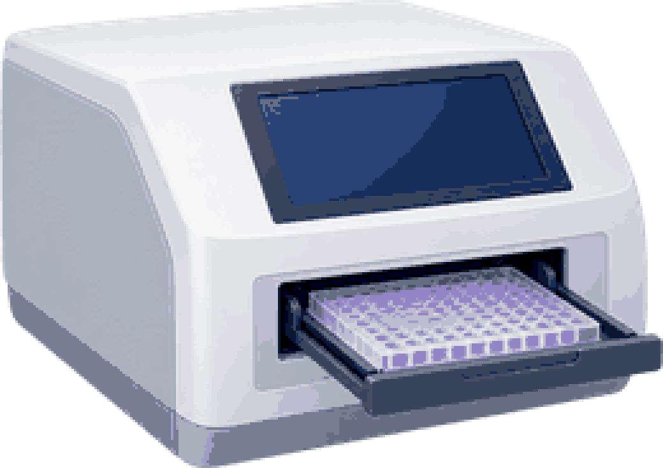


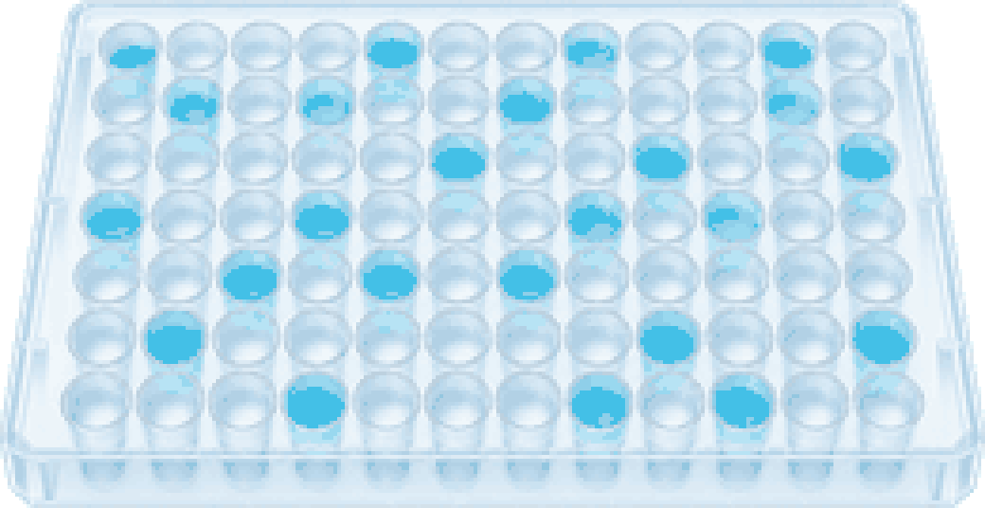
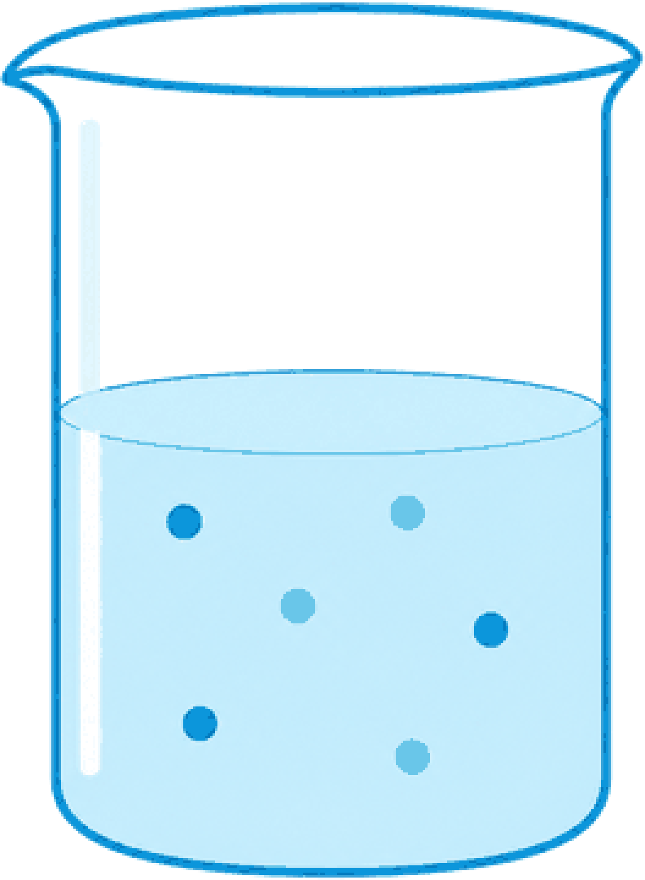
a
Data foundation
b
Model construction
CHO-K1
NCI-60
6,310
CHO-K1
NCI-60
Reported and proposed DBPs
Cl
OH
Cl
Chemical similarity
Cl
OH
Cl
cross-cell
response
context
Cell-state relation
•••
Time condition
•••
3–72 h
48 h
•••
365 records
2,136 responses
f
CHO
f
Transfer
=
S
Chem
×
S
Cell
×
S
Time
×
f
NCI
284 DBPs
36 compounds
60 cell lines
284
CHO-K1-tested DBPs
Curated toxicity data
Feature engineering
ET
RF
Cat
SVR
XGB
Select
ET
CHO-K1 pLC₅₀
c
Model validation
d
Applications
Independent validation
Transfer validity
Mixture toxicity
assessment
Confidence-aware
DBPs screening
Effect-weighted
prioritization
No transfer
Shuffled
Transfer
In domain
×
Out of
domain
f
f
f
Prediction uncertainty
8
Exposure
100
Effect
Measure LC₅₀
R²
RMSE
Prediction
SD
6
LC₅₀
100
1.0
1.0
4
50
2
SD
0
1
2
3
4
0
−1
0
1
2
3
4
Cell viability (%)
Compounds
Concentration
50
0.5
0.5
Concentration
Cytotoxicity
1.0
Candidate prioritization
LC₅₀
1.0
1.0
0
0
0
0.5
≠
0.5
0.5
CAT = ∑ᵢ (
Cᵢ
)
10⁻¹
10⁰
10¹
10²
10³
No transfer
Shuffled
Transfer
No transfer
Shuffled
Transfer
0
LC₅₀ᵢ
Concentration (µM)
0
1
2
3
0
1
2
3
1
2
3
4
5
Improved model performance
Compound
Compound
Candidate DBPs
Cytotoxicity assessment

