Slide 1
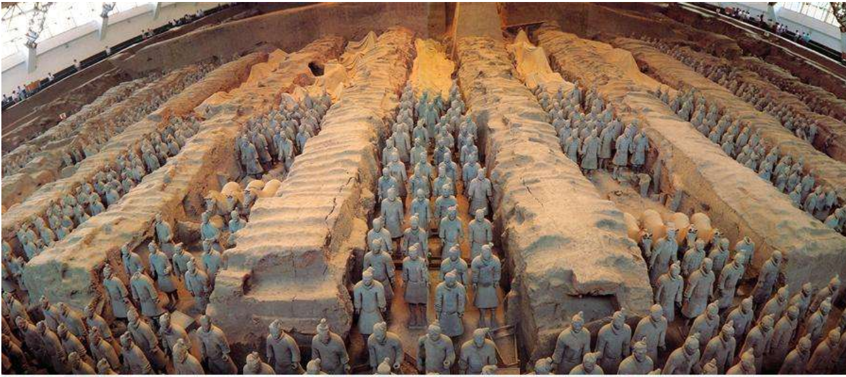
the Terracotta Army
Notes:
开头

Slide 2
video
Introduction of BingMaYong

Slide 3
introduction
The terra cotta warriors and horses, also referred to as the terra cotta warriors or terracotta warriors, is the first batch of national key cultural relics protection units, the first batch of China's world heritage sites.
Notes:
简介
兵马俑又称兵马俑或兵马俑，是我国首批国家重点文物保护单位、首批中国世界遗产地。

Slide 4
location
located in the terracotta warriors pit 1.5 km east of Qinshihuang Mausoleum in Lintong District, Xi'an City, Shaanxi Province.
Notes:
方位
位于陕西省西安市临潼区秦始皇陵以东1.5公里处的兵马俑坑内。

Slide 5
characteristics
There are 3 pit in it.The most famous pit is 1# pit.
Pit（井） 1# is in the south, 216 meters long and 62 meters wide from east to west, covering an area of 13260 square meters. Pit 2 is 124 meters long from east to west, 98 meters wide and covers an area of 6000 square meters.The area of pit 3 is 520 square meters.
Notes:
特征

Slide 6
history
When QINGSHIHUANG be the king he let people made many Ceramical dolls（铜人），because he wanted them Funerary objects（陪葬品）.
Notes:
历史

Slide 7
function
Terracotta warriors is a kind of ancient tomb sculpture(墓葬雕塑).
Terracotta warriors art sacrificial object（殉葬品） that made into the shape of horses and soldiers.
Notes:
功用
兵马俑是古代墓葬雕塑的一个类别。

Slide 8
awards
1.In 1987, Qinshihuang Mausoleum(秦始皇陵) and the Terra Cotta Warriors pit(兵马俑坑) were approved by UNESCO(联合国教科文组织) to be included in the <world heritage list>(《世界遗产名录》)
2. The Eighth Wonder of the World
Notes:
奖项称号
1.1987年，秦始皇陵及兵马俑坑被联合国教科文组织批准列入《世界遗产名录》
2.世界第八大奇迹

Slide 9
Thanks for listening~

