Slide 2
DEG filter condition
Qvalue<0.05
Foldchange>=2 or foldchange<=0.5

Slide 3
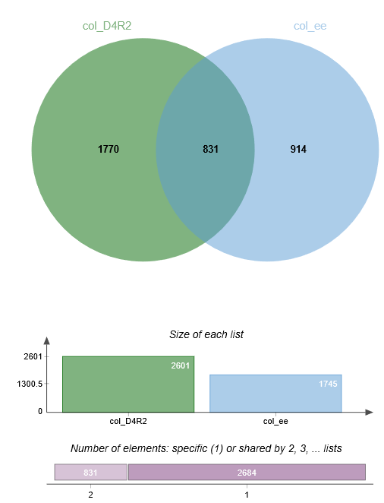
DEG

Slide 4

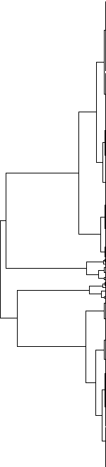

Both 831genes
log2(foldchange)

Slide 5
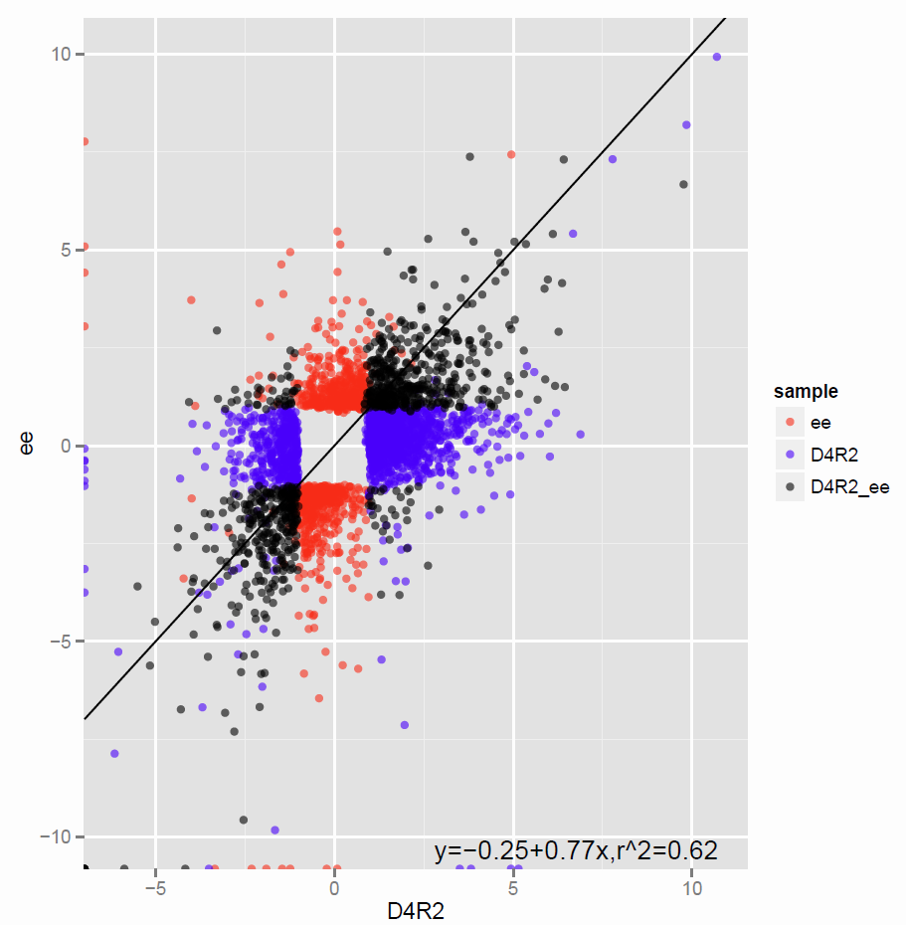
Merge 3515genes

Slide 6
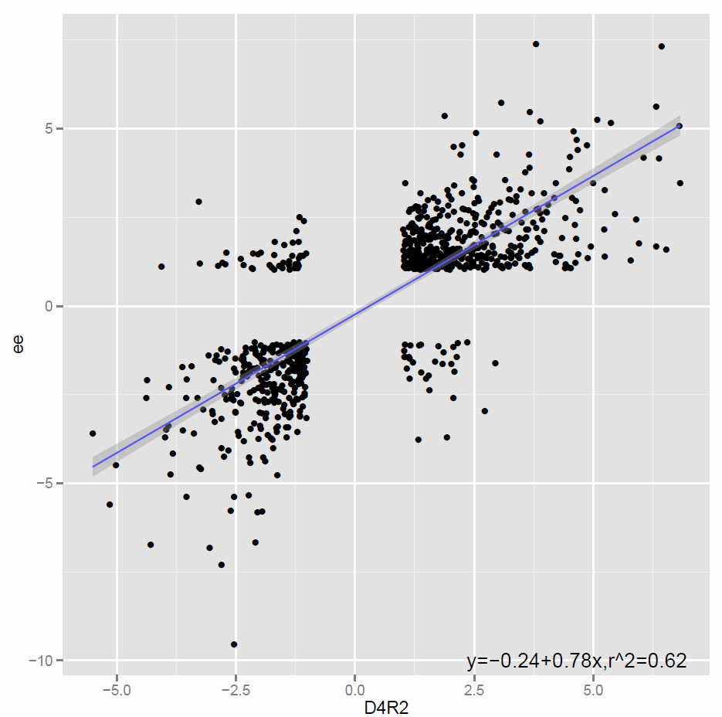
Both 831genes

Slide 8
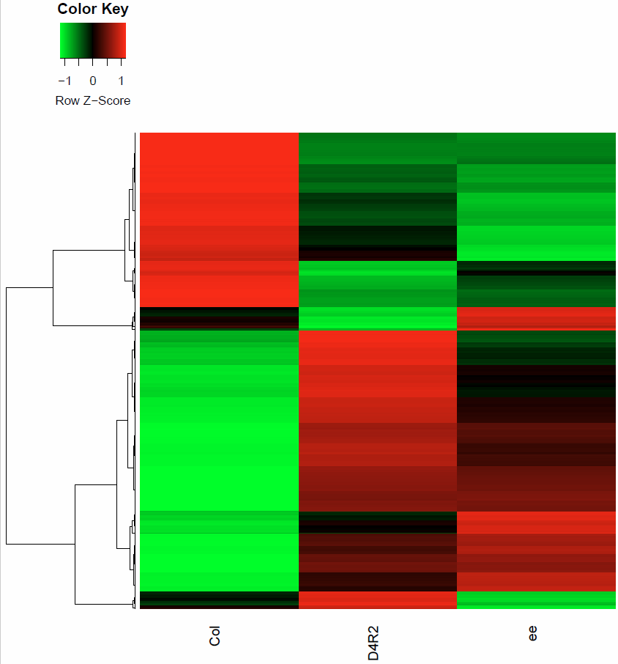
Both 831genes

Slide 9
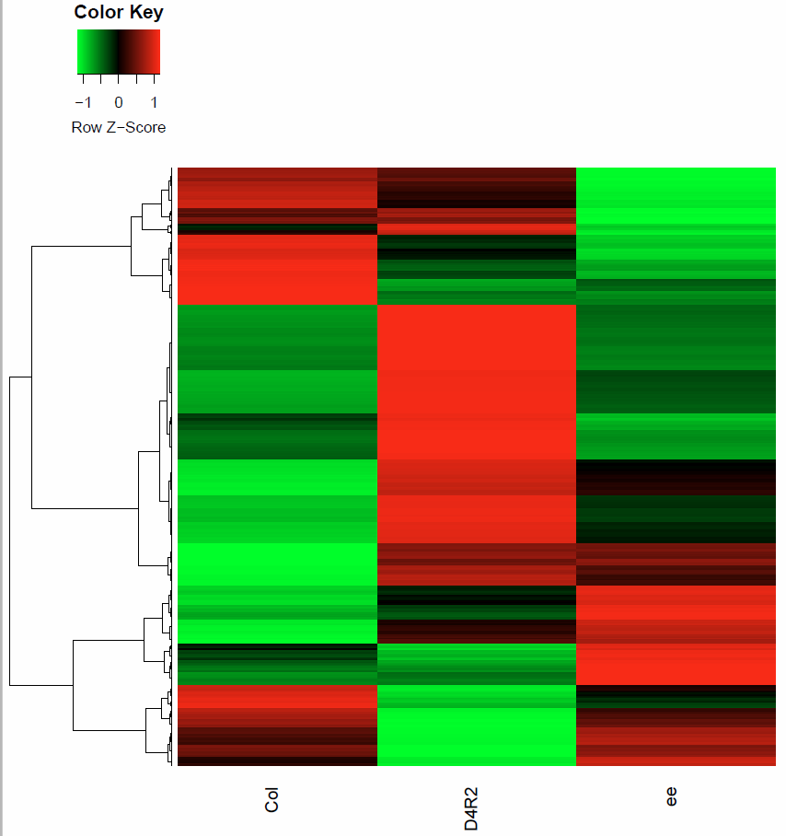
Merge 3515genes

Slide 10
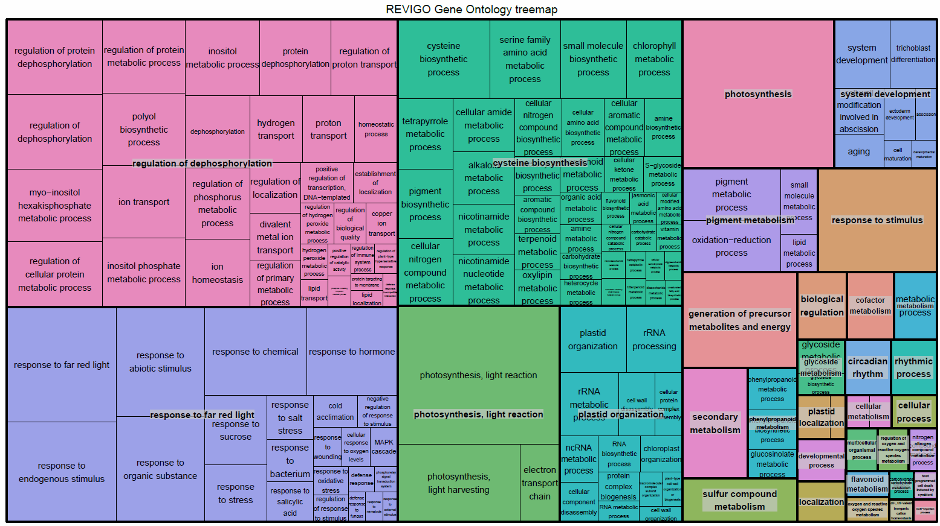
831genes

Slide 11
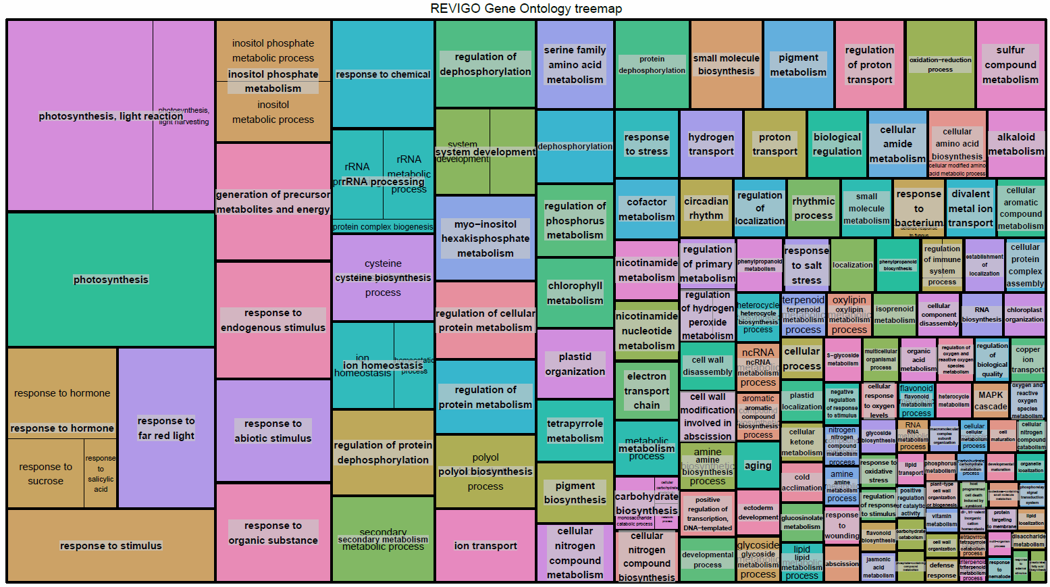
1770genes

Slide 12
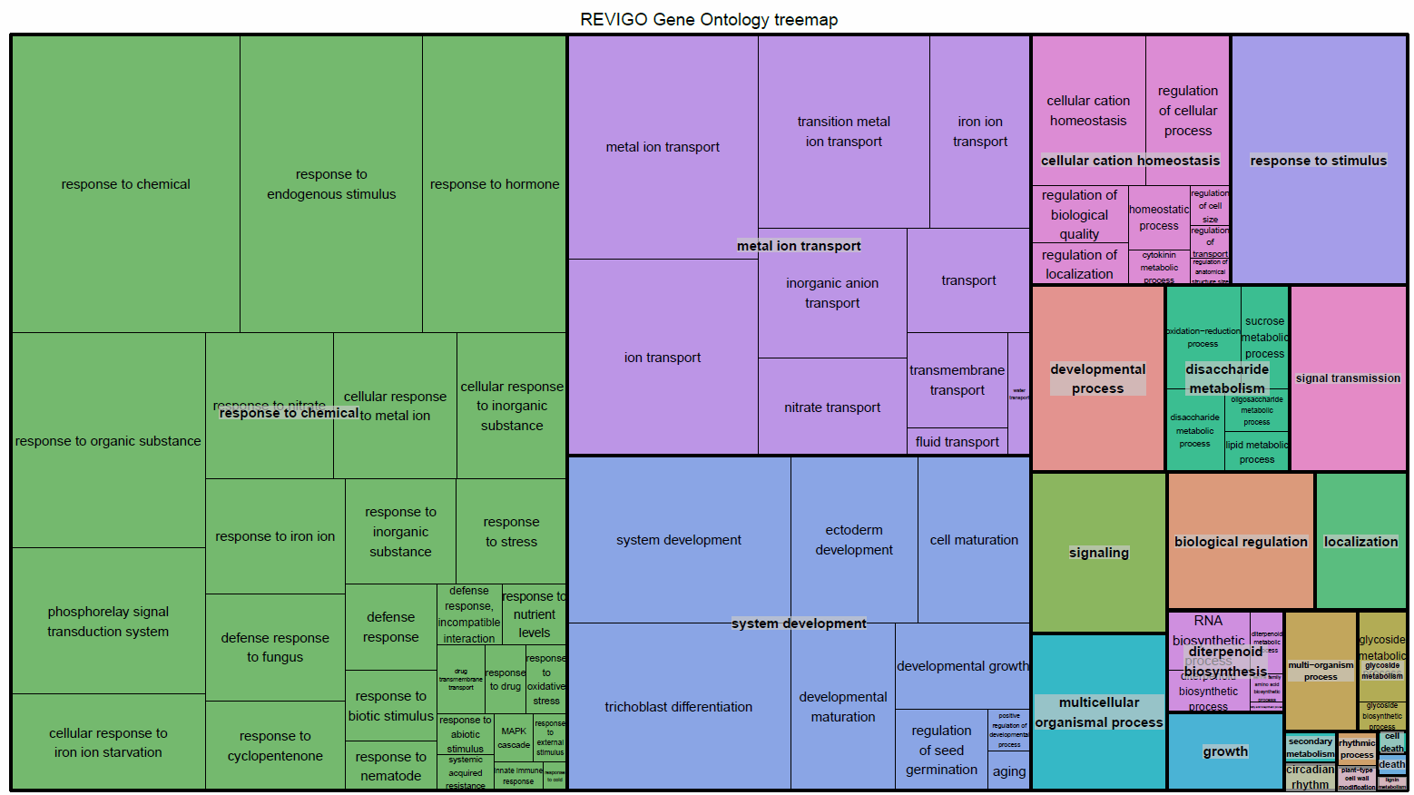
914genes

