Slide 2
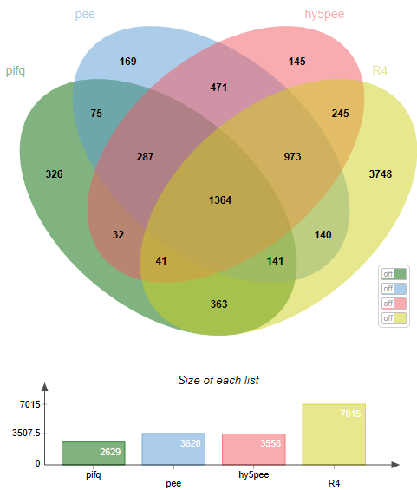

Slide 3
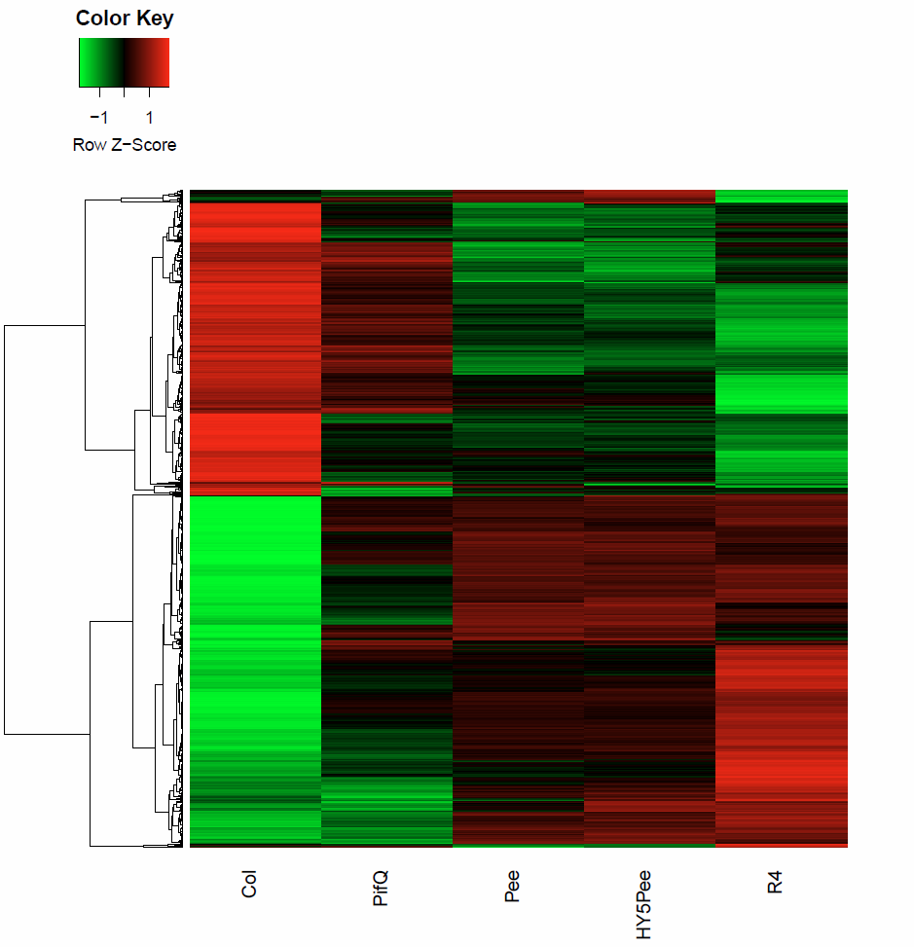
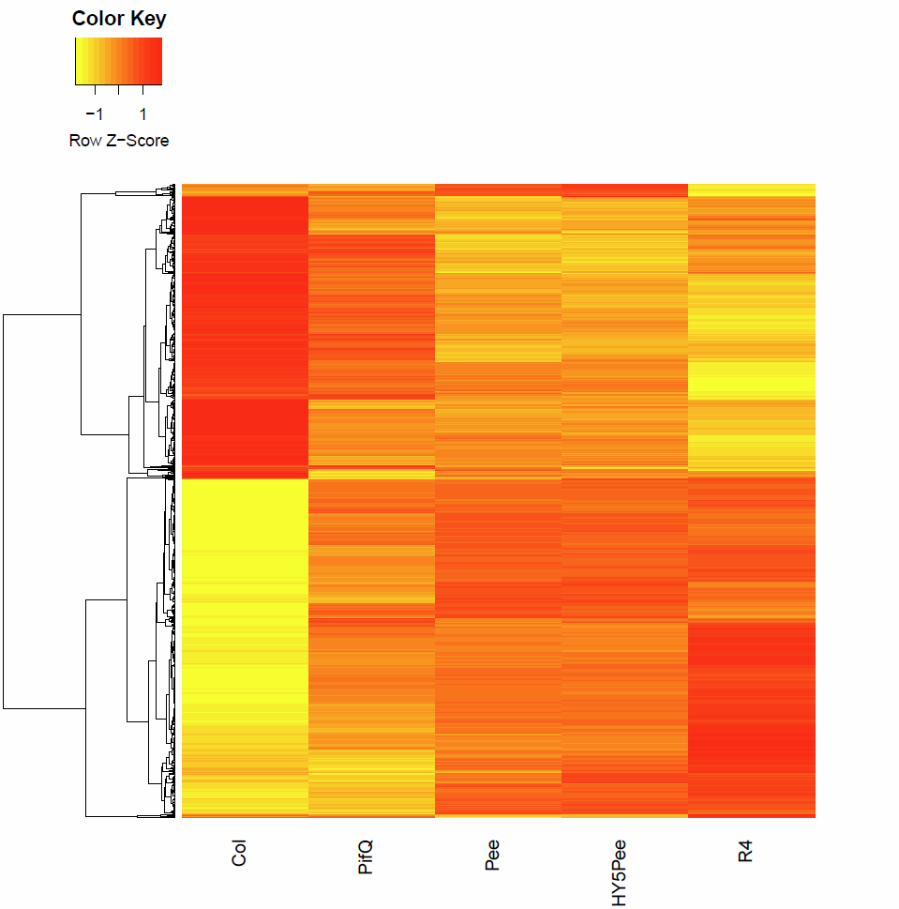

Slide 5
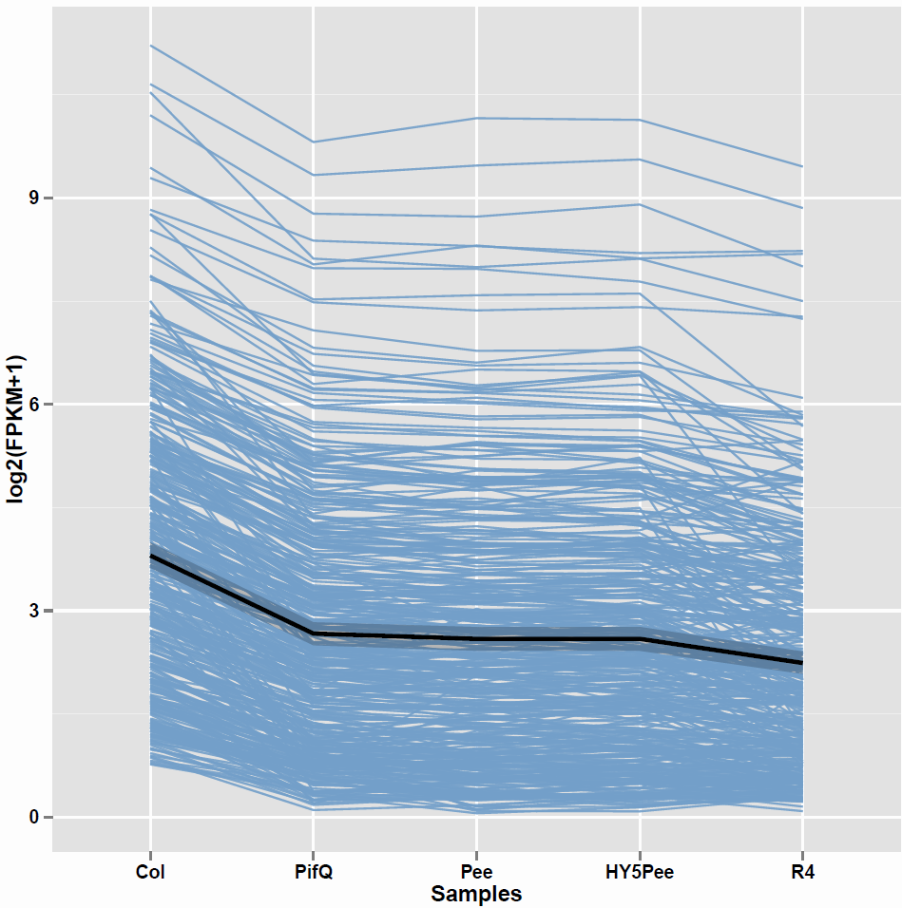
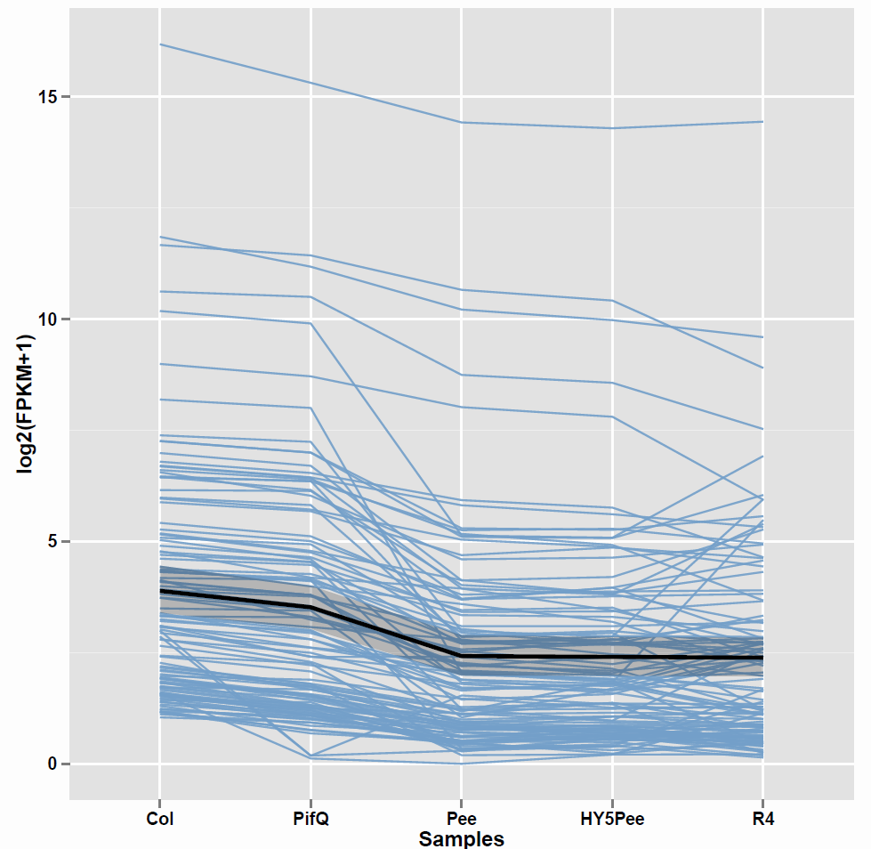
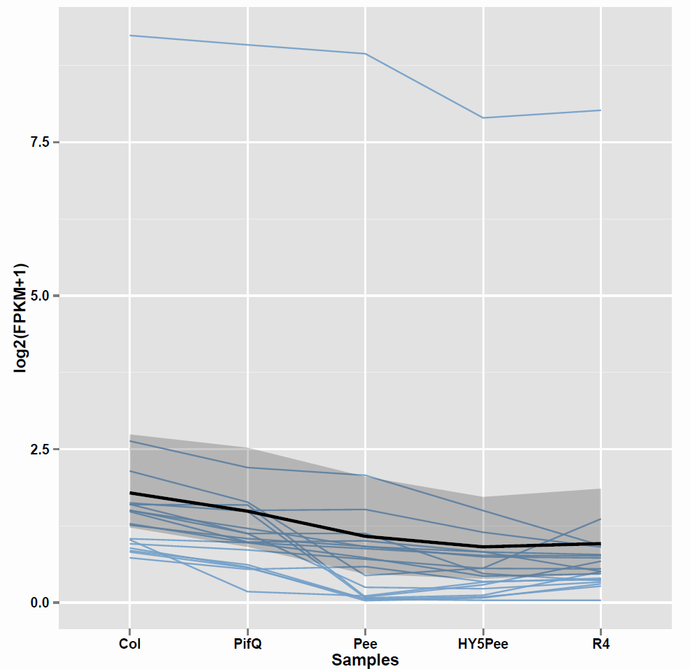
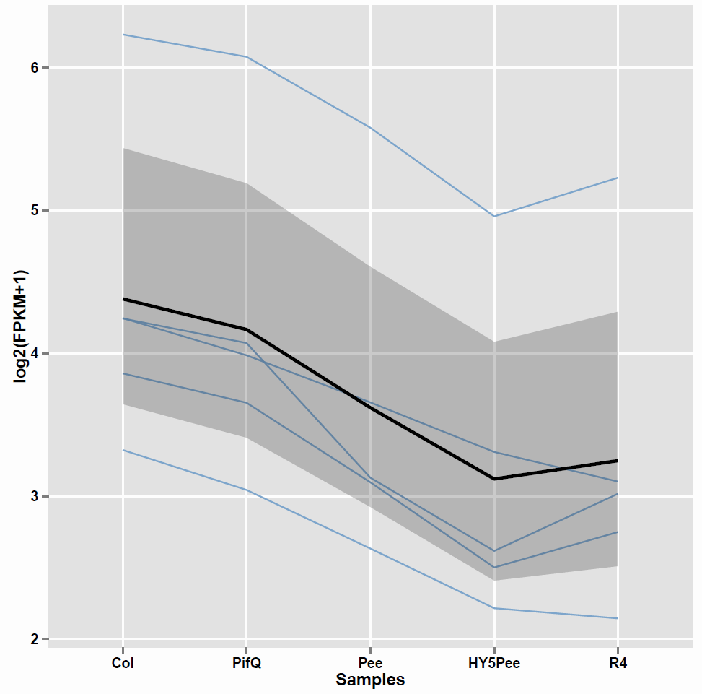
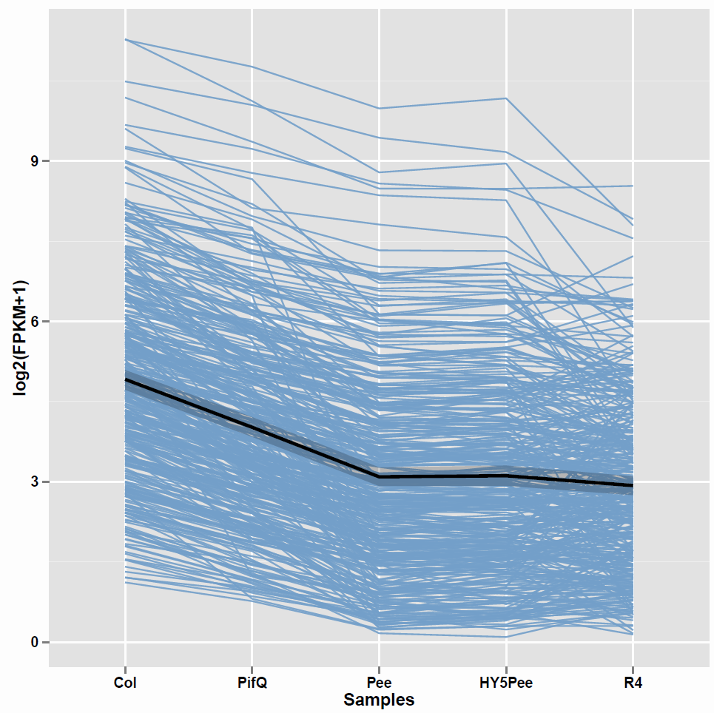
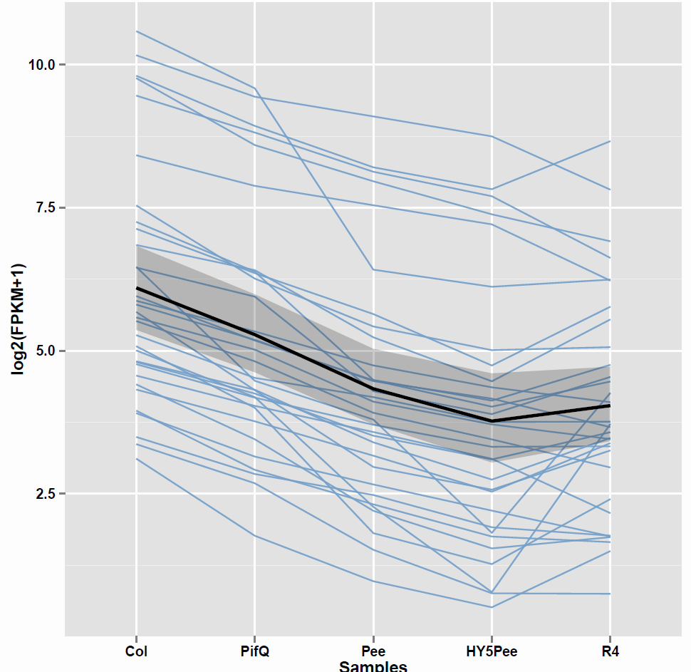
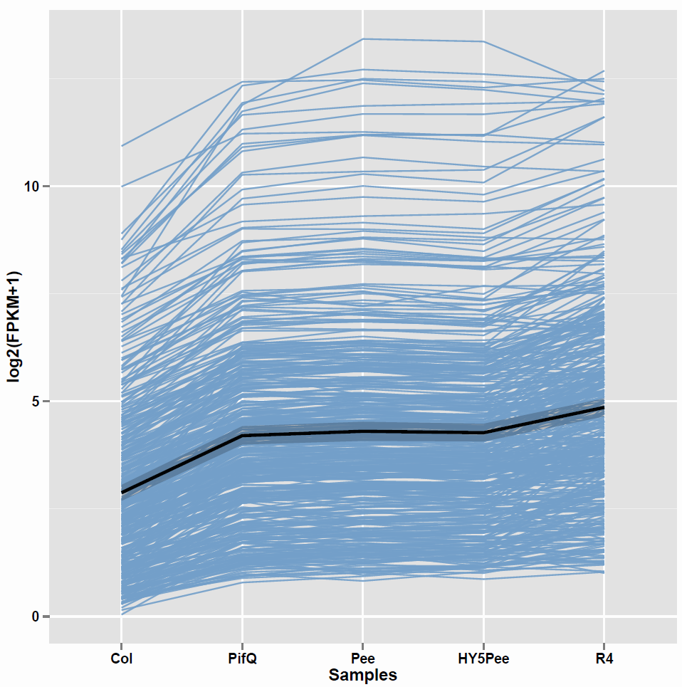
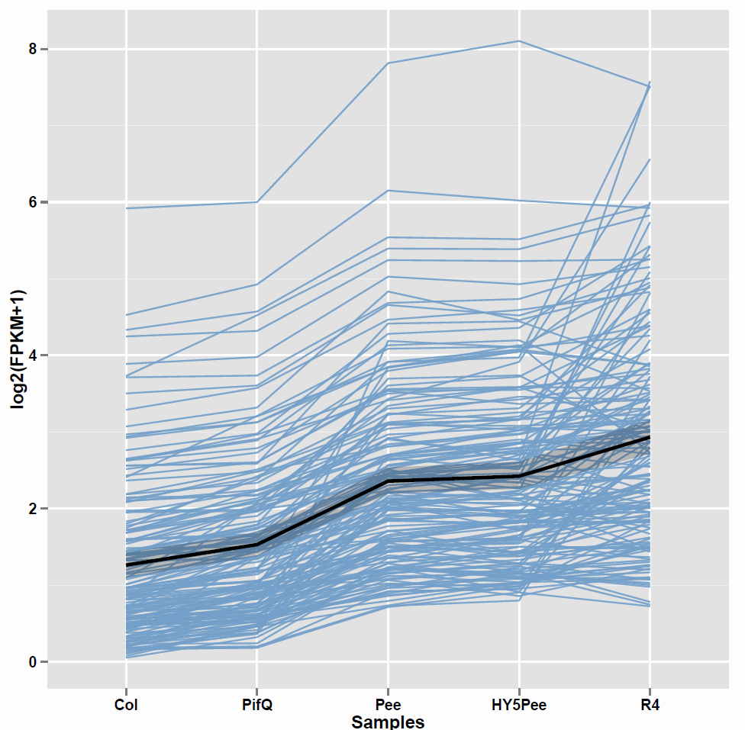
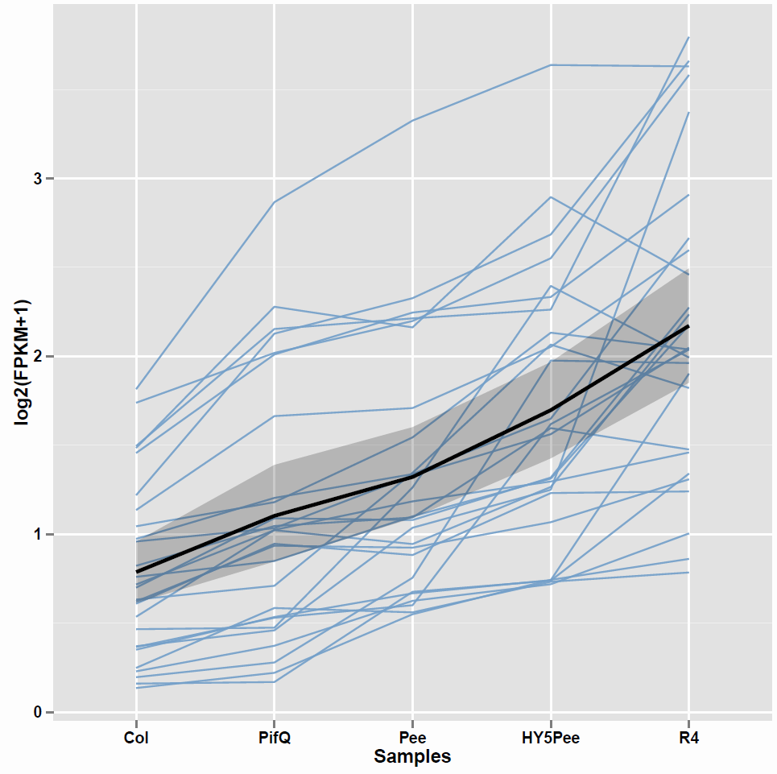
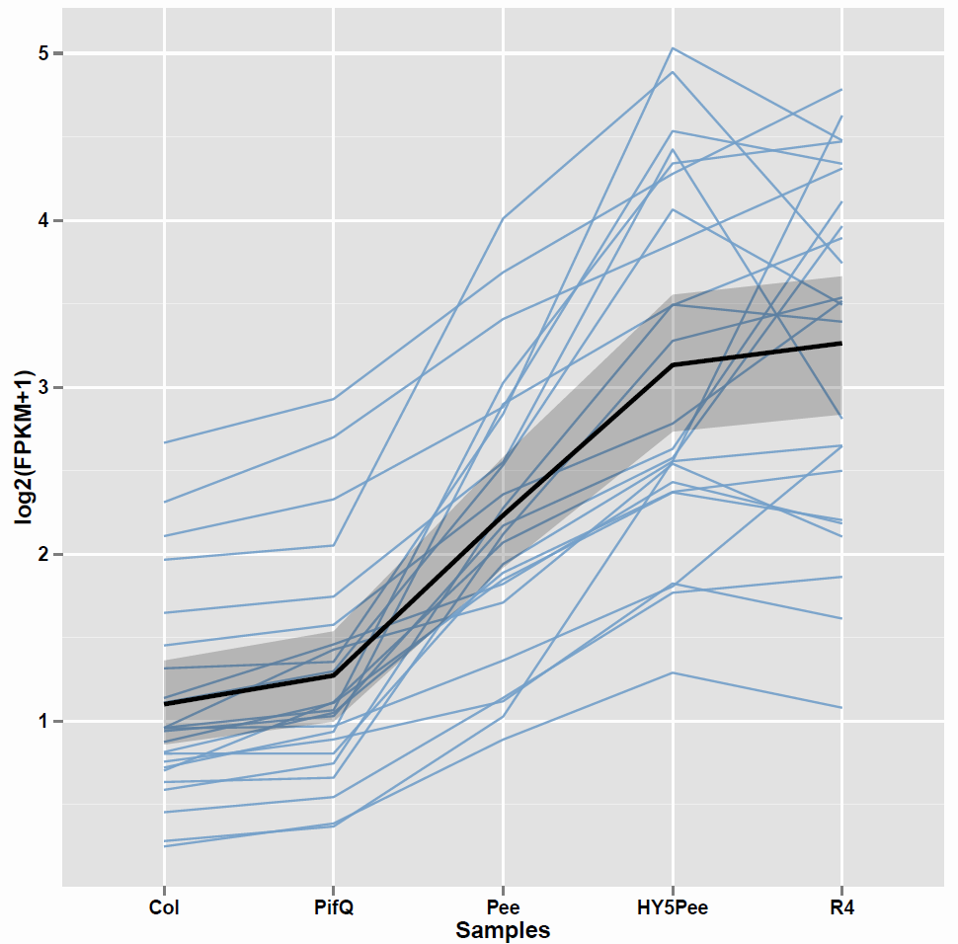
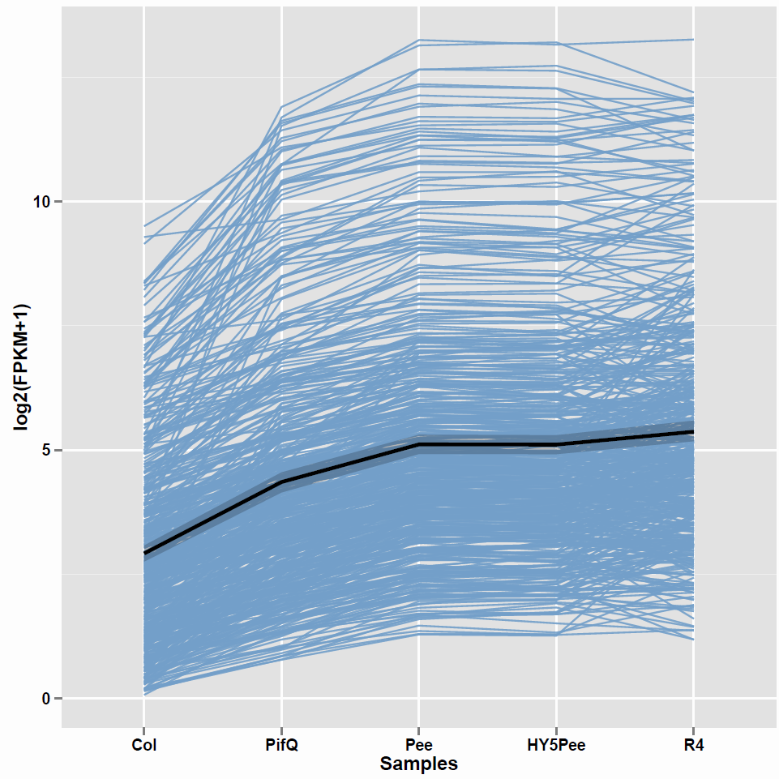
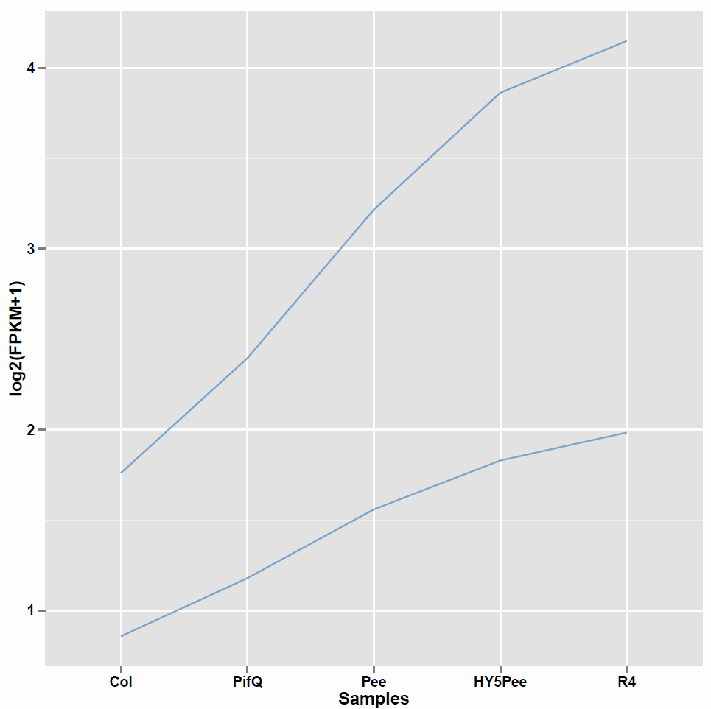
Only_pifq only_pee only_hy5 pee_hy5 pifq_pee pifq_pee_hy5

Slide 6
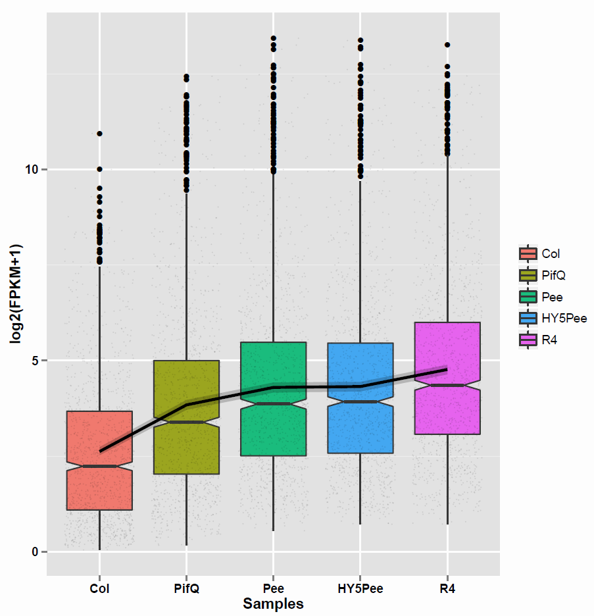
Up 1289

Slide 7
#Term | ID | Input number | Background number | P-Value | Corrected P-Value
Photosynthesis | ath00195 | 35 | 77 | 6.33E-17 | 1.92E-14
Photosynthesis - antenna proteins | ath00196 | 17 | 22 | 1.48E-11 | 2.25E-09
Metabolic pathways | ath01100 | 160 | 1861 | 2.00E-05 | 0.001462783
Porphyrin and chlorophyll metabolism | ath00860 | 13 | 45 | 2.41E-05 | 0.001462783
Starch and sucrose metabolism | ath00500 | 25 | 188 | 0.000733992 | 0.022166219
Biosynthesis of secondary metabolites | ath01110 | 86 | 995 | 0.00203173 | 0.043972434

Slide 8
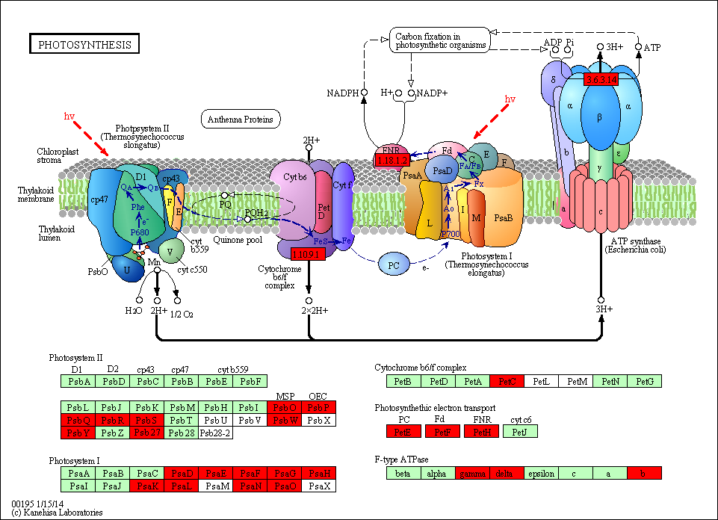

Slide 9
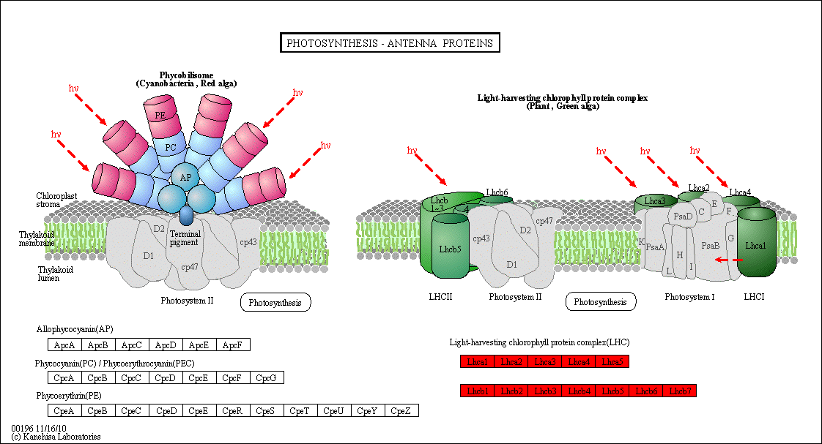

Slide 10
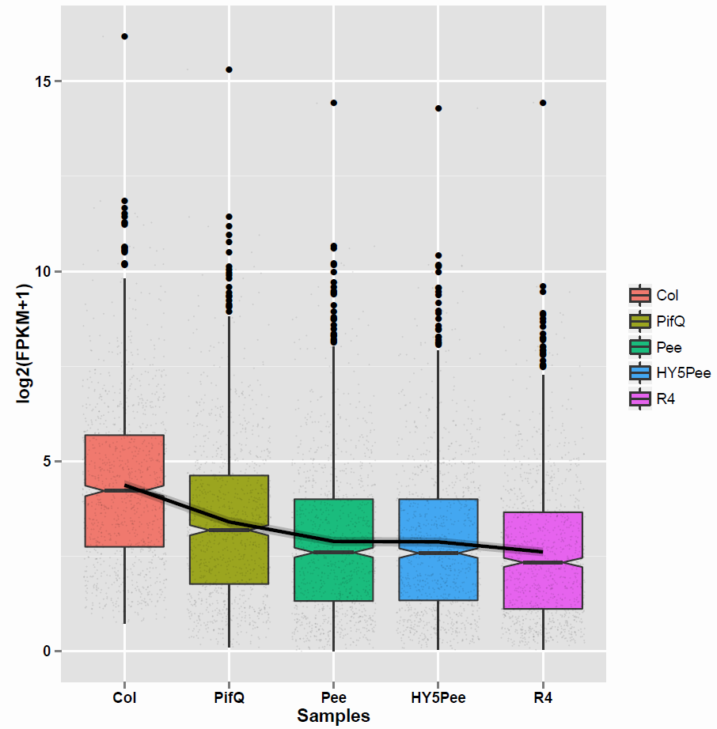
Down 1123

Slide 11
#Term | ID | Input number | Background number | P-Value | Corrected P-Value
Phenylalanine metabolism | ath00360 | 18 | 114 | 9.65E-07 | 8.20E-05
Phenylpropanoid biosynthesis | ath00940 | 20 | 154 | 3.73E-06 | 0.000158504
Plant hormone signal transduction | ath04075 | 27 | 271 | 8.00E-06 | 0.000226566

Slide 12
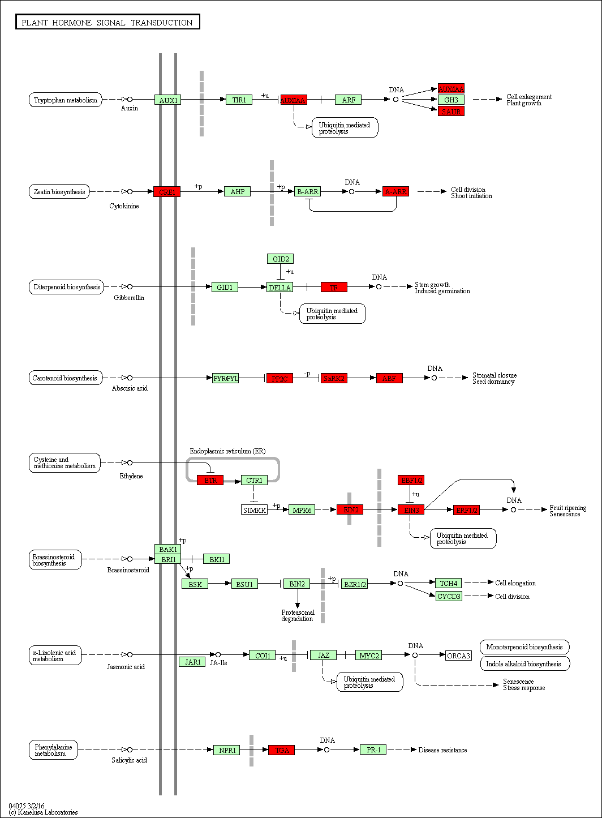

Slide 13
