Slide 1
Probase: A Probabilistic Taxonomy for Text Understanding
演讲人
刘森 MF1833040
组员
郭宇 MG1833101

Slide 2
什么是Probase？
Probase是一种基于概率的概念分类法。
它包含自动从16.8亿个网页中获得的270万个概念。 与将知识视为黑白的传统分类法不同，它使用概率来模拟其包含的不一致，模糊和不确定的信息。

Slide 3
Probase的特点
1
采用了新框架：采用了一种使用迭代算法来在web文本中提取isA（类属关系）对，并且使用一个分类构造算法把这些对连接成一个层次结构，这种分类法精度很高(92.8%)。
2
基于概率：Probase中的知识不再是黑白分明。 每个事实或关系都与一些概率相关联，以衡量其合理性和典型性。这种概率处理使Probase能够更好地捕获人类语言的语义（参见第4节）。
3
概念空间巨大：Probase完全由Web上的HTML文本自动构建，其概念空间大概有270万个概念，比YAGo大8倍。

Slide 4
信息提取
分类法构造
Probase的建模
CONTANTS

Slide 5

信息提取

Slide 6
信息提取
Probase是一种基于概率的概念分类法。
它包含自动从16.8亿个网页中获得的270万个概念。 与将知识视为黑白的传统分类法不同，它使用概率来模拟其包含的不一致，模糊和不确定的信息。

Slide 7
论文绪论
研究背景
研究方法
研究结果
问题讨论
论文总结
“
It was the best of times, it was the worst of times; it was the age of wisdom, it was the age of foolishness. It was the epoch of belief, and it was the epoch of incredulity. It was the season of light, and it was the season of darkness. It was the spring of hope, and it was the winter of despair.
It was the best of times, it was the worst of times; it was the age of wisdom, it was the age of foolishness. It was the epoch of belief, and it was the epoch of incredulity. It was the season of light, and it was the season of darkness. It was the spring of hope, and it was the winter of despair.
It was the best of times, it was the worst of times; it was the age of wisdom, it was the age of foolishness. It was the epoch of belief, and it was the epoch of incredulity. It was the season of light, and it was the season of darkness. It was the spring of hope, and it was the winter of despair.
”

Slide 8
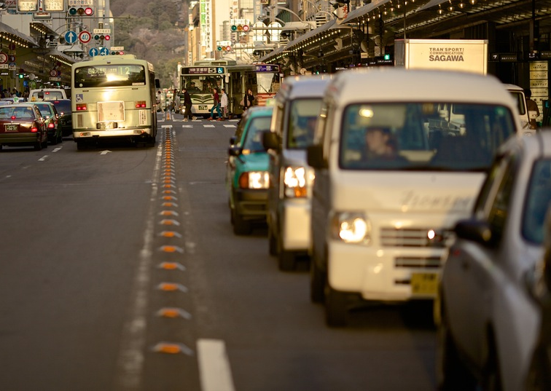
论文绪论
研究背景
研究方法
研究结果
问题讨论
论文总结
It was the best of times, it was the worst of times; it was the age of wisdom, it was the age of foolishness. It was the epoch of belief, and it was the epoch of incredulity. It was the season of light, and it was the season of darkness. It was the spring of hope, and it was the winter of despair.
It was the best of times, it was the worst of times; it was the age of wisdom, it was the age of foolishness. It was the epoch of belief, and it was the epoch of incredulity. It was the season of light, and it was the season of darkness. It was the spring of hope, and it was the winter of despair.

Slide 9
研究背景
It was the best of times, it was the worst of times; it was the age of wisdom, it was the age of foolishness.

Slide 10
论文绪论
研究背景
研究方法
研究结果
问题讨论
论文总结
ADD TITLE
It was the best of times, it was the worst of times; it was the age of wisdom, it was the age of foolishness.
ADD TITLE
It was the best of times, it was the worst of times; it was the age of wisdom, it was the age of foolishness.
ADD TITLE
It was the best of times, it was the worst of times; it was the age of wisdom, it was the age of foolishness.

Slide 11
论文绪论
研究背景
研究方法
研究结果
问题讨论
论文总结
TEXT
keyword
TEXT
keyword
keyword
TEXT
keyword
TEXT
TITLE
TITLE
TITLE
TITLE
It was the best of times, it was the worst of times; it was the age of wisdom, it was the age of foolishness. It was the epoch of belief, and it was the epoch of incredulity. It was the season of light, and it was the season of darkness. It was the spring of hope, and it was the winter of despair.
It was the best of times, it was the worst of times; it was the age of wisdom, it was the age of foolishness. It was the epoch of belief, and it was the epoch of incredulity. It was the season of light, and it was the season of darkness. It was the spring of hope, and it was the winter of despair.
It was the best of times, it was the worst of times; it was the age of wisdom, it was the age of foolishness. It was the epoch of belief, and it was the epoch of incredulity. It was the season of light, and it was the season of darkness. It was the spring of hope, and it was the winter of despair.
It was the best of times, it was the worst of times; it was the age of wisdom, it was the age of foolishness. It was the epoch of belief, and it was the epoch of incredulity. It was the season of light, and it was the season of darkness. It was the spring of hope, and it was the winter of despair.

Slide 12
论文绪论
研究背景
研究方法
研究结果
问题讨论
论文总结
TEXT
TEXT
TEXT
TEXT
TEXT
It was the best of times, it was the worst of times; it was the age of wisdom, it was the age of foolishness. It was the epoch of belief, and it was the epoch of incredulity. It was the season of light, and it was the season of darkness. It was the spring of hope, and it was the winter of despair.

Slide 13
研究方法
It was the best of times, it was the worst of times; it was the age of wisdom, it was the age of foolishness.

Slide 14
论文绪论
研究背景
研究方法
研究结果
问题讨论
论文总结
TEXT
TEXT
TEXT
TEXT
It was the best of times, it was the worst of times; it was the age of wisdom, it was the age of foolishness. It was the epoch of belief, and it was the epoch of incredulity.
It was the best of times, it was the worst of times; it was the age of wisdom, it was the age of foolishness. It was the epoch of belief, and it was the epoch of incredulity.
It was the best of times, it was the worst of times; it was the age of wisdom, it was the age of foolishness. It was the epoch of belief, and it was the epoch of incredulity.
It was the best of times, it was the worst of times; it was the age of wisdom, it was the age of foolishness. It was the epoch of belief, and it was the epoch of incredulity.

Slide 15
论文绪论
研究背景
研究方法
研究结果
问题讨论
论文总结
ADD YOUR TITLE
It was the best of times, it was the worst of times; it was the age of wisdom, it was the age of foolishness. It was the epoch of belief, and it was the epoch of incredulity. It was the season of light, and it was the season of darkness. It was the spring of hope, and it was the winter of despair.
ADD YOUR TITLE
It was the best of times, it was the worst of times; it was the age of wisdom, it was the age of foolishness. It was the epoch of belief, and it was the epoch of incredulity. It was the season of light, and it was the season of darkness. It was the spring of hope, and it was the winter of despair.

Slide 16
论文绪论
研究背景
研究方法
研究结果
问题讨论
论文总结
ADD TITLE
ADD TITLE
It was the best of times, it was the worst of times; it was the age of wisdom, it was the age of foolishness.
It was the best of times, it was the worst of times; it was the age of wisdom, it was the age of foolishness.
ADD TITLE
ADD TITLE
It was the best of times, it was the worst of times; it was the age of wisdom, it was the age of foolishness.
It was the best of times, it was the worst of times; it was the age of wisdom, it was the age of foolishness.

Slide 17
研究结果
It was the best of times, it was the worst of times; it was the age of wisdom, it was the age of foolishness.

Slide 18
论文绪论
研究背景
研究方法
研究结果
问题讨论
论文总结
It was the best of times, it was the worst of times; it was the age of wisdom, it was the age of foolishness.
It was the best of times, it was the worst of times; it was the age of wisdom, it was the age of foolishness.

Slide 19
论文绪论
研究背景
研究方法
研究结果
问题讨论
论文总结
TEXT
TEXT
TEXT
It was the best of times, it was the worst of times; it was the age of wisdom, it was the age of foolishness. It was the epoch of belief, and it was the epoch of incredulity. It was the season of light, and it was the season of darkness. It was the spring of hope, and it was the winter of despair.
毕业论文题目

Slide 20
论文绪论
研究背景
研究方法
研究结果
问题讨论
论文总结
It was the best of times, it was the worst of times; it was the age of wisdom, it was the age of foolishness.

Slide 21
问题讨论
It was the best of times, it was the worst of times; it was the age of wisdom, it was the age of foolishness.

Slide 22
论文绪论
研究背景
研究方法
研究结果
问题讨论
论文总结
ADD TITLE
ADD TITLE
It was the best of times, it was the worst of times; it was the age of wisdom, it was the age of foolishness.
s
It was the best of times, it was the worst of times; it was the age of wisdom, it was the age of foolishness.
T
TEXT
w
o
ADD TITLE
ADD TITLE
It was the best of times, it was the worst of times; it was the age of wisdom, it was the age of foolishness.
It was the best of times, it was the worst of times; it was the age of wisdom, it was the age of foolishness.

Slide 23
论文绪论
研究背景
研究方法
研究结果
问题讨论
论文总结
ADD YOUR TITLE
1
It was the best of times, it was the worst of times; it was the age of wisdom, it was the age of foolishness. It was the epoch of belief, and it was the epoch of incredulity. It was the season of light, and it was the season of darkness. It was the spring of hope, and it was the winter of despair.
TEXT
ADD YOUR TITLE
It was the best of times, it was the worst of times; it was the age of wisdom, it was the age of foolishness. It was the epoch of belief, and it was the epoch of incredulity. It was the season of light, and it was the season of darkness. It was the spring of hope, and it was the winter of despair.
2
3
ADD YOUR TITLE
It was the best of times, it was the worst of times; it was the age of wisdom, it was the age of foolishness. It was the epoch of belief, and it was the epoch of incredulity. It was the season of light, and it was the season of darkness. It was the spring of hope, and it was the winter of despair.

Slide 24
论文总结
It was the best of times, it was the worst of times; it was the age of wisdom, it was the age of foolishness.

Slide 25
论文绪论
研究背景
研究方法
研究结果
问题讨论
论文总结
ADD YOUR TITLE
A
It was the best of times, it was the worst of times; it was the age of wisdom, it was the age of foolishness. It was the epoch of belief, and it was the epoch of incredulity. It was the season of light, and it was the season of darkness. It was the spring of hope, and it was the winter of despair.
ADD YOUR TITLE
B
It was the best of times, it was the worst of times; it was the age of wisdom, it was the age of foolishness. It was the epoch of belief, and it was the epoch of incredulity. It was the season of light, and it was the season of darkness. It was the spring of hope, and it was the winter of despair.
ADD YOUR TITLE
C
It was the best of times, it was the worst of times; it was the age of wisdom, it was the age of foolishness. It was the epoch of belief, and it was the epoch of incredulity. It was the season of light, and it was the season of darkness. It was the spring of hope, and it was the winter of despair.

Slide 26
THANKS
NAME
DAMEN

