Slide 1

Weekly update
07/06/2023
Shangke Liu
刘尚柯

Slide 2
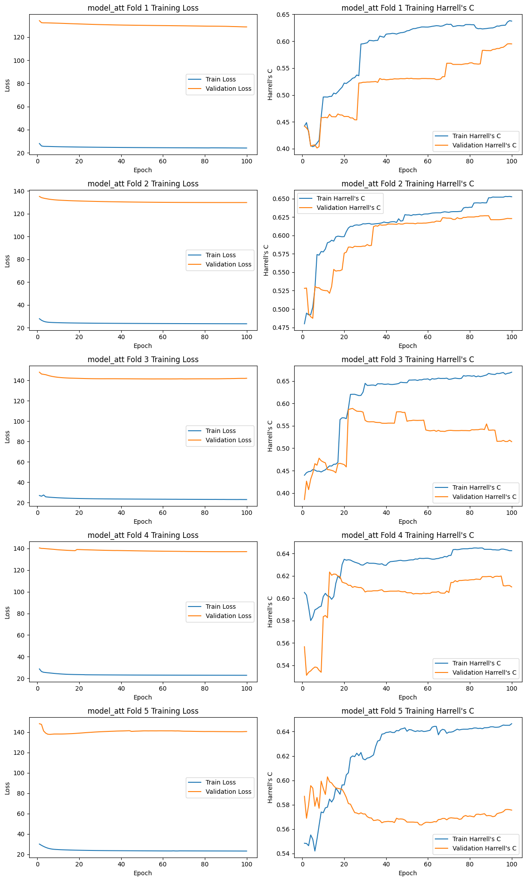
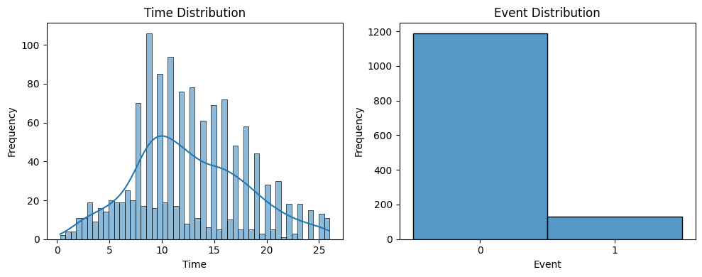
Progress
Good performance with sampling from 10 strata (5 time bins and event 1 or 0)
Skipping invalid batches in training using batch_size 64 (all “0” event)

Slide 3
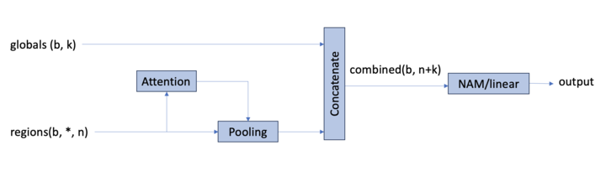
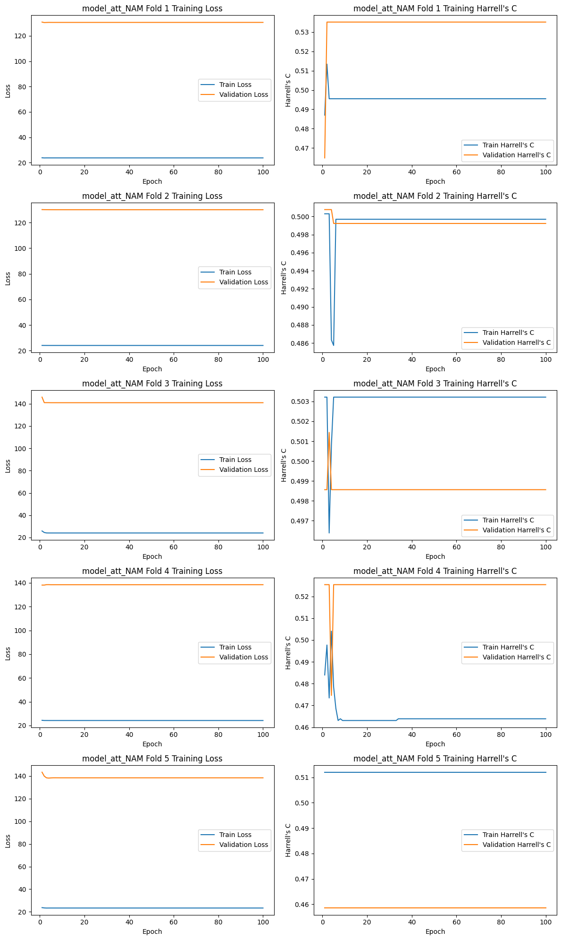
Progress
Concat global features with poolded vector
Explainability by deriving a NAM-attention model

Slide 4
Next Step
Get relative score for interpretability in NAM
Fix problems with NAM especially in data type
Keep experimenting with different NAM application

