Slide 1

Attention-based survival analysis
Shangke Liu

Slide 2
Content
Introduction
Dataset
Model
Results and Conclusion
Future Work
Q&A

Slide 3
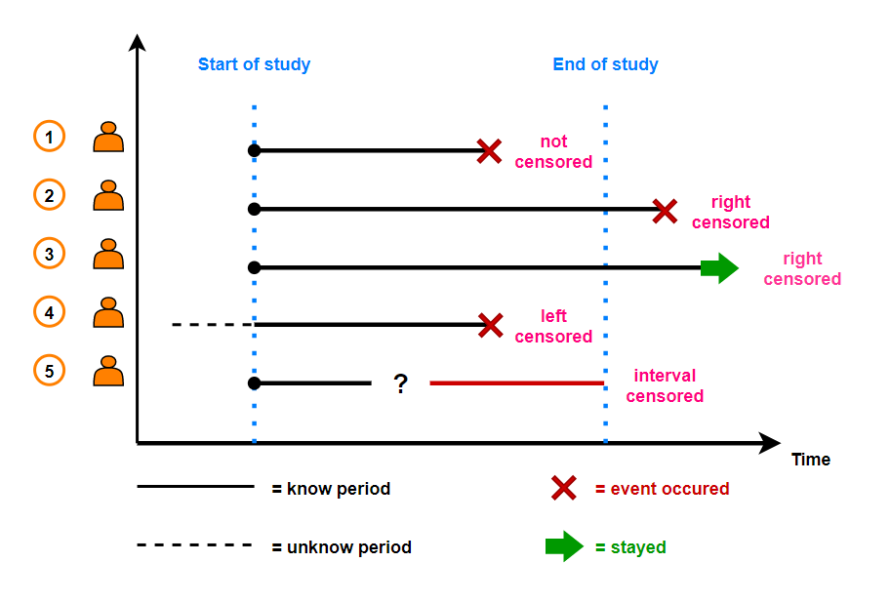
Introduction-survival analysis
Definition: Deal with the analysis of the time it takes for an event of interest to occur.
Censoring: The event of interest may not be observed for all subjects within the study period.
Hazard Function: Instantaneous risk of experiencing the event at a given time, given that the individual has survived up to that time.”
Data and Labels in Survival Analysis
Data: composed of a set of features (covariates) for each subject.
Labels: Consist of two components - survival time and event indicator.
Survival Time: The observed time to event or the time at which the subject was censored.
Event Indicator: A binary variable indicating whether the event occurred (1) or was censored (0).

Slide 4
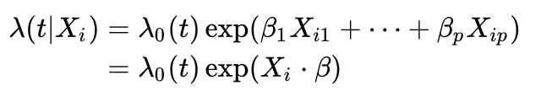
Introduction-Cox model
Cox Proportional Hazards Model: A Seminal Model in Survival Analysis
Introduced by Sir David Cox in 1972.
Aims to estimate the relationship between features (covariates) and the hazard function.
Key Features of Cox Model
No assumptions about the baseline hazard function.
Assumes a multiplicative relationship between covariates and the hazard function.
Provides hazard ratios for each covariate, allowing the comparison of relative risks.
Cox Model in Our Problem
Cox partial likelihood is used as the loss function for our neural network models.
The neural network learns to generate a risk score for each region based on their features.
Higher risk scores correspond to a higher risk of the event occurring

Slide 5
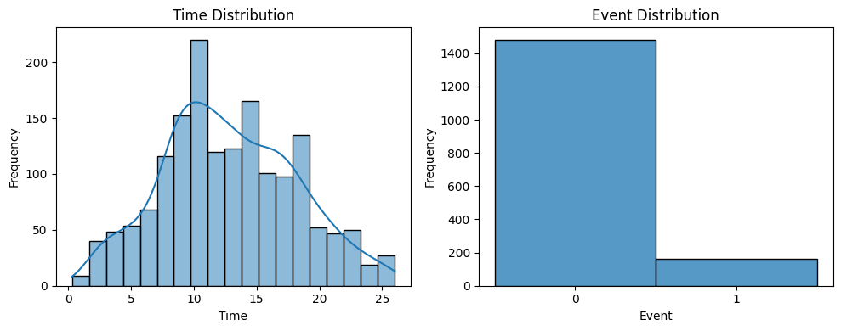
Dataset-overview
CPSII dataset contains 1708 slides, each contains different number of regions
Features (dim=49) and Survival Outcomes(time, event)
Challenges in Handling Irregular Data Structures

Slide 6
Dataset-preprocessing
Cleaning and Transformation of the Data
Handling Missing Values, padding with median values
Feature Scaling and Normalization

Slide 7


Dataset -ragged data loader
D
Working with Ragged Tensors in TensorFlow (batch_size, Ni, D)
Loading and Batching Data with a high batch size to avoid certain batches contain all 0 event.
B
Ni

Slide 8
model-overview
Attention-Based Model for Survival Analysis
Why Attention Mechanism Matters in this Context
Baseline Model: Averaging Features

Slide 9
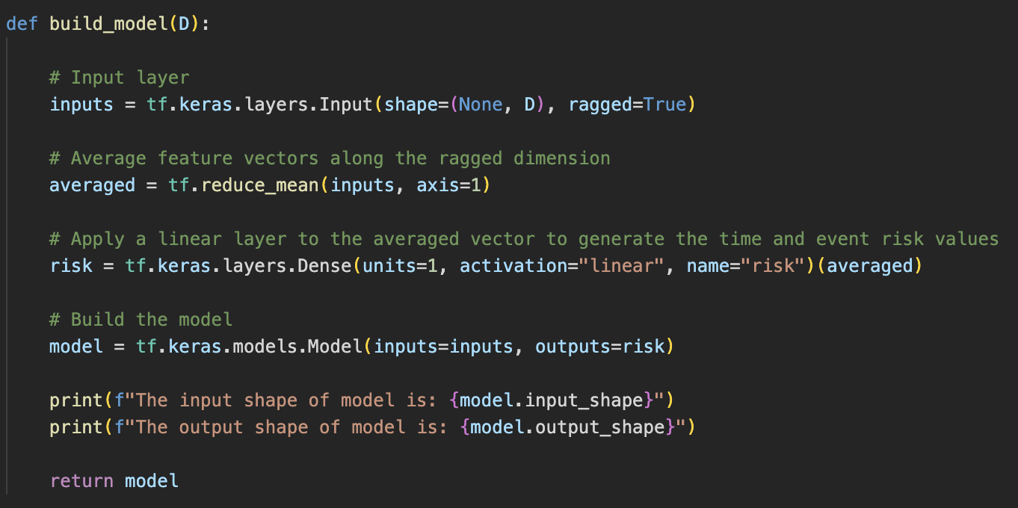
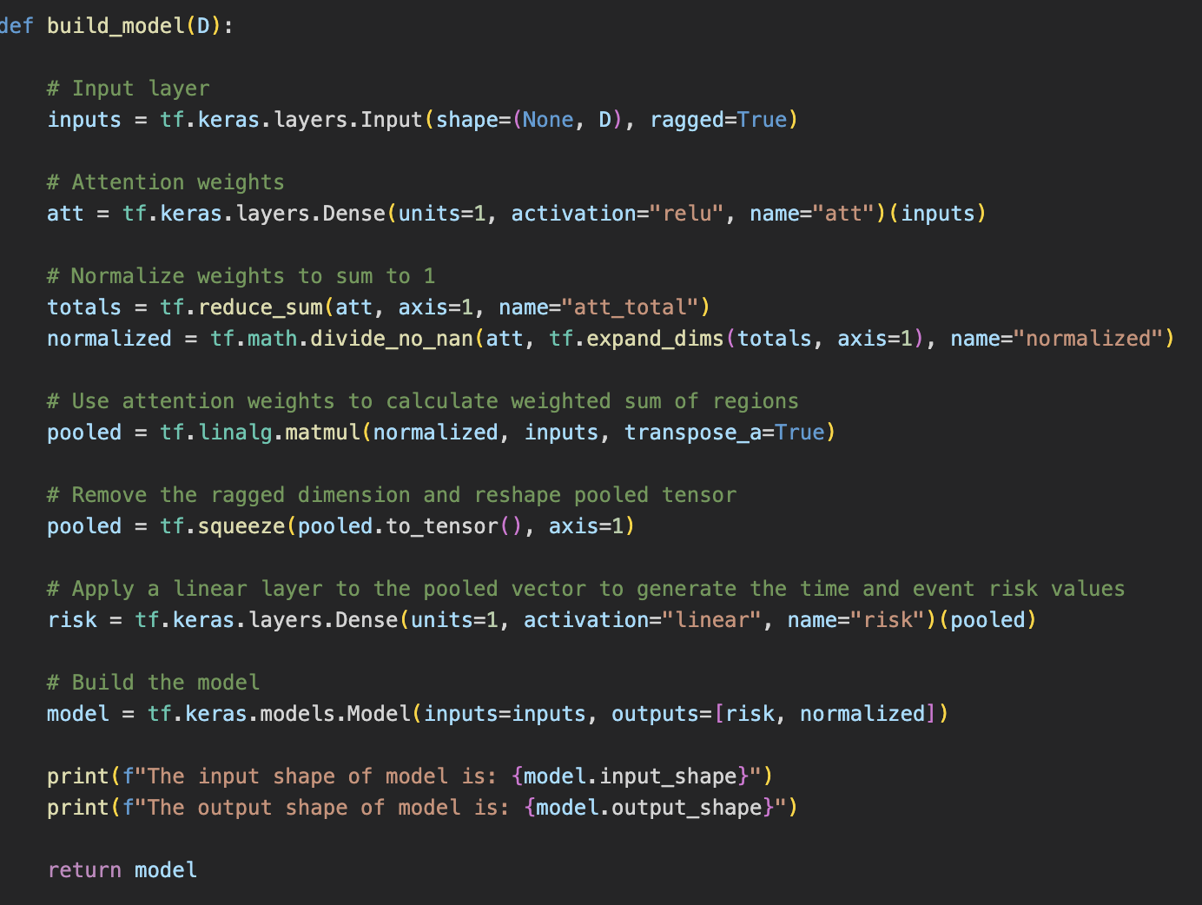
Model architecture
Comparison of Model Architectures: Attention vs. Baseline

Slide 10
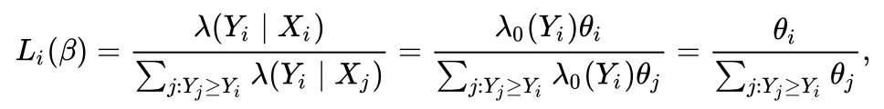
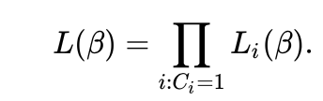
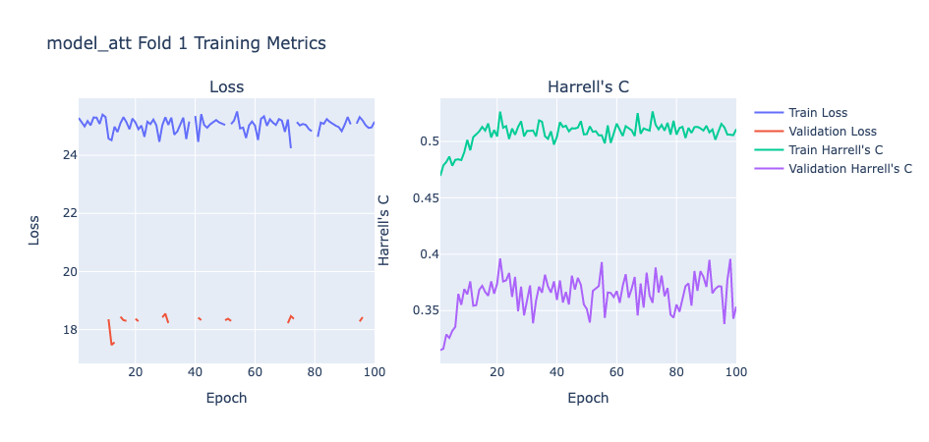
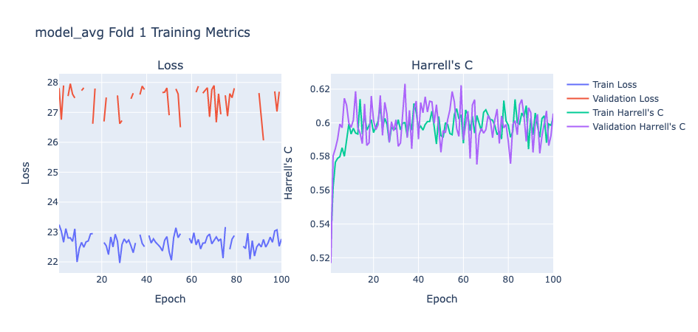
Model- training
Cox Partial Likelihood Loss Function
5-Fold Cross-Validation for Hyperparameter Tuning
- Monitoring Model Performance using Validation Set

Slide 11
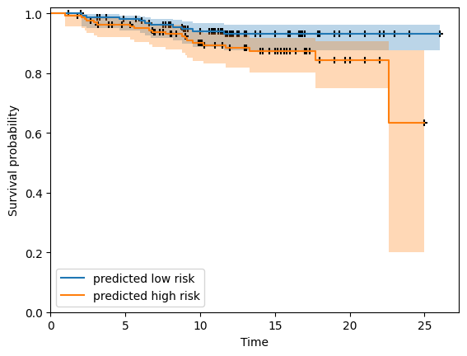
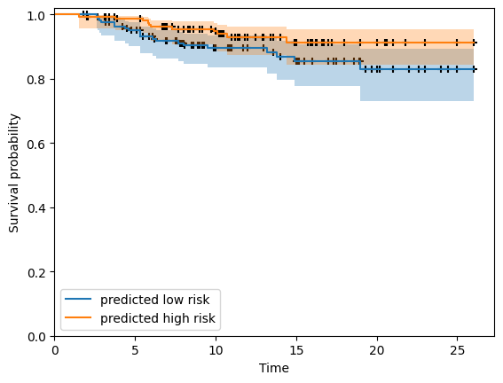
Results
Evaluation Metrics: Harrell's C-index
C-index Comparison: Attention Model vs. Baseline Model
Kaplan-Meier Survival Curves for Both Models

Slide 12
conclusion
Normalization needed for an expected attention effect
Improved Handling of Irregular Data Structures
Performance Comparison: Attention Model vs. Baseline Model
model_att Testing c-index: 0.349 model_avg Testing c-index: 0.619

Slide 13
Future work
Apply a good normalization method data (z-score)
Incorporating clinical variables in cox model
Exploring more advanced attention-based model
Apply explainability tool on obtained results

Slide 14
Q&A

Slide 15
Reference
https://en.wikipedia.org/wiki/Survival_analysis
http://www.stat.columbia.edu/~madigan/W2025/notes/survival.pdf
https://opus1993.github.io/myTidyTuesday/Survival.html

