Slide 1
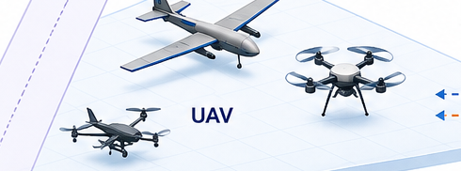


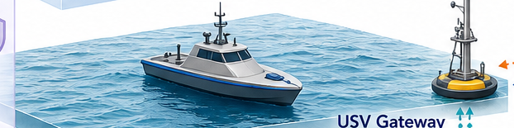


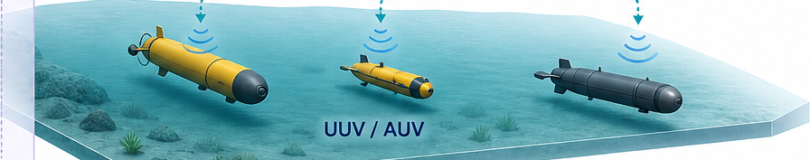

✓
Shore Services
Satellite / HAPS
UAV
✓
Policy + Ledger
✓
USV Gateway
Evidence Store
Auditor
UUV / AUV
✓
Radio Link
Acoustic Link
✓
Optical Link
Intermittent / Governance
Assurance + Governance
Notes:
[Sources]
- Visual reference and embedded pictorial crops: output/imagegen/figure-concepts/figure-01-reference-architecture.png
- Reconstruction: native PowerPoint text, frames, arrows, connectors, and diagram shapes; the aircraft, maritime, underwater, shore, ledger, storage, and audit scenes remain embedded raster crops
[/Sources]

Slide 2


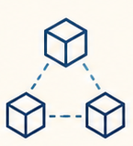


1
2
3
4
Observation
Validity
Provenance
Integrity
Ledger
Consistency
Mission
Suitability
✓
✓
✓
✓
✓
Physical
Corroboration
▣
Privacy
Controls
▤
Endpoint
Integrity
↗
Context +
Consequence
Notes:
[Sources]
- Visual reference and embedded pictorial crops: output/imagegen/figure-concepts/figure-02-assurance-chain.png
- Reconstruction: native PowerPoint text, frames, arrows, connectors, and diagram shapes; the lighthouse and four assurance icons remain embedded raster crops; the arches, shields, arrows, labels, and foundations are native objects
[/Sources]

Slide 3








TRUST OBJECTS
Entity
Platform / Device
Link / Path
Data Product
Observation
CROSS-CUTTING ASSURANCE
AND GOVERNANCE
ASSURANCE LAYERS
Provenance
Ledger +
Governance
Mission Use
Admit
Sense
Relay
Fuse + Share
Decide + Act
Audit + Recover
MISSION LIFECYCLE
Notes:
[Sources]
- Visual reference and embedded pictorial crops: output/imagegen/figure-concepts/figure-03-oal-framework.png
- Reconstruction: native PowerPoint text, frames, arrows, connectors, and diagram shapes; the reference icons remain embedded raster crops; all matrix cells, object headers, layer bands, lifecycle chevrons, boundary, and labels are native objects
[/Sources]

Slide 4
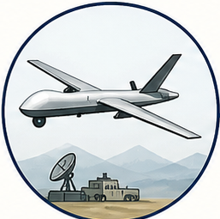
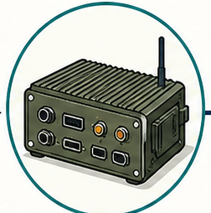
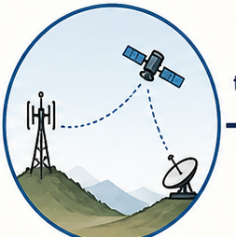
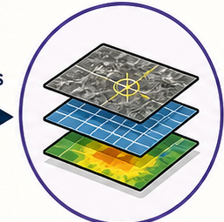
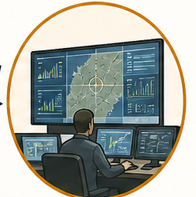


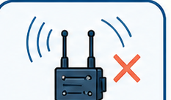

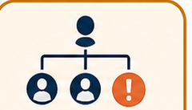




Entity
Platform / Device
Link / Path
Data Product
Mission Consumer
controls
hosts
transmits
consumed by
Credential Theft
Endpoint Capture
Jamming / Route Attack
Poisoning / Stale Replay
Unsafe Allocation
Malicious
Benign-Degraded
Unknown
Notes:
[Sources]
- Visual reference and embedded pictorial crops: output/imagegen/figure-concepts/figure-04-dependency-threat.png
- Reconstruction: native PowerPoint text, frames, arrows, connectors, and diagram shapes; object, threat, hypothesis, and target illustrations remain embedded raster crops; all circles, cards, arrows, labels, branches, and state chains are native objects
[/Sources]

Slide 5










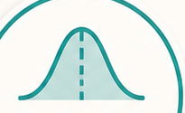
Evidence
Capture
Operational
Feedback
Reliability
Appraisal
Context
★
Time
Accountable
Audit
Object-State
Inference
Mission
Policy
Action
Dependency
Propagation
Uncertainty
Expression
Notes:
[Sources]
- Visual reference and embedded pictorial crops: output/imagegen/figure-concepts/figure-05-ctg-reasoning-loop.png
- Reconstruction: native PowerPoint text, frames, arrows, connectors, and diagram shapes; the eight stage icons and three context-disc illustrations remain embedded raster crops; all circles, labels, disc partitions, and cyclic arrows are native objects
[/Sources]

Slide 6











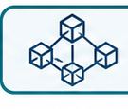



Membership +
Authority
Physical
Validation
Provenance
Commitments
Integrated
Mission Assurance
Endpoint
Protection
Permissioned
Ledger
Complementary
Assurance
Version
Coordination
Real-Time
Safety
Audit +
Reconciliation
Privacy +
Governance
Independent Parties
Permissioned
Ledger
Governance
Structure
Single Accountable Authority
Authenticated
Database
Notes:
[Sources]
- Visual reference and embedded pictorial crops: output/imagegen/figure-concepts/figure-06-blockchain-boundary.png
- Reconstruction: native PowerPoint text, frames, arrows, connectors, and diagram shapes; the hub and callout icons remain embedded raster crops; all hubs, rings, boxes, bridge, decision branches, connectors, and labels are native objects
[/Sources]

Slide 7
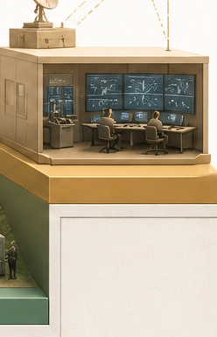
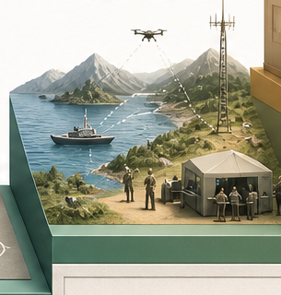
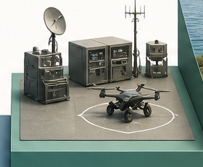
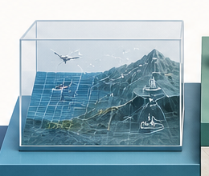


Increasing Ecological Evidence
Deployment
Field Trial
Prototype
Simulation
Analysis
Concept
Preserve Clarity + Traceability
Notes:
[Sources]
- Visual reference and embedded pictorial crops: output/imagegen/figure-concepts/figure-07-evidence-maturity.png
- Reconstruction: native PowerPoint text, frames, arrows, connectors, and diagram shapes; the six stage scenes remain embedded raster crops; all staircase bodies, top surfaces, labels, rising arrow, and traceability foundation are native objects
[/Sources]

