Slide 1


Geospatial Data Acquisition Model

Slide 2
Components
Resource Discovery
Data Profiling
Cleansing and Standardization
Merge and Fill
Validation
Data Ingestion

Slide 3
Resource Discovery
Source | Cost | Update | Standard | Format
Open Street Map | - | Once per Year | All ESPG | Road LineString SHP
Humdata | - | Once per 3 Years | ESPG 32618 | Road LineString SHP
…

Slide 4
Data Profiling
Source | # Records | Attributes | Completeness | Set As Master
Open Street Map | 153,759 | osmid, geometry, name, highway, length, oneway, etc | 51% | Y
Humdata | 78,095 | cod_tronc, cod_urbain, cod_route, nom_sec, nom_off | 45% | N
…

Slide 5
Data Profiling
OPEN STREET MAP
HUMDATA
Attribute | Type | Completeness
osmid | Unique ID | 8.2%
name | Road name | 0.6%
highway | Highway ID | 0.7%
oneway | Oneway flag | 0.0%
length | Segment length | 0.0%
geometry | LineString | 100%
Attribute | Type | Completeness
cod_tronc | Unique ID | 5.7%
cod_route | Road code | 0.4%
cod_urbain |  | 0.0%
nom_off | Road name | 0.9%
nom_sec | Segment Name | 0.7%
geometry | LineString | 100%

Slide 6
Cleansing & Standardization
Apply projection standard EPSG 4326
Apply standard missing value as NULL
Generate unique identifier for analysis
Rename attributes contain the same measurement
…

Slide 7
Merge
Explode geometry to points
Apply K Nearest Neighbors to match similar points
Transfer attributes from points to points
For each attribute, vote the most frequent value from points as the value of the geometry.
Aggregate points back to geometry

Slide 8
Merge – Geometry Explode
Before
After
ID | Geometry | Road Name
osm-1298 | ([lat,lon], [lat,lon], …) | NULL
osm-241 | ([lat,lon], [lat,lon], …) | xxx
ID | Geometry | Point ID | Point | Road Name
osm-1298 | ([lat,lon],..) | osm-1298-1 | [lat1, lon1] | NULL
osm-1298 | ([lat,lon],..) | osm-1298-2 | [lat2, lon2] | NULL
osm-1298 | ([lat,lon],..) | osm-1298-3 | [lat3, lon3] | NULL
osm-241 | ([lat,lon],..) | osm-241-1 | [lat4, lon4] | xxx
osm-241 | ([lat,lon],..) | osm-241-2 | [lat5, lon5] | xxx

Slide 9
Merge – KNN Matching
Point ID | ID | Road Name | Point ID Matched | ID Matched | Road Name Matched | Distance | Validate
osm-241-1 | osm-241 | xxx | hum-2059-1 | hum-2059 | NULL | 0.000109 | Y
osm-241-2 | osm-241 | xxx | hum-2059-3 | hum-2059 | NULL | 0.000031 | Y
osm-1298-1 | osm-1298 | NULL | hum-4211-7 | hum-4211 | www | 0.000389 | Y
osm-1298-2 | osm-1298 | NULL | hum-5892-1 | hum-5892 | yyy | 0.000180 | Y
osm-1298-3 | osm-1298 | NULL | hum-5892-3 | hum-5892 | yyy | 0.000076 | Y
osm-1298-4 | osm-1298 | NULL | hum-9087-1 | hum-9087 | zzz | 0.019021 | N
NULL | NULL | NULL | hum-9087-2 | hum-9087 | zzz | 0.000201 | Y
NULL | NULL | NULL | hum-9087-3 | hum-9087 | zzz | 0.000054 | Y

Slide 10
Merge – Transfer Attributes
Point ID | ID | Road Name | Point ID Matched | ID Matched | Road Name Matched | Distance | Validate
osm-241-1 | osm-241 | xxx | hum-2059-1 | hum-2059 | NULL | 0.000109 | Y
osm-241-2 | osm-241 | xxx | hum-2059-3 | hum-2059 | NULL | 0.000031 | Y
osm-1298-1 | osm-1298 | www | hum-4211-7 | hum-4211 | www | 0.000389 | Y
osm-1298-2 | osm-1298 | yyy | hum-5892-1 | hum-5892 | yyy | 0.000180 | Y
osm-1298-3 | osm-1298 | yyy | hum-5892-3 | hum-5892 | yyy | 0.000076 | Y
osm-1298-4 | osm-1298 | NULL | hum-9087-1 | hum-9087 | zzz | 0.019021 | N
hum-9087-2 | hum-9087 | zzz | hum-9087-2 | hum-9087 | zzz | 0.000201 | Y
hum-9087-3 | hum-9087 | zzz | hum-9087-3 | hum-9087 | zzz | 0.000054 | Y

Slide 11
Merge – Vote Most Frequent Attributes
Point ID | ID | Road Name | Point ID Matched | ID Matched | Road Name Matched | Distance | Validate
osm-241-1 | osm-241 | xxx | hum-2059-1 | hum-2059 | NULL | 0.000109 | Y
osm-241-2 | osm-241 | xxx | hum-2059-3 | hum-2059 | NULL | 0.000031 | Y
osm-1298-1 | osm-1298 | yyy | hum-4211-7 | hum-4211 | www | 0.000389 | Y
osm-1298-2 | osm-1298 | yyy | hum-5892-1 | hum-5892 | yyy | 0.000180 | Y
osm-1298-3 | osm-1298 | yyy | hum-5892-3 | hum-5892 | yyy | 0.000076 | Y
osm-1298-4 | osm-1298 | yyy | hum-9087-1 | hum-9087 | zzz | 0.019021 | N
hum-9087-2 | hum-9087 | zzz | hum-9087-2 | hum-9087 | zzz | 0.000201 | Y
hum-9087-3 | hum-9087 | zzz | hum-9087-3 | hum-9087 | zzz | 0.000054 | Y

Slide 12
Merge – Aggregate Back
Before
After
ID | Geometry | Road Name
osm-1298 | ([lat,lon], [lat,lon], …) | NULL
osm-241 | ([lat,lon], [lat,lon], …) | xxx
ID | Geometry | Road Name
osm-1298 | ([lat,lon], [lat,lon], …) | yyy
osm-241 | ([lat,lon], [lat,lon], …) | xxx
hum-9087 | ([lat,lon], [lat,lon], …) | zzz

Slide 13

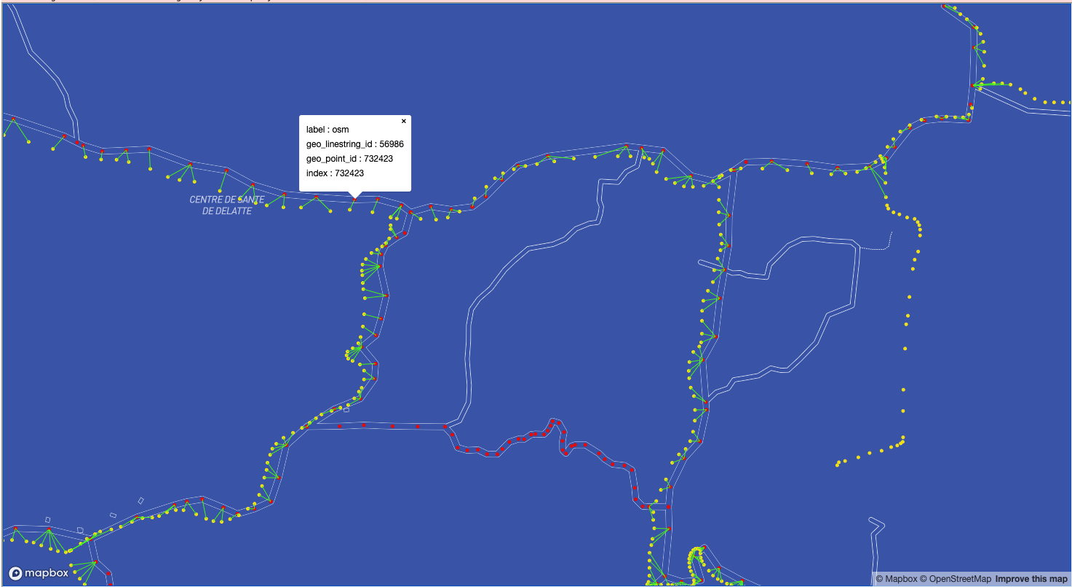
Validation

Slide 14
Data Ingestion
Ingest shape file to NGA database

Slide 15
Geospatial Data Acquisition Infrastructure & Tools

Slide 16
Tool Comparison
Features | ArcGIS | Mapbox | Azure Maps | GeoPandas
Cost | $$$ | $$ | $$ | Free
Profiling | ✓ | ✓ | ✕ | ✓
Standardization | ✓ | ✓ | ✓ | ✓
Merge | ✕ | ✕ | ✕ | ✓
Validation | ✓ | ✓ | ✓ | ✓
Automation | ✓ | ✓ | ✕ | ✓
Export | ✓ | ✓ | ✓ | ✓

Slide 17
Infrastructure Comparison
Features | On-Prem | Cloud Native | Cloud Agnostic
Cost | $$$ | $$ | $
Data Volume | ✕ | ✓ | ✓
Auto-Scaling | ✕ | ✓ | ✓
Processing Speed | ✕ | ✓ | ✓
Automation | ✓ | ✓ | ✓
Maintenance | ✕ | ✓ | ✕
Security | ✓ | ✕ | ✓

