Slide 1
Face Detection
Team Name: Power Machine
Team Members: Yu Du, Bincheng Huang, Siyi Liu
Notes:
Good evening everyone, today we are going to introduce our project, face detection. We’ll start with a quick demo.

Slide 2
Introduction
Notes:
Goal and dataset

Slide 3
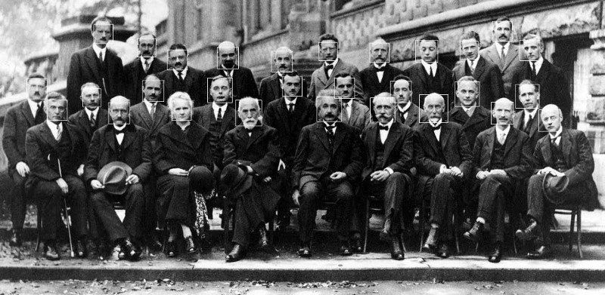
Background
Face detection is the pre-procedure of face recognition.
Face detection and face recognition are widely used currently. Such as DSLR camera can focus on a face by face detection.
Our GOAL is to find out the human face(s) in a digital photo
Notes:
Found out the Einstein in the photo, should detect the face at first
Wildly used
Goal

Slide 4
Dataset
There are two parts of dataset: training dataset and testing dataset. The training dataset contains 1100 celebrity face images (.png file), while the testing has 100 images. (Extract from https://www.kaggle.com/jessicali9530/celeba-dataset and http://www.milbo.org/muct/)
All images are about the whole front faces, including explicit eyes, ears, nose, and mouth.
For, training dataset, 1100 of them are used to train distance threshold and the remain 100 images are used to train probability bar (will be introduced later).
Notes:
The training image is a whole face

Slide 5
LBPH Algorithm
Notes:
First step of face detection is to extract the patterns from the training images
To get the patterns, we implement the LBPH Algorithm

Slide 6
Local Binary Patterns Histogram Procedure
Step 1: Convert the RBG image into grayscale image.
Step 2: Set the LBP environment as Radius = 1, Neighbor = 8.
Step 3: For non-boundary pixels, each pixel related to a 8 bits binary number, i.e. a decimal number between 0 and 255.
Step 4: Set number of cells in x-axis (Grid_X) and y-axis (Grid_Y) for dividing the image.
Step 5: Count the frequency of LBP result for each small piece of divided image.
Step 6: Concatenate all Grid_X * Grid_Y histogram into a whole histogram (with Grid_X * Grid Y * 256 positions). That whole histogram is the pattern for the original image.
Notes:
LBPH is the initial of Local Binary Patterns Histogram
Step 1: [0.2989 0.5870 0.1140]^T
Introduce this slide and next slide at the same time
Grid_X = 4
Grid_Y = 4

Slide 7
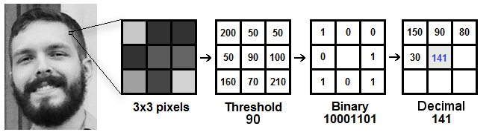
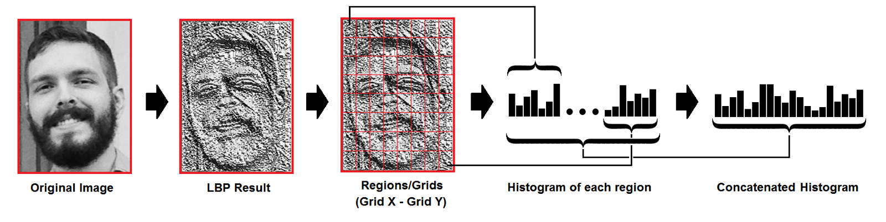
Notes:
Grid X = 4
Grid Y = 4

Slide 8
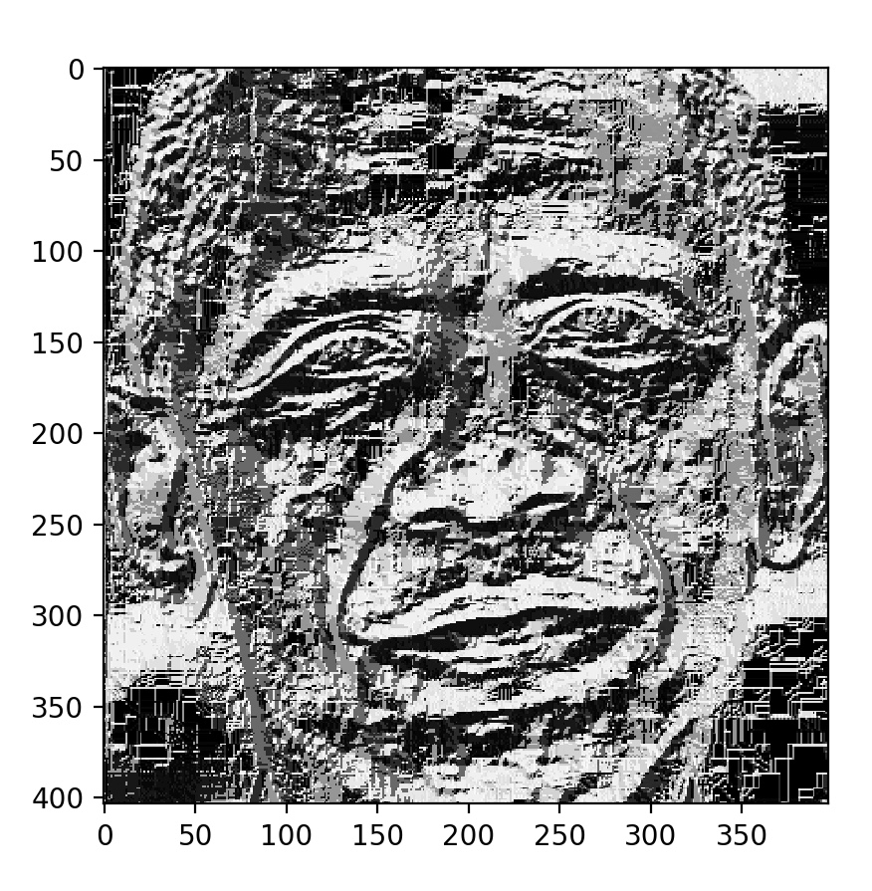
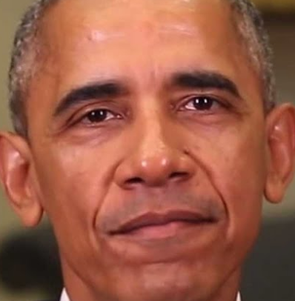
Local Binary Patterns

Slide 9
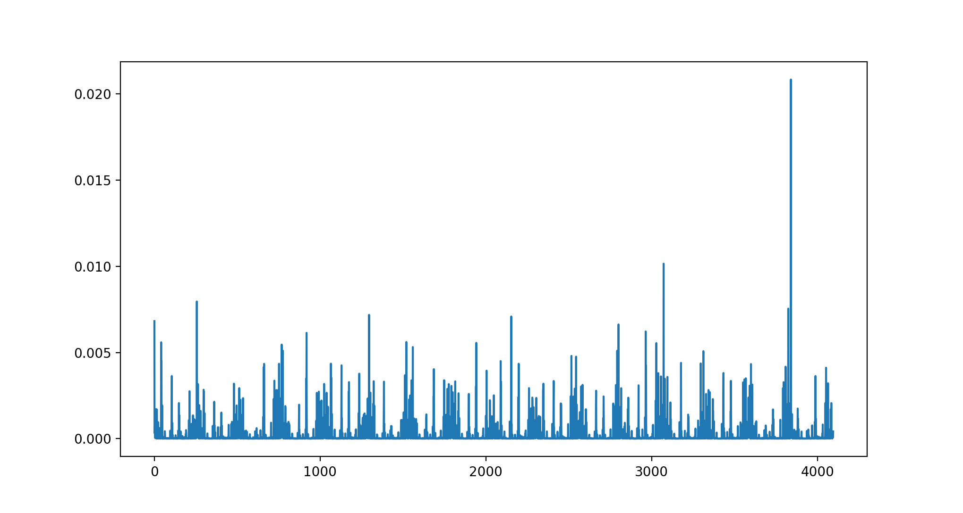
Histogram
Notes:
introduce normalization step

Slide 10
Training Model
Notes:
Since now we can get histogram patterns with LBPH algorithm now, I’ll introduce how to do face detection by using our training dataset.

Slide 11
Distance Threshold
Training Dataset 1
1000 hist patterns(faces)
Training Dataset 2
100 hist patterns(faces)
Euclidean Distances between patterns
Notes:
At first, we use the training dataset 1 to calculate the distance between each histogram pattern and its two neighbors.

Slide 12
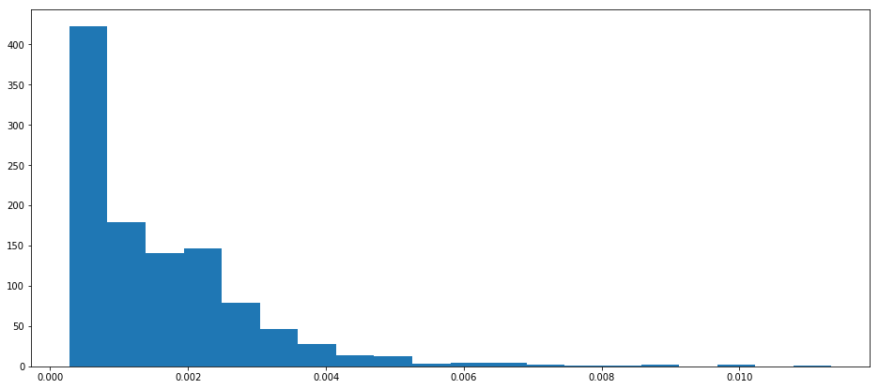
Training Dataset 1 Distance Distribution
Notes:
Then we plot the distance distribution, as the chart shows.

Slide 13
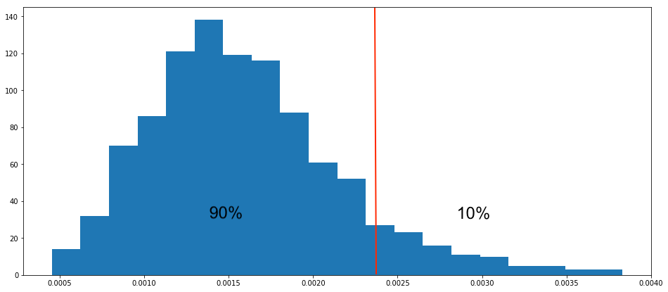
Distance Threshold mean+1.28std: 0.0023
Notes:
Then we calculate random mean, as the central limit theorem says, the distance distribution will have Gaussian distribution shape. So, we use all data’s mean plus 1.28 std, which is 0.0023, as the distance threshold, so that 90% of data in our training dataset 1 will below distance threshold.

Slide 14
Probability Threshold
Training Dataset 2
100 hist patterns
Training Dataset 1
1000 hist patterns
Pick one pattern
Calculate distances
Probability of distances below distance threshold
in 1000 distances
Get 100 probability data
Notes:
Then we will use training dataset 2 to get probability threshold. At first, we pick one pattern from training dataset 2. Then we calculate the distances between this pattern and 1000 patterns in training dataset 1. So that we can get 1000 distances data. Therefore we can calculate the probability of distances below distance threshold. By using 100 patterns in training dataset 2, we can get 100 probability data.

Slide 15
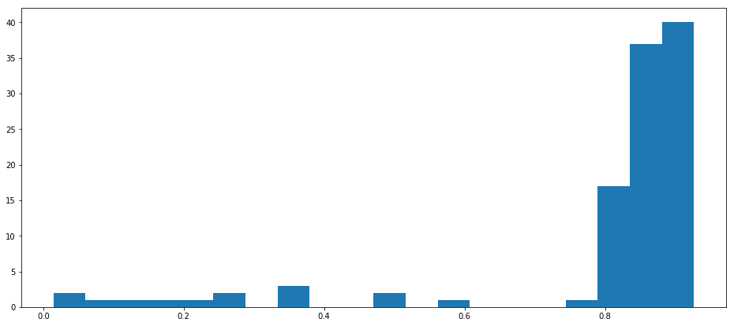
Training Dataset 2 Probability Distribution
Notes:
This is probability distribution

Slide 16
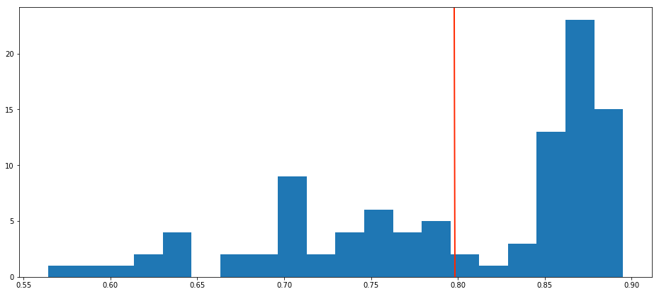
Probability Threshold mean: 79.8%
Notes:
After calculating random mean, we can get distribution like this, and we use the mean of probability data as threshold, which is 79.8%.

Slide 17
Face Detect Process
Notes:
After getting two thresholds, we can start face detect process.

Slide 18
Face Detection
New Input Image
Training Dataset 1
1000 hist patterns
LBPH
Calculate Distances
greater than
probability threshold
Detect as Face
Compare with distance bar
Get probability
Notes:
If there is a new image as input, first we will transfer the image into histogram pattern using LBPH algorithm. Then we will calculate distances between image pattern and 1000 patterns in training dataset 1, thus we can get 1000 distances. After that, we will calculate the probability of distances that below the distance threshold. If the probability is higher than probability threshold, we will label the input image as face.

Slide 19
Accuracy
Test Dataset
100 preprocessed faces
greater than
probability threshold
Accuracy is 83%
Notes:
And we get 83% accuracy when testing in our test dataset. Now we can detect face when the input is a whole human face. And what we are working on is to detect a sliding window algorithm based on our algorithm to detect faces in image. Although it still has low performance now, I’d like to show you a demo.

Slide 20
Haar Cascades

Slide 21
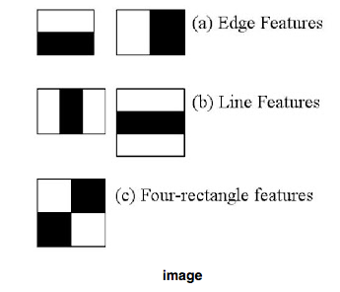
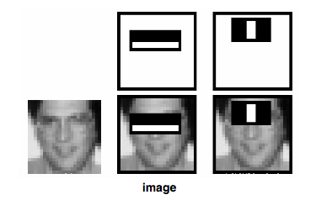
Haar Features
How does it work?
Each feature is a single value obtained by subtracting sum of pixels under the white rectangle from sum of pixels under the black rectangle.
For a 24*24 pixels image, we can have 160,000 Haar features from all possible sizes and locations of each feature.
Notes:
For example, consider the image below. The top row shows two good features. The first feature selected seems to focus on the property that the region of the eyes is often darker than the region of the nose and cheeks. The second feature selected relies on the property that the eyes are darker than the bridge of the nose

Slide 22
AdaBoost
160,000 --> 6,000
The output of the other learning algorithms ('weak learners') is combined into a weighted sum that represents the final output of the boosted classifier. AdaBoost is adaptive in the sense that subsequent weak learners are tweaked in favor of those instances misclassified by previous classifiers.
For this, we apply each and every feature on all the training images. For each feature, it finds the best threshold which will classify the faces to positive and negative. Obviously, there will be errors or misclassifications. We select the features with minimum error rate, which means they are the features that most accurately classify the face and non-face images.
Notes:
The final classifier is a weighted sum of these weak classifiers.
The process is not as simple as this. Each image is given an equal weight in the beginning. After each classification, weights of misclassified images are increased. Then the same process is done. New error rates are calculated. Also new weights. The process is continued until the required accuracy or error rate is achieved or the required number of features are found.

Slide 23
Cascades Classifiers
Take each 24*24 pixels window. Instead of applying all 6000 features on a window, the features are grouped into different stages of classifiers and applied one-by-one.
If a window fails the first stage, discard it. We don't consider the remaining features on it. If it passes, apply the second stage of features and continue the process. The window which passes all stages is a face region.
1 -> 10 -> 25 -> 25 -> 50
Notes:
The authors' detector had 6000+ features with 38 stages with 1, 10, 25, 25 and 50 features in the first five stages. The two features in the above image are actually obtained as the best two features from Adaboost.

Slide 24

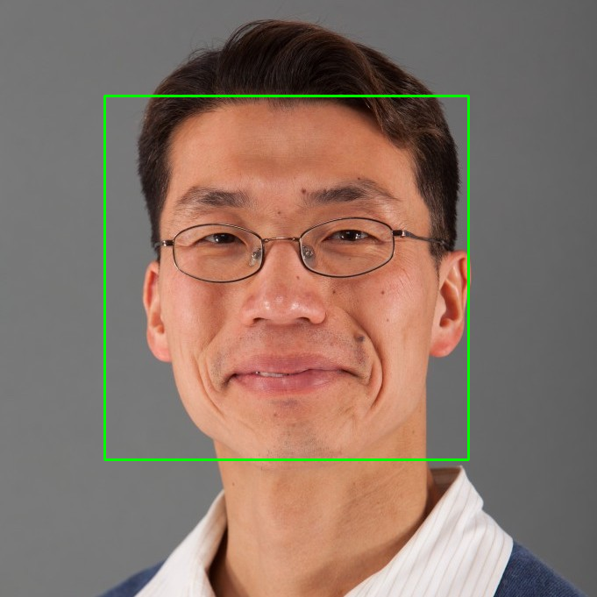
Haar Cascades Test Results

Slide 25
Conclusion

Slide 26
Conclusion
Face Detection Algorithm developed by our own has 83% accuracy.
Sliding Window Algorithm cannot locate people’s face perfectly.
Haar Cascades Algorithm has 93% ~ 95% accuracy based on OpenCV history record.
Next, we will try to develop Face Recognition Algorithm using SVM or Regression Classifier.

Slide 27
Q & A

Slide 28
Q & A
Q1 (from Prof. Chin): Just detect an image whether is a human face or not?
Answer: Not just it. We are also trying to detect the human faces in a normal photo, such as a photo taken in our classroom.
Q2 (from Prof. Chin): What the result will be just a partial face?
Answer: Our algorithm probably not be able to handle that situation. We need more time to tackle this problem.
Q3 (from classmate): What if the image contain a person with hat or glasses?
Answer: Because our training dataset doesn’t include a person with hat or glasses. So, our current model would give a wrong classification. But we can enlarge our training data with those images and re-train our model. That would be better.

Slide 29
Q & A (Cont’d)
Q4 (from classmate): Will it work if the human face is in the dark environment?
Answer: It will. The LBPH can extract the pattern even though the picture is in the dark environment since LBP operator is considering the relative value between center and neighbor. Thus, it doesn’t matter if the environment is dark or bright.
Q5 (from classmate): What if testing the painting face?
Answer: We are not sure, to be honest. It still can exclude some “faces” like the logo of Starbucks, but not sure for the masterpiece of a painting which is really like a real human.

