Slide 1
CS 589 Fall 2021 Lecture 4
Inverted Index
Monday 6:30-9:00
Babbio 122
All zoom links in Canvas
Most slides adapted from Stanford CS276
photo: https://www.scubedstudios.com/information-retrieval/
Notes:
In this lecture, we will be talking about probabilistic ranking models, which is

Slide 2
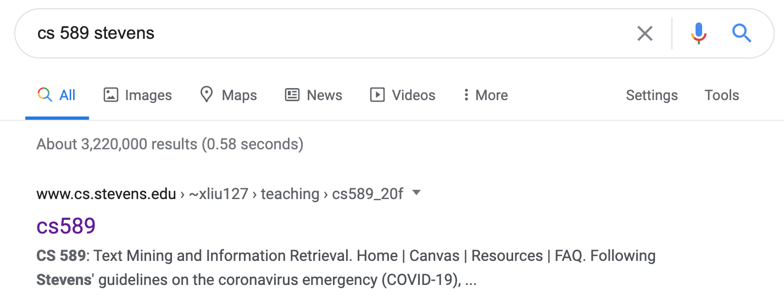
Lecture 4: Information retrieval infrastructure
How does Google know cs 589 refers to a course?
How does Google know stevens = SIT?
How does Google return results so quickly?
Notes:
creates the building block of more advanced techniques

Slide 3

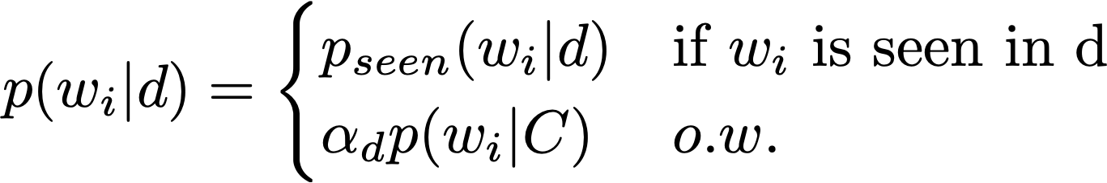
Review of Lecture 1-3: Retrieval models
Vector space model
Use the cosine score of TF-IDF to retrieve documents
BM25:
Approximated 2-Poisson model derived from PRP, i.e., rank by
Adding document length pivoting and IDF
LM-based retrieval model
Rank by p(q|d) based on i.i.d. assumption for words and unigram LM
Notes:
Before we begin today’s lecture, let’s first review what we learned from the last lecture. We learned that each document and each query can be represented as a vector in the same space. To retrieve a document from a query, we compute the similarity score as the dot product between the document and query vector. It is important to leverage the inverse document frequency to penalize the weight of stop words such as “the” and “a”.

Slide 4
Lecture 4: Information retrieval infrastructure
Notes:
Online shopping used to be very hard, because of the information overload, but thanks to the recommender system we can now. Now almost any website/application you visit, they can quickly adapt to your information need and know what you want immediately.

Slide 5
Pop quiz (IR Evaluation)
Suppose a query has a total of 4 relevant documents in a collection with 100 documents. System A and System B have each retrieved 10 documents, and the relevance status of the two ranked lists of results is:
System A: [+,+,-,-,-,-,-,-,-,-]
System B: [+,-,+,-,-,-,-,-,-,-]
1. What is the MAP of System A and System B?
2. What is the NDCG@5 of System A?
Notes:
we use Google playstore data as the data source, so we collect these data, we clean it, we split the sentence, and we build a filtering algorithm to select the high quality sentence

Slide 6
Lecture 4: Inverted index
Key data structure underlying all modern IR systems
Systems run on a single machine
Massive systems for the biggest commercial search engines
Exploiting the sparsity of the term-document matrix
Inverted index can generally be applied to retrieval models
TF-IDF, BM25, LM-based retrieval model
Notes:
we use Google playstore data as the data source, so we collect these data, we clean it, we split the sentence, and we build a filtering algorithm to select the high quality sentence

Slide 7
Lecture 4: Motivating example
Which plays of Shakespeare contain the words Brutus AND Caesar but NOT Calpurnia?
grep -r ./* “.* brutus .* caesar.*” then remove all documents containing calpurnia
Slow when the data size is large
Ranked retrieval
Notes:
we use Google playstore data as the data source, so we collect these data, we clean it, we split the sentence, and we build a filtering algorithm to select the high quality sentence

Slide 8
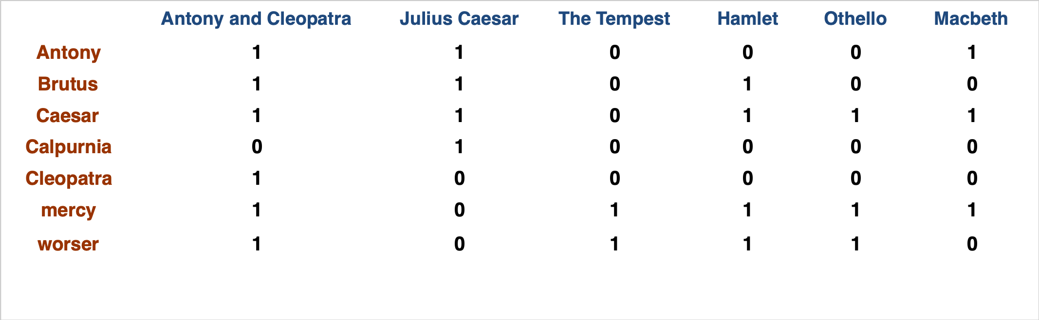
Lecture 4: Motivating example
Which plays of Shakespeare contain the words Brutus AND Caesar but NOT Calpurnia? Brutus AND Caesar AND NOT Calpurnia
1 0 1 1 1 1
Notes:
we use Google playstore data as the data source, so we collect these data, we clean it, we split the sentence, and we build a filtering algorithm to select the high quality sentence

Slide 9
Lecture 4: Motivating example
Which plays of Shakespeare contain the words Brutus AND Caesar but NOT Calpurnia? Brutus AND Caesar AND NOT Calpurnia
110100 AND
110111 AND
101111 =
100100
Notes:
we use Google playstore data as the data source, so we collect these data, we clean it, we split the sentence, and we build a filtering algorithm to select the high quality sentence

Slide 10
Lecture 4: Motivating example
Which plays of Shakespeare contain the words Brutus AND Caesar but NOT Calpurnia?
Antony and Cleopatra, Act III, Scene ii
Agrippa [Aside to DOMITIUS ENOBARBUS]: Why, Enobarbus,
When Antony found Julius Caesar dead,
He cried almost to roaring; and he wept
When at Philippi he found Brutus slain.
Hamlet, Act III, Scene ii
Lord Polonius: I did enact Julius Caesar I was killed i’ the
Capitol; Brutus killed me.
Notes:
we use Google playstore data as the data source, so we collect these data, we clean it, we split the sentence, and we build a filtering algorithm to select the high quality sentence

Slide 11
What if we have a bigger collection?
Consider N = 1 million documents, each with about 1000 words
Avg 6 bytes/word including spaces/punctuation, 6GB
Say there are M = 500K distinct terms among these.
500K x 1M matrix has half-a-trillion 0’s and 1’s
But it has no more than one billion 1’s (why?)
A better representation: only record the 1’s
Notes:
we use Google playstore data as the data source, so we collect these data, we clean it, we split the sentence, and we build a filtering algorithm to select the high quality sentence

Slide 12
Inverted index
For each term t, we must store a list of all documents that contain t.
Identify each doc by a docID, a document serial number
Can we used fixed-size arrays for this?
Brutus
1
2
4
11
31
45
173
174
Caesar
1
2
4
5
6
16
57
132
Calpurnia
2
31
54
101
Notes:
we use Google playstore data as the data source, so we collect these data, we clean it, we split the sentence, and we build a filtering algorithm to select the high quality sentence

Slide 13
Inverted index
We need variable-size postings lists
On disk, a continuous run of postings is normal and best
In memory, can use linked lists or variable length arrays
Some tradeoffs in size/ease of insertion (what’s the insertion complexity?)
Brutus
1
2
4
11
31
45
173
174
Posting
Caesar
1
2
4
5
6
16
57
132
Calpurnia
2
31
54
101
Dictionary
Postings
Sorted by docID (more later on why).
Notes:
we use Google playstore data as the data source, so we collect these data, we clean it, we split the sentence, and we build a filtering algorithm to select the high quality sentence

Slide 14

Building inverted index
Documents to
be indexed
Friends, Romans, countrymen.
Tokenizer
Token stream
Friends
Romans
Countrymen
Linguistic modules
Modified tokens
friend
roman
countryman
Indexer
friend
2
4
roman
1
2
Inverted index
countryman
13
16
Notes:
we use Google playstore data as the data source, so we collect these data, we clean it, we split the sentence, and we build a filtering algorithm to select the high quality sentence

Slide 15
Text preprocessing for building inverted index
Tokenization
Cut character sequence into word tokens
Deal with “John’s”, a state-of-the-art solution
Normalization
Map text and query term to same form
You want U.S.A. and USA to match
Stemming
We may wish different forms of a root to match
authorize, authorization
Stop words
We may omit very common words (or not)
the, a, to, of
Notes:
we use Google playstore data as the data source, so we collect these data, we clean it, we split the sentence, and we build a filtering algorithm to select the high quality sentence

Slide 16
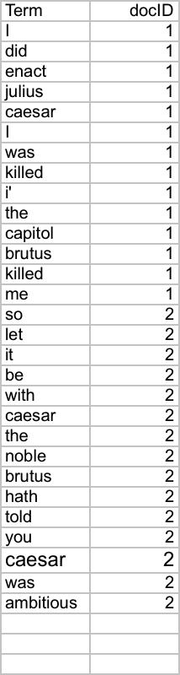
Indexer step: Tokenize sequence
Sequence of (Modified token, Document ID) pairs.
Doc 1
Doc 2
I did enact Julius
Caesar I was killed
i’ the Capitol;
Brutus killed me.
So let it be with
Caesar. The noble
Brutus hath told you
Caesar was ambitious
Notes:
we use Google playstore data as the data source, so we collect these data, we clean it, we split the sentence, and we build a filtering algorithm to select the high quality sentence

Slide 17
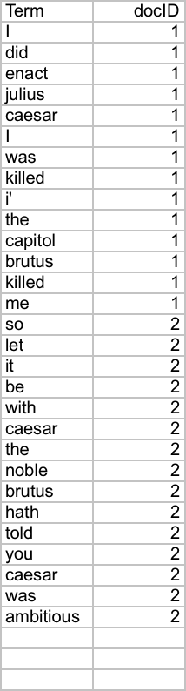
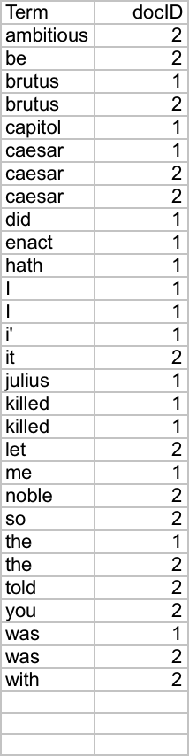
Indexer step: Sorting index terms
First sort by term then by docID
Notes:
we use Google playstore data as the data source, so we collect these data, we clean it, we split the sentence, and we build a filtering algorithm to select the high quality sentence

Slide 18
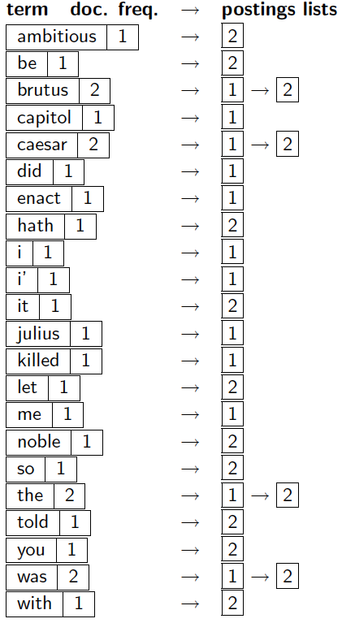
Indexer step: Dictionary and postings
Multiple term entries in a single document are merged
Split into Dictionary and Postings
Doc. frequency information is added.
Notes:
we use Google playstore data as the data source, so we collect these data, we clean it, we split the sentence, and we build a filtering algorithm to select the high quality sentence

Slide 19
Where do we pay in storage?
Lists of docIDs
Terms and counts
IR system implementation
How do we index efficiently?
How much storage do we need?
Pointers
Notes:
we use Google playstore data as the data source, so we collect these data, we clean it, we split the sentence, and we build a filtering algorithm to select the high quality sentence

Slide 20
Query processing for inverted index
Suppose we have constructed the inverted index, what query can we answer?
Consider processing the query: Brutus AND Caesar
Locate Brutus in the Dictionary;
Retrieve its postings.
Locate Caesar in the Dictionary;
Retrieve its postings.
“Merge” the two postings (intersect the document sets):
2
4
8
16
32
64
128
Brutus
1
2
3
5
8
13
21
34
Caesar
Notes:
we use Google playstore data as the data source, so we collect these data, we clean it, we split the sentence, and we build a filtering algorithm to select the high quality sentence

Slide 21
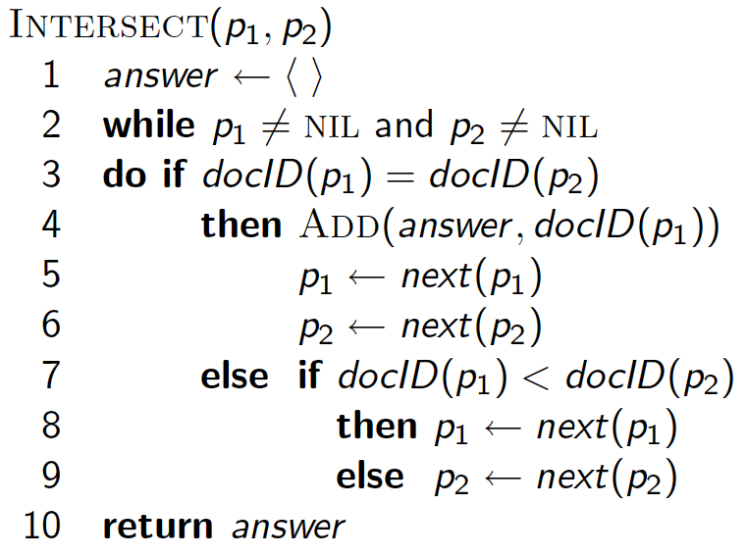
Merging two posting lists
Walk through the two postings simultaneously, in time linear in the total number of postings entries (using two pointers, without skipping O(x + y))
2
4
8
16
32
64
128
Brutus
1
2
3
5
8
13
21
34
Caesar
Notes:
we use Google playstore data as the data source, so we collect these data, we clean it, we split the sentence, and we build a filtering algorithm to select the high quality sentence

Slide 22
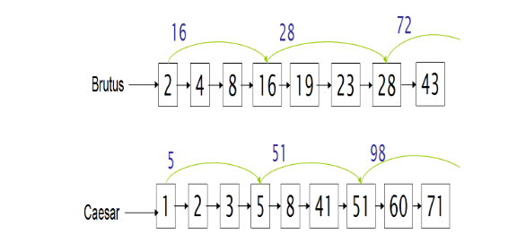
Merging two posting lists: skipping lists
Speeding up the merge by skipping every k pointers
Notes:
we use Google playstore data as the data source, so we collect these data, we clean it, we split the sentence, and we build a filtering algorithm to select the high quality sentence

Slide 23
Inverted index for the Boolean Retrieval System
The Boolean retrieval model is being able to ask a query that is a Boolean expression:
Boolean Queries are queries using AND, OR and NOT to join query terms
Views each document as a set of words
Is precise: document matches condition or not.
Perhaps the simplest model to build an IR system on
Primary commercial retrieval tool for 3 decades.
Many search systems you still use are Boolean:
Email, library catalog, macOS Spotlight
Notes:
we use Google playstore data as the data source, so we collect these data, we clean it, we split the sentence, and we build a filtering algorithm to select the high quality sentence

Slide 24
Boolean queries: more general merges
Exercise: Adapt the merge for the queries:
Brutus AND NOT Caesar
Brutus OR NOT Caesar
Can we still run through the merge in time O(x+y)? What can we achieve?
Notes:
we use Google playstore data as the data source, so we collect these data, we clean it, we split the sentence, and we build a filtering algorithm to select the high quality sentence

Slide 25
What about arbitrary Boolean formula?
(Brutus OR Caesar) AND NOT
(Antony OR Cleopatra)
Can we always merge in “linear” time?
Consider a query that is an AND of n terms, what is the best way of processing?
Brutus
2
4
8
16
32
64
128
Caesar
1
2
3
5
8
16
21
34
Calpurnia
13
16
Query: Brutus AND Calpurnia AND Caesar
Notes:
we use Google playstore data as the data source, so we collect these data, we clean it, we split the sentence, and we build a filtering algorithm to select the high quality sentence

Slide 26
What about arbitrary Boolean formula?
Process in order of increasing freq:
start with smallest set, then keep cutting further.
This is why we kept
document freq. in dictionary
Brutus
2
4
8
16
32
64
128
Caesar
1
2
3
5
8
16
21
34
Calpurnia
13
16
Query: (Calpurnia AND Brutus) AND Caesar
Notes:
we use Google playstore data as the data source, so we collect these data, we clean it, we split the sentence, and we build a filtering algorithm to select the high quality sentence

Slide 27
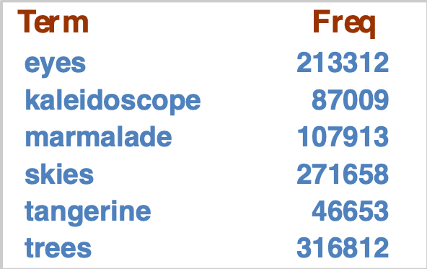
Query processing exercise
Recommend a query processing order for
(tangerine OR trees) AND
(marmalade OR skies) AND
(kaleidoscope OR eyes)
Which terms should we process first?
Notes:
we use Google playstore data as the data source, so we collect these data, we clean it, we split the sentence, and we build a filtering algorithm to select the high quality sentence

Slide 28
Phrase indexing
We want to be able to answer queries such as “Stevens Institute of Technology” – as a phrase
Sentence 1= “I went to Stevens Institute of Technology”
Sentence 2= “The Technology Institute that Steve Harvey went to. ”
For this, it no longer suffices to store only
<term : docs> entries
Notes:
we use Google playstore data as the data source, so we collect these data, we clean it, we split the sentence, and we build a filtering algorithm to select the high quality sentence

Slide 29
A first attempt: bi-gram indexing
Index every consecutive pair of terms in the text as a phrase
For example the text “Friends, Romans, Countrymen” would generate the biwords
friends romans
romans countrymen
Each of these biwords is now a dictionary term
Two-word phrase query-processing is now immediate.
Notes:
we use Google playstore data as the data source, so we collect these data, we clean it, we split the sentence, and we build a filtering algorithm to select the high quality sentence

Slide 30
Issues with bi-gram indexing
False positives, as noted before
Index blowup due to bigger dictionary
Infeasible for more than bigrams, big even for them
Bigram indexes are not the standard solution (for all bigrams) but can be part of a compound strategy
Notes:
we use Google playstore data as the data source, so we collect these data, we clean it, we split the sentence, and we build a filtering algorithm to select the high quality sentence

Slide 31
Solution 2: Positional indexing
In the postings, store, for each term the position(s) in which tokens of it appear:
<term, number of docs containing term;
doc1: position1, position2 … ;
doc2: position1, position2 … ;
etc.>
Notes:
we use Google playstore data as the data source, so we collect these data, we clean it, we split the sentence, and we build a filtering algorithm to select the high quality sentence

Slide 32
Solution 2: Positional indexing
<be: 993427;
1: 7, 18, 33, 72, 86, 231;
2: 3, 149;
4: 17, 191, 291, 430, 434;
5: 363, 367, …>
Which of docs 1,2,4,5
could contain “to be
or not to be”?
For phrase queries, we use a merge algorithm recursively at the document level
But we now need to deal with more than just equality
Notes:
we use Google playstore data as the data source, so we collect these data, we clean it, we split the sentence, and we build a filtering algorithm to select the high quality sentence

Slide 33
Proximity search
Extract inverted index entries for each distinct term: to, be, or, not.
Merge their doc:position lists to enumerate all positions with “to be or not to be”.
to:
2:1,17,74,222,551; 4:8,16,190,429,433; 7:13,23,191; ...
be:
1:17,19; 4:17,191,291,430,434; 5:14,19,101; …
LIMIT! /3 to /3 be /2 or /2 not
Here, /k means “within k words of”.
Notes:
we use Google playstore data as the data source, so we collect these data, we clean it, we split the sentence, and we build a filtering algorithm to select the high quality sentence

Slide 34
Positional indexing size
A positional index expands postings storage substantially
Even though indices can be compressed
Nevertheless, a positional index is now standardly used because of the power and usefulness of phrase and proximity queries … whether used explicitly or implicitly in a ranking retrieval system
A positional index is 2–4 as large as a non-positional index
Positional index size 35–50% of volume of original text
Notes:
we use Google playstore data as the data source, so we collect these data, we clean it, we split the sentence, and we build a filtering algorithm to select the high quality sentence

Slide 35
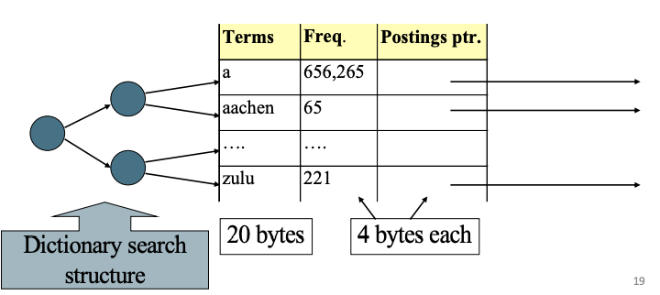
Index compression (for non-positional indexing)
Compressing the posting pointer table
Compressing the posting lists
Speeding up the dictionary search with trie
Speeding up the dictionary search
Compressing the posting ptr table
Compressing the posting list
Notes:
we use Google playstore data as the data source, so we collect these data, we clean it, we split the sentence, and we build a filtering algorithm to select the high quality sentence

Slide 36
Compressing the postings pointer table
Most of the space in the table is wasted
Most words < 20 bytes
Table storage = 28N
Compressing the posting ptr table
Notes:
we use Google playstore data as the data source, so we collect these data, we clean it, we split the sentence, and we build a filtering algorithm to select the high quality sentence

Slide 37
Compressing the postings pointer table
Concatenate the dictionary as one string
Table storage 28N -> 11N
How to further improve the storage space?
Instead of storing absolute term pointers, store the gaps
4 bytes
4 bytes
3 bytes
Notes:
we use Google playstore data as the data source, so we collect these data, we clean it, we split the sentence, and we build a filtering algorithm to select the high quality sentence

Slide 38
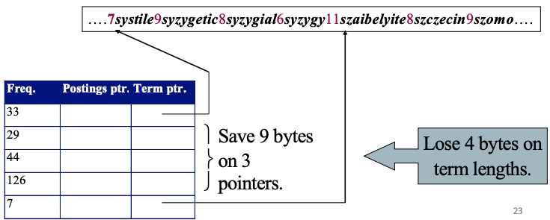
Compressing the postings pointer table
Save more space by skipping (k-1) pointers for every k pointers
Recover the skipped pointers by adding the length of words
Table storage is further reduced to 8N + 3N * (3+k/3*k). When k=4, the storage required is 9.75N < 11N
Trade-off between saving space (skipping more) vs. saving time (skipping less)
Length of word “systile”
1 byte
absolute value of ptr address
absolute value of ptr address
4 bytes
4 bytes
3 bytes
Notes:
we use Google playstore data as the data source, so we collect these data, we clean it, we split the sentence, and we build a filtering algorithm to select the high quality sentence

Slide 39
Compressing the posting lists
Observations of posting files
Instead of storing docID, store gaps
Brutus: 2,4,8,3,4,5,15
Binary seq: 10,100,1000,11,100,101,1111
Prefix encoding
Binary encoding such that the sequence can be uniquely decoded (why do we need this uniqueness?)
e.g., Huffman encoding
Unary encoding: {2:110,4:11110, …}
A uniquely decodable seq: 110111101111111101110…
Notes:
we use Google playstore data as the data source, so we collect these data, we clean it, we split the sentence, and we build a filtering algorithm to select the high quality sentence

Slide 40
Compressing the posting lists
Compressing the posting list
Notes:
we use Google playstore data as the data source, so we collect these data, we clean it, we split the sentence, and we build a filtering algorithm to select the high quality sentence

Slide 41
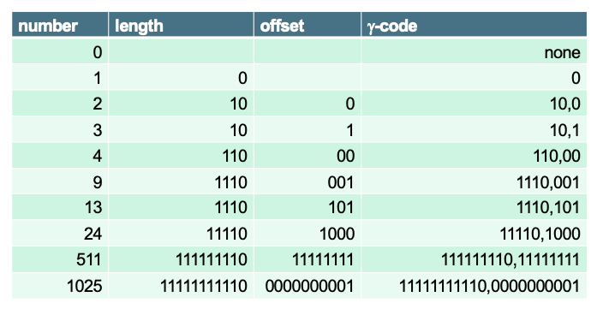
Compressing the posting lists
Unary encoding is too long!
Gamma code of 13: 1110,101
Binary code for {length - 1} followed by 0: 1110
Offset (last {length - 1} bits of the binary value): 13 =1101 → 101
What is the gamma code of 5? 101 -> 110,01
We can prove gamma code is uniquely decodable!
Gamma code compression rate: 11.7%
Notes:
we use Google playstore data as the data source, so we collect these data, we clean it, we split the sentence, and we build a filtering algorithm to select the high quality sentence

Slide 42
Speeding up the dictionary search
Speeding up the dictionary search
Notes:
we use Google playstore data as the data source, so we collect these data, we clean it, we split the sentence, and we build a filtering algorithm to select the high quality sentence

Slide 43
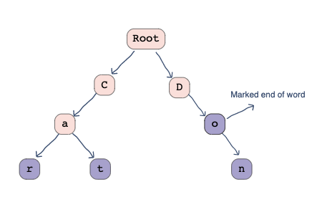
Speeding up the dictionary search with prefix tree
Time complexity for searching/insertion:
BST: O(m * log n), m is the maximum word length, n is the number of words in the vocabulary
Prefix-tree: O(m), m is the maximum word length
car
do
cat
do
don
don
car
cat
Notes:
we use Google playstore data as the data source, so we collect these data, we clean it, we split the sentence, and we build a filtering algorithm to select the high quality sentence

Slide 44
Handling web scale indexing
Web-scale indexing must use clusters of servers
Google had 1 million servers in 2011
Fault tolerance of a massive data center
If a non-fault tolerance system has 1000 nodes, each has 99.9% uptime, then 63% of the time one or more servers is down
Solution
Maintain a “master” server
Break indexing into parallel tasks
Assign each task to an idle machine
Notes:
we use Google playstore data as the data source, so we collect these data, we clean it, we split the sentence, and we build a filtering algorithm to select the high quality sentence

Slide 45
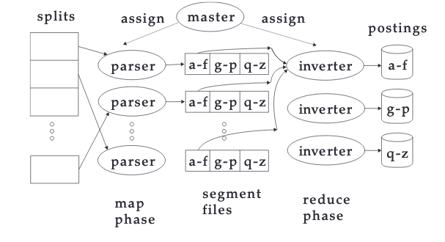
Map-reduce
master assigns split to idle machine
parser emits (term,doc) pair
merge partitions in inverter
complete the index
Notes:
we use Google playstore data as the data source, so we collect these data, we clean it, we split the sentence, and we build a filtering algorithm to select the high quality sentence

Slide 46
Examples of map-reduce
Notes:
we use Google playstore data as the data source, so we collect these data, we clean it, we split the sentence, and we build a filtering algorithm to select the high quality sentence

Slide 47
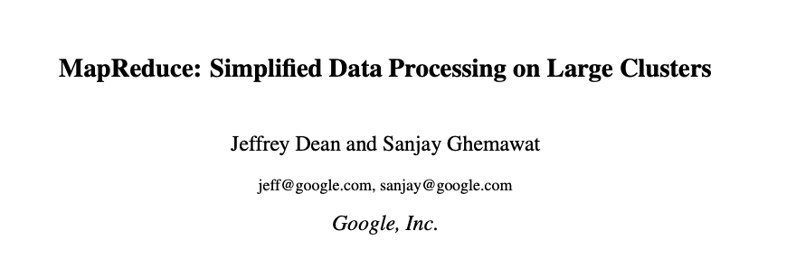
MapReduce: Industry practice
Term partition vs. document partition
Term-partitioned: one machine handles a subrange of terms
Document-partitioned: one machine handles a subrange of documents
Most industry search engine use document-partitioned index
Better load balancing (why?)
Notes:
we use Google playstore data as the data source, so we collect these data, we clean it, we split the sentence, and we build a filtering algorithm to select the high quality sentence

Slide 48
Logarithmic dynamic indexing
Z0
Z0
I0
Z0
I0
I1
Z0
I0
I1
I0
I1
I2
Z0
I0
I2
I2
I3
Z0
I1
I2
https://nlp.stanford.edu/IR-book/html/htmledition/dynamic-indexing-1.html
Notes:
we use Google playstore data as the data source, so we collect these data, we clean it, we split the sentence, and we build a filtering algorithm to select the high quality sentence

Slide 49
Real time search of Twitter
Requires high real time search
Low latency, high throughput query evaluation
High ingestion rate and immediate data availability
Concurrent reads and writes of the index
Solution: using segments
Each segment consists of 2^32 tweets (in memory)
New posts are appended to the posting lists
Only one segment can be written to at each time
Notes:
we use Google playstore data as the data source, so we collect these data, we clean it, we split the sentence, and we build a filtering algorithm to select the high quality sentence

Slide 50
Search engine tools
Apache Lucene
Free and open search engine library
First developed in 1999
ElasticSearch
A search engine
based on Lucene
Notes:
we use Google playstore data as the data source, so we collect these data, we clean it, we split the sentence, and we build a filtering algorithm to select the high quality sentence

Slide 51
ElasticSearch
Using a REST api
Notes:
we use Google playstore data as the data source, so we collect these data, we clean it, we split the sentence, and we build a filtering algorithm to select the high quality sentence

Slide 52
Homework 2: Using ElasticSearch to build a search engine
Build an inverted index
Evaluate three search algorithm’s performance
TF-IDF
BM25
Dirichlet-LM
Notes:
we use Google playstore data as the data source, so we collect these data, we clean it, we split the sentence, and we build a filtering algorithm to select the high quality sentence

