Slide 1
Visualizing Path Exploration to Assist Problem Diagnosis ^{for Structural Test Generation}
Jiayi Cao¹, Angello Astorga¹, Siwakorn Srisakaokul¹, Zhengkai Wu¹,
Xueqing (Susan) Liu¹, Xusheng Xiao², Tao Xie¹
Email: {jcao7,aastorg2,srisaka2,zw3,xliu93,taoxie}@illinois.edu, xusheng.xiao@case.edu
Notes:
My name is Xueqing,
I’m here to present our work:
Joint work of the data mining and software engineering groups at University of Illinois.

Slide 2



Test Generation with Dynamic Symbolic Execution (DSE)
Input: x;
while (x > 0)
x - -;
x > 0
flip the branch
x – 1 > 0
x – 1 <=0
….
Constraint solver:
x > 0 & x – 1 <= 0
=> x = 1
x – n >0
Symbol execution tree
??
Program
??
Program
Coverage 5/10
Coverage 5/10
Test
Test
Test
Test
Test
Test
Warning:
Max runs reached!
Max branches reached!
...
Warning:
Max runs reached!
Max branches reached!
...

Slide 3
Boundary Problem
public void BubbleSort(int[] array, int n){
for (int i = 0; i < array.length; i++)
{
for (j = 0; j < n; j++){
//…
}
}
if (array.Length > 200){
throw new Exception(“bug”);
}}
Cannot reach the bug!
1. Incremental test generation on number.Length
2. Inner loop: constraint solver cost increases with n
3. Time cost for reaching the bug exceeds the limit !
bug
??
Program
??
Program
Coverage 5/10
Coverage 5/10
Test
Test
Test
Test
Test
Test
Warning:
Max runs reached!
Max branches reached!
...
Warning:
Max runs reached!
Max branches reached!
...

Slide 4
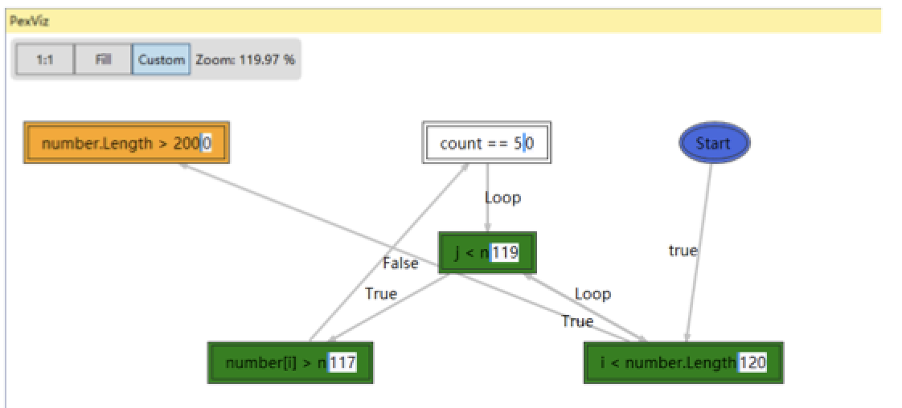
PexViz
Objective: Assist developers in diagnosing problems encountered during test generation using visualization

Slide 5
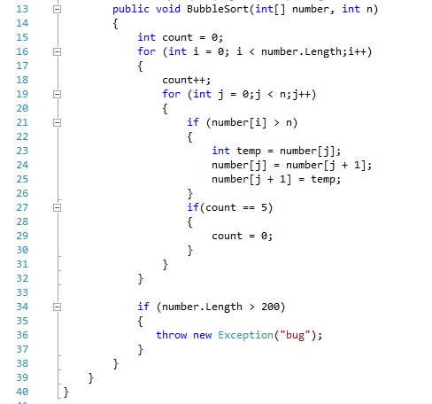
BubbleSort Example
Flip count = 0
Variant Control Flow Graph

Slide 6
PexViz Components
Variant control flow graph (VCFG) generator
Node: branch statement in source code
Edge: control flow between connected branch statements
Exploration-data Augmentor
Gathers information: incremental path condition, flip counts, etc.
Invoked by IntelliTest during runtime exploration
Graph Visualizer
VCFG -> Interactive visualization
Different colors and shapes of nodes to encode information:
Orange: Not-covered branch
Green: Covered branch

Slide 7
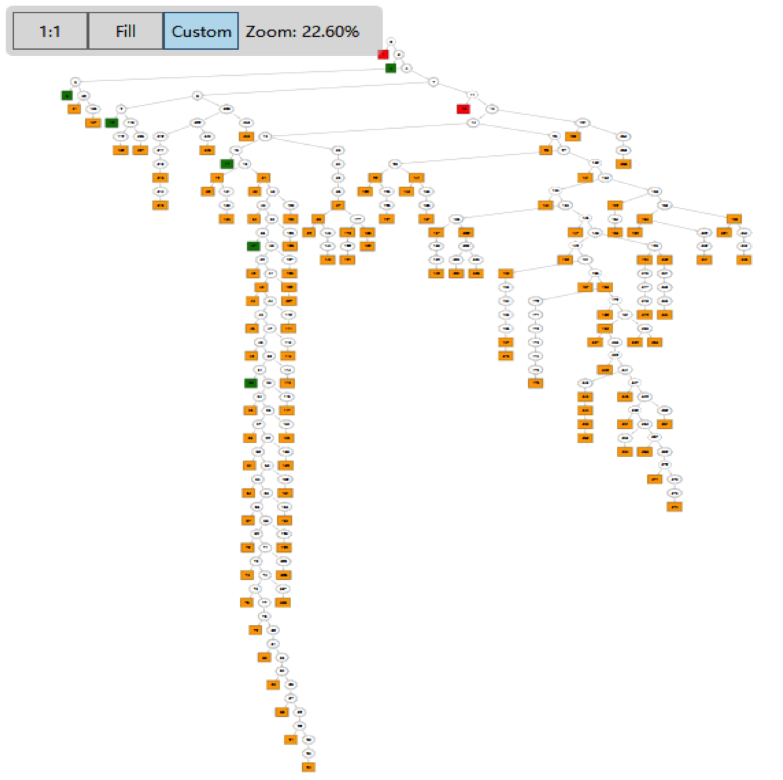
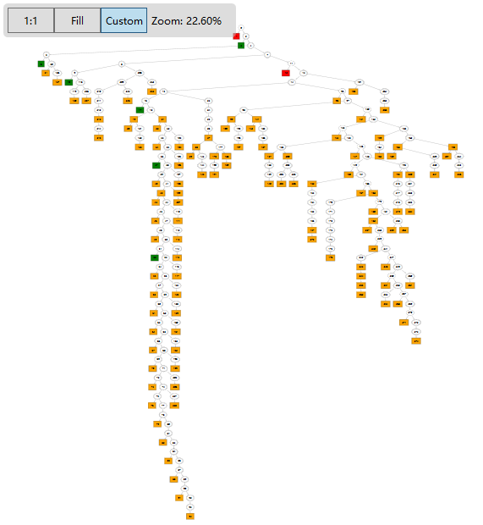
Comparison with Baseline
SEViz [1] outputs the symbolic execution tree → bad for visualization
6 nodes (PexViz) vs. 276 nodes (SEViz)
[1] SEViz: A Tool for Visualizing Symbolic Execution, Honfi et. al. ICST’15

Slide 8
Thank you!
Acknowledgment: NSF CNS-1513939, NSF CNS-1564274

