Slide 1
CS 589 Fall 2020
Information Retrieval Evaluation
Retrieval Feedback
Instructor: Susan Liu
TA: Huihui Liu
Stevens Institute of Technology

Slide 2

Information retrieval evaluation
Last lecture: basic ingredients for building a document search engine
You graduate and join Bing
Beat Google!
Notes:
we use Google playstore data as the data source, so we collect these data, we clean it, we split the sentence, and we build a filtering algorithm to select the high quality sentence

Slide 3
Information retrieval evaluation
How to know
If your search engine has outperformed another search engine
If your search engine performance has improved compared to last quarter?
Beat Amazon!
Notes:
we use Google playstore data as the data source, so we collect these data, we clean it, we split the sentence, and we build a filtering algorithm to select the high quality sentence

Slide 4
Metrics for a good search engine
Return what the users are looking for
Return results fast
Users likes to come back
Relevance, CTR = click thru rate
Latency
Retention rate
Notes:
we use Google playstore data as the data source, so we collect these data, we clean it, we split the sentence, and we build a filtering algorithm to select the high quality sentence

Slide 5
Rank-based measurements
Binary relevance
Precision@K
Mean average precision (MAP)
Mean reciprocal rank (MRR)
Multiple levels of relevance
Normalized discounted cumulative gain (NDCG)
Notes:
we use Google playstore data as the data source, so we collect these data, we clean it, we split the sentence, and we build a filtering algorithm to select the high quality sentence

Slide 6
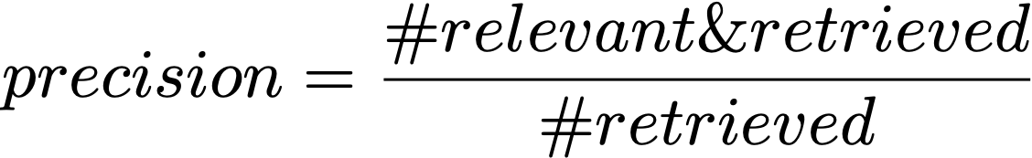
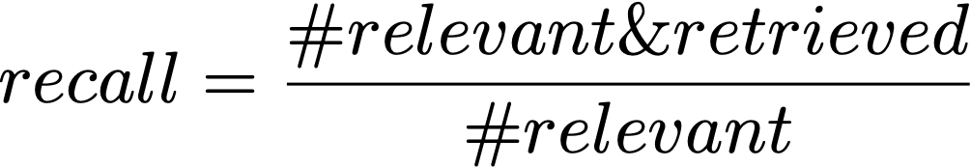
Precision of retrieved documents
Fraction of retrieved docs that are relevant
Fraction of relevant documents that are retrieved
Notes:
we use Google playstore data as the data source, so we collect these data, we clean it, we split the sentence, and we build a filtering algorithm to select the high quality sentence

Slide 7
Precision-recall curve
(1/1 + 2/2 + 3/5 + 4/8) / 4
Precision Recall
+
+
–
–
+
–
–
+
–
–
1/1 1/4
Precision
1.0
precision usually decreases (not always)
2/2 2/4
0.6
3/5 3/4
4/8 4/4
0.1
0.2
0.3 ….
1.0
Recall
Slides from UIUC CS598
Notes:
we use Google playstore data as the data source, so we collect these data, we clean it, we split the sentence, and we build a filtering algorithm to select the high quality sentence

Slide 8
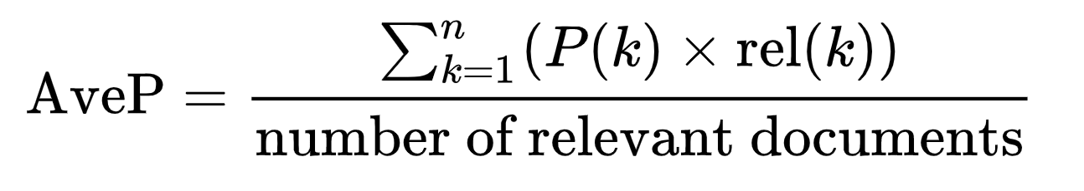
Average precision
Consider rank position of each relevant and retrieved doc
K₁, K₂, … K_{R}
Compute Precision@K for K = K₁, K₂, … K_{R}
Average precision:
# retrieved documents
# relevant documents, not # retrieved documents
Notes:
we use Google playstore data as the data source, so we collect these data, we clean it, we split the sentence, and we build a filtering algorithm to select the high quality sentence

Slide 9
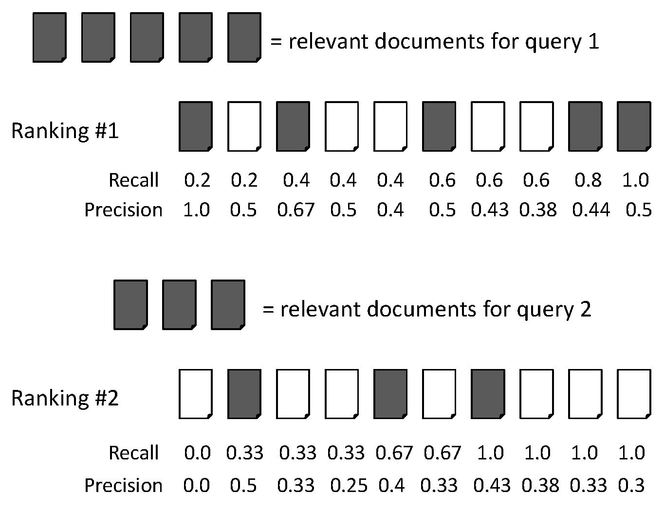
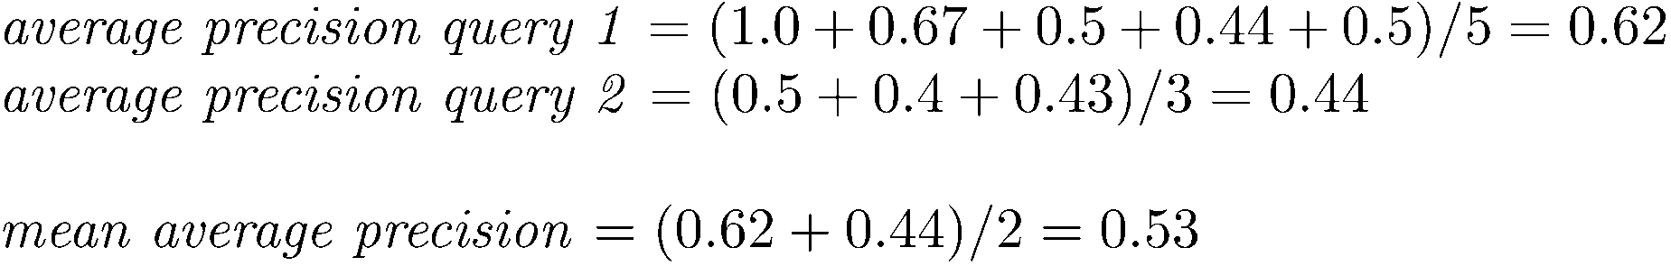


MAP
Suppose there are 5 relevant documents for both query 1 and 2
This value = #relevant documents, not # retrieved relevant documents (why?)
Slides from Stanford CS276
Notes:
we use Google playstore data as the data source, so we collect these data, we clean it, we split the sentence, and we build a filtering algorithm to select the high quality sentence

Slide 10
Mean reciprocal rank
Measure the effectiveness of the ranked results
Assume users are only looking for one relevant document
RR = 1.0 / (1.0 + rank_1)
p starts from 0
Slides from UVA CS4780
Notes:
we use Google playstore data as the data source, so we collect these data, we clean it, we split the sentence, and we build a filtering algorithm to select the high quality sentence

Slide 11
Beyond binary relevance
Discounted cumulative gain (DCG)
Popular measure for evaluating web search and related tasks
Information gain-based evaluation (economics)
For each relevant document, the user has gained some information
The higher the relevance, the higher gain
The gain is discounted when the relevant document appears in a lower position
Notes:
we use Google playstore data as the data source, so we collect these data, we clean it, we split the sentence, and we build a filtering algorithm to select the high quality sentence

Slide 12
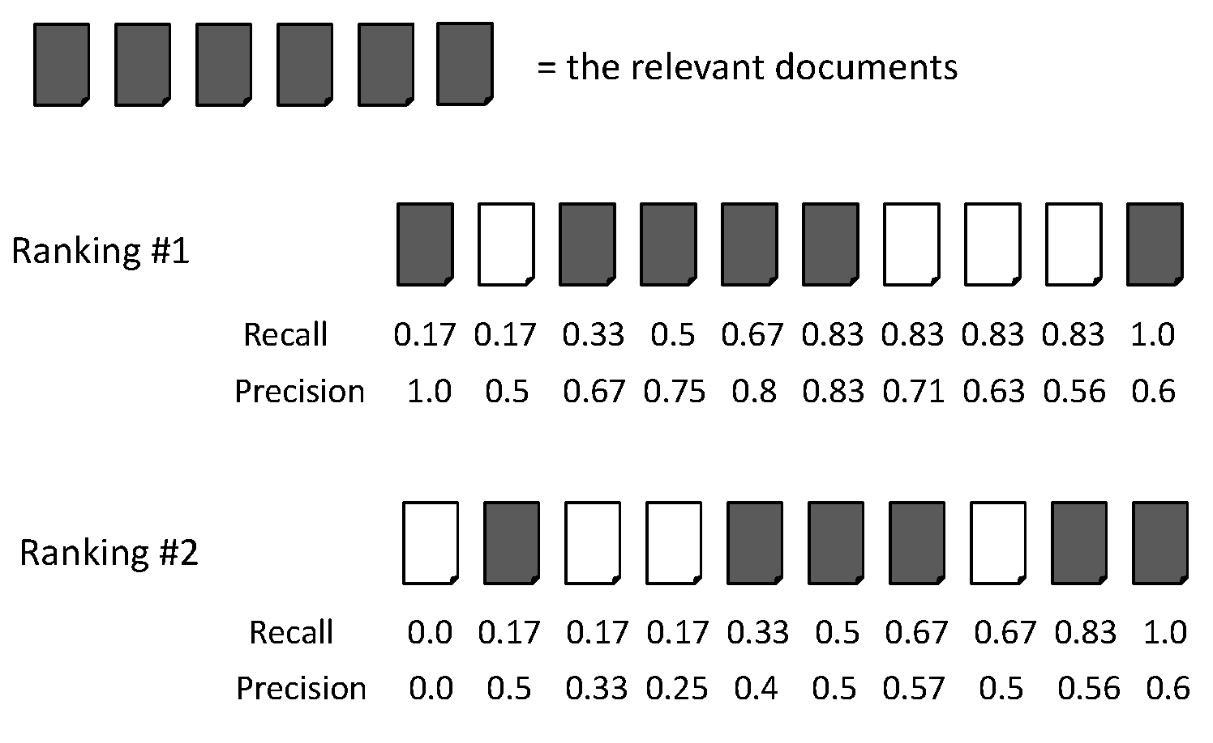
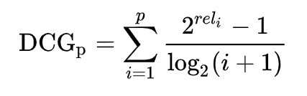
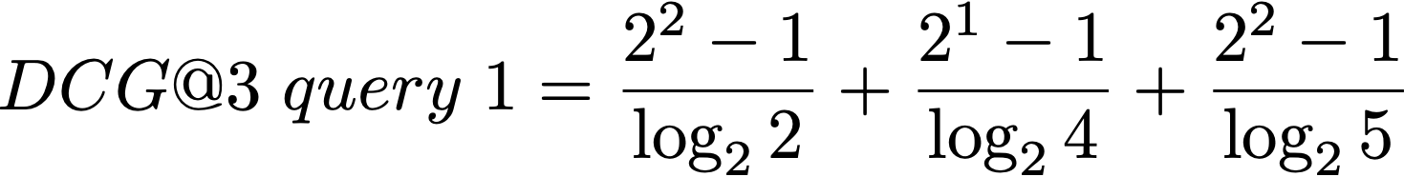


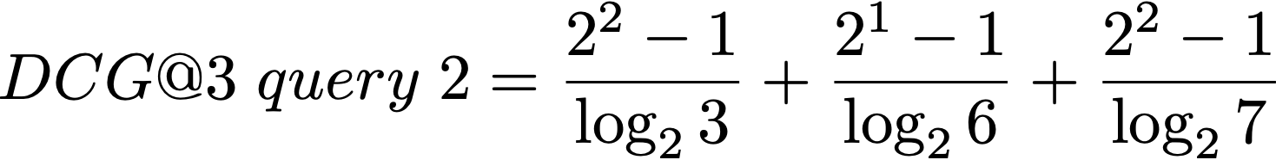


Discounted cumulative gain (DCG)
2 0 1 2 2 1 0 0 0 2
0 2 0 0 1 2 2 0 1 2
p starts from 1
Notes:
we use Google playstore data as the data source, so we collect these data, we clean it, we split the sentence, and we build a filtering algorithm to select the high quality sentence

Slide 13
Why normalizing DCG?
If we do not normalize DCG, the performance will be biased towards systems that perform well on queries with larger DCG scales
system A
system B
“TV”
DCG=4.79
DCG=5.79
2 0 1 2 2 1 0 0 0 2
“clothing”
DCG=1.89
DCG=1.39
0 2 0 0 1 2 2 0 1 2
avg=3.34
avg=3.59
bias towards B
Notes:
we use Google playstore data as the data source, so we collect these data, we clean it, we split the sentence, and we build a filtering algorithm to select the high quality sentence

Slide 14



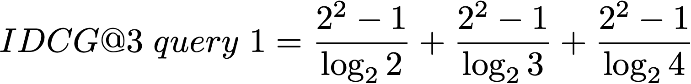
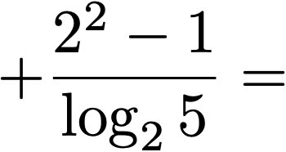

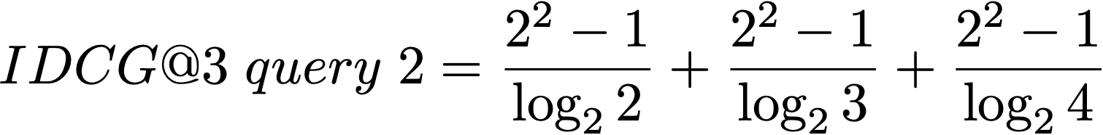
Normalized Discounted cumulative gain (nDCG)
2 0 1 2 2 1 0 0 0 2
0 2 0 0 1 2 2 0 1 2
Notes:
we use Google playstore data as the data source, so we collect these data, we clean it, we split the sentence, and we build a filtering algorithm to select the high quality sentence

Slide 15
Relevance evaluation methodology
Offline evaluation:
Evaluation based on annotators’ annotation (explicit)
TREC conference
Cranfield experiments
Pooling
Evaluation based on user click through logs (implicit)
Online evaluation
A/B testing
Notes:
we use Google playstore data as the data source, so we collect these data, we clean it, we split the sentence, and we build a filtering algorithm to select the high quality sentence

Slide 16
Text REtrieval Conference (TREC)
Since 1992, hosted by NIST
Relevance judgment are based on human annotations
The relevance judgment goes beyond keywords matching
Different tracks for TREC
Web
Question answering
Microblog
Notes:
we use Google playstore data as the data source, so we collect these data, we clean it, we split the sentence, and we build a filtering algorithm to select the high quality sentence

Slide 17
The Cranfield experiment (1958)
Imagine you need to help users search for literatures in a digital library, how would you design such a system?
computer science
query = “subject = AI & subject = bioinformatics”
artificial intelligence
bioinformatics
system 1: the Boolean retrieval system
Notes:
creates the building block of more advanced techniques

Slide 18
The Cranfield experiment (1958)
Imagine you need to help users search for literatures in a digital library, how would you design such a system?
Document-term matrix
 | intelligence | book | the | cat | artificial | dog | business
Doc1 | 0 | 1 | 3 | 1 | 0 | 1 | 0
Doc2 | 1 | 0 | 0 | 0 | 0 | 0 | 1
query | 1 | 0 | 1 | 0 | 1 | 0 | 0
artificial
query = “artificial intelligence”
bags of words representation
system 2: indexing documents by lists of words
Notes:
creates the building block of more advanced techniques

Slide 19
The Cranfield experiment (1958)
Basic ingredients
A corpus of documents (1.4k paper abstracts)
A set of 225 queries and their information needs
Binary relevance judgment for each (q, d) pair
Reuse the relevance judgments for each (q, d) pair
query = “best phone”, time = 2012, relevance = 1
Nokia
query = “best phone”, time = 2022, relevance = 0
Notes:
we use Google playstore data as the data source, so we collect these data, we clean it, we split the sentence, and we build a filtering algorithm to select the high quality sentence

Slide 20
Scalability problem in human annotation
TREC contains 225 x 1.4k = 315k (query, documents) pairs
How to annotate so many pairs?
Pooling strategy
For each of K system, first run the system to get top 100 results
Annotate the union of all such documents
Notes:
we use Google playstore data as the data source, so we collect these data, we clean it, we split the sentence, and we build a filtering algorithm to select the high quality sentence

Slide 21
Evaluation based on user click through logs
TREC style relevance judgment
Explicit relevance judgment
Difficult to achieve large scalability
Relevance is fixed
Relevance judgment using user clicks
Implicit relevance judgment
Effortless relevance judgment at a large scale
Relevance is fixed, (assume relevance judgment stays the same upon reranking)
Notes:
we use Google playstore data as the data source, so we collect these data, we clean it, we split the sentence, and we build a filtering algorithm to select the high quality sentence

Slide 22
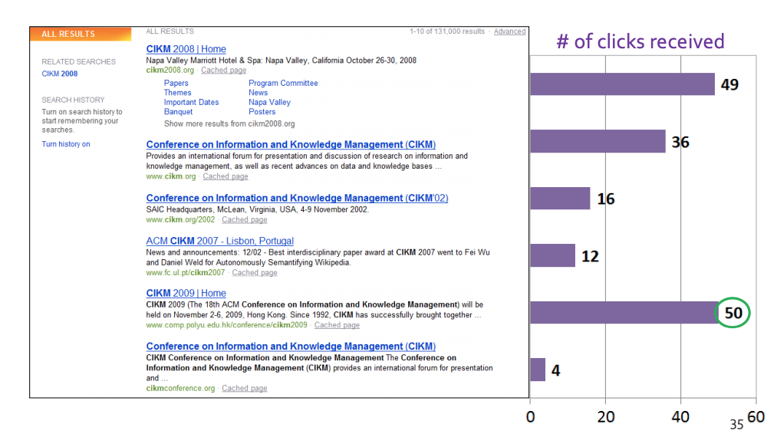
Evaluation based on user click through logs
slides from Stanford CS276
Click logs for “CIKM”
the most relevant document
Notes:
we use Google playstore data as the data source, so we collect these data, we clean it, we split the sentence, and we build a filtering algorithm to select the high quality sentence

Slide 23
Evaluation based on user click through logs
System logs the users engagement behaviors:
Time stamp
Session id
Query id, query content
Items viewed by the user (in sequential order)
Whether each item has been clicked by the user
User’s demographic information, search/click history, location, device
Dwell time, browsing time for each document
Eye tracking information
Notes:
we use Google playstore data as the data source, so we collect these data, we clean it, we split the sentence, and we build a filtering algorithm to select the high quality sentence

Slide 24
Evaluation based on user click through logs
Click logs are stored in large tables
Using SQL to extract a subset of query logs
Notes:
we use Google playstore data as the data source, so we collect these data, we clean it, we split the sentence, and we build a filtering algorithm to select the high quality sentence

Slide 25
Online evaluation methodology
Assumption made by offline evaluation
After reranking, relevance judgment stays the same
Which is not true…
Relevance judgment is dynamic, subject to user bias
Bias based on positions
Preference shifting over time, location
Decoy effects
Notes:
we use Google playstore data as the data source, so we collect these data, we clean it, we split the sentence, and we build a filtering algorithm to select the high quality sentence

Slide 26
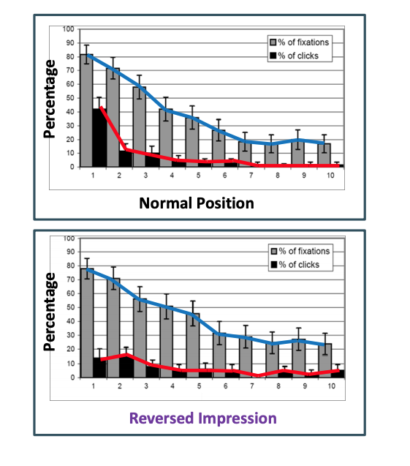
Position bias [Craswell 08]
Position bias
Higher position receives more attention
The same item gets lower click in lower position
click
not click
Notes:
we use Google playstore data as the data source, so we collect these data, we clean it, we split the sentence, and we build a filtering algorithm to select the high quality sentence

Slide 27
Decoy effects
vs
$400, 20G
$500, 30G
$550, 20G
click probability = 0.3
click probability = 0.4
click probability = 0.5
click probability = 0.5
Notes:
we use Google playstore data as the data source, so we collect these data, we clean it, we split the sentence, and we build a filtering algorithm to select the high quality sentence

Slide 28
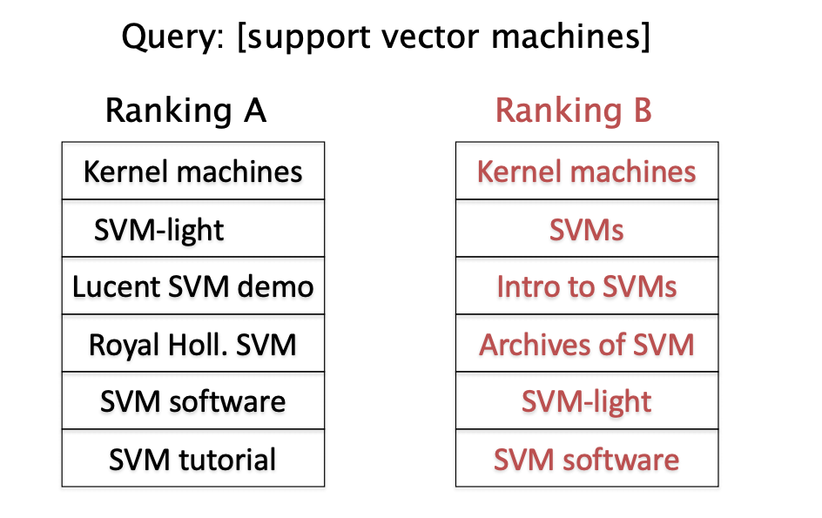
Online evaluation methodology
Evaluation by actually having the system deployed and observe user response
Less scalable
A/B testing
Notes:
we use Google playstore data as the data source, so we collect these data, we clean it, we split the sentence, and we build a filtering algorithm to select the high quality sentence

Slide 29
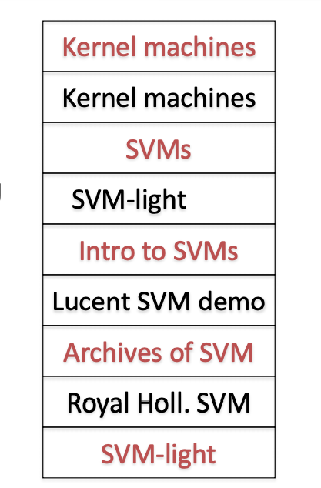
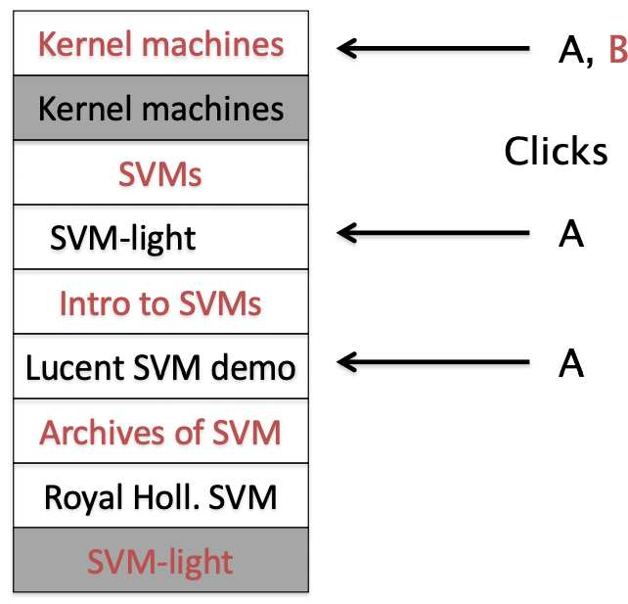
Interleaving
remove dup
A clicks = 3, B clicks = 1
Notes:
we use Google playstore data as the data source, so we collect these data, we clean it, we split the sentence, and we build a filtering algorithm to select the high quality sentence

Slide 30
Online evaluation methodology
Bing has an existing ranking algorithm A
Testing algorithm B is better than A
Strategy 1: Running A of 1 month, running B for the next month
Strategy 2: Running A 50% of the time, B 50% of the time
Disadvantage with Strategy 1 and 2:
If B fails, it will hurts user experience from the B group
Running B 5% of the time, running A 95% of the time
Notes:
we use Google playstore data as the data source, so we collect these data, we clean it, we split the sentence, and we build a filtering algorithm to select the high quality sentence

Slide 31
Statistical significance testing
How sure can you be that an observed difference doesn’t simply result from the particular queries you chose?
Experiment 1
Experiment 2
Query
System A
System B
Query
System A
System B
1
2
3
4
5
6
7
0.20
0.21
0.22
0.19
0.17
0.20
0.21
0.40
0.41
0.42
0.39
0.37
0.40
0.41
1
2
3
4
5
6
7
0.02
0.39
0.16
0.58
0.04
0.09
0.12
0.76
0.07
0.37
0.21
0.02
0.91
0.46
Average
0.20
0.40
Average
0.20
0.40
Slides from UIUC CS598
Notes:
we use Google playstore data as the data source, so we collect these data, we clean it, we split the sentence, and we build a filtering algorithm to select the high quality sentence

Slide 32
Statistical significance testing
Query
System A
System B
Sign Test
Wilcoxon
1
2
3
4
5
6
7
0.02
0.39
0.16
0.58
0.04
0.09
0.12
0.76
0.07
0.37
0.21
0.02
0.91
0.46
+
-
+
-
-
+
-
+0.74
- 0.32
+0.21
- 0.37
- 0.02
+0.82
- 0.38
Average
0.20
0.40
p=1.0
p=0.9375
95% of outcomes
0
Slides from UIUC CS598
Notes:
we use Google playstore data as the data source, so we collect these data, we clean it, we split the sentence, and we build a filtering algorithm to select the high quality sentence

Slide 33
Retrieval feedback in session search
$400, 20G, Nokia
$500, 30G, Nokia
$600, 40G, iphone
query = “best phone”
Does the user prefer lower priced phone, or high end phones? Larger storage, better camera?
observed click
session 1
session 2
The new query should match more relevant documents and fewer non-relevant documents
Notes:
we use Google playstore data as the data source, so we collect these data, we clean it, we split the sentence, and we build a filtering algorithm to select the high quality sentence

Slide 34
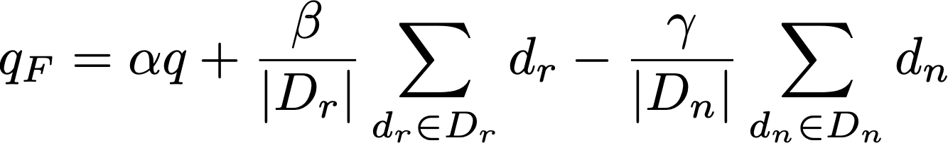
Rocchio feedback
Feedback for vector-space model
Rocchio’s practical issues
Large vocabularies (only consider important words)
Robust and effective
Requires relevance feedback
rel docs
non-rel docs
beta >> gamma
Notes:
we use Google playstore data as the data source, so we collect these data, we clean it, we split the sentence, and we build a filtering algorithm to select the high quality sentence

Slide 35
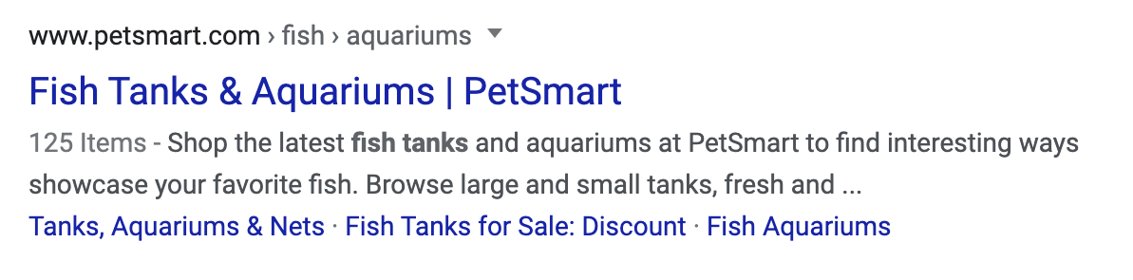
Pseudo-relevance feedback
What if we do not have relevance judgments?
Use the top retrieved documents as “pseudo relevance documents”
Why does pseudo-relevance feedback work?
query = “fish tank”
Notes:
we use Google playstore data as the data source, so we collect these data, we clean it, we split the sentence, and we build a filtering algorithm to select the high quality sentence

Slide 36
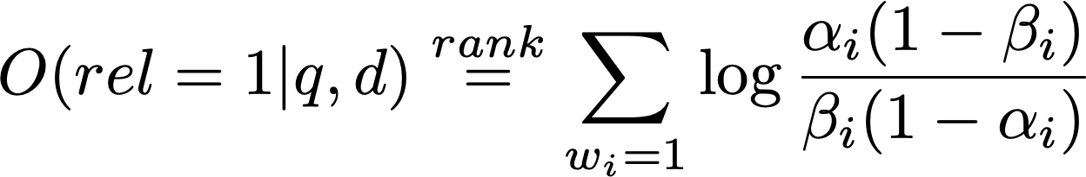
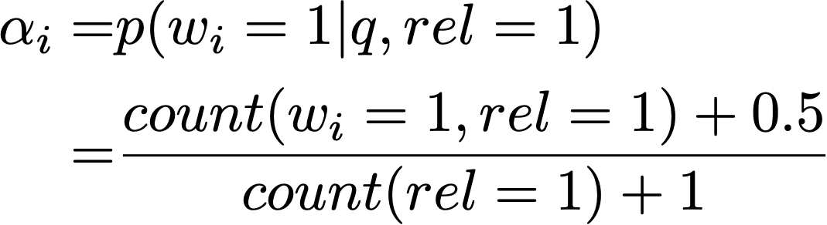
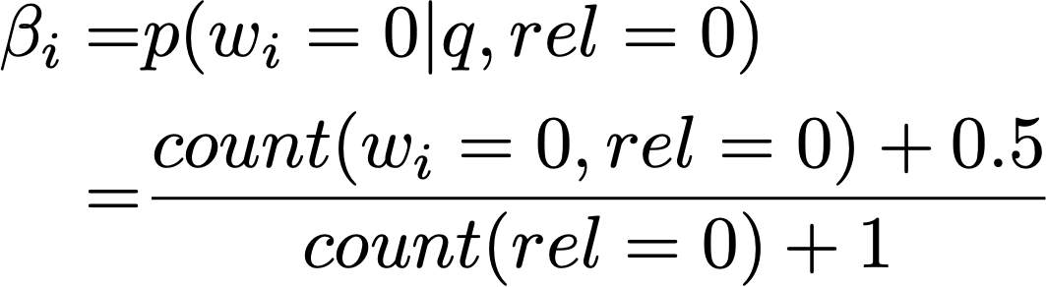
Relevance feedback in RSJ model
(Robertson & Sparck Jones 76)
Probability for a word to appear in a relevant doc
Probability for a word to appear in a non-relevant doc
Notes:
we use Google playstore data as the data source, so we collect these data, we clean it, we split the sentence, and we build a filtering algorithm to select the high quality sentence

Slide 37
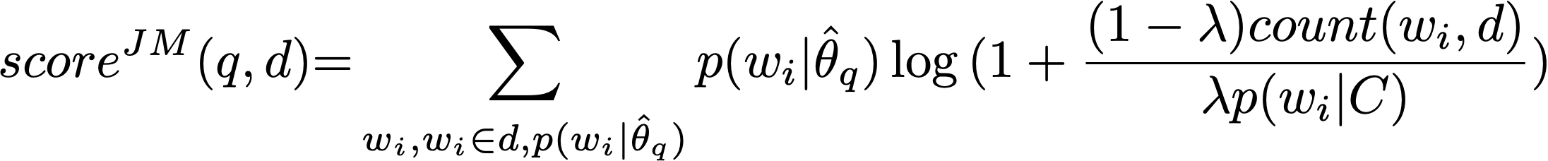
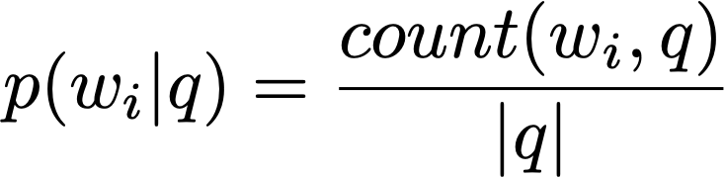








(Pseudo)relevance feedback language model
sparsity
get document model
retrieve
infer w/ EM algo
Model-based feedback in the language modeling approach to information retrieval
Notes:
we use Google playstore data as the data source, so we collect these data, we clean it, we split the sentence, and we build a filtering algorithm to select the high quality sentence

Slide 38
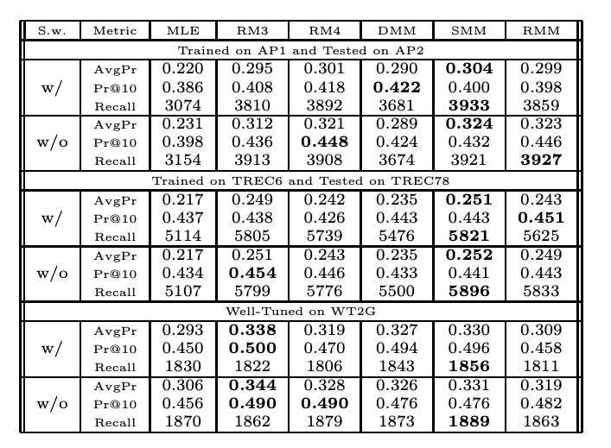
Performance of relevance feedback models
Notes:
we use Google playstore data as the data source, so we collect these data, we clean it, we split the sentence, and we build a filtering algorithm to select the high quality sentence

Slide 39
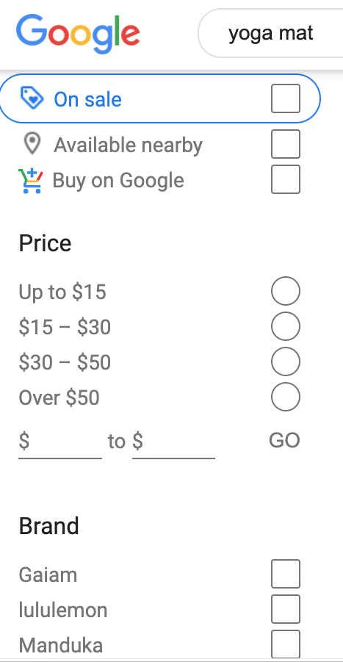
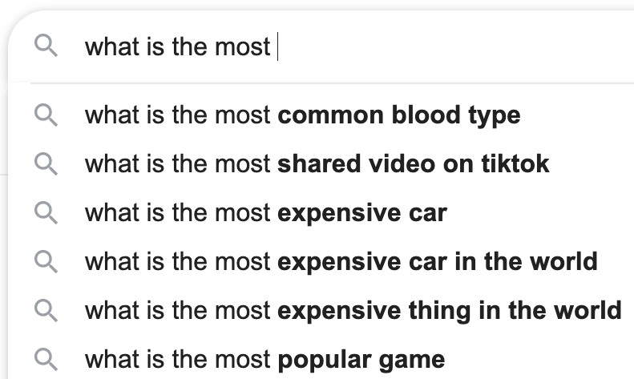
Query expansion
Notes:
we use Google playstore data as the data source, so we collect these data, we clean it, we split the sentence, and we build a filtering algorithm to select the high quality sentence

Slide 40
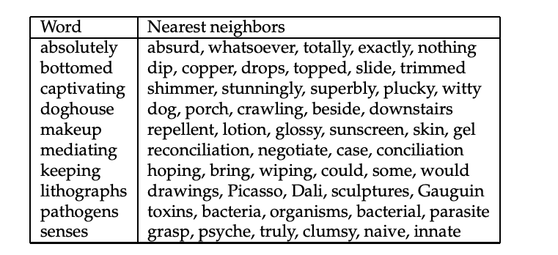
Query reformulation
Query expansion/reformulation techniques
Using manually created synonyms
Using automatically derived thesaurus
Using query log mining
Notes:
we use Google playstore data as the data source, so we collect these data, we clean it, we split the sentence, and we build a filtering algorithm to select the high quality sentence

