Slide 1
CS 589 Fall 2020
Maximum likelihood estimation
Expectation maximization
Instructor: Susan Liu
TA: Huihui Liu
Stevens Institute of Technology

Slide 2
Recap of Lecture 2
RSJ: no parameter
BM25: Due to the formulation of two-Poisson, parameters are difficult to estimate, so use a parameter free version to replace it
Language model based retrieval model
Leave-one-out
EM algorithm
Notes:
we use Google playstore data as the data source, so we collect these data, we clean it, we split the sentence, and we build a filtering algorithm to select the high quality sentence

Slide 3

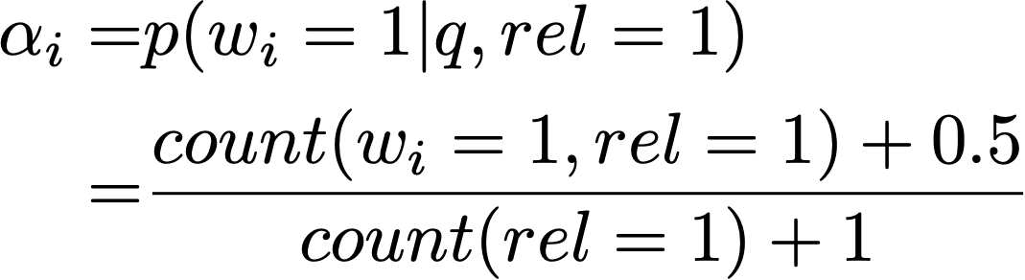
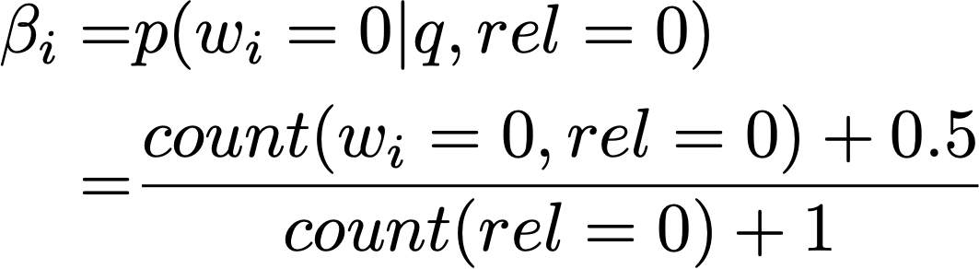
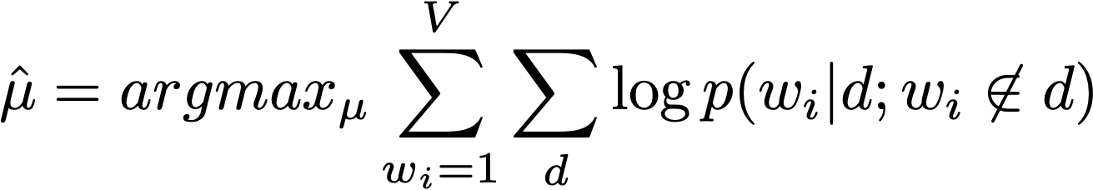
Maximum likelihood estimation
RSJ:
Language model
PRP: rank documents by
Notes:
we use Google playstore data as the data source, so we collect these data, we clean it, we split the sentence, and we build a filtering algorithm to select the high quality sentence

Slide 4
Today’s lecture
Maximum likelihood estimation
Expectation maximization
Coin-topic problem
Using EM algorithm to remove stop words
Mixture of topic models
Probabilistic latent semantic analysis
PLSA with partial labels
Notes:
we use Google playstore data as the data source, so we collect these data, we clean it, we split the sentence, and we build a filtering algorithm to select the high quality sentence

Slide 5
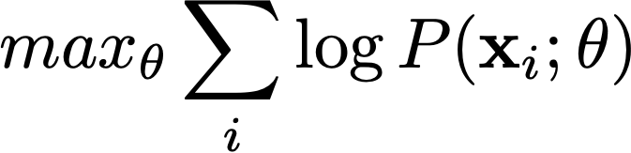




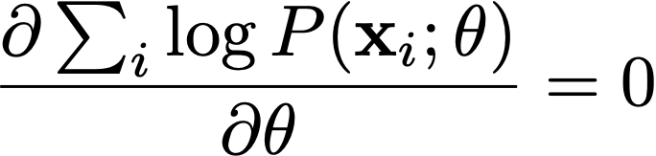


Maximum likelihood estimation
observations
e.g., mice weights
likelihood
parameters
If the optimal solution is within ’s space :
at
Notes:
we use Google playstore data as the data source, so we collect these data, we clean it, we split the sentence, and we build a filtering algorithm to select the high quality sentence

Slide 6


Expectation maximization algorithm
How to estimate the optimal ?
Expectation maximization (EM) algorithm:
Relies on the concept of complete data space
Iterative and alternative between conditional expectation and maximization steps
l(theta): Incomplete data space: observation, e.g., documents
l_{cd}(theta): Complete data space: observation + latent variables, e.g., topic
Notes:
we use Google playstore data as the data source, so we collect these data, we clean it, we split the sentence, and we build a filtering algorithm to select the high quality sentence

Slide 7
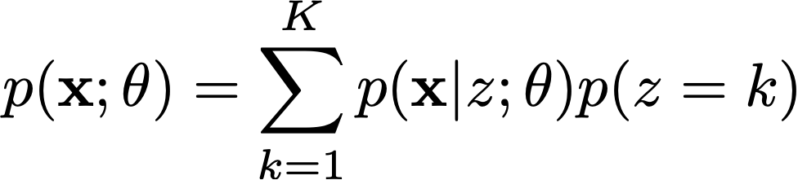
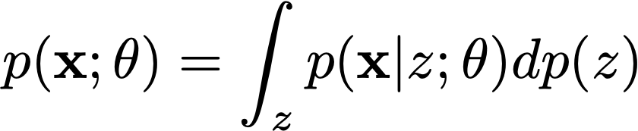

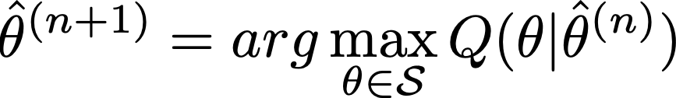
Expectation maximization algorithm
Estimating the incomplete probability using the complete space
EM algorithm: repeat n=1…N:
discrete space
continuous space
E step:
M step:
Notes:
we use Google playstore data as the data source, so we collect these data, we clean it, we split the sentence, and we build a filtering algorithm to select the high quality sentence

Slide 8

Expectation maximization: convergence guarantee
Theorem: the likelihood of observation, , monotonously increases with n
Notes:
we use Google playstore data as the data source, so we collect these data, we clean it, we split the sentence, and we build a filtering algorithm to select the high quality sentence

Slide 9




Expectation maximization: convergence guarantee
Take the expectation over on both side
EM chooses to maximize
KL divergence always nonneg
Notes:
we use Google playstore data as the data source, so we collect these data, we clean it, we split the sentence, and we build a filtering algorithm to select the high quality sentence

Slide 10


An example problem: Coin-topic problem
Author H and author T are co-authoring a paper in the following way:
At each time, they toss a coin to write the next word. If it’s “head”, author H writes the next word, if it’s “tail”, author T writes the next word. The probability for “head” is
The head author selects the next word by randomly sampling from , so does the tail author
Problem: estimating the parameters that maximizes the document likelihood
Notes:
we use Google playstore data as the data source, so we collect these data, we clean it, we split the sentence, and we build a filtering algorithm to select the high quality sentence

Slide 11
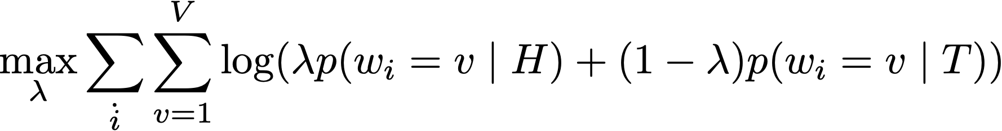
Coin-topic problem: known p(v|T), unknown
Maximum likelihood estimation:
Suppose both head and tail distributions are known, e.g.:
 | the | computer | data | baseball | game | interesting
p(w|T) | 0.2 | 0.05 | 0.05 | 0.4 | 0.2 | 0.1
p(w|H) | 0.25 | 0.2 | 0.2 | 0.15 | 0.1 | 0.1
Notes:
we use Google playstore data as the data source, so we collect these data, we clean it, we split the sentence, and we build a filtering algorithm to select the high quality sentence

Slide 12


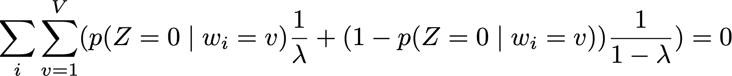
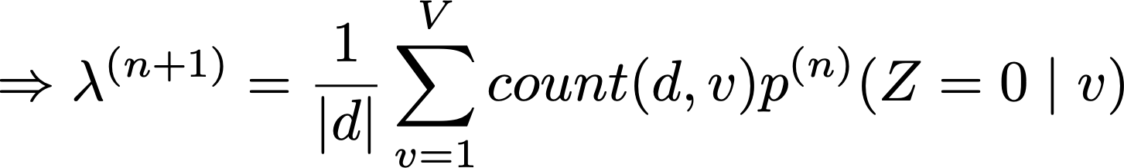
Expectation maximization
We use to represent the hidden variable, i.e., whether the topic for word v is head or tail topic
Take the derivative of over lambda:
(M step)
Notes:
we use Google playstore data as the data source, so we collect these data, we clean it, we split the sentence, and we build a filtering algorithm to select the high quality sentence

Slide 13
Expectation maximization
We use to represent the hidden variable, i.e., whether the topic for word v is head or tail topic
E step: the standard derivation is to apply Bayes theorem:
Notes:
we use Google playstore data as the data source, so we collect these data, we clean it, we split the sentence, and we build a filtering algorithm to select the high quality sentence

Slide 14
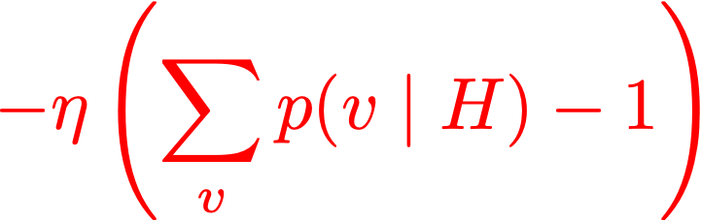
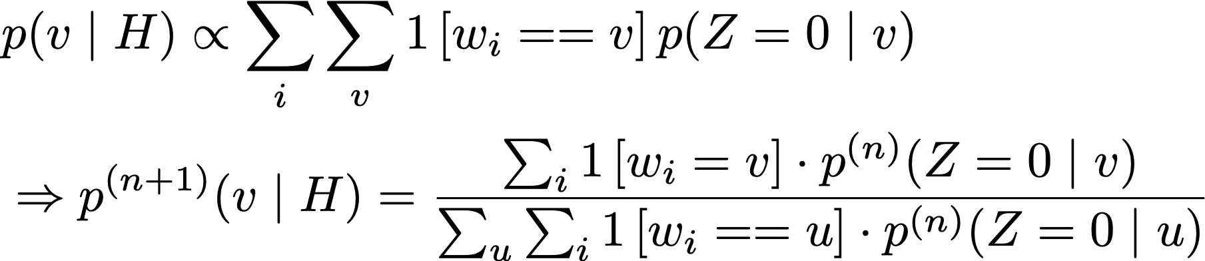
Coin-topic problem: unknown topic, known
For the same coin topic problem, assume lambda is known whereas is unknown, estimate
Take the derivative and set to 0, we can get (M step):
E step follows the same posterior estimation as the previous slide
Notes:
we use Google playstore data as the data source, so we collect these data, we clean it, we split the sentence, and we build a filtering algorithm to select the high quality sentence

Slide 15
Coin-topic problem: unknown topic, known
For the same coin topic problem, assume lambda is known whereas is unknown, estimate
Application: removing background topic
Suppose p(w|H) is the main topic (computer game)
p(w|T) is the background topic: the: 0.3, a: 0.2, …,
The mixture of head and tail topic is dominated by background words:
After stop words removal, the true topic p(w|T) is “revealed”:
Notes:
we use Google playstore data as the data source, so we collect these data, we clean it, we split the sentence, and we build a filtering algorithm to select the high quality sentence

Slide 16
Coin-topic problem: unknown topic and
Suppose both p(w|H) and lambda are unknown:
(M step of unknown lambda)
(M step of unknown topic)
(E step)
Notes:
we use Google playstore data as the data source, so we collect these data, we clean it, we split the sentence, and we build a filtering algorithm to select the high quality sentence

Slide 17
Applications of Coin Topic Problem for Text Mining
Application Scenarios:
p(w|H) & p(w|T) are known; estimate λ
p(w|H) & λ are known; estimate p(w|T)
p(w|H) is known; estimate λ & p(w|T)
λ is known; estimate p(w|H)& p(w|T)
Estimate λ, p(w|H), p(w|T)
how much percent of the document is about computer game?
30% of the doc is about computer game, what’s the other topic about?
rest about?
The doc is about computer game, is it also about some
other topic, and if so to what extent?
30% of the doc is about one topic and 70% is about
another, what are these two topics?
The doc is about two subtopics, find out what these two subtopics
are and to what extent the doc covers each.

Slide 18
Expectation maximization as hill climbing
next guess
current guess
M step object
converge to local optimal
Slides from UIUC CS510
Notes:
we use Google playstore data as the data source, so we collect these data, we clean it, we split the sentence, and we build a filtering algorithm to select the high quality sentence

Slide 19
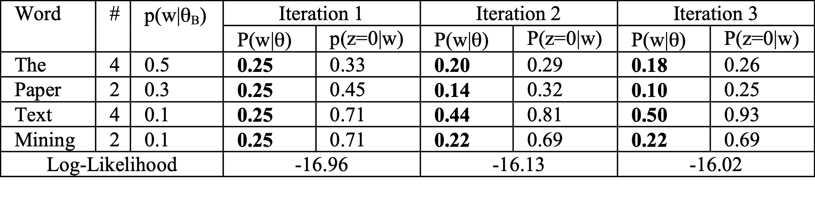
EM algorithm in action
Log likelihood increases:
Notes:
we use Google playstore data as the data source, so we collect these data, we clean it, we split the sentence, and we build a filtering algorithm to select the high quality sentence

Slide 20
Topic models and analysis
Topic ≈ main idea discussed in text data
Theme/subject of a discussion or conversation
Different granularities (e.g., topic of a sentence, an article, etc.)
Many applications require discovery of topics in text
What are Twitter users talking about today?
What are the current research topics in data mining? How are they different from those 5 years ago?
What do people like about the iPhone 6? What do they dislike?
What were the major topics debated in 2012 presidential election?
Slides from UIUC CS510
Notes:
we use Google playstore data as the data source, so we collect these data, we clean it, we split the sentence, and we build a filtering algorithm to select the high quality sentence

Slide 21

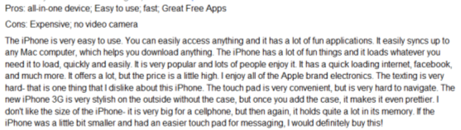

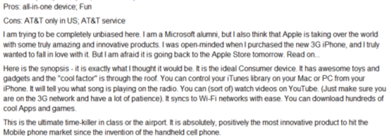

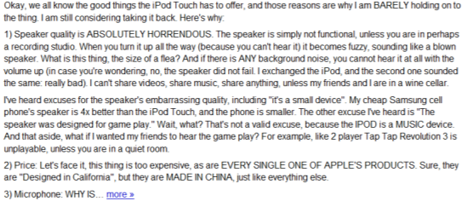
Lifecycle of topic and text data
Non-Text Data
Knowledge about the world
Text Data
Topic 1
+ Context
Time
Location
…
Real World
Topic 2
…
…
Topic k
Slides from UIUC CS510
Notes:
we use Google playstore data as the data source, so we collect these data, we clean it, we split the sentence, and we build a filtering algorithm to select the high quality sentence

Slide 22


A generative process of documents
Assume documents are generated by sampling words from k latent topics
For each document d:
For each token position i
Choose a topic z ∼ Multinomial( )
Choose a term w ∼ Multinomial( )
Probabilistic Latent Semantic Analysis. Thomas Hoffman. 2001.

Slide 23
Review of PLSA
Phi T x V, V: vocabulary size ~50,000, T: #topics, T=20
theta D x T, D: #documents: ~10,000, T: #topics, T=20
city 0.2 new 0.1 orleans 0.05 ...
donate 0.1 relief 0.05 help 0.02 ...
government 0.3 response 0.2 ...
the 0.04 a 0.03 ...
Orleans 0.05
0.5
0.3
0.1
0.1
[ Criticism of government response to the hurricane ..] to the [ flooding of New _______
[ Criticism of government response to the hurricane ..] to the [ flooding of New Orleans
Step 1: sample a topic: topic 2
Step 2: sample a word from topic 2
Probabilistic Latent Semantic Analysis. Thomas Hoffman. 2001.

Slide 24
Document as a Sample of Mixed Topics
government 0.3 response 0.2 ...
Blog article about “Hurricane Katrina”
Topic θ₁
[ Criticism of government response to the hurricane primarily consisted of criticism of its response to the approach of the storm and its aftermath, specifically in the delayed response ] to the [ flooding of New Orleans. … 80% of the 1.3 million residents of the greater New Orleans metropolitan area evacuated ] …[ Over seventy countries pledged monetary donations or other assistance]. …
city 0.2 new 0.1 orleans 0.05 ...
Topic θ₂
…
donate 0.1 relief 0.05 help 0.02 ...
Topic θ_{k}
Background θ_{B}
the 0.04 a 0.03 ...
proportion of topics

Slide 25
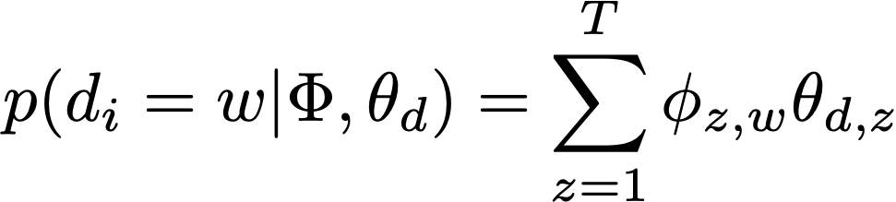
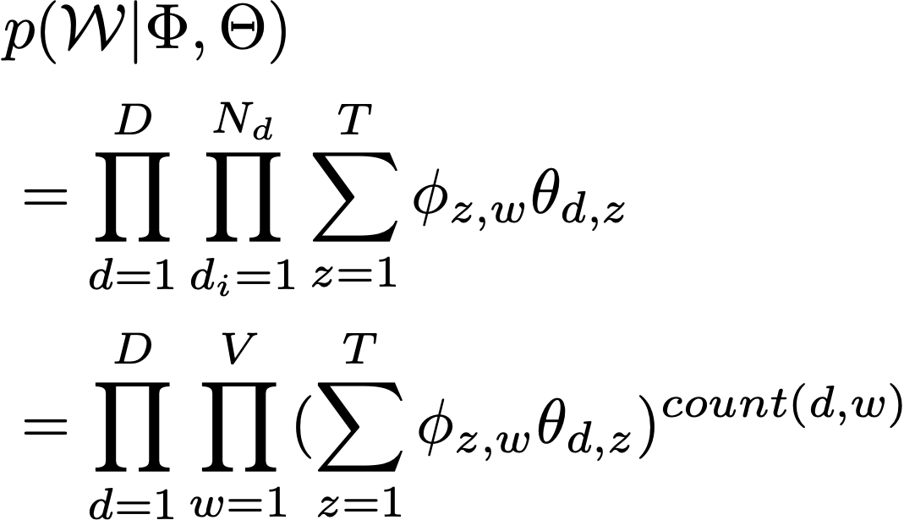
Probabilistic latent semantic analysis
Notes:
we use Google playstore data as the data source, so we collect these data, we clean it, we split the sentence, and we build a filtering algorithm to select the high quality sentence

Slide 26

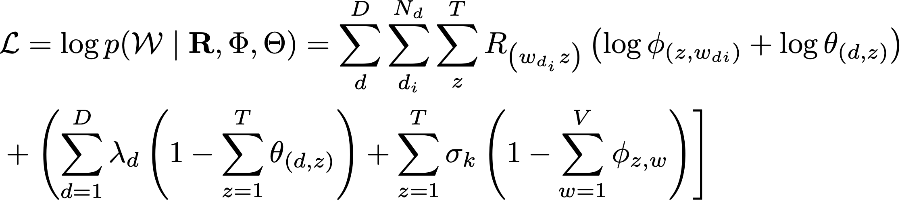


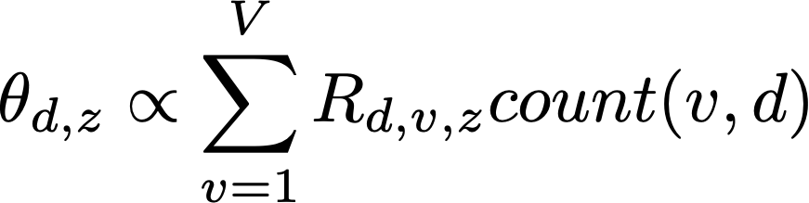

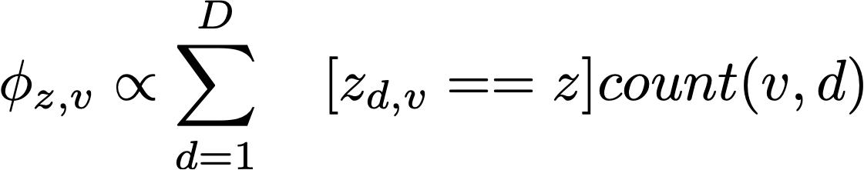
Probabilistic latent semantic analysis
Use to represent which topic d_i in document d comes from (repeated same tokens are from the same topic)
M step: set the derivative of L to 0:
E step:
Notes:
we use Google playstore data as the data source, so we collect these data, we clean it, we split the sentence, and we build a filtering algorithm to select the high quality sentence

Slide 27
Probabilistic latent semantic analysis: partially available labels
Generalized topic modeling:
Each document can contain just one topic, e.g., short documents
That is, topic inference = topic classification
If we already know the document tags for a part of the documents, does the partial labels help us make better predictions for the entire corpus? (Homework 3)
Example: news tagging, StackOverflow question tagging
Notes:
we use Google playstore data as the data source, so we collect these data, we clean it, we split the sentence, and we build a filtering algorithm to select the high quality sentence

Slide 28
Probabilistic latent semantic analysis: partially available labels
Notes:
we use Google playstore data as the data source, so we collect these data, we clean it, we split the sentence, and we build a filtering algorithm to select the high quality sentence

Slide 29
Homework 3
Suppose each document has only 1 topic. We have two document set: S1 (100 documents) contains all the tagged documents; S2 (10,000 documents) contains all the untagged documents. Each tag is a topic, there are only 2 topics
(Part 1): derive the EM algorithm using pLSA that maximizes the probability of the observed document, given the known topics from S1
(Part 2): implement your EM algorithm, output the predicted topic for each document in S2
Slides from UIUC CS510
Notes:
we use Google playstore data as the data source, so we collect these data, we clean it, we split the sentence, and we build a filtering algorithm to select the high quality sentence

Slide 30
PLSA applications
Topic modeling approach can be used for
Interpreting content of corpora
Clustering documents, predicting topics
Time series/trend analysis
Slides from UIUC CS510
Notes:
we use Google playstore data as the data source, so we collect these data, we clean it, we split the sentence, and we build a filtering algorithm to select the high quality sentence

Slide 31
Interpreting content of corpora [Mei et al. 07]
government 0.3 response 0.2 ...
Topic θ₁
How do users interpret a learned topic?
Human generated labels, but cannot scale up
What makes a good label?
Semantically close (relevance)
Understandable – phrases?
High coverage inside topic
Discriminative across topics
city 0.2 new 0.1 orleans 0.05 ...
Topic θ₂
donate 0.1 relief 0.05 help 0.02 ...
Topic θ_{k}
the 0.04 a 0.03 ...
Slides from UIUC CS510
Notes:
we use Google playstore data as the data source, so we collect these data, we clean it, we split the sentence, and we build a filtering algorithm to select the high quality sentence

Slide 32
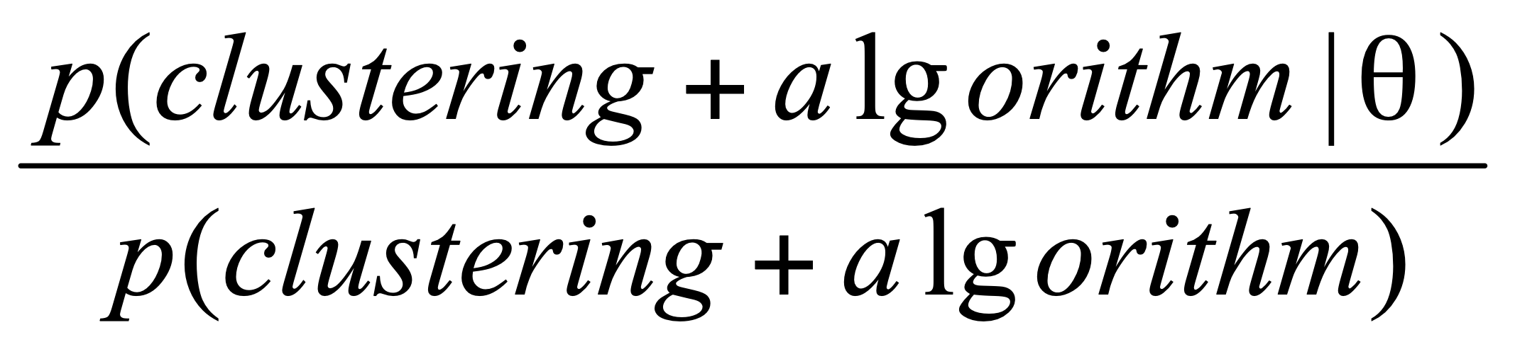
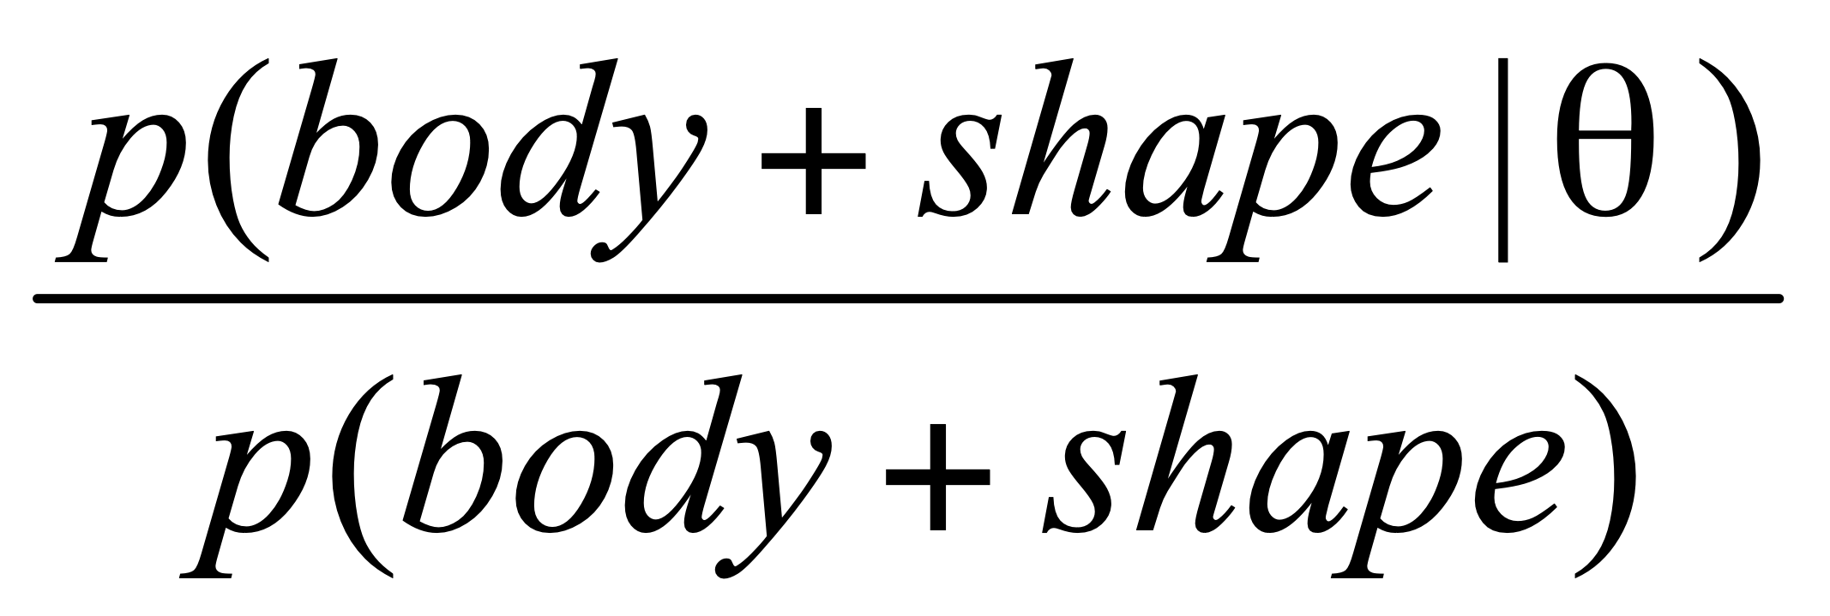
Relevance: the Zero-Order Score [Mei et al. 07]
Intuition: prefer phrases well covering top words
p(“clustering”|θ) = 0.4
Clustering
Good Label (l₁): “clustering algorithm”
√
p(“dimensional”|θ) = 0.3
dimensional
Latent Topic θ
algorithm
>
…
birch
shape
p(“shape”|θ) = 0.01
Bad Label (l₂): “body shape”
…
p(w|θ)
body
p(“body”|θ) = 0.001
Slides from UIUC CS510

Slide 33
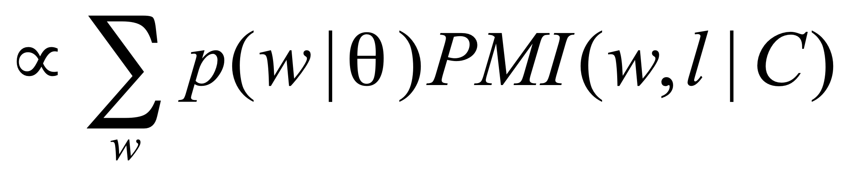
Relevance: the First-Order Score [Mei et al. 07]
Intuition: prefer phrases with similar context (distribution)
Clustering
Clustering
Clustering
dimension
dimension
Good Label (l₁): “clustering algorithm”
Bad Label (l₂): “hash join”
dimension
…
Topic
θ
algorithm
partition
partition
SIGMOD Proceedings
key
Score (l, θ )
algorithm
algorithm
…
…
P(w|θ)
hash
p(w | hash join)
hash
hash
p(w | clustering algorithm )
D(θ | clustering algorithm) < D(θ | hash join)
Slides from UIUC CS510

Slide 34
Topic labels [Mei et al. 07]
sampling 0.06
estimation 0.04
approximate 0.04
histograms 0.03
selectivity 0.03
histogram 0.02
answers 0.02
accurate 0.02
north 0.02
case 0.01
trial 0.01
iran 0.01
documents 0.01
walsh 0.009
reagan 0.009
charges 0.007
selectivity
estimation …
iran contra
…
the, of, a, and, to, data, > 0.02
…
clustering 0.02
time 0.01
clusters 0.01
databases 0.01
large 0.01
performance 0.01
quality 0.005
tree 0.09
trees 0.08
spatial 0.08
b 0.05
r 0.04
disk 0.02
array 0.01
cache 0.01
clustering algorithm
clustering structure
…
r tree b tree …
large data, data
quality, high data, data application, …
indexing
methods
Slides from UIUC CS510
Notes:
we use Google playstore data as the data source, so we collect these data, we clean it, we split the sentence, and we build a filtering algorithm to select the high quality sentence

Slide 35
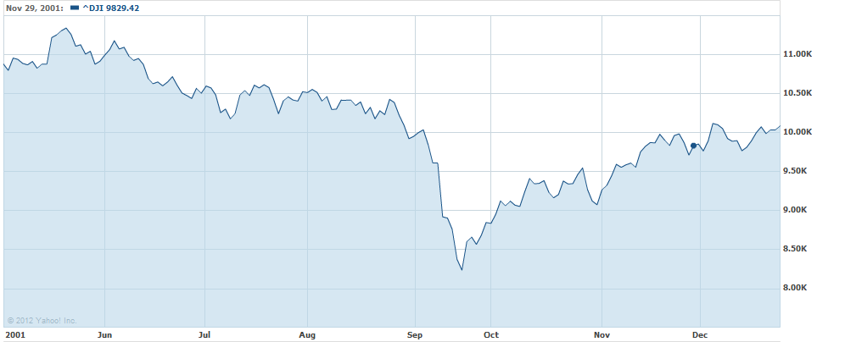
Text mining for understanding time series
…
Time
Any clues in the companion news stream?
Dow Jones Industrial Average [Source: Yahoo Finance]
Notes:
we use Google playstore data as the data source, so we collect these data, we clean it, we split the sentence, and we build a filtering algorithm to select the high quality sentence

Slide 36
Iterative Causal Topic Modeling [Kim et al. 13]
Text Stream
Topic Modeling
Causal Topics
Topic 1
Topic 2
Topic 1
Topic 2
Sept. 2001
Oct. … 2001
Topic 3
Topic 4
Topic 3
Topic 4
Non-text Time Series
Zoom into
Word Level
Feedback
as Prior
Split Words
Topic 1 Pos
W1 +
W3 +
Topic 1
W1 +
W2 --
W3 +
W4 --
W5
…
Causal Words
Topic 1 Neg
W2 --
W4 --

Slide 37
Measuring Causality (Correlation)
…
Time
Topic θ_{i}
government 0.3 response 0.2 ...
X_{t}
Causality(X_{t},Y_{t})=?
…
Does X_{t} cause Y_{t}?
Correlation(X_{t},Y_{t})=?
External Time Series
(e.g. stock prices)
Y_{t}
Granger Causality Test is often useful [Seth 07]

Slide 38
Topics in NY Times Correlated with Stocks [Kim et al. 13]: June 2000 ~ Dec. 2011
AAMRQ (American Airlines) | AAPL (Apple)
russia russian putin europe european germany bush gore presidential police court judge airlines airport air united trade terrorism food foods cheese nets scott basketball tennis williams open awards gay boy moss minnesota chechnya | paid notice st russia russian europe olympic games olympics she her ms oil ford prices black fashion blacks computer technology software internet com web football giants jets japan japanese plane …
Topics are biased toward each time series

Slide 39
Major Topics in 2000 Presidential Election [Kim et al. 13]
Top Three Words in Significant Topics from NY Times
tax cut 1 screen pataki guiliani enthusiasm door symbolic oil energy prices news w top pres al vice love tucker presented partial abortion privatization court supreme abortion gun control nra
Text: NY Times (May 2000 - Oct. 2000)
Time Series: Iowa Electronic Market
http://tippie.uiowa.edu/iem/
Issues known to be
important in the
2000 presidential election

Slide 40
Summary
Maximum likelihood estimation
Expectation maximization
Coin-topic problem
Using EM algorithm to remove stop words
Mixture of topic models
Probabilistic latent semantic analysis
PLSA with partial labels
Notes:
we use Google playstore data as the data source, so we collect these data, we clean it, we split the sentence, and we build a filtering algorithm to select the high quality sentence

