Slide 1
CS 589 Fall 2020
Probability ranking principle
Probabilistic retrieval models
Instructor: Susan Liu
TA: Huihui Liu
Stevens Institute of Technology

Slide 2

Piazza
Only 2 students had enrolled in Piazza
Therefore, I have to state our requirement again
Outside of OH, if you choose to use email, your question will be answered significantly slower, email: 2 days
Notes:
we use Google playstore data as the data source, so we collect these data, we clean it, we split the sentence, and we build a filtering algorithm to select the high quality sentence

Slide 3
Recap of last lecture
The boolean retrieval system
Vector-space model
TF: representing documents/queries with a term-document matrix
Rescaling methods:
IDF: penalizing words which appears everywhere
Term frequency rescaling (logarithmic, max normalization)
Pivoted length normalization
Notes:
we use Google playstore data as the data source, so we collect these data, we clean it, we split the sentence, and we build a filtering algorithm to select the high quality sentence

Slide 4
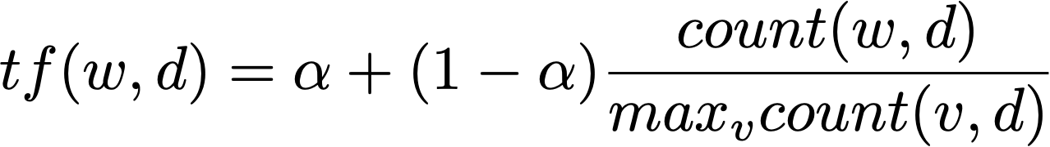
Question from last lecture
Between the two term-frequency rescaling methods, which one works better? Max normalization or logarithmic?
Max TF is unstable:
max TF in a document vary with change of stop words set
When max TF in document d is an outlier, the normalization is incomparable with other documents
Does not work well with documents with different TF distribution
Max TF normalization
Notes:
we use Google playstore data as the data source, so we collect these data, we clean it, we split the sentence, and we build a filtering algorithm to select the high quality sentence

Slide 5
Today’s lecture
Basic statistics knowledge
Random variables, Bayes rules, maximum likelihood estimation
Probabilistic ranking principle
Probability retrieval models
Robertson & Spark Jones model (RSJ model)
BM25 model
Language model based retrieval model
Notes:
we use Google playstore data as the data source, so we collect these data, we clean it, we split the sentence, and we build a filtering algorithm to select the high quality sentence

Slide 6
Quiz from last lecture
Suppose we have one query and two documents:
What are the rankings of score(q, doc) using VS model (w/o IDF)?
doc1 > doc2 > doc3
doc1 = doc3 > doc2
doc1 > doc3 > doc2
doc3 > doc1 > doc2
q = “covid 19”
doc1 = “covid patient”
doc2 = “19 99 car wash”
doc3 = “19 street covid testing facility is reopened next week”
Notes:
we use Google playstore data as the data source, so we collect these data, we clean it, we split the sentence, and we build a filtering algorithm to select the high quality sentence

Slide 7
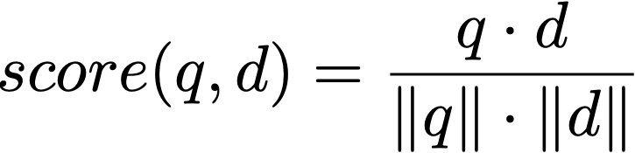
Answer
Recall the VS model:
score(q, doc1) = 1/sqrt(2)/sqrt(2) = 0.4999, score(q, doc2) = 1/sqrt(2)/sqrt(4) = 0.3535, score(q, doc3) = 2/sqrt(2)/sqrt(9) = 0.4714
Therefore the answer is C: doc1 > doc3 > doc2
q = “covid 19”
doc1 = “covid patient”
doc2 = “19 99 car wash”
doc3 = “19 street covid testing facility is reopen next week”
Notes:
we use Google playstore data as the data source, so we collect these data, we clean it, we split the sentence, and we build a filtering algorithm to select the high quality sentence

Slide 8

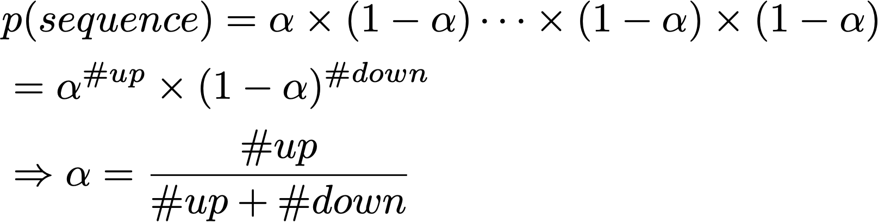
Random variables
Random variables
sequence = 0, 1, 0, 0, 1, 1, 0, 1, 0, 1, 0, 0
Observation
parameter
Bernoulli distribution
Maximum likelihood estimation
Notes:
we use Google playstore data as the data source, so we collect these data, we clean it, we split the sentence, and we build a filtering algorithm to select the high quality sentence

Slide 9
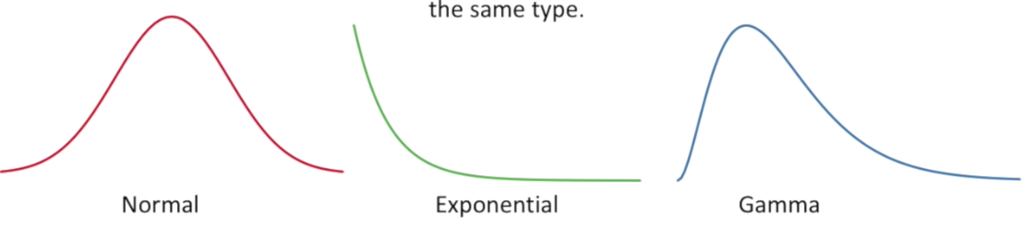
Maximum likelihood estimation
Fitting a distribution model to the data
Assumes mouse weights follow an underlying distribution
Notes:
we use Google playstore data as the data source, so we collect these data, we clean it, we split the sentence, and we build a filtering algorithm to select the high quality sentence

Slide 10
Maximum likelihood estimation
Fitting a distribution to the data
Distributions of mouse weights
Applications
Making estimations for probabilities for future events to happen
For example, predicting the probability for a document to be relevant to a query, and rank all documents by their estimated relevance score
Notes:
we use Google playstore data as the data source, so we collect these data, we clean it, we split the sentence, and we build a filtering algorithm to select the high quality sentence

Slide 11

Random variables in information retrieval
query = “artificial intelligence”
rel = 0, 1, 0, 0, 0, 0, 0, 0
d = artificial, intelligence, machine, intelligence, information, retrieval
q = artificial, intelligence
Observation
Notations: in future slides, q denotes the query, d denotes the document, rel denotes the relevance judgment
Notes:
we use Google playstore data as the data source, so we collect these data, we clean it, we split the sentence, and we build a filtering algorithm to select the high quality sentence

Slide 12
Random variables in information retrieval
query = “artificial intelligence”
rel = 0, 1, 0, 0, 0, 0, 0, 0
d = artificial, intelligence, machine, intelligence, information, retrieval
d = 56, 100, 120, 100, 50, 221
q = artificial, intelligence
q = 56, 100
Observation
Notations: in future slides, q denotes the query, d denotes the document, rel denotes the relevance judgment
Notes:
we use Google playstore data as the data source, so we collect these data, we clean it, we split the sentence, and we build a filtering algorithm to select the high quality sentence

Slide 13




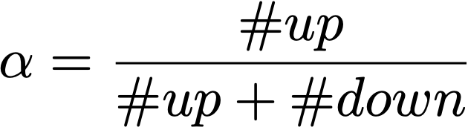
Probabilistic graphical model (underlying distribution)
seq
parameter
distribution
Bernoulli
Multinomial-Dirichlet, 2-Poisson, etc.
parameter estimation
maximum likelihood estimation
maximum a posterior estimation
Notes:
we use Google playstore data as the data source, so we collect these data, we clean it, we split the sentence, and we build a filtering algorithm to select the high quality sentence

Slide 14




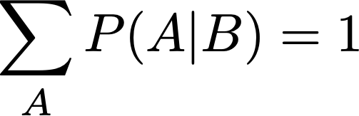
Bayes’ rules
Chain rule:
joint distribution
Bayes’ rule:
posterior
likelihood
prior
skipping estimating
trick for estimating the posterior
Notes:
we use Google playstore data as the data source, so we collect these data, we clean it, we split the sentence, and we build a filtering algorithm to select the high quality sentence

Slide 15

Probability ranking principle
Assume documents are labelled by 0/1 labels (i.e., the relevance judgement is either 0 or 1), given query q, documents should be ranked on their probabilities of relevance (van Rijsbergen 1979):
Theorem. The PRP is optimal, in the sense that it minimizes the expected loss (Ripley 1996)
PRP: rank documents by
Notations: in future slides, q denotes the query, d denotes the document, rel denotes the relevance judgment
Notes:
we use Google playstore data as the data source, so we collect these data, we clean it, we split the sentence, and we build a filtering algorithm to select the high quality sentence

Slide 16
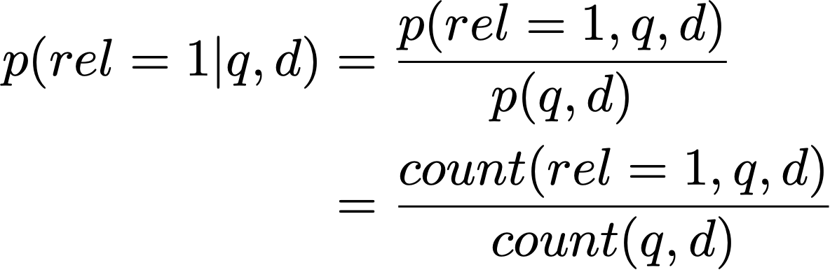
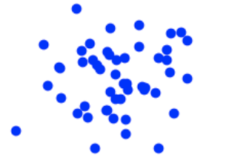
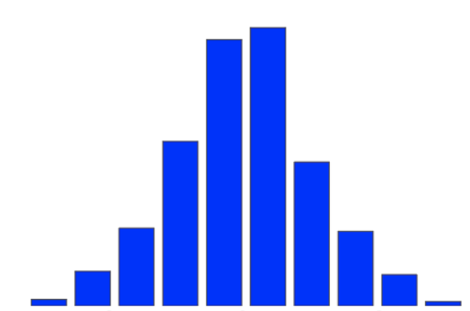
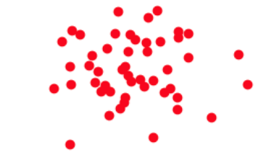
Estimating
Problems with this estimation?
not enough data
cannot adapt to new q
generative model
discriminative model
generative model
Notes:
we use Google playstore data as the data source, so we collect these data, we clean it, we split the sentence, and we build a filtering algorithm to select the high quality sentence

Slide 17
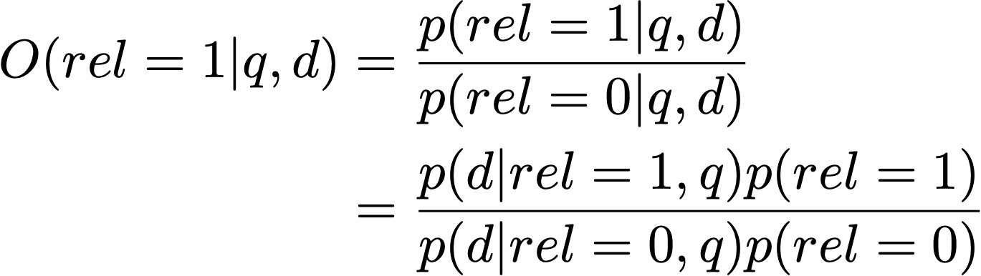

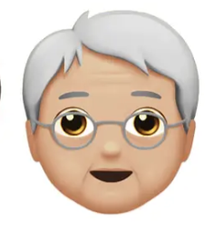
Estimating
Problems with this estimation
Difference in absolute probability of relevance
odds
agree on the relative order
Notes:
we use Google playstore data as the data source, so we collect these data, we clean it, we split the sentence, and we build a filtering algorithm to select the high quality sentence

Slide 18






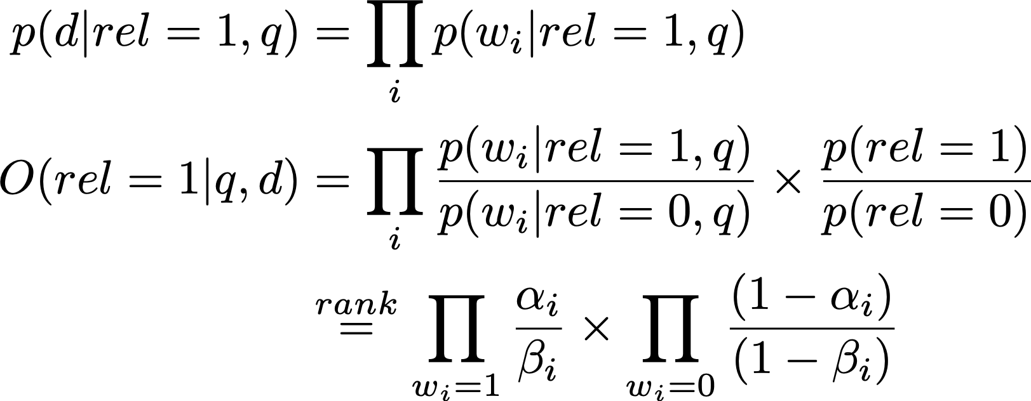
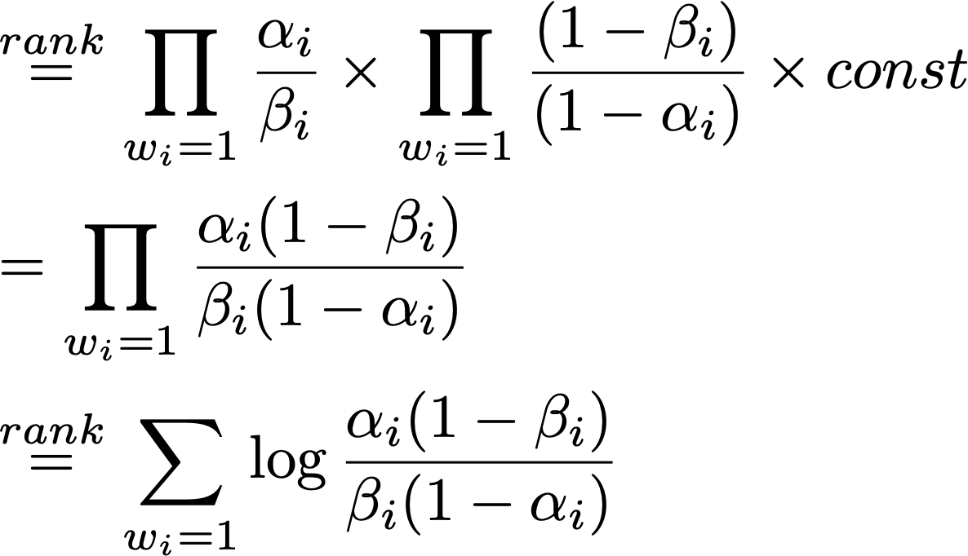




Estimating the generative model
…
i.i.d assumption
Notes:
we use Google playstore data as the data source, so we collect these data, we clean it, we split the sentence, and we build a filtering algorithm to select the high quality sentence

Slide 19
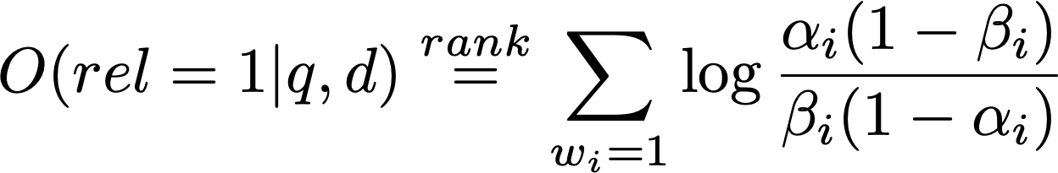
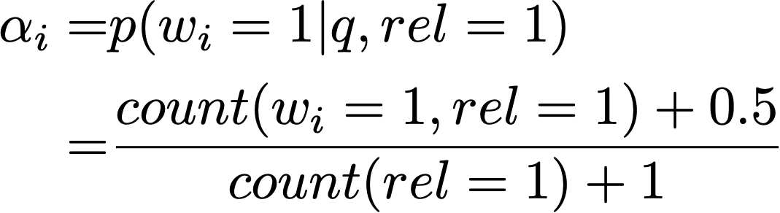
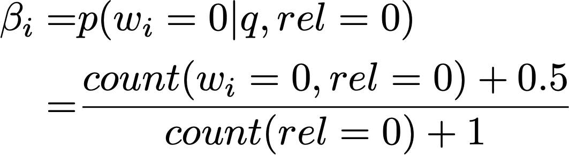
RSJ model
(Robertson & Sparck Jones 76)
Probability for a word to appear in a relevant doc
Probability for a word to appear in a non-relevant doc
Notes:
we use Google playstore data as the data source, so we collect these data, we clean it, we split the sentence, and we build a filtering algorithm to select the high quality sentence

Slide 20
RSJ model: Summary
Uses only binary word occurrence (binary inference model), does not leverage TF information
RSJ model was designed for retrieving short text and abstract!
Requires relevance judgment
No-relevance judgment version: [Croft & Harper 79]
Performance is not as good as tuned vector-space model
How to improve RSJ based on these desiderata?
Notes:
we use Google playstore data as the data source, so we collect these data, we clean it, we split the sentence, and we build a filtering algorithm to select the high quality sentence

Slide 21
Desiderata of retrieval models
Recall the desiderata of a retrieval models:
The importance of TF is sub-linear
Penalizing term with large document frequency using IDF
Pivot length normalization
How to improve RSJ based on these desiderata?
Notes:
we use Google playstore data as the data source, so we collect these data, we clean it, we split the sentence, and we build a filtering algorithm to select the high quality sentence

Slide 22

Okapi/BM25
Estimate probability using eliteness
What is eliteness?
A term/word is elite if the document is about the concept denoted by the term
Eliteness is binary
Term occurrence depends on eliteness
eliteness
Notes:
we use Google playstore data as the data source, so we collect these data, we clean it, we split the sentence, and we build a filtering algorithm to select the high quality sentence

Slide 23
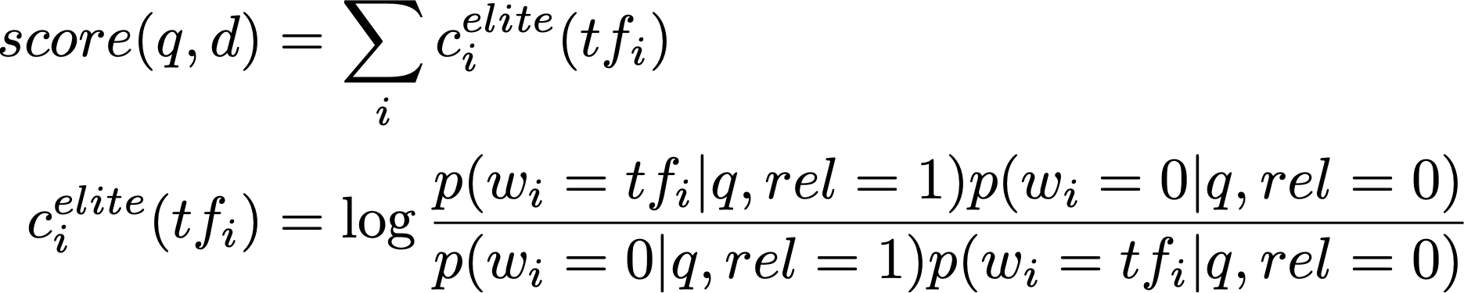


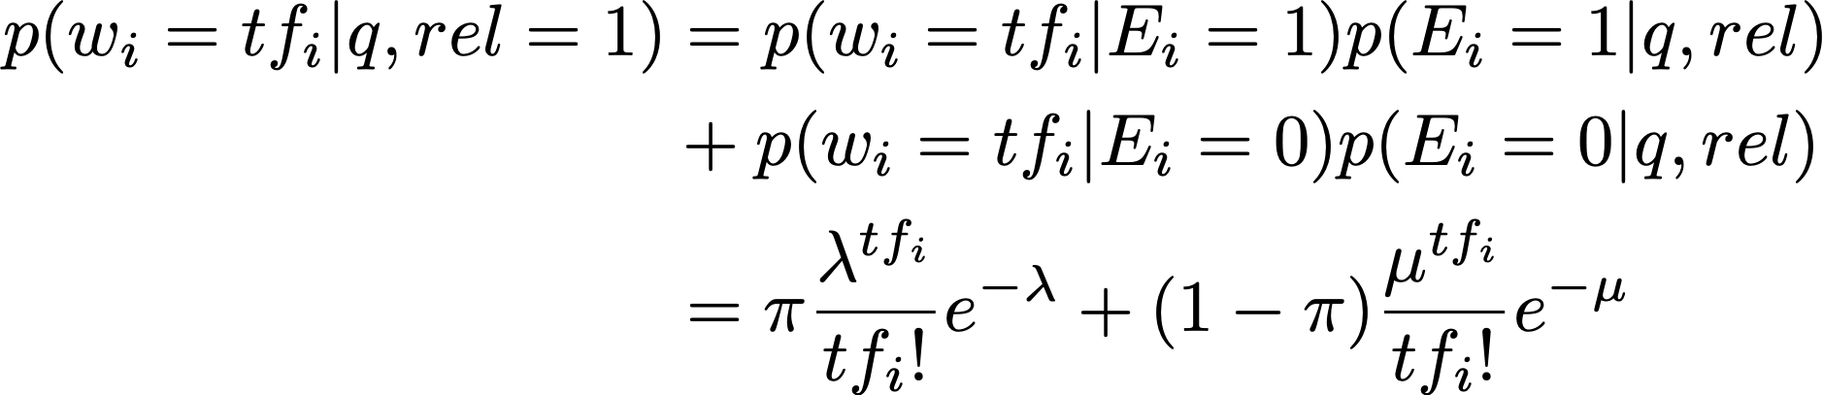
Okapi/BM25
Introduced in 1994
SOTA non-learning retrieval model
eliteness
(2 Poisson model)
Notes:
we use Google playstore data as the data source, so we collect these data, we clean it, we split the sentence, and we build a filtering algorithm to select the high quality sentence

Slide 24
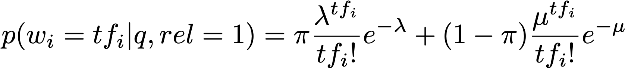


Okapi/BM25
We do not know
Can we estimate ? Difficulty to estimate
Designing a parameter-free model such that it simulates
Notes:
we use Google playstore data as the data source, so we collect these data, we clean it, we split the sentence, and we build a filtering algorithm to select the high quality sentence

Slide 25
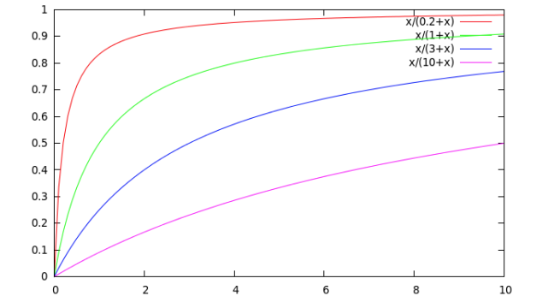
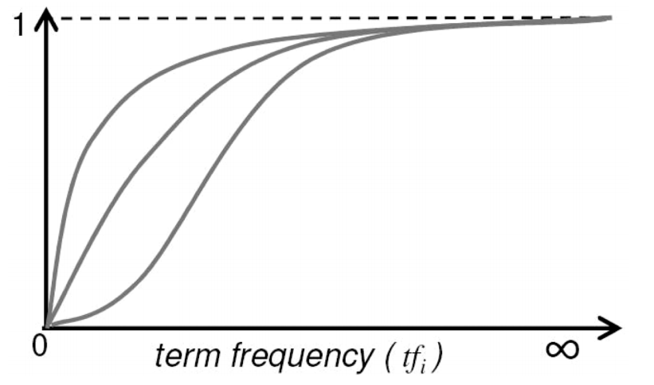

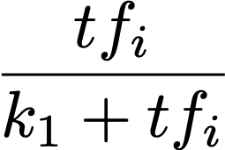
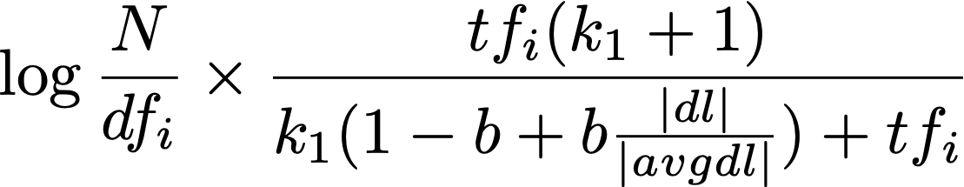
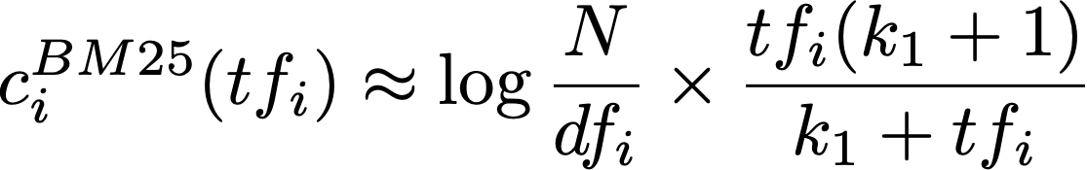

Simulating the 2-Poisson model
slides from Stanford CS276 Information retrieval
Notes:
we use Google playstore data as the data source, so we collect these data, we clean it, we split the sentence, and we build a filtering algorithm to select the high quality sentence

Slide 26

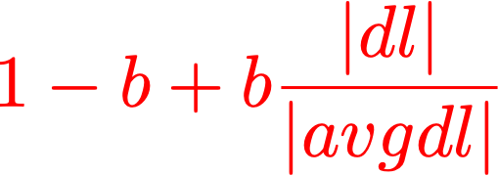
Analysis of BM25 formulation
IDF
Pivoted document length normalization
Notes:
we use Google playstore data as the data source, so we collect these data, we clean it, we split the sentence, and we build a filtering algorithm to select the high quality sentence

Slide 27
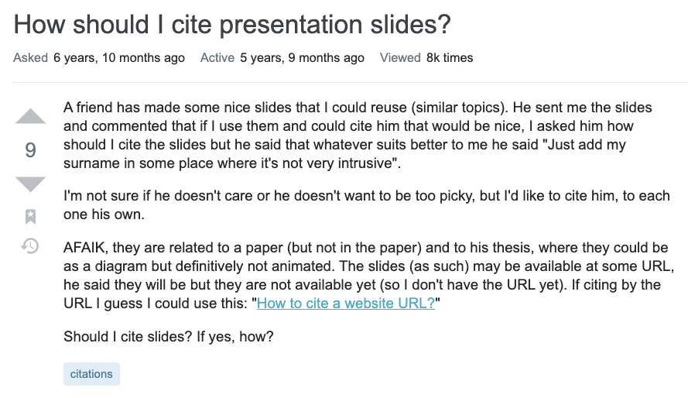
Multi-field retrieval
title
question
Notes:
we use Google playstore data as the data source, so we collect these data, we clean it, we split the sentence, and we build a filtering algorithm to select the high quality sentence

Slide 28
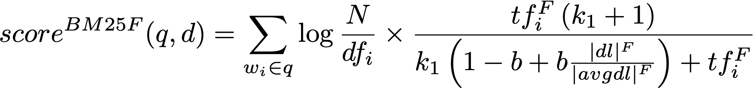
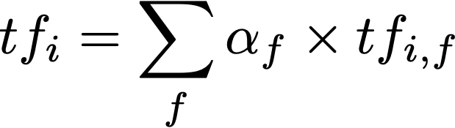
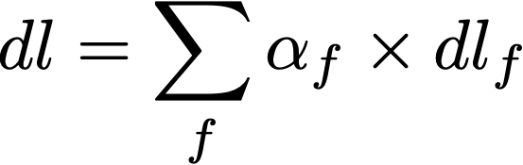
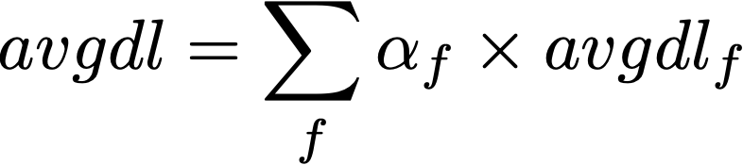
BM25F
Each variable is estimated as the weighted sum of its field value
parameter estimation using grid search
Notes:
we use Google playstore data as the data source, so we collect these data, we clean it, we split the sentence, and we build a filtering algorithm to select the high quality sentence

Slide 29
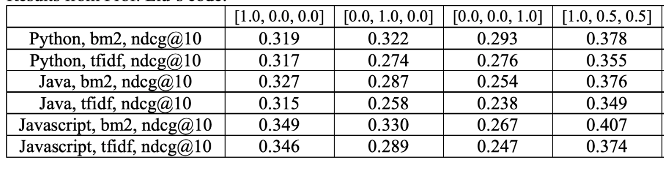
Multi-field retrieval
BM25 outperforms TF-IDF in every field & combined
Notes:
we use Google playstore data as the data source, so we collect these data, we clean it, we split the sentence, and we build a filtering algorithm to select the high quality sentence

Slide 30
Analysis on the n-Poisson model
Advantage: BM25 is based on the 2-Poisson model
eliteness: d satisfies q’s information need, when q is a single term
Disadvantages:
For single term, documents will not fall cleanly into elite/non-elite set
For multiple term, requires a combinatorial explosion of elite set
Requires explicit indexing of the ‘elite’ words
Notes:
we use Google playstore data as the data source, so we collect these data, we clean it, we split the sentence, and we build a filtering algorithm to select the high quality sentence

Slide 31
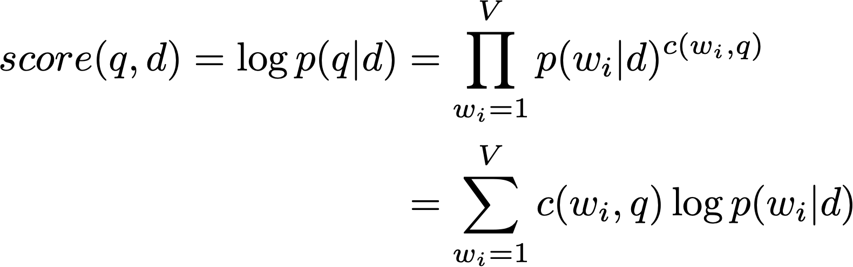
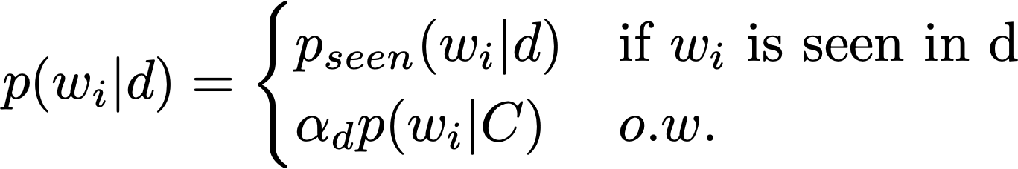

Language model-based retrieval
A language model-based retrieval method [Ponte and Croft, 1998]
Bernoulli -> multinomial
corpus unigram LM
Notes:
we use Google playstore data as the data source, so we collect these data, we clean it, we split the sentence, and we build a filtering algorithm to select the high quality sentence

Slide 32
Language model-based retrieval
Disclaimer: the right figure is a schematic model, not a rigorous graphical model
Notes:
we use Google playstore data as the data source, so we collect these data, we clean it, we split the sentence, and we build a filtering algorithm to select the high quality sentence

Slide 33
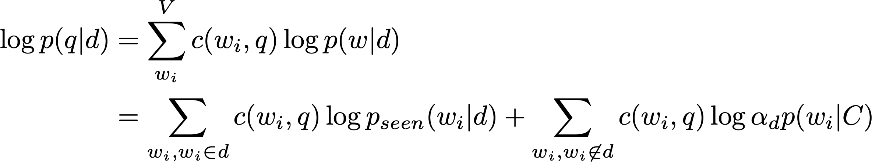
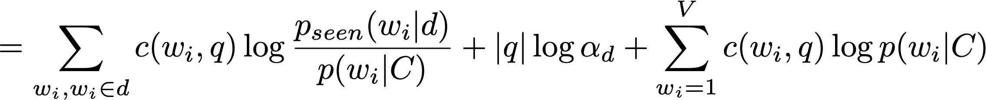

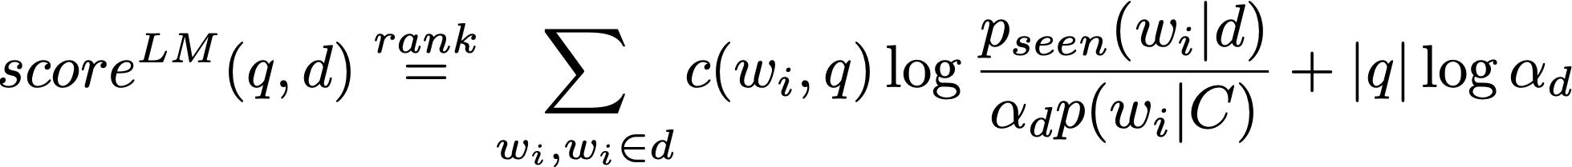
Language model-based retrieval
. . .
constant
efficient to compute, general formulation
Notes:
we use Google playstore data as the data source, so we collect these data, we clean it, we split the sentence, and we build a filtering algorithm to select the high quality sentence

Slide 34

Different senses of ‘model’ [Ponte and Croft, 98]
First sense (high level): an abstraction of the retrieval task itself
Second sense (mid level): modeling the distribution, e.g., 2-Poisson model
Thirds sense (low level): which statistical language model is used in
decouple
+
retrieval model
other problems (e.g., indexing)
RSJ model without relevance judgment
Notes:
we use Google playstore data as the data source, so we collect these data, we clean it, we split the sentence, and we build a filtering algorithm to select the high quality sentence

Slide 35
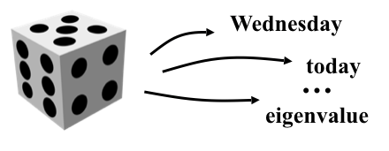
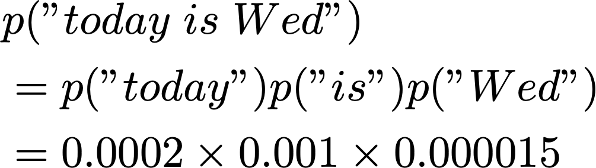
Statistical language model
A probability distribution over word sequences
p(“Today is Wednesday”) ≈ 0.001
p(“Today Wednesday is”) ≈ 0.0000000000001
p(“The eigenvalue is positive”) ≈ 0.00001
Unigram language model
Generate text by generating each word INDEPENDENTLY
Thus, p(w₁ w₂ ... w_{n})=p(w₁)p(w₂)…p(w_{n})
Parameters: {p(t_{i})} p(t₁)+…+p(t_{N})=1 (N is voc. size)
Notes:
we use Google playstore data as the data source, so we collect these data, we clean it, we split the sentence, and we build a filtering algorithm to select the high quality sentence

Slide 36
Notes on language model-based retrieval
Advantages:
Avoided the disadvantages in eliteness
Defines a general framework, more accurate can further improve the model
In some cases, has outperformed BM25
Disadvantages:
The assumed equivalence between query and document is unrealistic
Only studied unigram language model
Performance is not always good
Notes:
we use Google playstore data as the data source, so we collect these data, we clean it, we split the sentence, and we build a filtering algorithm to select the high quality sentence

Slide 37
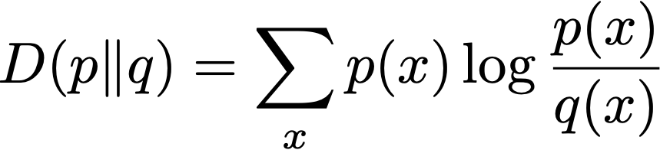
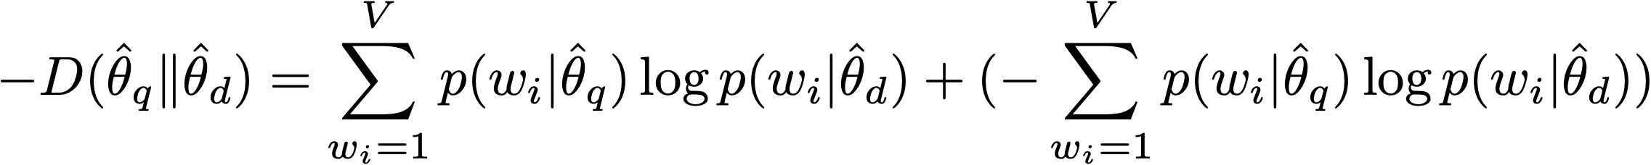

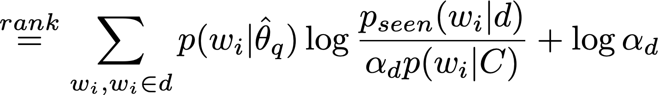
Equivalence to KL-divergence retrieval model
KL divergence
. . .
smoothed
constant
why not the opposite?
(Eq. 1)
Notes on the KL-divergence retrieval formula and Dirichlet prior smoothing
Notes:
we use Google playstore data as the data source, so we collect these data, we clean it, we split the sentence, and we build a filtering algorithm to select the high quality sentence

Slide 38
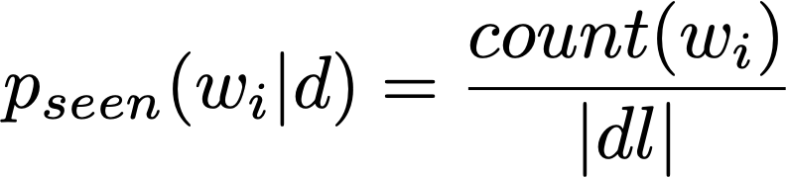
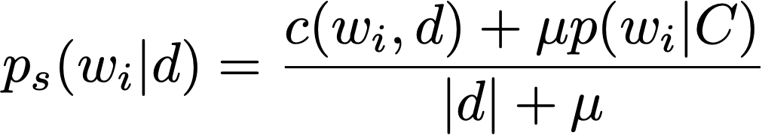
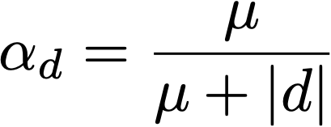
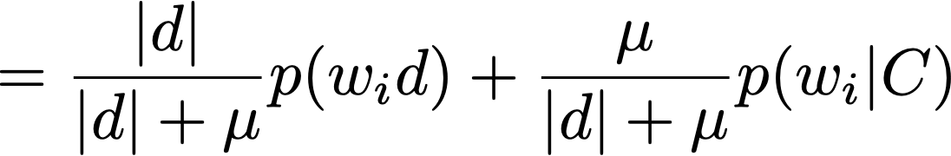
Estimating
Estimating based on the maximum likelihood estimation
Disadvantage: if the word is unseen, probability will be 0
Solution: language model smoothing:
(plug in Eq. 1)
Dirichlet smoothing
Notes:
we use Google playstore data as the data source, so we collect these data, we clean it, we split the sentence, and we build a filtering algorithm to select the high quality sentence

Slide 39
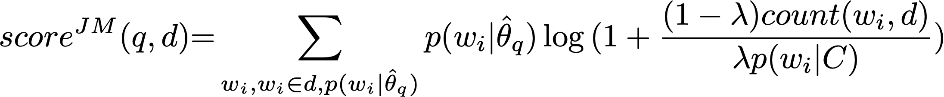
Estimating
Dirichlet smoothing
Jelinek-Mercer smoothing
Notes:
we use Google playstore data as the data source, so we collect these data, we clean it, we split the sentence, and we build a filtering algorithm to select the high quality sentence

Slide 40
Other smoothing methods
Additive smoothing
Good-Turing smoothing
Absolute discounting
Kneser-ney smoothing
Notes:
we use Google playstore data as the data source, so we collect these data, we clean it, we split the sentence, and we build a filtering algorithm to select the high quality sentence

Slide 41

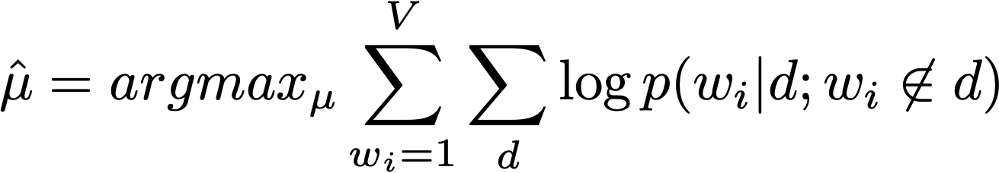

Tuning parameters in smoothing models [Zhai and Lafferty 02]
Tuning parameter using “leave-one-out” method
Estimating parameter using Newton’s method (2nd derivative)
remove
Two-stage language models for information retrieval
Notes:
we use Google playstore data as the data source, so we collect these data, we clean it, we split the sentence, and we build a filtering algorithm to select the high quality sentence

Slide 42

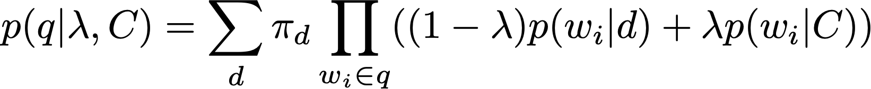
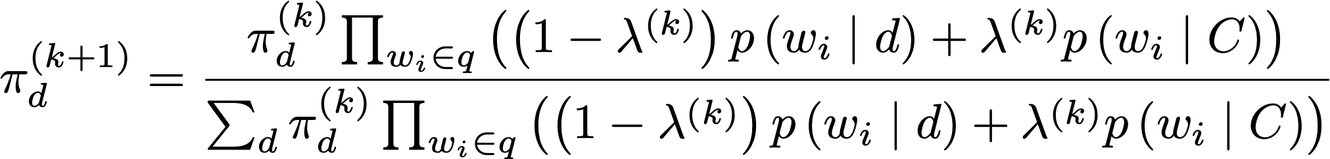

Tuning parameters in smoothing models [Zhai and Lafferty 02]
Tuning parameter using MLE for the query probability
EM algorithm:
Two-stage language models for information retrieval
Notes:
we use Google playstore data as the data source, so we collect these data, we clean it, we split the sentence, and we build a filtering algorithm to select the high quality sentence

Slide 43

Feedback language model [Zhai and Lafferty 01]
Model-based feedback in the language modeling approach to information retrieval
Notes:
we use Google playstore data as the data source, so we collect these data, we clean it, we split the sentence, and we build a filtering algorithm to select the high quality sentence

Slide 44







Feedback language model [Zhai and Lafferty 01]
sparsity
get document model
retrieve
infer w/ EM algo
Model-based feedback in the language modeling approach to information retrieval
Notes:
we use Google playstore data as the data source, so we collect these data, we clean it, we split the sentence, and we build a filtering algorithm to select the high quality sentence

Slide 45

Evaluation on smoothing methods [Zhai & Lafferty 02]
Two-stage language models for information retrieval
Notes:
we use Google playstore data as the data source, so we collect these data, we clean it, we split the sentence, and we build a filtering algorithm to select the high quality sentence

Slide 46

Evaluation on smoothing methods [Zhai & Lafferty 01b]
Notes:
we use Google playstore data as the data source, so we collect these data, we clean it, we split the sentence, and we build a filtering algorithm to select the high quality sentence

Slide 47

Comparison between BM25 and LM [Bennett et al. 2008]
However, BM25 outperforms LM in other cases
A Comparative Study of Probabilistic and Language Models for Information Retrieval
Notes:
we use Google playstore data as the data source, so we collect these data, we clean it, we split the sentence, and we build a filtering algorithm to select the high quality sentence

Slide 48
Summary on parameter tuning
RSJ: no parameter
BM25: Due to the formulation of two-Poisson, parameters are difficult to estimate, so use a parameter free version to replace it
Language model
Leave-one-out
EM algorithm
Notes:
we use Google playstore data as the data source, so we collect these data, we clean it, we split the sentence, and we build a filtering algorithm to select the high quality sentence

Slide 49


Translation-based language model [Xue et al. 2008]
The retrieval model can benefit from incorporating knowledge in the formulation
Translation matrix:
Retrieval Models for Question and Answer Archives
Notes:
we use Google playstore data as the data source, so we collect these data, we clean it, we split the sentence, and we build a filtering algorithm to select the high quality sentence

Slide 50


Translation-based language model
SMT
Disclaimer: both figures are schematic models, not rigorous graphical models
Notes:
we use Google playstore data as the data source, so we collect these data, we clean it, we split the sentence, and we build a filtering algorithm to select the high quality sentence

Slide 51


Performance of translation based LM [Xue et al. 2008]
Notes:
we use Google playstore data as the data source, so we collect these data, we clean it, we split the sentence, and we build a filtering algorithm to select the high quality sentence

Slide 52
Discussion on query length
What if the query is very long?
For example, the query is a paragraph or a document
The problem of retrieval is turned into a matching problem
i.e., semantic matching
Notes:
we use Google playstore data as the data source, so we collect these data, we clean it, we split the sentence, and we build a filtering algorithm to select the high quality sentence

Slide 53

Deep semantic matching [Pang et al. 2016]
d
v1
v2
….
vm
w1
each cell:
distributed representation of words (word2vec)
w2
q
….
wn
A Study of MatchPyramid Models on Ad-hoc Retrieval
Notes:
we use Google playstore data as the data source, so we collect these data, we clean it, we split the sentence, and we build a filtering algorithm to select the high quality sentence

Slide 54
Question asking protocol
Regrading requests: email TA, cc myself, titled [CS589 regrading]
Deadline extension requests: email myself, titled [CS589 deadline]
Dropping: email myself, titled [CS589 drop]
All technical questions: Piazza
Homework description clarification
Clarification on course materials
Having trouble with homework: join my office hour directly, no need to email me
If you have a time conflict, email me & schedule another time
Project discussion: join my office hour
Ask any common questions shared by the class on Piazza
Notes:
creates the building block of more advanced techniques

Slide 55
Homework 1
Homework 1 is released in Canvas:
Implementing TF-IDF and BM25 on the LinkSO dataset:
https://sit.instructure.com/courses/44342/assignments/218604
Notes:
creates the building block of more advanced techniques

