Slide 1
CS 589 Fall 2020
Information retrieval infrastructure
Instructor: Susan Liu
TA: Huihui Liu
Stevens Institute of Technology

Slide 2
Metrics for a good search engine
Return what the users are looking for
Return results fast
Users likes to come back
Relevance, CTR = click thru rate
Latency
Retention rate
Notes:
we use Google playstore data as the data source, so we collect these data, we clean it, we split the sentence, and we build a filtering algorithm to select the high quality sentence

Slide 3
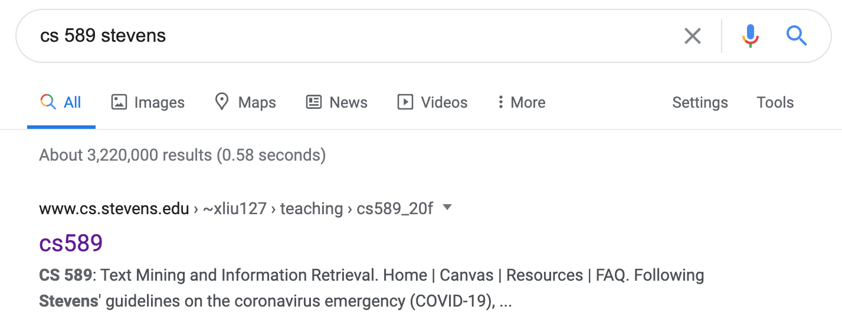
Information Retrieval Techniques
How does Google know cs 589 refers to a course?
How does Google know stevens = SIT?
How does Google return results so quickly?
Notes:
creates the building block of more advanced techniques

Slide 4
Information Retrieval Infrastructure
Notes:
creates the building block of more advanced techniques

Slide 5
Inverted index
In Lecture 2, we learned retrieval models
Compute score(q, d)
Select the d that maximizes score(q, d)
In an industry scale search engine, there could be trillions of q’s and billions of d’s
For each query, search time complexity = O(|D|)
Solution for faster retrieval: inverted index
Notes:
we use Google playstore data as the data source, so we collect these data, we clean it, we split the sentence, and we build a filtering algorithm to select the high quality sentence

Slide 6

Inverted index
time complexity: O(#unique words in q x avg_len(postings lists))
Notes:
we use Google playstore data as the data source, so we collect these data, we clean it, we split the sentence, and we build a filtering algorithm to select the high quality sentence

Slide 7
Problems with inverted indexing
Data processing
Choosing the unit for indexing
Determining the vocabulary
Constructing/speeding up inverted index
Skipping index
Prefix indexing
Indexing with blocks
MapReduce
Index compression
Other issues
Indexing position
Spelling correction
Notes:
we use Google playstore data as the data source, so we collect these data, we clean it, we split the sentence, and we build a filtering algorithm to select the high quality sentence

Slide 8
Choosing the correct document unit for indexing
Documents often consists of sub documents
e.g., email contains multiple attached documents
Trade-off on the unit size
Smaller units: missing important passages
Larger unit: gets spurious matches, e.g., ….text messages….gold mining…
Notes:
we use Google playstore data as the data source, so we collect these data, we clean it, we split the sentence, and we build a filtering algorithm to select the high quality sentence

Slide 9

Determining the vocabulary
Tokenization
o’neil, aren’t, C#
Dropping stop words
Stop words are common terms
Web search engines generally do not use stop words!
Notes:
we use Google playstore data as the data source, so we collect these data, we clean it, we split the sentence, and we build a filtering algorithm to select the high quality sentence

Slide 10
Determining the vocabulary
Normalization
Abbrev: USA vs. United states of America
Case:
Cat -> cat
SAT -> sat
Stemming/lemmatization
singing -> sing, cars -> car, sat -> sit
porter stemmer, snowball stemmer
Notes:
we use Google playstore data as the data source, so we collect these data, we clean it, we split the sentence, and we build a filtering algorithm to select the high quality sentence

Slide 11
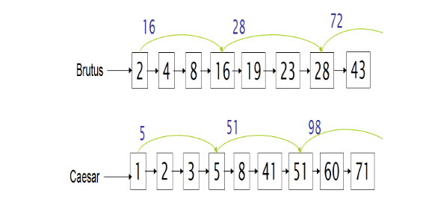
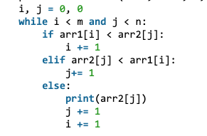
Speeding up: skipping lists
Finding the intersection of two post listings
Without skip: O(m + n)
Notes:
we use Google playstore data as the data source, so we collect these data, we clean it, we split the sentence, and we build a filtering algorithm to select the high quality sentence

Slide 12
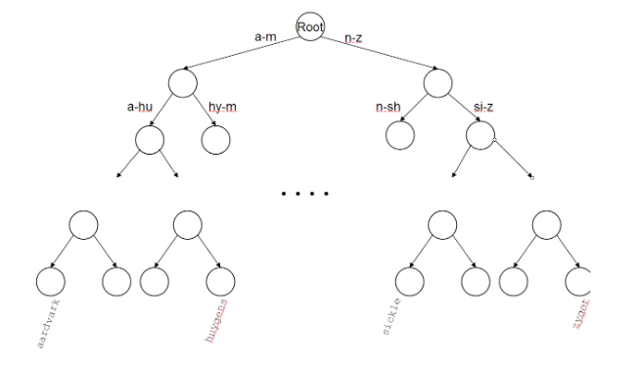
Speeding up: prefix indexing
Speeding up the indexing using prefix tree
time complexity: O(#unique words in q x avg_len(postings lists))
Notes:
we use Google playstore data as the data source, so we collect these data, we clean it, we split the sentence, and we build a filtering algorithm to select the high quality sentence

Slide 13
Constructing inverted index: hardware basics
Decisions on an IR system largely depends on the hardware which the system runs on
Chunks:
Splitting data into more chunks takes more seek time
Blocks
Accessing data in memory >> accessing data on disk
Constructing inverted index using blocks
Typical IR system: GBs of memory, disk space orders of magnitude larger
Notes:
we use Google playstore data as the data source, so we collect these data, we clean it, we split the sentence, and we build a filtering algorithm to select the high quality sentence

Slide 14
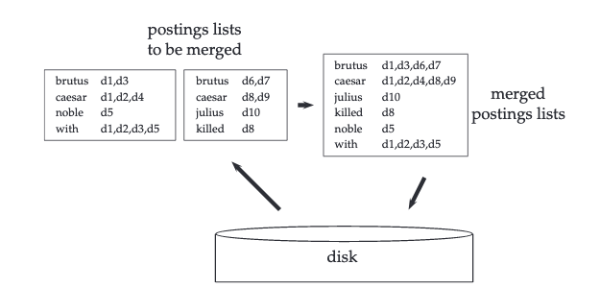
Block sort-based indexing (BSBI)
Indexing large corpus
Reuters-RCV1: 2.5GB = 2.5 x 10^9Bytes, 1 billion
Today’s text corpus contains petabytes of data: 10^15Bytes
Memory << size of corpus
Index each block using memory
Write each blocks’ index into disk
Merge all inverted indices
Notes:
we use Google playstore data as the data source, so we collect these data, we clean it, we split the sentence, and we build a filtering algorithm to select the high quality sentence

Slide 15
Block sort-based indexing
segment corpus into blocks
sort (term, doc) pair in mem
store the pairs in disk
merge all pairs into final index
Notes:
we use Google playstore data as the data source, so we collect these data, we clean it, we split the sentence, and we build a filtering algorithm to select the high quality sentence

Slide 16
Single-pass in-memory indexing
segment corpus into blocks
Handling posting lists directly
Eliminating the expensive sorting in BSBI
Leveraging compression
write block into posting lists & dict
store the postings lists in disk
merge all blocks into final index
Notes:
we use Google playstore data as the data source, so we collect these data, we clean it, we split the sentence, and we build a filtering algorithm to select the high quality sentence

Slide 17
Handling web scale indexing
Web-scale indexing must use clusters of servers
Google had 1 million servers in 2011
Fault tolerance of a massive data center
If a non-fault tolerance system has 1000 nodes, each has 99.9% uptime, then 63% of the time one or more servers is down
Solution
Maintain a “master” server
Break indexing into parallel tasks
Assign each task to an idle machine
Notes:
we use Google playstore data as the data source, so we collect these data, we clean it, we split the sentence, and we build a filtering algorithm to select the high quality sentence

Slide 18
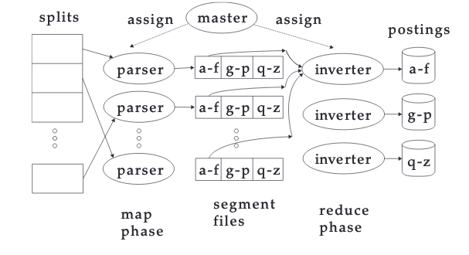
Map-reduce
master assigns split to idle machine
parser emits (term,doc) pair
merge partitions in inverter
complete the index
Notes:
we use Google playstore data as the data source, so we collect these data, we clean it, we split the sentence, and we build a filtering algorithm to select the high quality sentence

Slide 19
Examples of map-reduce
Notes:
we use Google playstore data as the data source, so we collect these data, we clean it, we split the sentence, and we build a filtering algorithm to select the high quality sentence

Slide 20
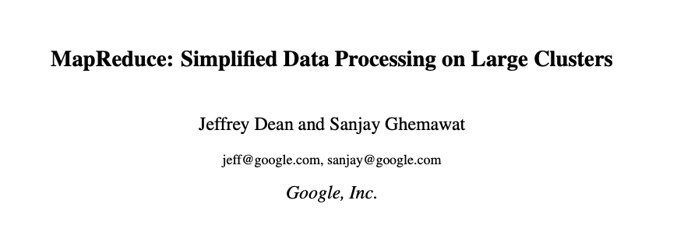
MapReduce: Industry practice
Term partition vs. document partition
Term-partitioned: one machine handles a subrange of terms
Document-partitioned: one machine handles a subrange of documents
Most industry search engine use document-partitioned index
Better load balancing (why?)
Notes:
we use Google playstore data as the data source, so we collect these data, we clean it, we split the sentence, and we build a filtering algorithm to select the high quality sentence

Slide 21
Logarithmic dynamic indexing
Logarithmic merge:
Maintain a series of indexes, each twice the size of the previous one
Keep smaller ones in memory (Z0)
Larger ones on disks (I0, I1, …)
If Z0 gets too big, write to disk as l0
Or merge with l0 as Z1
Either merge Z1 to disk as l1
Or merge with existing l1 to form Z2
Notes:
we use Google playstore data as the data source, so we collect these data, we clean it, we split the sentence, and we build a filtering algorithm to select the high quality sentence

Slide 22
Real time search of Twitter
Requires high real time search
Low latency, high throughput query evaluation
High ingestion rate and immediate data availability
Concurrent reads and writes of the index
Solution: using segments
Each segment consists of 2^32 tweets (in memory)
New posts are appended to the posting lists
Only one segment can be written to at each time
Notes:
we use Google playstore data as the data source, so we collect these data, we clean it, we split the sentence, and we build a filtering algorithm to select the high quality sentence

Slide 23
Index compression
Why compression?
Using less disk space
Compressing dictionary
Allowing the dictionary to be stored in memory
Compressing posting files
Reducing disk space
Zipf’s law
The ith most frequent term has frequency proportional to 1/i
Notes:
we use Google playstore data as the data source, so we collect these data, we clean it, we split the sentence, and we build a filtering algorithm to select the high quality sentence

Slide 24
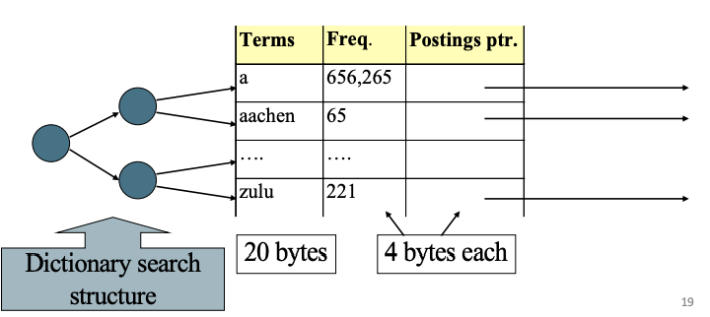
Dictionary compression
Most of the space in the table is wasted
Most words are 20 bytes
Table storage = 28N
Notes:
we use Google playstore data as the data source, so we collect these data, we clean it, we split the sentence, and we build a filtering algorithm to select the high quality sentence

Slide 25
Dictionary-as-a-string
Table storage = 11N
How to further improve the storage space?
Instead of storing absolute term pointers, store the gaps
4 bytes
4 bytes
3 bytes
Notes:
we use Google playstore data as the data source, so we collect these data, we clean it, we split the sentence, and we build a filtering algorithm to select the high quality sentence

Slide 26
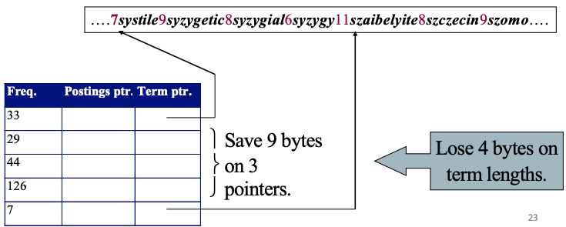
Dictionary-as-a-string
Table storage = 8N + 3N * (7/12) = 9.75N < 11N
Trade-off between skipping more vs. skipping less
1 byte
4 bytes
4 bytes
3 bytes
Notes:
we use Google playstore data as the data source, so we collect these data, we clean it, we split the sentence, and we build a filtering algorithm to select the high quality sentence

Slide 27
Postings compression
Observations of posting files
Instead of storing docID, store gaps
Brutus: 2,4,8,3,4,5,15
Binary seq: 10,100,1000,11,100,101,1111
Prefix encoding
Binary encoding such that the sequence can be uniquely decoded
e.g., Huffman encoding
Unary encoding: {2:110,4:11110, …}
A uniquely decodable seq: 110111101111111101110…
Notes:
we use Google playstore data as the data source, so we collect these data, we clean it, we split the sentence, and we build a filtering algorithm to select the high quality sentence

Slide 28
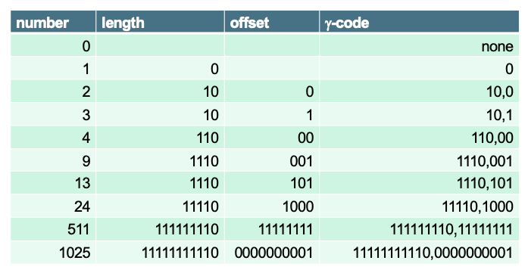
Postings compression
Problem with unary encoding
Too long!
Gamma code of 13: 1110,101
Unary code of length - 1: 1110
Offset (last length - 1 bits): 13 → 1101 → 101
What is the gamma code of 5? 101 -> 110,01
We can prove gamma code is uniquely decodable
Gamma code compression rate: 11.7%
Notes:
we use Google playstore data as the data source, so we collect these data, we clean it, we split the sentence, and we build a filtering algorithm to select the high quality sentence

Slide 29
Indexing Position
Indexing the position of word within the document
Intersection algorithm finds where the two terms appear between within k words
Brutus: 2:<0>, 4: <429,433>, 8: <150>, …
Ceasar: 1:<10>, 2: <5>, 8: <17, 250>, …
Notes:
we use Google playstore data as the data source, so we collect these data, we clean it, we split the sentence, and we build a filtering algorithm to select the high quality sentence

Slide 30

Spelling correction
Edit distance
k-gram index for spelling correction
context sensitive spelling correction
Notes:
we use Google playstore data as the data source, so we collect these data, we clean it, we split the sentence, and we build a filtering algorithm to select the high quality sentence

Slide 31
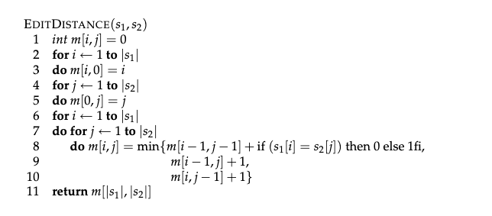
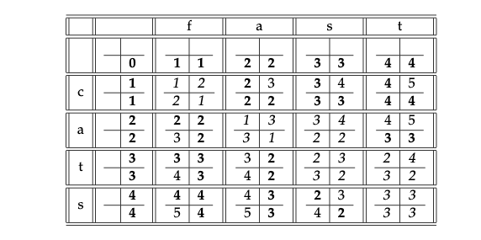
Edit distance
Dynamic programming: O(|s1| x |s2|)
Levenshtein distance
Notes:
we use Google playstore data as the data source, so we collect these data, we clean it, we split the sentence, and we build a filtering algorithm to select the high quality sentence

Slide 32
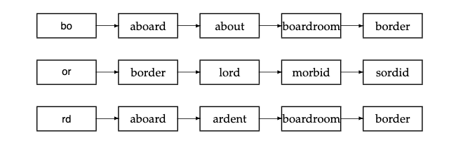
k-gram indexes for spelling correction
Running DP on all pairs of words is time consuming
Leveraging k-gram index to speed up spelling correction
boardroom vs. bord
boarder:3
boardroom: 2
aboard: 2
ardent:1
…
Notes:
we use Google playstore data as the data source, so we collect these data, we clean it, we split the sentence, and we build a filtering algorithm to select the high quality sentence

Slide 33
Context sensitive spelling correction
How to correct “flew form healthrow”?
All three words are spelled correctly
Enumerating each character: the space is large
Solution: using logs of queries, e.g., flew from vs. fled fore
Li et al. A generalized hidden Markov model with discriminative training for query spelling correction. SIGIR 2012
Notes:
we use Google playstore data as the data source, so we collect these data, we clean it, we split the sentence, and we build a filtering algorithm to select the high quality sentence

Slide 34
PageRank
How to rank webpages?
Using retrieval models: only captures relevance
Capturing quality of web pages:
Based on how often the page is cited
Intuition: a popular website (e.g., Google) would be cited by a lot of other webpages
Notes:
we use Google playstore data as the data source, so we collect these data, we clean it, we split the sentence, and we build a filtering algorithm to select the high quality sentence

Slide 35
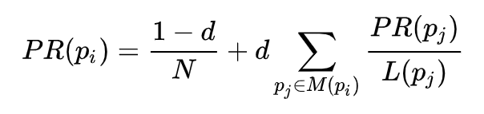
PageRank
“The Anatomy of a Large-Scale Hypertextual Web Search Engine” - Sergey Brin and Lawrence Page, Computer networks and ISDN systems, 1998
Favors pages that are highly cited, and pages cited by highly cited pages
1/2 probability of randomly walking into B
Notes:
we use Google playstore data as the data source, so we collect these data, we clean it, we split the sentence, and we build a filtering algorithm to select the high quality sentence

Slide 36
PageRank
Assign each node an initial page rank
Repeat until convergence
Calculate the page rank of each node using the equation
Notes:
we use Google playstore data as the data source, so we collect these data, we clean it, we split the sentence, and we build a filtering algorithm to select the high quality sentence

Slide 37
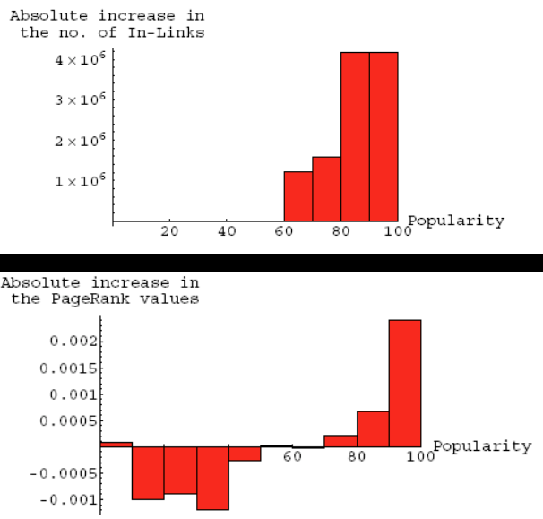
Problems of page rank
rich gets richer
Google bombing
Notes:
we use Google playstore data as the data source, so we collect these data, we clean it, we split the sentence, and we build a filtering algorithm to select the high quality sentence

Slide 38
HITS
Hubs: compilations of a broad catalog of information that led users direct to other authoritative pages
Authorities: a page that is linked by many different hubs
Notes:
we use Google playstore data as the data source, so we collect these data, we clean it, we split the sentence, and we build a filtering algorithm to select the high quality sentence

Slide 39
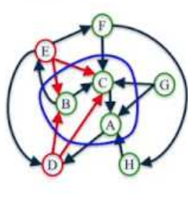
HITS
Repeat k times
Update hub score: v = A^T u
Update authority score: u = A^T v
Notes:
we use Google playstore data as the data source, so we collect these data, we clean it, we split the sentence, and we build a filtering algorithm to select the high quality sentence

Slide 40
Search engine tools
Apache Lucene
Free and open search engine library
First developed in 1999
ElasticSearch
A search engine
based on Lucene
Notes:
we use Google playstore data as the data source, so we collect these data, we clean it, we split the sentence, and we build a filtering algorithm to select the high quality sentence

Slide 41
ElasticSearch
Using a REST api
Notes:
we use Google playstore data as the data source, so we collect these data, we clean it, we split the sentence, and we build a filtering algorithm to select the high quality sentence

Slide 42
Homework 2: Using ElasticSearch to build a search engine
Build an inverted index
Evaluate three search algorithm’s performance
TF-IDF
BM25
Dirichlet-LM
Notes:
we use Google playstore data as the data source, so we collect these data, we clean it, we split the sentence, and we build a filtering algorithm to select the high quality sentence

