Slide 1
CS 589 Fall 2020
Latent semantic indexing
Latent Dirichlet allocation
Instructor: Susan Liu
TA: Huihui Liu
Stevens Institute of Technology
Most slides come from UIUC CS510 LDA lecture by Chase Geigle, ChengXiang Zhai

Slide 2


Review of PLSA
Phi T x V, V: vocabulary size ~50,000, T: #topics, T=20
theta D x T, D: #documents: ~10,000, T: #topics, T=20
city 0.2 new 0.1 orleans 0.05 ...
donate 0.1 relief 0.05 help 0.02 ...
government 0.3 response 0.2 ...
the 0.04 a 0.03 ...
Orleans 0.05
0.5
0.3
0.1
0.1
[ Criticism of government response to the hurricane ..] to the [ flooding of New _______
[ Criticism of government response to the hurricane ..] to the [ flooding of New Orleans
Step 1: sample a topic: topic 2
Step 2: sample a word from topic 2
Probabilistic Latent Semantic Analysis. Thomas Hoffman. 2001.

Slide 3
Today’s lecture
Latent semantic indexing
Continue on topic model: Latent Dirichlet allocation
Bayesian inference of topic model
Variational inference for LDA
Gibbs sampling, Markov chain Monte-Carlo
Notes:
we use Google playstore data as the data source, so we collect these data, we clean it, we split the sentence, and we build a filtering algorithm to select the high quality sentence

Slide 4
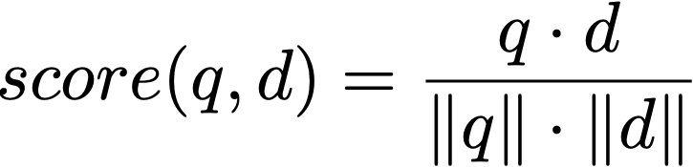
Vocabulary gap problem with vector space model
Vector space model:
Challenges matching synonyms
e.g., auto vs. car
Challenges matching polysemy
e.g., apple (fruit vs. company)
doc1
doc2
car
0
1
0
0
auto
1
x
0
0
0
0
0
0
0
Notes:
we use Google playstore data as the data source, so we collect these data, we clean it, we split the sentence, and we build a filtering algorithm to select the high quality sentence

Slide 5
Low-dimensional, dense vector representation [Deerwester et al. 1998]
word indexing
latent concept indexing
car
0
1
0
0
0.5
0.2
latent semantic indexing
auto
1
x
0
0.3
x
0.3
0
0
0.2
0.1
0
0
0
0
Notes:
we use Google playstore data as the data source, so we collect these data, we clean it, we split the sentence, and we build a filtering algorithm to select the high quality sentence

Slide 6
Latent semantic indexing
Uses statistically derived conceptual indices instead of individual word indexing for retrieval
Assumes that there is some underlying or latent structure in word usage that is obscured by variability in word choice
Key idea: instead of representing documents and queries as vectors in a low dimensional space of terms
Notes:
we use Google playstore data as the data source, so we collect these data, we clean it, we split the sentence, and we build a filtering algorithm to select the high quality sentence

Slide 7
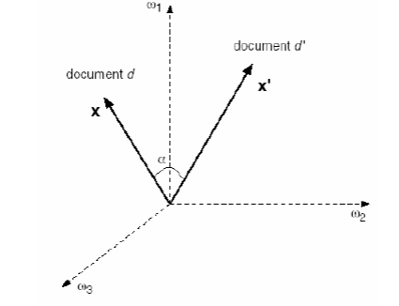
Low dimensional vector representation of words
Axes are concepts, also called principal components (PCA)
“auto”
“car”
“auto repair”
“car insurance”
Notes:
we use Google playstore data as the data source, so we collect these data, we clean it, we split the sentence, and we build a filtering algorithm to select the high quality sentence

Slide 8



Singular value decomposition (matrix factorization)
For a matrix A of rank r, there exists a factorization (SVD) as follows:
U: orthogonal eigen vectors of AA^T
V: orthogonal eigen vectors of A^TA
Sigma: eigen values
Notes:
we use Google playstore data as the data source, so we collect these data, we clean it, we split the sentence, and we build a filtering algorithm to select the high quality sentence

Slide 9
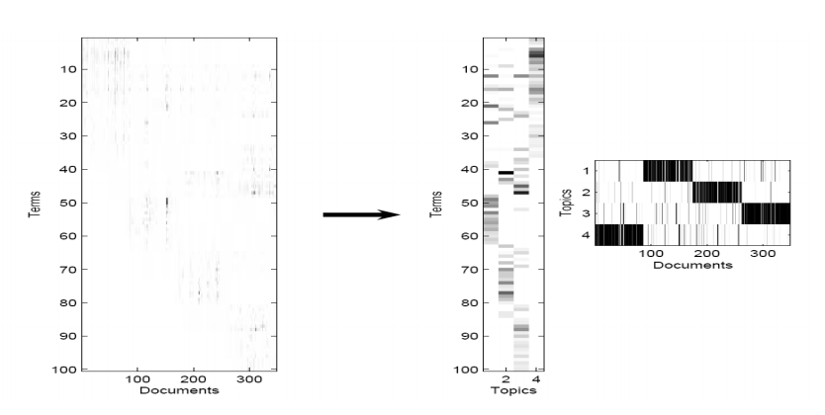
Dimension reduction
Map documents and queries to a low dimensional space
Retrieval in this space may be superior to retrieval in the original space
m
n
r
Notes:
we use Google playstore data as the data source, so we collect these data, we clean it, we split the sentence, and we build a filtering algorithm to select the high quality sentence

Slide 10
What LSI can do
LSI effectively does
Dimensionality reduction
Noise reduction
Exploitation of redundant data (linearity)
Correlation analysis and query expansion (with related words)
Some of the individual effects can be achieved with simpler techniques (e.g. thesaurus construction). LSI does them together
LSI handles synonymy well, not so much polysemy (vs word embedding)
Challenge: SVD is complex to compute (O(n3 )) – Needs to be updated as new documents are found/updated
Notes:
we use Google playstore data as the data source, so we collect these data, we clean it, we split the sentence, and we build a filtering algorithm to select the high quality sentence

Slide 11
Latent Dirichlet allocation [Blei et al. 03]
A Bayesian topic model by considering the prior distribution of topics
That is, assuming the topic portions are randomly sampled from another distribution
LSI (1998)
PLSA (2002)
LDA (2003)
Notes:
we use Google playstore data as the data source, so we collect these data, we clean it, we split the sentence, and we build a filtering algorithm to select the high quality sentence

Slide 12
Review of PLSA
Documents are generated by sampling words from k latent topics
For each document d:
For each token position i
Choose a topic z ∼ Multinomial( )
Choose a term w ∼ Multinomial( )
is a fixed distribution
Probabilistic Latent Semantic Analysis. Thomas Hoffman. 2001.

Slide 13
Review of PLSA
city 0.2 new 0.1 orleans 0.05 ...
donate 0.1 relief 0.05 help 0.02 ...
government 0.3 response 0.2 ...
the 0.04 a 0.03 ...
Orleans 0.05
0.5
0.3
0.1
0.1
[ Criticism of government response to the hurricane ..] to the [ flooding of New _______
[ Criticism of government response to the hurricane ..] to the [ flooding of New Orleans
Step 1: sample a topic: topic 2
Step 2: sample a word from topic 2
Probabilistic Latent Semantic Analysis. Thomas Hoffman. 2001.

Slide 14
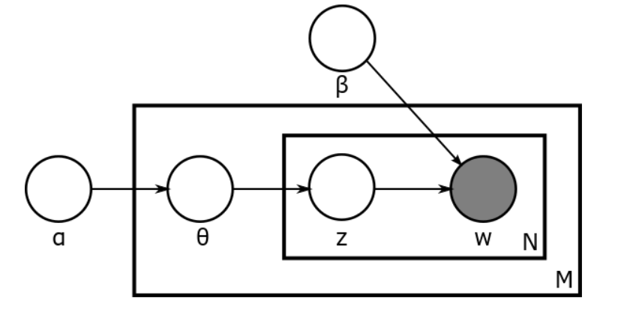
Latent Dirichlet allocation [Blei et al. 2003]
A generative statistical topic model
Adding a prior hyper parameter alpha to PLSA model
The document-topic probability is randomly sampled from the same prior distribution
beta’s dimension: V - 1
alpha’s dimension: k - 1
Notes:
we use Google playstore data as the data source, so we collect these data, we clean it, we split the sentence, and we build a filtering algorithm to select the high quality sentence

Slide 15
Notation table for LDA
d (or n): index of document, d=1,…, D
i: word inside document d, i = 1,2,…, N_d
z: topic index, z = 1,2,…, k
w or v: word index
w_{d,i}: the i-th word in document d
theta_{d,z}: probability of the z-th topic in document d
phi_{z, w}: probability of the w-th word in topic z
alpha: prior distribution of theta, dimension = k - 1
beta: prior distribution of phi, dimension = V - 1
Notes:
we use Google playstore data as the data source, so we collect these data, we clean it, we split the sentence, and we build a filtering algorithm to select the high quality sentence

Slide 16




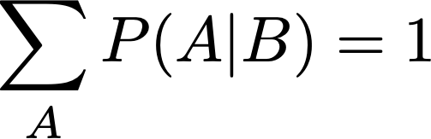
Bayes’ rules
Chain rule:
joint distribution
Bayes’ rule:
posterior
likelihood
prior
skipping estimating
trick for estimating the posterior
Notes:
we use Google playstore data as the data source, so we collect these data, we clean it, we split the sentence, and we build a filtering algorithm to select the high quality sentence

Slide 17


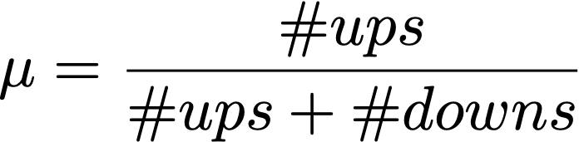


Frequentist vs. Bayesian inference
Frequentist treats parameters as fixed
Bayesians treats parameters as random
Consider the force that causes the coin to be biased
The forces are explained a prior distribution:
sequence = 0, 1, 0, 0, 1, 1, 0, 1, 0, 1, 0, 0

Slide 18
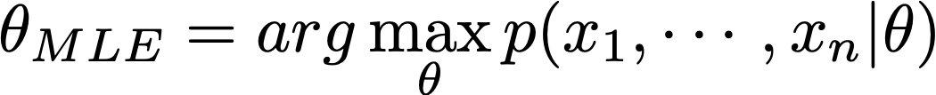
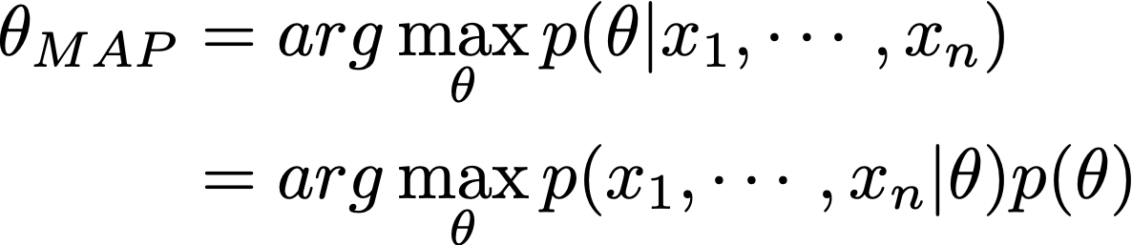
Maximum a Posterior (MAP) estimation
Maximum likelihood estimation:
Choose the parameter with the maximum posterior probability
How many parameters in PLSA vs. LDA? PLSA: d*(k-1) + k*(V-1), LDA: d*(k-1)+k*(V-1) + (k - 1) + (V - 1)
Notes:
we use Google playstore data as the data source, so we collect these data, we clean it, we split the sentence, and we build a filtering algorithm to select the high quality sentence

Slide 19
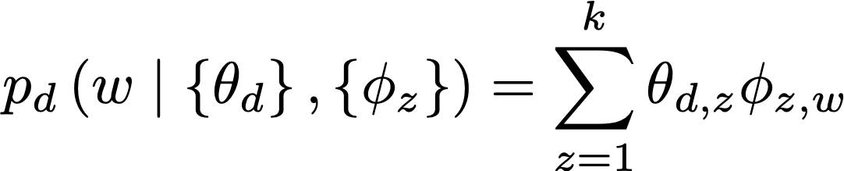
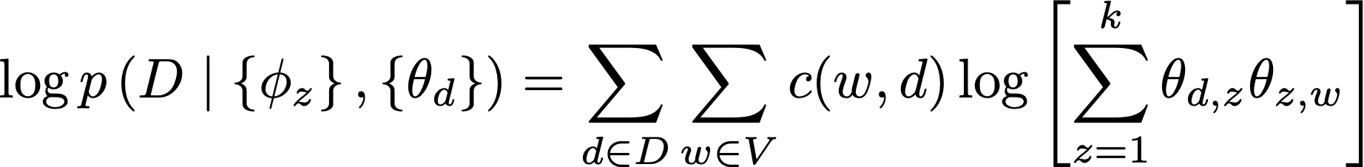
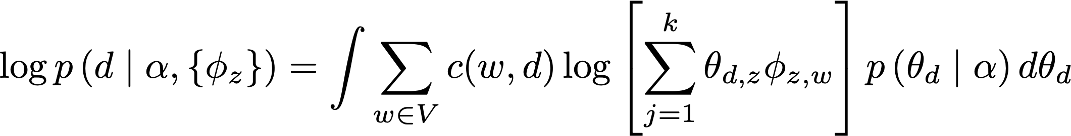

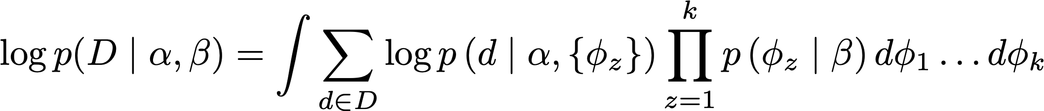
PLSA -> LDA
PLSA:
LDA:
marginalized probability:
Notes:
we use Google playstore data as the data source, so we collect these data, we clean it, we split the sentence, and we build a filtering algorithm to select the high quality sentence

Slide 20

PLSA -> LDA
city 0.2 new 0.1 orleans 0.05 ...
donate 0.1 relief 0.05 help 0.02 ...
government 0.3 response 0.2 ...
the 0.04 a 0.03 ...
Orleans 0.05
0.1
?
0.5
?
0.3
?
?
0.1
Step 0: sample topic distribution
[ Criticism of government response to the hurricane ..] to the [ flooding of New _______
[ Criticism of government response to the hurricane ..] to the [ flooding of New Orleans
Step 1: sample a topic: topic 2
Step 2: sample a word from topic 2

Slide 21
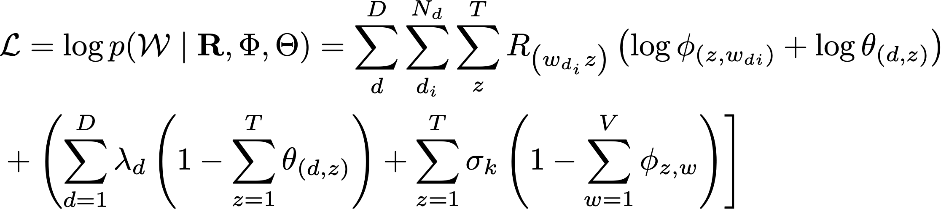
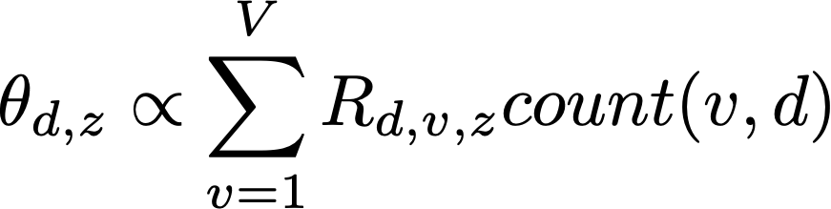

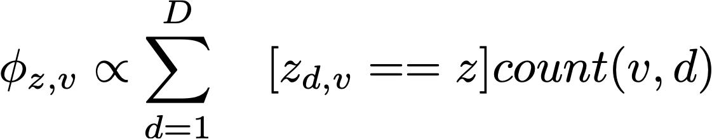
Solving Maximum a Posteriori inference for LDA
Maximum likelihood estimation:
M step:
E step:
Notes:
we use Google playstore data as the data source, so we collect these data, we clean it, we split the sentence, and we build a filtering algorithm to select the high quality sentence

Slide 22
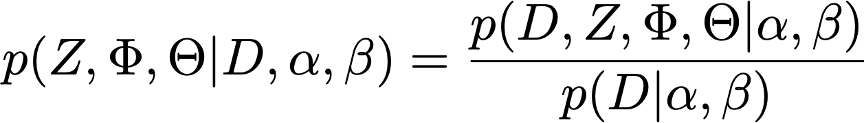
Solving Maximum a Posteriori inference for LDA
Exact inference is intractable:
Equation (1) is computationally intractable due to the coupling of beta and phi in the denominator
Question: why do we need to compute the denominator?
Notes:
we use Google playstore data as the data source, so we collect these data, we clean it, we split the sentence, and we build a filtering algorithm to select the high quality sentence

Slide 23
Variational inference
Key idea: use a surrogate distribution to approximate the posterior distribution of latent variables
Surrogate distribution is simpler to estimate than the true posterior
Goal: finding the “best” surrogate distribution from a certain parametric family by minimizing the KL-divergence between the surrogate function (Q) to the true posterior (P)
Typical surrogate distributions
Mean-field approximation [Blei et al. 03]
Expectation propagation [Minka et al. 02]
Collapsed variational Bayes [Teh et al. 07]
Notes:
we use Google playstore data as the data source, so we collect these data, we clean it, we split the sentence, and we build a filtering algorithm to select the high quality sentence

Slide 24
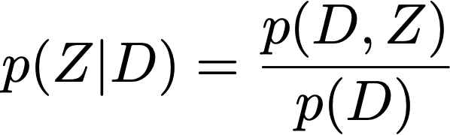
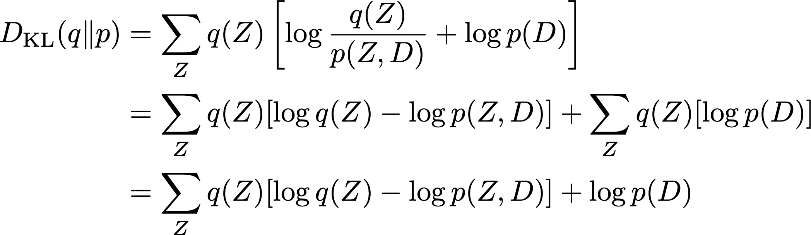
Evidence lower bound (ELBO)
Given that , we want to minimize the KL divergence between Q(Z) and p(Z|D):

Slide 25
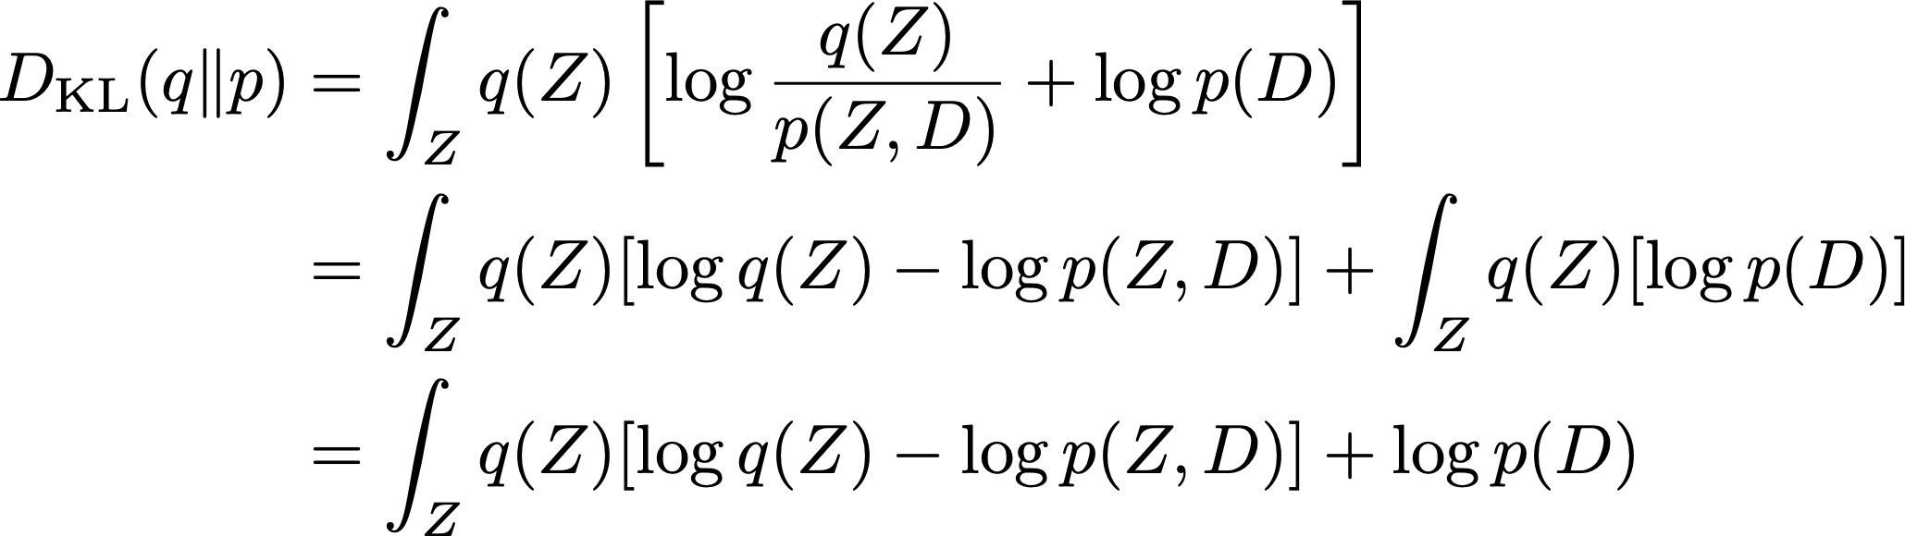
Evidence lower bound (ELBO)
Given that , we want to minimize the KL divergence between Q(Z) and p(Z|D):

Slide 26
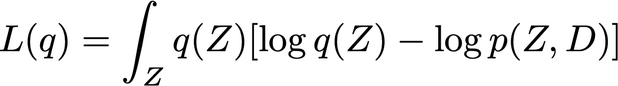
Evidence lower bound (ELBO)
p(D) does not rely on the latent variable Z:
Therefore minimizing KL divergence = maximizing L(q), which we call evidence lower bound, as KL divergence is non-negative
The lower bound is more tractable to optimize than the evidence:

Slide 27
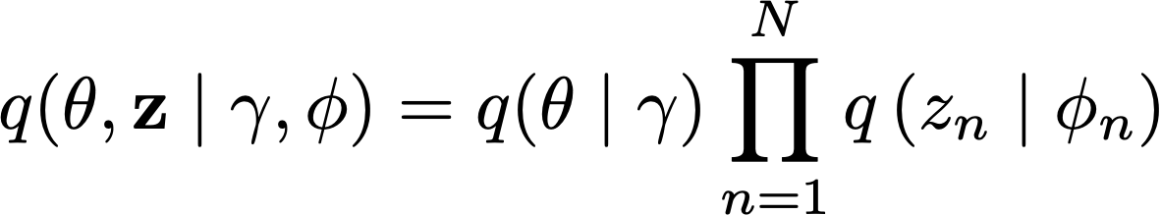
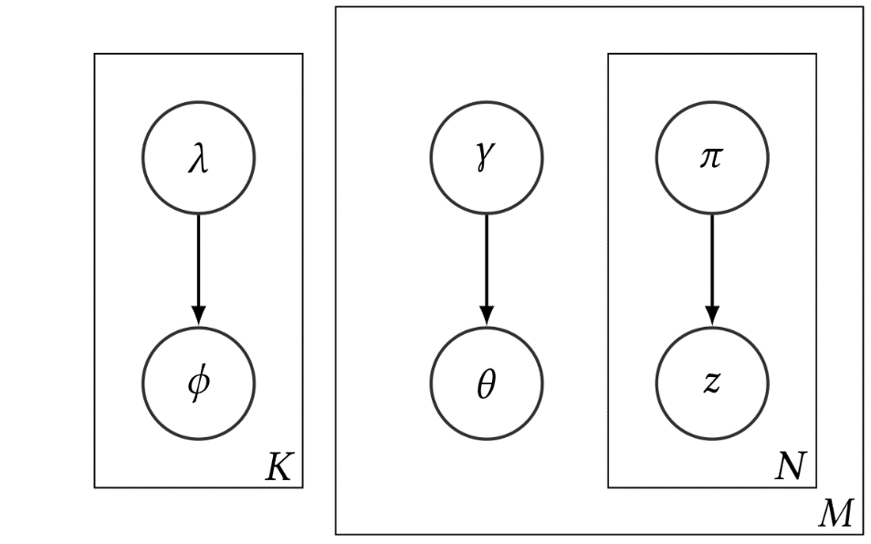
LDA variational inference
Assumption: q belongs to a family of distribution which can be factorized

Slide 28
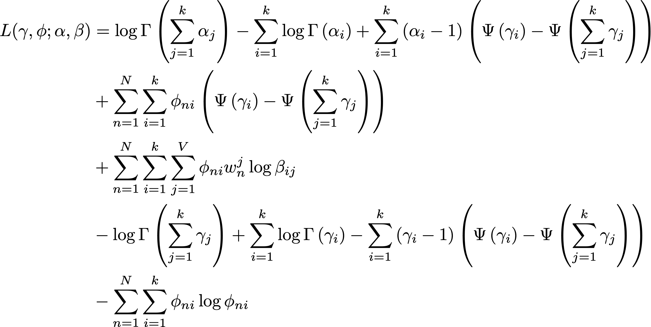
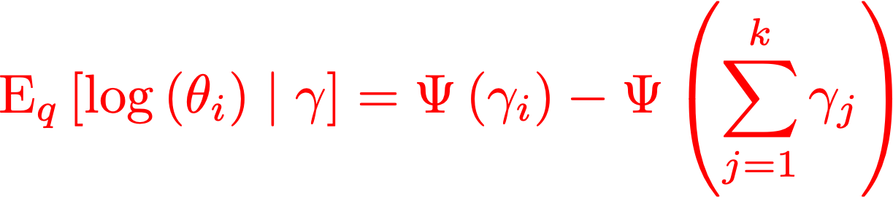
LDA variational inference
ELBO of LDA under the factorization assumption:
no , why?

Slide 29
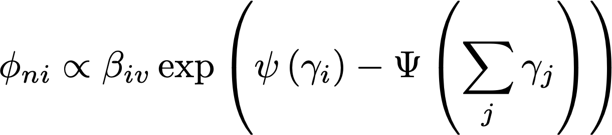
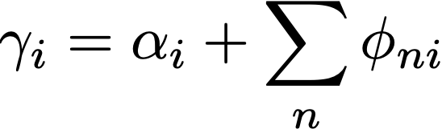
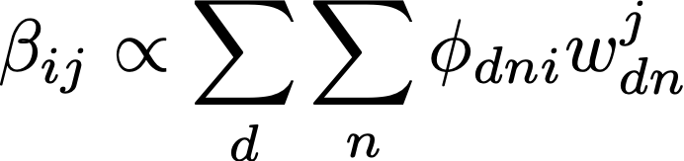
LDA variational inference
LDA variational inference algorithm: optimizing γ, φ, β
Randomly initialize variational parameters (can’t be uniform)
For each iteration:
For each document, update γ and φ
For corpus, update β
Compute L for diagnostics
Return expectation of variational parameters for solution to latent variables

Slide 30
Pros and Cons of Variational inference
Pros
Deterministic algorithm - easy to tell when converged
Embarrassingly parallelizable
Cons:
Speed: make many calls to transcendental functions (no close form solution)
Quality is questionable due to the factorization assumption
Memory usage: requires O(MNK) to store the per-token variational distributions

Slide 31
Monte Carlo for LDA inference
Monte Carlo
A broad class of computational algorithms that rely on repeated random sampling to obtain numerical results
Markov chain Monte Carlo (MCMC)
A Monte Carlo method with the Markov assumption, i.e., the next sample only rely on the previous state

Slide 32


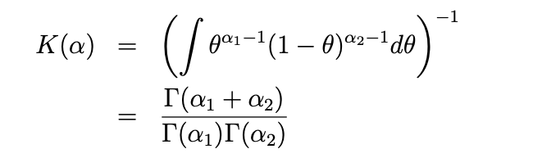
Conjugate prior distribution
That is, the posterior distributions are in the same probability distribution family as the prior probability distribution
The prior is called the conjugate prior of the likelihood probability
Conjugate prior makes denominator easy to compute because you can integrate out theta
e.g., Beta distribution is the conjugate prior of Bernoulli distribution
Bernoulli:
Beta:
Demominator:

Slide 33


Collapsed variational inference [Teh et al. 07]
If your priors are conjugate, they can be integrated out!
Let be the number of times that word v in document d has topic z
Let be the number of times word v in any document has topic z
No theta or phi in the above formula

Slide 34


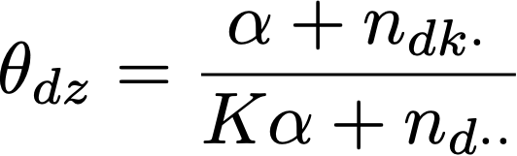
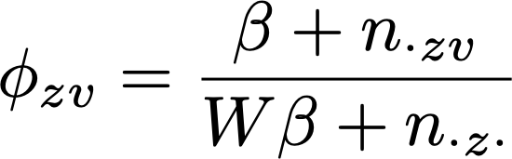
Collapsed variational inference [Teh et al. 07]
How do we get back phi and theta? MAP estimates from and
How do we get ?
Gibbs sampling: sample values of Z, count from those examples

Slide 35
Collapsed Gibbs sampling [Griffths et al. 04; Teh et al. 07]
Key idea: construct a well-behaved Markov chain such that
the states of the chain represent an assignment of $Z$
state transitions occur between states that differ in only one z_{d,i}
transition probabilities are based on the full conditional:
where z^{di} is the set of assignments for $Z$ without the i-th word in document d

Slide 36
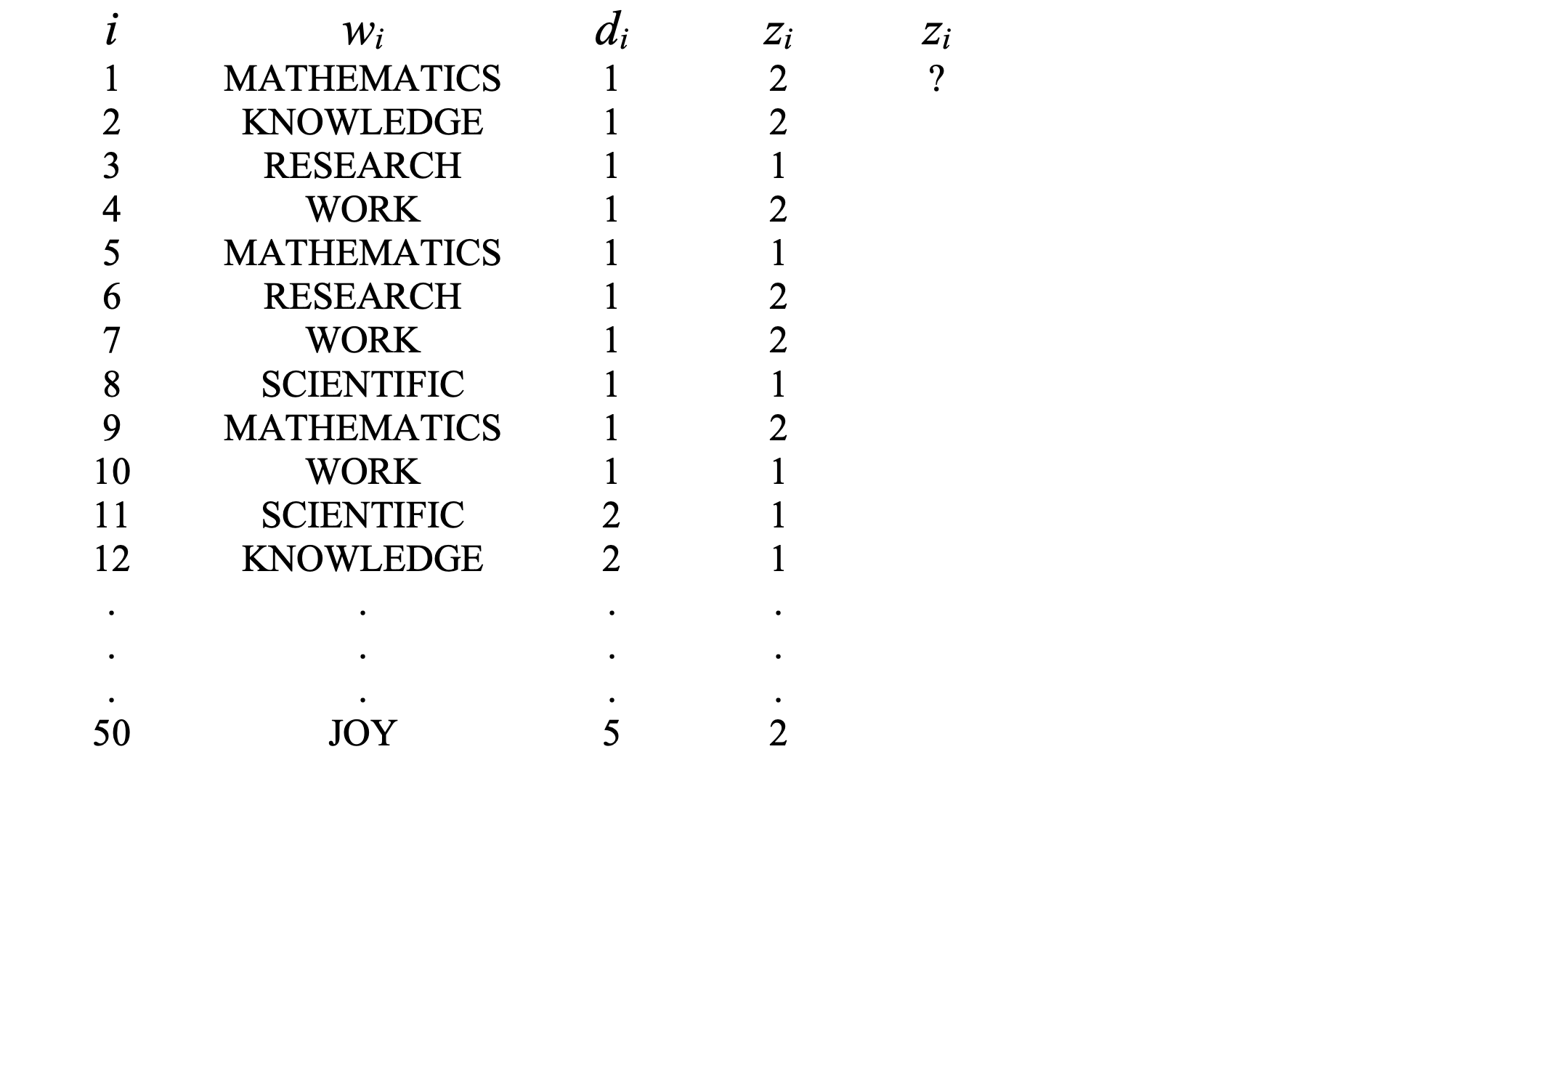
Collapsed Gibbs sampling [Griffths et al. 04]
iteration
1 2

Slide 37
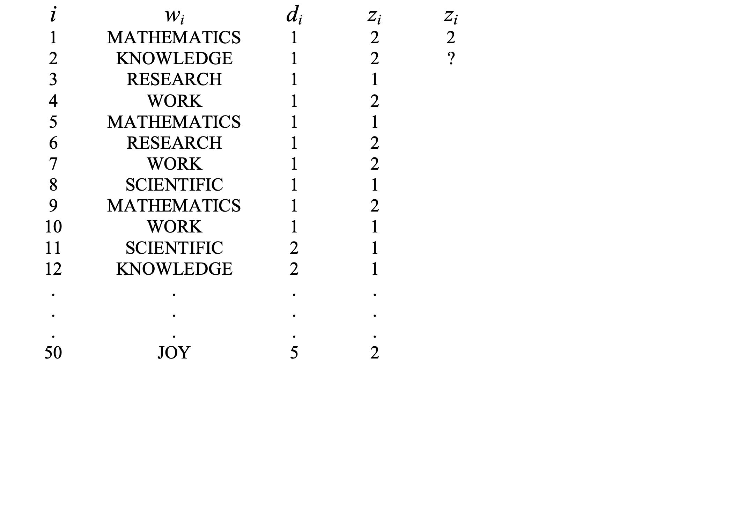
Collapsed Gibbs sampling [Griffths et al. 04]
iteration
1 2

Slide 38
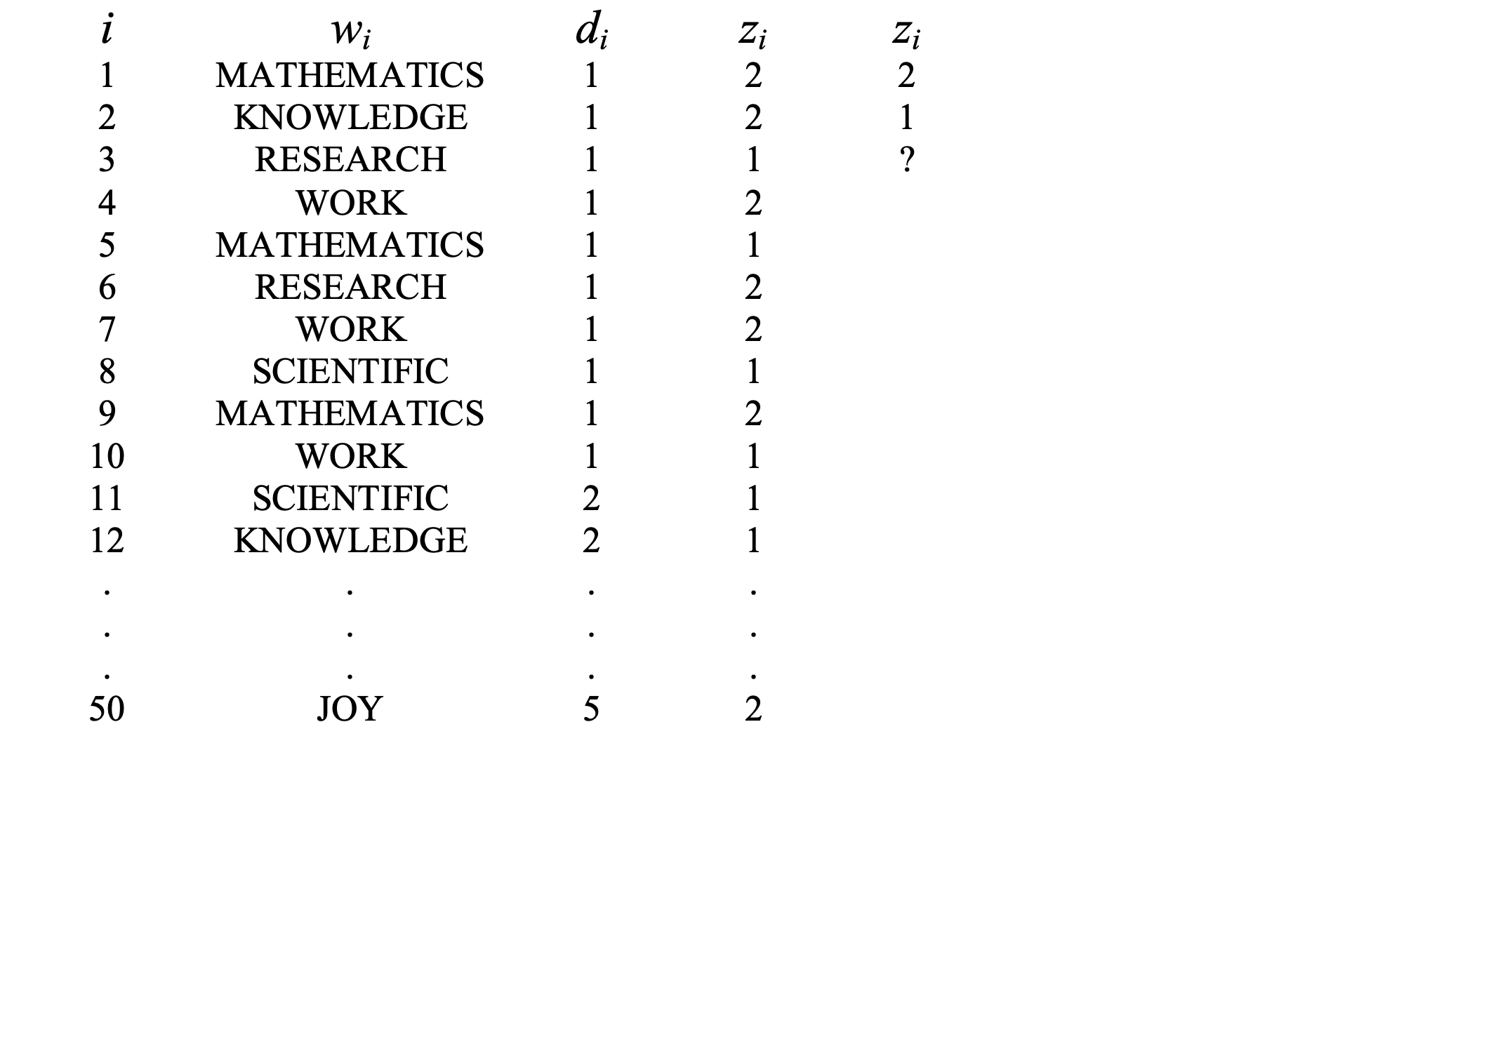
Collapsed Gibbs sampling [Griffths et al. 04]
iteration
1 2

Slide 39
Pros/Cons of Gibbs sampling
Pros:
Ease of implementation
Fast iterations (no transcendental functions), fast convergence (at least relative to a full Gibbs sampler)
Low memory usage (only require $O(MN)$ storage for the current values of $z_{j,t}$)
Cons:
No obvious parallelization strategy (each iteration depends on previous)
Can be difficult to assess convergence

Slide 40
LDA result

Slide 41
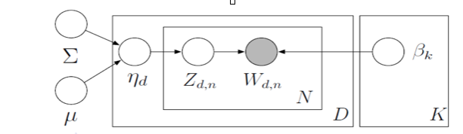
Correlated topic models (CTM) [Blei et al. 2005]
Draw topics from a logistic normal, where topic occurrence can exhibit correlations

Slide 42
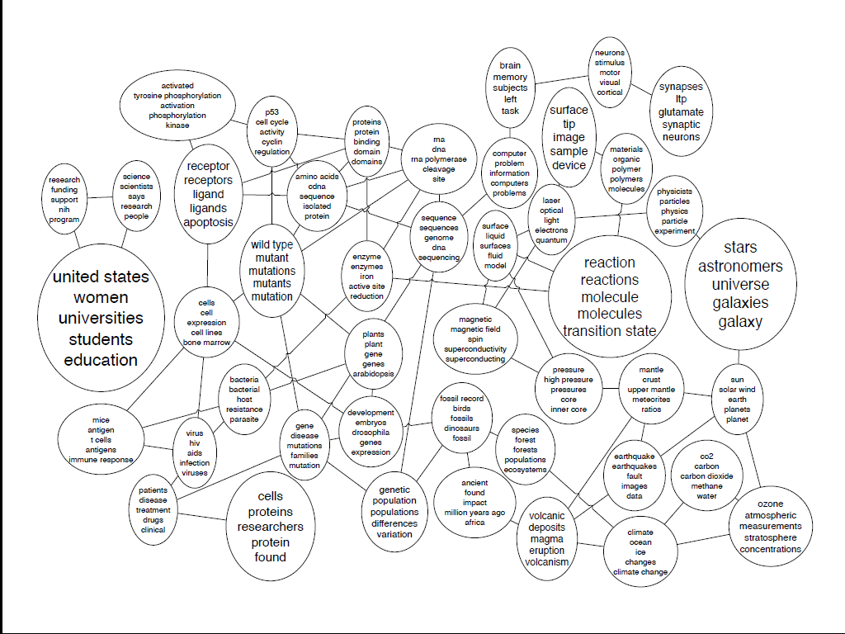
Correlated topic models (CTM) [Blei et al. 2005]

Slide 43
Correlated topic models (CTM) [Blei et al. 2005]
Draw topics from a logistic normal, where topic occurrence can exhibit correlations

Slide 44
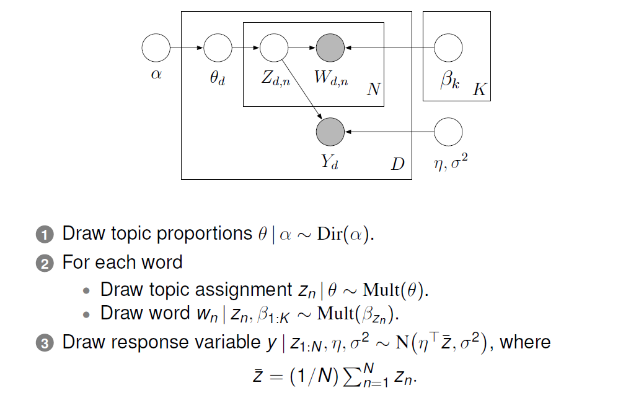
Supervised LDA [Blei & McAuliffe 07]

Slide 45
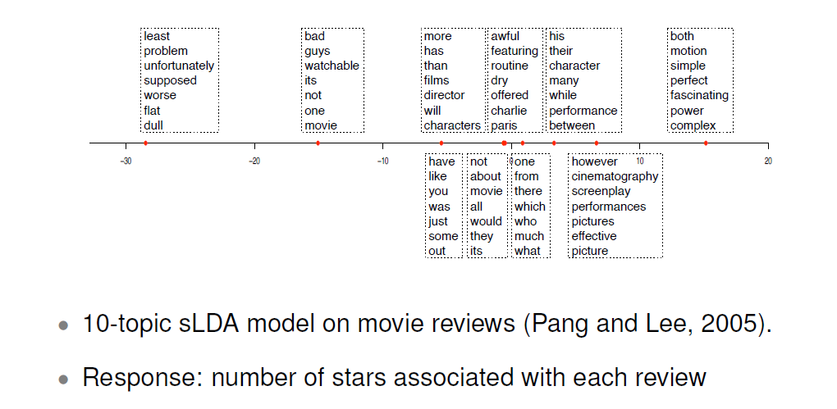
Supervised LDA [Blei & McAuliffe 07]

Slide 46
Learning topic hierarchies
Topic
0
The topics in each document form a path from root to leaf
Topic
1.1
Topic
1.2
Topic
2.1
Topic
2.2
Topic
2.3

Slide 47
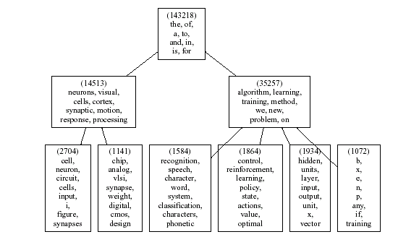
Learning topic hierarchies

Slide 48
Today’s lecture
Latent semantic indexing
Continue on topic model
Bayesian inference of topic model
Variational inference for LDA
Gibbs sampling, Markov chain Monte-Carlo
Notes:
we use Google playstore data as the data source, so we collect these data, we clean it, we split the sentence, and we build a filtering algorithm to select the high quality sentence

