Slide 1
Introduction to Elasticsearch
Huihui Liu
September 28, 2020

Slide 2
Elasticsearch
Open source
Distributed
Scalable
Enterprise-grade
Search engine

Slide 3
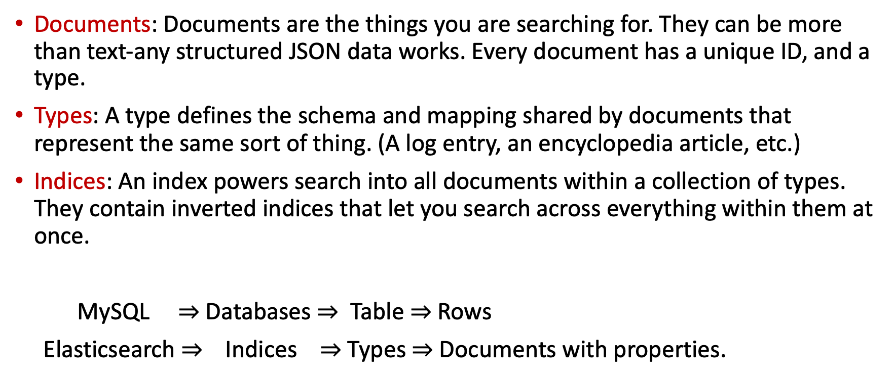
Logic concepts of Elasticsearch
Documents: Documents are the things you are searching for. They can be more than text-any structured JSON data works. Every document has a unique ID, and a type.
Types: A type defines the schema and mapping shared by documents that represent the same sort of thing. (A log entry, an encyclopedia article, etc.)
Indices: An index powers search into all documents within a collection of types. They contain inverted indices that let you search across everything within them at once.
MySQL $⇒$Databases $⇒$ Table $⇒$Rows
Elasticsearch $⇒$ Indices $⇒$Types $⇒$Documents with properties.
Reference: https://www.youtube.com/watch?v=C3tlMqaNSaI

Slide 4
Using Indices
Restful API: Elasticsearch fundamentally works via HTTP requests and JSON data. Any language or tool that can handle HTTP can use Elasticsearch.
Client API’s: Most languages have specialized Elasticsearch libraries to make it even easier.
Analytic tools: Web-based graphical UI’s such as Kibana let you interact with your indices and explore them without writing code.

Slide 5
Kibana
Web UI for searching and visualizing
Complex aggregations, graphs, charts
Often used for log analysis

Slide 6
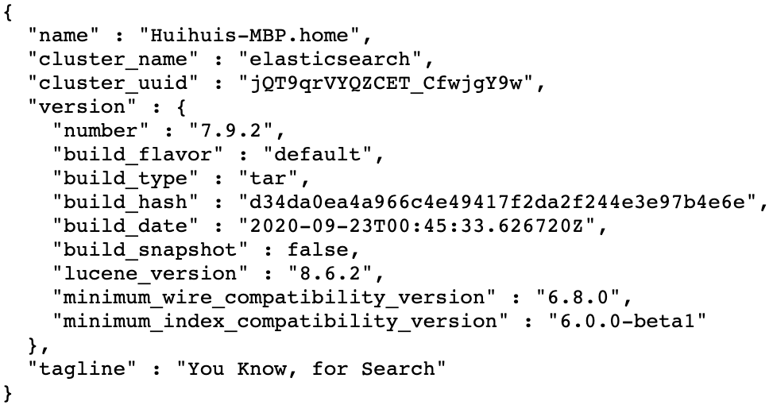
Install Elasticsearch
Download the latest version from the official website: https://www.elastic.co/downloads/elasticsearch
Unzip it and you will see a folder called ‘elasticsearch-7.9.2’. In a terminal window, go to the directory and run bin/elasticsearch (or bin\elasticsearch.bat on Windows) to start the service.
Open http://localhost:9200/ in a browser. If you can see information like below then you already started it successfully.

Slide 7
Install Kibana
Download the latest version from the official website: https://www.elastic.co/downloads/kibana.
Unzip it and you will see a folder called ‘kibana-7.9.2-darwin-x86_64’. In a terminal window, go to the directory and run bin/kibana (or bin\kibana.bat on Windows) to start the service.
Open this link http://localhost:5601 in a browser.

Slide 8
Common Operations
Create Index
Indexing Documents
Query

Slide 9
Create Index
Method1: Analytic tools (Kibana)
Method2: Resful API(terminal)
PUT /test
{
"mappings": {
"properties": {
"title": { "type": "text" },
"body": { "type": "text" },
"answer": { "type": "text" }
}
},
"settings":{
"index":{
"number_of_shards": 1,
"number_of_replicas": 1
}
}
}
curl -XPUT "http://localhost:9200/test" -H 'Content-Type: application/json' -d’
{
"mappings": {
"properties": {
"title": { "type": "text" },
"body": { "type": "text" },
"answer": { "type": "text" } } },
"settings":{
"index":{
"number_of_shards": 5,
"number_of_replicas": 1
} }}'
Reference: https://www.elastic.co/guide/en/elasticsearch/reference/current/indices-create-index.html

Slide 10
Create Index
Method3: Client API’s (python)
from elasticsearch import Elasticsearch def main(): _index = {
"mappings": {
"properties": {
"title": { "type": "text" },
"body": { "type": "text" },
"answer": { "type": "text" }
}
},
"settings":{
"index":{
"number_of_shards": 1,
"number_of_replicas": 1
}
}
} es = Elasticsearch()
red = es.indices.create(index = 'test', body = _index) if __name__ == '__main__’:
main()
API: https://elasticsearch-py.readthedocs.io/en/master/index.html

Slide 11
Indexing Documents Method1: Analytic tools (Kibana)
PUT /test/_doc/27787264
{
"title":"pandas query throws error column name starts number",
"body":"trying perform query following dataframe works fine however column name starts number throws syntax error file line syntaxerror invalid syntax think problem related format string wondering correct way form query",
"answer":"query uses pandas eval evaluate python expression string query valid python expression d valid syntax python use query refer column way things pandas generally easier make sure columns valid python identifiers"
}

Slide 12
Bulk Indexing Documents
Step 1: Converting data into JSON format
Original data:
46137355 pandas dataframe apply printing junk consider simple dataframe perform apply pandas printing junk time verified happens v edit looking answer workaround looks like bug opened working add tolist answer work around tracked pd lib reduce versus
JSON:
{"index": {"_id": "46137355"}}
{"title": "pandas dataframe apply printing junk ", "body": "consider simple dataframe perform apply pandas printing junk time verified happens v edit looking answer workaround ", "answer": "looks like bug opened working add tolist answer work around tracked pd lib reduce versus "}
Bulk API: https://www.elastic.co/guide/en/elasticsearch/reference/7.9/docs-bulk.html

Slide 13
Bulk Indexing Documents
JSON from lang_qid2all.txt :
{"index": {"_id": "27787264"}}
{"title": "pandas query throws error column name starts number ", "body": "trying perform query following dataframe works fine however column name starts number throws syntax error file line syntaxerror invalid syntax think problem related format string wondering correct way form query ", "answer": "query uses pandas eval evaluate python expression string query valid python expression d valid syntax python use query refer column way things pandas generally easier make sure columns valid python identifiers "}
{"index": {"_id": "35651586"}}
{"title": "psycopg cursor already closed ", "body": "using psycopg bunch queries need execute sequence suppose q fails ssl connection closed unexpectedly rest queries also fail cursor already closed ensure one query fails following queries executed successfully ", "answer": "presumably connection dropped would need reestablish get another cursor exception handler specific exceptions catch assuming exception cursor somehow closed catch like less drastic problems prevent subsequent queries executing e g transaction aborted case need rollback current transaction try next query query tried non existent table programmingerror exception raised connection must rolled back another query attempted second query succeed glosses details exceptions raised exception handlers e g connect might fail attempting reestablish connection handle explicitely regenerate cursor except bloc case something went wrong lower level query "}
{"index": {"_id": "30342145"}}
{"title": "redemption setting display name ", "body": "using add pst file attached pst outlook problem use one adds correctly display name attached personal folders provide display name set doesnt use still add pst personal folders way changes display name according rd optional argument setting display name something different expecting inform info needed ", "answer": "pst provider sometimes ignores specified displayed name pst store added try set name property store added "}

Slide 14
Bulk Indexing Documents
Step2: Indexing data
Open a terminal window. Bulk indexing of all the posts by the following command:
curl -s -H "Content-Type: application/json" -XPOST localhost:9200/test /_doc/_bulk --data-binary "@python.json"

Slide 15
Query
Match All Query: it returns all the contents
POST /test/_search
{
"query":{
"match_all":{}
}
}
Match query
GET test/_search
{
"query":{"match":{"title": " pandas "}}
}
Reference: https://www.elastic.co/guide/en/elasticsearch/reference/current/query-dsl-query-string-query.html

