Slide 1
DATA SCIENCE PROJECT
California Housing
Predicting district home values from census data
Data, methods and results
Notes:
Analysis: ml_models_tutorial.ipynb.
Measured results: run_results/ml_models_tutorial/results.json.

Slide 2
01 Summary
Summary
Best model
0.4393
LightGBM reaches RMSE 0.4393 and MAE about $28,834.
Comparison
Test RMSE
RMSE is 41.1% below OLS. Its small lead over stacking is uncertain under paired resampling.
Recommendation
Keep LightGBM as the simpler leading candidate and validate on geographically separate districts.
California Housing
02 / 47
Notes:
Analysis: ml_models_tutorial.ipynb.
Measured results: run_results/ml_models_tutorial/results.json.
{"LightGBM": {"RMSE": 0.43928996315596835, "MAE": 0.2883439901615231, "R2": 0.8527363022278559}, "LightGBM (tuned)": {"RMSE": 0.43928996315596835, "MAE": 0.2883439901615231, "R2": 0.8527363022278559}, "Stacking": {"RMSE": 0.44100361032693314, "MAE": 0.29044104373365365, "R2": 0.8515851252923601}, "XGBoost": {"RMSE": 0.4555634441360824, "MAE": 0.30181217401972577, "R2": 0.8416234510910252}, "XGBoost (tuned)": {"RMSE": 0.4555634441360824, "MAE": 0.30181217401972577, "R2": 0.8416234510910252}, "CatBoost": {"RMSE": 0.4715267015244089, "MAE": 0.31515490211107766, "R2": 0.830329741369022}, "CatBoost (tuned)": {"RMSE": 0.4715267015244089, "MAE": 0.31515490211107766, "R2": 0.830329741369022}, "RandomForest": {"RMSE": 0.5039333509016345, "MAE": 0.32629377073627364, "R2": 0.8062064390829707}, "MLP": {"RMSE": 0.5205192821031435, "MAE": 0.35275574036305657, "R2": 0.7932398758402253}, "MLP (tuned)": {"RMSE": 0.5205192821031435, "MAE": 0.35275574036305657, "R2": 0.7932398758402253}, "RandomForest (tuned)": {"RMSE": 0.5238512997535342, "MAE": 0.344116506057907, "R2": 0.7905843222916175}, "KNN": {"RMSE": 0.6425902852338763, "MAE": 0.43521505301008967, "R2": 0.6848905330065247}, "KNN (tuned)": {"RMSE": 0.6425902852338763, "MAE": 0.43521505301008967, "R2": 0.6848905330065247}, "Lasso": {"RMSE": 0.7404423656125414, "MAE": 0.5353261423609053, "R2": 0.5816154300698727}, "ElasticNet": {"RMSE": 0.7415883901375351, "MAE": 0.534077200417684, "R2": 0.5803193128873084}, "Ridge": {"RMSE": 0.7438185949703784, "MAE": 0.5330142193095552, "R2": 0.5777912763033604}, "LinearRegression": {"RMSE": 0.7455813830127765, "MAE": 0.5332001304956565, "R2": 0.5757877060324507}}

Slide 3
02 Objective and data
Objective
Objective
Estimate the median home value of a California census district from its location, income and housing characteristics.
Prediction unit
One census district. Values are recorded in units of $100,000.
Evaluation
RMSE for model ranking, MAE for typical error, and R² for explained variation.
California Housing
03 / 47
Notes:
Analysis: ml_models_tutorial.ipynb.
Measured results: run_results/ml_models_tutorial/results.json.

Slide 4
02 Objective and data
Dataset
Item | Details
Records | 20,640 California census districts
Features | 8 numerical census and location features
Target | Median district value, recorded in units of $100,000
Scope | Historical district aggregates. Individual property transactions are outside the dataset.
California Housing
04 / 47
Notes:
Analysis: ml_models_tutorial.ipynb.
Measured results: run_results/ml_models_tutorial/results.json.

Slide 5
02 Objective and data
Preprocessing
Step | Processing
Input data | Load all 20,640 districts and the eight numerical predictors.
Missing values | The benchmark has complete numerical fields.
Scaling | Standardize predictors using the training partition for linear models, KNN and MLP.
Target values | Retain the recorded home-value ceiling of 5.00001.
California Housing
05 / 47
Notes:
Analysis: ml_models_tutorial.ipynb.
Measured results: run_results/ml_models_tutorial/results.json.

Slide 6
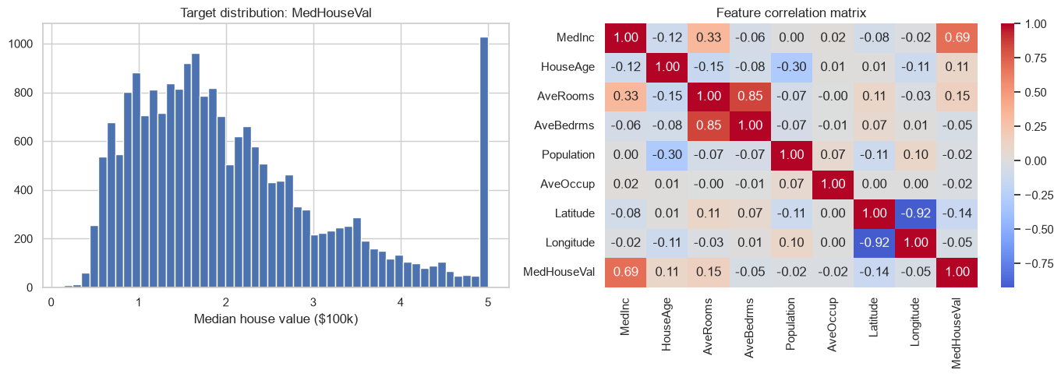
03 EDA and features
Target distribution and correlations
The distribution is right-skewed and includes a pile-up at the maximum recorded value.
California Housing
06 / 47
Notes:
Analysis: ml_models_tutorial.ipynb.
Figure: figures/notebook/ml_models/cell_008_figure_1.png
Measured results: run_results/ml_models_tutorial/results.json.
Notebook cell ID: d391a27d.

Slide 7
03 EDA and features
EDA findings
Home values
The distribution is right-skewed and includes a pile-up at the maximum recorded value.
Related features
Rooms and bedrooms are strongly related. Nearby districts also share geographic and market characteristics.
Modeling choice
Test nonlinear models and report errors separately for districts at the recording ceiling.
California Housing
07 / 47
Notes:
Analysis: ml_models_tutorial.ipynb.
Measured results: run_results/ml_models_tutorial/results.json.

Slide 8
03 EDA and features
Feature engineering
Feature group | Predictors
Income and age | Median income and median house age
Housing | Average rooms, average bedrooms and average occupancy
Population | District population
Location | Latitude and longitude
California Housing
08 / 47
Notes:
Analysis: ml_models_tutorial.ipynb.
Measured results: run_results/ml_models_tutorial/results.json.

Slide 9
04 Validation
Train–test split
Partition
Random 80/20 split with seed 42. Training has 16,512 districts and testing has 4,128 districts.
Transforms
Fit feature scaling on training rows, then apply the same transformation to the test partition.
Evaluation
The test partition is separate from the rows used to fit each model.
California Housing
09 / 47
Notes:
Analysis: ml_models_tutorial.ipynb.
Measured results: run_results/ml_models_tutorial/results.json.

Slide 10
05 Methods
Methods
Family | Models | Role
Linear | OLS, Ridge, Lasso and Elastic Net | Interpretable reference
Local | K-nearest neighbors | Predict from similar records
Neural | Multilayer perceptron | Learn nonlinear relationships
Trees | Random Forest, XGBoost, CatBoost and LightGBM | Learn thresholds and interactions
Ensemble | Stacking of Random Forest, XGBoost and LightGBM | Combine predictions using a fitted meta-model
California Housing
10 / 47
Notes:
Analysis: ml_models_tutorial.ipynb.
Measured results: run_results/ml_models_tutorial/results.json.

Slide 11
05 Methods
Linear models
Model | Strength | Weakness
OLS | Easy to inspect and use as a baseline | Misses nonlinear effects without added features
Ridge | Stabilizes coefficients when predictors overlap | Keeps all predictors and introduces shrinkage bias
Lasso | Can remove weak predictors with zero coefficients | Can select inconsistently among correlated inputs
Elastic Net | Combines sparse selection with L2 shrinkage | Requires penalty strength and mixing to be selected
California Housing
11 / 47
Notes:
Analysis: ml_models_tutorial.ipynb.
https://scikit-learn.org/stable/modules/linear_model.html
Measured results: run_results/ml_models_tutorial/results.json.

Slide 12
05 Methods
KNN and neural networks
Model | Strength | Weakness
KNN | Simple local prediction with few modeling assumptions | Distances depend on scaling. Prediction slows as the reference set grows.
MLP | Learns smooth nonlinear effects and interactions | Sensitive to scaling and optimization. Needs regularization and convergence checks.
California Housing
12 / 47
Notes:
Analysis: ml_models_tutorial.ipynb.
Measured results: run_results/ml_models_tutorial/results.json.

Slide 13
05 Methods
Tree-based models
Model | Strength | Weakness
Random Forest | Averaging many trees reduces variance and captures interactions | Large ensembles use memory and extrapolate poorly
XGBoost | Regularized boosting handles complex tabular relationships | Tree depth, learning rate and tree count need joint selection
CatBoost | Supports categorical features alongside numerical features | Training can be costly. Data quality still limits performance
LightGBM | Histogram splits support efficient training on large tables | Flexible leaf growth can overfit small groups
California Housing
13 / 47
Notes:
Analysis: ml_models_tutorial.ipynb.
Measured results: run_results/ml_models_tutorial/results.json.

Slide 14
05 Methods
Stacking
Random Forest, XGBoost and LightGBM generate out-of-fold predictions. A Ridge meta-model learns how to combine them.
Strengths
Weaknesses
Can reduce error when the base models make different mistakes. The meta-model learns the weights from training predictions.
Adds fitting and inference cost. Similar base-model errors can limit the gain.
RESULT IN THIS STUDY
RMSE 0.4410 and MAE 0.2904. It does not exceed the best individual model on the primary metric.
California Housing
14 / 47
Notes:
Analysis: ml_models_tutorial.ipynb.
Base models: fitted reference configurations, each cloned and refitted by StackingRegressor/Classifier. cv=2. Meta-model: Ridge(alpha=1.0).
https://scikit-learn.org/stable/modules/ensemble.html#stacking
Measured results: run_results/ml_models_tutorial/results.json.

Slide 15
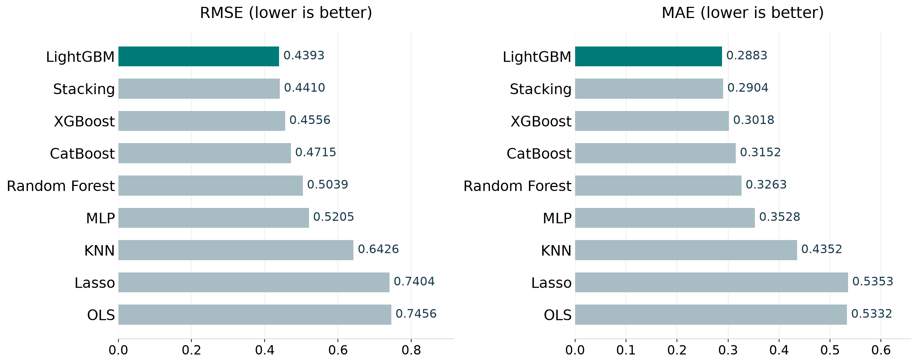
06 Results
Model comparison
Best test score per family, including the strongest penalized linear model. Full results appear in the appendix.
California Housing
15 / 47
Notes:
Analysis: ml_models_tutorial.ipynb.
Figure: figures/ml_models/comparison.png
Measured results: run_results/ml_models_tutorial/results.json.

Slide 16
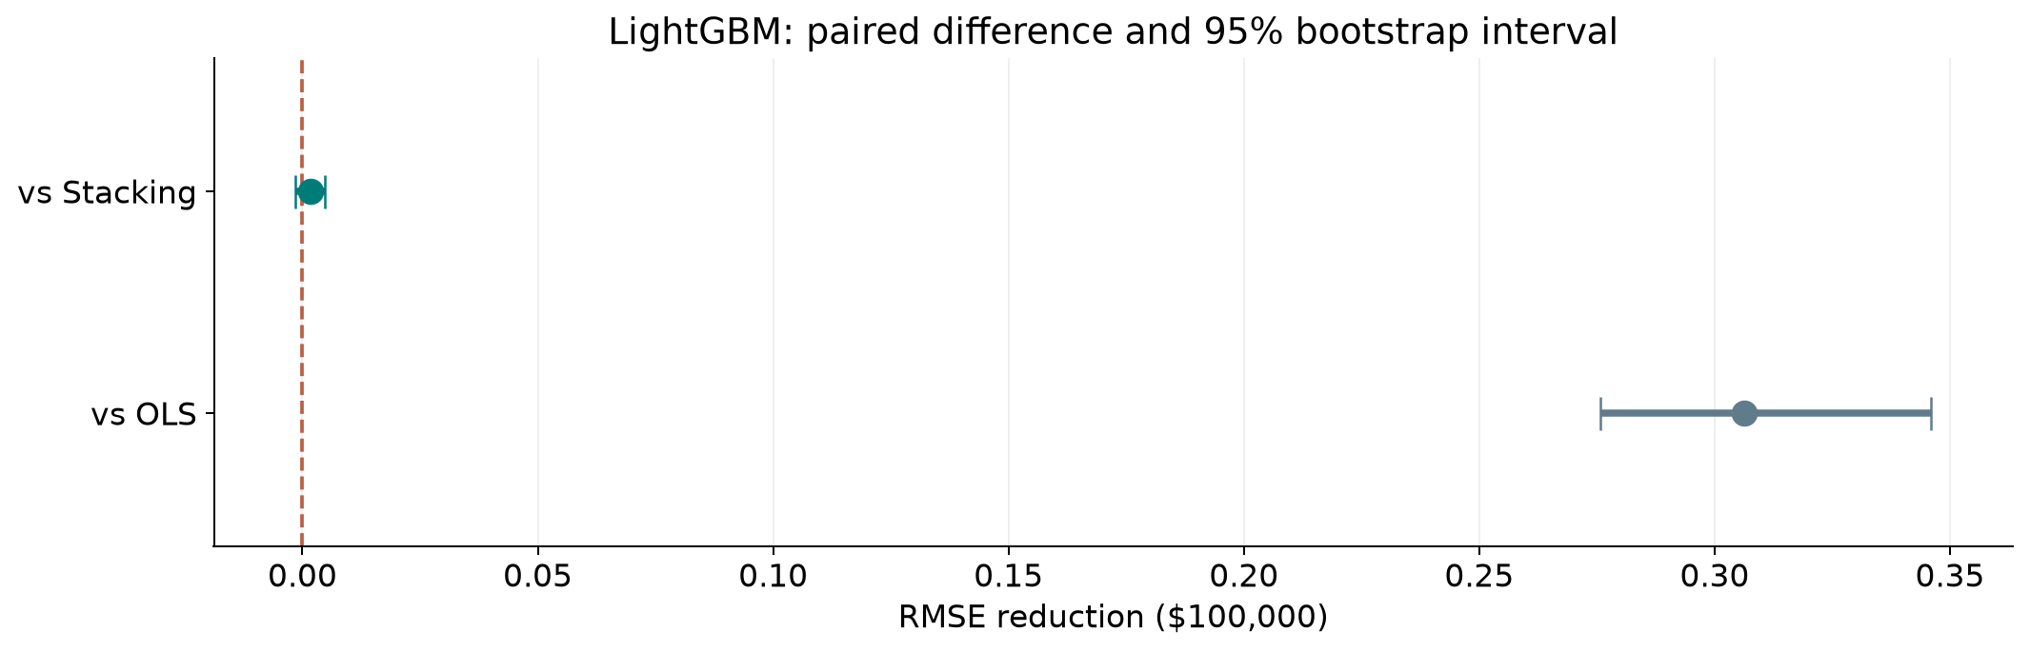
06 Results
Ranking stability
The 95% interval includes zero for LightGBM versus Stacking. Their ordering remains uncertain.
California Housing
16 / 47
Notes:
Analysis: ml_models_tutorial.ipynb.
paired row bootstrap. 1,000 paired resamples. Fitted models remain fixed.
[{"comparison": "LightGBM versus Stacking", "other": "Stacking", "advantage": 0.0017136471709647827, "ci_low": -0.0014348846957895566, "ci_high": 0.004762718439082734}, {"comparison": "LightGBM versus OLS", "other": "OLS", "advantage": 0.3062914198568082, "ci_low": 0.27564976928646623, "ci_high": 0.34602851468750845}]
Figure: figures/ml_models/ranking_stability.png
Measured results: run_results/ml_models_tutorial/results.json.

Slide 17
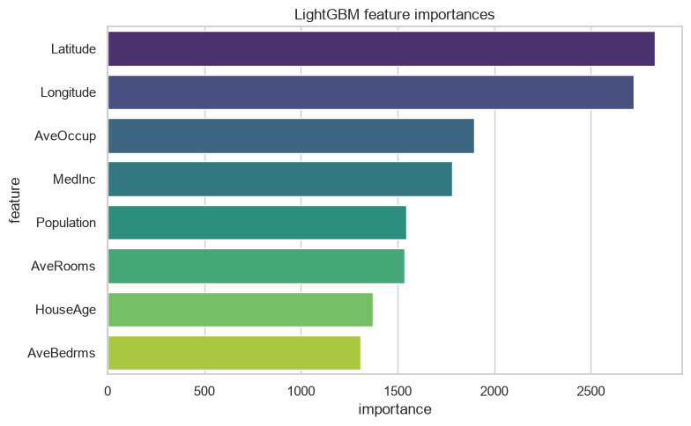
06 Results
LightGBM feature importance
Income and location provide useful predictive information. Correlated housing features can share importance.
California Housing
17 / 47
Notes:
Analysis: ml_models_tutorial.ipynb.
Figure: figures/notebook/ml_models/cell_057_figure_1.png
Measured results: run_results/ml_models_tutorial/results.json.
Notebook cell ID: 67e62f3c.

Slide 18
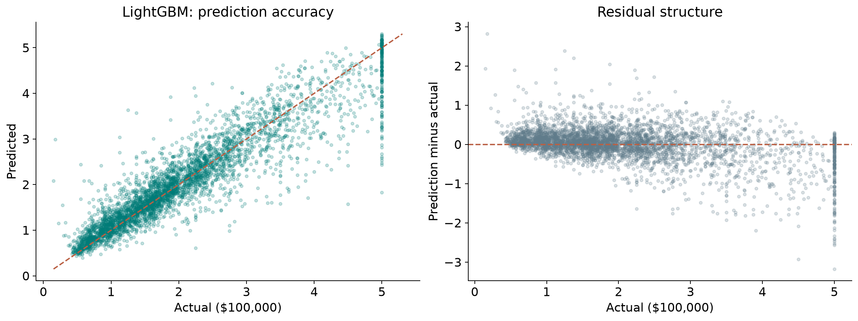
06 Results
Prediction errors
Residual = prediction − actual. Positive residuals indicate overprediction.
California Housing
18 / 47
Notes:
Analysis: ml_models_tutorial.ipynb.
Figure: figures/ml_models/winner_diagnostics.png
Measured results: run_results/ml_models_tutorial/results.json.
Diagnostics use LightGBM predictions.

Slide 19
06 Results
Simple baselines
Method | RMSE | MAE | R²
Training mean | 1.1449 | 0.9061 | -0.000219
LightGBM | 0.4393 | 0.2883 | 0.8527
Same test targets for every row. Error units: 100,000 USD.
California Housing
19 / 47
Notes:
Analysis: ml_models_tutorial.ipynb.
Measured results: run_results/ml_models_tutorial/results.json.

Slide 20
06 Results
Results
Prediction accuracy
LightGBM and stacking have similar test error. Both improve substantially on the linear models.
High-value districts
The 184 capped test targets have MAE about $62,005. Mean underprediction is about $55,610.
Use of the model
The target is a district median. A property valuation model needs property-level inputs and transaction prices.
California Housing
20 / 47
Notes:
Analysis: ml_models_tutorial.ipynb.
Measured results: run_results/ml_models_tutorial/results.json.
{"LightGBM": {"RMSE": 0.43928996315596835, "MAE": 0.2883439901615231, "R2": 0.8527363022278559}, "LightGBM (tuned)": {"RMSE": 0.43928996315596835, "MAE": 0.2883439901615231, "R2": 0.8527363022278559}, "Stacking": {"RMSE": 0.44100361032693314, "MAE": 0.29044104373365365, "R2": 0.8515851252923601}, "XGBoost": {"RMSE": 0.4555634441360824, "MAE": 0.30181217401972577, "R2": 0.8416234510910252}, "XGBoost (tuned)": {"RMSE": 0.4555634441360824, "MAE": 0.30181217401972577, "R2": 0.8416234510910252}, "CatBoost": {"RMSE": 0.4715267015244089, "MAE": 0.31515490211107766, "R2": 0.830329741369022}, "CatBoost (tuned)": {"RMSE": 0.4715267015244089, "MAE": 0.31515490211107766, "R2": 0.830329741369022}, "RandomForest": {"RMSE": 0.5039333509016345, "MAE": 0.32629377073627364, "R2": 0.8062064390829707}, "MLP": {"RMSE": 0.5205192821031435, "MAE": 0.35275574036305657, "R2": 0.7932398758402253}, "MLP (tuned)": {"RMSE": 0.5205192821031435, "MAE": 0.35275574036305657, "R2": 0.7932398758402253}, "RandomForest (tuned)": {"RMSE": 0.5238512997535342, "MAE": 0.344116506057907, "R2": 0.7905843222916175}, "KNN": {"RMSE": 0.6425902852338763, "MAE": 0.43521505301008967, "R2": 0.6848905330065247}, "KNN (tuned)": {"RMSE": 0.6425902852338763, "MAE": 0.43521505301008967, "R2": 0.6848905330065247}, "Lasso": {"RMSE": 0.7404423656125414, "MAE": 0.5353261423609053, "R2": 0.5816154300698727}, "ElasticNet": {"RMSE": 0.7415883901375351, "MAE": 0.534077200417684, "R2": 0.5803193128873084}, "Ridge": {"RMSE": 0.7438185949703784, "MAE": 0.5330142193095552, "R2": 0.5777912763033604}, "LinearRegression": {"RMSE": 0.7455813830127765, "MAE": 0.5332001304956565, "R2": 0.5757877060324507}}

Slide 21
07 Conclusion
Limitations
Limitation | Details
Geography | A random split can place nearby districts in both training and test data.
Date of data | Market conditions may differ from the historical population.
Target ceiling | The most expensive districts have capped labels.
Model selection | Confirm the selected model on data that did not guide model choice.
California Housing
21 / 47
Notes:
Analysis: ml_models_tutorial.ipynb.
Measured results: run_results/ml_models_tutorial/results.json.

Slide 22
07 Conclusion
Next steps
# | Test | Method | Measure
1 | Spatial validation | Group districts by geographic blocks and keep regions separate. | Stable error across held-out regions
2 | Feature ablation | Compare location-only, income-only and complete feature sets. | Incremental value of each feature family
3 | Ceiling sensitivity | Score capped and uncapped districts separately. | Explicit error at the upper limit
4 | Final refit | Tune using training folds, refit all training rows, then score a new holdout. | One untouched final estimate
California Housing
22 / 47
Notes:
Analysis: ml_models_tutorial.ipynb.
Measured results: run_results/ml_models_tutorial/results.json.

Slide 23
07 Conclusion
Conclusion
LightGBM is the leading candidate
RMSE 0.4393
Its score is close to stacking, with lower ensemble complexity. Geographic validation and capped-target errors remain the next priorities.
California Housing
23 / 47
Notes:
Analysis: ml_models_tutorial.ipynb.
Measured results: run_results/ml_models_tutorial/results.json.
{"LightGBM": {"RMSE": 0.43928996315596835, "MAE": 0.2883439901615231, "R2": 0.8527363022278559}, "LightGBM (tuned)": {"RMSE": 0.43928996315596835, "MAE": 0.2883439901615231, "R2": 0.8527363022278559}, "Stacking": {"RMSE": 0.44100361032693314, "MAE": 0.29044104373365365, "R2": 0.8515851252923601}, "XGBoost": {"RMSE": 0.4555634441360824, "MAE": 0.30181217401972577, "R2": 0.8416234510910252}, "XGBoost (tuned)": {"RMSE": 0.4555634441360824, "MAE": 0.30181217401972577, "R2": 0.8416234510910252}, "CatBoost": {"RMSE": 0.4715267015244089, "MAE": 0.31515490211107766, "R2": 0.830329741369022}, "CatBoost (tuned)": {"RMSE": 0.4715267015244089, "MAE": 0.31515490211107766, "R2": 0.830329741369022}, "RandomForest": {"RMSE": 0.5039333509016345, "MAE": 0.32629377073627364, "R2": 0.8062064390829707}, "MLP": {"RMSE": 0.5205192821031435, "MAE": 0.35275574036305657, "R2": 0.7932398758402253}, "MLP (tuned)": {"RMSE": 0.5205192821031435, "MAE": 0.35275574036305657, "R2": 0.7932398758402253}, "RandomForest (tuned)": {"RMSE": 0.5238512997535342, "MAE": 0.344116506057907, "R2": 0.7905843222916175}, "KNN": {"RMSE": 0.6425902852338763, "MAE": 0.43521505301008967, "R2": 0.6848905330065247}, "KNN (tuned)": {"RMSE": 0.6425902852338763, "MAE": 0.43521505301008967, "R2": 0.6848905330065247}, "Lasso": {"RMSE": 0.7404423656125414, "MAE": 0.5353261423609053, "R2": 0.5816154300698727}, "ElasticNet": {"RMSE": 0.7415883901375351, "MAE": 0.534077200417684, "R2": 0.5803193128873084}, "Ridge": {"RMSE": 0.7438185949703784, "MAE": 0.5330142193095552, "R2": 0.5777912763033604}, "LinearRegression": {"RMSE": 0.7455813830127765, "MAE": 0.5332001304956565, "R2": 0.5757877060324507}}

Slide 24
08 Appendix
Evaluation metrics
Metric | Meaning | Role
RMSE | Square root of mean squared error | Ranks models and emphasizes large misses
MAE | Mean absolute error | Describes typical error magnitude
R² | Improvement over predicting the test mean | Measures explained variation
Group errors | Metrics by target range or time group | Locates concentrated errors
California Housing
24 / 47
Notes:
Analysis: ml_models_tutorial.ipynb.
Measured results: run_results/ml_models_tutorial/results.json.

Slide 25
08 Appendix
Regularization
Model | Objective | Main effect
OLS | Squared error | Fits an additive linear relationship
Ridge | Squared error + L2 penalty | Shrinks correlated coefficients
Lasso | Squared error + L1 penalty | Can set coefficients to zero
Elastic Net | Squared error + L1 and L2 penalties | Combines sparsity and shrinkage
California Housing
25 / 47
Notes:
Analysis: ml_models_tutorial.ipynb.
https://scikit-learn.org/stable/modules/linear_model.html
Measured results: run_results/ml_models_tutorial/results.json.

Slide 26
08 Appendix
Linear model results
Model | RMSE | MAE | R²
OLS | 0.7456 | 0.5332 | 0.5758
Ridge | 0.7438 | 0.5330 | 0.5778
Lasso | 0.7404 | 0.5353 | 0.5816
Elastic Net | 0.7416 | 0.5341 | 0.5803
California Housing
26 / 47
Notes:
Analysis: ml_models_tutorial.ipynb.
Measured results: run_results/ml_models_tutorial/results.json.
{"LightGBM": {"RMSE": 0.43928996315596835, "MAE": 0.2883439901615231, "R2": 0.8527363022278559}, "LightGBM (tuned)": {"RMSE": 0.43928996315596835, "MAE": 0.2883439901615231, "R2": 0.8527363022278559}, "Stacking": {"RMSE": 0.44100361032693314, "MAE": 0.29044104373365365, "R2": 0.8515851252923601}, "XGBoost": {"RMSE": 0.4555634441360824, "MAE": 0.30181217401972577, "R2": 0.8416234510910252}, "XGBoost (tuned)": {"RMSE": 0.4555634441360824, "MAE": 0.30181217401972577, "R2": 0.8416234510910252}, "CatBoost": {"RMSE": 0.4715267015244089, "MAE": 0.31515490211107766, "R2": 0.830329741369022}, "CatBoost (tuned)": {"RMSE": 0.4715267015244089, "MAE": 0.31515490211107766, "R2": 0.830329741369022}, "RandomForest": {"RMSE": 0.5039333509016345, "MAE": 0.32629377073627364, "R2": 0.8062064390829707}, "MLP": {"RMSE": 0.5205192821031435, "MAE": 0.35275574036305657, "R2": 0.7932398758402253}, "MLP (tuned)": {"RMSE": 0.5205192821031435, "MAE": 0.35275574036305657, "R2": 0.7932398758402253}, "RandomForest (tuned)": {"RMSE": 0.5238512997535342, "MAE": 0.344116506057907, "R2": 0.7905843222916175}, "KNN": {"RMSE": 0.6425902852338763, "MAE": 0.43521505301008967, "R2": 0.6848905330065247}, "KNN (tuned)": {"RMSE": 0.6425902852338763, "MAE": 0.43521505301008967, "R2": 0.6848905330065247}, "Lasso": {"RMSE": 0.7404423656125414, "MAE": 0.5353261423609053, "R2": 0.5816154300698727}, "ElasticNet": {"RMSE": 0.7415883901375351, "MAE": 0.534077200417684, "R2": 0.5803193128873084}, "Ridge": {"RMSE": 0.7438185949703784, "MAE": 0.5330142193095552, "R2": 0.5777912763033604}, "LinearRegression": {"RMSE": 0.7455813830127765, "MAE": 0.5332001304956565, "R2": 0.5757877060324507}}

Slide 27
08 Appendix
Linear model discussion
Results
Lasso has the lowest linear-model RMSE, 0.7404. The gain over OLS is small compared with the nonlinear models.
Interpretation
Income and location have strong fitted associations. Correlated housing variables can share or exchange coefficient weight.
Further work
Test income–location interactions and compare coefficient stability across geographic folds.
California Housing
27 / 47
Notes:
Analysis: ml_models_tutorial.ipynb.
https://scikit-learn.org/stable/modules/linear_model.html
Measured results: run_results/ml_models_tutorial/results.json.

Slide 28
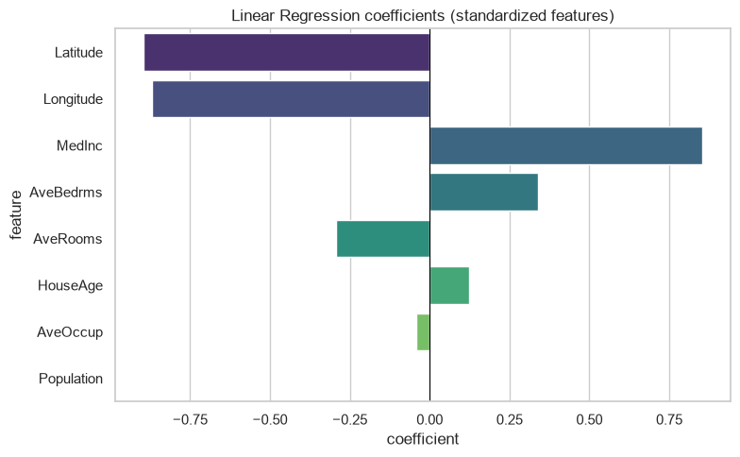
08 Appendix
Linear coefficients
Coefficients describe fitted associations after accounting for the other encoded inputs.
California Housing
28 / 47
Notes:
Analysis: ml_models_tutorial.ipynb.
Figure: figures/notebook/ml_models/cell_016_figure_1.png
Measured results: run_results/ml_models_tutorial/results.json.
Notebook cell ID: b8d16811.

Slide 29
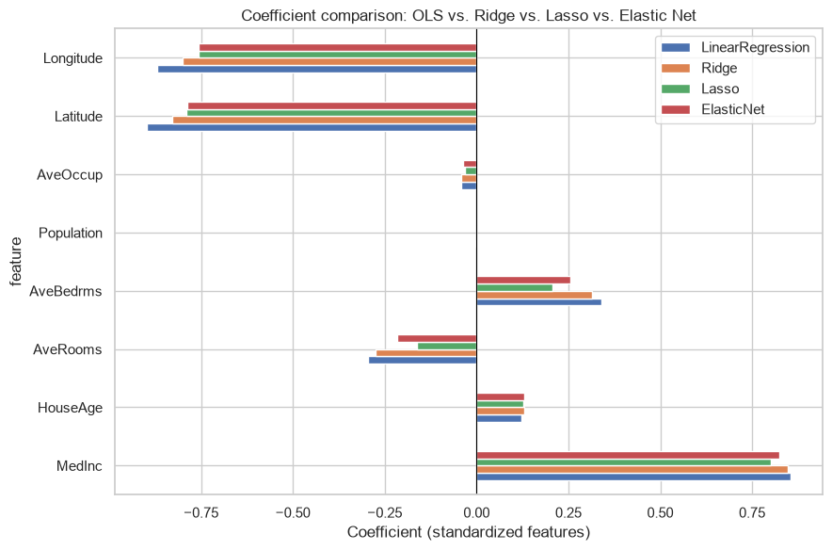
08 Appendix
Regularized coefficients
Coefficients describe fitted associations after accounting for the other encoded inputs.
California Housing
29 / 47
Notes:
Analysis: ml_models_tutorial.ipynb.
Figure: figures/notebook/ml_models/cell_023_figure_1.png
Measured results: run_results/ml_models_tutorial/results.json.
Notebook cell ID: 08603448.

Slide 30
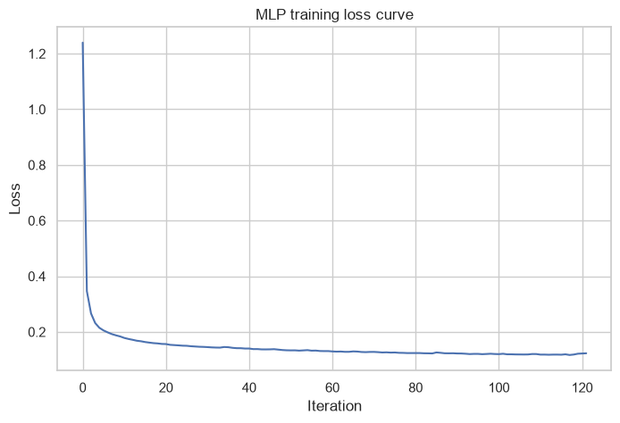
08 Appendix
MLP training loss
Training loss by optimization iteration.
California Housing
30 / 47
Notes:
Analysis: ml_models_tutorial.ipynb.
Figure: figures/notebook/ml_models/cell_032_figure_1.png
Measured results: run_results/ml_models_tutorial/results.json.
Notebook cell ID: 05b47cdb.

Slide 31
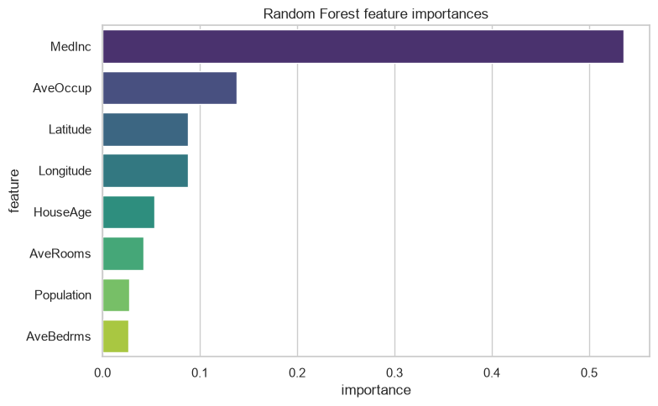
08 Appendix
Random Forest feature importance
Income and location provide useful predictive information. Correlated housing features can share importance.
California Housing
31 / 47
Notes:
Analysis: ml_models_tutorial.ipynb.
Figure: figures/notebook/ml_models/cell_039_figure_1.png
Measured results: run_results/ml_models_tutorial/results.json.
Notebook cell ID: fdb89a0a.

Slide 32
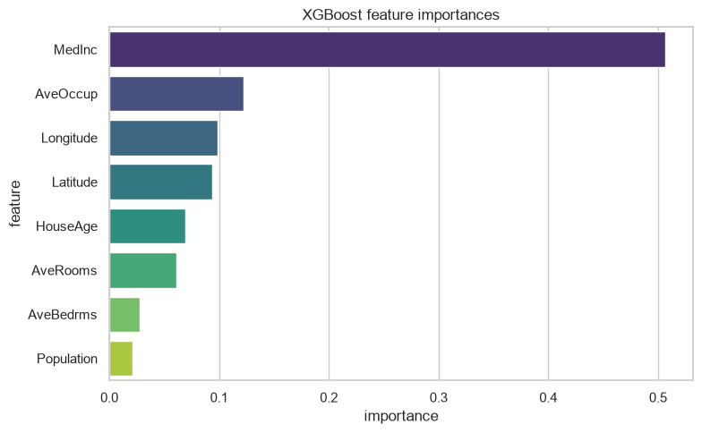
08 Appendix
XGBoost feature importance
Income and location provide useful predictive information. Correlated housing features can share importance.
California Housing
32 / 47
Notes:
Analysis: ml_models_tutorial.ipynb.
Figure: figures/notebook/ml_models/cell_045_figure_1.png
Measured results: run_results/ml_models_tutorial/results.json.
Notebook cell ID: 61c4e466.

Slide 33
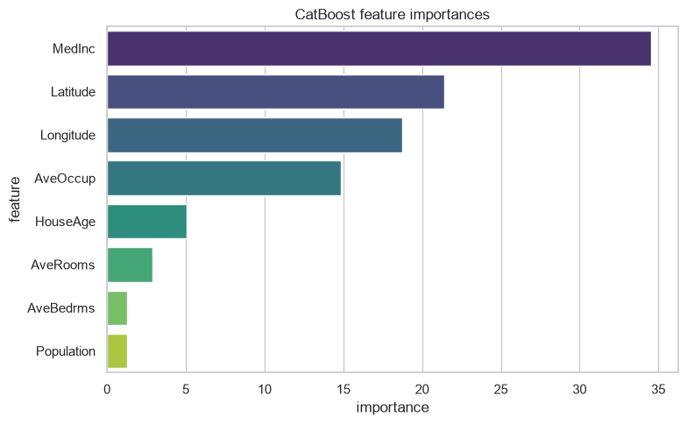
08 Appendix
CatBoost feature importance
Income and location provide useful predictive information. Correlated housing features can share importance.
California Housing
33 / 47
Notes:
Analysis: ml_models_tutorial.ipynb.
Figure: figures/notebook/ml_models/cell_051_figure_1.png
Measured results: run_results/ml_models_tutorial/results.json.
Notebook cell ID: a5b2e8d8.

Slide 34
08 Appendix
Error by target range
Test target band | Rows | MAE | Mean prediction error
Q1: (0.149, 1.193] | 1,032 | 0.2002 | 0.1504
Q2: (1.193, 1.786] | 1,032 | 0.2150 | 0.0848
Q3: (1.786, 2.63] | 1,032 | 0.2614 | 0.0328
Q4: (2.63, 5.0] | 1,032 | 0.4768 | -0.2451
Errors for LightGBM. Mean error = prediction − actual. Units: 100,000 USD.
California Housing
34 / 47
Notes:
Analysis: ml_models_tutorial.ipynb.
Measured results: run_results/ml_models_tutorial/results.json.

Slide 35
08 Appendix
Application
Topic | Application
Prediction | Estimate a district median, with an error range appropriate to the local market.
Coverage | The historical dataset does not establish accuracy for current property prices.
Validation | Reserve geographic blocks to measure performance in a new area.
California Housing
35 / 47
Notes:
Analysis: ml_models_tutorial.ipynb.
Measured results: run_results/ml_models_tutorial/results.json.

Slide 36
08 Appendix
Model selection Q&A
Why include penalized linear models?
Ridge uses L2 shrinkage to stabilize coefficients. Lasso uses L1 to encourage zeros. Elastic Net combines the penalties. Logistic models use the same penalty types for classification.
Why standardize the predictors?
Penalties and distance calculations depend on feature units. Scaling also helps neural-network optimization. Estimate the scaling parameters from training data.
Why include stacking?
It does not improve the leading individual model here. Combining models helps only when their errors are sufficiently different. Compare its gain with inference and maintenance cost.
California Housing
36 / 47
Notes:
Analysis: ml_models_tutorial.ipynb.
https://scikit-learn.org/stable/modules/linear_model.html
https://scikit-learn.org/stable/modules/neighbors.html
https://scikit-learn.org/stable/modules/neural_networks_supervised.html
Measured results: run_results/ml_models_tutorial/results.json.

Slide 37
08 Appendix
Model interpretation Q&A
How do forests and boosting differ?
Random Forest averages trees trained with randomized rows and features. Boosting adds trees sequentially to reduce the chosen loss.
What does feature importance mean?
It describes how the fitted model uses its inputs. Related predictors can share importance. A high value does not establish a causal effect.
What do the resampling intervals cover?
They measure variation in the available test predictions with the fitted models fixed. A new split also tests sensitivity to training and model selection.
California Housing
37 / 47
Notes:
Analysis: ml_models_tutorial.ipynb.
https://scikit-learn.org/stable/modules/ensemble.html
https://xgboost.readthedocs.io/en/stable/tutorials/model.html
Measured results: run_results/ml_models_tutorial/results.json.

Slide 38
08 Appendix
Data Q&A
Why include location?
Home values vary geographically. Holding out entire areas tests whether the relationship transfers to a new location.
How does the target ceiling affect evaluation?
Capped records hide values above the ceiling. Evaluate these districts separately and avoid treating the recorded cap as their exact market value.
California Housing
38 / 47
Notes:
Analysis: ml_models_tutorial.ipynb.
Measured results: run_results/ml_models_tutorial/results.json.

Slide 39
08 Appendix
Results Q&A
Can this predict an individual house price?
The fitted target is a district median. A property model needs property-level features and transaction prices.
How would you validate LightGBM next?
Compare geographically separated folds and report errors by value range. Reserve a final region or period for the selected model.
California Housing
39 / 47
Notes:
Analysis: ml_models_tutorial.ipynb.
Measured results: run_results/ml_models_tutorial/results.json.

Slide 40
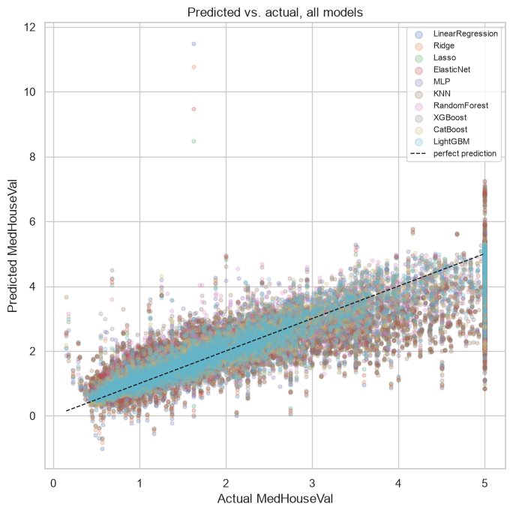
08 Appendix
Actual and predicted district values
Actual outcomes and predictions on the test partition.
California Housing
40 / 47
Notes:
Analysis: ml_models_tutorial.ipynb.
Figure: figures/notebook/ml_models/cell_064_figure_1.png
Measured results: run_results/ml_models_tutorial/results.json.
Notebook cell ID: 6737e6ce.

Slide 41
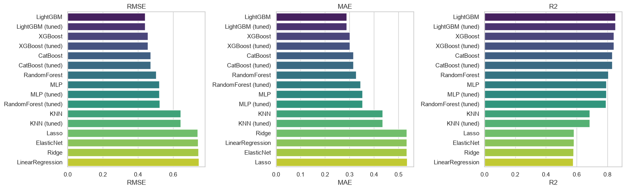
08 Appendix
Individual model metrics
Notebook comparison of individual models. The full results tables also include stacking.
California Housing
41 / 47
Notes:
Analysis: ml_models_tutorial.ipynb.
Figure: figures/notebook/ml_models/cell_063_figure_1.png
Measured results: run_results/ml_models_tutorial/results.json.
Notebook cell ID: f7104818.

Slide 42
08 Appendix
Full results (1 of 2)
Model | RMSE | MAE | R²
LightGBM | 0.4393 | 0.2883 | 0.8527
LightGBM (tuned) | 0.4393 | 0.2883 | 0.8527
Stacking | 0.4410 | 0.2904 | 0.8516
XGBoost | 0.4556 | 0.3018 | 0.8416
XGBoost (tuned) | 0.4556 | 0.3018 | 0.8416
CatBoost | 0.4715 | 0.3152 | 0.8303
CatBoost (tuned) | 0.4715 | 0.3152 | 0.8303
Random Forest | 0.5039 | 0.3263 | 0.8062
MLP | 0.5205 | 0.3528 | 0.7932
California Housing
42 / 47
Notes:
Analysis: ml_models_tutorial.ipynb.
Measured results: run_results/ml_models_tutorial/results.json.
{"LightGBM": {"RMSE": 0.43928996315596835, "MAE": 0.2883439901615231, "R2": 0.8527363022278559}, "LightGBM (tuned)": {"RMSE": 0.43928996315596835, "MAE": 0.2883439901615231, "R2": 0.8527363022278559}, "Stacking": {"RMSE": 0.44100361032693314, "MAE": 0.29044104373365365, "R2": 0.8515851252923601}, "XGBoost": {"RMSE": 0.4555634441360824, "MAE": 0.30181217401972577, "R2": 0.8416234510910252}, "XGBoost (tuned)": {"RMSE": 0.4555634441360824, "MAE": 0.30181217401972577, "R2": 0.8416234510910252}, "CatBoost": {"RMSE": 0.4715267015244089, "MAE": 0.31515490211107766, "R2": 0.830329741369022}, "CatBoost (tuned)": {"RMSE": 0.4715267015244089, "MAE": 0.31515490211107766, "R2": 0.830329741369022}, "RandomForest": {"RMSE": 0.5039333509016345, "MAE": 0.32629377073627364, "R2": 0.8062064390829707}, "MLP": {"RMSE": 0.5205192821031435, "MAE": 0.35275574036305657, "R2": 0.7932398758402253}, "MLP (tuned)": {"RMSE": 0.5205192821031435, "MAE": 0.35275574036305657, "R2": 0.7932398758402253}, "RandomForest (tuned)": {"RMSE": 0.5238512997535342, "MAE": 0.344116506057907, "R2": 0.7905843222916175}, "KNN": {"RMSE": 0.6425902852338763, "MAE": 0.43521505301008967, "R2": 0.6848905330065247}, "KNN (tuned)": {"RMSE": 0.6425902852338763, "MAE": 0.43521505301008967, "R2": 0.6848905330065247}, "Lasso": {"RMSE": 0.7404423656125414, "MAE": 0.5353261423609053, "R2": 0.5816154300698727}, "ElasticNet": {"RMSE": 0.7415883901375351, "MAE": 0.534077200417684, "R2": 0.5803193128873084}, "Ridge": {"RMSE": 0.7438185949703784, "MAE": 0.5330142193095552, "R2": 0.5777912763033604}, "LinearRegression": {"RMSE": 0.7455813830127765, "MAE": 0.5332001304956565, "R2": 0.5757877060324507}}

Slide 43
08 Appendix
Full results (2 of 2)
Model | RMSE | MAE | R²
MLP (tuned) | 0.5205 | 0.3528 | 0.7932
Forest (tuned) | 0.5239 | 0.3441 | 0.7906
KNN | 0.6426 | 0.4352 | 0.6849
KNN (tuned) | 0.6426 | 0.4352 | 0.6849
Lasso | 0.7404 | 0.5353 | 0.5816
Elastic Net | 0.7416 | 0.5341 | 0.5803
Ridge | 0.7438 | 0.5330 | 0.5778
OLS | 0.7456 | 0.5332 | 0.5758
California Housing
43 / 47
Notes:
Analysis: ml_models_tutorial.ipynb.
Measured results: run_results/ml_models_tutorial/results.json.
{"LightGBM": {"RMSE": 0.43928996315596835, "MAE": 0.2883439901615231, "R2": 0.8527363022278559}, "LightGBM (tuned)": {"RMSE": 0.43928996315596835, "MAE": 0.2883439901615231, "R2": 0.8527363022278559}, "Stacking": {"RMSE": 0.44100361032693314, "MAE": 0.29044104373365365, "R2": 0.8515851252923601}, "XGBoost": {"RMSE": 0.4555634441360824, "MAE": 0.30181217401972577, "R2": 0.8416234510910252}, "XGBoost (tuned)": {"RMSE": 0.4555634441360824, "MAE": 0.30181217401972577, "R2": 0.8416234510910252}, "CatBoost": {"RMSE": 0.4715267015244089, "MAE": 0.31515490211107766, "R2": 0.830329741369022}, "CatBoost (tuned)": {"RMSE": 0.4715267015244089, "MAE": 0.31515490211107766, "R2": 0.830329741369022}, "RandomForest": {"RMSE": 0.5039333509016345, "MAE": 0.32629377073627364, "R2": 0.8062064390829707}, "MLP": {"RMSE": 0.5205192821031435, "MAE": 0.35275574036305657, "R2": 0.7932398758402253}, "MLP (tuned)": {"RMSE": 0.5205192821031435, "MAE": 0.35275574036305657, "R2": 0.7932398758402253}, "RandomForest (tuned)": {"RMSE": 0.5238512997535342, "MAE": 0.344116506057907, "R2": 0.7905843222916175}, "KNN": {"RMSE": 0.6425902852338763, "MAE": 0.43521505301008967, "R2": 0.6848905330065247}, "KNN (tuned)": {"RMSE": 0.6425902852338763, "MAE": 0.43521505301008967, "R2": 0.6848905330065247}, "Lasso": {"RMSE": 0.7404423656125414, "MAE": 0.5353261423609053, "R2": 0.5816154300698727}, "ElasticNet": {"RMSE": 0.7415883901375351, "MAE": 0.534077200417684, "R2": 0.5803193128873084}, "Ridge": {"RMSE": 0.7438185949703784, "MAE": 0.5330142193095552, "R2": 0.5777912763033604}, "LinearRegression": {"RMSE": 0.7455813830127765, "MAE": 0.5332001304956565, "R2": 0.5757877060324507}}

Slide 44
08 Appendix
Model settings
Model | Parameters
KNN | n_neighbors=15, weights='distance'
MLP | hidden_layer_sizes=(64, 32), alpha=0.0001, max_iter=500, early_stopping=True
Random Forest | n_estimators=300, max_depth=None, min_samples_leaf=2
XGBoost | n_estimators=500, learning_rate=0.05, max_depth=5
CatBoost | iterations=500, learning_rate=0.05, depth=6
LightGBM | n_estimators=500, learning_rate=0.05, num_leaves=31
Searches use two folds and two candidates. Each selected estimator refits on the full training partition.
California Housing
44 / 47
Notes:
Analysis: ml_models_tutorial.ipynb.
Seed 42. Stacking uses two ordinary folds. Penalized linear models test three strengths. See the notebook for all constructor arguments.
Measured results: run_results/ml_models_tutorial/results.json.

Slide 45
08 Appendix
Selected hyperparameters (1 of 2)
Model | Selected parameters
KNN | n_neighbors=15, p=2, weights=distance
MLP | hidden_layer_sizes=(64, 32), alpha=0.0001
Random Forest | n_estimators=300, min_samples_leaf=5, max_depth=12
California Housing
45 / 47
Notes:
Analysis: ml_models_tutorial.ipynb.
Measured results: run_results/ml_models_tutorial/results.json.

Slide 46
08 Appendix
Selected hyperparameters (2 of 2)
Model | Selected parameters
XGBoost | n_estimators=500, max_depth=5, learning_rate=0.05
CatBoost | learning_rate=0.05, iterations=500, depth=6
LightGBM | num_leaves=31, n_estimators=500, learning_rate=0.05
California Housing
46 / 47
Notes:
Analysis: ml_models_tutorial.ipynb.
Measured results: run_results/ml_models_tutorial/results.json.

Slide 47
08 Appendix
Sources
Dataset
Methods
scikit-learn California Housing dataset
scikit-learn, XGBoost, CatBoost and LightGBM documentation.
Project analysis
ml_models_tutorial.ipynb
Statistical analysis
Paired resampling of test predictions, residual analysis and group-level error checks.
California Housing
47 / 47
Notes:
Analysis: ml_models_tutorial.ipynb.
https://scikit-learn.org/stable/modules/linear_model.html
https://scikit-learn.org/stable/modules/neighbors.html
https://scikit-learn.org/stable/modules/neural_networks_supervised.html
https://scikit-learn.org/stable/modules/ensemble.html
https://xgboost.readthedocs.io/en/stable/tutorials/model.html
https://catboost.ai/docs/en/concepts/algorithm-main-stages_cat-to-numberic
https://lightgbm.readthedocs.io/en/stable/Features.html
https://www.statsmodels.org/stable/generated/statsmodels.tsa.statespace.sarimax.SARIMAX.html
Measured results: run_results/ml_models_tutorial/results.json.

