Slide 1
DATA SCIENCE PROJECT
Wine Quality
Predicting quality scores from wine chemistry
Data, methods and results
Notes:
Analysis: wine_quality_tutorial.ipynb.
Measured results: run_results/wine_quality_tutorial/results.json.

Slide 2
01 Summary
Summary
Regression
0.5550
Stacking has the lowest RMSE, 0.5550 quality points. Its lead over Random Forest is uncertain.
Test RMSE
Classification
XGBoost leads macro F1 at 0.3780. LightGBM has the highest accuracy at 68.1%.
Main finding
Common scores are easier to predict than rare extremes. The intended grading task determines which metric matters.
Wine Quality
02 / 63
Notes:
Analysis: wine_quality_tutorial.ipynb.
Measured results: run_results/wine_quality_tutorial/results.json.
{"Stacking": {"RMSE": 0.5549913966378784, "MAE": 0.4283674207987781, "R2": 0.5286722438316884}, "RandomForest": {"RMSE": 0.5575661146966961, "MAE": 0.4295514580327081, "R2": 0.5242889290154358}, "LightGBM (tuned)": {"RMSE": 0.5578866490737082, "MAE": 0.41807865651687093, "R2": 0.5237418169251732}, "LightGBM": {"RMSE": 0.5636639431482275, "MAE": 0.41176460501695616, "R2": 0.5138267909192634}, "CatBoost": {"RMSE": 0.5652341051949006, "MAE": 0.441229298138325, "R2": 0.5111144160497147}, "CatBoost (tuned)": {"RMSE": 0.5652341051949006, "MAE": 0.441229298138325, "R2": 0.5111144160497147}, "KNN": {"RMSE": 0.5668600516770959, "MAE": 0.4030822272564838, "R2": 0.5082977243774467}, "KNN (tuned)": {"RMSE": 0.5668600516770959, "MAE": 0.4030822272564838, "R2": 0.5082977243774467}, "RandomForest (tuned)": {"RMSE": 0.5687423417739416, "MAE": 0.449496815165997, "R2": 0.5050268537211506}, "XGBoost": {"RMSE": 0.5722901791457304, "MAE": 0.4241098463535309, "R2": 0.49883222579956055}, "XGBoost (tuned)": {"RMSE": 0.5722901791457304, "MAE": 0.4241098463535309, "R2": 0.49883222579956055}, "LinearRegression": {"RMSE": 0.6245199307980159, "MAE": 0.5035304415524378, "R2": 0.4031803412796163}, "ElasticNet": {"RMSE": 0.6262903097990697, "MAE": 0.5059836252337779, "R2": 0.3997918358018322}, "Ridge": {"RMSE": 0.6266550478538917, "MAE": 0.506976912684755, "R2": 0.3990925354880056}, "Lasso": {"RMSE": 0.6269090970078809, "MAE": 0.5077443121373391, "R2": 0.39860521482223843}, "MLP (tuned)": {"RMSE": 0.627826711292709, "MAE": 0.49413862782420787, "R2": 0.3968433889948725}, "MLP": {"RMSE": 0.6309825451975835, "MAE": 0.49573295627367153, "R2": 0.390764494866515}}

Slide 3
02 Objective and data
Objective
Objective
Predict red-wine quality from laboratory measurements, both as a numerical score and as one of six observed quality classes.
Prediction unit
One wine sample. The observed scores run from 3 to 8.
Evaluation
RMSE and MAE for regression. Macro F1 and per-class recall for classification.
Wine Quality
03 / 63
Notes:
Analysis: wine_quality_tutorial.ipynb.
Measured results: run_results/wine_quality_tutorial/results.json.

Slide 4
02 Objective and data
Dataset
Item | Details
Records | 1,599 red Vinho Verde wine samples
Features | 11 physicochemical measurements
Target | Observed integer scores 3, 4, 5, 6, 7 and 8
Scope | Red-wine benchmark. Generalization to other regions or white wines remains untested.
Wine Quality
04 / 63
Notes:
Analysis: wine_quality_tutorial.ipynb.
Measured results: run_results/wine_quality_tutorial/results.json.

Slide 5
02 Objective and data
Preprocessing
Step | Processing
Input data | Load OpenML wine-quality-red, version 1. Rename the target to quality.
Target | Convert quality to integer scores from 3 to 8.
Missing values | The chemistry measurements are complete.
Scaling | Standardize the predictors using the training partition for linear models, KNN and MLP.
Wine Quality
05 / 63
Notes:
Analysis: wine_quality_tutorial.ipynb.
Measured results: run_results/wine_quality_tutorial/results.json.

Slide 6
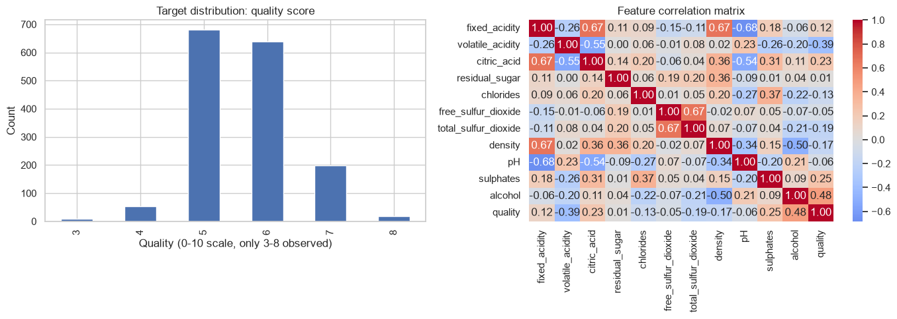
03 EDA and features
Quality distribution and chemistry correlations
Most samples have scores of 5 or 6. Scores of 3 and 8 have little support.
Wine Quality
06 / 63
Notes:
Analysis: wine_quality_tutorial.ipynb.
Figure: figures/notebook/wine_quality/cell_008_figure_1.png
Measured results: run_results/wine_quality_tutorial/results.json.
Notebook cell ID: 058413dc.

Slide 7
03 EDA and features
EDA findings
Quality scores
Most samples have scores of 5 or 6. Scores of 3 and 8 have little support.
Chemistry
Alcohol has a positive fitted association with quality, while volatile acidity has a negative association.
Validation
Repeated chemistry profiles should stay in the same fold. Rare classes need repeated stratified evaluation.
Wine Quality
07 / 63
Notes:
Analysis: wine_quality_tutorial.ipynb.
Measured results: run_results/wine_quality_tutorial/results.json.

Slide 8
03 EDA and features
Feature engineering
Feature group | Predictors
Acidity | Fixed acidity, volatile acidity, citric acid and pH
Composition | Residual sugar, chlorides, density and sulphates
Preservation | Free and total sulfur dioxide
Alcohol | Alcohol percentage
Wine Quality
08 / 63
Notes:
Analysis: wine_quality_tutorial.ipynb.
Measured results: run_results/wine_quality_tutorial/results.json.

Slide 9
04 Validation
Train–test split
Partition
One random 80/20 split with seed 42. Both tasks reuse the same 1,279 training samples and 320 test samples. The split does not stratify quality.
Transforms
Fit feature scaling on training rows, then apply the same transformation to the test partition.
Evaluation
The test partition is separate from the rows used to fit each model.
Wine Quality
09 / 63
Notes:
Analysis: wine_quality_tutorial.ipynb.
Measured results: run_results/wine_quality_tutorial/results.json.

Slide 10
05 Methods
Methods
Family | Models | Role
Linear | OLS, Ridge, Lasso and Elastic Net | Interpretable reference
Local | K-nearest neighbors | Predict from similar records
Neural | Multilayer perceptron | Learn nonlinear relationships
Trees | Random Forest, XGBoost, CatBoost and LightGBM | Learn thresholds and interactions
Ensemble | Stacking of Random Forest, XGBoost and LightGBM | Combine predictions using a fitted meta-model
Wine Quality
10 / 63
Notes:
Analysis: wine_quality_tutorial.ipynb.
Measured results: run_results/wine_quality_tutorial/results.json.

Slide 11
05 Methods
Linear models
Model | Strength | Weakness
OLS | Easy to inspect and use as a baseline | Misses nonlinear effects without added features
Ridge | Stabilizes coefficients when predictors overlap | Keeps all predictors and introduces shrinkage bias
Lasso | Can remove weak predictors with zero coefficients | Can select inconsistently among correlated inputs
Elastic Net | Combines sparse selection with L2 shrinkage | Requires penalty strength and mixing to be selected
Wine Quality
11 / 63
Notes:
Analysis: wine_quality_tutorial.ipynb.
https://scikit-learn.org/stable/modules/linear_model.html
Measured results: run_results/wine_quality_tutorial/results.json.

Slide 12
05 Methods
KNN and neural networks
Model | Strength | Weakness
KNN | Simple local prediction with few modeling assumptions | Distances depend on scaling. Prediction slows as the reference set grows.
MLP | Learns smooth nonlinear effects and interactions | Sensitive to scaling and optimization. Needs regularization and convergence checks.
Wine Quality
12 / 63
Notes:
Analysis: wine_quality_tutorial.ipynb.
Measured results: run_results/wine_quality_tutorial/results.json.

Slide 13
05 Methods
Tree-based models
Model | Strength | Weakness
Random Forest | Averaging many trees reduces variance and captures interactions | Large ensembles use memory and extrapolate poorly
XGBoost | Regularized boosting handles complex tabular relationships | Tree depth, learning rate and tree count need joint selection
CatBoost | Supports categorical features alongside numerical features | Training can be costly. Data quality still limits performance
LightGBM | Histogram splits support efficient training on large tables | Flexible leaf growth can overfit small groups
Wine Quality
13 / 63
Notes:
Analysis: wine_quality_tutorial.ipynb.
Measured results: run_results/wine_quality_tutorial/results.json.

Slide 14
05 Methods
Stacking
Random Forest, XGBoost and LightGBM generate out-of-fold predictions. A Ridge meta-model learns how to combine them.
Strengths
Weaknesses
Can reduce error when the base models make different mistakes. The meta-model learns the weights from training predictions.
Adds fitting and inference cost. Similar base-model errors can limit the gain.
RESULT IN THIS STUDY
RMSE 0.5550 and MAE 0.4284. It has the best observed test score.
Wine Quality
14 / 63
Notes:
Analysis: wine_quality_tutorial.ipynb.
Base models: fitted reference configurations, each cloned and refitted by StackingRegressor/Classifier. cv=2. Meta-model: Ridge(alpha=1.0).
https://scikit-learn.org/stable/modules/ensemble.html#stacking
Measured results: run_results/wine_quality_tutorial/results.json.

Slide 15
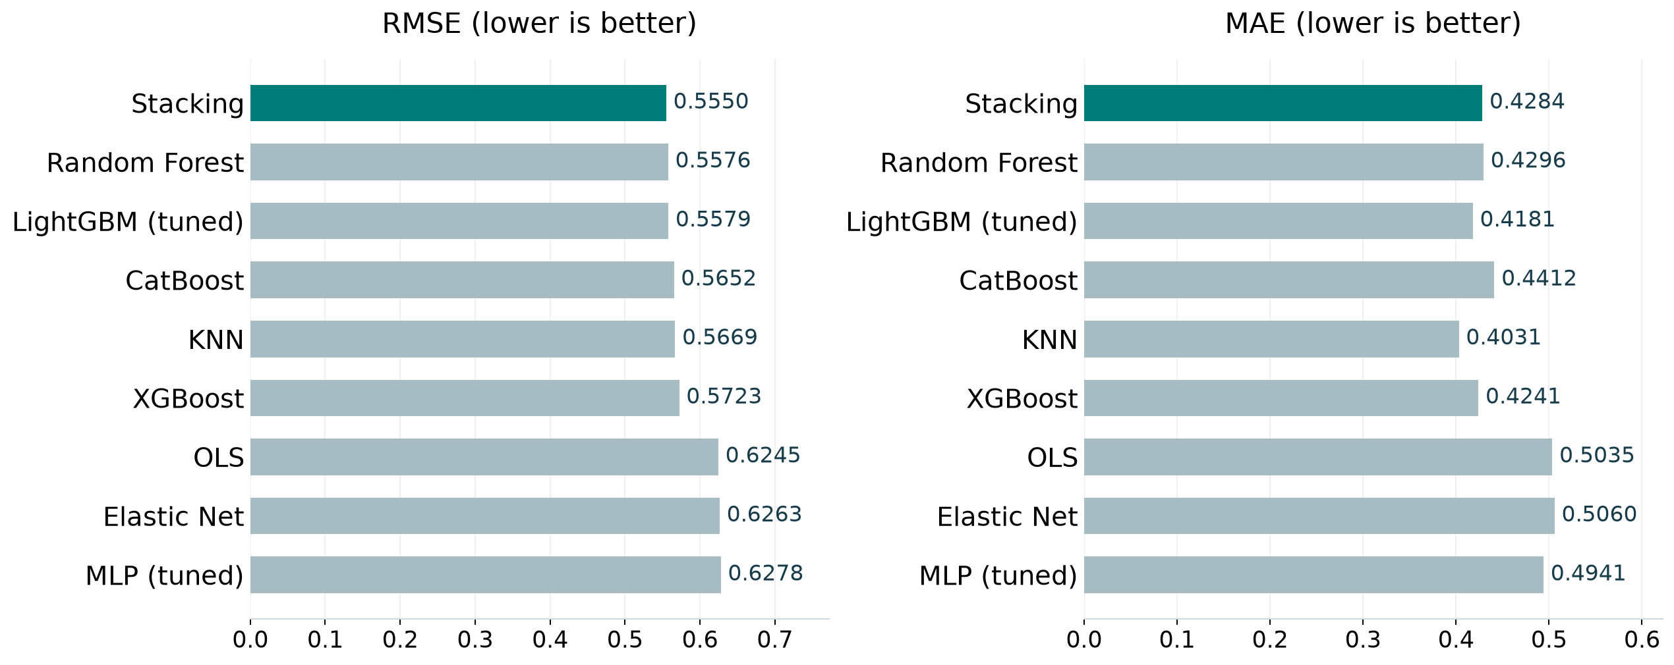
06 Results
Model comparison
Best test score per family, including the strongest penalized linear model. Full results appear in the appendix.
Wine Quality
15 / 63
Notes:
Analysis: wine_quality_tutorial.ipynb.
Figure: figures/wine_quality/comparison.png
Measured results: run_results/wine_quality_tutorial/results.json.

Slide 16
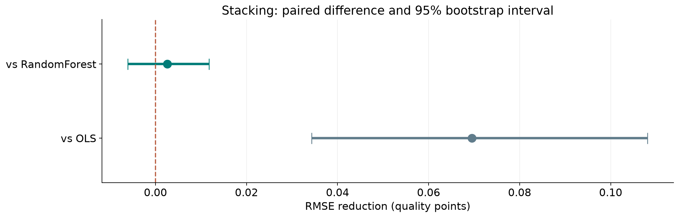
06 Results
Ranking stability
The 95% interval includes zero for Stacking versus Random Forest. Their ordering remains uncertain.
Wine Quality
16 / 63
Notes:
Analysis: wine_quality_tutorial.ipynb.
paired row bootstrap. 1,000 paired resamples. Fitted models remain fixed.
[{"comparison": "Stacking versus RandomForest", "other": "RandomForest", "advantage": 0.0025747180588177043, "ci_low": -0.006052673595425295, "ci_high": 0.0117741256557128}, {"comparison": "Stacking versus OLS", "other": "OLS", "advantage": 0.06952853416013749, "ci_low": 0.034273156825030474, "ci_high": 0.1081055561664954}]
Figure: figures/wine_quality/ranking_stability.png
Measured results: run_results/wine_quality_tutorial/results.json.

Slide 17
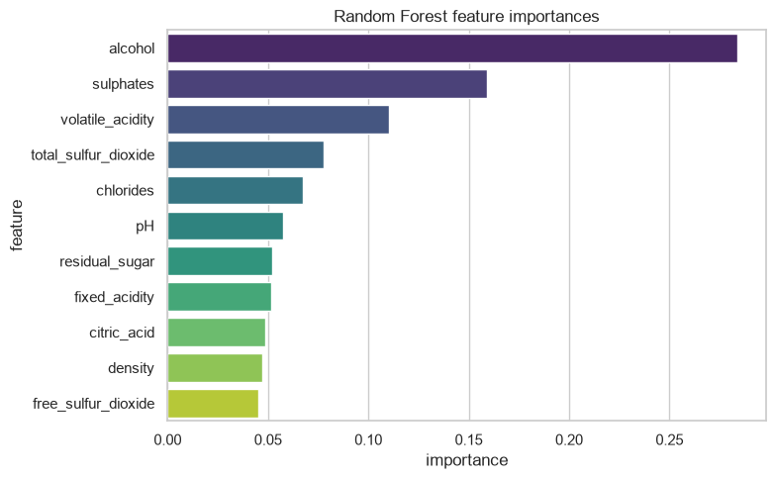
06 Results
Random Forest feature importance
The chemistry measurements overlap. Compare alcohol, acidity and preservation variables as groups as well as individual features.
Wine Quality
17 / 63
Notes:
Analysis: wine_quality_tutorial.ipynb.
Figure: figures/notebook/wine_quality/cell_037_figure_1.png
Measured results: run_results/wine_quality_tutorial/results.json.
Notebook cell ID: ad8d6757.

Slide 18
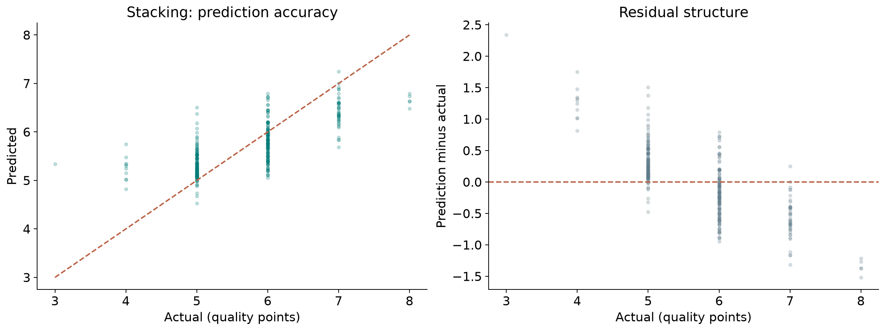
06 Results
Prediction errors
Residual = prediction − actual. Positive residuals indicate overprediction.
Wine Quality
18 / 63
Notes:
Analysis: wine_quality_tutorial.ipynb.
Figure: figures/wine_quality/winner_diagnostics.png
Measured results: run_results/wine_quality_tutorial/results.json.
Diagnostics use Stacking predictions.

Slide 19
06 Results
Simple baselines
Method | RMSE | MAE | R²
Training mean | 0.8107 | 0.6853 | -0.005592
Stacking | 0.5550 | 0.4284 | 0.5287
Same test targets for every row. Error units: quality points.
Wine Quality
19 / 63
Notes:
Analysis: wine_quality_tutorial.ipynb.
Measured results: run_results/wine_quality_tutorial/results.json.

Slide 20
06 Results
Six-class classification
Classes
Predict one quality score from 3 to 8, using the same partition as regression.
Training
Use balanced class or sample weights where supported. KNN is unweighted. Reuse the reference model settings.
Results
XGBoost has macro F1 of 0.3780, accuracy of 67.2% and weighted F1 of 0.6675.
Wine Quality
20 / 63
Notes:
Analysis: wine_quality_tutorial.ipynb.
Measured results: run_results/wine_quality_tutorial/results.json.

Slide 21
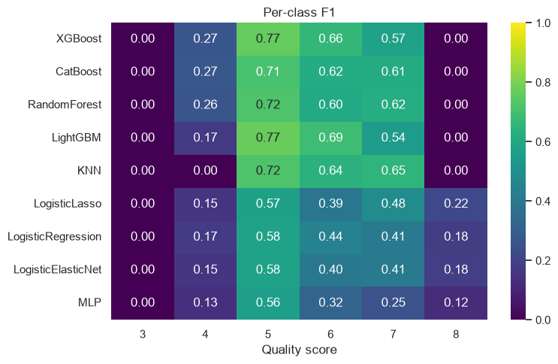
06 Results
F1 by quality score
Wine Quality
21 / 63
Notes:
Analysis: wine_quality_tutorial.ipynb.
Figure: figures/notebook/wine_quality/cell_074_figure_1.png
Measured results: run_results/wine_quality_tutorial/results.json.
Notebook cell ID: e20d52f4.

Slide 22
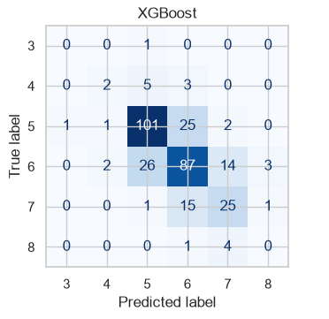
06 Results
XGBoost confusion matrix
Rows show actual classes. Columns show predicted classes.
Wine Quality
22 / 63
Notes:
Analysis: wine_quality_tutorial.ipynb.
Figure: figures/wine_quality/class_confusion.png
Measured results: run_results/wine_quality_tutorial/results.json.

Slide 23
06 Results
Results
Regression
Stacking reaches RMSE 0.5550 and MAE 0.4284. Random Forest is a close, simpler alternative.
Classification
XGBoost reaches macro F1 0.3780 and accuracy 67.2%. LightGBM improves overall accuracy but has lower macro F1.
Model choice
Use regression for score estimation. Test ordinal classification and grouped stratified folds for exact grades.
Wine Quality
23 / 63
Notes:
Analysis: wine_quality_tutorial.ipynb.
Measured results: run_results/wine_quality_tutorial/results.json.
{"Stacking": {"RMSE": 0.5549913966378784, "MAE": 0.4283674207987781, "R2": 0.5286722438316884}, "RandomForest": {"RMSE": 0.5575661146966961, "MAE": 0.4295514580327081, "R2": 0.5242889290154358}, "LightGBM (tuned)": {"RMSE": 0.5578866490737082, "MAE": 0.41807865651687093, "R2": 0.5237418169251732}, "LightGBM": {"RMSE": 0.5636639431482275, "MAE": 0.41176460501695616, "R2": 0.5138267909192634}, "CatBoost": {"RMSE": 0.5652341051949006, "MAE": 0.441229298138325, "R2": 0.5111144160497147}, "CatBoost (tuned)": {"RMSE": 0.5652341051949006, "MAE": 0.441229298138325, "R2": 0.5111144160497147}, "KNN": {"RMSE": 0.5668600516770959, "MAE": 0.4030822272564838, "R2": 0.5082977243774467}, "KNN (tuned)": {"RMSE": 0.5668600516770959, "MAE": 0.4030822272564838, "R2": 0.5082977243774467}, "RandomForest (tuned)": {"RMSE": 0.5687423417739416, "MAE": 0.449496815165997, "R2": 0.5050268537211506}, "XGBoost": {"RMSE": 0.5722901791457304, "MAE": 0.4241098463535309, "R2": 0.49883222579956055}, "XGBoost (tuned)": {"RMSE": 0.5722901791457304, "MAE": 0.4241098463535309, "R2": 0.49883222579956055}, "LinearRegression": {"RMSE": 0.6245199307980159, "MAE": 0.5035304415524378, "R2": 0.4031803412796163}, "ElasticNet": {"RMSE": 0.6262903097990697, "MAE": 0.5059836252337779, "R2": 0.3997918358018322}, "Ridge": {"RMSE": 0.6266550478538917, "MAE": 0.506976912684755, "R2": 0.3990925354880056}, "Lasso": {"RMSE": 0.6269090970078809, "MAE": 0.5077443121373391, "R2": 0.39860521482223843}, "MLP (tuned)": {"RMSE": 0.627826711292709, "MAE": 0.49413862782420787, "R2": 0.3968433889948725}, "MLP": {"RMSE": 0.6309825451975835, "MAE": 0.49573295627367153, "R2": 0.390764494866515}}

Slide 24
07 Conclusion
Limitations
Limitation | Details
Sample size | Only 320 samples are in the test partition.
Rare classes | The test set contains only one sample with quality 3.
Repeated profiles | Identical chemistry profiles may appear in both partitions.
Ordered target | Standard multiclass loss does not distinguish small and large grading errors.
Optimization | L1 and Elastic Net logistic classifiers reached 8,000 iterations without convergence. Their scores remain provisional.
Wine Quality
24 / 63
Notes:
Analysis: wine_quality_tutorial.ipynb.
Measured results: run_results/wine_quality_tutorial/results.json.

Slide 25
07 Conclusion
Next steps
# | Test | Method | Measure
1 | Grouped validation | Keep identical chemistry profiles within the same fold. | Performance without duplicate overlap
2 | Ordinal loss | Compare ordinal classification with regression and multiclass models. | Lower large-score error with useful macro F1
3 | Balanced evaluation | Use repeated stratified folds with enough support for each score. | Per-class uncertainty estimates
4 | Final model | Tune using folds, refit all training rows and reserve an independent test. | One final unbiased comparison
Wine Quality
25 / 63
Notes:
Analysis: wine_quality_tutorial.ipynb.
Measured results: run_results/wine_quality_tutorial/results.json.

Slide 26
07 Conclusion
Conclusion
Stacking leads score estimation
RMSE 0.5550
Random Forest remains a close alternative. XGBoost leads macro F1 for exact grades, while rare-score detection needs further work.
Wine Quality
26 / 63
Notes:
Analysis: wine_quality_tutorial.ipynb.
Measured results: run_results/wine_quality_tutorial/results.json.
{"Stacking": {"RMSE": 0.5549913966378784, "MAE": 0.4283674207987781, "R2": 0.5286722438316884}, "RandomForest": {"RMSE": 0.5575661146966961, "MAE": 0.4295514580327081, "R2": 0.5242889290154358}, "LightGBM (tuned)": {"RMSE": 0.5578866490737082, "MAE": 0.41807865651687093, "R2": 0.5237418169251732}, "LightGBM": {"RMSE": 0.5636639431482275, "MAE": 0.41176460501695616, "R2": 0.5138267909192634}, "CatBoost": {"RMSE": 0.5652341051949006, "MAE": 0.441229298138325, "R2": 0.5111144160497147}, "CatBoost (tuned)": {"RMSE": 0.5652341051949006, "MAE": 0.441229298138325, "R2": 0.5111144160497147}, "KNN": {"RMSE": 0.5668600516770959, "MAE": 0.4030822272564838, "R2": 0.5082977243774467}, "KNN (tuned)": {"RMSE": 0.5668600516770959, "MAE": 0.4030822272564838, "R2": 0.5082977243774467}, "RandomForest (tuned)": {"RMSE": 0.5687423417739416, "MAE": 0.449496815165997, "R2": 0.5050268537211506}, "XGBoost": {"RMSE": 0.5722901791457304, "MAE": 0.4241098463535309, "R2": 0.49883222579956055}, "XGBoost (tuned)": {"RMSE": 0.5722901791457304, "MAE": 0.4241098463535309, "R2": 0.49883222579956055}, "LinearRegression": {"RMSE": 0.6245199307980159, "MAE": 0.5035304415524378, "R2": 0.4031803412796163}, "ElasticNet": {"RMSE": 0.6262903097990697, "MAE": 0.5059836252337779, "R2": 0.3997918358018322}, "Ridge": {"RMSE": 0.6266550478538917, "MAE": 0.506976912684755, "R2": 0.3990925354880056}, "Lasso": {"RMSE": 0.6269090970078809, "MAE": 0.5077443121373391, "R2": 0.39860521482223843}, "MLP (tuned)": {"RMSE": 0.627826711292709, "MAE": 0.49413862782420787, "R2": 0.3968433889948725}, "MLP": {"RMSE": 0.6309825451975835, "MAE": 0.49573295627367153, "R2": 0.390764494866515}}

Slide 27
08 Appendix
Evaluation metrics
Metric | Meaning | Role
RMSE / MAE | Numerical score error | Regression comparison
Macro F1 | Equal weight for each quality class | Classification comparison
Per-class recall | Share of each class detected | Rare-score assessment
Accuracy | Share of exact grades predicted correctly | Overall grading accuracy
Wine Quality
27 / 63
Notes:
Analysis: wine_quality_tutorial.ipynb.
Measured results: run_results/wine_quality_tutorial/results.json.

Slide 28
08 Appendix
Regularization
Model | Objective | Main effect
OLS | Squared error | Fits an additive linear relationship
Ridge | Squared error + L2 penalty | Shrinks correlated coefficients
Lasso | Squared error + L1 penalty | Can set coefficients to zero
Elastic Net | Squared error + L1 and L2 penalties | Combines sparsity and shrinkage
Wine Quality
28 / 63
Notes:
Analysis: wine_quality_tutorial.ipynb.
https://scikit-learn.org/stable/modules/linear_model.html
Measured results: run_results/wine_quality_tutorial/results.json.

Slide 29
08 Appendix
Linear model results
Model | RMSE | MAE | R²
OLS | 0.6245 | 0.5035 | 0.4032
Ridge | 0.6267 | 0.5070 | 0.3991
Lasso | 0.6269 | 0.5077 | 0.3986
Elastic Net | 0.6263 | 0.5060 | 0.3998
Wine Quality
29 / 63
Notes:
Analysis: wine_quality_tutorial.ipynb.
Measured results: run_results/wine_quality_tutorial/results.json.
{"Stacking": {"RMSE": 0.5549913966378784, "MAE": 0.4283674207987781, "R2": 0.5286722438316884}, "RandomForest": {"RMSE": 0.5575661146966961, "MAE": 0.4295514580327081, "R2": 0.5242889290154358}, "LightGBM (tuned)": {"RMSE": 0.5578866490737082, "MAE": 0.41807865651687093, "R2": 0.5237418169251732}, "LightGBM": {"RMSE": 0.5636639431482275, "MAE": 0.41176460501695616, "R2": 0.5138267909192634}, "CatBoost": {"RMSE": 0.5652341051949006, "MAE": 0.441229298138325, "R2": 0.5111144160497147}, "CatBoost (tuned)": {"RMSE": 0.5652341051949006, "MAE": 0.441229298138325, "R2": 0.5111144160497147}, "KNN": {"RMSE": 0.5668600516770959, "MAE": 0.4030822272564838, "R2": 0.5082977243774467}, "KNN (tuned)": {"RMSE": 0.5668600516770959, "MAE": 0.4030822272564838, "R2": 0.5082977243774467}, "RandomForest (tuned)": {"RMSE": 0.5687423417739416, "MAE": 0.449496815165997, "R2": 0.5050268537211506}, "XGBoost": {"RMSE": 0.5722901791457304, "MAE": 0.4241098463535309, "R2": 0.49883222579956055}, "XGBoost (tuned)": {"RMSE": 0.5722901791457304, "MAE": 0.4241098463535309, "R2": 0.49883222579956055}, "LinearRegression": {"RMSE": 0.6245199307980159, "MAE": 0.5035304415524378, "R2": 0.4031803412796163}, "ElasticNet": {"RMSE": 0.6262903097990697, "MAE": 0.5059836252337779, "R2": 0.3997918358018322}, "Ridge": {"RMSE": 0.6266550478538917, "MAE": 0.506976912684755, "R2": 0.3990925354880056}, "Lasso": {"RMSE": 0.6269090970078809, "MAE": 0.5077443121373391, "R2": 0.39860521482223843}, "MLP (tuned)": {"RMSE": 0.627826711292709, "MAE": 0.49413862782420787, "R2": 0.3968433889948725}, "MLP": {"RMSE": 0.6309825451975835, "MAE": 0.49573295627367153, "R2": 0.390764494866515}}

Slide 30
08 Appendix
Linear model discussion
Results
OLS has RMSE 0.6245. Ridge, Lasso and Elastic Net are all close to this error level.
Interpretation
Alcohol and acidity relate to quality, while correlated chemistry measurements make individual coefficients less stable.
Further work
Compare penalties with chemistry-profile groups kept together. Check whether the small score differences persist.
Wine Quality
30 / 63
Notes:
Analysis: wine_quality_tutorial.ipynb.
https://scikit-learn.org/stable/modules/linear_model.html
Measured results: run_results/wine_quality_tutorial/results.json.

Slide 31
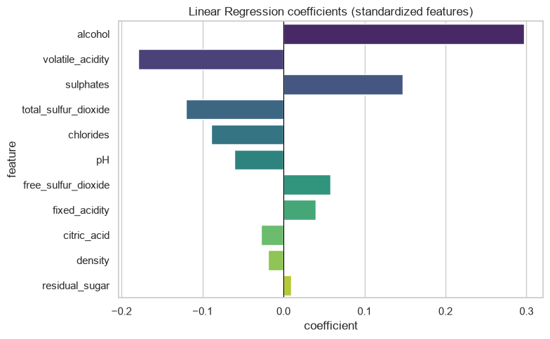
08 Appendix
Linear coefficients
Coefficients describe fitted associations after accounting for the other encoded inputs.
Wine Quality
31 / 63
Notes:
Analysis: wine_quality_tutorial.ipynb.
Figure: figures/notebook/wine_quality/cell_015_figure_1.png
Measured results: run_results/wine_quality_tutorial/results.json.
Notebook cell ID: e3594128.

Slide 32
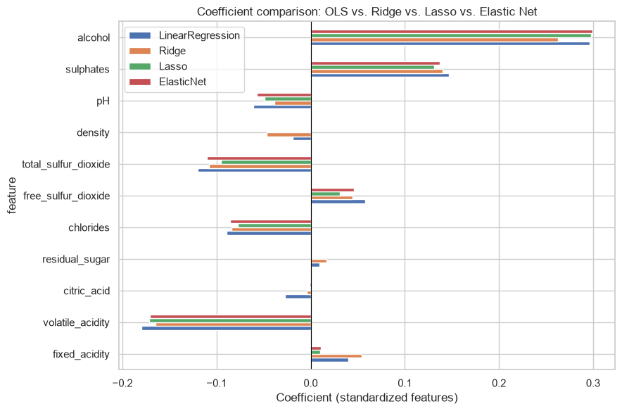
08 Appendix
Regularized coefficients
Coefficients describe fitted associations after accounting for the other encoded inputs.
Wine Quality
32 / 63
Notes:
Analysis: wine_quality_tutorial.ipynb.
Figure: figures/notebook/wine_quality/cell_022_figure_1.png
Measured results: run_results/wine_quality_tutorial/results.json.
Notebook cell ID: 3d9bb664.

Slide 33
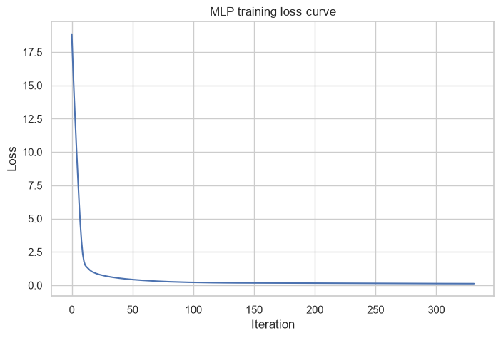
08 Appendix
MLP training loss
Training loss by optimization iteration.
Wine Quality
33 / 63
Notes:
Analysis: wine_quality_tutorial.ipynb.
Figure: figures/notebook/wine_quality/cell_031_figure_1.png
Measured results: run_results/wine_quality_tutorial/results.json.
Notebook cell ID: 12f6e4cf.

Slide 34
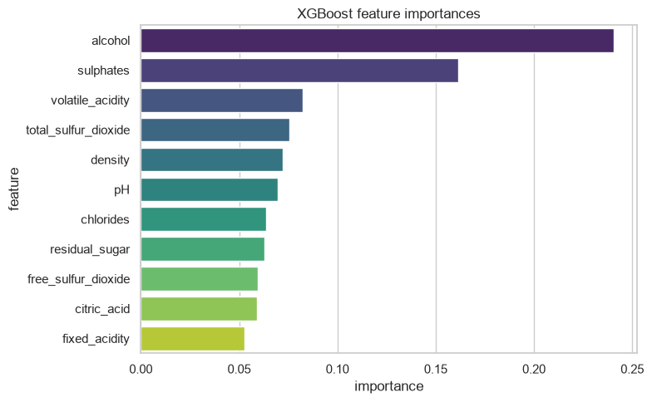
08 Appendix
XGBoost feature importance
The chemistry measurements overlap. Compare alcohol, acidity and preservation variables as groups as well as individual features.
Wine Quality
34 / 63
Notes:
Analysis: wine_quality_tutorial.ipynb.
Figure: figures/notebook/wine_quality/cell_043_figure_1.png
Measured results: run_results/wine_quality_tutorial/results.json.
Notebook cell ID: 664a6845.

Slide 35
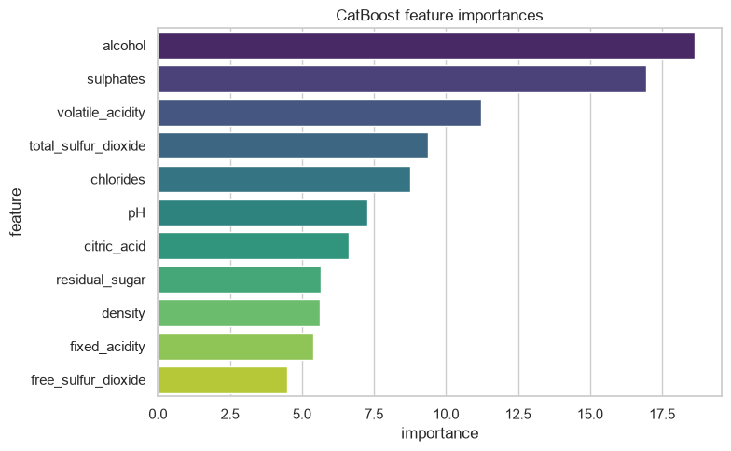
08 Appendix
CatBoost feature importance
The chemistry measurements overlap. Compare alcohol, acidity and preservation variables as groups as well as individual features.
Wine Quality
35 / 63
Notes:
Analysis: wine_quality_tutorial.ipynb.
Figure: figures/notebook/wine_quality/cell_049_figure_1.png
Measured results: run_results/wine_quality_tutorial/results.json.
Notebook cell ID: adb31f0d.

Slide 36
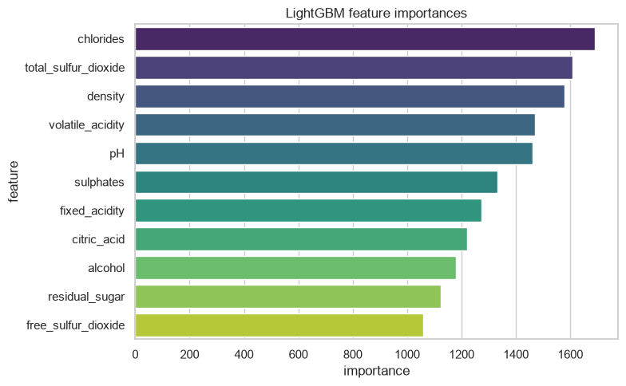
08 Appendix
LightGBM feature importance
The chemistry measurements overlap. Compare alcohol, acidity and preservation variables as groups as well as individual features.
Wine Quality
36 / 63
Notes:
Analysis: wine_quality_tutorial.ipynb.
Figure: figures/notebook/wine_quality/cell_055_figure_1.png
Measured results: run_results/wine_quality_tutorial/results.json.
Notebook cell ID: 0d4d7a94.

Slide 37
08 Appendix
Error by target range
Test target band | Rows | MAE | Mean prediction error
Q1: (2.999, 5.0] | 141 | 0.4155 | 0.3956
Q2: (5.0, 6.0] | 132 | 0.3567 | -0.2017
Q3: (6.0, 8.0] | 47 | 0.6684 | -0.6578
Errors for Stacking. Mean error = prediction − actual. Units: quality points.
Wine Quality
37 / 63
Notes:
Analysis: wine_quality_tutorial.ipynb.
Measured results: run_results/wine_quality_tutorial/results.json.

Slide 38
08 Appendix
Application
Topic | Application
Score estimation | Continuous predictions support screening and prioritizing expert review.
Exact grading | A classifier must choose an observed score. Adjacent-score errors still count as classification errors.
Rare scores | Extreme grades need more validation data before automated decisions.
Wine Quality
38 / 63
Notes:
Analysis: wine_quality_tutorial.ipynb.
Measured results: run_results/wine_quality_tutorial/results.json.

Slide 39
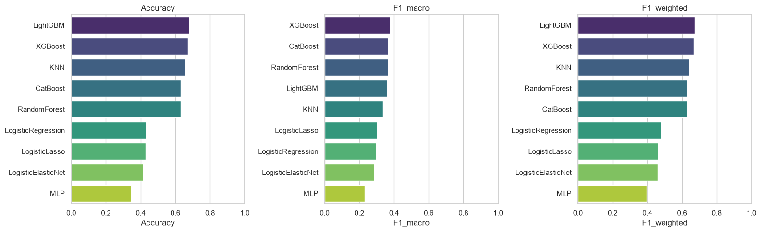
08 Appendix
Six-class model comparison
Wine Quality
39 / 63
Notes:
Analysis: wine_quality_tutorial.ipynb.
Figure: figures/notebook/wine_quality/cell_073_figure_1.png
Measured results: run_results/wine_quality_tutorial/results.json.
Notebook cell ID: e74127a8.

Slide 40
08 Appendix
Per-class quality performance
Classifier | 3 | 4 | 5 | 6 | 7 | 8
XGBoost | 0.000 | 0.267 | 0.765 | 0.662 | 0.575 | 0.000
CatBoost | 0.000 | 0.273 | 0.708 | 0.615 | 0.610 | 0.000
Random Forest | 0.000 | 0.261 | 0.721 | 0.603 | 0.618 | 0.000
LightGBM | 0.000 | 0.167 | 0.769 | 0.688 | 0.543 | 0.000
KNN | 0.000 | 0.000 | 0.722 | 0.640 | 0.651 | 0.000
L1 logistic | 0.000 | 0.154 | 0.567 | 0.392 | 0.481 | 0.222
L2 logistic | 0.000 | 0.172 | 0.578 | 0.444 | 0.409 | 0.178
Elastic Net logistic | 0.000 | 0.154 | 0.575 | 0.402 | 0.409 | 0.182
MLP | 0.000 | 0.133 | 0.558 | 0.319 | 0.250 | 0.122
Per-class F1. L1 and Elastic Net logistic results remain provisional because the solver did not converge.
Wine Quality
40 / 63
Notes:
Analysis: wine_quality_tutorial.ipynb.
Measured results: run_results/wine_quality_tutorial/results.json.

Slide 41
08 Appendix
Class distribution by partition
Quality | Training bottles | Test bottles
3 | 9 | 1
4 | 43 | 10
5 | 551 | 130
6 | 506 | 132
7 | 157 | 42
8 | 13 | 5
Wine Quality
41 / 63
Notes:
Analysis: wine_quality_tutorial.ipynb.
Measured results: run_results/wine_quality_tutorial/results.json.

Slide 42
08 Appendix
Model selection Q&A
Why include penalized linear models?
Ridge uses L2 shrinkage to stabilize coefficients. Lasso uses L1 to encourage zeros. Elastic Net combines the penalties. Logistic models use the same penalty types for classification.
Why standardize the predictors?
Penalties and distance calculations depend on feature units. Scaling also helps neural-network optimization. Estimate the scaling parameters from training data.
Why include stacking?
It has the best observed score here. Combining models helps only when their errors are sufficiently different. Compare its gain with inference and maintenance cost.
Wine Quality
42 / 63
Notes:
Analysis: wine_quality_tutorial.ipynb.
https://scikit-learn.org/stable/modules/linear_model.html
https://scikit-learn.org/stable/modules/neighbors.html
https://scikit-learn.org/stable/modules/neural_networks_supervised.html
Measured results: run_results/wine_quality_tutorial/results.json.

Slide 43
08 Appendix
Model interpretation Q&A
How do forests and boosting differ?
Random Forest averages trees trained with randomized rows and features. Boosting adds trees sequentially to reduce the chosen loss.
What does feature importance mean?
It describes how the fitted model uses its inputs. Related predictors can share importance. A high value does not establish a causal effect.
What do the resampling intervals cover?
They measure variation in the available test predictions with the fitted models fixed. A new split also tests sensitivity to training and model selection.
Wine Quality
43 / 63
Notes:
Analysis: wine_quality_tutorial.ipynb.
https://scikit-learn.org/stable/modules/ensemble.html
https://xgboost.readthedocs.io/en/stable/tutorials/model.html
Measured results: run_results/wine_quality_tutorial/results.json.

Slide 44
08 Appendix
Data Q&A
Why use regression and classification?
Regression estimates a numerical score. Classification predicts an exact observed grade and shows which grades the model misses.
Why report macro F1?
Macro F1 gives every quality class equal weight. Accuracy is more influenced by the common scores of 5 and 6.
Wine Quality
44 / 63
Notes:
Analysis: wine_quality_tutorial.ipynb.
Measured results: run_results/wine_quality_tutorial/results.json.

Slide 45
08 Appendix
Results Q&A
What does a prediction of 5.4 mean?
It is a continuous score estimate. Rounding it creates a separate grading rule that needs its own evaluation.
Can we trust performance on quality 3?
The test set contains one example. More rare-score data and repeated stratified evaluation are needed for a useful estimate.
Wine Quality
45 / 63
Notes:
Analysis: wine_quality_tutorial.ipynb.
Measured results: run_results/wine_quality_tutorial/results.json.

Slide 46
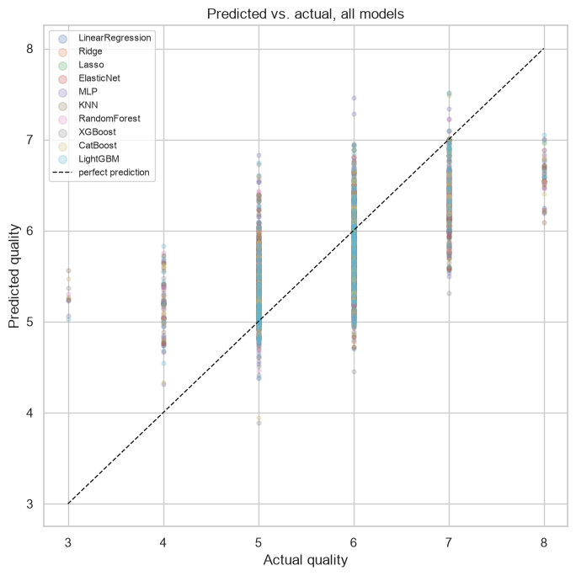
08 Appendix
Actual and predicted quality scores
Actual outcomes and predictions on the test partition.
Wine Quality
46 / 63
Notes:
Analysis: wine_quality_tutorial.ipynb.
Figure: figures/notebook/wine_quality/cell_062_figure_1.png
Measured results: run_results/wine_quality_tutorial/results.json.
Notebook cell ID: 2d26e3e2.

Slide 47
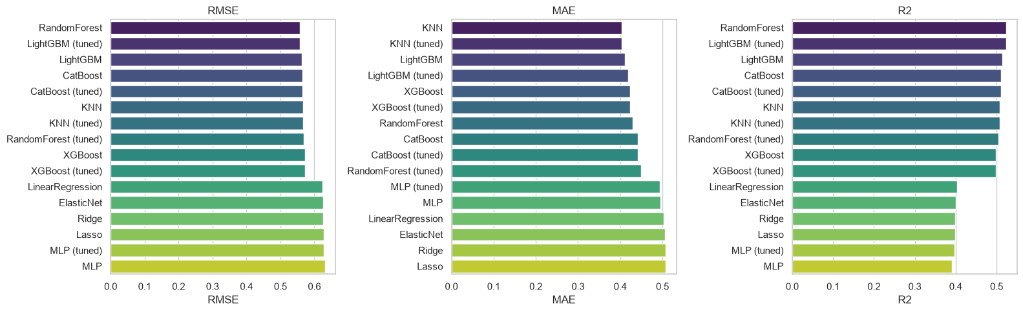
08 Appendix
Individual model metrics
Notebook comparison of individual models. The full results tables also include stacking.
Wine Quality
47 / 63
Notes:
Analysis: wine_quality_tutorial.ipynb.
Figure: figures/notebook/wine_quality/cell_061_figure_1.png
Measured results: run_results/wine_quality_tutorial/results.json.
Notebook cell ID: 8a197887.

Slide 48
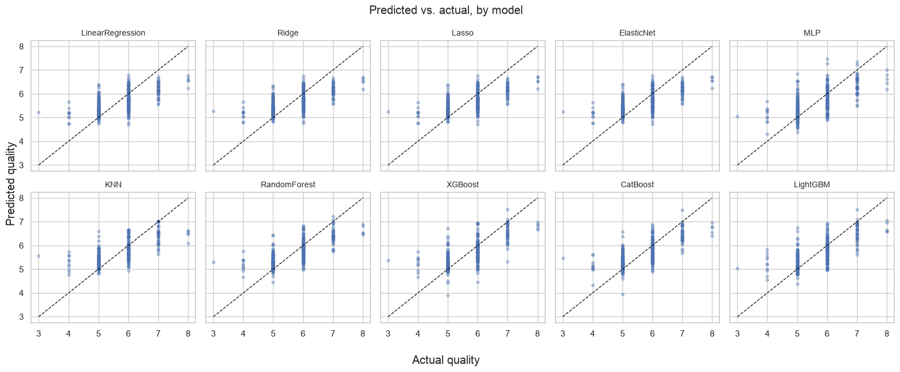
08 Appendix
All regression predictions
Actual outcomes and predictions on the test partition.
Wine Quality
48 / 63
Notes:
Analysis: wine_quality_tutorial.ipynb.
Figure: figures/notebook/wine_quality/cell_063_figure_1.png
Measured results: run_results/wine_quality_tutorial/results.json.
Notebook cell ID: 7d76e260.

Slide 49
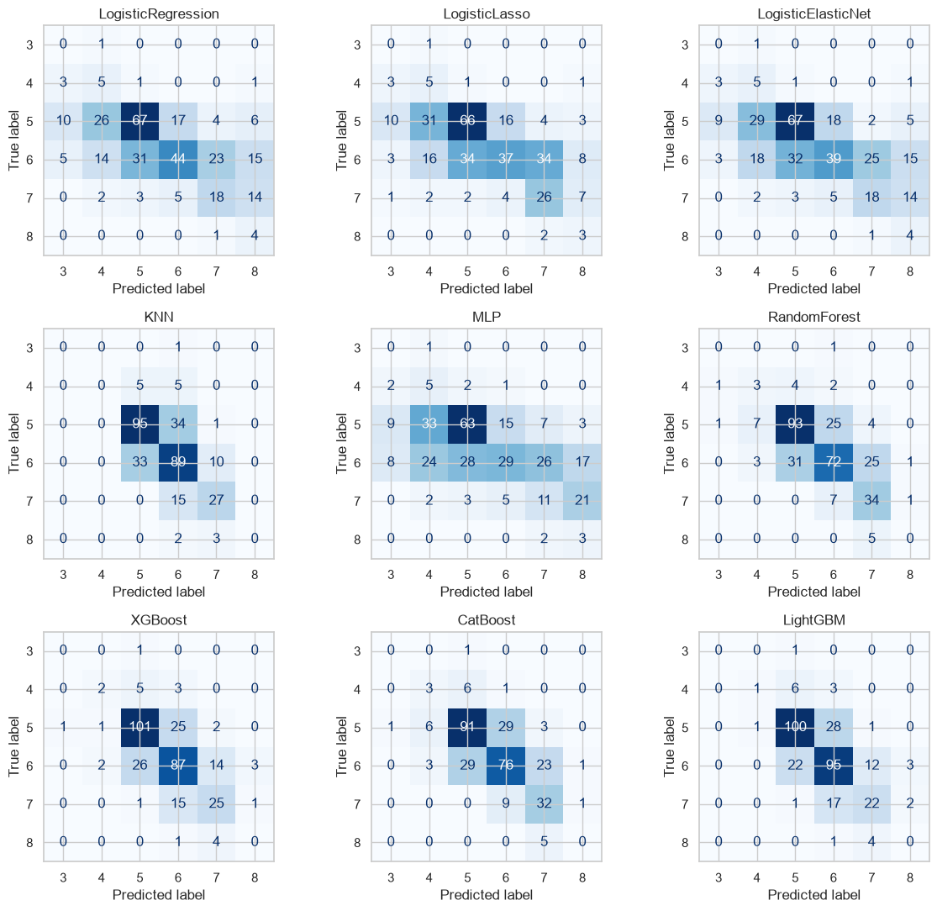
08 Appendix
All classification errors
Wine Quality
49 / 63
Notes:
Analysis: wine_quality_tutorial.ipynb.
Figure: figures/notebook/wine_quality/cell_075_figure_1.png
Measured results: run_results/wine_quality_tutorial/results.json.
Notebook cell ID: 57faadd1.

Slide 50
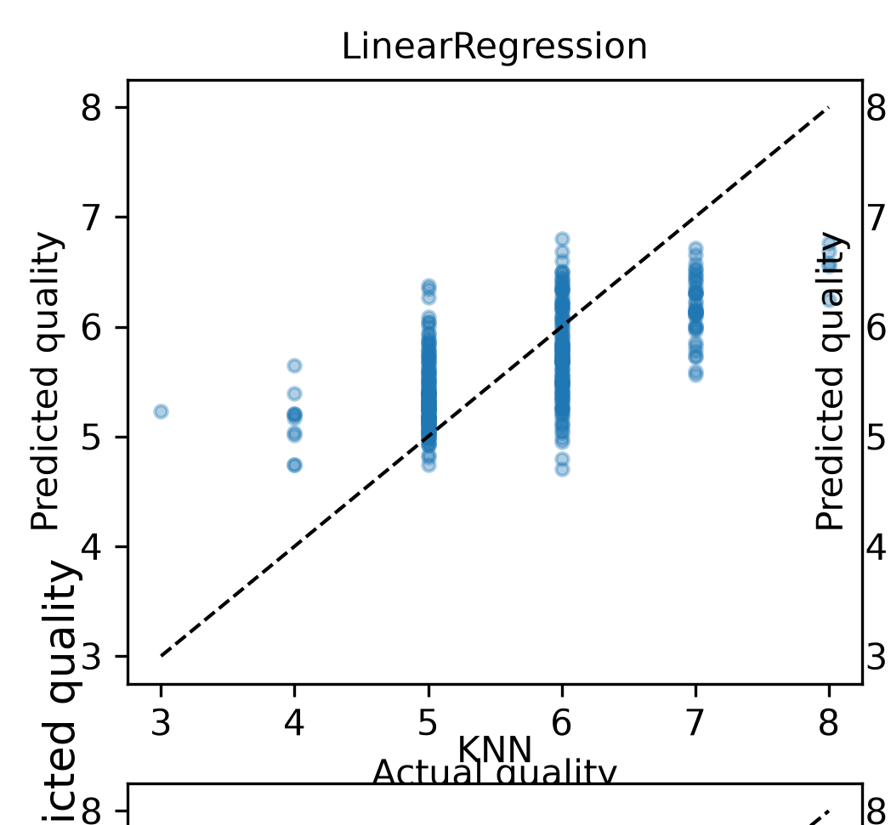
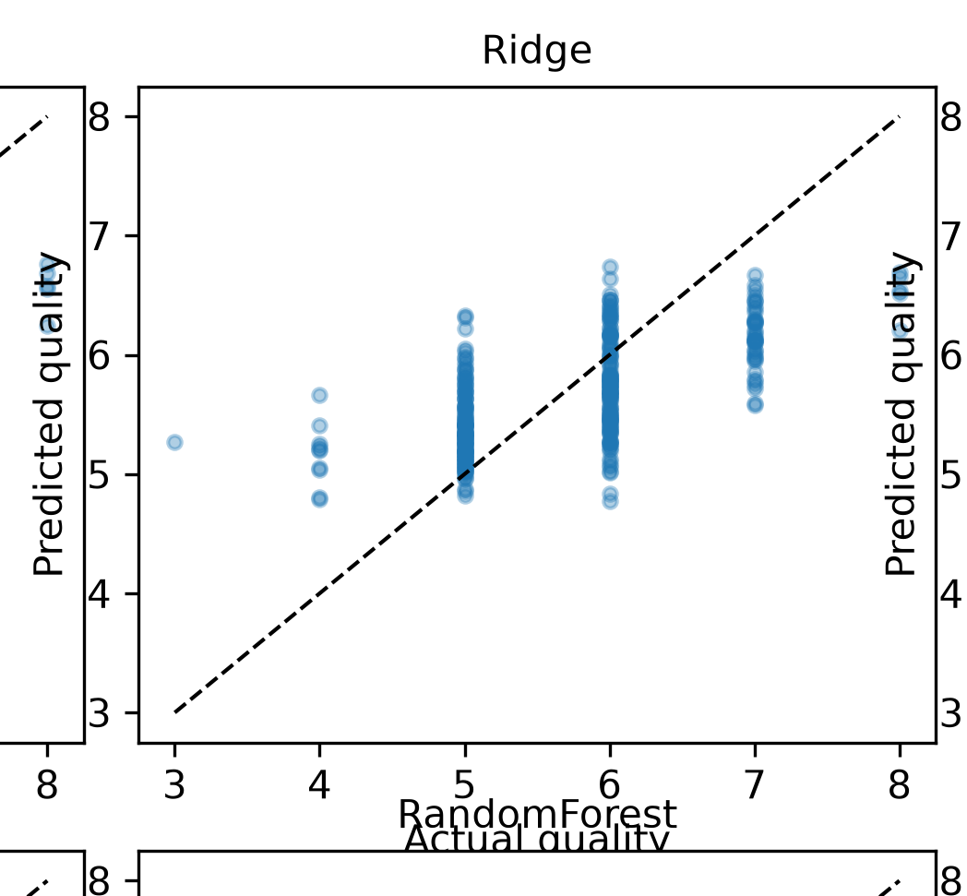
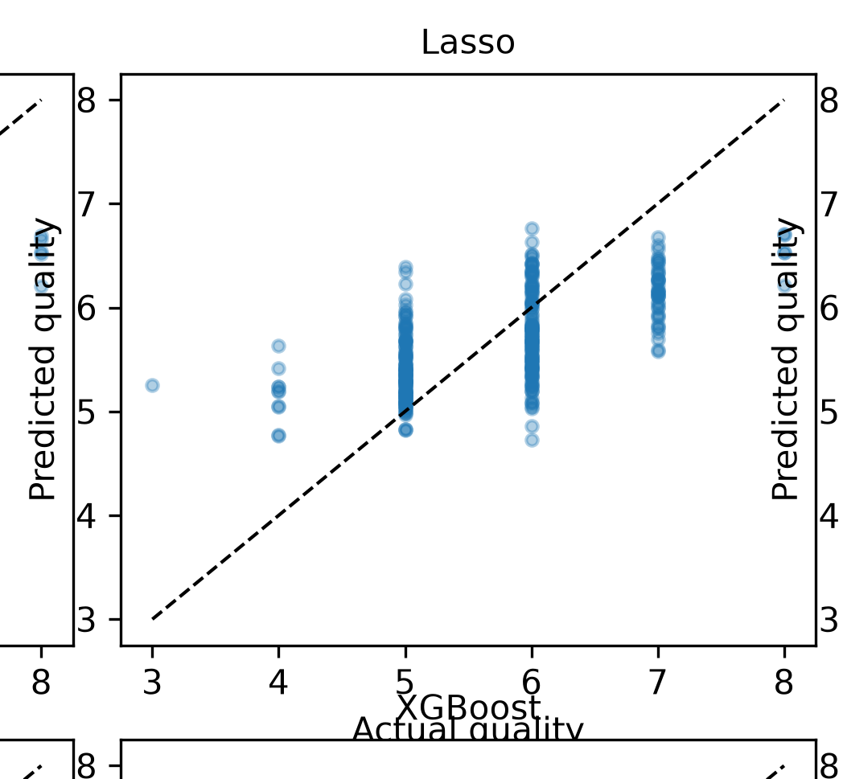
08 Appendix
Regression predictions (1 of 4)
Models shown: LinearRegression, Ridge, Lasso.
Wine Quality
50 / 63
Notes:
Analysis: wine_quality_tutorial.ipynb.
Measured results: run_results/wine_quality_tutorial/results.json.
Panels: figures/panels/wine_quality/regression_01.png, figures/panels/wine_quality/regression_02.png, figures/panels/wine_quality/regression_03.png

Slide 51
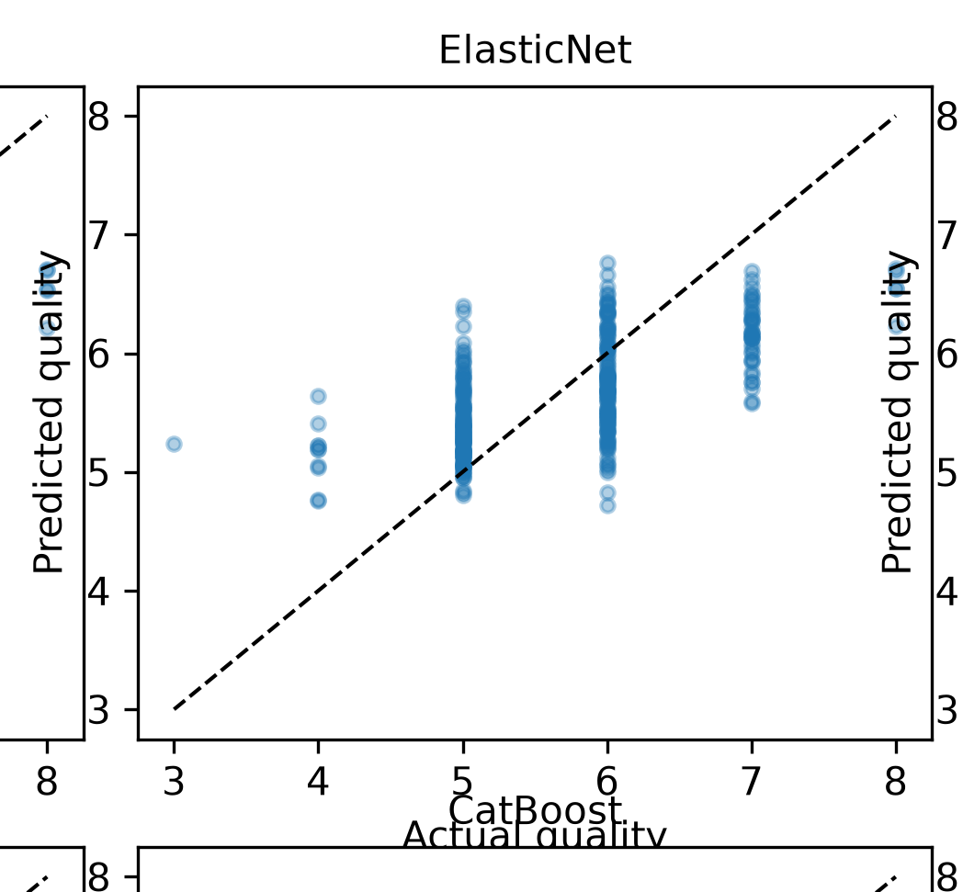
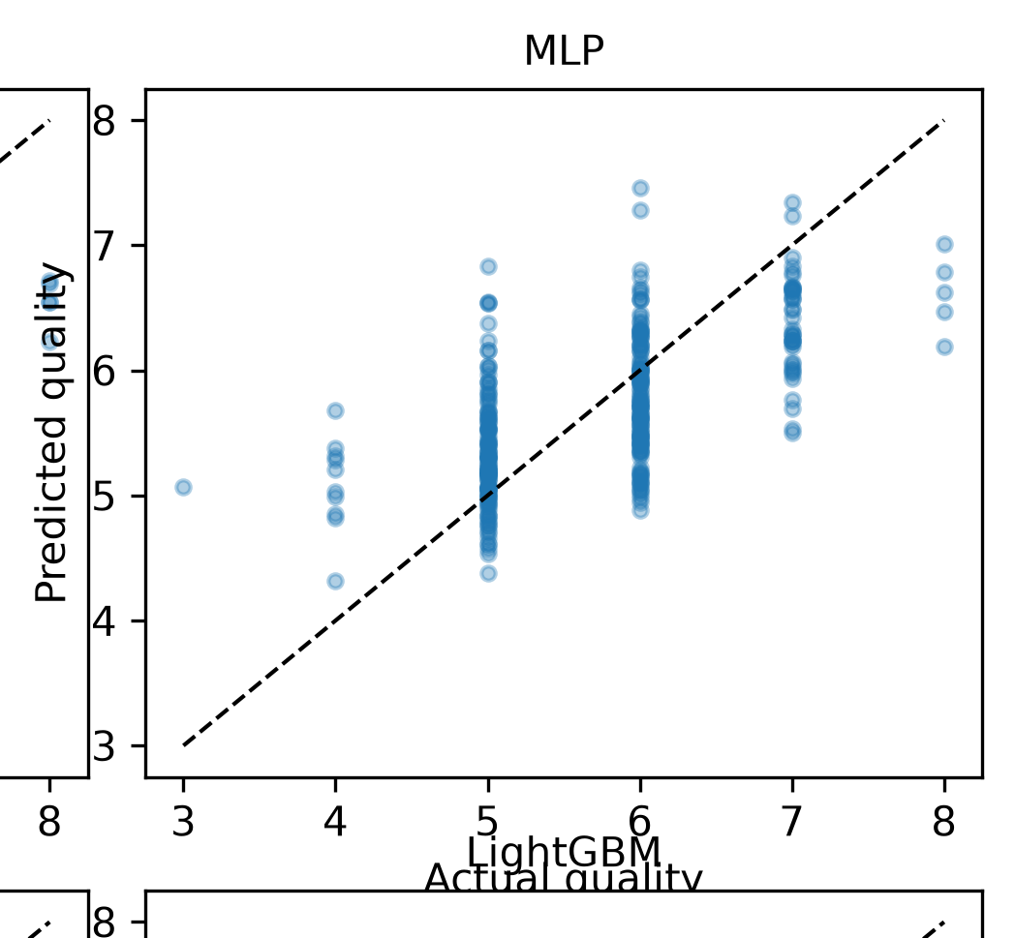
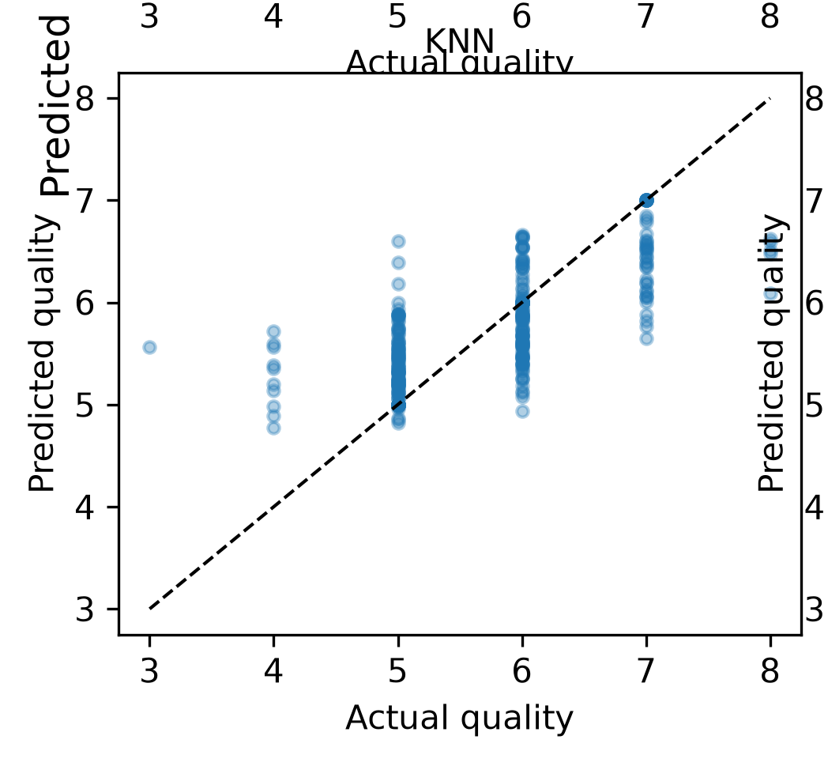
08 Appendix
Regression predictions (2 of 4)
Models shown: ElasticNet, MLP, KNN.
Wine Quality
51 / 63
Notes:
Analysis: wine_quality_tutorial.ipynb.
Measured results: run_results/wine_quality_tutorial/results.json.
Panels: figures/panels/wine_quality/regression_04.png, figures/panels/wine_quality/regression_05.png, figures/panels/wine_quality/regression_06.png

Slide 52
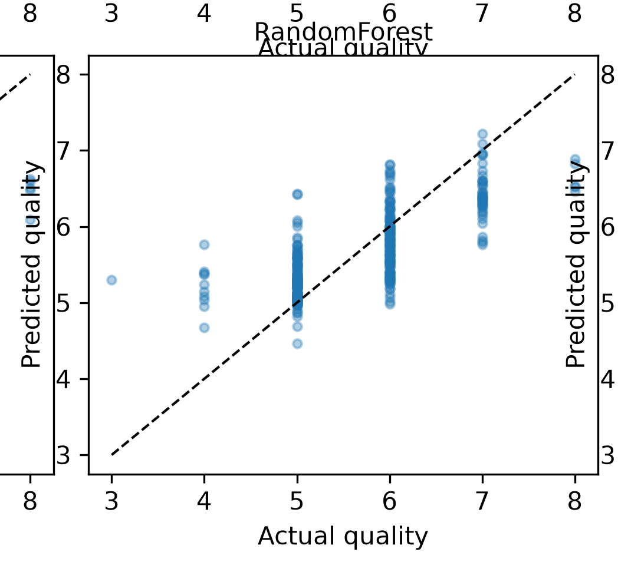
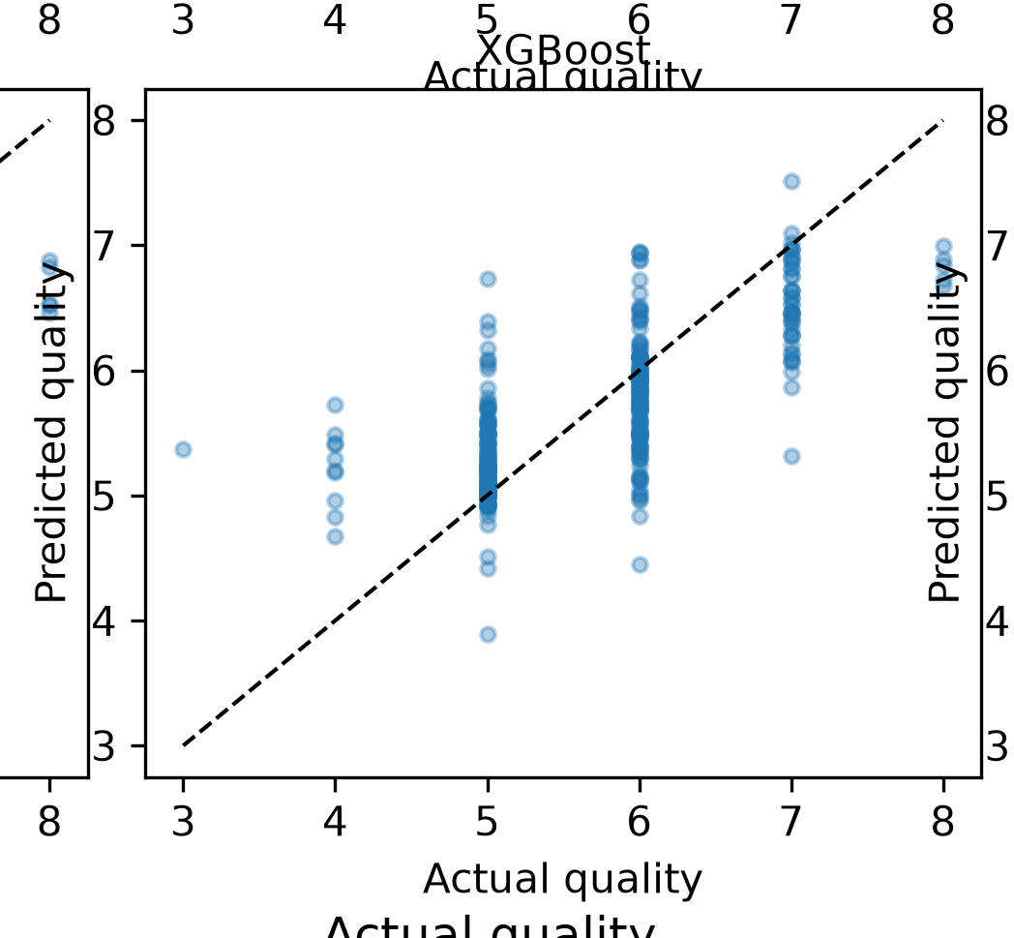
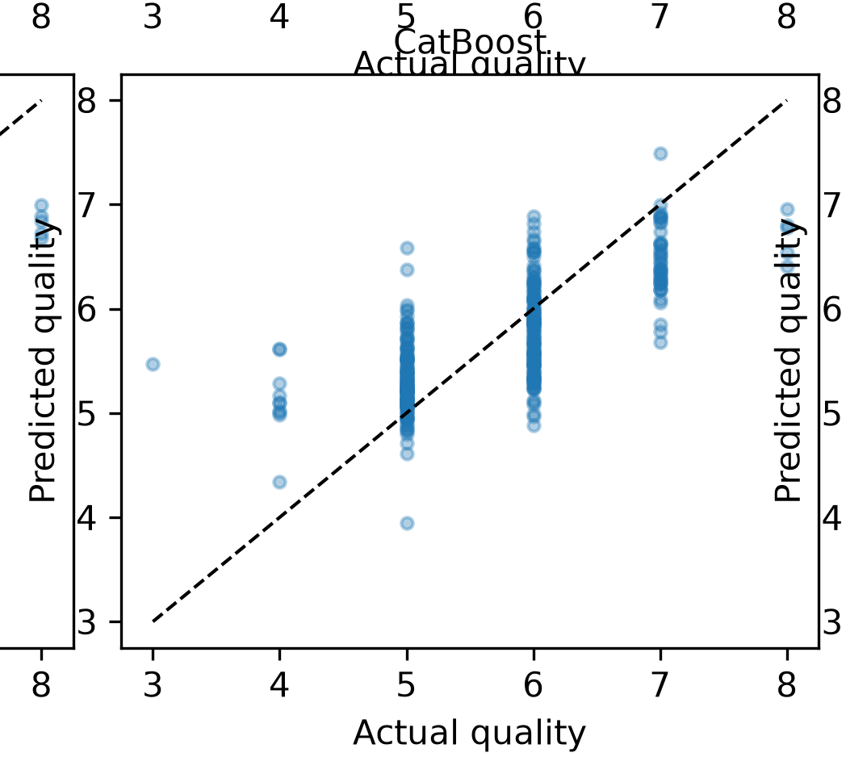
08 Appendix
Regression predictions (3 of 4)
Models shown: RandomForest, XGBoost, CatBoost.
Wine Quality
52 / 63
Notes:
Analysis: wine_quality_tutorial.ipynb.
Measured results: run_results/wine_quality_tutorial/results.json.
Panels: figures/panels/wine_quality/regression_07.png, figures/panels/wine_quality/regression_08.png, figures/panels/wine_quality/regression_09.png

Slide 53
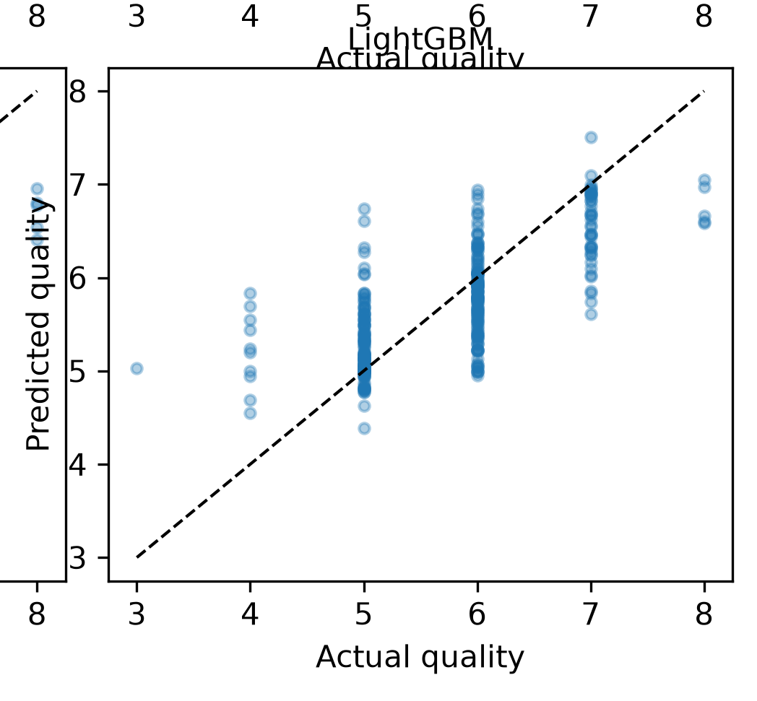
08 Appendix
Regression predictions (4 of 4)
Models shown: LightGBM.
Wine Quality
53 / 63
Notes:
Analysis: wine_quality_tutorial.ipynb.
Measured results: run_results/wine_quality_tutorial/results.json.
Panels: figures/panels/wine_quality/regression_10.png

Slide 54
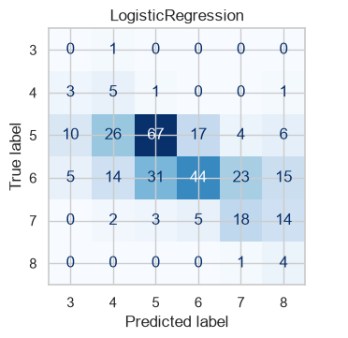
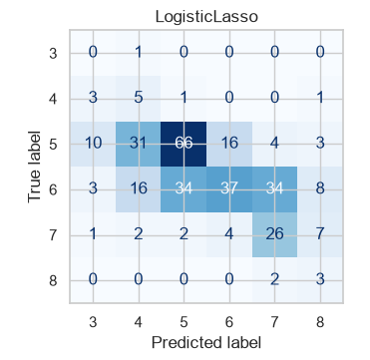
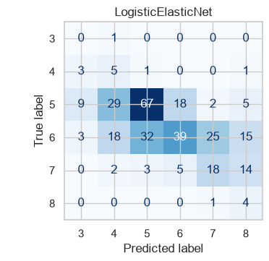
08 Appendix
Classification confusion matrices (1 of 3)
Models shown: LogisticRegression, LogisticLasso, LogisticElasticNet.
Wine Quality
54 / 63
Notes:
Analysis: wine_quality_tutorial.ipynb.
Measured results: run_results/wine_quality_tutorial/results.json.
Panels: figures/panels/wine_quality/classification_01.png, figures/panels/wine_quality/classification_02.png, figures/panels/wine_quality/classification_03.png

Slide 55
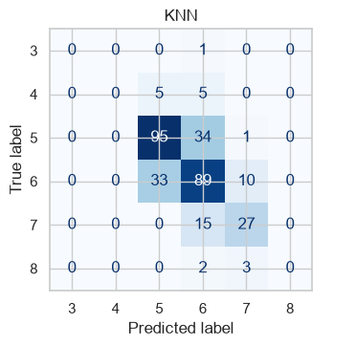
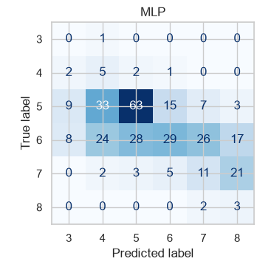
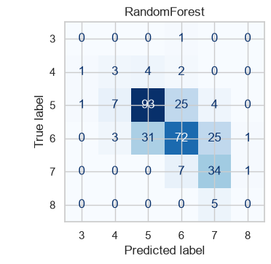
08 Appendix
Classification confusion matrices (2 of 3)
Models shown: KNN, MLP, RandomForest.
Wine Quality
55 / 63
Notes:
Analysis: wine_quality_tutorial.ipynb.
Measured results: run_results/wine_quality_tutorial/results.json.
Panels: figures/panels/wine_quality/classification_04.png, figures/panels/wine_quality/classification_05.png, figures/panels/wine_quality/classification_06.png

Slide 56
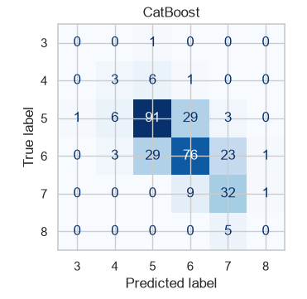
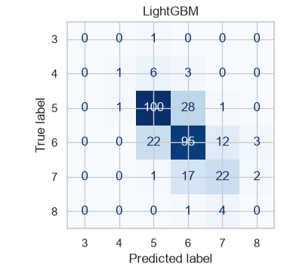
08 Appendix
Classification confusion matrices (3 of 3)
Models shown: XGBoost, CatBoost, LightGBM.
Wine Quality
56 / 63
Notes:
Analysis: wine_quality_tutorial.ipynb.
Measured results: run_results/wine_quality_tutorial/results.json.
Panels: figures/panels/wine_quality/classification_07.png, figures/panels/wine_quality/classification_08.png, figures/panels/wine_quality/classification_09.png

Slide 57
08 Appendix
Full results (1 of 2)
Model | RMSE | MAE | R²
Stacking | 0.5550 | 0.4284 | 0.5287
Random Forest | 0.5576 | 0.4296 | 0.5243
LightGBM (tuned) | 0.5579 | 0.4181 | 0.5237
LightGBM | 0.5637 | 0.4118 | 0.5138
CatBoost | 0.5652 | 0.4412 | 0.5111
CatBoost (tuned) | 0.5652 | 0.4412 | 0.5111
KNN | 0.5669 | 0.4031 | 0.5083
KNN (tuned) | 0.5669 | 0.4031 | 0.5083
Forest (tuned) | 0.5687 | 0.4495 | 0.5050
Wine Quality
57 / 63
Notes:
Analysis: wine_quality_tutorial.ipynb.
Measured results: run_results/wine_quality_tutorial/results.json.
{"Stacking": {"RMSE": 0.5549913966378784, "MAE": 0.4283674207987781, "R2": 0.5286722438316884}, "RandomForest": {"RMSE": 0.5575661146966961, "MAE": 0.4295514580327081, "R2": 0.5242889290154358}, "LightGBM (tuned)": {"RMSE": 0.5578866490737082, "MAE": 0.41807865651687093, "R2": 0.5237418169251732}, "LightGBM": {"RMSE": 0.5636639431482275, "MAE": 0.41176460501695616, "R2": 0.5138267909192634}, "CatBoost": {"RMSE": 0.5652341051949006, "MAE": 0.441229298138325, "R2": 0.5111144160497147}, "CatBoost (tuned)": {"RMSE": 0.5652341051949006, "MAE": 0.441229298138325, "R2": 0.5111144160497147}, "KNN": {"RMSE": 0.5668600516770959, "MAE": 0.4030822272564838, "R2": 0.5082977243774467}, "KNN (tuned)": {"RMSE": 0.5668600516770959, "MAE": 0.4030822272564838, "R2": 0.5082977243774467}, "RandomForest (tuned)": {"RMSE": 0.5687423417739416, "MAE": 0.449496815165997, "R2": 0.5050268537211506}, "XGBoost": {"RMSE": 0.5722901791457304, "MAE": 0.4241098463535309, "R2": 0.49883222579956055}, "XGBoost (tuned)": {"RMSE": 0.5722901791457304, "MAE": 0.4241098463535309, "R2": 0.49883222579956055}, "LinearRegression": {"RMSE": 0.6245199307980159, "MAE": 0.5035304415524378, "R2": 0.4031803412796163}, "ElasticNet": {"RMSE": 0.6262903097990697, "MAE": 0.5059836252337779, "R2": 0.3997918358018322}, "Ridge": {"RMSE": 0.6266550478538917, "MAE": 0.506976912684755, "R2": 0.3990925354880056}, "Lasso": {"RMSE": 0.6269090970078809, "MAE": 0.5077443121373391, "R2": 0.39860521482223843}, "MLP (tuned)": {"RMSE": 0.627826711292709, "MAE": 0.49413862782420787, "R2": 0.3968433889948725}, "MLP": {"RMSE": 0.6309825451975835, "MAE": 0.49573295627367153, "R2": 0.390764494866515}}

Slide 58
08 Appendix
Full results (2 of 2)
Model | RMSE | MAE | R²
XGBoost | 0.5723 | 0.4241 | 0.4988
XGBoost (tuned) | 0.5723 | 0.4241 | 0.4988
OLS | 0.6245 | 0.5035 | 0.4032
Elastic Net | 0.6263 | 0.5060 | 0.3998
Ridge | 0.6267 | 0.5070 | 0.3991
Lasso | 0.6269 | 0.5077 | 0.3986
MLP (tuned) | 0.6278 | 0.4941 | 0.3968
MLP | 0.6310 | 0.4957 | 0.3908
Wine Quality
58 / 63
Notes:
Analysis: wine_quality_tutorial.ipynb.
Measured results: run_results/wine_quality_tutorial/results.json.
{"Stacking": {"RMSE": 0.5549913966378784, "MAE": 0.4283674207987781, "R2": 0.5286722438316884}, "RandomForest": {"RMSE": 0.5575661146966961, "MAE": 0.4295514580327081, "R2": 0.5242889290154358}, "LightGBM (tuned)": {"RMSE": 0.5578866490737082, "MAE": 0.41807865651687093, "R2": 0.5237418169251732}, "LightGBM": {"RMSE": 0.5636639431482275, "MAE": 0.41176460501695616, "R2": 0.5138267909192634}, "CatBoost": {"RMSE": 0.5652341051949006, "MAE": 0.441229298138325, "R2": 0.5111144160497147}, "CatBoost (tuned)": {"RMSE": 0.5652341051949006, "MAE": 0.441229298138325, "R2": 0.5111144160497147}, "KNN": {"RMSE": 0.5668600516770959, "MAE": 0.4030822272564838, "R2": 0.5082977243774467}, "KNN (tuned)": {"RMSE": 0.5668600516770959, "MAE": 0.4030822272564838, "R2": 0.5082977243774467}, "RandomForest (tuned)": {"RMSE": 0.5687423417739416, "MAE": 0.449496815165997, "R2": 0.5050268537211506}, "XGBoost": {"RMSE": 0.5722901791457304, "MAE": 0.4241098463535309, "R2": 0.49883222579956055}, "XGBoost (tuned)": {"RMSE": 0.5722901791457304, "MAE": 0.4241098463535309, "R2": 0.49883222579956055}, "LinearRegression": {"RMSE": 0.6245199307980159, "MAE": 0.5035304415524378, "R2": 0.4031803412796163}, "ElasticNet": {"RMSE": 0.6262903097990697, "MAE": 0.5059836252337779, "R2": 0.3997918358018322}, "Ridge": {"RMSE": 0.6266550478538917, "MAE": 0.506976912684755, "R2": 0.3990925354880056}, "Lasso": {"RMSE": 0.6269090970078809, "MAE": 0.5077443121373391, "R2": 0.39860521482223843}, "MLP (tuned)": {"RMSE": 0.627826711292709, "MAE": 0.49413862782420787, "R2": 0.3968433889948725}, "MLP": {"RMSE": 0.6309825451975835, "MAE": 0.49573295627367153, "R2": 0.390764494866515}}

Slide 59
08 Appendix
Classification results
Classifier | Accuracy | Macro F1 | Weighted F1
XGBoost | 0.6719 | 0.3780 | 0.6675
CatBoost | 0.6312 | 0.3676 | 0.6301
Random Forest | 0.6312 | 0.3671 | 0.6307
LightGBM | 0.6813 | 0.3613 | 0.6730
KNN | 0.6594 | 0.3356 | 0.6430
L1 logistic | 0.4281 | 0.3026 | 0.4631
L2 logistic | 0.4313 | 0.2969 | 0.4798
Elastic Net logistic | 0.4156 | 0.2870 | 0.4608
MLP | 0.3469 | 0.2303 | 0.3968
L1 and Elastic Net logistic fits did not converge within 8,000 iterations.
Wine Quality
59 / 63
Notes:
Analysis: wine_quality_tutorial.ipynb.
Measured results: run_results/wine_quality_tutorial/results.json.

Slide 60
08 Appendix
Model settings
Model | Parameters
KNN | n_neighbors=15, weights='distance'
MLP | hidden_layer_sizes=(64, 32), alpha=0.0001, max_iter=500, early_stopping=True
Random Forest | n_estimators=300, max_depth=None, min_samples_leaf=2
XGBoost | n_estimators=500, learning_rate=0.05, max_depth=5
CatBoost | iterations=500, learning_rate=0.05, depth=6
LightGBM | n_estimators=500, learning_rate=0.05, num_leaves=31
Searches use two folds and two candidates. Each selected estimator refits on the full training partition.
Wine Quality
60 / 63
Notes:
Analysis: wine_quality_tutorial.ipynb.
Seed 42. Stacking uses two ordinary folds. Penalized linear models test three strengths. See the notebook for all constructor arguments.
Measured results: run_results/wine_quality_tutorial/results.json.

Slide 61
08 Appendix
Selected hyperparameters (1 of 2)
Model | Selected parameters
KNN | n_neighbors=15, p=2, weights=distance
MLP | hidden_layer_sizes=(64, 32), alpha=0.001
Random Forest | n_estimators=300, min_samples_leaf=5, max_depth=12
Wine Quality
61 / 63
Notes:
Analysis: wine_quality_tutorial.ipynb.
Measured results: run_results/wine_quality_tutorial/results.json.

Slide 62
08 Appendix
Selected hyperparameters (2 of 2)
Model | Selected parameters
XGBoost | n_estimators=500, max_depth=5, learning_rate=0.05
CatBoost | learning_rate=0.05, iterations=500, depth=6
LightGBM | num_leaves=31, n_estimators=500, learning_rate=0.03
Wine Quality
62 / 63
Notes:
Analysis: wine_quality_tutorial.ipynb.
Measured results: run_results/wine_quality_tutorial/results.json.

Slide 63
08 Appendix
Sources
Dataset
Methods
OpenML wine-quality-red, version 1
scikit-learn, XGBoost, CatBoost and LightGBM documentation.
Project analysis
wine_quality_tutorial.ipynb
Statistical analysis
Paired resampling of test predictions, residual analysis and group-level error checks.
Wine Quality
63 / 63
Notes:
Analysis: wine_quality_tutorial.ipynb.
https://scikit-learn.org/stable/modules/linear_model.html
https://scikit-learn.org/stable/modules/neighbors.html
https://scikit-learn.org/stable/modules/neural_networks_supervised.html
https://scikit-learn.org/stable/modules/ensemble.html
https://xgboost.readthedocs.io/en/stable/tutorials/model.html
https://catboost.ai/docs/en/concepts/algorithm-main-stages_cat-to-numberic
https://lightgbm.readthedocs.io/en/stable/Features.html
https://www.statsmodels.org/stable/generated/statsmodels.tsa.statespace.sarimax.SARIMAX.html
Measured results: run_results/wine_quality_tutorial/results.json.

