Slide 1
DATA SCIENCE PROJECT
Sailing Boat Displacement
Estimating displacement from boat dimensions
Data, methods and results
Notes:
Analysis: sailing_boats_tutorial.ipynb.
Measured results: run_results/sailing_boats_tutorial/results.json.

Slide 2
01 Summary
Summary
Best score
0.2446
Stacking reaches RMSE 0.2446 in log-displacement units.
Physical error
Test RMSE
Median absolute percentage error is 12.1%. Mean absolute error is about 874 kg.
Model choice
The improvement over XGBoost is small. Validate on unseen design families before accepting the ensemble cost.
Sailing Boat Displacement
02 / 54
Notes:
Analysis: sailing_boats_tutorial.ipynb.
Measured results: run_results/sailing_boats_tutorial/results.json.
{"Stacking": {"RMSE": 0.2446004610158774, "MAE": 0.16933745184173685, "R2": 0.9597583213978413}, "XGBoost": {"RMSE": 0.24682100947882624, "MAE": 0.17199422654751456, "R2": 0.9590243554206033}, "XGBoost (tuned)": {"RMSE": 0.24682100947882624, "MAE": 0.17199422654751456, "R2": 0.9590243554206033}, "LightGBM": {"RMSE": 0.24807432584775257, "MAE": 0.17157630637963336, "R2": 0.9586071637607116}, "LightGBM (tuned)": {"RMSE": 0.24903434280815648, "MAE": 0.17219038332792794, "R2": 0.9582861735500026}, "CatBoost": {"RMSE": 0.24970354900677919, "MAE": 0.17409666099244372, "R2": 0.9580616851700229}, "CatBoost (tuned)": {"RMSE": 0.2497125219104879, "MAE": 0.17410745189088742, "R2": 0.9580586710741212}, "RandomForest": {"RMSE": 0.2542315411422066, "MAE": 0.17300536424449772, "R2": 0.9565269204413807}, "MLP": {"RMSE": 0.26340704440778595, "MAE": 0.1817235223699488, "R2": 0.9533323087140334}, "MLP (tuned)": {"RMSE": 0.26340704440778595, "MAE": 0.1817235223699488, "R2": 0.9533323087140334}, "RandomForest (tuned)": {"RMSE": 0.26364310304488536, "MAE": 0.18207653969311935, "R2": 0.9532486264579703}, "KNN (tuned)": {"RMSE": 0.2858497167322371, "MAE": 0.1931268468149899, "R2": 0.945041220691632}, "KNN": {"RMSE": 0.2869346659851518, "MAE": 0.1930389499845721, "R2": 0.9446232343036014}, "LinearRegression": {"RMSE": 0.44884557080326276, "MAE": 0.3106852655859412, "R2": 0.8644949647442559}, "Ridge": {"RMSE": 0.4489247133925313, "MAE": 0.3107030741334147, "R2": 0.8644471747446684}, "ElasticNet": {"RMSE": 0.464141983608828, "MAE": 0.3187572336902306, "R2": 0.8551017122067692}, "Lasso": {"RMSE": 0.47818258518604545, "MAE": 0.327173408904206, "R2": 0.8462025776002552}}

Slide 3
02 Objective and data
Objective
Objective
Estimate sailboat displacement from hull dimensions, sail area, build year, hull type and rigging type.
Prediction unit
One boat design. Models predict ln(1 + displacement in kilograms).
Evaluation
RMSE for model ranking, MAE for typical error, and R² for explained variation.
Sailing Boat Displacement
03 / 54
Notes:
Analysis: sailing_boats_tutorial.ipynb.
Measured results: run_results/sailing_boats_tutorial/results.json.

Slide 4
02 Objective and data
Dataset
Item | Details
Records | 8,777 source boat models, 7,458 retained after cleaning
Features | 6 numeric design features and 2 design categories
Target | Natural log of 1 + displacement in kilograms
Scope | Complete cleaned records. Small craft and large yachts share one prediction task.
Sailing Boat Displacement
04 / 54
Notes:
Analysis: sailing_boats_tutorial.ipynb.
Measured results: run_results/sailing_boats_tutorial/results.json.

Slide 5
02 Objective and data
Preprocessing
Step | Processing
Units | Extract metric measurements from fields containing imperial and metric values.
Rows | Remove duplicates and rows missing required measurements. Retain 7,458 of 8,777 records.
Categories | Group infrequent hull and rigging labels. Encode them or pass categories to CatBoost.
Predictors | Exclude ratios calculated directly from the displacement target.
Sailing Boat Displacement
05 / 54
Notes:
Analysis: sailing_boats_tutorial.ipynb.
Measured results: run_results/sailing_boats_tutorial/results.json.

Slide 6
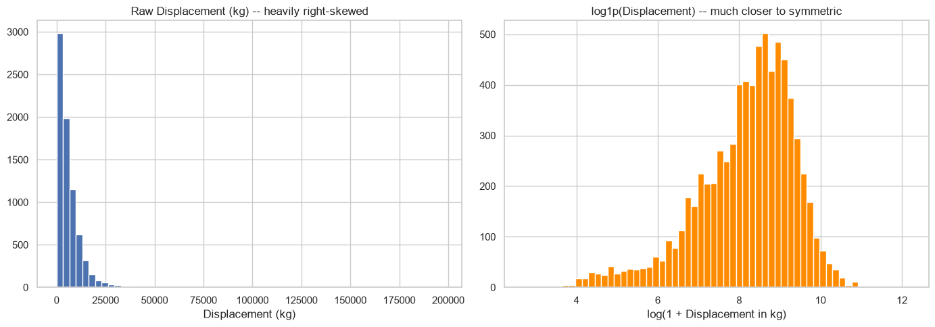
03 EDA and features
Displacement distribution and target transformation
Sailing Boat Displacement
06 / 54
Notes:
Analysis: sailing_boats_tutorial.ipynb.
Figure: figures/notebook/sailing_boats/cell_008_figure_1.png
Measured results: run_results/sailing_boats_tutorial/results.json.
Notebook cell ID: 8f2e7ffe.

Slide 7
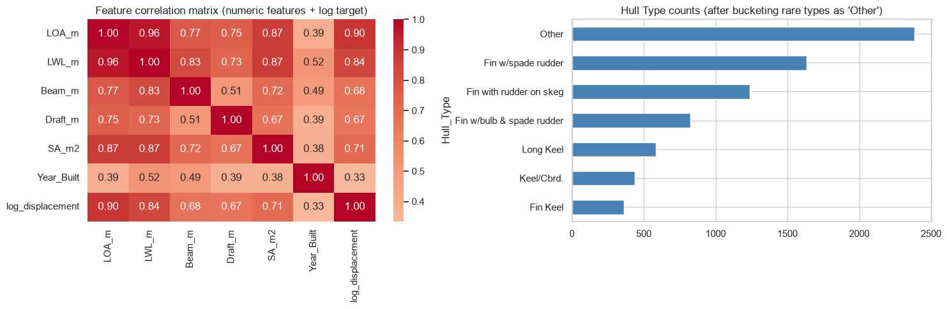
03 EDA and features
Feature correlations and hull types
Sailing Boat Displacement
07 / 54
Notes:
Analysis: sailing_boats_tutorial.ipynb.
Figure: figures/notebook/sailing_boats/cell_009_figure_1.png
Measured results: run_results/sailing_boats_tutorial/results.json.
Notebook cell ID: e7ce1d5a.

Slide 8
03 EDA and features
EDA findings
Boat sizes
Displacement ranges from 14 to 197,000 kg, so errors in kilograms would be dominated by the largest vessels.
Target transform
The log transform makes proportional errors more comparable across boat sizes.
Related dimensions
Length, waterline length, beam and draft overlap. Their linear coefficients describe conditional associations.
Sailing Boat Displacement
08 / 54
Notes:
Analysis: sailing_boats_tutorial.ipynb.
Measured results: run_results/sailing_boats_tutorial/results.json.

Slide 9
03 EDA and features
Feature engineering
Feature group | Predictors
Hull dimensions | Length overall, waterline length, beam and maximum draft
Sail area | Reported sail area
Build year | First year of construction
Design type | Hull and rigging categories
Sailing Boat Displacement
09 / 54
Notes:
Analysis: sailing_boats_tutorial.ipynb.
Measured results: run_results/sailing_boats_tutorial/results.json.

Slide 10
04 Validation
Train–test split
Partition
Random 80/20 split with seed 42. Training contains 5,966 records and testing contains 1,492 records. The common encoded matrix has 19 features.
Transforms
Fit feature scaling on training rows, then apply the same transformation to the test partition.
Evaluation
The test partition is separate from the rows used to fit each model.
Sailing Boat Displacement
10 / 54
Notes:
Analysis: sailing_boats_tutorial.ipynb.
Measured results: run_results/sailing_boats_tutorial/results.json.

Slide 11
05 Methods
Methods
Family | Models | Role
Linear | OLS, Ridge, Lasso and Elastic Net | Interpretable reference
Local | K-nearest neighbors | Predict from similar records
Neural | Multilayer perceptron | Learn nonlinear relationships
Trees | Random Forest, XGBoost, CatBoost and LightGBM | Learn thresholds and interactions
Ensemble | Stacking of Random Forest, XGBoost and LightGBM | Combine predictions using a fitted meta-model
Sailing Boat Displacement
11 / 54
Notes:
Analysis: sailing_boats_tutorial.ipynb.
Measured results: run_results/sailing_boats_tutorial/results.json.

Slide 12
05 Methods
Linear models
Model | Strength | Weakness
OLS | Easy to inspect and use as a baseline | Misses nonlinear effects without added features
Ridge | Stabilizes coefficients when predictors overlap | Keeps all predictors and introduces shrinkage bias
Lasso | Can remove weak predictors with zero coefficients | Can select inconsistently among correlated inputs
Elastic Net | Combines sparse selection with L2 shrinkage | Requires penalty strength and mixing to be selected
Sailing Boat Displacement
12 / 54
Notes:
Analysis: sailing_boats_tutorial.ipynb.
https://scikit-learn.org/stable/modules/linear_model.html
Measured results: run_results/sailing_boats_tutorial/results.json.

Slide 13
05 Methods
KNN and neural networks
Model | Strength | Weakness
KNN | Simple local prediction with few modeling assumptions | Distances depend on scaling. Prediction slows as the reference set grows.
MLP | Learns smooth nonlinear effects and interactions | Sensitive to scaling and optimization. Needs regularization and convergence checks.
Sailing Boat Displacement
13 / 54
Notes:
Analysis: sailing_boats_tutorial.ipynb.
Measured results: run_results/sailing_boats_tutorial/results.json.

Slide 14
05 Methods
Tree-based models
Model | Strength | Weakness
Random Forest | Averaging many trees reduces variance and captures interactions | Large ensembles use memory and extrapolate poorly
XGBoost | Regularized boosting handles complex tabular relationships | Tree depth, learning rate and tree count need joint selection
CatBoost | Supports categorical features alongside numerical features | Training can be costly. Data quality still limits performance
LightGBM | Histogram splits support efficient training on large tables | Flexible leaf growth can overfit small groups
Sailing Boat Displacement
14 / 54
Notes:
Analysis: sailing_boats_tutorial.ipynb.
Measured results: run_results/sailing_boats_tutorial/results.json.

Slide 15
05 Methods
Stacking
Random Forest, XGBoost and LightGBM generate out-of-fold predictions. A Ridge meta-model learns how to combine them.
Strengths
Weaknesses
Can reduce error when the base models make different mistakes. The meta-model learns the weights from training predictions.
Adds fitting and inference cost. Similar base-model errors can limit the gain.
RESULT IN THIS STUDY
RMSE 0.2446 and MAE 0.1693. It has the best observed test score.
Sailing Boat Displacement
15 / 54
Notes:
Analysis: sailing_boats_tutorial.ipynb.
Base models: fitted reference configurations, each cloned and refitted by StackingRegressor/Classifier. cv=2. Meta-model: Ridge(alpha=1.0).
https://scikit-learn.org/stable/modules/ensemble.html#stacking
Measured results: run_results/sailing_boats_tutorial/results.json.

Slide 16
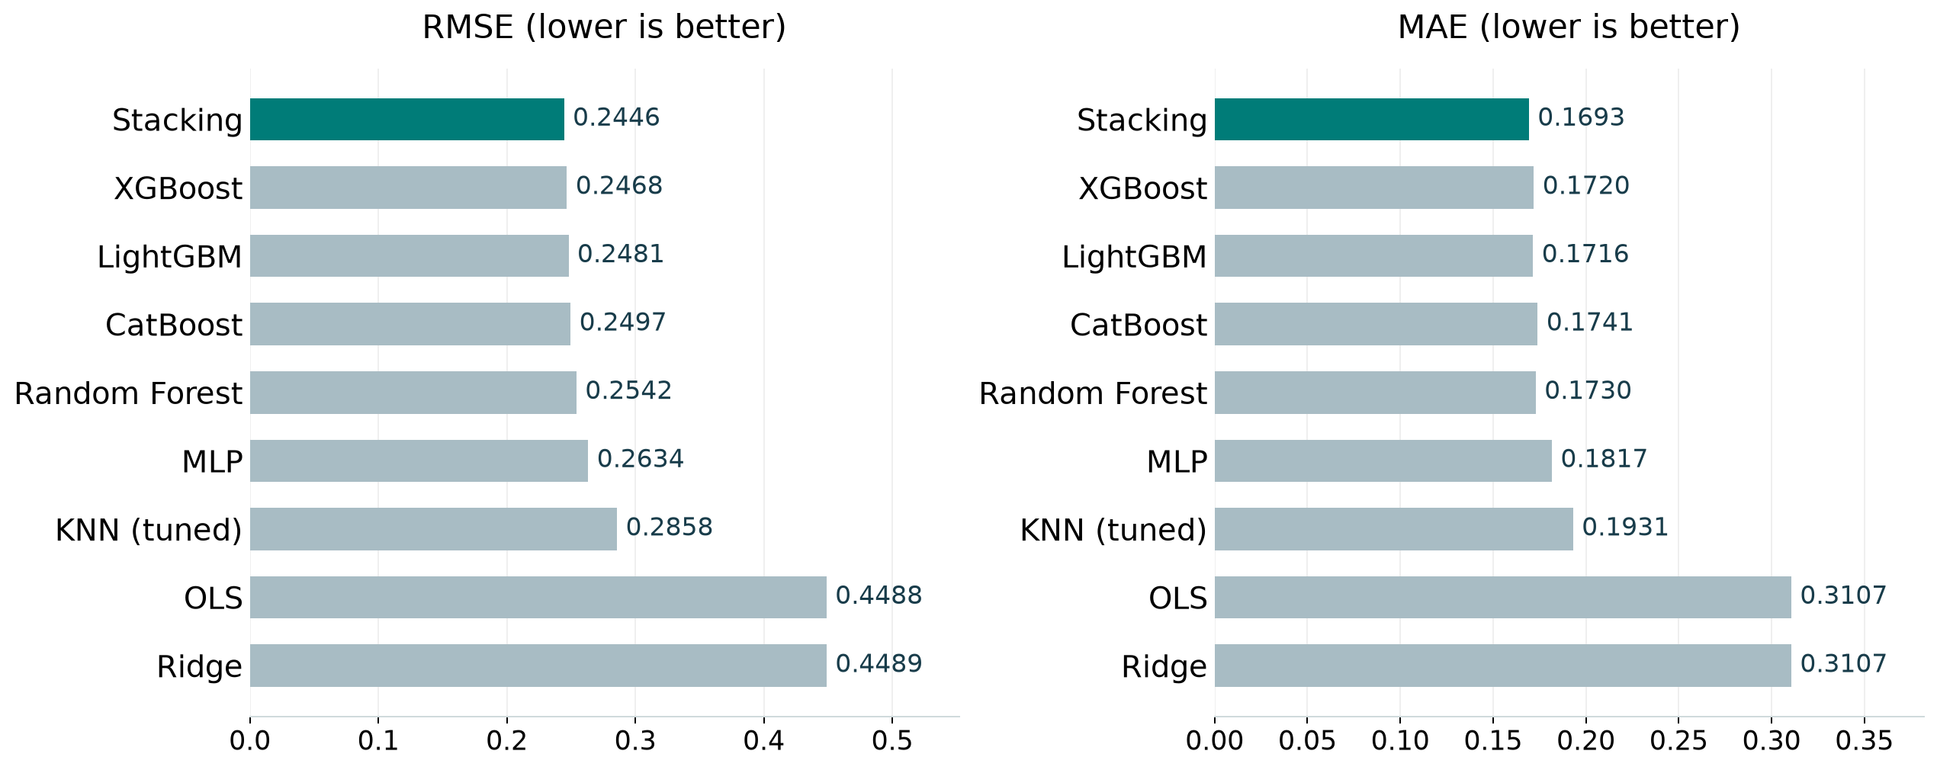
06 Results
Model comparison
Best test score per family, including the strongest penalized linear model. Full results appear in the appendix.
Sailing Boat Displacement
16 / 54
Notes:
Analysis: sailing_boats_tutorial.ipynb.
Figure: figures/sailing_boats/comparison.png
Measured results: run_results/sailing_boats_tutorial/results.json.

Slide 17
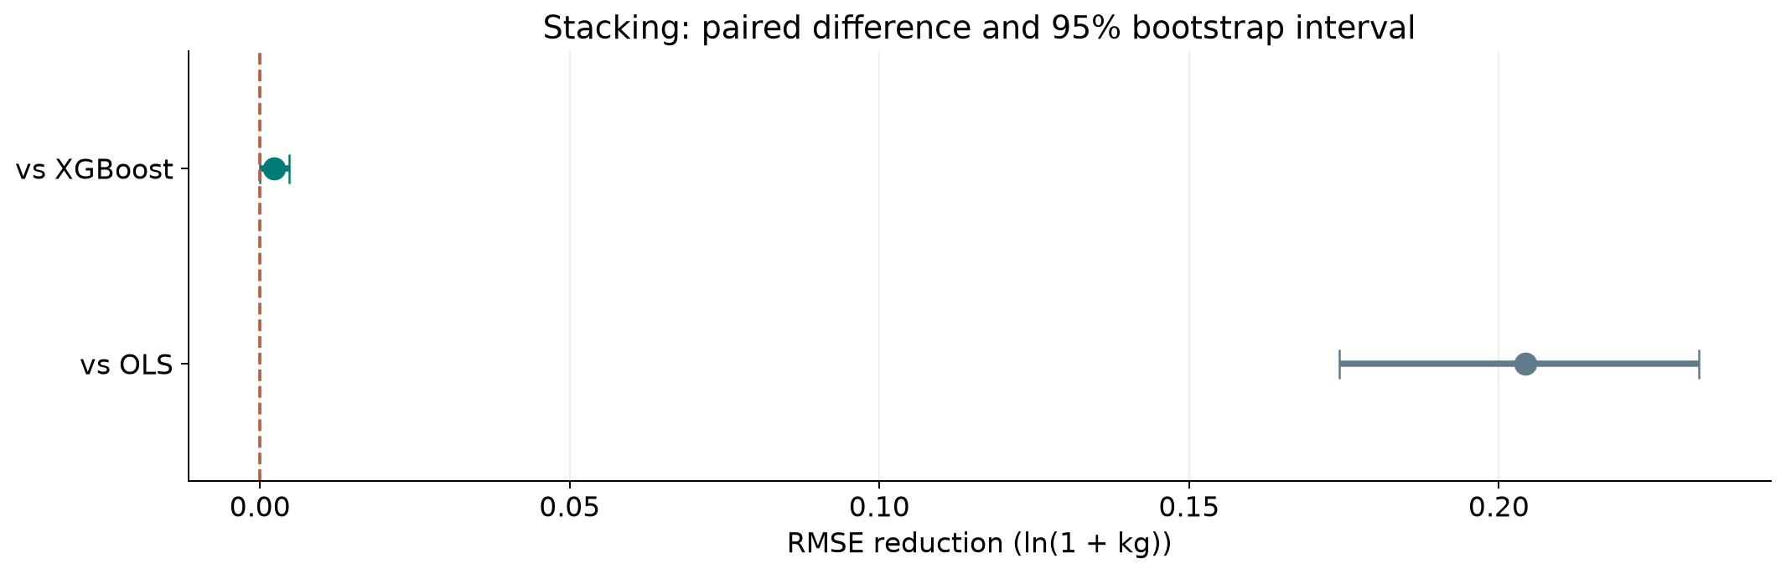
06 Results
Ranking stability
Stacking has lower RMSE than XGBoost across the 95% resampling interval.
Sailing Boat Displacement
17 / 54
Notes:
Analysis: sailing_boats_tutorial.ipynb.
paired row bootstrap. 1,000 paired resamples. Fitted models remain fixed.
[{"comparison": "Stacking versus XGBoost", "other": "XGBoost", "advantage": 0.002220548462948835, "ci_low": 2.031796225986099e-05, "ci_high": 0.004734702622031453}, {"comparison": "Stacking versus OLS", "other": "OLS", "advantage": 0.20424510978738536, "ci_low": 0.1742333616915442, "ci_high": 0.23233296883653673}]
Figure: figures/sailing_boats/ranking_stability.png
Measured results: run_results/sailing_boats_tutorial/results.json.

Slide 18
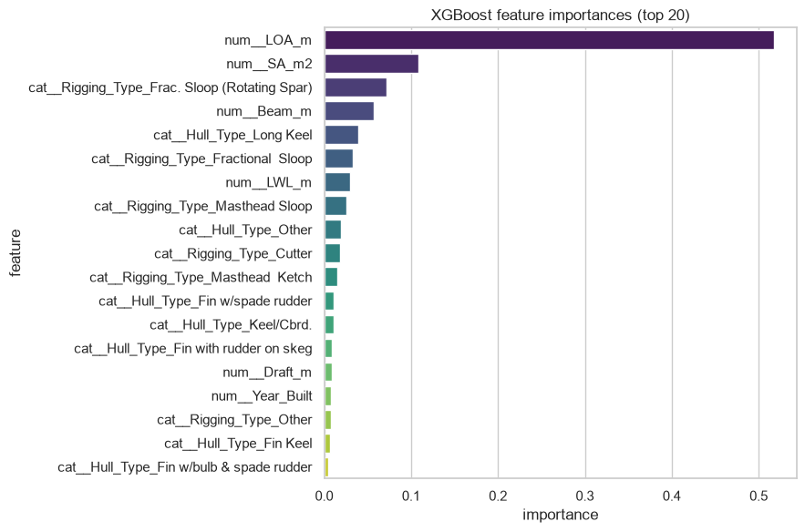
06 Results
XGBoost feature importance
Hull dimensions carry much of the size information. Their rankings can change when correlated features share predictive value.
Sailing Boat Displacement
18 / 54
Notes:
Analysis: sailing_boats_tutorial.ipynb.
Figure: figures/notebook/sailing_boats/cell_044_figure_1.png
Measured results: run_results/sailing_boats_tutorial/results.json.
Notebook cell ID: 7eb91fef.

Slide 19
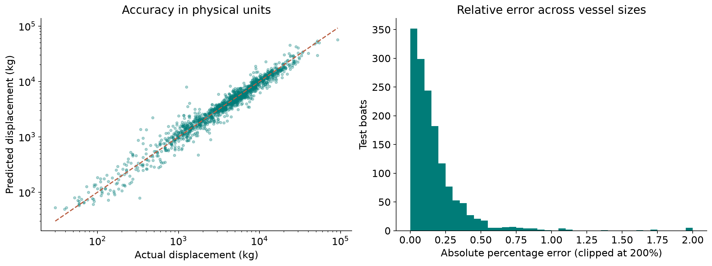
06 Results
Displacement error in kilograms
Back-transformed stacking predictions: MAE about 874 kg and median relative error 12.1%.
Sailing Boat Displacement
19 / 54
Notes:
Analysis: sailing_boats_tutorial.ipynb.
Figure: figures/sailing_boats/physical_errors.png
Measured results: run_results/sailing_boats_tutorial/results.json.
Diagnostics use Stacking predictions.

Slide 20
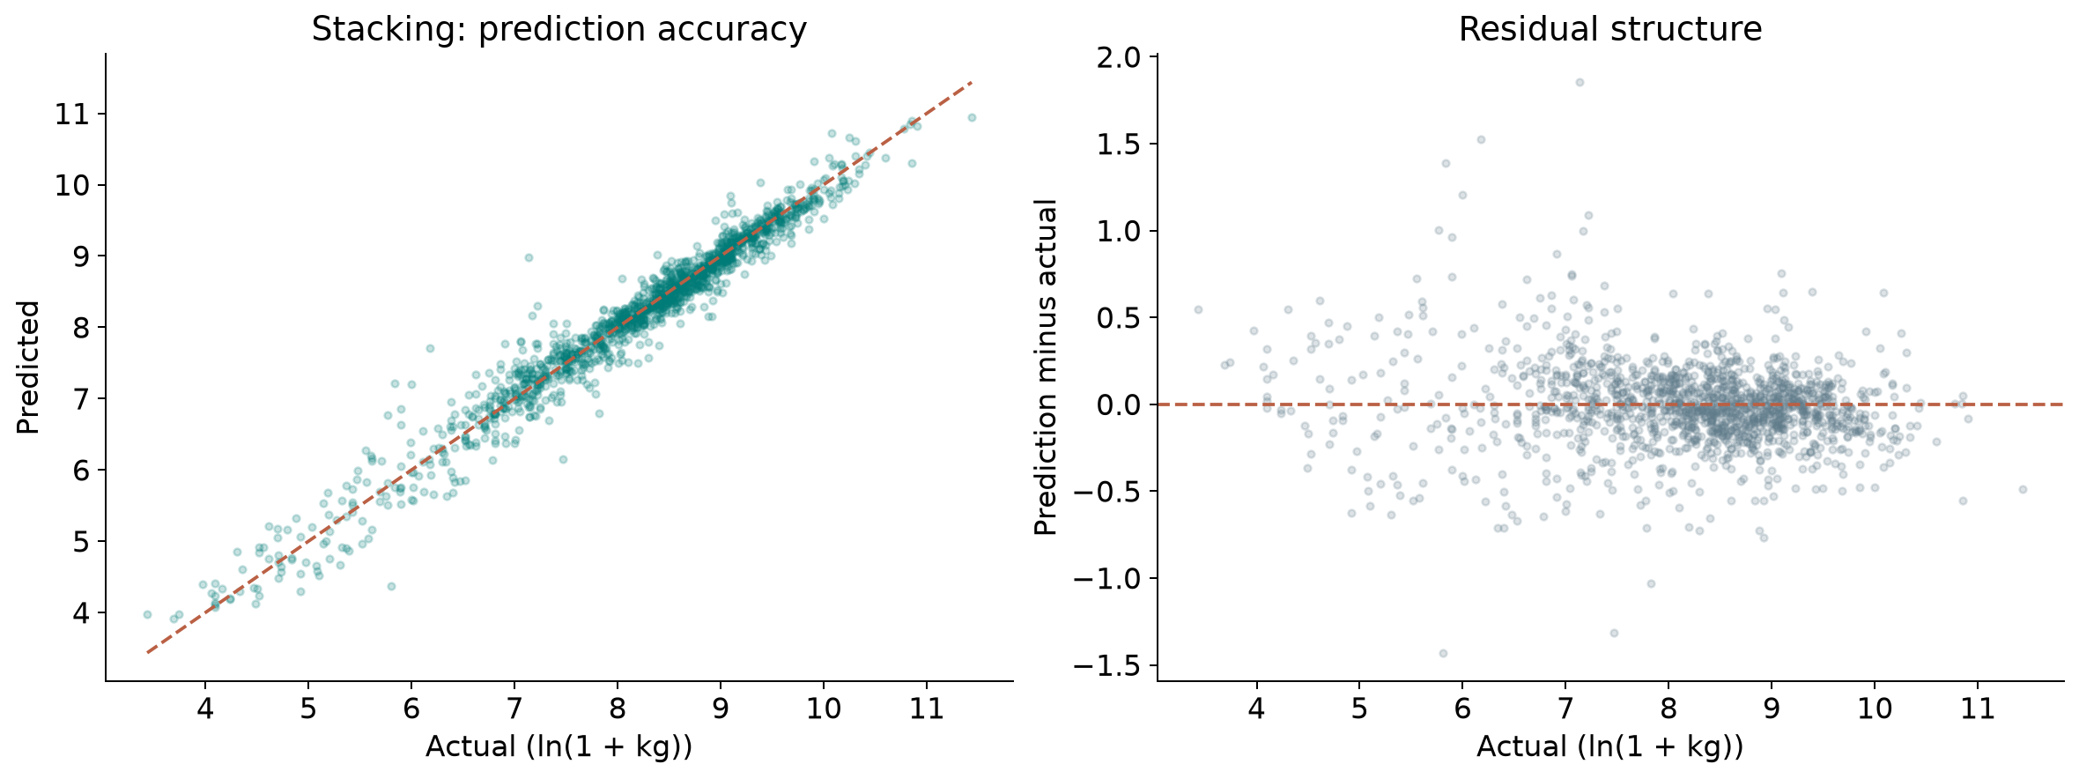
06 Results
Prediction errors
Residual = prediction − actual. Positive residuals indicate overprediction.
Sailing Boat Displacement
20 / 54
Notes:
Analysis: sailing_boats_tutorial.ipynb.
Figure: figures/sailing_boats/winner_diagnostics.png
Measured results: run_results/sailing_boats_tutorial/results.json.
Diagnostics use Stacking predictions.

Slide 21
06 Results
Simple baselines
Method | RMSE | MAE | R²
Training mean | 1.2193 | 0.9355 | -0.000004
Stacking | 0.2446 | 0.1693 | 0.9598
Same test targets for every row. Error units: log1p(kg).
Sailing Boat Displacement
21 / 54
Notes:
Analysis: sailing_boats_tutorial.ipynb.
Measured results: run_results/sailing_boats_tutorial/results.json.

Slide 22
06 Results
Results
Prediction accuracy
Stacking reduces log RMSE by 45.5% versus OLS and by 0.9% versus XGBoost.
Error in kilograms
MAE is about 874 kg. Median relative error is 12.1%, and the 90th percentile is 37.0%.
Generalization
Keep related designs or manufacturers together in validation and compare errors across vessel sizes.
Sailing Boat Displacement
22 / 54
Notes:
Analysis: sailing_boats_tutorial.ipynb.
Measured results: run_results/sailing_boats_tutorial/results.json.
{"Stacking": {"RMSE": 0.2446004610158774, "MAE": 0.16933745184173685, "R2": 0.9597583213978413}, "XGBoost": {"RMSE": 0.24682100947882624, "MAE": 0.17199422654751456, "R2": 0.9590243554206033}, "XGBoost (tuned)": {"RMSE": 0.24682100947882624, "MAE": 0.17199422654751456, "R2": 0.9590243554206033}, "LightGBM": {"RMSE": 0.24807432584775257, "MAE": 0.17157630637963336, "R2": 0.9586071637607116}, "LightGBM (tuned)": {"RMSE": 0.24903434280815648, "MAE": 0.17219038332792794, "R2": 0.9582861735500026}, "CatBoost": {"RMSE": 0.24970354900677919, "MAE": 0.17409666099244372, "R2": 0.9580616851700229}, "CatBoost (tuned)": {"RMSE": 0.2497125219104879, "MAE": 0.17410745189088742, "R2": 0.9580586710741212}, "RandomForest": {"RMSE": 0.2542315411422066, "MAE": 0.17300536424449772, "R2": 0.9565269204413807}, "MLP": {"RMSE": 0.26340704440778595, "MAE": 0.1817235223699488, "R2": 0.9533323087140334}, "MLP (tuned)": {"RMSE": 0.26340704440778595, "MAE": 0.1817235223699488, "R2": 0.9533323087140334}, "RandomForest (tuned)": {"RMSE": 0.26364310304488536, "MAE": 0.18207653969311935, "R2": 0.9532486264579703}, "KNN (tuned)": {"RMSE": 0.2858497167322371, "MAE": 0.1931268468149899, "R2": 0.945041220691632}, "KNN": {"RMSE": 0.2869346659851518, "MAE": 0.1930389499845721, "R2": 0.9446232343036014}, "LinearRegression": {"RMSE": 0.44884557080326276, "MAE": 0.3106852655859412, "R2": 0.8644949647442559}, "Ridge": {"RMSE": 0.4489247133925313, "MAE": 0.3107030741334147, "R2": 0.8644471747446684}, "ElasticNet": {"RMSE": 0.464141983608828, "MAE": 0.3187572336902306, "R2": 0.8551017122067692}, "Lasso": {"RMSE": 0.47818258518604545, "MAE": 0.327173408904206, "R2": 0.8462025776002552}}

Slide 23
07 Conclusion
Limitations
Limitation | Details
Missing records | Complete-case filtering retains 85.0% of the source rows.
Related designs | Variants from the same family may cross a random split.
Back transformation | Exponentiating a log prediction does not generally give an unbiased mean in kilograms.
Size extremes | Small craft and large yachts need separate error checks.
Sailing Boat Displacement
23 / 54
Notes:
Analysis: sailing_boats_tutorial.ipynb.
Measured results: run_results/sailing_boats_tutorial/results.json.

Slide 24
07 Conclusion
Next steps
# | Test | Method | Measure
1 | Design-family split | Group related boat models or manufacturers before validation. | Accuracy on unseen design families
2 | Physical baseline | Fit log dimensions and compare an explicit volume proxy. | Improvement over physical scaling
3 | Missing-data study | Compare imputation with complete-case filtering. | Broader coverage with stable errors
4 | Metric expansion | Report kg MAE and relative error by size band alongside log RMSE. | Interpretable error across boat sizes
Sailing Boat Displacement
24 / 54
Notes:
Analysis: sailing_boats_tutorial.ipynb.
Measured results: run_results/sailing_boats_tutorial/results.json.

Slide 25
07 Conclusion
Conclusion
Stacking gives a small accuracy gain
RMSE 0.2446
XGBoost is a close, simpler alternative. Validate the gain across vessel families and inspect errors in kilograms before choosing a model.
Sailing Boat Displacement
25 / 54
Notes:
Analysis: sailing_boats_tutorial.ipynb.
Measured results: run_results/sailing_boats_tutorial/results.json.
{"Stacking": {"RMSE": 0.2446004610158774, "MAE": 0.16933745184173685, "R2": 0.9597583213978413}, "XGBoost": {"RMSE": 0.24682100947882624, "MAE": 0.17199422654751456, "R2": 0.9590243554206033}, "XGBoost (tuned)": {"RMSE": 0.24682100947882624, "MAE": 0.17199422654751456, "R2": 0.9590243554206033}, "LightGBM": {"RMSE": 0.24807432584775257, "MAE": 0.17157630637963336, "R2": 0.9586071637607116}, "LightGBM (tuned)": {"RMSE": 0.24903434280815648, "MAE": 0.17219038332792794, "R2": 0.9582861735500026}, "CatBoost": {"RMSE": 0.24970354900677919, "MAE": 0.17409666099244372, "R2": 0.9580616851700229}, "CatBoost (tuned)": {"RMSE": 0.2497125219104879, "MAE": 0.17410745189088742, "R2": 0.9580586710741212}, "RandomForest": {"RMSE": 0.2542315411422066, "MAE": 0.17300536424449772, "R2": 0.9565269204413807}, "MLP": {"RMSE": 0.26340704440778595, "MAE": 0.1817235223699488, "R2": 0.9533323087140334}, "MLP (tuned)": {"RMSE": 0.26340704440778595, "MAE": 0.1817235223699488, "R2": 0.9533323087140334}, "RandomForest (tuned)": {"RMSE": 0.26364310304488536, "MAE": 0.18207653969311935, "R2": 0.9532486264579703}, "KNN (tuned)": {"RMSE": 0.2858497167322371, "MAE": 0.1931268468149899, "R2": 0.945041220691632}, "KNN": {"RMSE": 0.2869346659851518, "MAE": 0.1930389499845721, "R2": 0.9446232343036014}, "LinearRegression": {"RMSE": 0.44884557080326276, "MAE": 0.3106852655859412, "R2": 0.8644949647442559}, "Ridge": {"RMSE": 0.4489247133925313, "MAE": 0.3107030741334147, "R2": 0.8644471747446684}, "ElasticNet": {"RMSE": 0.464141983608828, "MAE": 0.3187572336902306, "R2": 0.8551017122067692}, "Lasso": {"RMSE": 0.47818258518604545, "MAE": 0.327173408904206, "R2": 0.8462025776002552}}

Slide 26
08 Appendix
Evaluation metrics
Metric | Meaning | Role
RMSE | Square root of mean squared error | Ranks models and emphasizes large misses
MAE | Mean absolute error | Describes typical error magnitude
R² | Improvement over predicting the test mean | Measures explained variation
Group errors | Metrics by target range or time group | Locates concentrated errors
Sailing Boat Displacement
26 / 54
Notes:
Analysis: sailing_boats_tutorial.ipynb.
Measured results: run_results/sailing_boats_tutorial/results.json.

Slide 27
08 Appendix
Regularization
Model | Objective | Main effect
OLS | Squared error | Fits an additive linear relationship
Ridge | Squared error + L2 penalty | Shrinks correlated coefficients
Lasso | Squared error + L1 penalty | Can set coefficients to zero
Elastic Net | Squared error + L1 and L2 penalties | Combines sparsity and shrinkage
Sailing Boat Displacement
27 / 54
Notes:
Analysis: sailing_boats_tutorial.ipynb.
https://scikit-learn.org/stable/modules/linear_model.html
Measured results: run_results/sailing_boats_tutorial/results.json.

Slide 28
08 Appendix
Linear model results
Model | RMSE | MAE | R²
OLS | 0.4488 | 0.3107 | 0.8645
Ridge | 0.4489 | 0.3107 | 0.8644
Lasso | 0.4782 | 0.3272 | 0.8462
Elastic Net | 0.4641 | 0.3188 | 0.8551
Sailing Boat Displacement
28 / 54
Notes:
Analysis: sailing_boats_tutorial.ipynb.
Measured results: run_results/sailing_boats_tutorial/results.json.
{"Stacking": {"RMSE": 0.2446004610158774, "MAE": 0.16933745184173685, "R2": 0.9597583213978413}, "XGBoost": {"RMSE": 0.24682100947882624, "MAE": 0.17199422654751456, "R2": 0.9590243554206033}, "XGBoost (tuned)": {"RMSE": 0.24682100947882624, "MAE": 0.17199422654751456, "R2": 0.9590243554206033}, "LightGBM": {"RMSE": 0.24807432584775257, "MAE": 0.17157630637963336, "R2": 0.9586071637607116}, "LightGBM (tuned)": {"RMSE": 0.24903434280815648, "MAE": 0.17219038332792794, "R2": 0.9582861735500026}, "CatBoost": {"RMSE": 0.24970354900677919, "MAE": 0.17409666099244372, "R2": 0.9580616851700229}, "CatBoost (tuned)": {"RMSE": 0.2497125219104879, "MAE": 0.17410745189088742, "R2": 0.9580586710741212}, "RandomForest": {"RMSE": 0.2542315411422066, "MAE": 0.17300536424449772, "R2": 0.9565269204413807}, "MLP": {"RMSE": 0.26340704440778595, "MAE": 0.1817235223699488, "R2": 0.9533323087140334}, "MLP (tuned)": {"RMSE": 0.26340704440778595, "MAE": 0.1817235223699488, "R2": 0.9533323087140334}, "RandomForest (tuned)": {"RMSE": 0.26364310304488536, "MAE": 0.18207653969311935, "R2": 0.9532486264579703}, "KNN (tuned)": {"RMSE": 0.2858497167322371, "MAE": 0.1931268468149899, "R2": 0.945041220691632}, "KNN": {"RMSE": 0.2869346659851518, "MAE": 0.1930389499845721, "R2": 0.9446232343036014}, "LinearRegression": {"RMSE": 0.44884557080326276, "MAE": 0.3106852655859412, "R2": 0.8644949647442559}, "Ridge": {"RMSE": 0.4489247133925313, "MAE": 0.3107030741334147, "R2": 0.8644471747446684}, "ElasticNet": {"RMSE": 0.464141983608828, "MAE": 0.3187572336902306, "R2": 0.8551017122067692}, "Lasso": {"RMSE": 0.47818258518604545, "MAE": 0.327173408904206, "R2": 0.8462025776002552}}

Slide 29
08 Appendix
Linear model discussion
Results
OLS and Ridge have nearly identical RMSE. Lasso and Elastic Net have higher errors under the selected penalties.
Interpretation
Hull dimensions overlap. Coefficients describe conditional associations and can change sign when related dimensions enter together.
Further work
Compare log-transformed dimensions with a physical volume model and validate by design family.
Sailing Boat Displacement
29 / 54
Notes:
Analysis: sailing_boats_tutorial.ipynb.
https://scikit-learn.org/stable/modules/linear_model.html
Measured results: run_results/sailing_boats_tutorial/results.json.

Slide 30
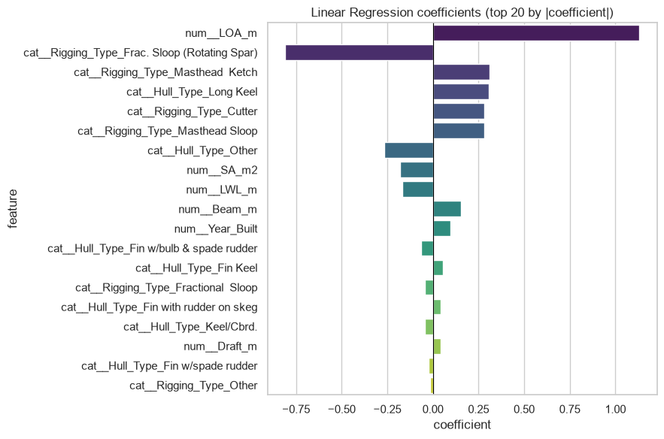
08 Appendix
Linear coefficients
Coefficients describe fitted associations after accounting for the other encoded inputs.
Sailing Boat Displacement
30 / 54
Notes:
Analysis: sailing_boats_tutorial.ipynb.
Figure: figures/notebook/sailing_boats/cell_016_figure_1.png
Measured results: run_results/sailing_boats_tutorial/results.json.
Notebook cell ID: 6d707cb9.

Slide 31
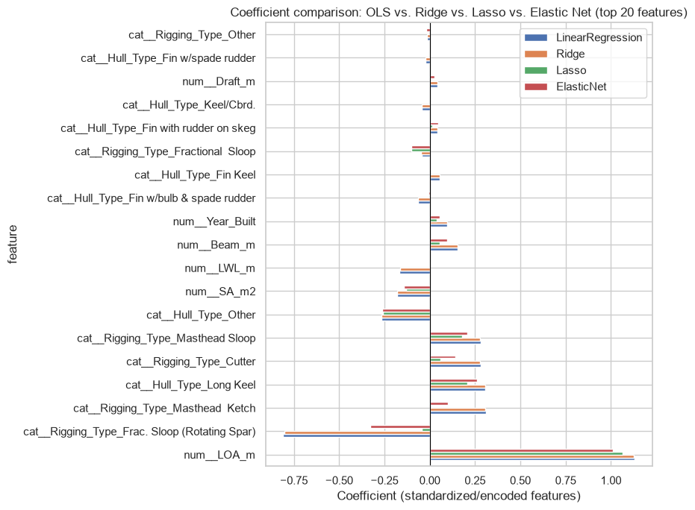
08 Appendix
Regularized coefficients
Coefficients describe fitted associations after accounting for the other encoded inputs.
Sailing Boat Displacement
31 / 54
Notes:
Analysis: sailing_boats_tutorial.ipynb.
Figure: figures/notebook/sailing_boats/cell_023_figure_1.png
Measured results: run_results/sailing_boats_tutorial/results.json.
Notebook cell ID: 1ec74409.

Slide 32
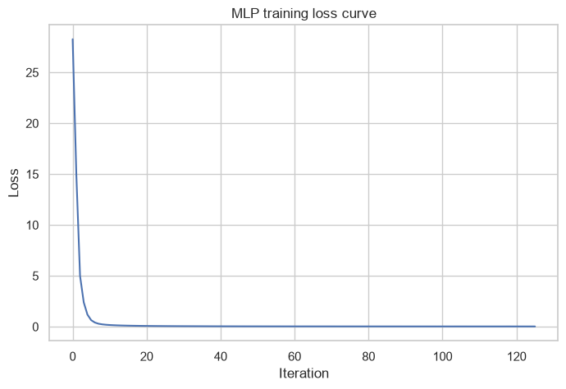
08 Appendix
MLP training loss
Training loss by optimization iteration.
Sailing Boat Displacement
32 / 54
Notes:
Analysis: sailing_boats_tutorial.ipynb.
Figure: figures/notebook/sailing_boats/cell_032_figure_1.png
Measured results: run_results/sailing_boats_tutorial/results.json.
Notebook cell ID: cd1a0c8e.

Slide 33
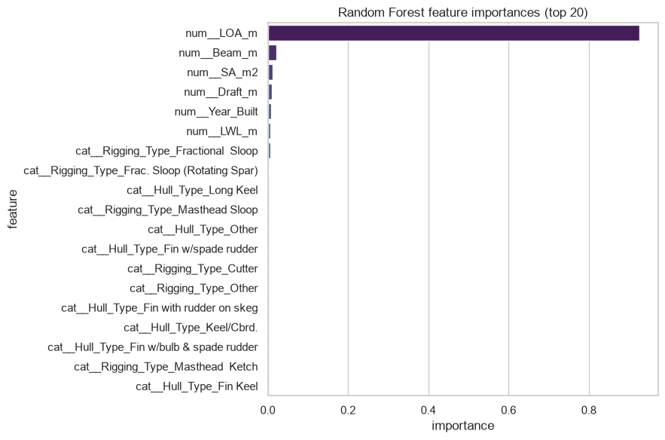
08 Appendix
Random Forest feature importance
Hull dimensions carry much of the size information. Their rankings can change when correlated features share predictive value.
Sailing Boat Displacement
33 / 54
Notes:
Analysis: sailing_boats_tutorial.ipynb.
Figure: figures/notebook/sailing_boats/cell_038_figure_1.png
Measured results: run_results/sailing_boats_tutorial/results.json.
Notebook cell ID: 4ac5e662.

Slide 34
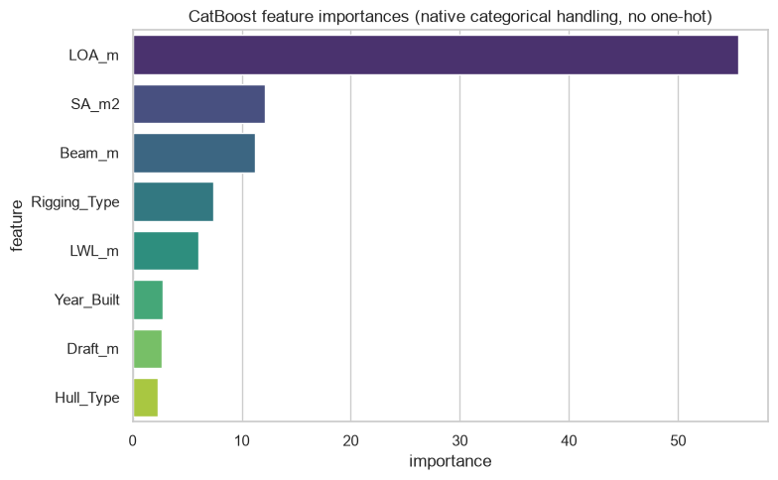
08 Appendix
CatBoost feature importance
Hull dimensions carry much of the size information. Their rankings can change when correlated features share predictive value.
Sailing Boat Displacement
34 / 54
Notes:
Analysis: sailing_boats_tutorial.ipynb.
Figure: figures/notebook/sailing_boats/cell_050_figure_1.png
Measured results: run_results/sailing_boats_tutorial/results.json.
Notebook cell ID: 020061fe.

Slide 35
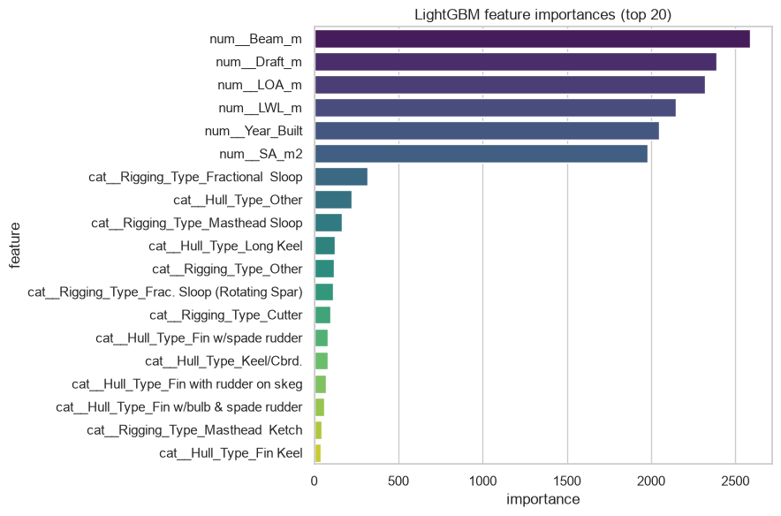
08 Appendix
LightGBM feature importance
Hull dimensions carry much of the size information. Their rankings can change when correlated features share predictive value.
Sailing Boat Displacement
35 / 54
Notes:
Analysis: sailing_boats_tutorial.ipynb.
Figure: figures/notebook/sailing_boats/cell_057_figure_1.png
Measured results: run_results/sailing_boats_tutorial/results.json.
Notebook cell ID: baca06c9.

Slide 36
08 Appendix
Error by target range
Test target band | Rows | MAE | Mean prediction error
Q1: (3.4330000000000003, 7.502] | 373 | 0.2636 | 0.0556
Q2: (7.502, 8.408] | 373 | 0.1447 | -0.0201
Q3: (8.408, 9.009] | 373 | 0.1335 | -0.0426
Q4: (9.009, 11.435] | 373 | 0.1355 | -0.0321
Errors for Stacking. Mean error = prediction − actual. Units: log1p(kg).
Sailing Boat Displacement
36 / 54
Notes:
Analysis: sailing_boats_tutorial.ipynb.
Measured results: run_results/sailing_boats_tutorial/results.json.

Slide 37
08 Appendix
Application
Topic | Application
Prediction scale | The fitted target is log displacement. This is different from minimizing error in kilograms.
Back transformation | Use exp(prediction) − 1 to return to kilograms. A mean estimate may need a bias adjustment.
Engineering use | Treat predictions as a design reference or data check. Verify vessel specifications for engineering decisions.
Sailing Boat Displacement
37 / 54
Notes:
Analysis: sailing_boats_tutorial.ipynb.
Measured results: run_results/sailing_boats_tutorial/results.json.

Slide 38
08 Appendix
Model selection Q&A
Why include penalized linear models?
Ridge uses L2 shrinkage to stabilize coefficients. Lasso uses L1 to encourage zeros. Elastic Net combines the penalties. Logistic models use the same penalty types for classification.
Why standardize the predictors?
Penalties and distance calculations depend on feature units. Scaling also helps neural-network optimization. Estimate the scaling parameters from training data.
Why include stacking?
It has the best observed score here. Combining models helps only when their errors are sufficiently different. Compare its gain with inference and maintenance cost.
Sailing Boat Displacement
38 / 54
Notes:
Analysis: sailing_boats_tutorial.ipynb.
https://scikit-learn.org/stable/modules/linear_model.html
https://scikit-learn.org/stable/modules/neighbors.html
https://scikit-learn.org/stable/modules/neural_networks_supervised.html
Measured results: run_results/sailing_boats_tutorial/results.json.

Slide 39
08 Appendix
Model interpretation Q&A
How do forests and boosting differ?
Random Forest averages trees trained with randomized rows and features. Boosting adds trees sequentially to reduce the chosen loss.
What does feature importance mean?
It describes how the fitted model uses its inputs. Related predictors can share importance. A high value does not establish a causal effect.
What do the resampling intervals cover?
They measure variation in the available test predictions with the fitted models fixed. A new split also tests sensitivity to training and model selection.
Sailing Boat Displacement
39 / 54
Notes:
Analysis: sailing_boats_tutorial.ipynb.
https://scikit-learn.org/stable/modules/ensemble.html
https://xgboost.readthedocs.io/en/stable/tutorials/model.html
Measured results: run_results/sailing_boats_tutorial/results.json.

Slide 40
08 Appendix
Data Q&A
Why transform displacement?
Boat sizes span several orders of magnitude. Log errors give greater emphasis to proportional accuracy across that range.
Does exponentiating give mean displacement?
Exponentiating a predicted log target can produce a biased mean in kilograms. Evaluate the back-transformed errors and test a bias adjustment if mean kilograms is the goal.
Sailing Boat Displacement
40 / 54
Notes:
Analysis: sailing_boats_tutorial.ipynb.
Measured results: run_results/sailing_boats_tutorial/results.json.

Slide 41
08 Appendix
Results Q&A
Why can a dimension have a negative coefficient?
Hull dimensions overlap. A coefficient describes the fitted association while the other dimensions stay fixed.
How would you test a new design family?
Keep related models or manufacturers together in validation, then compare errors by size and hull type.
Sailing Boat Displacement
41 / 54
Notes:
Analysis: sailing_boats_tutorial.ipynb.
Measured results: run_results/sailing_boats_tutorial/results.json.

Slide 42
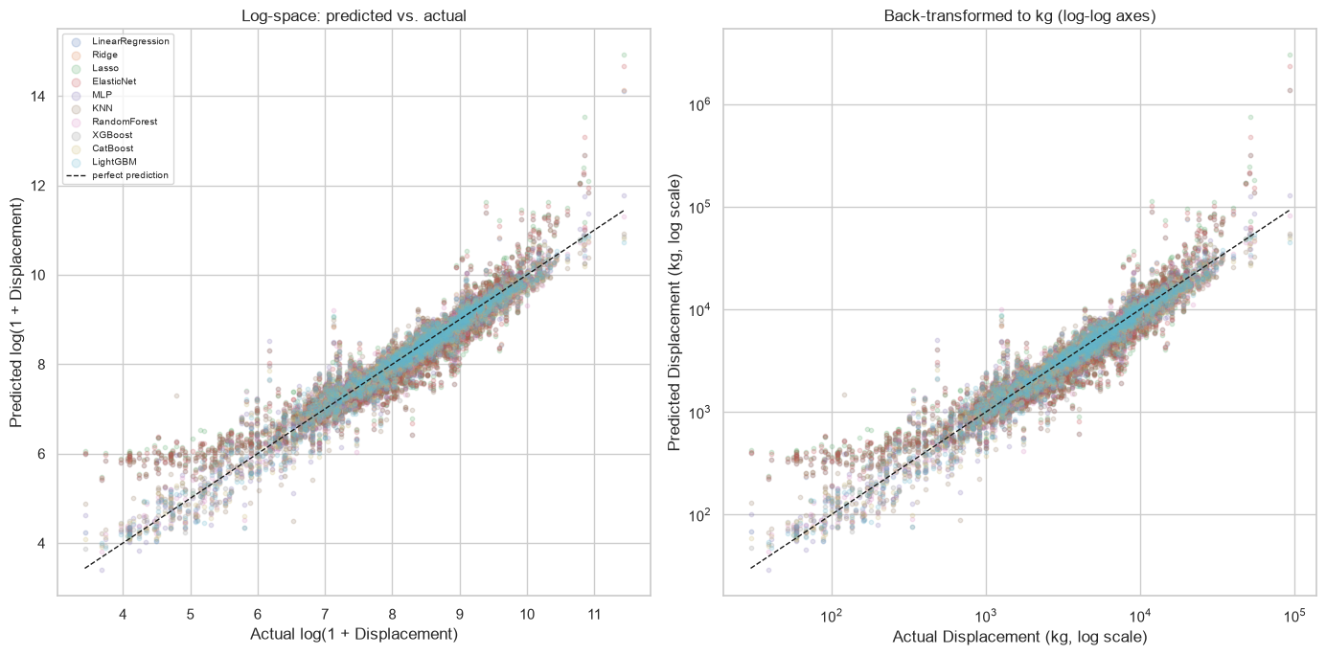
08 Appendix
Displacement predictions on both scales
Sailing Boat Displacement
42 / 54
Notes:
Analysis: sailing_boats_tutorial.ipynb.
Figure: figures/notebook/sailing_boats/cell_064_figure_1.png
Measured results: run_results/sailing_boats_tutorial/results.json.
Notebook cell ID: c1f347c4.

Slide 43
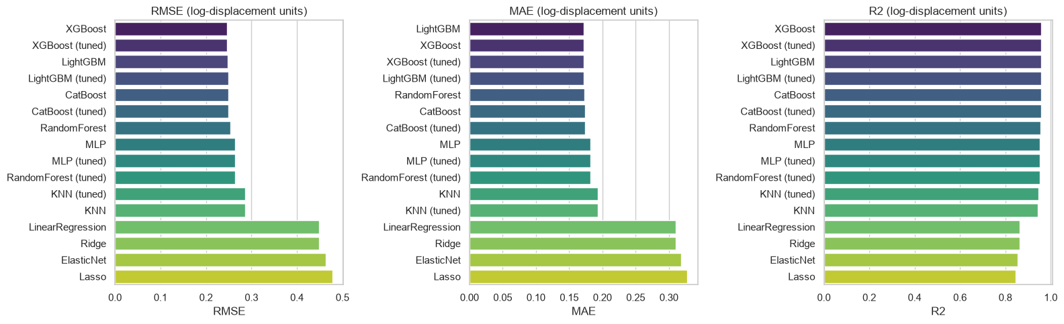
08 Appendix
Individual model metrics
Notebook comparison of individual models. The full results tables also include stacking.
Sailing Boat Displacement
43 / 54
Notes:
Analysis: sailing_boats_tutorial.ipynb.
Figure: figures/notebook/sailing_boats/cell_063_figure_1.png
Measured results: run_results/sailing_boats_tutorial/results.json.
Notebook cell ID: 69fc2389.

Slide 44
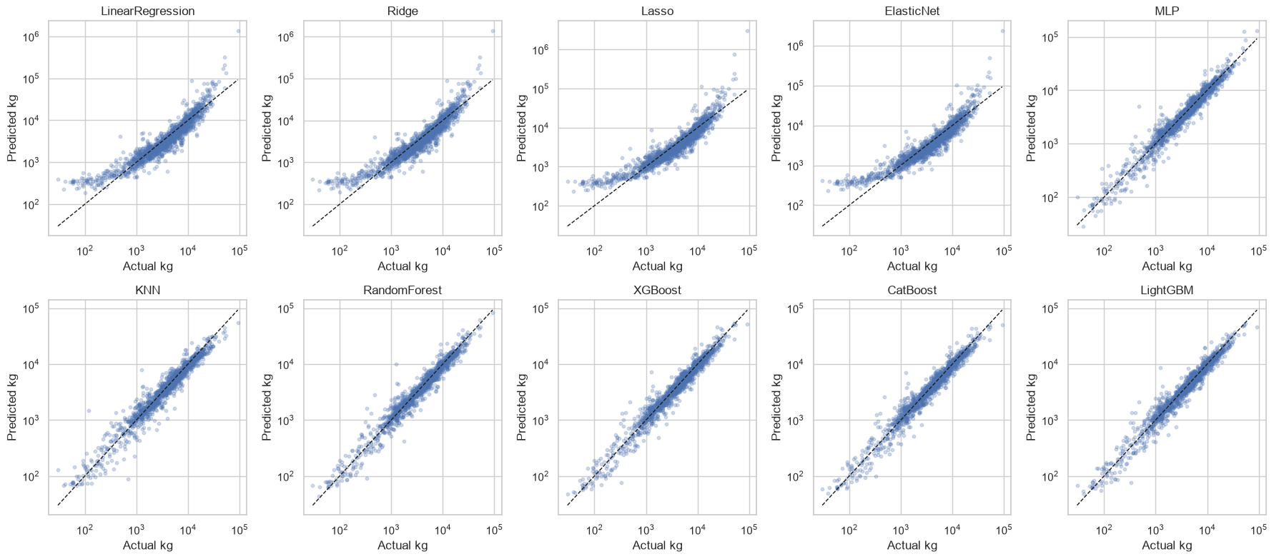
08 Appendix
All regression predictions
Actual outcomes and predictions on the test partition.
Sailing Boat Displacement
44 / 54
Notes:
Analysis: sailing_boats_tutorial.ipynb.
Figure: figures/notebook/sailing_boats/cell_065_figure_1.png
Measured results: run_results/sailing_boats_tutorial/results.json.
Notebook cell ID: dca36775.

Slide 45
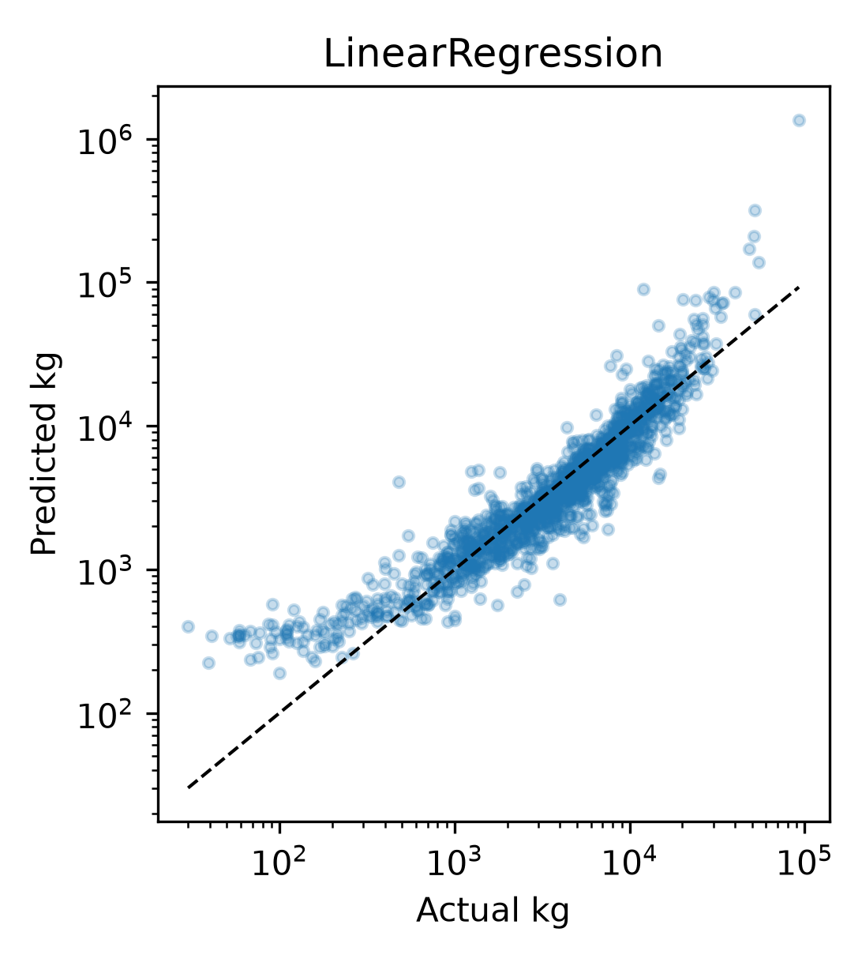
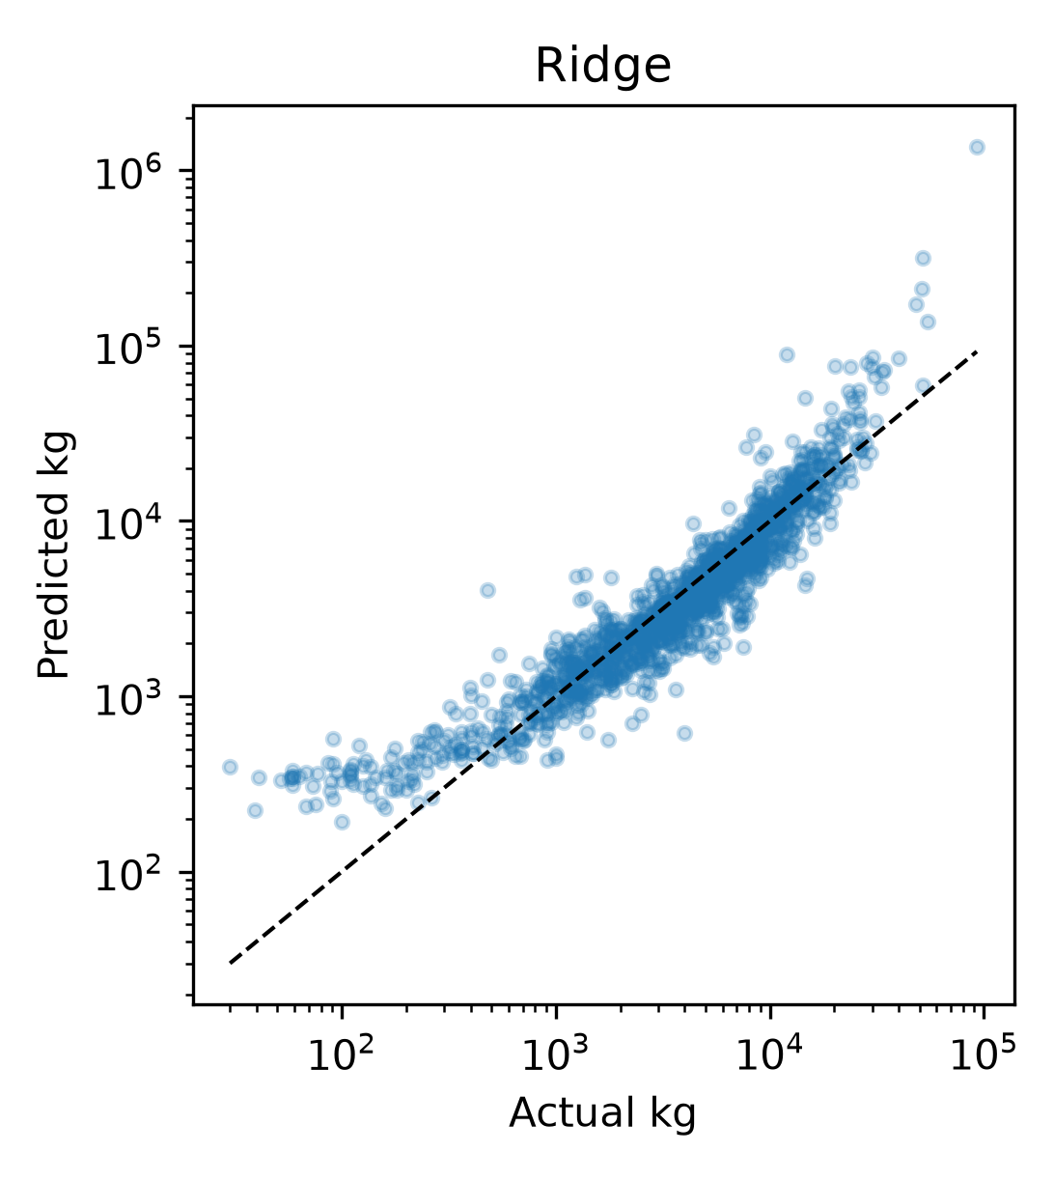
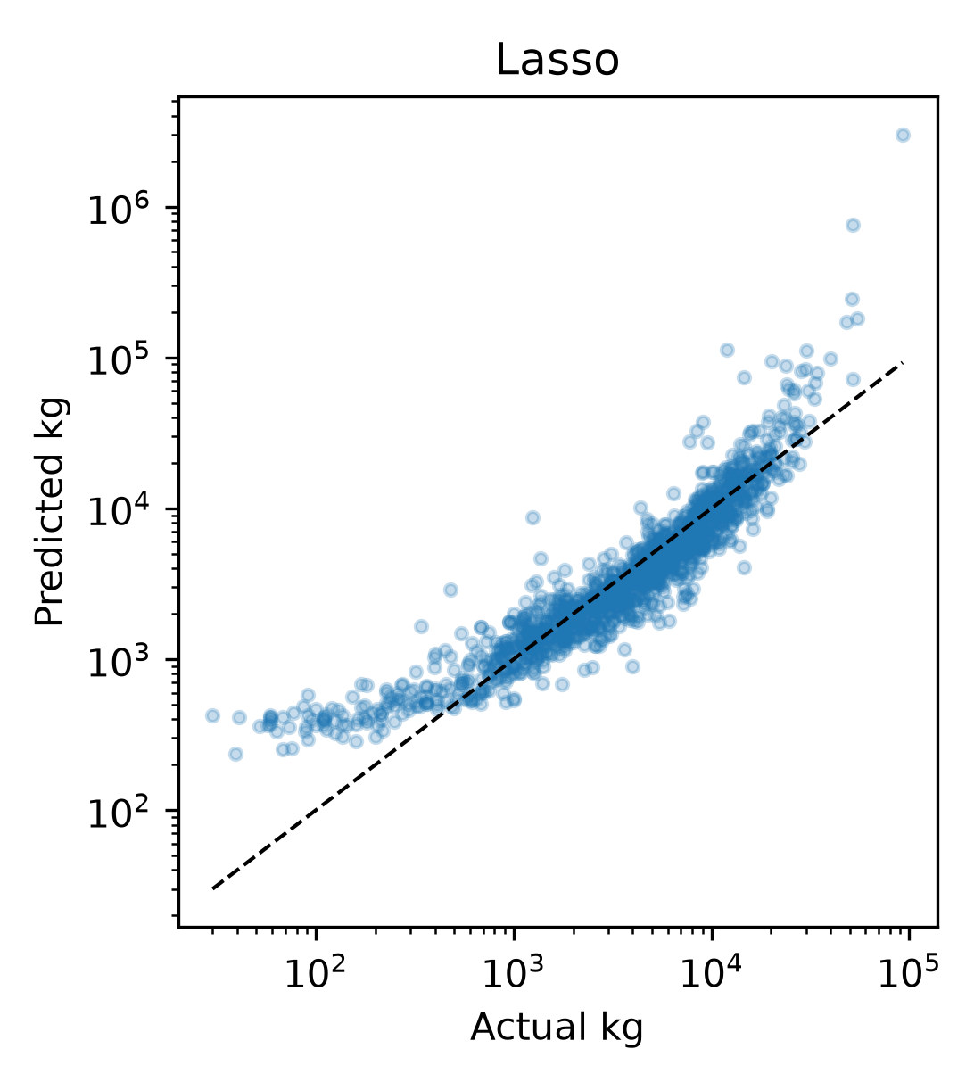
08 Appendix
Regression predictions (1 of 4)
Models shown: LinearRegression, Ridge, Lasso.
Sailing Boat Displacement
45 / 54
Notes:
Analysis: sailing_boats_tutorial.ipynb.
Measured results: run_results/sailing_boats_tutorial/results.json.
Panels: figures/panels/sailing_boats/regression_01.png, figures/panels/sailing_boats/regression_02.png, figures/panels/sailing_boats/regression_03.png

Slide 46
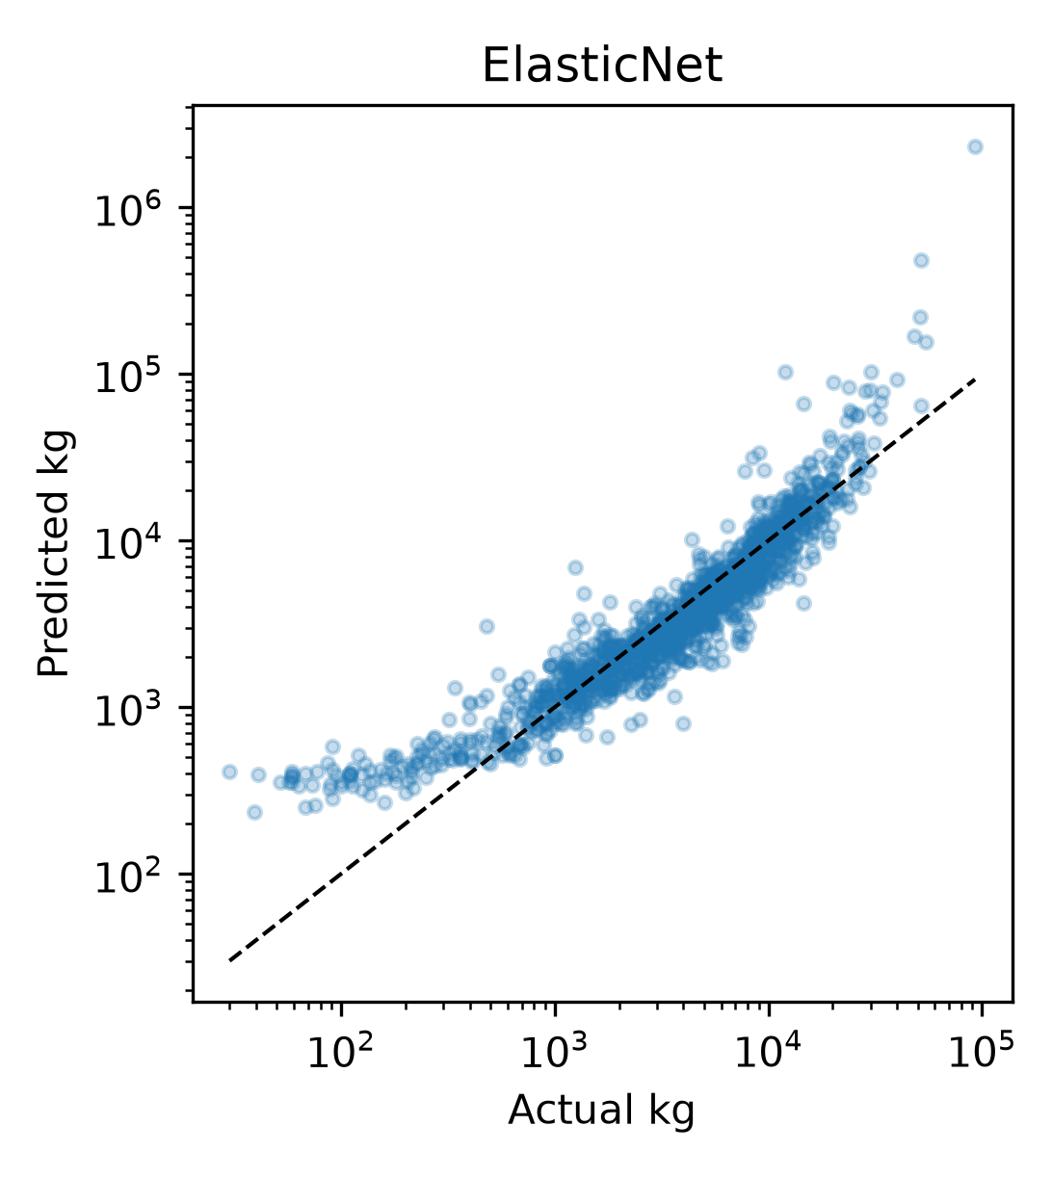
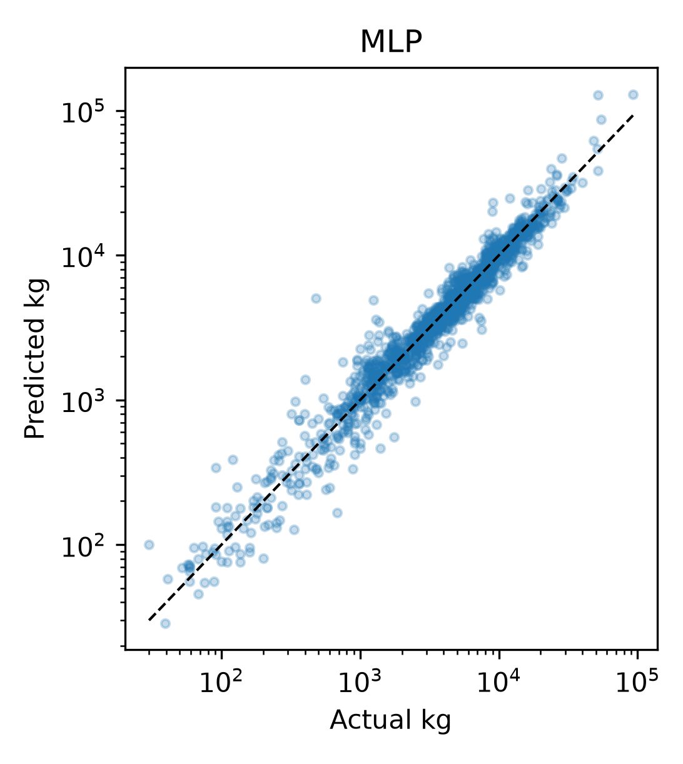
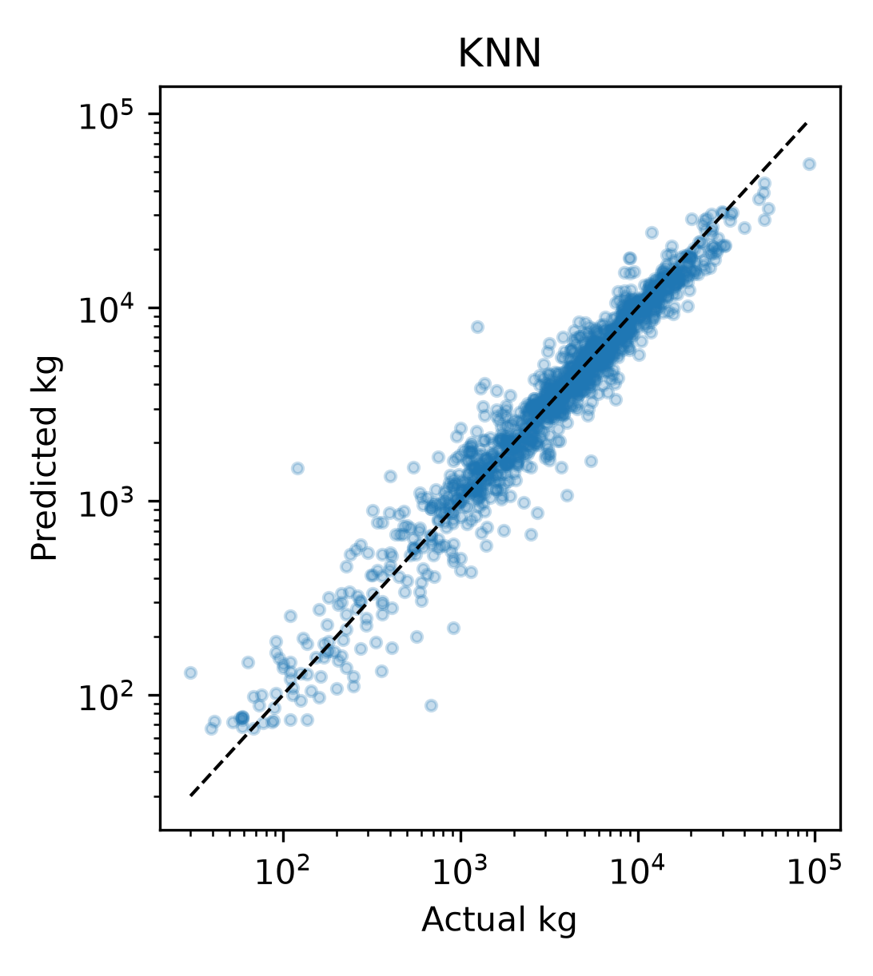
08 Appendix
Regression predictions (2 of 4)
Models shown: ElasticNet, MLP, KNN.
Sailing Boat Displacement
46 / 54
Notes:
Analysis: sailing_boats_tutorial.ipynb.
Measured results: run_results/sailing_boats_tutorial/results.json.
Panels: figures/panels/sailing_boats/regression_04.png, figures/panels/sailing_boats/regression_05.png, figures/panels/sailing_boats/regression_06.png

Slide 47
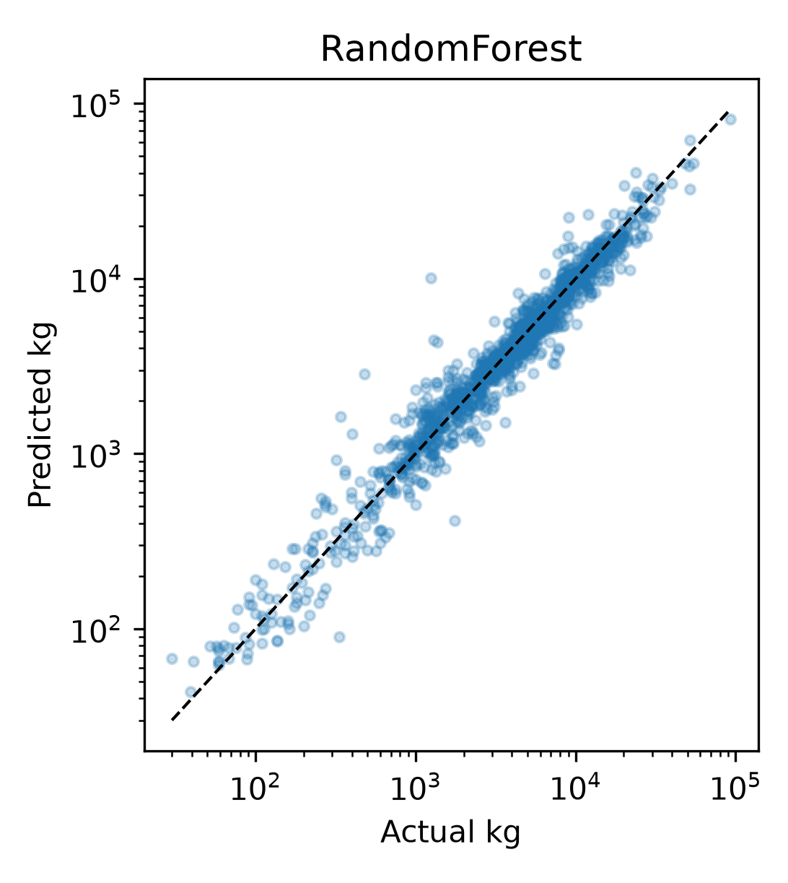
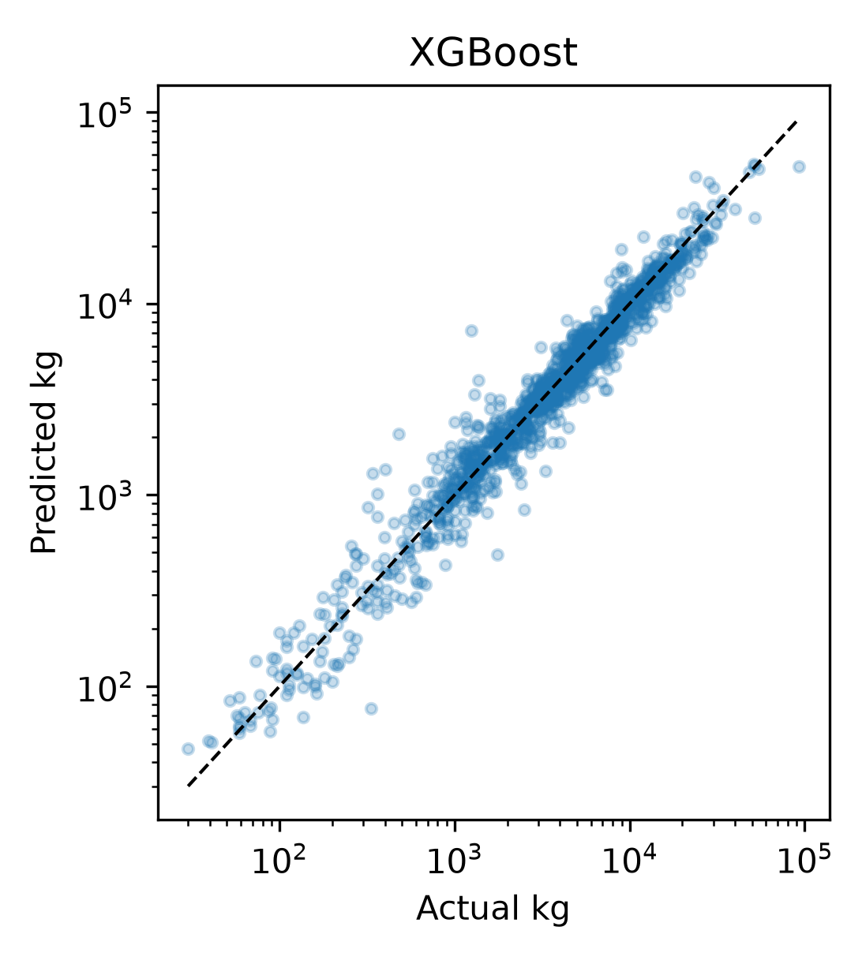
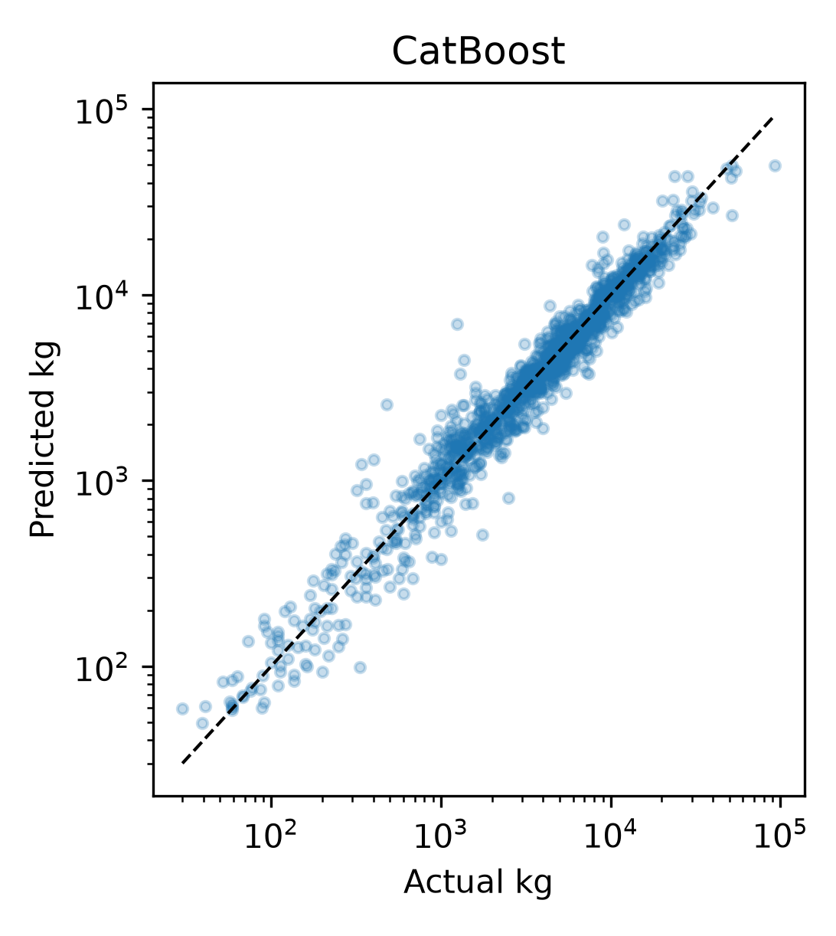
08 Appendix
Regression predictions (3 of 4)
Models shown: RandomForest, XGBoost, CatBoost.
Sailing Boat Displacement
47 / 54
Notes:
Analysis: sailing_boats_tutorial.ipynb.
Measured results: run_results/sailing_boats_tutorial/results.json.
Panels: figures/panels/sailing_boats/regression_07.png, figures/panels/sailing_boats/regression_08.png, figures/panels/sailing_boats/regression_09.png

Slide 48

08 Appendix
Regression predictions (4 of 4)
Models shown: LightGBM.
Sailing Boat Displacement
48 / 54
Notes:
Analysis: sailing_boats_tutorial.ipynb.
Measured results: run_results/sailing_boats_tutorial/results.json.
Panels: figures/panels/sailing_boats/regression_10.png

Slide 49
08 Appendix
Full results (1 of 2)
Model | RMSE | MAE | R²
Stacking | 0.2446 | 0.1693 | 0.9598
XGBoost | 0.2468 | 0.1720 | 0.9590
XGBoost (tuned) | 0.2468 | 0.1720 | 0.9590
LightGBM | 0.2481 | 0.1716 | 0.9586
LightGBM (tuned) | 0.2490 | 0.1722 | 0.9583
CatBoost | 0.2497 | 0.1741 | 0.9581
CatBoost (tuned) | 0.2497 | 0.1741 | 0.9581
Random Forest | 0.2542 | 0.1730 | 0.9565
MLP | 0.2634 | 0.1817 | 0.9533
Sailing Boat Displacement
49 / 54
Notes:
Analysis: sailing_boats_tutorial.ipynb.
Measured results: run_results/sailing_boats_tutorial/results.json.
{"Stacking": {"RMSE": 0.2446004610158774, "MAE": 0.16933745184173685, "R2": 0.9597583213978413}, "XGBoost": {"RMSE": 0.24682100947882624, "MAE": 0.17199422654751456, "R2": 0.9590243554206033}, "XGBoost (tuned)": {"RMSE": 0.24682100947882624, "MAE": 0.17199422654751456, "R2": 0.9590243554206033}, "LightGBM": {"RMSE": 0.24807432584775257, "MAE": 0.17157630637963336, "R2": 0.9586071637607116}, "LightGBM (tuned)": {"RMSE": 0.24903434280815648, "MAE": 0.17219038332792794, "R2": 0.9582861735500026}, "CatBoost": {"RMSE": 0.24970354900677919, "MAE": 0.17409666099244372, "R2": 0.9580616851700229}, "CatBoost (tuned)": {"RMSE": 0.2497125219104879, "MAE": 0.17410745189088742, "R2": 0.9580586710741212}, "RandomForest": {"RMSE": 0.2542315411422066, "MAE": 0.17300536424449772, "R2": 0.9565269204413807}, "MLP": {"RMSE": 0.26340704440778595, "MAE": 0.1817235223699488, "R2": 0.9533323087140334}, "MLP (tuned)": {"RMSE": 0.26340704440778595, "MAE": 0.1817235223699488, "R2": 0.9533323087140334}, "RandomForest (tuned)": {"RMSE": 0.26364310304488536, "MAE": 0.18207653969311935, "R2": 0.9532486264579703}, "KNN (tuned)": {"RMSE": 0.2858497167322371, "MAE": 0.1931268468149899, "R2": 0.945041220691632}, "KNN": {"RMSE": 0.2869346659851518, "MAE": 0.1930389499845721, "R2": 0.9446232343036014}, "LinearRegression": {"RMSE": 0.44884557080326276, "MAE": 0.3106852655859412, "R2": 0.8644949647442559}, "Ridge": {"RMSE": 0.4489247133925313, "MAE": 0.3107030741334147, "R2": 0.8644471747446684}, "ElasticNet": {"RMSE": 0.464141983608828, "MAE": 0.3187572336902306, "R2": 0.8551017122067692}, "Lasso": {"RMSE": 0.47818258518604545, "MAE": 0.327173408904206, "R2": 0.8462025776002552}}

Slide 50
08 Appendix
Full results (2 of 2)
Model | RMSE | MAE | R²
MLP (tuned) | 0.2634 | 0.1817 | 0.9533
Forest (tuned) | 0.2636 | 0.1821 | 0.9532
KNN (tuned) | 0.2858 | 0.1931 | 0.9450
KNN | 0.2869 | 0.1930 | 0.9446
OLS | 0.4488 | 0.3107 | 0.8645
Ridge | 0.4489 | 0.3107 | 0.8644
Elastic Net | 0.4641 | 0.3188 | 0.8551
Lasso | 0.4782 | 0.3272 | 0.8462
Sailing Boat Displacement
50 / 54
Notes:
Analysis: sailing_boats_tutorial.ipynb.
Measured results: run_results/sailing_boats_tutorial/results.json.
{"Stacking": {"RMSE": 0.2446004610158774, "MAE": 0.16933745184173685, "R2": 0.9597583213978413}, "XGBoost": {"RMSE": 0.24682100947882624, "MAE": 0.17199422654751456, "R2": 0.9590243554206033}, "XGBoost (tuned)": {"RMSE": 0.24682100947882624, "MAE": 0.17199422654751456, "R2": 0.9590243554206033}, "LightGBM": {"RMSE": 0.24807432584775257, "MAE": 0.17157630637963336, "R2": 0.9586071637607116}, "LightGBM (tuned)": {"RMSE": 0.24903434280815648, "MAE": 0.17219038332792794, "R2": 0.9582861735500026}, "CatBoost": {"RMSE": 0.24970354900677919, "MAE": 0.17409666099244372, "R2": 0.9580616851700229}, "CatBoost (tuned)": {"RMSE": 0.2497125219104879, "MAE": 0.17410745189088742, "R2": 0.9580586710741212}, "RandomForest": {"RMSE": 0.2542315411422066, "MAE": 0.17300536424449772, "R2": 0.9565269204413807}, "MLP": {"RMSE": 0.26340704440778595, "MAE": 0.1817235223699488, "R2": 0.9533323087140334}, "MLP (tuned)": {"RMSE": 0.26340704440778595, "MAE": 0.1817235223699488, "R2": 0.9533323087140334}, "RandomForest (tuned)": {"RMSE": 0.26364310304488536, "MAE": 0.18207653969311935, "R2": 0.9532486264579703}, "KNN (tuned)": {"RMSE": 0.2858497167322371, "MAE": 0.1931268468149899, "R2": 0.945041220691632}, "KNN": {"RMSE": 0.2869346659851518, "MAE": 0.1930389499845721, "R2": 0.9446232343036014}, "LinearRegression": {"RMSE": 0.44884557080326276, "MAE": 0.3106852655859412, "R2": 0.8644949647442559}, "Ridge": {"RMSE": 0.4489247133925313, "MAE": 0.3107030741334147, "R2": 0.8644471747446684}, "ElasticNet": {"RMSE": 0.464141983608828, "MAE": 0.3187572336902306, "R2": 0.8551017122067692}, "Lasso": {"RMSE": 0.47818258518604545, "MAE": 0.327173408904206, "R2": 0.8462025776002552}}

Slide 51
08 Appendix
Model settings
Model | Parameters
KNN | n_neighbors=15, weights='distance'
MLP | hidden_layer_sizes=(64, 32), alpha=0.0001, max_iter=500, early_stopping=True
Random Forest | n_estimators=300, max_depth=None, min_samples_leaf=2
XGBoost | n_estimators=500, learning_rate=0.05, max_depth=5
CatBoost | iterations=500, learning_rate=0.05, depth=6
LightGBM | n_estimators=500, learning_rate=0.05, num_leaves=31
Searches use two folds and two candidates. Each selected estimator refits on the full training partition.
Sailing Boat Displacement
51 / 54
Notes:
Analysis: sailing_boats_tutorial.ipynb.
Seed 42. Stacking uses two ordinary folds. Penalized linear models test three strengths. See the notebook for all constructor arguments.
Measured results: run_results/sailing_boats_tutorial/results.json.

Slide 52
08 Appendix
Selected hyperparameters (1 of 2)
Model | Selected parameters
KNN | n_neighbors=5, p=2, weights=distance
MLP | hidden_layer_sizes=(64, 32), alpha=0.0001
Random Forest | n_estimators=300, min_samples_leaf=5, max_depth=12
Sailing Boat Displacement
52 / 54
Notes:
Analysis: sailing_boats_tutorial.ipynb.
Measured results: run_results/sailing_boats_tutorial/results.json.

Slide 53
08 Appendix
Selected hyperparameters (2 of 2)
Model | Selected parameters
XGBoost | n_estimators=500, max_depth=5, learning_rate=0.05
CatBoost | learning_rate=0.05, iterations=500, depth=6
LightGBM | num_leaves=31, n_estimators=500, learning_rate=0.03
Sailing Boat Displacement
53 / 54
Notes:
Analysis: sailing_boats_tutorial.ipynb.
Measured results: run_results/sailing_boats_tutorial/results.json.

Slide 54
08 Appendix
Sources
Dataset
Methods
Boat specifications and source links in the notebook
scikit-learn, XGBoost, CatBoost and LightGBM documentation.
Project analysis
Statistical analysis
sailing_boats_tutorial.ipynb
Paired resampling of test predictions, residual analysis and group-level error checks.
Sailing Boat Displacement
54 / 54
Notes:
Analysis: sailing_boats_tutorial.ipynb.
https://scikit-learn.org/stable/modules/linear_model.html
https://scikit-learn.org/stable/modules/neighbors.html
https://scikit-learn.org/stable/modules/neural_networks_supervised.html
https://scikit-learn.org/stable/modules/ensemble.html
https://xgboost.readthedocs.io/en/stable/tutorials/model.html
https://catboost.ai/docs/en/concepts/algorithm-main-stages_cat-to-numberic
https://lightgbm.readthedocs.io/en/stable/Features.html
https://www.statsmodels.org/stable/generated/statsmodels.tsa.statespace.sarimax.SARIMAX.html
Measured results: run_results/sailing_boats_tutorial/results.json.

