Slide 1
DATA SCIENCE PROJECT
Crypto Microstructure
Predicting the next return magnitude from market data
Data, methods and results
Notes:
Analysis: crypto_microstructure_tutorial.ipynb.
Measured results: run_results/crypto_microstructure_tutorial/results.json.

Slide 2
01 Summary
Summary
Best score
0.001238
MLP has RMSE 0.001238, about 0.24% below OLS.
Comparison
Test RMSE
The resampling intervals overlap zero for MLP versus Ridge and OLS. The observed ranking is uncertain.
Recommendation
Keep a linear reference and evaluate synchronized date splits and large market moves.
Crypto Microstructure
02 / 50
Notes:
Analysis: crypto_microstructure_tutorial.ipynb.
Measured results: run_results/crypto_microstructure_tutorial/results.json.
{"MLP": {"RMSE": 0.0012378142700370878, "MAE": 0.0006186274232856902, "R2": 0.27650304765931044}, "Ridge": {"RMSE": 0.0012406024167191912, "MAE": 0.0006142974820581686, "R2": 0.2732400581450485}, "LinearRegression": {"RMSE": 0.0012408111017226738, "MAE": 0.0006143308963397135, "R2": 0.2729955371690369}, "RandomForest (tuned)": {"RMSE": 0.001242409064177192, "MAE": 0.0006439774548061888, "R2": 0.2711218049127435}, "MLP (tuned)": {"RMSE": 0.001252937832098235, "MAE": 0.000620704865559331, "R2": 0.2587157351981477}, "RandomForest": {"RMSE": 0.0012609895833111805, "MAE": 0.000698950633721147, "R2": 0.24915769577817093}, "CatBoost": {"RMSE": 0.0012677694886415575, "MAE": 0.0006203285881759839, "R2": 0.24106195079537163}, "CatBoost (tuned)": {"RMSE": 0.0012732962830943678, "MAE": 0.0006239378358885142, "R2": 0.23443040222050215}, "KNN": {"RMSE": 0.0012808660286895831, "MAE": 0.0006230823773533314, "R2": 0.2253007231346016}, "KNN (tuned)": {"RMSE": 0.0012808660286895831, "MAE": 0.0006230823773533314, "R2": 0.2253007231346016}, "XGBoost": {"RMSE": 0.0012812282602092957, "MAE": 0.0006450163219227839, "R2": 0.2248624881121769}, "XGBoost (tuned)": {"RMSE": 0.0012840457830829617, "MAE": 0.0006443221227739389, "R2": 0.22144956147418593}, "LightGBM": {"RMSE": 0.0012865720366797909, "MAE": 0.0006459392744951608, "R2": 0.21838308106497584}, "LightGBM (tuned)": {"RMSE": 0.0012865720366797909, "MAE": 0.0006459392744951608, "R2": 0.21838308106497584}, "Stacking": {"RMSE": 0.0014622358649105166, "MAE": 0.0006851944953858625, "R2": -0.009626170715160365}, "Lasso": {"RMSE": 0.0014691719854798956, "MAE": 0.0006939495199361974, "R2": -0.01922721816792672}, "ElasticNet": {"RMSE": 0.0014691719854798956, "MAE": 0.0006939495199361974, "R2": -0.01922721816792672}}

Slide 3
02 Objective and data
Objective
Objective
Predict the magnitude of the next observed log return from current order-book and trading features for ADA, BTC and ETH.
Prediction unit
One asset–venue observation. The target is ln(1 + the next absolute log return).
Evaluation
RMSE for model ranking, MAE for typical error, and R² for explained variation.
Crypto Microstructure
03 / 50
Notes:
Analysis: crypto_microstructure_tutorial.ipynb.
Measured results: run_results/crypto_microstructure_tutorial/results.json.

Slide 4
02 Objective and data
Dataset
Item | Details
Records | 103,832 source snapshots across 6 asset–venue series
Features | 103,820 rows after groupwise lag and lead filtering
Inputs | 10 numeric fields, symbol and venue
Coverage | Coinbase covers April 2021. Binance covers September–October 2024.
Crypto Microstructure
04 / 50
Notes:
Analysis: crypto_microstructure_tutorial.ipynb.
Measured results: run_results/crypto_microstructure_tutorial/results.json.

Slide 5
02 Objective and data
Preprocessing
Step | Processing
Common fields | Align timestamps, quotes, order-book depth and trade-flow fields across the two sources.
Quotes and depth | Calculate midpoint, spread in basis points and notional depth across five levels.
Trade data | Fill unavailable trade-flow fields with zero and add an availability indicator.
Series | Compute returns and the next-observation target within each asset–venue group.
Crypto Microstructure
05 / 50
Notes:
Analysis: crypto_microstructure_tutorial.ipynb.
Measured results: run_results/crypto_microstructure_tutorial/results.json.

Slide 6
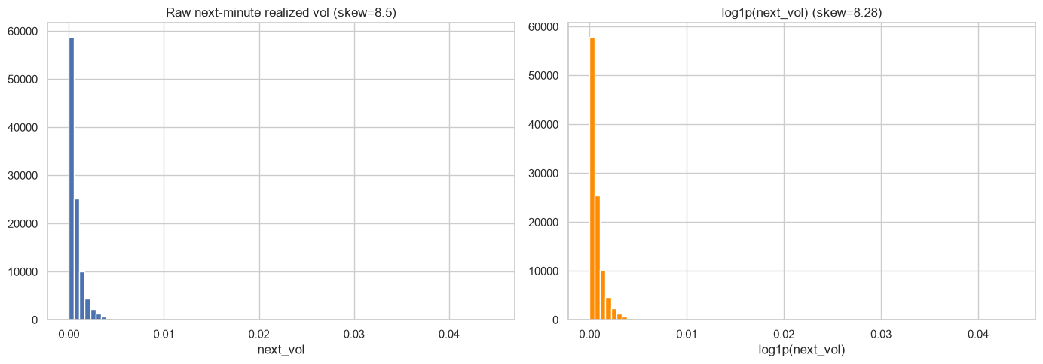
03 EDA and features
Return distribution and target transformation
Crypto Microstructure
06 / 50
Notes:
Analysis: crypto_microstructure_tutorial.ipynb.
Figure: figures/notebook/crypto_microstructure/cell_009_figure_1.png
Measured results: run_results/crypto_microstructure_tutorial/results.json.
Notebook cell ID: 6594c574.

Slide 7
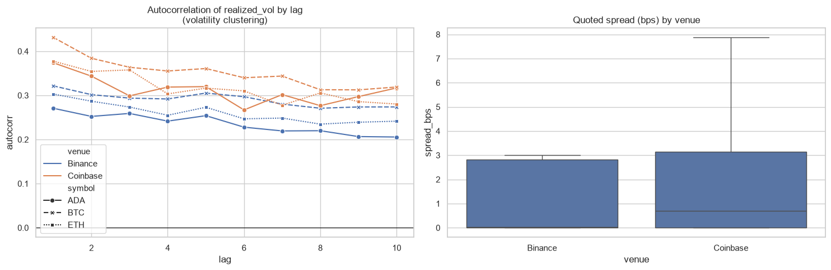
03 EDA and features
Return persistence and spreads
Crypto Microstructure
07 / 50
Notes:
Analysis: crypto_microstructure_tutorial.ipynb.
Figure: figures/notebook/crypto_microstructure/cell_011_figure_1.png
Measured results: run_results/crypto_microstructure_tutorial/results.json.
Notebook cell ID: 9e568e86.

Slide 8
03 EDA and features
EDA findings
Return sizes
Most observed returns are small. A few large moves contribute heavily to squared error.
Predictive features
Current absolute return and spread have strong positive linear associations with the next return magnitude.
Data sources
The venues cover different years and schemas, so venue labels also identify differences in period and data collection.
Crypto Microstructure
08 / 50
Notes:
Analysis: crypto_microstructure_tutorial.ipynb.
Measured results: run_results/crypto_microstructure_tutorial/results.json.

Slide 9
03 EDA and features
Feature engineering
Feature group | Predictors
Quotes | Midpoint and relative bid–ask spread
Depth | Bid and ask notional depth, plus normalized imbalance
Recent activity | Current absolute log return and buy/sell flow
Context | Minute of day, trade-data availability, asset and venue
Crypto Microstructure
09 / 50
Notes:
Analysis: crypto_microstructure_tutorial.ipynb.
Measured results: run_results/crypto_microstructure_tutorial/results.json.

Slide 10
04 Validation
Train–test split
Partition
Within each of the 6 series, use the first 80% for training and the final 20% for testing. The combined split has 83,053 training rows and 20,767 test rows.
Transforms
Fit feature scaling on training rows, then apply the same transformation to the test partition.
Evaluation
A chronological holdout evaluates later observations.
Crypto Microstructure
10 / 50
Notes:
Analysis: crypto_microstructure_tutorial.ipynb.
Measured results: run_results/crypto_microstructure_tutorial/results.json.

Slide 11
05 Methods
Methods
Family | Models | Role
Linear | OLS, Ridge, Lasso and Elastic Net | Interpretable reference
Local | K-nearest neighbors | Predict from similar records
Neural | Multilayer perceptron | Learn nonlinear relationships
Trees | Random Forest, XGBoost, CatBoost and LightGBM | Learn thresholds and interactions
Ensemble | Stacking of Random Forest, XGBoost and LightGBM | Combine predictions using a fitted meta-model
Crypto Microstructure
11 / 50
Notes:
Analysis: crypto_microstructure_tutorial.ipynb.
Measured results: run_results/crypto_microstructure_tutorial/results.json.

Slide 12
05 Methods
Linear models
Model | Strength | Weakness
OLS | Easy to inspect and use as a baseline | Misses nonlinear effects without added features
Ridge | Stabilizes coefficients when predictors overlap | Keeps all predictors and introduces shrinkage bias
Lasso | Can remove weak predictors with zero coefficients | Can select inconsistently among correlated inputs
Elastic Net | Combines sparse selection with L2 shrinkage | Requires penalty strength and mixing to be selected
Crypto Microstructure
12 / 50
Notes:
Analysis: crypto_microstructure_tutorial.ipynb.
https://scikit-learn.org/stable/modules/linear_model.html
Measured results: run_results/crypto_microstructure_tutorial/results.json.

Slide 13
05 Methods
KNN and neural networks
Model | Strength | Weakness
KNN | Simple local prediction with few modeling assumptions | Distances depend on scaling. Prediction slows as the reference set grows.
MLP | Learns smooth nonlinear effects and interactions | Sensitive to scaling and optimization. Needs regularization and convergence checks.
Crypto Microstructure
13 / 50
Notes:
Analysis: crypto_microstructure_tutorial.ipynb.
Measured results: run_results/crypto_microstructure_tutorial/results.json.

Slide 14
05 Methods
Tree-based models
Model | Strength | Weakness
Random Forest | Averaging many trees reduces variance and captures interactions | Large ensembles use memory and extrapolate poorly
XGBoost | Regularized boosting handles complex tabular relationships | Tree depth, learning rate and tree count need joint selection
CatBoost | Supports categorical features alongside numerical features | Training can be costly. Data quality still limits performance
LightGBM | Histogram splits support efficient training on large tables | Flexible leaf growth can overfit small groups
Crypto Microstructure
14 / 50
Notes:
Analysis: crypto_microstructure_tutorial.ipynb.
Measured results: run_results/crypto_microstructure_tutorial/results.json.

Slide 15
05 Methods
Stacking
Random Forest, XGBoost and LightGBM generate out-of-fold predictions. A Ridge meta-model learns how to combine them.
Strengths
Weaknesses
Can reduce error when the base models make different mistakes. The meta-model learns the weights from training predictions.
Adds fitting and inference cost. Similar base-model errors can limit the gain. Forward-only folds are needed for temporal meta-training.
RESULT IN THIS STUDY
RMSE 0.001462 and MAE 0.000685. It does not exceed the best individual model on the primary metric.
Crypto Microstructure
15 / 50
Notes:
Analysis: crypto_microstructure_tutorial.ipynb.
Base models: fitted reference configurations, each cloned and refitted by StackingRegressor/Classifier. cv=2. Meta-model: Ridge(alpha=1.0).
https://scikit-learn.org/stable/modules/ensemble.html#stacking
The notebook uses ordinary folds for stacking, rather than forward-only time splits.
Measured results: run_results/crypto_microstructure_tutorial/results.json.

Slide 16
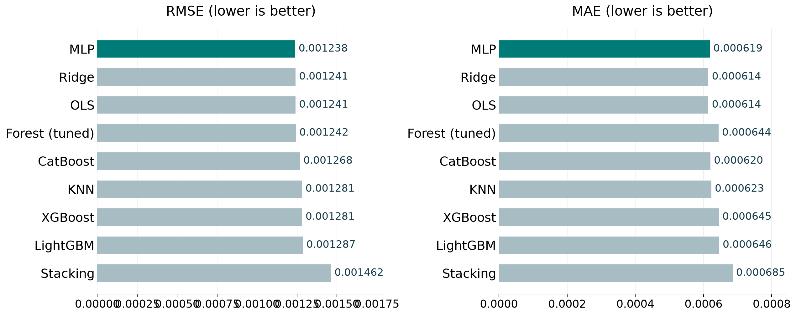
06 Results
Model comparison
Best test score per family, including the strongest penalized linear model. Full results appear in the appendix.
Crypto Microstructure
16 / 50
Notes:
Analysis: crypto_microstructure_tutorial.ipynb.
Figure: figures/crypto_microstructure/comparison.png
Measured results: run_results/crypto_microstructure_tutorial/results.json.

Slide 17
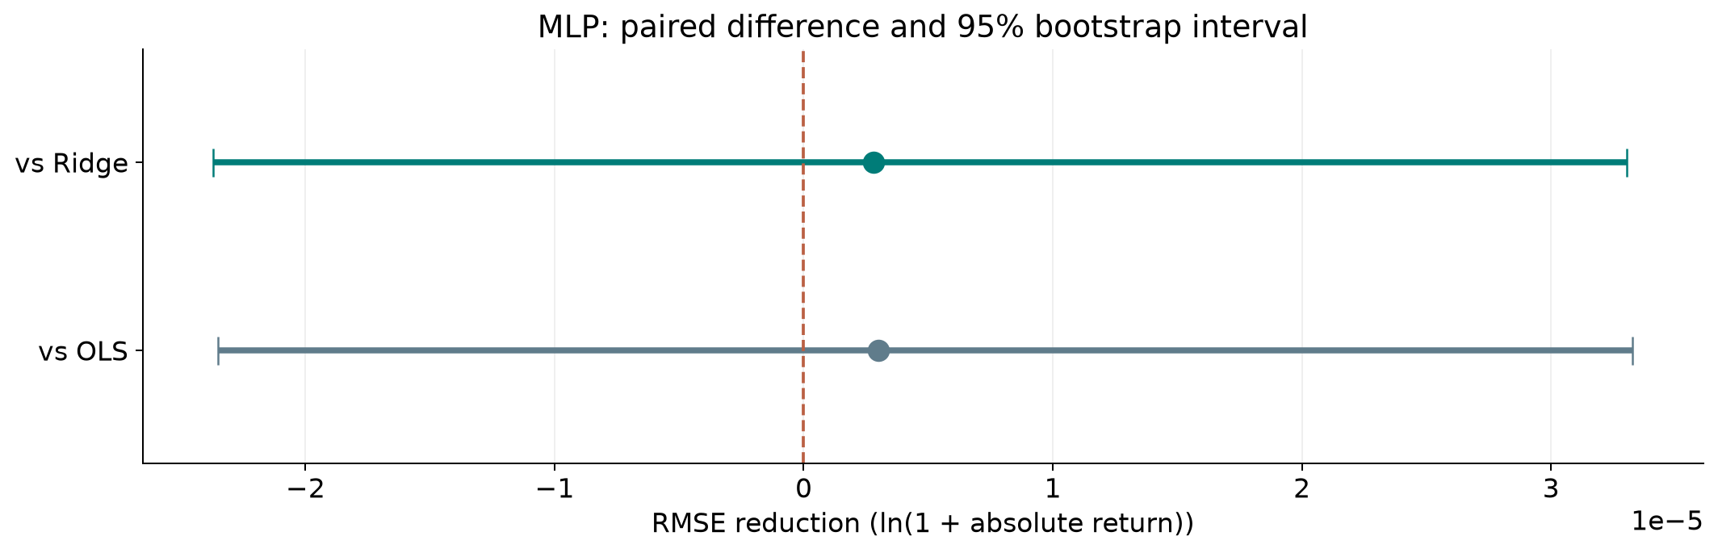
06 Results
Ranking stability
The 95% interval includes zero for MLP versus Ridge. Their ordering remains uncertain.
Crypto Microstructure
17 / 50
Notes:
Analysis: crypto_microstructure_tutorial.ipynb.
paired circular blocks within each asset–venue series, 60 observations. 1,000 paired resamples. Fitted models remain fixed.
[{"comparison": "MLP versus Ridge", "other": "Ridge", "advantage": 2.7881466821034085e-06, "ci_low": -2.369319003762979e-05, "ci_high": 3.302633837470464e-05}, {"comparison": "MLP versus OLS", "other": "OLS", "advantage": 2.99683168558597e-06, "ci_low": -2.349812439659298e-05, "ci_high": 3.327763830847921e-05}]
Figure: figures/crypto_microstructure/ranking_stability.png
Measured results: run_results/crypto_microstructure_tutorial/results.json.

Slide 18
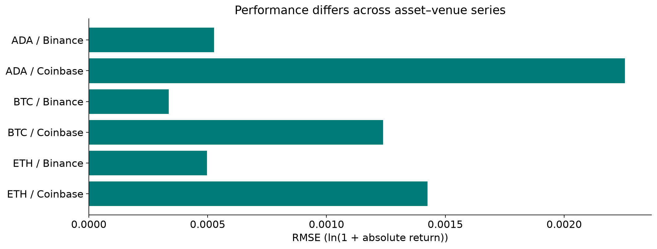
06 Results
Error by asset and venue
Each slice is one asset–venue series. The source datasets cover different market periods.
Crypto Microstructure
18 / 50
Notes:
Analysis: crypto_microstructure_tutorial.ipynb.
Figure: figures/crypto_microstructure/series_errors.png
Measured results: run_results/crypto_microstructure_tutorial/results.json.

Slide 19
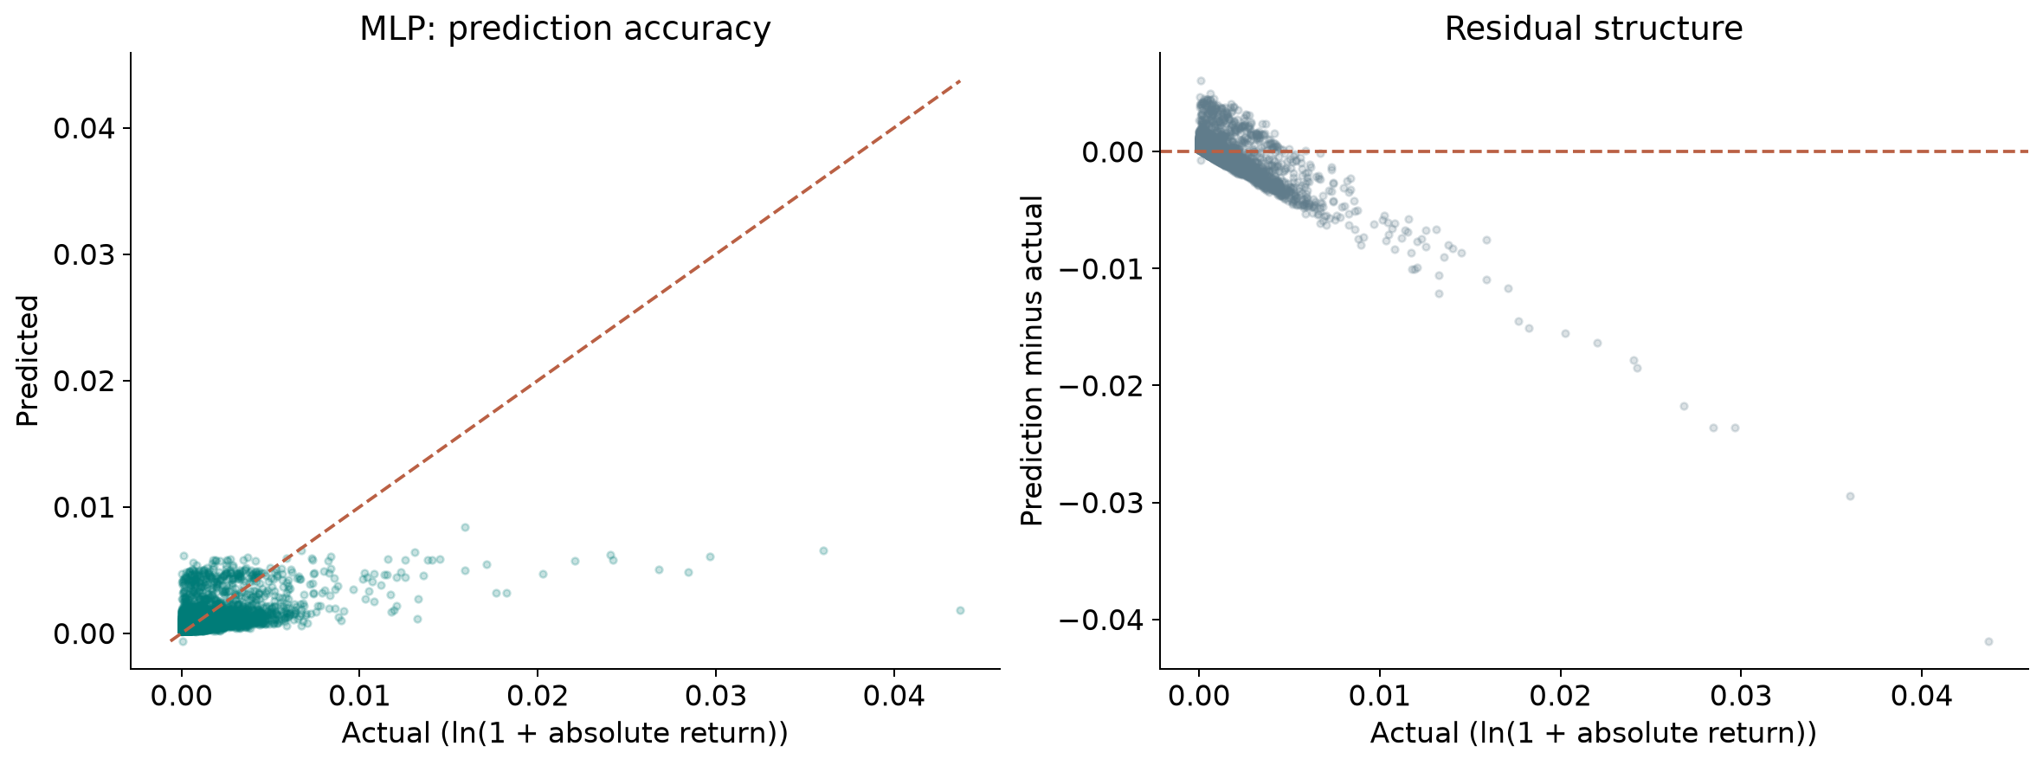
06 Results
Prediction errors
Residual = prediction − actual. Positive residuals indicate overprediction.
Crypto Microstructure
19 / 50
Notes:
Analysis: crypto_microstructure_tutorial.ipynb.
Figure: figures/crypto_microstructure/winner_diagnostics.png
Measured results: run_results/crypto_microstructure_tutorial/results.json.
Diagnostics use MLP predictions.

Slide 20
06 Results
Simple baselines
Method | RMSE | MAE | R²
Training mean | 0.001469 | 0.000694 | -0.0192
Current absolute return | 0.001493 | 0.000751 | -0.0531
MLP | 0.001238 | 0.000619 | 0.2765
Same test targets for every row. Error units: log1p absolute return.
Crypto Microstructure
20 / 50
Notes:
Analysis: crypto_microstructure_tutorial.ipynb.
Measured results: run_results/crypto_microstructure_tutorial/results.json.

Slide 21
06 Results
Results
Prediction accuracy
MLP has the lowest point RMSE. Ridge and OLS are close, while their relative performance depends on the error measure.
Series differences
The aggregate combines six asset–venue series drawn from different market periods. Report each series separately.
Model choice
Repeat purged date splits and stress-period tests before accepting the extra complexity of the neural model.
Crypto Microstructure
21 / 50
Notes:
Analysis: crypto_microstructure_tutorial.ipynb.
Measured results: run_results/crypto_microstructure_tutorial/results.json.
{"MLP": {"RMSE": 0.0012378142700370878, "MAE": 0.0006186274232856902, "R2": 0.27650304765931044}, "Ridge": {"RMSE": 0.0012406024167191912, "MAE": 0.0006142974820581686, "R2": 0.2732400581450485}, "LinearRegression": {"RMSE": 0.0012408111017226738, "MAE": 0.0006143308963397135, "R2": 0.2729955371690369}, "RandomForest (tuned)": {"RMSE": 0.001242409064177192, "MAE": 0.0006439774548061888, "R2": 0.2711218049127435}, "MLP (tuned)": {"RMSE": 0.001252937832098235, "MAE": 0.000620704865559331, "R2": 0.2587157351981477}, "RandomForest": {"RMSE": 0.0012609895833111805, "MAE": 0.000698950633721147, "R2": 0.24915769577817093}, "CatBoost": {"RMSE": 0.0012677694886415575, "MAE": 0.0006203285881759839, "R2": 0.24106195079537163}, "CatBoost (tuned)": {"RMSE": 0.0012732962830943678, "MAE": 0.0006239378358885142, "R2": 0.23443040222050215}, "KNN": {"RMSE": 0.0012808660286895831, "MAE": 0.0006230823773533314, "R2": 0.2253007231346016}, "KNN (tuned)": {"RMSE": 0.0012808660286895831, "MAE": 0.0006230823773533314, "R2": 0.2253007231346016}, "XGBoost": {"RMSE": 0.0012812282602092957, "MAE": 0.0006450163219227839, "R2": 0.2248624881121769}, "XGBoost (tuned)": {"RMSE": 0.0012840457830829617, "MAE": 0.0006443221227739389, "R2": 0.22144956147418593}, "LightGBM": {"RMSE": 0.0012865720366797909, "MAE": 0.0006459392744951608, "R2": 0.21838308106497584}, "LightGBM (tuned)": {"RMSE": 0.0012865720366797909, "MAE": 0.0006459392744951608, "R2": 0.21838308106497584}, "Stacking": {"RMSE": 0.0014622358649105166, "MAE": 0.0006851944953858625, "R2": -0.009626170715160365}, "Lasso": {"RMSE": 0.0014691719854798956, "MAE": 0.0006939495199361974, "R2": -0.01922721816792672}, "ElasticNet": {"RMSE": 0.0014691719854798956, "MAE": 0.0006939495199361974, "R2": -0.01922721816792672}}

Slide 22
07 Conclusion
Limitations
Limitation | Details
Market periods | The venue samples come from different years.
Cross-validation | Series ordering does not create a shared chronological cutoff across all assets.
Split boundary | The one-step target can cross the train–test boundary unless the last training observation is purged.
Tail behavior | The log1p transform changes these small return magnitudes very little.
Stacking folds | The notebook uses two ordinary training folds. Temporal meta-training needs a forward-only evaluation.
Crypto Microstructure
22 / 50
Notes:
Analysis: crypto_microstructure_tutorial.ipynb.
Measured results: run_results/crypto_microstructure_tutorial/results.json.

Slide 23
07 Conclusion
Next steps
# | Test | Method | Measure
1 | Purged folds | Use synchronized date cutoffs and purge labels overlapping the next partition. | Chronological isolation across series
2 | Persistence baseline | Compare the current absolute return with the next absolute return. | Incremental forecast skill
3 | Venue ablation | Remove venue and source-specific trade fields, then compare by series. | Signal beyond data-source identity
4 | Tail evaluation | Score stressed periods and high-volatility quantiles separately. | Stable risk estimates in extreme moves
Crypto Microstructure
23 / 50
Notes:
Analysis: crypto_microstructure_tutorial.ipynb.
Measured results: run_results/crypto_microstructure_tutorial/results.json.

Slide 24
07 Conclusion
Conclusion
A linear model remains competitive
RMSE 0.001238
MLP has a small point-score advantage. Test stability across dates, assets and large market moves before accepting the added complexity.
Crypto Microstructure
24 / 50
Notes:
Analysis: crypto_microstructure_tutorial.ipynb.
Measured results: run_results/crypto_microstructure_tutorial/results.json.
{"MLP": {"RMSE": 0.0012378142700370878, "MAE": 0.0006186274232856902, "R2": 0.27650304765931044}, "Ridge": {"RMSE": 0.0012406024167191912, "MAE": 0.0006142974820581686, "R2": 0.2732400581450485}, "LinearRegression": {"RMSE": 0.0012408111017226738, "MAE": 0.0006143308963397135, "R2": 0.2729955371690369}, "RandomForest (tuned)": {"RMSE": 0.001242409064177192, "MAE": 0.0006439774548061888, "R2": 0.2711218049127435}, "MLP (tuned)": {"RMSE": 0.001252937832098235, "MAE": 0.000620704865559331, "R2": 0.2587157351981477}, "RandomForest": {"RMSE": 0.0012609895833111805, "MAE": 0.000698950633721147, "R2": 0.24915769577817093}, "CatBoost": {"RMSE": 0.0012677694886415575, "MAE": 0.0006203285881759839, "R2": 0.24106195079537163}, "CatBoost (tuned)": {"RMSE": 0.0012732962830943678, "MAE": 0.0006239378358885142, "R2": 0.23443040222050215}, "KNN": {"RMSE": 0.0012808660286895831, "MAE": 0.0006230823773533314, "R2": 0.2253007231346016}, "KNN (tuned)": {"RMSE": 0.0012808660286895831, "MAE": 0.0006230823773533314, "R2": 0.2253007231346016}, "XGBoost": {"RMSE": 0.0012812282602092957, "MAE": 0.0006450163219227839, "R2": 0.2248624881121769}, "XGBoost (tuned)": {"RMSE": 0.0012840457830829617, "MAE": 0.0006443221227739389, "R2": 0.22144956147418593}, "LightGBM": {"RMSE": 0.0012865720366797909, "MAE": 0.0006459392744951608, "R2": 0.21838308106497584}, "LightGBM (tuned)": {"RMSE": 0.0012865720366797909, "MAE": 0.0006459392744951608, "R2": 0.21838308106497584}, "Stacking": {"RMSE": 0.0014622358649105166, "MAE": 0.0006851944953858625, "R2": -0.009626170715160365}, "Lasso": {"RMSE": 0.0014691719854798956, "MAE": 0.0006939495199361974, "R2": -0.01922721816792672}, "ElasticNet": {"RMSE": 0.0014691719854798956, "MAE": 0.0006939495199361974, "R2": -0.01922721816792672}}

Slide 25
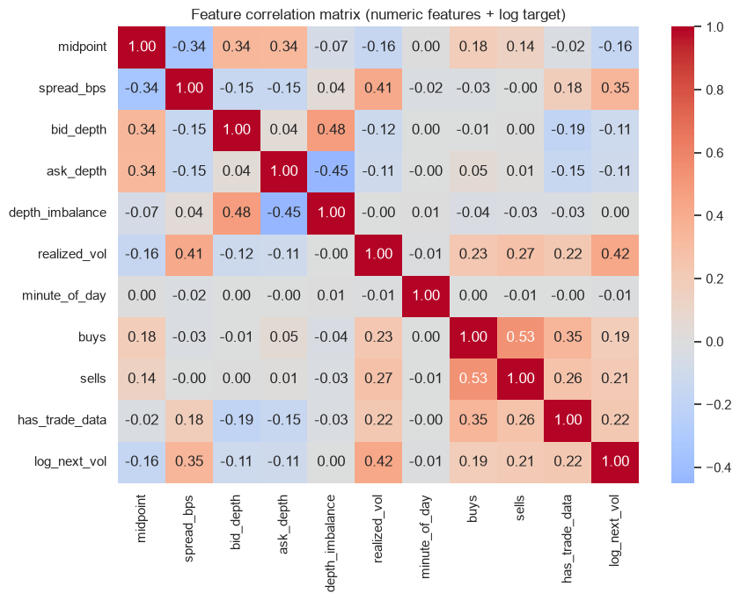
08 Appendix
Microstructure feature correlations
Crypto Microstructure
25 / 50
Notes:
Analysis: crypto_microstructure_tutorial.ipynb.
Figure: figures/notebook/crypto_microstructure/cell_013_figure_1.png
Measured results: run_results/crypto_microstructure_tutorial/results.json.
Notebook cell ID: a75b845e.

Slide 26
08 Appendix
Evaluation metrics
Metric | Meaning | Role
RMSE | Square root of mean squared error | Ranks models and emphasizes large misses
MAE | Mean absolute error | Describes typical error magnitude
R² | Improvement over predicting the test mean | Measures explained variation
Group errors | Metrics by target range or time group | Locates concentrated errors
Crypto Microstructure
26 / 50
Notes:
Analysis: crypto_microstructure_tutorial.ipynb.
Measured results: run_results/crypto_microstructure_tutorial/results.json.

Slide 27
08 Appendix
Regularization
Model | Objective | Main effect
OLS | Squared error | Fits an additive linear relationship
Ridge | Squared error + L2 penalty | Shrinks correlated coefficients
Lasso | Squared error + L1 penalty | Can set coefficients to zero
Elastic Net | Squared error + L1 and L2 penalties | Combines sparsity and shrinkage
Crypto Microstructure
27 / 50
Notes:
Analysis: crypto_microstructure_tutorial.ipynb.
https://scikit-learn.org/stable/modules/linear_model.html
Measured results: run_results/crypto_microstructure_tutorial/results.json.

Slide 28
08 Appendix
Linear model results
Model | RMSE | MAE | R²
OLS | 0.001241 | 0.000614 | 0.2730
Ridge | 0.001241 | 0.000614 | 0.2732
Lasso | 0.001469 | 0.000694 | -0.0192
Elastic Net | 0.001469 | 0.000694 | -0.0192
Crypto Microstructure
28 / 50
Notes:
Analysis: crypto_microstructure_tutorial.ipynb.
Measured results: run_results/crypto_microstructure_tutorial/results.json.
{"MLP": {"RMSE": 0.0012378142700370878, "MAE": 0.0006186274232856902, "R2": 0.27650304765931044}, "Ridge": {"RMSE": 0.0012406024167191912, "MAE": 0.0006142974820581686, "R2": 0.2732400581450485}, "LinearRegression": {"RMSE": 0.0012408111017226738, "MAE": 0.0006143308963397135, "R2": 0.2729955371690369}, "RandomForest (tuned)": {"RMSE": 0.001242409064177192, "MAE": 0.0006439774548061888, "R2": 0.2711218049127435}, "MLP (tuned)": {"RMSE": 0.001252937832098235, "MAE": 0.000620704865559331, "R2": 0.2587157351981477}, "RandomForest": {"RMSE": 0.0012609895833111805, "MAE": 0.000698950633721147, "R2": 0.24915769577817093}, "CatBoost": {"RMSE": 0.0012677694886415575, "MAE": 0.0006203285881759839, "R2": 0.24106195079537163}, "CatBoost (tuned)": {"RMSE": 0.0012732962830943678, "MAE": 0.0006239378358885142, "R2": 0.23443040222050215}, "KNN": {"RMSE": 0.0012808660286895831, "MAE": 0.0006230823773533314, "R2": 0.2253007231346016}, "KNN (tuned)": {"RMSE": 0.0012808660286895831, "MAE": 0.0006230823773533314, "R2": 0.2253007231346016}, "XGBoost": {"RMSE": 0.0012812282602092957, "MAE": 0.0006450163219227839, "R2": 0.2248624881121769}, "XGBoost (tuned)": {"RMSE": 0.0012840457830829617, "MAE": 0.0006443221227739389, "R2": 0.22144956147418593}, "LightGBM": {"RMSE": 0.0012865720366797909, "MAE": 0.0006459392744951608, "R2": 0.21838308106497584}, "LightGBM (tuned)": {"RMSE": 0.0012865720366797909, "MAE": 0.0006459392744951608, "R2": 0.21838308106497584}, "Stacking": {"RMSE": 0.0014622358649105166, "MAE": 0.0006851944953858625, "R2": -0.009626170715160365}, "Lasso": {"RMSE": 0.0014691719854798956, "MAE": 0.0006939495199361974, "R2": -0.01922721816792672}, "ElasticNet": {"RMSE": 0.0014691719854798956, "MAE": 0.0006939495199361974, "R2": -0.01922721816792672}}

Slide 29
08 Appendix
Linear model discussion
Results
Ridge slightly improves OLS RMSE to 0.001241. Lasso and Elastic Net have weaker R² under the selected penalties.
Interpretation
Return persistence and spread contain signal. Venue and asset fields can also absorb differences in source coverage.
Further work
Use common date boundaries, remove target overlap at the split, and test sensitivity to venue-specific fields.
Crypto Microstructure
29 / 50
Notes:
Analysis: crypto_microstructure_tutorial.ipynb.
https://scikit-learn.org/stable/modules/linear_model.html
Measured results: run_results/crypto_microstructure_tutorial/results.json.

Slide 30
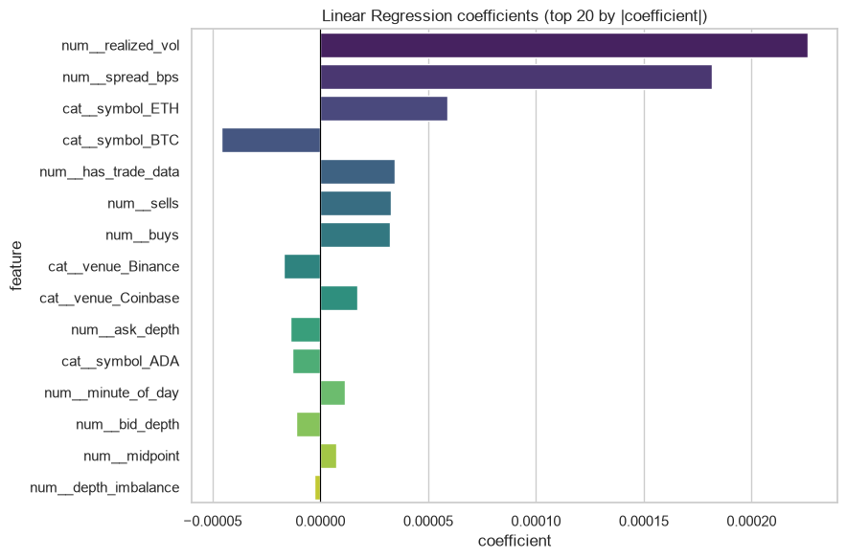
08 Appendix
Linear coefficients
Coefficients describe fitted associations after accounting for the other encoded inputs.
Crypto Microstructure
30 / 50
Notes:
Analysis: crypto_microstructure_tutorial.ipynb.
Figure: figures/notebook/crypto_microstructure/cell_020_figure_1.png
Measured results: run_results/crypto_microstructure_tutorial/results.json.
Notebook cell ID: acb8ace5.

Slide 31
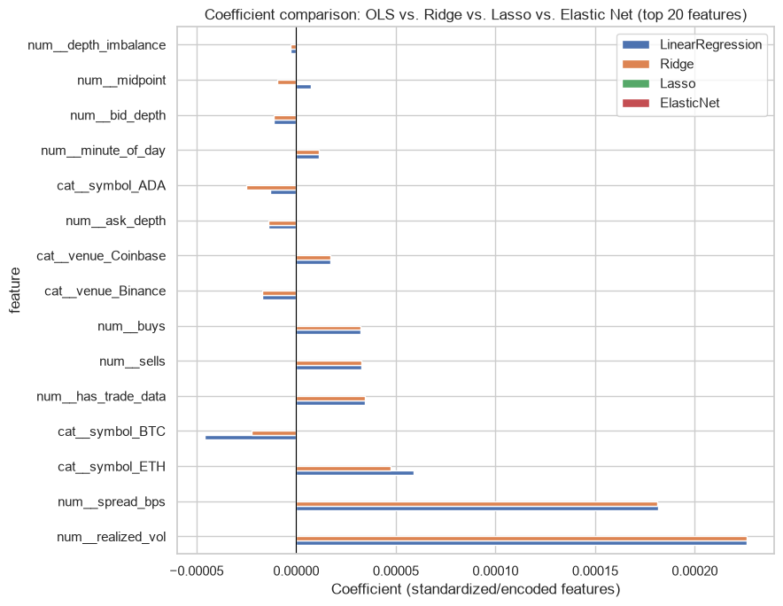
08 Appendix
Regularized coefficients
Coefficients describe fitted associations after accounting for the other encoded inputs.
Crypto Microstructure
31 / 50
Notes:
Analysis: crypto_microstructure_tutorial.ipynb.
Figure: figures/notebook/crypto_microstructure/cell_027_figure_1.png
Measured results: run_results/crypto_microstructure_tutorial/results.json.
Notebook cell ID: c90b6156.

Slide 32
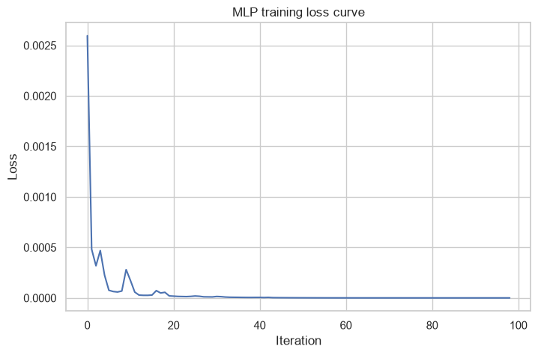
08 Appendix
MLP training loss
Training loss by optimization iteration.
Crypto Microstructure
32 / 50
Notes:
Analysis: crypto_microstructure_tutorial.ipynb.
Figure: figures/notebook/crypto_microstructure/cell_036_figure_1.png
Measured results: run_results/crypto_microstructure_tutorial/results.json.
Notebook cell ID: 83af3a08.

Slide 33
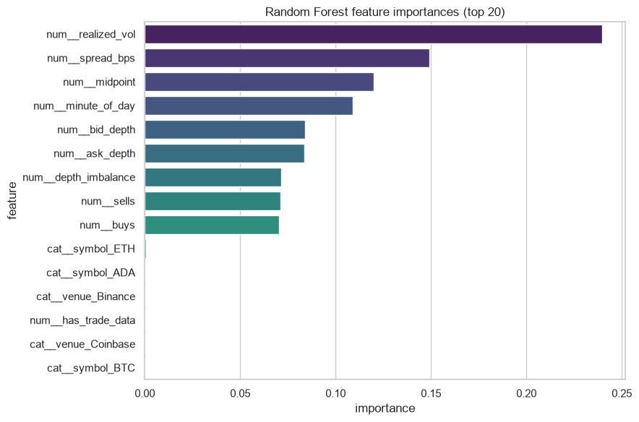
08 Appendix
Random Forest feature importance
Return persistence, spread and activity are candidate signals. Venue-related importance can also reflect period and source differences.
Crypto Microstructure
33 / 50
Notes:
Analysis: crypto_microstructure_tutorial.ipynb.
Figure: figures/notebook/crypto_microstructure/cell_042_figure_1.png
Measured results: run_results/crypto_microstructure_tutorial/results.json.
Notebook cell ID: ad4b9b63.

Slide 34
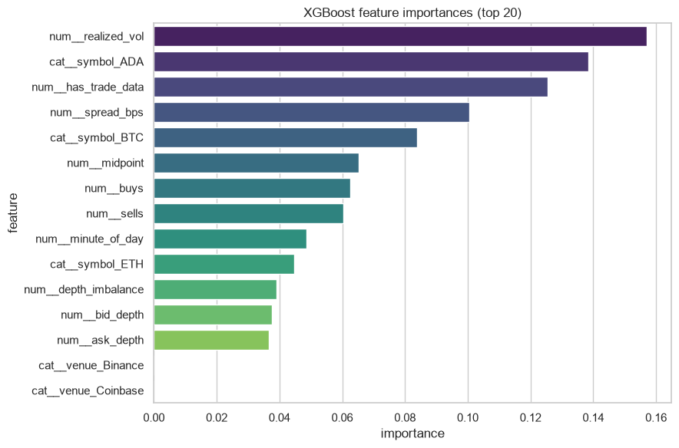
08 Appendix
XGBoost feature importance
Return persistence, spread and activity are candidate signals. Venue-related importance can also reflect period and source differences.
Crypto Microstructure
34 / 50
Notes:
Analysis: crypto_microstructure_tutorial.ipynb.
Figure: figures/notebook/crypto_microstructure/cell_048_figure_1.png
Measured results: run_results/crypto_microstructure_tutorial/results.json.
Notebook cell ID: a34b2ba9.

Slide 35
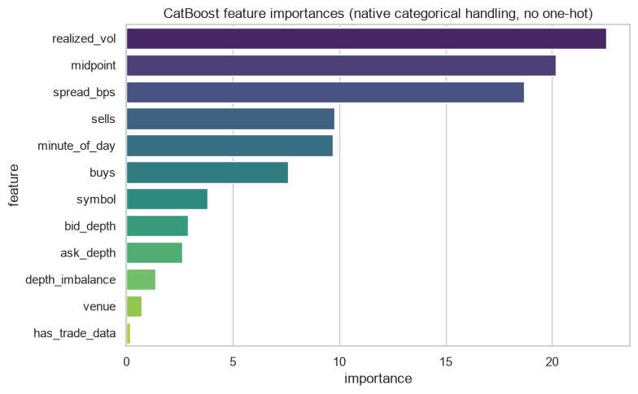
08 Appendix
CatBoost feature importance
Return persistence, spread and activity are candidate signals. Venue-related importance can also reflect period and source differences.
Crypto Microstructure
35 / 50
Notes:
Analysis: crypto_microstructure_tutorial.ipynb.
Figure: figures/notebook/crypto_microstructure/cell_054_figure_1.png
Measured results: run_results/crypto_microstructure_tutorial/results.json.
Notebook cell ID: 95083c80.

Slide 36
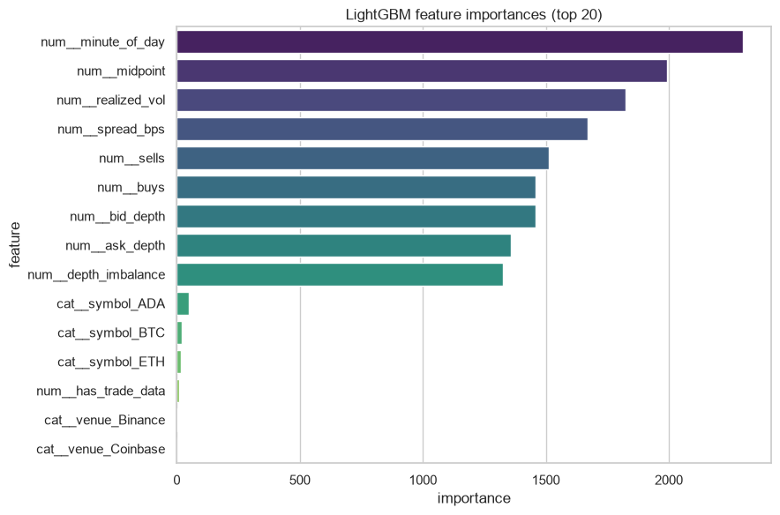
08 Appendix
LightGBM feature importance
Return persistence, spread and activity are candidate signals. Venue-related importance can also reflect period and source differences.
Crypto Microstructure
36 / 50
Notes:
Analysis: crypto_microstructure_tutorial.ipynb.
Figure: figures/notebook/crypto_microstructure/cell_060_figure_1.png
Measured results: run_results/crypto_microstructure_tutorial/results.json.
Notebook cell ID: 1717a9d2.

Slide 37
08 Appendix
Error by target range
Test target band | Rows | MAE | Mean prediction error
Q1: (-0.001, 0.000207] | 5,192 | 0.000500 | 0.000500
Q2: (0.000207, 0.000508] | 5,192 | 0.000337 | 0.000315
Q3: (0.000508, 0.00105] | 5,191 | 0.000316 | 0.000047
Q4: (0.00105, 0.0437] | 5,192 | 0.001321 | -0.001076
Errors for MLP. Mean error = prediction − actual. Units: log1p absolute return.
Crypto Microstructure
37 / 50
Notes:
Analysis: crypto_microstructure_tutorial.ipynb.
Measured results: run_results/crypto_microstructure_tutorial/results.json.

Slide 38
08 Appendix
Application
Topic | Application
Target | The prediction concerns the next return magnitude, rather than price direction.
Horizon | Check observation spacing before describing the horizon in minutes.
Trading use | Profitability requires a separate strategy test with costs and execution assumptions.
Crypto Microstructure
38 / 50
Notes:
Analysis: crypto_microstructure_tutorial.ipynb.
Measured results: run_results/crypto_microstructure_tutorial/results.json.

Slide 39
08 Appendix
Model selection Q&A
Why include penalized linear models?
Ridge uses L2 shrinkage to stabilize coefficients. Lasso uses L1 to encourage zeros. Elastic Net combines the penalties. Logistic models use the same penalty types for classification.
Why standardize the predictors?
Penalties and distance calculations depend on feature units. Scaling also helps neural-network optimization. Estimate the scaling parameters from training data.
Why include stacking?
It does not improve the leading individual model here. Combining models helps only when their errors are sufficiently different. Compare its gain with inference and maintenance cost.
Crypto Microstructure
39 / 50
Notes:
Analysis: crypto_microstructure_tutorial.ipynb.
https://scikit-learn.org/stable/modules/linear_model.html
https://scikit-learn.org/stable/modules/neighbors.html
https://scikit-learn.org/stable/modules/neural_networks_supervised.html
Measured results: run_results/crypto_microstructure_tutorial/results.json.

Slide 40
08 Appendix
Model interpretation Q&A
How do forests and boosting differ?
Random Forest averages trees trained with randomized rows and features. Boosting adds trees sequentially to reduce the chosen loss.
What does feature importance mean?
It describes how the fitted model uses its inputs. Related predictors can share importance. A high value does not establish a causal effect.
What do the resampling intervals cover?
They measure variation in the available test predictions with the fitted models fixed. A new split also tests sensitivity to training and model selection.
Crypto Microstructure
40 / 50
Notes:
Analysis: crypto_microstructure_tutorial.ipynb.
https://scikit-learn.org/stable/modules/ensemble.html
https://xgboost.readthedocs.io/en/stable/tutorials/model.html
Measured results: run_results/crypto_microstructure_tutorial/results.json.

Slide 41
08 Appendix
Data Q&A
What exactly is the target?
The next observed absolute log return, transformed with log1p. Check timestamp spacing before assigning a horizon in minutes.
Why remove a row at the split boundary?
The last training row uses the next observation for its target. Removing that row per series prevents its label from entering the test period.
Crypto Microstructure
41 / 50
Notes:
Analysis: crypto_microstructure_tutorial.ipynb.
Measured results: run_results/crypto_microstructure_tutorial/results.json.

Slide 42
08 Appendix
Results Q&A
Is the MLP worth the extra complexity?
The RMSE gain is about 0.24%. Compare repeated date splits, large market moves and inference time against OLS.
Can these results identify a venue effect?
The sources cover different years and fields. A venue comparison requires overlapping dates and comparable measurements.
Crypto Microstructure
42 / 50
Notes:
Analysis: crypto_microstructure_tutorial.ipynb.
Measured results: run_results/crypto_microstructure_tutorial/results.json.

Slide 43
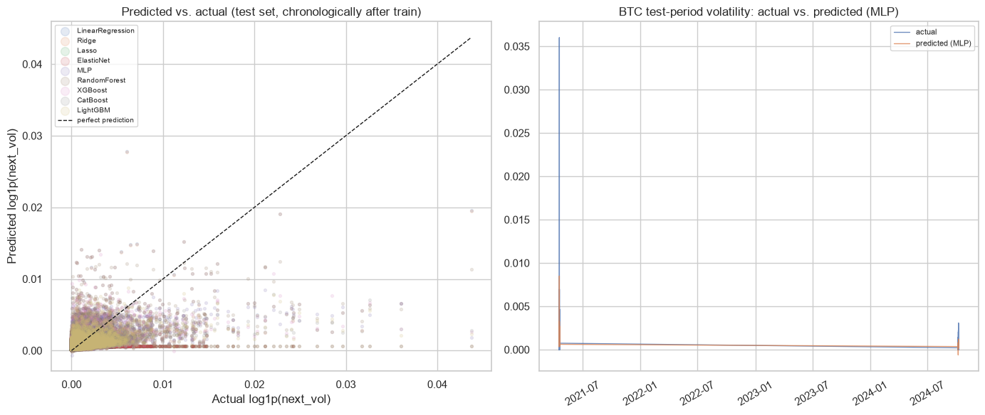
08 Appendix
Predicted and actual return magnitudes
Actual outcomes and predictions on the test partition.
Crypto Microstructure
43 / 50
Notes:
Analysis: crypto_microstructure_tutorial.ipynb.
Figure: figures/notebook/crypto_microstructure/cell_067_figure_1.png
Measured results: run_results/crypto_microstructure_tutorial/results.json.
Notebook cell ID: b67da88d.

Slide 44
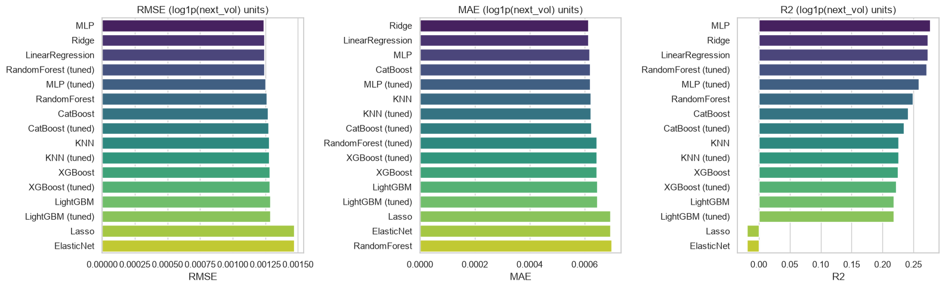
08 Appendix
Individual model metrics
Notebook comparison of individual models. The full results tables also include stacking.
Crypto Microstructure
44 / 50
Notes:
Analysis: crypto_microstructure_tutorial.ipynb.
Figure: figures/notebook/crypto_microstructure/cell_066_figure_1.png
Measured results: run_results/crypto_microstructure_tutorial/results.json.
Notebook cell ID: c6e2f811.

Slide 45
08 Appendix
Full results (1 of 2)
Model | RMSE | MAE | R²
MLP | 0.001238 | 0.000619 | 0.2765
Ridge | 0.001241 | 0.000614 | 0.2732
OLS | 0.001241 | 0.000614 | 0.2730
Forest (tuned) | 0.001242 | 0.000644 | 0.2711
MLP (tuned) | 0.001253 | 0.000621 | 0.2587
Random Forest | 0.001261 | 0.000699 | 0.2492
CatBoost | 0.001268 | 0.000620 | 0.2411
CatBoost (tuned) | 0.001273 | 0.000624 | 0.2344
KNN | 0.001281 | 0.000623 | 0.2253
Crypto Microstructure
45 / 50
Notes:
Analysis: crypto_microstructure_tutorial.ipynb.
Measured results: run_results/crypto_microstructure_tutorial/results.json.
{"MLP": {"RMSE": 0.0012378142700370878, "MAE": 0.0006186274232856902, "R2": 0.27650304765931044}, "Ridge": {"RMSE": 0.0012406024167191912, "MAE": 0.0006142974820581686, "R2": 0.2732400581450485}, "LinearRegression": {"RMSE": 0.0012408111017226738, "MAE": 0.0006143308963397135, "R2": 0.2729955371690369}, "RandomForest (tuned)": {"RMSE": 0.001242409064177192, "MAE": 0.0006439774548061888, "R2": 0.2711218049127435}, "MLP (tuned)": {"RMSE": 0.001252937832098235, "MAE": 0.000620704865559331, "R2": 0.2587157351981477}, "RandomForest": {"RMSE": 0.0012609895833111805, "MAE": 0.000698950633721147, "R2": 0.24915769577817093}, "CatBoost": {"RMSE": 0.0012677694886415575, "MAE": 0.0006203285881759839, "R2": 0.24106195079537163}, "CatBoost (tuned)": {"RMSE": 0.0012732962830943678, "MAE": 0.0006239378358885142, "R2": 0.23443040222050215}, "KNN": {"RMSE": 0.0012808660286895831, "MAE": 0.0006230823773533314, "R2": 0.2253007231346016}, "KNN (tuned)": {"RMSE": 0.0012808660286895831, "MAE": 0.0006230823773533314, "R2": 0.2253007231346016}, "XGBoost": {"RMSE": 0.0012812282602092957, "MAE": 0.0006450163219227839, "R2": 0.2248624881121769}, "XGBoost (tuned)": {"RMSE": 0.0012840457830829617, "MAE": 0.0006443221227739389, "R2": 0.22144956147418593}, "LightGBM": {"RMSE": 0.0012865720366797909, "MAE": 0.0006459392744951608, "R2": 0.21838308106497584}, "LightGBM (tuned)": {"RMSE": 0.0012865720366797909, "MAE": 0.0006459392744951608, "R2": 0.21838308106497584}, "Stacking": {"RMSE": 0.0014622358649105166, "MAE": 0.0006851944953858625, "R2": -0.009626170715160365}, "Lasso": {"RMSE": 0.0014691719854798956, "MAE": 0.0006939495199361974, "R2": -0.01922721816792672}, "ElasticNet": {"RMSE": 0.0014691719854798956, "MAE": 0.0006939495199361974, "R2": -0.01922721816792672}}

Slide 46
08 Appendix
Full results (2 of 2)
Model | RMSE | MAE | R²
KNN (tuned) | 0.001281 | 0.000623 | 0.2253
XGBoost | 0.001281 | 0.000645 | 0.2249
XGBoost (tuned) | 0.001284 | 0.000644 | 0.2214
LightGBM | 0.001287 | 0.000646 | 0.2184
LightGBM (tuned) | 0.001287 | 0.000646 | 0.2184
Stacking | 0.001462 | 0.000685 | -0.009626
Lasso | 0.001469 | 0.000694 | -0.0192
Elastic Net | 0.001469 | 0.000694 | -0.0192
Crypto Microstructure
46 / 50
Notes:
Analysis: crypto_microstructure_tutorial.ipynb.
Measured results: run_results/crypto_microstructure_tutorial/results.json.
{"MLP": {"RMSE": 0.0012378142700370878, "MAE": 0.0006186274232856902, "R2": 0.27650304765931044}, "Ridge": {"RMSE": 0.0012406024167191912, "MAE": 0.0006142974820581686, "R2": 0.2732400581450485}, "LinearRegression": {"RMSE": 0.0012408111017226738, "MAE": 0.0006143308963397135, "R2": 0.2729955371690369}, "RandomForest (tuned)": {"RMSE": 0.001242409064177192, "MAE": 0.0006439774548061888, "R2": 0.2711218049127435}, "MLP (tuned)": {"RMSE": 0.001252937832098235, "MAE": 0.000620704865559331, "R2": 0.2587157351981477}, "RandomForest": {"RMSE": 0.0012609895833111805, "MAE": 0.000698950633721147, "R2": 0.24915769577817093}, "CatBoost": {"RMSE": 0.0012677694886415575, "MAE": 0.0006203285881759839, "R2": 0.24106195079537163}, "CatBoost (tuned)": {"RMSE": 0.0012732962830943678, "MAE": 0.0006239378358885142, "R2": 0.23443040222050215}, "KNN": {"RMSE": 0.0012808660286895831, "MAE": 0.0006230823773533314, "R2": 0.2253007231346016}, "KNN (tuned)": {"RMSE": 0.0012808660286895831, "MAE": 0.0006230823773533314, "R2": 0.2253007231346016}, "XGBoost": {"RMSE": 0.0012812282602092957, "MAE": 0.0006450163219227839, "R2": 0.2248624881121769}, "XGBoost (tuned)": {"RMSE": 0.0012840457830829617, "MAE": 0.0006443221227739389, "R2": 0.22144956147418593}, "LightGBM": {"RMSE": 0.0012865720366797909, "MAE": 0.0006459392744951608, "R2": 0.21838308106497584}, "LightGBM (tuned)": {"RMSE": 0.0012865720366797909, "MAE": 0.0006459392744951608, "R2": 0.21838308106497584}, "Stacking": {"RMSE": 0.0014622358649105166, "MAE": 0.0006851944953858625, "R2": -0.009626170715160365}, "Lasso": {"RMSE": 0.0014691719854798956, "MAE": 0.0006939495199361974, "R2": -0.01922721816792672}, "ElasticNet": {"RMSE": 0.0014691719854798956, "MAE": 0.0006939495199361974, "R2": -0.01922721816792672}}

Slide 47
08 Appendix
Model settings
Model | Parameters
KNN | n_neighbors=15, weights='distance'
MLP | hidden_layer_sizes=(64, 32), alpha=0.0001, max_iter=500, early_stopping=True
Random Forest | n_estimators=300, max_depth=None, min_samples_leaf=2
XGBoost | n_estimators=500, learning_rate=0.05, max_depth=5
CatBoost | iterations=500, learning_rate=0.05, depth=6
LightGBM | n_estimators=500, learning_rate=0.05, num_leaves=31
Searches use two folds and two candidates. Each selected estimator refits on the full training partition.
Crypto Microstructure
47 / 50
Notes:
Analysis: crypto_microstructure_tutorial.ipynb.
Seed 42. Stacking uses two ordinary folds. Penalized linear models test three strengths. See the notebook for all constructor arguments.
Measured results: run_results/crypto_microstructure_tutorial/results.json.

Slide 48
08 Appendix
Selected hyperparameters (1 of 2)
Model | Selected parameters
KNN | n_neighbors=15, p=2, weights=distance
MLP | hidden_layer_sizes=(64, 32), alpha=0.001
Random Forest | n_estimators=300, min_samples_leaf=5, max_depth=8
Crypto Microstructure
48 / 50
Notes:
Analysis: crypto_microstructure_tutorial.ipynb.
Measured results: run_results/crypto_microstructure_tutorial/results.json.

Slide 49
08 Appendix
Selected hyperparameters (2 of 2)
Model | Selected parameters
XGBoost | n_estimators=500, max_depth=5, learning_rate=0.03
CatBoost | learning_rate=0.05, iterations=500, depth=4
LightGBM | num_leaves=31, n_estimators=500, learning_rate=0.05
Crypto Microstructure
49 / 50
Notes:
Analysis: crypto_microstructure_tutorial.ipynb.
Measured results: run_results/crypto_microstructure_tutorial/results.json.

Slide 50
08 Appendix
Sources
Dataset
Methods
Binance and Coinbase order-book and trading files
scikit-learn, XGBoost, CatBoost and LightGBM documentation.
Project analysis
Statistical analysis
crypto_microstructure_tutorial.ipynb
Paired resampling of test predictions, residual analysis and group-level error checks.
Crypto Microstructure
50 / 50
Notes:
Analysis: crypto_microstructure_tutorial.ipynb.
https://scikit-learn.org/stable/modules/linear_model.html
https://scikit-learn.org/stable/modules/neighbors.html
https://scikit-learn.org/stable/modules/neural_networks_supervised.html
https://scikit-learn.org/stable/modules/ensemble.html
https://xgboost.readthedocs.io/en/stable/tutorials/model.html
https://catboost.ai/docs/en/concepts/algorithm-main-stages_cat-to-numberic
https://lightgbm.readthedocs.io/en/stable/Features.html
https://www.statsmodels.org/stable/generated/statsmodels.tsa.statespace.sarimax.SARIMAX.html
Measured results: run_results/crypto_microstructure_tutorial/results.json.

