Slide 1
DATA SCIENCE PROJECT
PJM Hourly Load
Forecasting hourly electricity demand
Data, methods and results
Notes:
Analysis: pjm_energy_tutorial.ipynb.
Measured results: run_results/pjm_energy_tutorial/results.json.

Slide 2
01 Summary
Summary
Best model
287.1980
SARIMA has one-step RMSE 287.2 MW and MAE 208.0 MW.
Comparison
Test RMSE
RMSE is 30.8% below stacking, the strongest tabular approach.
Forecast horizon
The one-step test uses observed load updates. Longer forecasts need a separate evaluation at their intended lead time.
PJM Hourly Load
02 / 54
Notes:
Analysis: pjm_energy_tutorial.ipynb.
Measured results: run_results/pjm_energy_tutorial/results.json.
{"SARIMA": {"RMSE": 287.1979798046258, "MAE": 207.99915955320202, "R2": 0.997751639336172, "MAPE_%": 0.6775109995331485}, "Stacking": {"RMSE": 414.97953890376306, "MAE": 307.5499269570426, "R2": 0.9953058540911646, "MAPE_%": 0.9645291287691979}, "RandomForest": {"RMSE": 430.87681797686446, "MAE": 311.13570438253504, "R2": 0.9949393130299606, "MAPE_%": 0.9721756799684708}, "LightGBM": {"RMSE": 439.75645623956996, "MAE": 332.9425788076001, "R2": 0.9947285794465206, "MAPE_%": 1.0529744778326537}, "LightGBM (tuned)": {"RMSE": 439.75645623956996, "MAE": 332.9425788076001, "R2": 0.9947285794465206, "MAPE_%": 1.0529744778326537}, "CatBoost": {"RMSE": 451.1094796561299, "MAE": 338.66884543714883, "R2": 0.9944528855802729, "MAPE_%": 1.064651908792969}, "CatBoost (tuned)": {"RMSE": 451.1094796561299, "MAE": 338.66884543714883, "R2": 0.9944528855802729, "MAPE_%": 1.064651908792969}, "XGBoost": {"RMSE": 452.4238799319056, "MAE": 340.28600996182934, "R2": 0.9944205131689, "MAPE_%": 1.0708053893542864}, "XGBoost (tuned)": {"RMSE": 452.4238799319056, "MAE": 340.28600996182934, "R2": 0.9944205131689, "MAPE_%": 1.0708053893542864}, "RandomForest (tuned)": {"RMSE": 516.7157892592235, "MAE": 376.8811320594227, "R2": 0.9927220899776807, "MAPE_%": 1.177050411627558}, "MLP (tuned)": {"RMSE": 524.4235012182093, "MAE": 389.0859302919412, "R2": 0.9925033452824397, "MAPE_%": 1.2168820038907866}, "MLP": {"RMSE": 534.6546175610881, "MAE": 395.4071632293288, "R2": 0.9922079835438689, "MAPE_%": 1.2396926300012194}, "ARIMA": {"RMSE": 551.3531326283294, "MAE": 399.35703620210495, "R2": 0.9917136569282337, "MAPE_%": 1.2641890633216328}, "KNN": {"RMSE": 1134.2243155696647, "MAE": 869.4104217793458, "R2": 0.9649327972711288, "MAPE_%": 2.7828412346024756}, "KNN (tuned)": {"RMSE": 1134.2243155696647, "MAE": 869.4104217793458, "R2": 0.9649327972711288, "MAPE_%": 2.7828412346024756}, "Lasso": {"RMSE": 1228.9328051743244, "MAE": 964.7855253975243, "R2": 0.9588320262427147, "MAPE_%": 3.1071453346171305}, "LinearRegression": {"RMSE": 1228.9368009441957, "MAE": 964.7891571510552, "R2": 0.9588317585339905, "MAPE_%": 3.1071600414007543}, "Ridge": {"RMSE": 1228.9369338801916, "MAE": 964.7892454447995, "R2": 0.9588317496275253, "MAPE_%": 3.107160248753797}, "ElasticNet": {"RMSE": 1238.6586891881454, "MAE": 971.0576743519155, "R2": 0.958177833732254, "MAPE_%": 3.1222296481532297}}

Slide 3
02 Objective and data
Objective
Objective
Forecast the next hour of PJM East electricity demand using recent load and calendar information.
Prediction unit
One hourly forecast. Demand and prediction errors are measured in megawatts.
Evaluation
RMSE for model ranking, MAE for typical error, and R² for explained variation.
PJM Hourly Load
03 / 54
Notes:
Analysis: pjm_energy_tutorial.ipynb.
Measured results: run_results/pjm_energy_tutorial/results.json.

Slide 4
02 Objective and data
Dataset
Item | Details
Records | 145,366 source records, regularized to 145,392 hourly timestamps
Features | 1 January 2002 to 3 August 2018
Modeling rows | 145,224 hours after the initial 168-hour lag window
Inputs | 10 historical-load and calendar variables
PJM Hourly Load
04 / 54
Notes:
Analysis: pjm_energy_tutorial.ipynb.
Measured results: run_results/pjm_energy_tutorial/results.json.

Slide 5
02 Objective and data
Preprocessing
Step | Processing
Timestamps | Sort observations and create a regular hourly index.
Duplicate hours | Average the four duplicate timestamps.
Missing hours | Interpolate the 30 missing hourly observations.
History features | Shift rolling statistics by one hour so they use earlier load values.
PJM Hourly Load
05 / 54
Notes:
Analysis: pjm_energy_tutorial.ipynb.
Measured results: run_results/pjm_energy_tutorial/results.json.

Slide 6
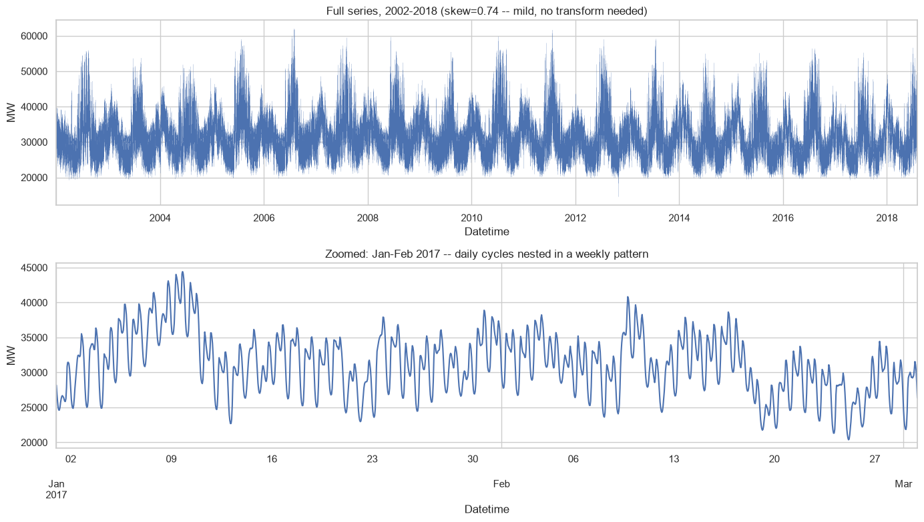
03 EDA and features
Hourly load history
PJM Hourly Load
06 / 54
Notes:
Analysis: pjm_energy_tutorial.ipynb.
Figure: figures/notebook/pjm_energy/cell_007_figure_1.png
Measured results: run_results/pjm_energy_tutorial/results.json.
Notebook cell ID: a5325d5e.

Slide 7
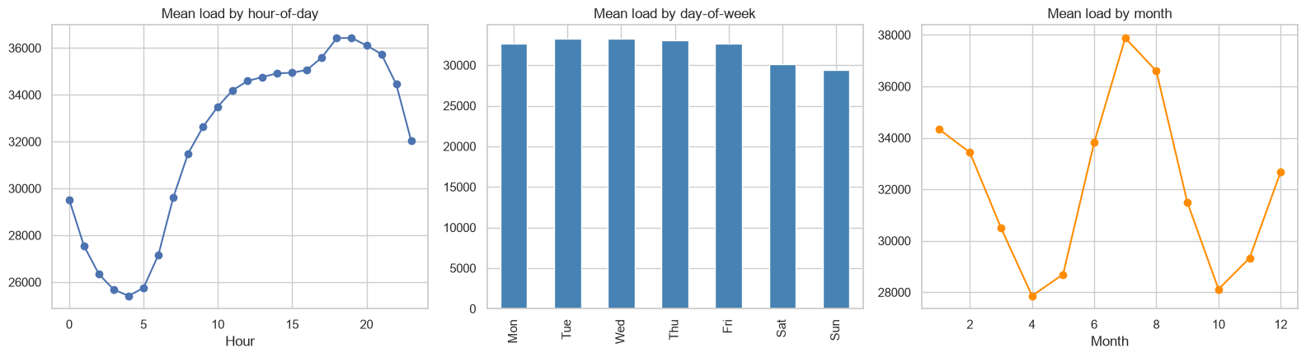
03 EDA and features
Daily and seasonal demand patterns
PJM Hourly Load
07 / 54
Notes:
Analysis: pjm_energy_tutorial.ipynb.
Figure: figures/notebook/pjm_energy/cell_008_figure_1.png
Measured results: run_results/pjm_energy_tutorial/results.json.
Notebook cell ID: 69769fd3.

Slide 8
03 EDA and features
EDA findings
Daily pattern
Load changes substantially by hour of day.
Seasonality
Weekday and monthly patterns support daily and weekly lag features.
Short-term dependence
The previous hour is the strongest linear predictor. Longer lags provide seasonal context.
PJM Hourly Load
08 / 54
Notes:
Analysis: pjm_energy_tutorial.ipynb.
Measured results: run_results/pjm_energy_tutorial/results.json.

Slide 9
03 EDA and features
Feature engineering
Feature group | Predictors
Calendar | Hour, weekday, month and weekend indicator
Load lags | Load from 1, 24 and 168 hours earlier
Daily history | Previous 24-hour mean and standard deviation
Weekly history | Previous 168-hour mean
PJM Hourly Load
09 / 54
Notes:
Analysis: pjm_energy_tutorial.ipynb.
Measured results: run_results/pjm_energy_tutorial/results.json.

Slide 10
04 Validation
Train–test split
Partition
Train on 136,464 hours through 3 August 2017 00:00. Test on the final 8,760 hours through 3 August 2018 00:00. TimeSeriesSplit uses two folds for tuning.
Transforms
Fit feature scaling on training rows, then apply the same transformation to the test partition.
Evaluation
A chronological holdout evaluates later observations.
PJM Hourly Load
10 / 54
Notes:
Analysis: pjm_energy_tutorial.ipynb.
Measured results: run_results/pjm_energy_tutorial/results.json.

Slide 11
05 Methods
Methods
Family | Models | Role
Linear | OLS, Ridge, Lasso and Elastic Net | Interpretable reference
Local | K-nearest neighbors | Predict from similar records
Neural | Multilayer perceptron | Learn nonlinear relationships
Trees | Random Forest, XGBoost, CatBoost and LightGBM | Learn thresholds and interactions
Time series | ARIMA and SARIMA | Model serial and seasonal dependence
Ensemble | Stacking of Random Forest, XGBoost and LightGBM | Combine predictions using a fitted meta-model
PJM Hourly Load
11 / 54
Notes:
Analysis: pjm_energy_tutorial.ipynb.
Measured results: run_results/pjm_energy_tutorial/results.json.

Slide 12
05 Methods
Linear models
Model | Strength | Weakness
OLS | Easy to inspect and use as a baseline | Misses nonlinear effects without added features
Ridge | Stabilizes coefficients when predictors overlap | Keeps all predictors and introduces shrinkage bias
Lasso | Can remove weak predictors with zero coefficients | Can select inconsistently among correlated inputs
Elastic Net | Combines sparse selection with L2 shrinkage | Requires penalty strength and mixing to be selected
PJM Hourly Load
12 / 54
Notes:
Analysis: pjm_energy_tutorial.ipynb.
https://scikit-learn.org/stable/modules/linear_model.html
Measured results: run_results/pjm_energy_tutorial/results.json.

Slide 13
05 Methods
KNN and neural networks
Model | Strength | Weakness
KNN | Simple local prediction with few modeling assumptions | Distances depend on scaling. Prediction slows as the reference set grows.
MLP | Learns smooth nonlinear effects and interactions | Sensitive to scaling and optimization. Needs regularization and convergence checks.
PJM Hourly Load
13 / 54
Notes:
Analysis: pjm_energy_tutorial.ipynb.
Measured results: run_results/pjm_energy_tutorial/results.json.

Slide 14
05 Methods
Tree-based models
Model | Strength | Weakness
Random Forest | Averaging many trees reduces variance and captures interactions | Large ensembles use memory and extrapolate poorly
XGBoost | Regularized boosting handles complex tabular relationships | Tree depth, learning rate and tree count need joint selection
CatBoost | Supports categorical features alongside numerical features | Training can be costly. Data quality still limits performance
LightGBM | Histogram splits support efficient training on large tables | Flexible leaf growth can overfit small groups
PJM Hourly Load
14 / 54
Notes:
Analysis: pjm_energy_tutorial.ipynb.
Measured results: run_results/pjm_energy_tutorial/results.json.

Slide 15
05 Methods
Stacking
Random Forest, XGBoost and LightGBM generate out-of-fold predictions. A Ridge meta-model learns how to combine them.
Strengths
Weaknesses
Can reduce error when the base models make different mistakes. The meta-model learns the weights from training predictions.
Adds fitting and inference cost. Similar base-model errors can limit the gain. Forward-only folds are needed for temporal meta-training.
RESULT IN THIS STUDY
RMSE 414.9795 and MAE 307.5499. It does not exceed the best individual model on the primary metric.
PJM Hourly Load
15 / 54
Notes:
Analysis: pjm_energy_tutorial.ipynb.
Base models: fitted reference configurations, each cloned and refitted by StackingRegressor/Classifier. cv=2. Meta-model: Ridge(alpha=1.0).
https://scikit-learn.org/stable/modules/ensemble.html#stacking
The notebook uses ordinary folds for stacking, rather than forward-only time splits.
Measured results: run_results/pjm_energy_tutorial/results.json.

Slide 16
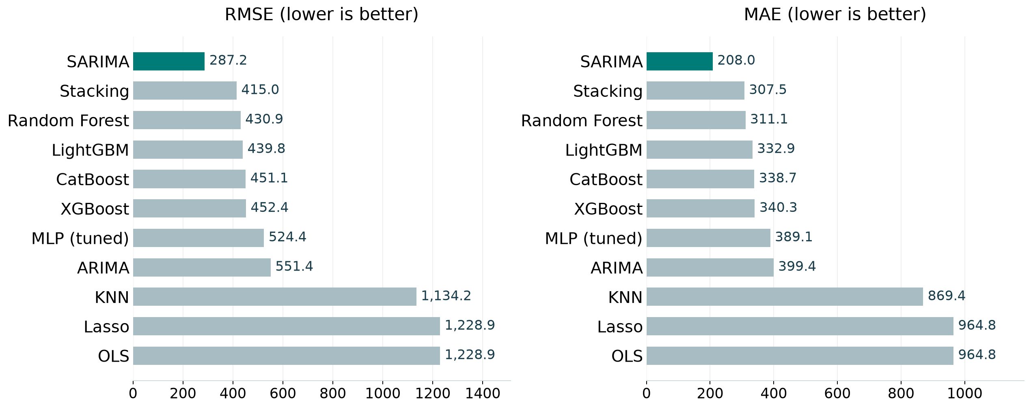
06 Results
Model comparison
Best test score per family, including the strongest penalized linear model. Full results appear in the appendix.
PJM Hourly Load
16 / 54
Notes:
Analysis: pjm_energy_tutorial.ipynb.
Figure: figures/pjm_energy/comparison.png
Measured results: run_results/pjm_energy_tutorial/results.json.

Slide 17
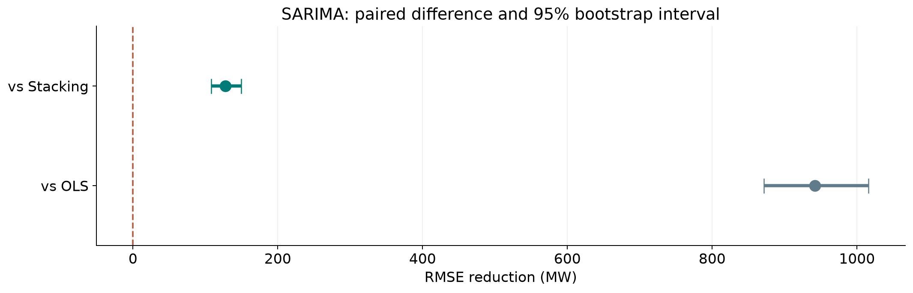
06 Results
Ranking stability
SARIMA has lower RMSE than Stacking across the 95% resampling interval.
PJM Hourly Load
17 / 54
Notes:
Analysis: pjm_energy_tutorial.ipynb.
paired circular block bootstrap, 168 hours. 1,000 paired resamples. Fitted models remain fixed.
[{"comparison": "SARIMA versus Stacking", "other": "Stacking", "advantage": 127.78155909913727, "ci_low": 107.9991436708712, "ci_high": 149.2837980845288}, {"comparison": "SARIMA versus OLS", "other": "OLS", "advantage": 941.73882113957, "ci_low": 871.341767296107, "ci_high": 1016.0332964923774}]
Figure: figures/pjm_energy/ranking_stability.png
Measured results: run_results/pjm_energy_tutorial/results.json.

Slide 18
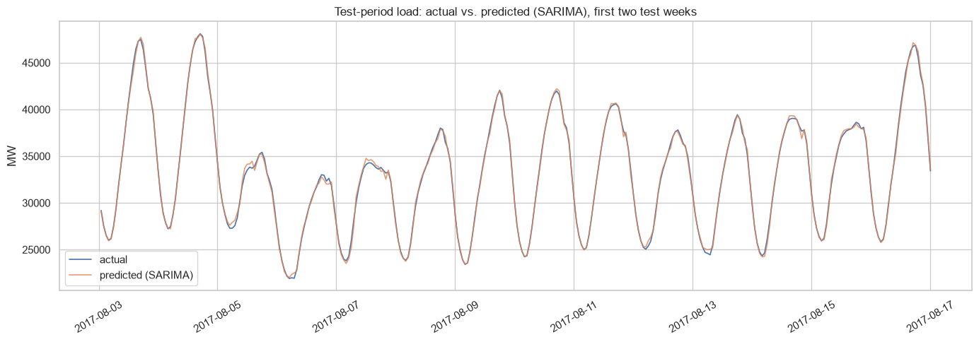
06 Results
Predictions at the start of the holdout
Actual outcomes and predictions on the test partition.
PJM Hourly Load
18 / 54
Notes:
Analysis: pjm_energy_tutorial.ipynb.
Figure: figures/notebook/pjm_energy/cell_067_figure_1.png
Measured results: run_results/pjm_energy_tutorial/results.json.
Notebook cell ID: be9c00c0.

Slide 19
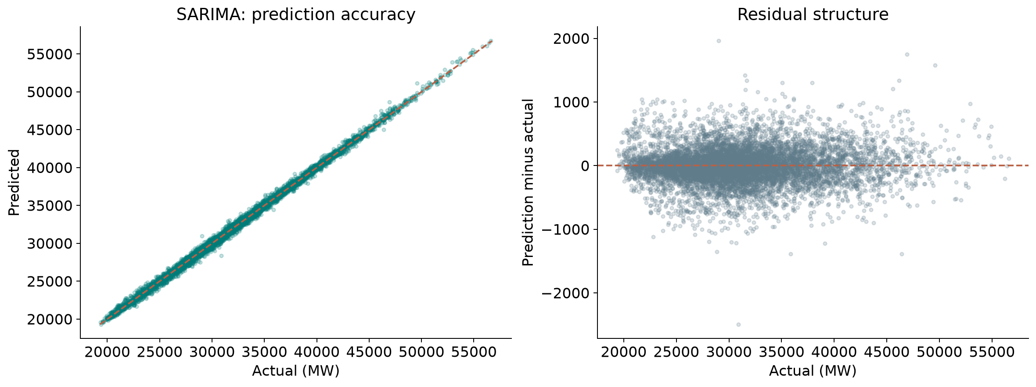
06 Results
Error by demand level
SARIMA: prediction error across observed demand levels. Residual = prediction − actual.
PJM Hourly Load
19 / 54
Notes:
Analysis: pjm_energy_tutorial.ipynb.
Figure: figures/pjm_energy/winner_diagnostics.png
Measured results: run_results/pjm_energy_tutorial/results.json.
Diagnostics use SARIMA predictions.

Slide 20
06 Results
Simple baselines
Method | RMSE | MAE | R²
Training mean | 6,128.8 | 4,903.5 | -0.0239
Persistence lag_1 | 1,319.4 | 1,036.1 | 0.9525
Persistence lag_24 | 3,146.2 | 2,306.8 | 0.7302
Persistence lag_168 | 4,852.3 | 3,581.8 | 0.3582
SARIMA | 287.1980 | 207.9992 | 0.9978
Same test targets for every row. Error units: MW.
PJM Hourly Load
20 / 54
Notes:
Analysis: pjm_energy_tutorial.ipynb.
Measured results: run_results/pjm_energy_tutorial/results.json.

Slide 21
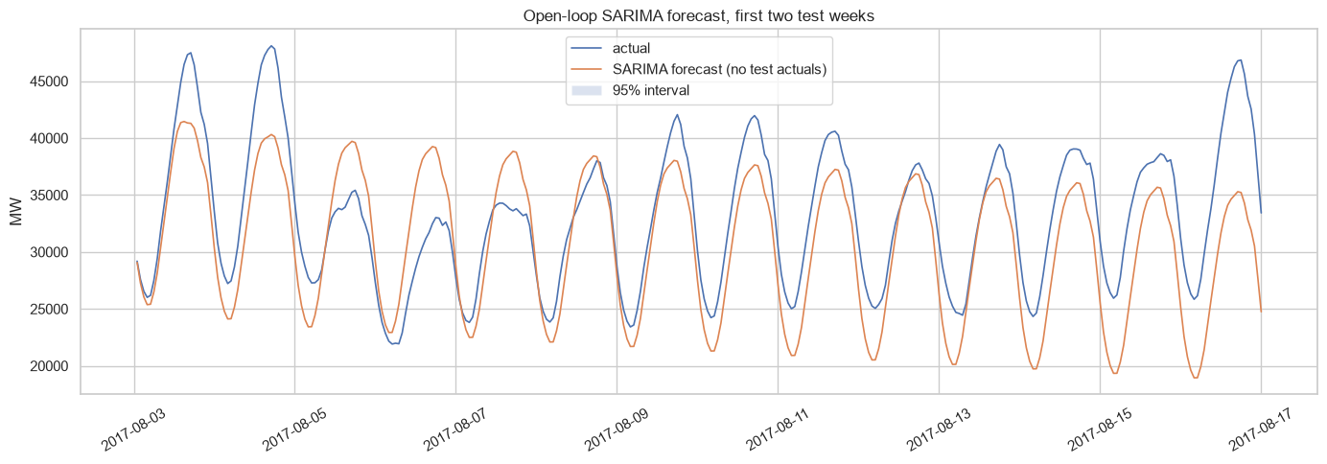
06 Results
14-day SARIMA forecast
The forecast covers the first 336 test hours and uses no future observed load updates.
PJM Hourly Load
21 / 54
Notes:
Analysis: pjm_energy_tutorial.ipynb.
Figure: figures/notebook/pjm_energy/cell_063_figure_1.png
Measured results: run_results/pjm_energy_tutorial/results.json.
Notebook cell ID: 41bbb10a.

Slide 22
06 Results
Results
One-step accuracy
SARIMA leads with RMSE 287.2 MW. Stacking improves on the individual tabular models at 415.0 MW.
Longer forecasts
The first 14-day open-loop forecast has RMSE 4,426.7 MW. It receives no future observed load.
Next evaluation
Compare 1-hour and 24-hour forecasts over several rolling origins, using inputs available at each issue time.
PJM Hourly Load
22 / 54
Notes:
Analysis: pjm_energy_tutorial.ipynb.
Measured results: run_results/pjm_energy_tutorial/results.json.
{"SARIMA": {"RMSE": 287.1979798046258, "MAE": 207.99915955320202, "R2": 0.997751639336172, "MAPE_%": 0.6775109995331485}, "Stacking": {"RMSE": 414.97953890376306, "MAE": 307.5499269570426, "R2": 0.9953058540911646, "MAPE_%": 0.9645291287691979}, "RandomForest": {"RMSE": 430.87681797686446, "MAE": 311.13570438253504, "R2": 0.9949393130299606, "MAPE_%": 0.9721756799684708}, "LightGBM": {"RMSE": 439.75645623956996, "MAE": 332.9425788076001, "R2": 0.9947285794465206, "MAPE_%": 1.0529744778326537}, "LightGBM (tuned)": {"RMSE": 439.75645623956996, "MAE": 332.9425788076001, "R2": 0.9947285794465206, "MAPE_%": 1.0529744778326537}, "CatBoost": {"RMSE": 451.1094796561299, "MAE": 338.66884543714883, "R2": 0.9944528855802729, "MAPE_%": 1.064651908792969}, "CatBoost (tuned)": {"RMSE": 451.1094796561299, "MAE": 338.66884543714883, "R2": 0.9944528855802729, "MAPE_%": 1.064651908792969}, "XGBoost": {"RMSE": 452.4238799319056, "MAE": 340.28600996182934, "R2": 0.9944205131689, "MAPE_%": 1.0708053893542864}, "XGBoost (tuned)": {"RMSE": 452.4238799319056, "MAE": 340.28600996182934, "R2": 0.9944205131689, "MAPE_%": 1.0708053893542864}, "RandomForest (tuned)": {"RMSE": 516.7157892592235, "MAE": 376.8811320594227, "R2": 0.9927220899776807, "MAPE_%": 1.177050411627558}, "MLP (tuned)": {"RMSE": 524.4235012182093, "MAE": 389.0859302919412, "R2": 0.9925033452824397, "MAPE_%": 1.2168820038907866}, "MLP": {"RMSE": 534.6546175610881, "MAE": 395.4071632293288, "R2": 0.9922079835438689, "MAPE_%": 1.2396926300012194}, "ARIMA": {"RMSE": 551.3531326283294, "MAE": 399.35703620210495, "R2": 0.9917136569282337, "MAPE_%": 1.2641890633216328}, "KNN": {"RMSE": 1134.2243155696647, "MAE": 869.4104217793458, "R2": 0.9649327972711288, "MAPE_%": 2.7828412346024756}, "KNN (tuned)": {"RMSE": 1134.2243155696647, "MAE": 869.4104217793458, "R2": 0.9649327972711288, "MAPE_%": 2.7828412346024756}, "Lasso": {"RMSE": 1228.9328051743244, "MAE": 964.7855253975243, "R2": 0.9588320262427147, "MAPE_%": 3.1071453346171305}, "LinearRegression": {"RMSE": 1228.9368009441957, "MAE": 964.7891571510552, "R2": 0.9588317585339905, "MAPE_%": 3.1071600414007543}, "Ridge": {"RMSE": 1228.9369338801916, "MAE": 964.7892454447995, "R2": 0.9588317496275253, "MAPE_%": 3.107160248753797}, "ElasticNet": {"RMSE": 1238.6586891881454, "MAE": 971.0576743519155, "R2": 0.958177833732254, "MAPE_%": 3.1222296481532297}}

Slide 23
07 Conclusion
Limitations
Limitation | Details
Forecast horizon | One-step accuracy does not establish day-ahead accuracy.
Missing hours | Retrospective interpolation can use later observations.
Test period | One year does not show performance across earlier operating regimes.
Peak conditions | Peak-load and unusual-calendar errors need separate assessment.
Stacking folds | The notebook uses two ordinary training folds. Temporal meta-training needs a forward-only evaluation.
PJM Hourly Load
23 / 54
Notes:
Analysis: pjm_energy_tutorial.ipynb.
Measured results: run_results/pjm_energy_tutorial/results.json.

Slide 24
07 Conclusion
Next steps
# | Test | Method | Measure
1 | Seasonal baselines | Compare previous hour, previous day and previous week on the same test period. | Forecast skill relative to persistence
2 | Rolling origins | Evaluate several consecutive years with strictly past training data. | Stable seasonal performance
3 | Horizon-specific models | Build separate 1-hour and 24-hour tasks with valid information sets. | Comparable error by lead time
4 | Operational features | Add weather forecasts and holiday calendars known at prediction time. | Improvement during peak demand
PJM Hourly Load
24 / 54
Notes:
Analysis: pjm_energy_tutorial.ipynb.
Measured results: run_results/pjm_energy_tutorial/results.json.

Slide 25
07 Conclusion
Conclusion
SARIMA leads one-step forecasting
RMSE 287.1980
Its advantage applies when observed load updates the state each hour. Day-ahead scheduling needs validation at a fixed issue time.
PJM Hourly Load
25 / 54
Notes:
Analysis: pjm_energy_tutorial.ipynb.
Measured results: run_results/pjm_energy_tutorial/results.json.
{"SARIMA": {"RMSE": 287.1979798046258, "MAE": 207.99915955320202, "R2": 0.997751639336172, "MAPE_%": 0.6775109995331485}, "Stacking": {"RMSE": 414.97953890376306, "MAE": 307.5499269570426, "R2": 0.9953058540911646, "MAPE_%": 0.9645291287691979}, "RandomForest": {"RMSE": 430.87681797686446, "MAE": 311.13570438253504, "R2": 0.9949393130299606, "MAPE_%": 0.9721756799684708}, "LightGBM": {"RMSE": 439.75645623956996, "MAE": 332.9425788076001, "R2": 0.9947285794465206, "MAPE_%": 1.0529744778326537}, "LightGBM (tuned)": {"RMSE": 439.75645623956996, "MAE": 332.9425788076001, "R2": 0.9947285794465206, "MAPE_%": 1.0529744778326537}, "CatBoost": {"RMSE": 451.1094796561299, "MAE": 338.66884543714883, "R2": 0.9944528855802729, "MAPE_%": 1.064651908792969}, "CatBoost (tuned)": {"RMSE": 451.1094796561299, "MAE": 338.66884543714883, "R2": 0.9944528855802729, "MAPE_%": 1.064651908792969}, "XGBoost": {"RMSE": 452.4238799319056, "MAE": 340.28600996182934, "R2": 0.9944205131689, "MAPE_%": 1.0708053893542864}, "XGBoost (tuned)": {"RMSE": 452.4238799319056, "MAE": 340.28600996182934, "R2": 0.9944205131689, "MAPE_%": 1.0708053893542864}, "RandomForest (tuned)": {"RMSE": 516.7157892592235, "MAE": 376.8811320594227, "R2": 0.9927220899776807, "MAPE_%": 1.177050411627558}, "MLP (tuned)": {"RMSE": 524.4235012182093, "MAE": 389.0859302919412, "R2": 0.9925033452824397, "MAPE_%": 1.2168820038907866}, "MLP": {"RMSE": 534.6546175610881, "MAE": 395.4071632293288, "R2": 0.9922079835438689, "MAPE_%": 1.2396926300012194}, "ARIMA": {"RMSE": 551.3531326283294, "MAE": 399.35703620210495, "R2": 0.9917136569282337, "MAPE_%": 1.2641890633216328}, "KNN": {"RMSE": 1134.2243155696647, "MAE": 869.4104217793458, "R2": 0.9649327972711288, "MAPE_%": 2.7828412346024756}, "KNN (tuned)": {"RMSE": 1134.2243155696647, "MAE": 869.4104217793458, "R2": 0.9649327972711288, "MAPE_%": 2.7828412346024756}, "Lasso": {"RMSE": 1228.9328051743244, "MAE": 964.7855253975243, "R2": 0.9588320262427147, "MAPE_%": 3.1071453346171305}, "LinearRegression": {"RMSE": 1228.9368009441957, "MAE": 964.7891571510552, "R2": 0.9588317585339905, "MAPE_%": 3.1071600414007543}, "Ridge": {"RMSE": 1228.9369338801916, "MAE": 964.7892454447995, "R2": 0.9588317496275253, "MAPE_%": 3.107160248753797}, "ElasticNet": {"RMSE": 1238.6586891881454, "MAE": 971.0576743519155, "R2": 0.958177833732254, "MAPE_%": 3.1222296481532297}}

Slide 26
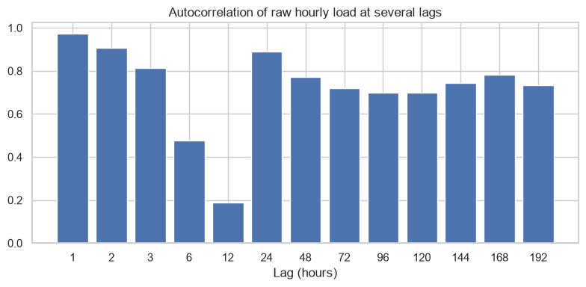
08 Appendix
Load autocorrelation
PJM Hourly Load
26 / 54
Notes:
Analysis: pjm_energy_tutorial.ipynb.
Figure: figures/notebook/pjm_energy/cell_012_figure_1.png
Measured results: run_results/pjm_energy_tutorial/results.json.
Notebook cell ID: 8ead2f00.

Slide 27
08 Appendix
Evaluation metrics
Metric | Meaning | Role
RMSE | Square root of mean squared error | Ranks models and emphasizes large misses
MAE | Mean absolute error | Describes typical error magnitude
R² | Improvement over predicting the test mean | Measures explained variation
Group errors | Metrics by target range or time group | Locates concentrated errors
PJM Hourly Load
27 / 54
Notes:
Analysis: pjm_energy_tutorial.ipynb.
Measured results: run_results/pjm_energy_tutorial/results.json.

Slide 28
08 Appendix
Regularization
Model | Objective | Main effect
OLS | Squared error | Fits an additive linear relationship
Ridge | Squared error + L2 penalty | Shrinks correlated coefficients
Lasso | Squared error + L1 penalty | Can set coefficients to zero
Elastic Net | Squared error + L1 and L2 penalties | Combines sparsity and shrinkage
PJM Hourly Load
28 / 54
Notes:
Analysis: pjm_energy_tutorial.ipynb.
https://scikit-learn.org/stable/modules/linear_model.html
Measured results: run_results/pjm_energy_tutorial/results.json.

Slide 29
08 Appendix
Linear model results
Model | RMSE | MAE | R²
OLS | 1,228.9 | 964.7892 | 0.9588
Ridge | 1,228.9 | 964.7892 | 0.9588
Lasso | 1,228.9 | 964.7855 | 0.9588
Elastic Net | 1,238.7 | 971.0577 | 0.9582
PJM Hourly Load
29 / 54
Notes:
Analysis: pjm_energy_tutorial.ipynb.
Measured results: run_results/pjm_energy_tutorial/results.json.
{"SARIMA": {"RMSE": 287.1979798046258, "MAE": 207.99915955320202, "R2": 0.997751639336172, "MAPE_%": 0.6775109995331485}, "Stacking": {"RMSE": 414.97953890376306, "MAE": 307.5499269570426, "R2": 0.9953058540911646, "MAPE_%": 0.9645291287691979}, "RandomForest": {"RMSE": 430.87681797686446, "MAE": 311.13570438253504, "R2": 0.9949393130299606, "MAPE_%": 0.9721756799684708}, "LightGBM": {"RMSE": 439.75645623956996, "MAE": 332.9425788076001, "R2": 0.9947285794465206, "MAPE_%": 1.0529744778326537}, "LightGBM (tuned)": {"RMSE": 439.75645623956996, "MAE": 332.9425788076001, "R2": 0.9947285794465206, "MAPE_%": 1.0529744778326537}, "CatBoost": {"RMSE": 451.1094796561299, "MAE": 338.66884543714883, "R2": 0.9944528855802729, "MAPE_%": 1.064651908792969}, "CatBoost (tuned)": {"RMSE": 451.1094796561299, "MAE": 338.66884543714883, "R2": 0.9944528855802729, "MAPE_%": 1.064651908792969}, "XGBoost": {"RMSE": 452.4238799319056, "MAE": 340.28600996182934, "R2": 0.9944205131689, "MAPE_%": 1.0708053893542864}, "XGBoost (tuned)": {"RMSE": 452.4238799319056, "MAE": 340.28600996182934, "R2": 0.9944205131689, "MAPE_%": 1.0708053893542864}, "RandomForest (tuned)": {"RMSE": 516.7157892592235, "MAE": 376.8811320594227, "R2": 0.9927220899776807, "MAPE_%": 1.177050411627558}, "MLP (tuned)": {"RMSE": 524.4235012182093, "MAE": 389.0859302919412, "R2": 0.9925033452824397, "MAPE_%": 1.2168820038907866}, "MLP": {"RMSE": 534.6546175610881, "MAE": 395.4071632293288, "R2": 0.9922079835438689, "MAPE_%": 1.2396926300012194}, "ARIMA": {"RMSE": 551.3531326283294, "MAE": 399.35703620210495, "R2": 0.9917136569282337, "MAPE_%": 1.2641890633216328}, "KNN": {"RMSE": 1134.2243155696647, "MAE": 869.4104217793458, "R2": 0.9649327972711288, "MAPE_%": 2.7828412346024756}, "KNN (tuned)": {"RMSE": 1134.2243155696647, "MAE": 869.4104217793458, "R2": 0.9649327972711288, "MAPE_%": 2.7828412346024756}, "Lasso": {"RMSE": 1228.9328051743244, "MAE": 964.7855253975243, "R2": 0.9588320262427147, "MAPE_%": 3.1071453346171305}, "LinearRegression": {"RMSE": 1228.9368009441957, "MAE": 964.7891571510552, "R2": 0.9588317585339905, "MAPE_%": 3.1071600414007543}, "Ridge": {"RMSE": 1228.9369338801916, "MAE": 964.7892454447995, "R2": 0.9588317496275253, "MAPE_%": 3.107160248753797}, "ElasticNet": {"RMSE": 1238.6586891881454, "MAE": 971.0576743519155, "R2": 0.958177833732254, "MAPE_%": 3.1222296481532297}}

Slide 30
08 Appendix
Linear model discussion
Results
OLS, Ridge and Lasso have nearly identical RMSE. Elastic Net is slightly worse under the selected penalty.
Interpretation
Recent load and daily and weekly lags contain overlapping information. Shrinkage changes coefficients more than prediction accuracy here.
Further work
Check residual autocorrelation and add issue-time weather forecasts and holiday information.
PJM Hourly Load
30 / 54
Notes:
Analysis: pjm_energy_tutorial.ipynb.
https://scikit-learn.org/stable/modules/linear_model.html
Measured results: run_results/pjm_energy_tutorial/results.json.

Slide 31
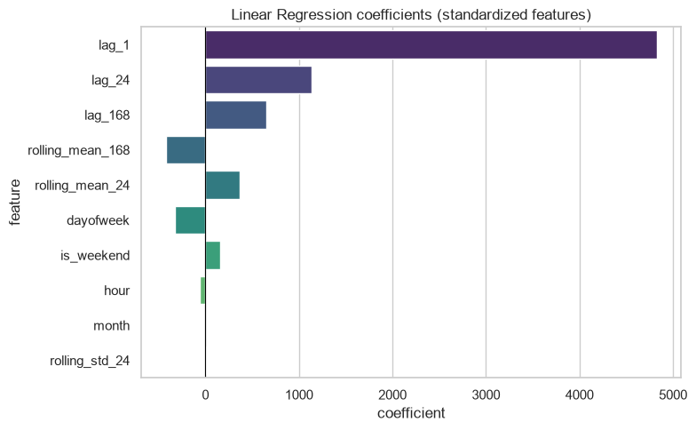
08 Appendix
Linear coefficients
Coefficients describe fitted associations after accounting for the other encoded inputs.
PJM Hourly Load
31 / 54
Notes:
Analysis: pjm_energy_tutorial.ipynb.
Figure: figures/notebook/pjm_energy/cell_019_figure_1.png
Measured results: run_results/pjm_energy_tutorial/results.json.
Notebook cell ID: 55ad4b11.

Slide 32
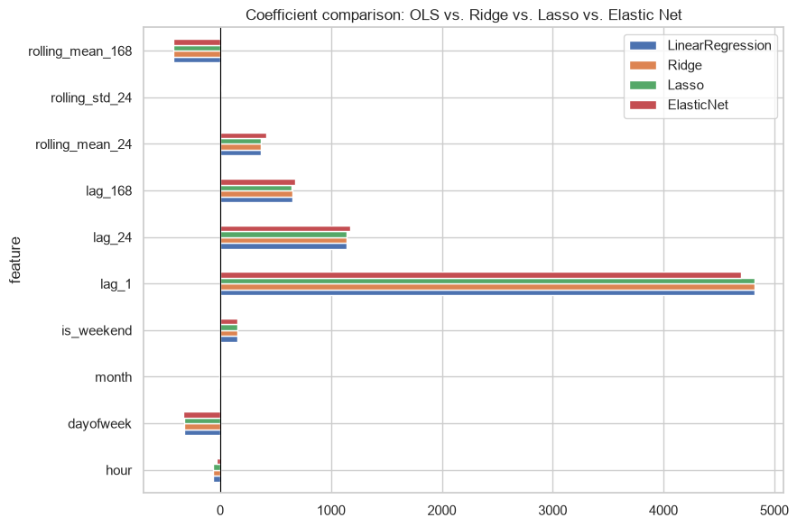
08 Appendix
Regularized coefficients
Coefficients describe fitted associations after accounting for the other encoded inputs.
PJM Hourly Load
32 / 54
Notes:
Analysis: pjm_energy_tutorial.ipynb.
Figure: figures/notebook/pjm_energy/cell_024_figure_1.png
Measured results: run_results/pjm_energy_tutorial/results.json.
Notebook cell ID: 33657b38.

Slide 33
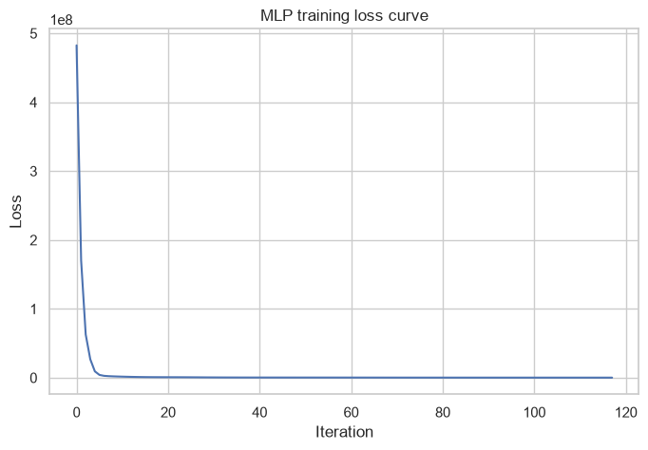
08 Appendix
MLP training loss
Training loss by optimization iteration.
PJM Hourly Load
33 / 54
Notes:
Analysis: pjm_energy_tutorial.ipynb.
Figure: figures/notebook/pjm_energy/cell_033_figure_1.png
Measured results: run_results/pjm_energy_tutorial/results.json.
Notebook cell ID: 27e50985.

Slide 34
08 Appendix
ARIMA and SARIMA
ARIMA fits autoregressive and moving-average dynamics after differencing. SARIMA adds seasonal terms.
Strengths
Weaknesses
Models serial dependence directly and supports sequential updates as new observations arrive.
Seasonal assumptions and order selection affect accuracy. Errors can accumulate over longer forecast horizons.
RESULT IN THIS STUDY
SARIMA: RMSE 287.2 MW and MAE 208.0 MW. All 136,464 training hours enter fitting. Observed test hours update each next-hour prediction.
PJM Hourly Load
34 / 54
Notes:
Analysis: pjm_energy_tutorial.ipynb.
https://www.statsmodels.org/stable/generated/statsmodels.tsa.statespace.sarimax.SARIMAX.html
Measured results: run_results/pjm_energy_tutorial/results.json.

Slide 35
08 Appendix
SARIMA order selection
Order | Seasonal order | Training AIC
(2, 1, 2) | (1, 1, 1, 24) | 1,963,436
(1, 1, 1) | (1, 0, 1, 24) | 1,977,220
Lower training AIC selects (2,1,2) × (1,1,1,24). Both candidates use 136,464 training hours.
PJM Hourly Load
35 / 54
Notes:
Analysis: pjm_energy_tutorial.ipynb.
Measured results: run_results/pjm_energy_tutorial/results.json.

Slide 36
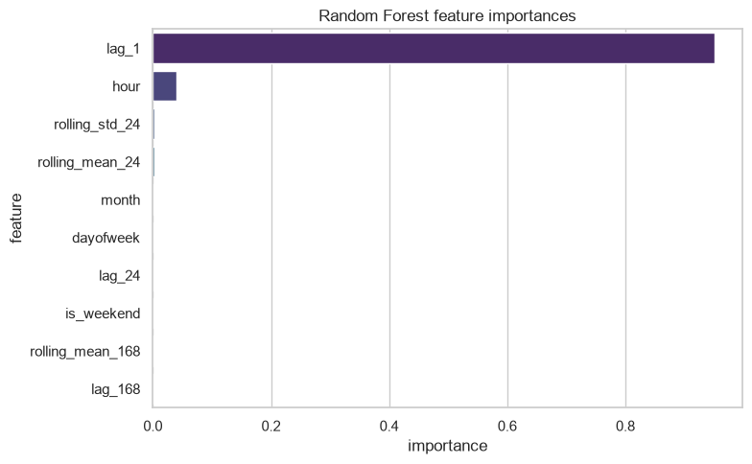
08 Appendix
Random Forest feature importance
Recent load is central to short-horizon prediction. Calendar variables and longer lags add information about seasonal patterns.
PJM Hourly Load
36 / 54
Notes:
Analysis: pjm_energy_tutorial.ipynb.
Figure: figures/notebook/pjm_energy/cell_039_figure_1.png
Measured results: run_results/pjm_energy_tutorial/results.json.
Notebook cell ID: f6556cc8.

Slide 37
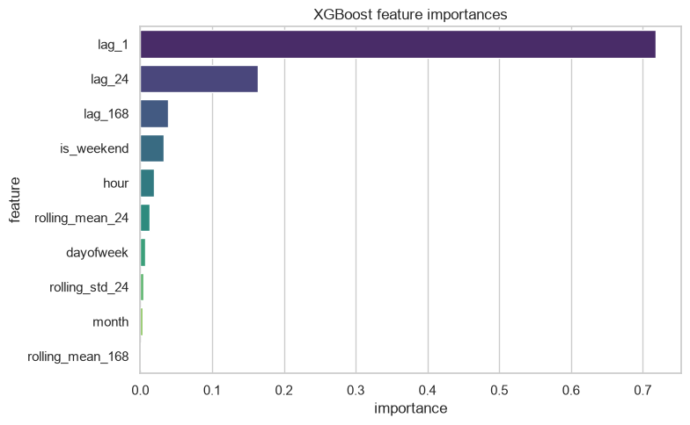
08 Appendix
XGBoost feature importance
Recent load is central to short-horizon prediction. Calendar variables and longer lags add information about seasonal patterns.
PJM Hourly Load
37 / 54
Notes:
Analysis: pjm_energy_tutorial.ipynb.
Figure: figures/notebook/pjm_energy/cell_045_figure_1.png
Measured results: run_results/pjm_energy_tutorial/results.json.
Notebook cell ID: f5ba027a.

Slide 38
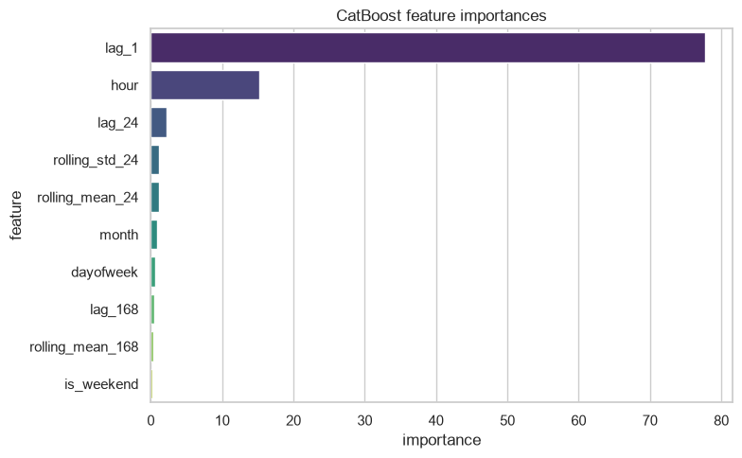
08 Appendix
CatBoost feature importance
Recent load is central to short-horizon prediction. Calendar variables and longer lags add information about seasonal patterns.
PJM Hourly Load
38 / 54
Notes:
Analysis: pjm_energy_tutorial.ipynb.
Figure: figures/notebook/pjm_energy/cell_051_figure_1.png
Measured results: run_results/pjm_energy_tutorial/results.json.
Notebook cell ID: 7f5ac0f3.

Slide 39
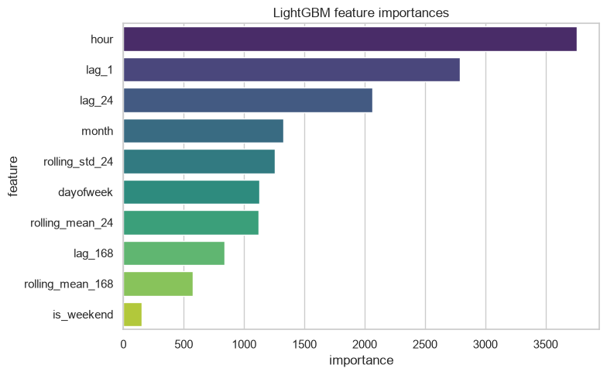
08 Appendix
LightGBM feature importance
Recent load is central to short-horizon prediction. Calendar variables and longer lags add information about seasonal patterns.
PJM Hourly Load
39 / 54
Notes:
Analysis: pjm_energy_tutorial.ipynb.
Figure: figures/notebook/pjm_energy/cell_057_figure_1.png
Measured results: run_results/pjm_energy_tutorial/results.json.
Notebook cell ID: a3aa57b9.

Slide 40
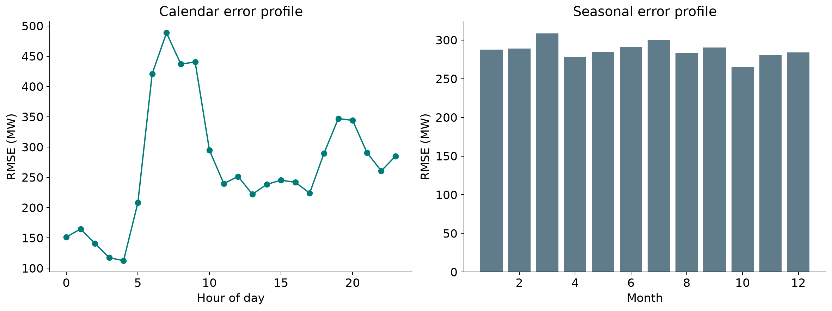
08 Appendix
Error by month and weekday
Calendar slices show how prediction error varies across operating conditions.
PJM Hourly Load
40 / 54
Notes:
Analysis: pjm_energy_tutorial.ipynb.
Figure: figures/pjm_energy/calendar_errors.png
Measured results: run_results/pjm_energy_tutorial/results.json.

Slide 41
08 Appendix
Error by target range
Test target band | Rows | MAE | Mean prediction error
Q1: (19366.999, 27004.0] | 2,191 | 181.2254 | -9.8971
Q2: (27004.0, 30398.0] | 2,189 | 196.8711 | -7.6518
Q3: (30398.0, 34545.75] | 2,190 | 216.3743 | -8.7432
Q4: (34545.75, 56609.0] | 2,190 | 237.5331 | 25.8294
Errors for SARIMA. Mean error = prediction − actual. Units: MW.
PJM Hourly Load
41 / 54
Notes:
Analysis: pjm_energy_tutorial.ipynb.
Measured results: run_results/pjm_energy_tutorial/results.json.

Slide 42
08 Appendix
Application
Topic | Application
Hourly updates | Use recent observed load when issuing each next-hour prediction.
Longer horizons | A day-ahead forecast cannot use future load observations.
Evaluation | Compare methods using the same issue time, horizon and available inputs.
PJM Hourly Load
42 / 54
Notes:
Analysis: pjm_energy_tutorial.ipynb.
Measured results: run_results/pjm_energy_tutorial/results.json.

Slide 43
08 Appendix
Forecast horizons
Next hour
SARIMA reaches RMSE 287.2 MW over the final test year with hourly observed updates.
Next 14 days
The first 336-hour forecast has RMSE 4,426.7 MW without future load observations.
Evaluation
These scores use different horizons and windows. Compare models at common issue times and lead times.
PJM Hourly Load
43 / 54
Notes:
Analysis: pjm_energy_tutorial.ipynb.
Measured results: run_results/pjm_energy_tutorial/results.json.

Slide 44
08 Appendix
Model selection Q&A
Why include penalized linear models?
Ridge uses L2 shrinkage to stabilize coefficients. Lasso uses L1 to encourage zeros. Elastic Net combines the penalties. Logistic models use the same penalty types for classification.
Why standardize the predictors?
Penalties and distance calculations depend on feature units. Scaling also helps neural-network optimization. Estimate the scaling parameters from training data.
Why include stacking?
It does not improve the leading individual model here. Combining models helps only when their errors are sufficiently different. Compare its gain with inference and maintenance cost.
PJM Hourly Load
44 / 54
Notes:
Analysis: pjm_energy_tutorial.ipynb.
https://scikit-learn.org/stable/modules/linear_model.html
https://scikit-learn.org/stable/modules/neighbors.html
https://scikit-learn.org/stable/modules/neural_networks_supervised.html
Measured results: run_results/pjm_energy_tutorial/results.json.

Slide 45
08 Appendix
Model interpretation Q&A
How do forests and boosting differ?
Random Forest averages trees trained with randomized rows and features. Boosting adds trees sequentially to reduce the chosen loss.
What does feature importance mean?
It describes how the fitted model uses its inputs. Related predictors can share importance. A high value does not establish a causal effect.
What do the resampling intervals cover?
They measure variation in the available test predictions with the fitted models fixed. A new split also tests sensitivity to training and model selection.
PJM Hourly Load
45 / 54
Notes:
Analysis: pjm_energy_tutorial.ipynb.
https://scikit-learn.org/stable/modules/ensemble.html
https://xgboost.readthedocs.io/en/stable/tutorials/model.html
Measured results: run_results/pjm_energy_tutorial/results.json.

Slide 46
08 Appendix
Data Q&A
Why is next-hour accuracy strong?
Recent load is highly informative. SARIMA updates its state with each observed test value before predicting the next hour.
Does this establish day-ahead accuracy?
A day-ahead forecast uses one issue time and cannot access future actual load. Score that task separately at each lead time.
PJM Hourly Load
46 / 54
Notes:
Analysis: pjm_energy_tutorial.ipynb.
Measured results: run_results/pjm_energy_tutorial/results.json.

Slide 47
08 Appendix
Results Q&A
Why include ARIMA and SARIMA?
They model serial dependence directly. SARIMA adds seasonal dynamics, while the tabular models learn from supplied lags and calendar features.
What should the residual analysis check?
Check remaining autocorrelation, peak-hour bias and calendar patterns. Repeat the comparison over multiple forecast origins.
PJM Hourly Load
47 / 54
Notes:
Analysis: pjm_energy_tutorial.ipynb.
Measured results: run_results/pjm_energy_tutorial/results.json.

Slide 48
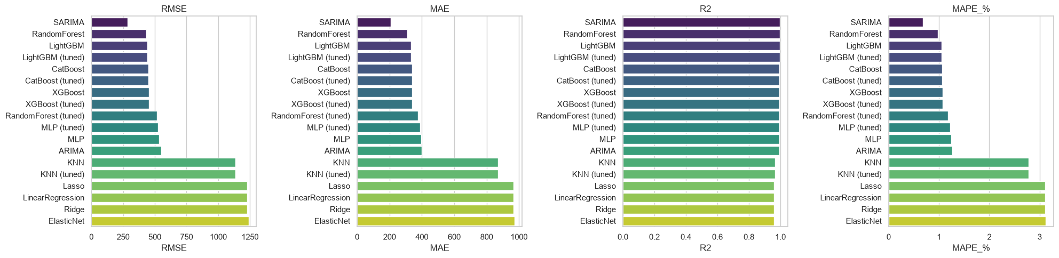
08 Appendix
Individual model metrics
Notebook comparison of individual models. The full results tables also include stacking.
PJM Hourly Load
48 / 54
Notes:
Analysis: pjm_energy_tutorial.ipynb.
Figure: figures/notebook/pjm_energy/cell_066_figure_1.png
Measured results: run_results/pjm_energy_tutorial/results.json.
Notebook cell ID: 053de118.

Slide 49
08 Appendix
Full results (1 of 2)
Model | RMSE | MAE | R² | MAPE %
SARIMA | 287.1980 | 207.9992 | 0.9978 | 0.6775
Stacking | 414.9795 | 307.5499 | 0.9953 | 0.9645
Random Forest | 430.8768 | 311.1357 | 0.9949 | 0.9722
LightGBM | 439.7565 | 332.9426 | 0.9947 | 1.0530
LightGBM (tuned) | 439.7565 | 332.9426 | 0.9947 | 1.0530
CatBoost | 451.1095 | 338.6688 | 0.9945 | 1.0647
CatBoost (tuned) | 451.1095 | 338.6688 | 0.9945 | 1.0647
XGBoost | 452.4239 | 340.2860 | 0.9944 | 1.0708
XGBoost (tuned) | 452.4239 | 340.2860 | 0.9944 | 1.0708
Forest (tuned) | 516.7158 | 376.8811 | 0.9927 | 1.1771
PJM Hourly Load
49 / 54
Notes:
Analysis: pjm_energy_tutorial.ipynb.
Measured results: run_results/pjm_energy_tutorial/results.json.
{"SARIMA": {"RMSE": 287.1979798046258, "MAE": 207.99915955320202, "R2": 0.997751639336172, "MAPE_%": 0.6775109995331485}, "Stacking": {"RMSE": 414.97953890376306, "MAE": 307.5499269570426, "R2": 0.9953058540911646, "MAPE_%": 0.9645291287691979}, "RandomForest": {"RMSE": 430.87681797686446, "MAE": 311.13570438253504, "R2": 0.9949393130299606, "MAPE_%": 0.9721756799684708}, "LightGBM": {"RMSE": 439.75645623956996, "MAE": 332.9425788076001, "R2": 0.9947285794465206, "MAPE_%": 1.0529744778326537}, "LightGBM (tuned)": {"RMSE": 439.75645623956996, "MAE": 332.9425788076001, "R2": 0.9947285794465206, "MAPE_%": 1.0529744778326537}, "CatBoost": {"RMSE": 451.1094796561299, "MAE": 338.66884543714883, "R2": 0.9944528855802729, "MAPE_%": 1.064651908792969}, "CatBoost (tuned)": {"RMSE": 451.1094796561299, "MAE": 338.66884543714883, "R2": 0.9944528855802729, "MAPE_%": 1.064651908792969}, "XGBoost": {"RMSE": 452.4238799319056, "MAE": 340.28600996182934, "R2": 0.9944205131689, "MAPE_%": 1.0708053893542864}, "XGBoost (tuned)": {"RMSE": 452.4238799319056, "MAE": 340.28600996182934, "R2": 0.9944205131689, "MAPE_%": 1.0708053893542864}, "RandomForest (tuned)": {"RMSE": 516.7157892592235, "MAE": 376.8811320594227, "R2": 0.9927220899776807, "MAPE_%": 1.177050411627558}, "MLP (tuned)": {"RMSE": 524.4235012182093, "MAE": 389.0859302919412, "R2": 0.9925033452824397, "MAPE_%": 1.2168820038907866}, "MLP": {"RMSE": 534.6546175610881, "MAE": 395.4071632293288, "R2": 0.9922079835438689, "MAPE_%": 1.2396926300012194}, "ARIMA": {"RMSE": 551.3531326283294, "MAE": 399.35703620210495, "R2": 0.9917136569282337, "MAPE_%": 1.2641890633216328}, "KNN": {"RMSE": 1134.2243155696647, "MAE": 869.4104217793458, "R2": 0.9649327972711288, "MAPE_%": 2.7828412346024756}, "KNN (tuned)": {"RMSE": 1134.2243155696647, "MAE": 869.4104217793458, "R2": 0.9649327972711288, "MAPE_%": 2.7828412346024756}, "Lasso": {"RMSE": 1228.9328051743244, "MAE": 964.7855253975243, "R2": 0.9588320262427147, "MAPE_%": 3.1071453346171305}, "LinearRegression": {"RMSE": 1228.9368009441957, "MAE": 964.7891571510552, "R2": 0.9588317585339905, "MAPE_%": 3.1071600414007543}, "Ridge": {"RMSE": 1228.9369338801916, "MAE": 964.7892454447995, "R2": 0.9588317496275253, "MAPE_%": 3.107160248753797}, "ElasticNet": {"RMSE": 1238.6586891881454, "MAE": 971.0576743519155, "R2": 0.958177833732254, "MAPE_%": 3.1222296481532297}}

Slide 50
08 Appendix
Full results (2 of 2)
Model | RMSE | MAE | R² | MAPE %
MLP (tuned) | 524.4235 | 389.0859 | 0.9925 | 1.2169
MLP | 534.6546 | 395.4072 | 0.9922 | 1.2397
ARIMA | 551.3531 | 399.3570 | 0.9917 | 1.2642
KNN | 1,134.2 | 869.4104 | 0.9649 | 2.7828
KNN (tuned) | 1,134.2 | 869.4104 | 0.9649 | 2.7828
Lasso | 1,228.9 | 964.7855 | 0.9588 | 3.1071
OLS | 1,228.9 | 964.7892 | 0.9588 | 3.1072
Ridge | 1,228.9 | 964.7892 | 0.9588 | 3.1072
Elastic Net | 1,238.7 | 971.0577 | 0.9582 | 3.1222
PJM Hourly Load
50 / 54
Notes:
Analysis: pjm_energy_tutorial.ipynb.
Measured results: run_results/pjm_energy_tutorial/results.json.
{"SARIMA": {"RMSE": 287.1979798046258, "MAE": 207.99915955320202, "R2": 0.997751639336172, "MAPE_%": 0.6775109995331485}, "Stacking": {"RMSE": 414.97953890376306, "MAE": 307.5499269570426, "R2": 0.9953058540911646, "MAPE_%": 0.9645291287691979}, "RandomForest": {"RMSE": 430.87681797686446, "MAE": 311.13570438253504, "R2": 0.9949393130299606, "MAPE_%": 0.9721756799684708}, "LightGBM": {"RMSE": 439.75645623956996, "MAE": 332.9425788076001, "R2": 0.9947285794465206, "MAPE_%": 1.0529744778326537}, "LightGBM (tuned)": {"RMSE": 439.75645623956996, "MAE": 332.9425788076001, "R2": 0.9947285794465206, "MAPE_%": 1.0529744778326537}, "CatBoost": {"RMSE": 451.1094796561299, "MAE": 338.66884543714883, "R2": 0.9944528855802729, "MAPE_%": 1.064651908792969}, "CatBoost (tuned)": {"RMSE": 451.1094796561299, "MAE": 338.66884543714883, "R2": 0.9944528855802729, "MAPE_%": 1.064651908792969}, "XGBoost": {"RMSE": 452.4238799319056, "MAE": 340.28600996182934, "R2": 0.9944205131689, "MAPE_%": 1.0708053893542864}, "XGBoost (tuned)": {"RMSE": 452.4238799319056, "MAE": 340.28600996182934, "R2": 0.9944205131689, "MAPE_%": 1.0708053893542864}, "RandomForest (tuned)": {"RMSE": 516.7157892592235, "MAE": 376.8811320594227, "R2": 0.9927220899776807, "MAPE_%": 1.177050411627558}, "MLP (tuned)": {"RMSE": 524.4235012182093, "MAE": 389.0859302919412, "R2": 0.9925033452824397, "MAPE_%": 1.2168820038907866}, "MLP": {"RMSE": 534.6546175610881, "MAE": 395.4071632293288, "R2": 0.9922079835438689, "MAPE_%": 1.2396926300012194}, "ARIMA": {"RMSE": 551.3531326283294, "MAE": 399.35703620210495, "R2": 0.9917136569282337, "MAPE_%": 1.2641890633216328}, "KNN": {"RMSE": 1134.2243155696647, "MAE": 869.4104217793458, "R2": 0.9649327972711288, "MAPE_%": 2.7828412346024756}, "KNN (tuned)": {"RMSE": 1134.2243155696647, "MAE": 869.4104217793458, "R2": 0.9649327972711288, "MAPE_%": 2.7828412346024756}, "Lasso": {"RMSE": 1228.9328051743244, "MAE": 964.7855253975243, "R2": 0.9588320262427147, "MAPE_%": 3.1071453346171305}, "LinearRegression": {"RMSE": 1228.9368009441957, "MAE": 964.7891571510552, "R2": 0.9588317585339905, "MAPE_%": 3.1071600414007543}, "Ridge": {"RMSE": 1228.9369338801916, "MAE": 964.7892454447995, "R2": 0.9588317496275253, "MAPE_%": 3.107160248753797}, "ElasticNet": {"RMSE": 1238.6586891881454, "MAE": 971.0576743519155, "R2": 0.958177833732254, "MAPE_%": 3.1222296481532297}}

Slide 51
08 Appendix
Model settings
Model | Parameters
KNN | n_neighbors=15, weights='distance'
MLP | hidden_layer_sizes=(64, 32), alpha=0.0001, max_iter=500, early_stopping=True
Random Forest | n_estimators=300, max_depth=None, min_samples_leaf=2
XGBoost | n_estimators=500, learning_rate=0.05, max_depth=5
CatBoost | iterations=500, learning_rate=0.05, depth=6
LightGBM | n_estimators=500, learning_rate=0.05, num_leaves=31
Searches use two folds and two candidates. Each selected estimator refits on the full training partition.
PJM Hourly Load
51 / 54
Notes:
Analysis: pjm_energy_tutorial.ipynb.
Seed 42. Stacking uses two ordinary folds. Penalized linear models test three strengths. See the notebook for all constructor arguments.
Measured results: run_results/pjm_energy_tutorial/results.json.

Slide 52
08 Appendix
Selected hyperparameters (1 of 2)
Model | Selected parameters
KNN | n_neighbors=15, p=2, weights=distance
MLP | hidden_layer_sizes=(64, 32), alpha=0.001
Random Forest | n_estimators=300, min_samples_leaf=5, max_depth=12
PJM Hourly Load
52 / 54
Notes:
Analysis: pjm_energy_tutorial.ipynb.
Measured results: run_results/pjm_energy_tutorial/results.json.

Slide 53
08 Appendix
Selected hyperparameters (2 of 2)
Model | Selected parameters
XGBoost | n_estimators=500, max_depth=5, learning_rate=0.05
CatBoost | learning_rate=0.05, iterations=500, depth=6
LightGBM | num_leaves=31, n_estimators=500, learning_rate=0.05
PJM Hourly Load
53 / 54
Notes:
Analysis: pjm_energy_tutorial.ipynb.
Measured results: run_results/pjm_energy_tutorial/results.json.

Slide 54
08 Appendix
Sources
Dataset
Methods
PJM East hourly electricity consumption
scikit-learn, XGBoost, CatBoost and LightGBM documentation. SARIMAX documentation from statsmodels.
Project analysis
pjm_energy_tutorial.ipynb
Statistical analysis
Paired resampling of test predictions, residual analysis and group-level error checks.
PJM Hourly Load
54 / 54
Notes:
Analysis: pjm_energy_tutorial.ipynb.
https://scikit-learn.org/stable/modules/linear_model.html
https://scikit-learn.org/stable/modules/neighbors.html
https://scikit-learn.org/stable/modules/neural_networks_supervised.html
https://scikit-learn.org/stable/modules/ensemble.html
https://xgboost.readthedocs.io/en/stable/tutorials/model.html
https://catboost.ai/docs/en/concepts/algorithm-main-stages_cat-to-numberic
https://lightgbm.readthedocs.io/en/stable/Features.html
https://www.statsmodels.org/stable/generated/statsmodels.tsa.statespace.sarimax.SARIMAX.html
Measured results: run_results/pjm_energy_tutorial/results.json.

