Slide 1
DATA SCIENCE PROJECT
German Daily Electricity
Predicting daily electricity consumption in Germany
Data, methods and results
Notes:
Analysis: open_power_systems_tutorial.ipynb.
Measured results: run_results/open_power_systems_tutorial/results.json.

Slide 2
01 Summary
Summary
Best score
43.8941
Stacking reaches RMSE 43.89 GWh/day and MAE 23.11 GWh/day.
Comparison
Test RMSE
Its small lead over tuned XGBoost is uncertain under weekly block resampling.
Input availability
The models use same-day wind and solar measurements. Day-ahead use requires forecasts or earlier observations.
German Daily Electricity
02 / 53
Notes:
Analysis: open_power_systems_tutorial.ipynb.
Measured results: run_results/open_power_systems_tutorial/results.json.
{"Stacking": {"RMSE": 43.89412801672414, "MAE": 23.111985906748576, "R2": 0.92627975515373, "MAPE_%": 1.7590113312719111}, "XGBoost (tuned)": {"RMSE": 44.32737510128147, "MAE": 23.728195158711472, "R2": 0.9248172950776797, "MAPE_%": 1.8075057689566605}, "XGBoost": {"RMSE": 44.52592446664416, "MAE": 23.733372677252785, "R2": 0.9241422761039821, "MAPE_%": 1.8055470996221397}, "RandomForest": {"RMSE": 44.734797950621335, "MAE": 23.855417204029525, "R2": 0.9234289015314964, "MAPE_%": 1.8104909529933908}, "LightGBM": {"RMSE": 44.929503758887314, "MAE": 24.650096208628955, "R2": 0.922760907787942, "MAPE_%": 1.883395530028567}, "CatBoost": {"RMSE": 45.196249923742805, "MAE": 24.061999274464544, "R2": 0.921841049319889, "MAPE_%": 1.8343082366584897}, "CatBoost (tuned)": {"RMSE": 45.20919668992244, "MAE": 24.06889247079699, "R2": 0.9217962646045836, "MAPE_%": 1.8348702565624513}, "LightGBM (tuned)": {"RMSE": 45.22245793500578, "MAE": 24.024346151752493, "R2": 0.9217503787636048, "MAPE_%": 1.8366855433365117}, "RandomForest (tuned)": {"RMSE": 46.47720125626321, "MAE": 24.248138114889123, "R2": 0.9173479074844259, "MAPE_%": 1.8457870477593799}, "MLP": {"RMSE": 50.36941955482558, "MAE": 28.591562269360736, "R2": 0.9029249082973939, "MAPE_%": 2.172497844779718}, "MLP (tuned)": {"RMSE": 52.77832401646748, "MAE": 30.31615413327778, "R2": 0.8934176952740258, "MAPE_%": 2.294327805424836}, "KNN": {"RMSE": 54.023563194926076, "MAE": 30.857072032988917, "R2": 0.8883290096621802, "MAPE_%": 2.3245654290353754}, "LinearRegression": {"RMSE": 55.10910990260637, "MAE": 34.13112474140186, "R2": 0.8837960983233141, "MAPE_%": 2.567487949174709}, "Ridge": {"RMSE": 55.1091651547699, "MAE": 34.13124594897226, "R2": 0.8837958653121039, "MAPE_%": 2.567495964458486}, "ElasticNet": {"RMSE": 55.21412032777479, "MAE": 34.3200905566686, "R2": 0.8833528232571061, "MAPE_%": 2.5799900291010758}, "Lasso": {"RMSE": 56.224500373354495, "MAE": 34.889089292722005, "R2": 0.8790446376471266, "MAPE_%": 2.6179076750014243}, "KNN (tuned)": {"RMSE": 56.69762211672362, "MAE": 33.49819345446784, "R2": 0.8770004260057818, "MAPE_%": 2.505199607283679}}

Slide 3
02 Objective and data
Objective
Objective
Predict German daily electricity consumption from demand history, calendar variables and renewable generation.
Prediction unit
One day. Consumption and errors are measured in GWh per day.
Evaluation
RMSE for model ranking, MAE for typical error, and R² for explained variation.
German Daily Electricity
03 / 53
Notes:
Analysis: open_power_systems_tutorial.ipynb.
Measured results: run_results/open_power_systems_tutorial/results.json.

Slide 4
02 Objective and data
Dataset
Item | Details
Records | 4,383 daily records covering 2006–2017
Features | 4,018 days after creating the 365-day lag
Inputs | 12 calendar, renewable-generation and historical-load features
Scope | Same-day renewable-generation measurements appear in the current feature set.
German Daily Electricity
04 / 53
Notes:
Analysis: open_power_systems_tutorial.ipynb.
Measured results: run_results/open_power_systems_tutorial/results.json.

Slide 5
02 Objective and data
Preprocessing
Step | Processing
Dates | Sort dates and reindex the data to a daily frequency.
Renewables | Fill unavailable wind and solar fields with zero. Add missingness indicators.
Missing values | Keep missingness separate from measured zero generation.
History features | Shift rolling windows to use only earlier consumption values.
German Daily Electricity
05 / 53
Notes:
Analysis: open_power_systems_tutorial.ipynb.
Measured results: run_results/open_power_systems_tutorial/results.json.

Slide 6
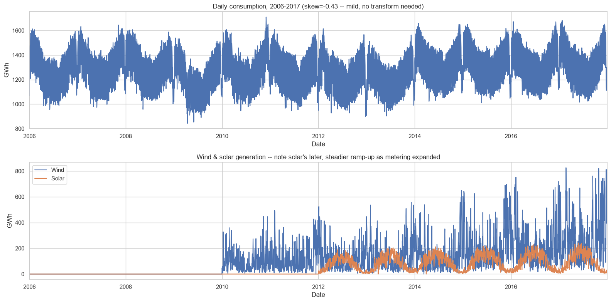
03 EDA and features
Consumption and renewable generation history
German Daily Electricity
06 / 53
Notes:
Analysis: open_power_systems_tutorial.ipynb.
Figure: figures/notebook/open_power_systems/cell_009_figure_1.png
Measured results: run_results/open_power_systems_tutorial/results.json.
Notebook cell ID: 9f266c8a.

Slide 7
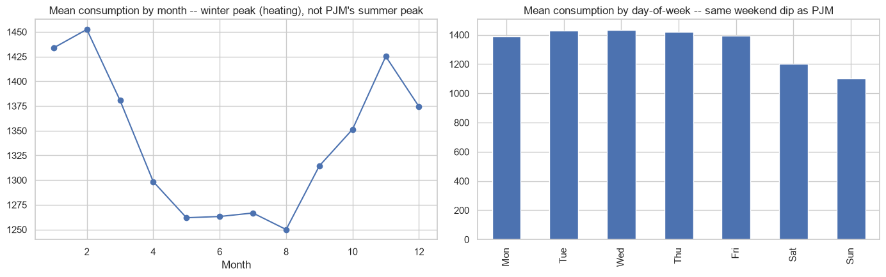
03 EDA and features
Monthly and weekly demand patterns
German Daily Electricity
07 / 53
Notes:
Analysis: open_power_systems_tutorial.ipynb.
Figure: figures/notebook/open_power_systems/cell_011_figure_1.png
Measured results: run_results/open_power_systems_tutorial/results.json.
Notebook cell ID: 39286243.

Slide 8
03 EDA and features
EDA findings
Calendar patterns
Consumption varies by month and weekday.
Generation history
Renewable fields have different measurement coverage over time. A missing value is different from observed zero generation.
Prediction inputs
Demand lags and calendar features are available in advance. Realized same-day generation may not be.
German Daily Electricity
08 / 53
Notes:
Analysis: open_power_systems_tutorial.ipynb.
Measured results: run_results/open_power_systems_tutorial/results.json.

Slide 9
03 EDA and features
Feature engineering
Feature group | Predictors
Calendar | Weekday, month and weekend indicator
Generation | Same-day wind and solar, with missingness indicators
Demand lags | Consumption from 1, 7 and 365 days earlier
Rolling demand | Mean consumption over the preceding 7 and 30 days
German Daily Electricity
09 / 53
Notes:
Analysis: open_power_systems_tutorial.ipynb.
Measured results: run_results/open_power_systems_tutorial/results.json.

Slide 10
04 Validation
Train–test split
Partition
Train on the first 3,288 modeling days from 2007 through 2016-01-01. Test on the last 730 days from 2016-01-02 through 2017-12-31. Tuning uses chronological folds.
Transforms
Fit feature scaling on training rows, then apply the same transformation to the test partition.
Evaluation
A chronological holdout evaluates later observations.
German Daily Electricity
10 / 53
Notes:
Analysis: open_power_systems_tutorial.ipynb.
Measured results: run_results/open_power_systems_tutorial/results.json.

Slide 11
05 Methods
Methods
Family | Models | Role
Linear | OLS, Ridge, Lasso and Elastic Net | Interpretable reference
Local | K-nearest neighbors | Predict from similar records
Neural | Multilayer perceptron | Learn nonlinear relationships
Trees | Random Forest, XGBoost, CatBoost and LightGBM | Learn thresholds and interactions
Ensemble | Stacking of Random Forest, XGBoost and LightGBM | Combine predictions using a fitted meta-model
German Daily Electricity
11 / 53
Notes:
Analysis: open_power_systems_tutorial.ipynb.
Measured results: run_results/open_power_systems_tutorial/results.json.

Slide 12
05 Methods
Linear models
Model | Strength | Weakness
OLS | Easy to inspect and use as a baseline | Misses nonlinear effects without added features
Ridge | Stabilizes coefficients when predictors overlap | Keeps all predictors and introduces shrinkage bias
Lasso | Can remove weak predictors with zero coefficients | Can select inconsistently among correlated inputs
Elastic Net | Combines sparse selection with L2 shrinkage | Requires penalty strength and mixing to be selected
German Daily Electricity
12 / 53
Notes:
Analysis: open_power_systems_tutorial.ipynb.
https://scikit-learn.org/stable/modules/linear_model.html
Measured results: run_results/open_power_systems_tutorial/results.json.

Slide 13
05 Methods
KNN and neural networks
Model | Strength | Weakness
KNN | Simple local prediction with few modeling assumptions | Distances depend on scaling. Prediction slows as the reference set grows.
MLP | Learns smooth nonlinear effects and interactions | Sensitive to scaling and optimization. Needs regularization and convergence checks.
German Daily Electricity
13 / 53
Notes:
Analysis: open_power_systems_tutorial.ipynb.
Measured results: run_results/open_power_systems_tutorial/results.json.

Slide 14
05 Methods
Tree-based models
Model | Strength | Weakness
Random Forest | Averaging many trees reduces variance and captures interactions | Large ensembles use memory and extrapolate poorly
XGBoost | Regularized boosting handles complex tabular relationships | Tree depth, learning rate and tree count need joint selection
CatBoost | Supports categorical features alongside numerical features | Training can be costly. Data quality still limits performance
LightGBM | Histogram splits support efficient training on large tables | Flexible leaf growth can overfit small groups
German Daily Electricity
14 / 53
Notes:
Analysis: open_power_systems_tutorial.ipynb.
Measured results: run_results/open_power_systems_tutorial/results.json.

Slide 15
05 Methods
Stacking
Random Forest, XGBoost and LightGBM generate out-of-fold predictions. A Ridge meta-model learns how to combine them.
Strengths
Weaknesses
Can reduce error when the base models make different mistakes. The meta-model learns the weights from training predictions.
Adds fitting and inference cost. Similar base-model errors can limit the gain. Forward-only folds are needed for temporal meta-training.
RESULT IN THIS STUDY
RMSE 43.8941 and MAE 23.1120. It has the best observed test score.
German Daily Electricity
15 / 53
Notes:
Analysis: open_power_systems_tutorial.ipynb.
Base models: fitted reference configurations, each cloned and refitted by StackingRegressor/Classifier. cv=2. Meta-model: Ridge(alpha=1.0).
https://scikit-learn.org/stable/modules/ensemble.html#stacking
The notebook uses ordinary folds for stacking, rather than forward-only time splits.
Measured results: run_results/open_power_systems_tutorial/results.json.

Slide 16
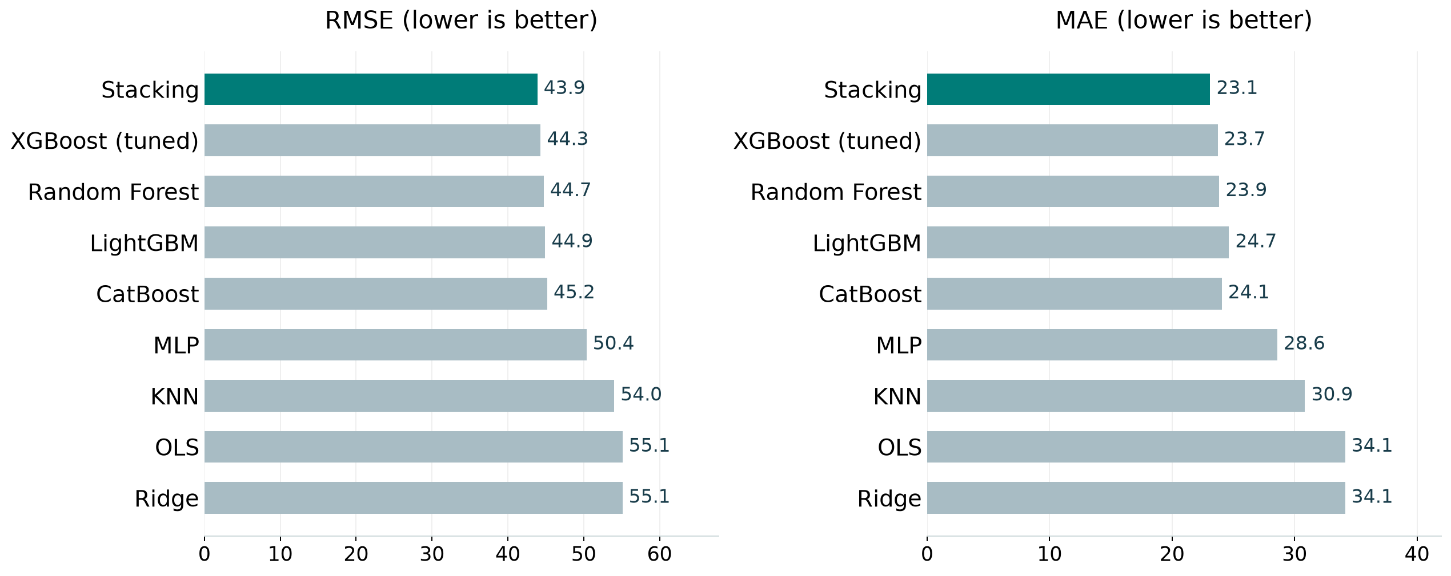
06 Results
Model comparison
Best test score per family, including the strongest penalized linear model. Full results appear in the appendix.
German Daily Electricity
16 / 53
Notes:
Analysis: open_power_systems_tutorial.ipynb.
Figure: figures/open_power_systems/comparison.png
Measured results: run_results/open_power_systems_tutorial/results.json.

Slide 17
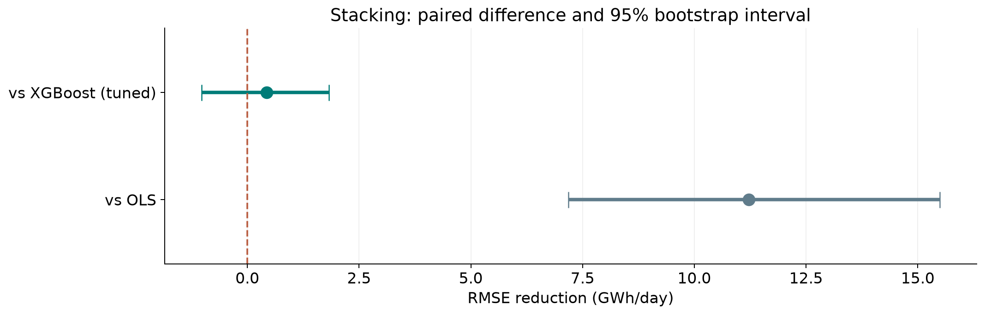
06 Results
Ranking stability
The 95% interval includes zero for Stacking versus XGBoost (tuned). Their ordering remains uncertain.
German Daily Electricity
17 / 53
Notes:
Analysis: open_power_systems_tutorial.ipynb.
paired circular block bootstrap, 7 days. 1,000 paired resamples. Fitted models remain fixed.
[{"comparison": "Stacking versus XGBoost (tuned)", "other": "XGBoost (tuned)", "advantage": 0.43324708455732974, "ci_low": -1.0277698128804302, "ci_high": 1.8252383107579178}, {"comparison": "Stacking versus OLS", "other": "OLS", "advantage": 11.214981885882231, "ci_low": 7.180868699890031, "ci_high": 15.495805571573399}]
Figure: figures/open_power_systems/ranking_stability.png
Measured results: run_results/open_power_systems_tutorial/results.json.

Slide 18
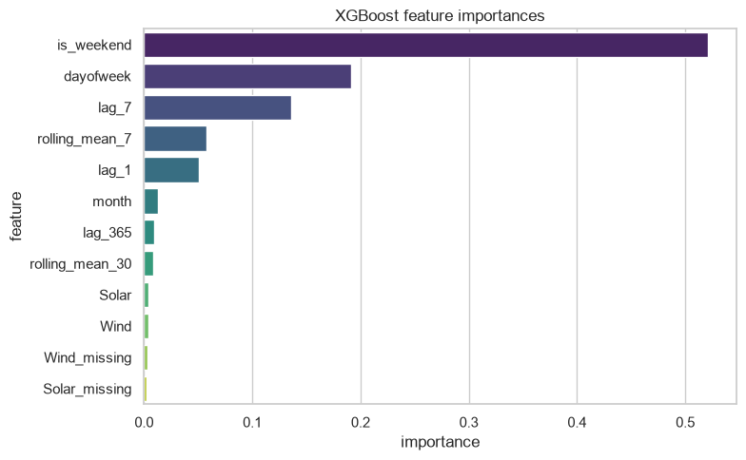
06 Results
XGBoost feature importance
Demand history and calendar features provide core signal. Generation-related importance depends on measurement coverage and input timing.
German Daily Electricity
18 / 53
Notes:
Analysis: open_power_systems_tutorial.ipynb.
Figure: figures/notebook/open_power_systems/cell_054_figure_1.png
Measured results: run_results/open_power_systems_tutorial/results.json.
Notebook cell ID: 1094de78.

Slide 19
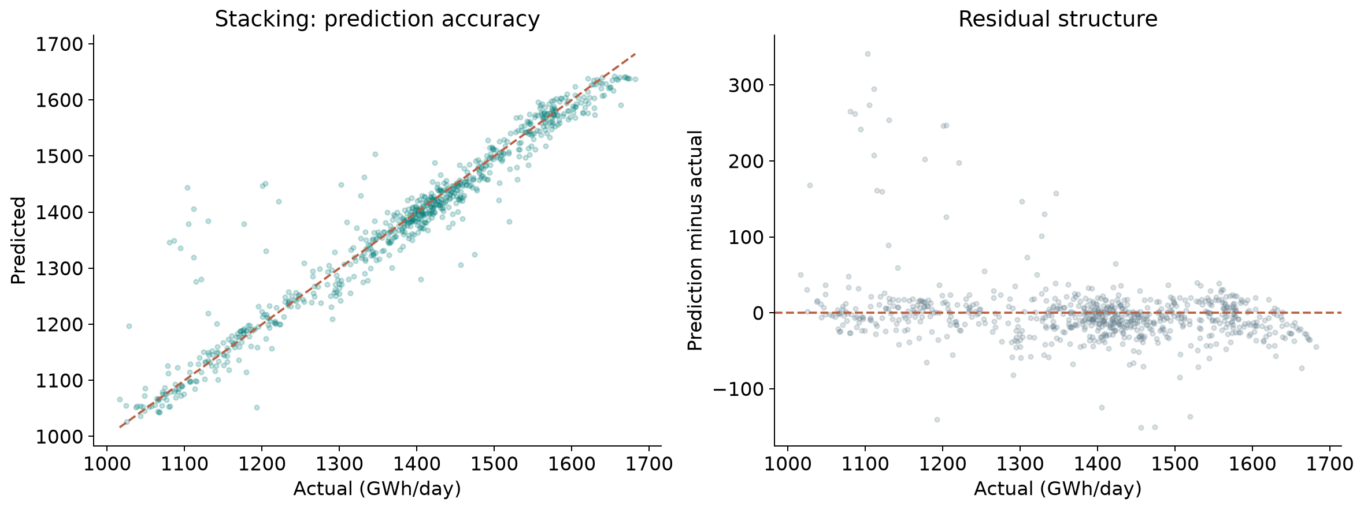
06 Results
Error by demand level
Stacking: prediction error across observed demand levels. Residual = prediction − actual.
German Daily Electricity
19 / 53
Notes:
Analysis: open_power_systems_tutorial.ipynb.
Figure: figures/open_power_systems/winner_diagnostics.png
Measured results: run_results/open_power_systems_tutorial/results.json.
Diagnostics use Stacking predictions.

Slide 20
06 Results
Simple baselines
Method | RMSE | MAE | R²
Training mean | 170.5473 | 146.7870 | -0.1129
Persistence lag_1 | 149.6992 | 102.3081 | 0.1425
Persistence lag_7 | 93.1549 | 51.0257 | 0.6680
Persistence lag_365 | 153.7235 | 107.9827 | 0.0958
Stacking | 43.8941 | 23.1120 | 0.9263
Same test targets for every row. Error units: GWh per day.
German Daily Electricity
20 / 53
Notes:
Analysis: open_power_systems_tutorial.ipynb.
Measured results: run_results/open_power_systems_tutorial/results.json.

Slide 21
06 Results
Results
Prediction accuracy
Stacking reduces RMSE by 20.4% compared with OLS. Tuned XGBoost is a close alternative.
Model choice
The ensemble lead is smaller than the resampled uncertainty. Keep XGBoost as a simpler candidate.
Next evaluation
Use issue-time renewable forecasts, then repeat chronological validation with forward-only stacking folds.
German Daily Electricity
21 / 53
Notes:
Analysis: open_power_systems_tutorial.ipynb.
Measured results: run_results/open_power_systems_tutorial/results.json.
{"Stacking": {"RMSE": 43.89412801672414, "MAE": 23.111985906748576, "R2": 0.92627975515373, "MAPE_%": 1.7590113312719111}, "XGBoost (tuned)": {"RMSE": 44.32737510128147, "MAE": 23.728195158711472, "R2": 0.9248172950776797, "MAPE_%": 1.8075057689566605}, "XGBoost": {"RMSE": 44.52592446664416, "MAE": 23.733372677252785, "R2": 0.9241422761039821, "MAPE_%": 1.8055470996221397}, "RandomForest": {"RMSE": 44.734797950621335, "MAE": 23.855417204029525, "R2": 0.9234289015314964, "MAPE_%": 1.8104909529933908}, "LightGBM": {"RMSE": 44.929503758887314, "MAE": 24.650096208628955, "R2": 0.922760907787942, "MAPE_%": 1.883395530028567}, "CatBoost": {"RMSE": 45.196249923742805, "MAE": 24.061999274464544, "R2": 0.921841049319889, "MAPE_%": 1.8343082366584897}, "CatBoost (tuned)": {"RMSE": 45.20919668992244, "MAE": 24.06889247079699, "R2": 0.9217962646045836, "MAPE_%": 1.8348702565624513}, "LightGBM (tuned)": {"RMSE": 45.22245793500578, "MAE": 24.024346151752493, "R2": 0.9217503787636048, "MAPE_%": 1.8366855433365117}, "RandomForest (tuned)": {"RMSE": 46.47720125626321, "MAE": 24.248138114889123, "R2": 0.9173479074844259, "MAPE_%": 1.8457870477593799}, "MLP": {"RMSE": 50.36941955482558, "MAE": 28.591562269360736, "R2": 0.9029249082973939, "MAPE_%": 2.172497844779718}, "MLP (tuned)": {"RMSE": 52.77832401646748, "MAE": 30.31615413327778, "R2": 0.8934176952740258, "MAPE_%": 2.294327805424836}, "KNN": {"RMSE": 54.023563194926076, "MAE": 30.857072032988917, "R2": 0.8883290096621802, "MAPE_%": 2.3245654290353754}, "LinearRegression": {"RMSE": 55.10910990260637, "MAE": 34.13112474140186, "R2": 0.8837960983233141, "MAPE_%": 2.567487949174709}, "Ridge": {"RMSE": 55.1091651547699, "MAE": 34.13124594897226, "R2": 0.8837958653121039, "MAPE_%": 2.567495964458486}, "ElasticNet": {"RMSE": 55.21412032777479, "MAE": 34.3200905566686, "R2": 0.8833528232571061, "MAPE_%": 2.5799900291010758}, "Lasso": {"RMSE": 56.224500373354495, "MAE": 34.889089292722005, "R2": 0.8790446376471266, "MAPE_%": 2.6179076750014243}, "KNN (tuned)": {"RMSE": 56.69762211672362, "MAE": 33.49819345446784, "R2": 0.8770004260057818, "MAPE_%": 2.505199607283679}}

Slide 22
07 Conclusion
Limitations
Limitation | Details
Input timing | Realized generation may be unavailable for a day-ahead forecast.
Missing data | Zero fills and missingness flags can identify changes in measurement coverage.
Annual lag | A 365-day lag can misalign weekdays and leap years.
Test period | Repeat the evaluation across several chronological windows.
Stacking folds | The notebook uses two ordinary training folds. Temporal meta-training needs a forward-only evaluation.
German Daily Electricity
22 / 53
Notes:
Analysis: open_power_systems_tutorial.ipynb.
Measured results: run_results/open_power_systems_tutorial/results.json.

Slide 23
07 Conclusion
Next steps
# | Test | Method | Measure
1 | Availability audit | Declare the issue time and replace realized renewables with valid inputs. | A reproducible operational horizon
2 | Seasonal baselines | Compare lag-1, lag-7 and lag-365 predictions on identical dates. | Added value beyond seasonality
3 | Weather and holidays | Add weather forecasts and public-holiday indicators. | Lower peak and holiday errors
4 | Rolling validation | Use multiple expanding training windows and retrain after selection. | Stable results across years
German Daily Electricity
23 / 53
Notes:
Analysis: open_power_systems_tutorial.ipynb.
Measured results: run_results/open_power_systems_tutorial/results.json.

Slide 24
07 Conclusion
Conclusion
Stacking and XGBoost remain close
RMSE 43.8941
Stacking has the best point score. Input availability and forward-only validation should determine the final choice for forecasting.
German Daily Electricity
24 / 53
Notes:
Analysis: open_power_systems_tutorial.ipynb.
Measured results: run_results/open_power_systems_tutorial/results.json.
{"Stacking": {"RMSE": 43.89412801672414, "MAE": 23.111985906748576, "R2": 0.92627975515373, "MAPE_%": 1.7590113312719111}, "XGBoost (tuned)": {"RMSE": 44.32737510128147, "MAE": 23.728195158711472, "R2": 0.9248172950776797, "MAPE_%": 1.8075057689566605}, "XGBoost": {"RMSE": 44.52592446664416, "MAE": 23.733372677252785, "R2": 0.9241422761039821, "MAPE_%": 1.8055470996221397}, "RandomForest": {"RMSE": 44.734797950621335, "MAE": 23.855417204029525, "R2": 0.9234289015314964, "MAPE_%": 1.8104909529933908}, "LightGBM": {"RMSE": 44.929503758887314, "MAE": 24.650096208628955, "R2": 0.922760907787942, "MAPE_%": 1.883395530028567}, "CatBoost": {"RMSE": 45.196249923742805, "MAE": 24.061999274464544, "R2": 0.921841049319889, "MAPE_%": 1.8343082366584897}, "CatBoost (tuned)": {"RMSE": 45.20919668992244, "MAE": 24.06889247079699, "R2": 0.9217962646045836, "MAPE_%": 1.8348702565624513}, "LightGBM (tuned)": {"RMSE": 45.22245793500578, "MAE": 24.024346151752493, "R2": 0.9217503787636048, "MAPE_%": 1.8366855433365117}, "RandomForest (tuned)": {"RMSE": 46.47720125626321, "MAE": 24.248138114889123, "R2": 0.9173479074844259, "MAPE_%": 1.8457870477593799}, "MLP": {"RMSE": 50.36941955482558, "MAE": 28.591562269360736, "R2": 0.9029249082973939, "MAPE_%": 2.172497844779718}, "MLP (tuned)": {"RMSE": 52.77832401646748, "MAE": 30.31615413327778, "R2": 0.8934176952740258, "MAPE_%": 2.294327805424836}, "KNN": {"RMSE": 54.023563194926076, "MAE": 30.857072032988917, "R2": 0.8883290096621802, "MAPE_%": 2.3245654290353754}, "LinearRegression": {"RMSE": 55.10910990260637, "MAE": 34.13112474140186, "R2": 0.8837960983233141, "MAPE_%": 2.567487949174709}, "Ridge": {"RMSE": 55.1091651547699, "MAE": 34.13124594897226, "R2": 0.8837958653121039, "MAPE_%": 2.567495964458486}, "ElasticNet": {"RMSE": 55.21412032777479, "MAE": 34.3200905566686, "R2": 0.8833528232571061, "MAPE_%": 2.5799900291010758}, "Lasso": {"RMSE": 56.224500373354495, "MAE": 34.889089292722005, "R2": 0.8790446376471266, "MAPE_%": 2.6179076750014243}, "KNN (tuned)": {"RMSE": 56.69762211672362, "MAE": 33.49819345446784, "R2": 0.8770004260057818, "MAPE_%": 2.505199607283679}}

Slide 25
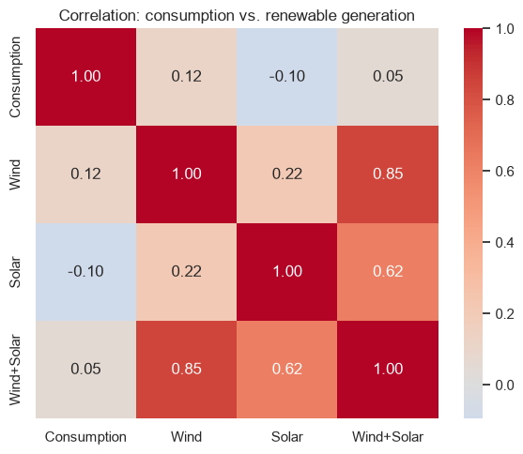
08 Appendix
Consumption and renewable correlations
German Daily Electricity
25 / 53
Notes:
Analysis: open_power_systems_tutorial.ipynb.
Figure: figures/notebook/open_power_systems/cell_013_figure_1.png
Measured results: run_results/open_power_systems_tutorial/results.json.
Notebook cell ID: 4829ec24.

Slide 26
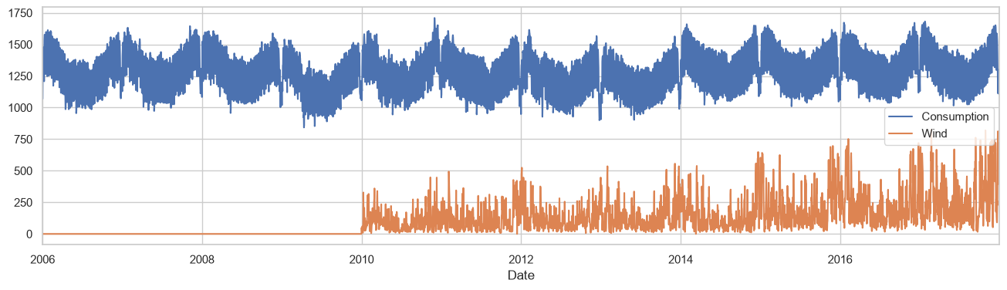
08 Appendix
Consumption and wind generation history
German Daily Electricity
26 / 53
Notes:
Analysis: open_power_systems_tutorial.ipynb.
Figure: figures/notebook/open_power_systems/cell_010_figure_1.png
Measured results: run_results/open_power_systems_tutorial/results.json.
Notebook cell ID: f09e9c35.

Slide 27
08 Appendix
Evaluation metrics
Metric | Meaning | Role
RMSE | Square root of mean squared error | Ranks models and emphasizes large misses
MAE | Mean absolute error | Describes typical error magnitude
R² | Improvement over predicting the test mean | Measures explained variation
Group errors | Metrics by target range or time group | Locates concentrated errors
German Daily Electricity
27 / 53
Notes:
Analysis: open_power_systems_tutorial.ipynb.
Measured results: run_results/open_power_systems_tutorial/results.json.

Slide 28
08 Appendix
Regularization
Model | Objective | Main effect
OLS | Squared error | Fits an additive linear relationship
Ridge | Squared error + L2 penalty | Shrinks correlated coefficients
Lasso | Squared error + L1 penalty | Can set coefficients to zero
Elastic Net | Squared error + L1 and L2 penalties | Combines sparsity and shrinkage
German Daily Electricity
28 / 53
Notes:
Analysis: open_power_systems_tutorial.ipynb.
https://scikit-learn.org/stable/modules/linear_model.html
Measured results: run_results/open_power_systems_tutorial/results.json.

Slide 29
08 Appendix
Linear model results
Model | RMSE | MAE | R²
OLS | 55.1091 | 34.1311 | 0.8838
Ridge | 55.1092 | 34.1312 | 0.8838
Lasso | 56.2245 | 34.8891 | 0.8790
Elastic Net | 55.2141 | 34.3201 | 0.8834
German Daily Electricity
29 / 53
Notes:
Analysis: open_power_systems_tutorial.ipynb.
Measured results: run_results/open_power_systems_tutorial/results.json.
{"Stacking": {"RMSE": 43.89412801672414, "MAE": 23.111985906748576, "R2": 0.92627975515373, "MAPE_%": 1.7590113312719111}, "XGBoost (tuned)": {"RMSE": 44.32737510128147, "MAE": 23.728195158711472, "R2": 0.9248172950776797, "MAPE_%": 1.8075057689566605}, "XGBoost": {"RMSE": 44.52592446664416, "MAE": 23.733372677252785, "R2": 0.9241422761039821, "MAPE_%": 1.8055470996221397}, "RandomForest": {"RMSE": 44.734797950621335, "MAE": 23.855417204029525, "R2": 0.9234289015314964, "MAPE_%": 1.8104909529933908}, "LightGBM": {"RMSE": 44.929503758887314, "MAE": 24.650096208628955, "R2": 0.922760907787942, "MAPE_%": 1.883395530028567}, "CatBoost": {"RMSE": 45.196249923742805, "MAE": 24.061999274464544, "R2": 0.921841049319889, "MAPE_%": 1.8343082366584897}, "CatBoost (tuned)": {"RMSE": 45.20919668992244, "MAE": 24.06889247079699, "R2": 0.9217962646045836, "MAPE_%": 1.8348702565624513}, "LightGBM (tuned)": {"RMSE": 45.22245793500578, "MAE": 24.024346151752493, "R2": 0.9217503787636048, "MAPE_%": 1.8366855433365117}, "RandomForest (tuned)": {"RMSE": 46.47720125626321, "MAE": 24.248138114889123, "R2": 0.9173479074844259, "MAPE_%": 1.8457870477593799}, "MLP": {"RMSE": 50.36941955482558, "MAE": 28.591562269360736, "R2": 0.9029249082973939, "MAPE_%": 2.172497844779718}, "MLP (tuned)": {"RMSE": 52.77832401646748, "MAE": 30.31615413327778, "R2": 0.8934176952740258, "MAPE_%": 2.294327805424836}, "KNN": {"RMSE": 54.023563194926076, "MAE": 30.857072032988917, "R2": 0.8883290096621802, "MAPE_%": 2.3245654290353754}, "LinearRegression": {"RMSE": 55.10910990260637, "MAE": 34.13112474140186, "R2": 0.8837960983233141, "MAPE_%": 2.567487949174709}, "Ridge": {"RMSE": 55.1091651547699, "MAE": 34.13124594897226, "R2": 0.8837958653121039, "MAPE_%": 2.567495964458486}, "ElasticNet": {"RMSE": 55.21412032777479, "MAE": 34.3200905566686, "R2": 0.8833528232571061, "MAPE_%": 2.5799900291010758}, "Lasso": {"RMSE": 56.224500373354495, "MAE": 34.889089292722005, "R2": 0.8790446376471266, "MAPE_%": 2.6179076750014243}, "KNN (tuned)": {"RMSE": 56.69762211672362, "MAE": 33.49819345446784, "R2": 0.8770004260057818, "MAPE_%": 2.505199607283679}}

Slide 30
08 Appendix
Linear model discussion
Results
OLS and Ridge have nearly identical RMSE. Lasso and Elastic Net do not improve it under the selected penalties.
Interpretation
Calendar and demand-history fields overlap. Renewable coefficients can also reflect season and measurement coverage.
Further work
Compare demand-history-only models with models using renewable forecasts available at issue time.
German Daily Electricity
30 / 53
Notes:
Analysis: open_power_systems_tutorial.ipynb.
https://scikit-learn.org/stable/modules/linear_model.html
Measured results: run_results/open_power_systems_tutorial/results.json.

Slide 31
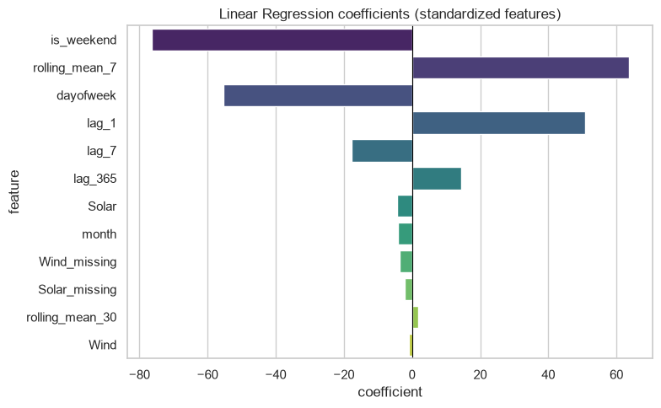
08 Appendix
Linear coefficients
Coefficients describe fitted associations after accounting for the other encoded inputs.
German Daily Electricity
31 / 53
Notes:
Analysis: open_power_systems_tutorial.ipynb.
Figure: figures/notebook/open_power_systems/cell_024_figure_1.png
Measured results: run_results/open_power_systems_tutorial/results.json.
Notebook cell ID: 765fbea4.

Slide 32
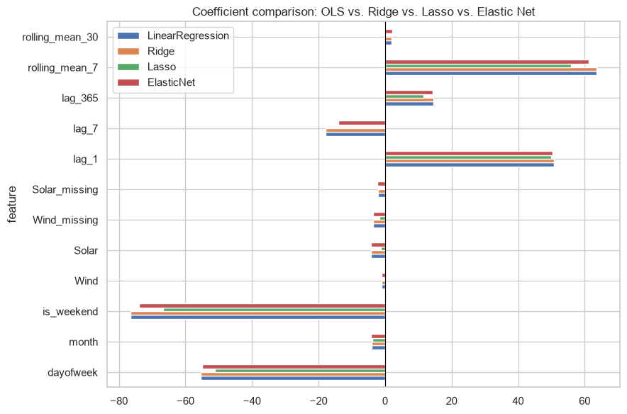
08 Appendix
Regularized coefficients
Coefficients describe fitted associations after accounting for the other encoded inputs.
German Daily Electricity
32 / 53
Notes:
Analysis: open_power_systems_tutorial.ipynb.
Figure: figures/notebook/open_power_systems/cell_029_figure_1.png
Measured results: run_results/open_power_systems_tutorial/results.json.
Notebook cell ID: 7950dfdd.

Slide 33
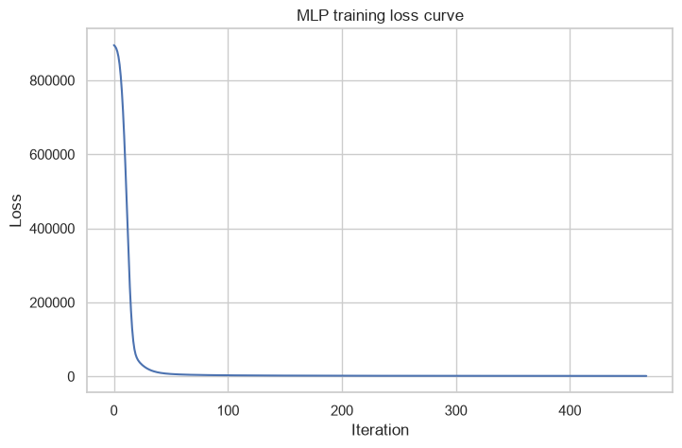
08 Appendix
MLP training loss
Training loss by optimization iteration.
German Daily Electricity
33 / 53
Notes:
Analysis: open_power_systems_tutorial.ipynb.
Figure: figures/notebook/open_power_systems/cell_042_figure_1.png
Measured results: run_results/open_power_systems_tutorial/results.json.
Notebook cell ID: 56bc3bbf.

Slide 34
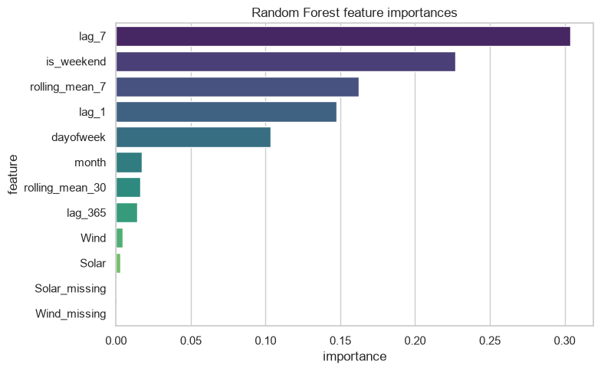
08 Appendix
Random Forest feature importance
Demand history and calendar features provide core signal. Generation-related importance depends on measurement coverage and input timing.
German Daily Electricity
34 / 53
Notes:
Analysis: open_power_systems_tutorial.ipynb.
Figure: figures/notebook/open_power_systems/cell_047_figure_1.png
Measured results: run_results/open_power_systems_tutorial/results.json.
Notebook cell ID: 8cb8f20e.

Slide 35
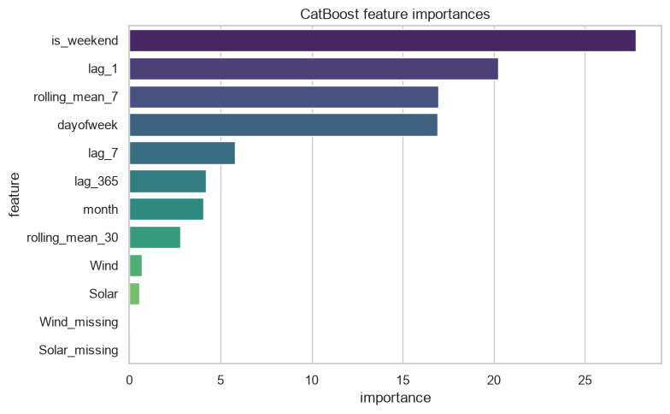
08 Appendix
CatBoost feature importance
Demand history and calendar features provide core signal. Generation-related importance depends on measurement coverage and input timing.
German Daily Electricity
35 / 53
Notes:
Analysis: open_power_systems_tutorial.ipynb.
Figure: figures/notebook/open_power_systems/cell_060_figure_1.png
Measured results: run_results/open_power_systems_tutorial/results.json.
Notebook cell ID: e72900db.

Slide 36
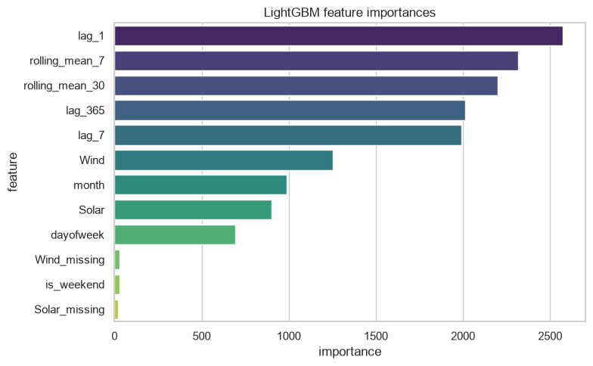
08 Appendix
LightGBM feature importance
Demand history and calendar features provide core signal. Generation-related importance depends on measurement coverage and input timing.
German Daily Electricity
36 / 53
Notes:
Analysis: open_power_systems_tutorial.ipynb.
Figure: figures/notebook/open_power_systems/cell_066_figure_1.png
Measured results: run_results/open_power_systems_tutorial/results.json.
Notebook cell ID: 3d28aa25.

Slide 37
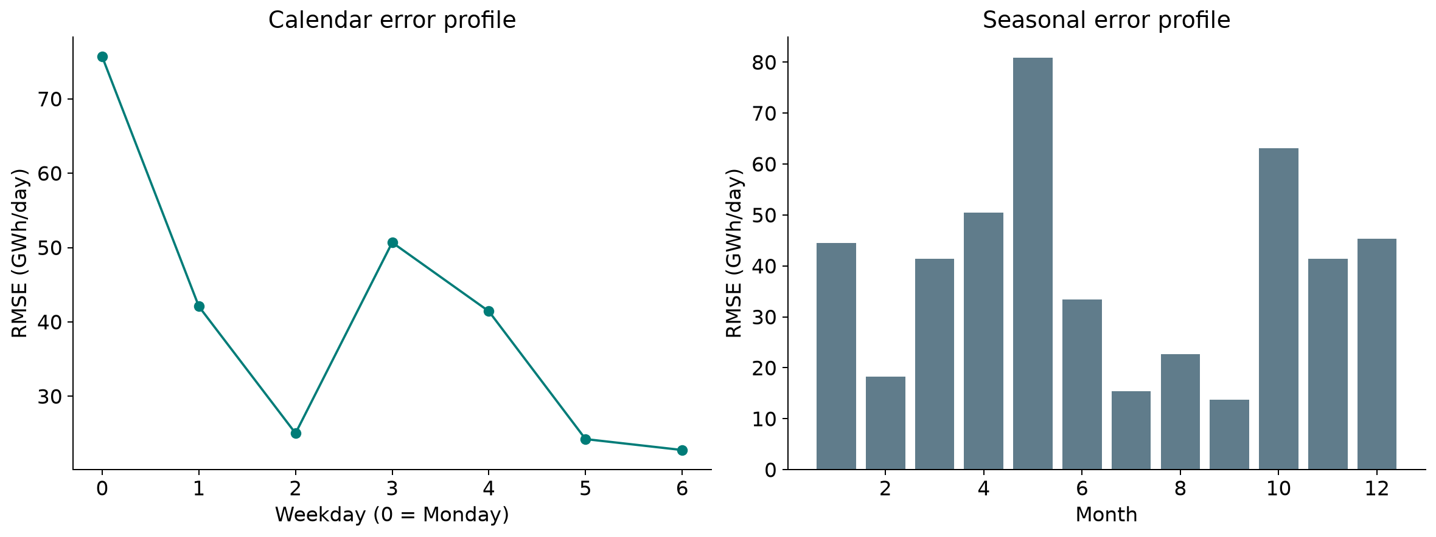
08 Appendix
Error by month and weekday
Calendar slices show how prediction error varies across operating conditions.
German Daily Electricity
37 / 53
Notes:
Analysis: open_power_systems_tutorial.ipynb.
Figure: figures/open_power_systems/calendar_errors.png
Measured results: run_results/open_power_systems_tutorial/results.json.

Slide 38
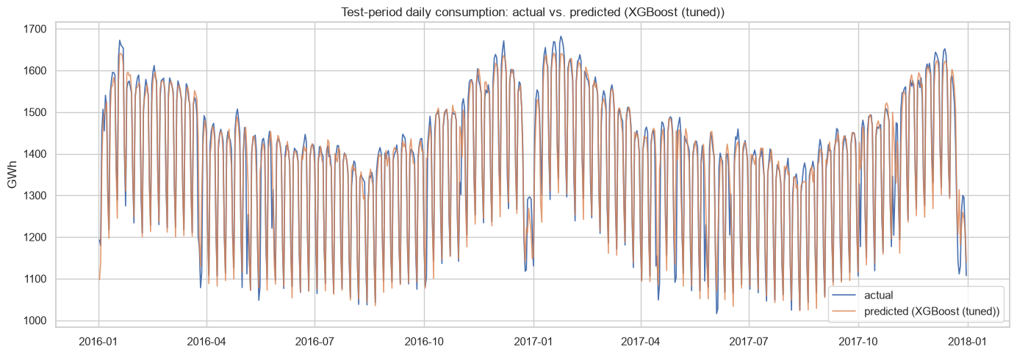
08 Appendix
Actual and predicted test-period consumption
Actual outcomes and predictions on the test partition.
German Daily Electricity
38 / 53
Notes:
Analysis: open_power_systems_tutorial.ipynb.
Figure: figures/notebook/open_power_systems/cell_073_figure_1.png
Measured results: run_results/open_power_systems_tutorial/results.json.
Notebook cell ID: 099a1c0d.

Slide 39
08 Appendix
Error by target range
Test target band | Rows | MAE | Mean prediction error
Q1: (1016.023, 1272.785] | 183 | 33.9776 | 19.9998
Q2: (1272.785, 1407.601] | 182 | 21.5892 | -5.4501
Q3: (1407.601, 1498.972] | 182 | 17.5383 | -10.5658
Q4: (1498.972, 1682.002] | 183 | 19.3040 | -9.2031
Errors for Stacking. Mean error = prediction − actual. Units: GWh per day.
German Daily Electricity
39 / 53
Notes:
Analysis: open_power_systems_tutorial.ipynb.
Measured results: run_results/open_power_systems_tutorial/results.json.

Slide 40
08 Appendix
Application
Topic | Application
Current inputs | Wind and solar measurements refer to the same day as the consumption target.
Day-ahead use | Replace them with forecasts or lagged observations available when the forecast is issued.
Calendar effects | Add public holidays and weather forecasts, then compare peak-day errors.
German Daily Electricity
40 / 53
Notes:
Analysis: open_power_systems_tutorial.ipynb.
Measured results: run_results/open_power_systems_tutorial/results.json.

Slide 41
08 Appendix
Model selection Q&A
Why include penalized linear models?
Ridge uses L2 shrinkage to stabilize coefficients. Lasso uses L1 to encourage zeros. Elastic Net combines the penalties. Logistic models use the same penalty types for classification.
Why standardize the predictors?
Penalties and distance calculations depend on feature units. Scaling also helps neural-network optimization. Estimate the scaling parameters from training data.
Why include stacking?
It has the best observed score here. Combining models helps only when their errors are sufficiently different. Compare its gain with inference and maintenance cost.
German Daily Electricity
41 / 53
Notes:
Analysis: open_power_systems_tutorial.ipynb.
https://scikit-learn.org/stable/modules/linear_model.html
https://scikit-learn.org/stable/modules/neighbors.html
https://scikit-learn.org/stable/modules/neural_networks_supervised.html
Measured results: run_results/open_power_systems_tutorial/results.json.

Slide 42
08 Appendix
Model interpretation Q&A
How do forests and boosting differ?
Random Forest averages trees trained with randomized rows and features. Boosting adds trees sequentially to reduce the chosen loss.
What does feature importance mean?
It describes how the fitted model uses its inputs. Related predictors can share importance. A high value does not establish a causal effect.
What do the resampling intervals cover?
They measure variation in the available test predictions with the fitted models fixed. A new split also tests sensitivity to training and model selection.
German Daily Electricity
42 / 53
Notes:
Analysis: open_power_systems_tutorial.ipynb.
https://scikit-learn.org/stable/modules/ensemble.html
https://xgboost.readthedocs.io/en/stable/tutorials/model.html
Measured results: run_results/open_power_systems_tutorial/results.json.

Slide 43
08 Appendix
Data Q&A
Can same-day generation be used?
It can support prediction when available at the decision time. Day-ahead use requires generation forecasts or lagged measurements.
Why add missingness indicators?
They distinguish an unavailable generation measurement from an observed zero. Coverage changes can then be inspected explicitly.
German Daily Electricity
43 / 53
Notes:
Analysis: open_power_systems_tutorial.ipynb.
Measured results: run_results/open_power_systems_tutorial/results.json.

Slide 44
08 Appendix
Results Q&A
Why use weekly and annual lags?
They capture recurring demand patterns. The annual lag can shift weekdays and leap-year alignment, so calendar features also matter.
Which features could improve peak-day errors?
Test weather forecasts and public holidays. Compare their value over several chronological evaluation windows.
German Daily Electricity
44 / 53
Notes:
Analysis: open_power_systems_tutorial.ipynb.
Measured results: run_results/open_power_systems_tutorial/results.json.

Slide 45
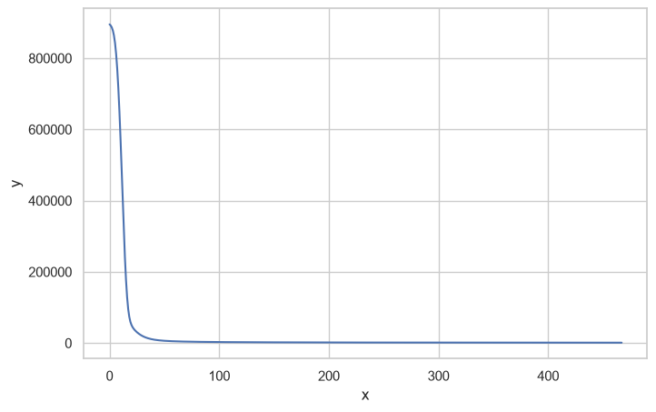
08 Appendix
MLP training loss
Training loss by optimization iteration.
German Daily Electricity
45 / 53
Notes:
Analysis: open_power_systems_tutorial.ipynb.
Figure: figures/notebook/open_power_systems/cell_043_figure_1.png
Measured results: run_results/open_power_systems_tutorial/results.json.
Notebook cell ID: 715e6d7e.

Slide 46
08 Appendix
Random Forest feature importance
Demand history and calendar features provide core signal. Generation-related importance depends on measurement coverage and input timing.
German Daily Electricity
46 / 53
Notes:
Analysis: open_power_systems_tutorial.ipynb.
Figure: figures/notebook/open_power_systems/cell_048_figure_1.png
Measured results: run_results/open_power_systems_tutorial/results.json.
Notebook cell ID: bba47913.

Slide 47
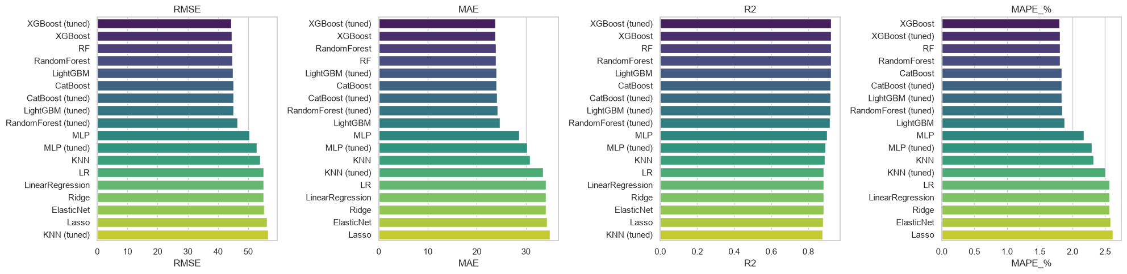
08 Appendix
Individual model metrics
Notebook comparison of individual models. The full results tables also include stacking.
German Daily Electricity
47 / 53
Notes:
Analysis: open_power_systems_tutorial.ipynb.
Figure: figures/notebook/open_power_systems/cell_072_figure_1.png
Measured results: run_results/open_power_systems_tutorial/results.json.
Notebook cell ID: 585ef066.

Slide 48
08 Appendix
Full results (1 of 2)
Model | RMSE | MAE | R² | MAPE %
Stacking | 43.8941 | 23.1120 | 0.9263 | 1.7590
XGBoost (tuned) | 44.3274 | 23.7282 | 0.9248 | 1.8075
XGBoost | 44.5259 | 23.7334 | 0.9241 | 1.8055
Random Forest | 44.7348 | 23.8554 | 0.9234 | 1.8105
LightGBM | 44.9295 | 24.6501 | 0.9228 | 1.8834
CatBoost | 45.1962 | 24.0620 | 0.9218 | 1.8343
CatBoost (tuned) | 45.2092 | 24.0689 | 0.9218 | 1.8349
LightGBM (tuned) | 45.2225 | 24.0243 | 0.9218 | 1.8367
Forest (tuned) | 46.4772 | 24.2481 | 0.9173 | 1.8458
German Daily Electricity
48 / 53
Notes:
Analysis: open_power_systems_tutorial.ipynb.
Measured results: run_results/open_power_systems_tutorial/results.json.
{"Stacking": {"RMSE": 43.89412801672414, "MAE": 23.111985906748576, "R2": 0.92627975515373, "MAPE_%": 1.7590113312719111}, "XGBoost (tuned)": {"RMSE": 44.32737510128147, "MAE": 23.728195158711472, "R2": 0.9248172950776797, "MAPE_%": 1.8075057689566605}, "XGBoost": {"RMSE": 44.52592446664416, "MAE": 23.733372677252785, "R2": 0.9241422761039821, "MAPE_%": 1.8055470996221397}, "RandomForest": {"RMSE": 44.734797950621335, "MAE": 23.855417204029525, "R2": 0.9234289015314964, "MAPE_%": 1.8104909529933908}, "LightGBM": {"RMSE": 44.929503758887314, "MAE": 24.650096208628955, "R2": 0.922760907787942, "MAPE_%": 1.883395530028567}, "CatBoost": {"RMSE": 45.196249923742805, "MAE": 24.061999274464544, "R2": 0.921841049319889, "MAPE_%": 1.8343082366584897}, "CatBoost (tuned)": {"RMSE": 45.20919668992244, "MAE": 24.06889247079699, "R2": 0.9217962646045836, "MAPE_%": 1.8348702565624513}, "LightGBM (tuned)": {"RMSE": 45.22245793500578, "MAE": 24.024346151752493, "R2": 0.9217503787636048, "MAPE_%": 1.8366855433365117}, "RandomForest (tuned)": {"RMSE": 46.47720125626321, "MAE": 24.248138114889123, "R2": 0.9173479074844259, "MAPE_%": 1.8457870477593799}, "MLP": {"RMSE": 50.36941955482558, "MAE": 28.591562269360736, "R2": 0.9029249082973939, "MAPE_%": 2.172497844779718}, "MLP (tuned)": {"RMSE": 52.77832401646748, "MAE": 30.31615413327778, "R2": 0.8934176952740258, "MAPE_%": 2.294327805424836}, "KNN": {"RMSE": 54.023563194926076, "MAE": 30.857072032988917, "R2": 0.8883290096621802, "MAPE_%": 2.3245654290353754}, "LinearRegression": {"RMSE": 55.10910990260637, "MAE": 34.13112474140186, "R2": 0.8837960983233141, "MAPE_%": 2.567487949174709}, "Ridge": {"RMSE": 55.1091651547699, "MAE": 34.13124594897226, "R2": 0.8837958653121039, "MAPE_%": 2.567495964458486}, "ElasticNet": {"RMSE": 55.21412032777479, "MAE": 34.3200905566686, "R2": 0.8833528232571061, "MAPE_%": 2.5799900291010758}, "Lasso": {"RMSE": 56.224500373354495, "MAE": 34.889089292722005, "R2": 0.8790446376471266, "MAPE_%": 2.6179076750014243}, "KNN (tuned)": {"RMSE": 56.69762211672362, "MAE": 33.49819345446784, "R2": 0.8770004260057818, "MAPE_%": 2.505199607283679}}

Slide 49
08 Appendix
Full results (2 of 2)
Model | RMSE | MAE | R² | MAPE %
MLP | 50.3694 | 28.5916 | 0.9029 | 2.1725
MLP (tuned) | 52.7783 | 30.3162 | 0.8934 | 2.2943
KNN | 54.0236 | 30.8571 | 0.8883 | 2.3246
OLS | 55.1091 | 34.1311 | 0.8838 | 2.5675
Ridge | 55.1092 | 34.1312 | 0.8838 | 2.5675
Elastic Net | 55.2141 | 34.3201 | 0.8834 | 2.5800
Lasso | 56.2245 | 34.8891 | 0.8790 | 2.6179
KNN (tuned) | 56.6976 | 33.4982 | 0.8770 | 2.5052
German Daily Electricity
49 / 53
Notes:
Analysis: open_power_systems_tutorial.ipynb.
Measured results: run_results/open_power_systems_tutorial/results.json.
{"Stacking": {"RMSE": 43.89412801672414, "MAE": 23.111985906748576, "R2": 0.92627975515373, "MAPE_%": 1.7590113312719111}, "XGBoost (tuned)": {"RMSE": 44.32737510128147, "MAE": 23.728195158711472, "R2": 0.9248172950776797, "MAPE_%": 1.8075057689566605}, "XGBoost": {"RMSE": 44.52592446664416, "MAE": 23.733372677252785, "R2": 0.9241422761039821, "MAPE_%": 1.8055470996221397}, "RandomForest": {"RMSE": 44.734797950621335, "MAE": 23.855417204029525, "R2": 0.9234289015314964, "MAPE_%": 1.8104909529933908}, "LightGBM": {"RMSE": 44.929503758887314, "MAE": 24.650096208628955, "R2": 0.922760907787942, "MAPE_%": 1.883395530028567}, "CatBoost": {"RMSE": 45.196249923742805, "MAE": 24.061999274464544, "R2": 0.921841049319889, "MAPE_%": 1.8343082366584897}, "CatBoost (tuned)": {"RMSE": 45.20919668992244, "MAE": 24.06889247079699, "R2": 0.9217962646045836, "MAPE_%": 1.8348702565624513}, "LightGBM (tuned)": {"RMSE": 45.22245793500578, "MAE": 24.024346151752493, "R2": 0.9217503787636048, "MAPE_%": 1.8366855433365117}, "RandomForest (tuned)": {"RMSE": 46.47720125626321, "MAE": 24.248138114889123, "R2": 0.9173479074844259, "MAPE_%": 1.8457870477593799}, "MLP": {"RMSE": 50.36941955482558, "MAE": 28.591562269360736, "R2": 0.9029249082973939, "MAPE_%": 2.172497844779718}, "MLP (tuned)": {"RMSE": 52.77832401646748, "MAE": 30.31615413327778, "R2": 0.8934176952740258, "MAPE_%": 2.294327805424836}, "KNN": {"RMSE": 54.023563194926076, "MAE": 30.857072032988917, "R2": 0.8883290096621802, "MAPE_%": 2.3245654290353754}, "LinearRegression": {"RMSE": 55.10910990260637, "MAE": 34.13112474140186, "R2": 0.8837960983233141, "MAPE_%": 2.567487949174709}, "Ridge": {"RMSE": 55.1091651547699, "MAE": 34.13124594897226, "R2": 0.8837958653121039, "MAPE_%": 2.567495964458486}, "ElasticNet": {"RMSE": 55.21412032777479, "MAE": 34.3200905566686, "R2": 0.8833528232571061, "MAPE_%": 2.5799900291010758}, "Lasso": {"RMSE": 56.224500373354495, "MAE": 34.889089292722005, "R2": 0.8790446376471266, "MAPE_%": 2.6179076750014243}, "KNN (tuned)": {"RMSE": 56.69762211672362, "MAE": 33.49819345446784, "R2": 0.8770004260057818, "MAPE_%": 2.505199607283679}}

Slide 50
08 Appendix
Model settings
Model | Parameters
KNN | n_neighbors=15, weights='distance', p=1
MLP | hidden_layer_sizes=(128, 64), alpha=0.0001, max_iter=1000, early_stopping=True
Random Forest | n_estimators=300, max_depth=None, min_samples_leaf=2
XGBoost | n_estimators=500, learning_rate=0.05, max_depth=5
CatBoost | iterations=500, learning_rate=0.05, depth=6
LightGBM | n_estimators=500, learning_rate=0.05, num_leaves=31
Searches use two folds and two candidates. Each selected estimator refits on the full training partition.
German Daily Electricity
50 / 53
Notes:
Analysis: open_power_systems_tutorial.ipynb.
Seed 42. Stacking uses two ordinary folds. Penalized linear models test three strengths. See the notebook for all constructor arguments.
Measured results: run_results/open_power_systems_tutorial/results.json.

Slide 51
08 Appendix
Selected hyperparameters (1 of 2)
Model | Selected parameters
KNN | n_neighbors=15, p=2, weights=distance
MLP | hidden_layer_sizes=(64, 32), alpha=0.001
Random Forest | n_estimators=300, min_samples_leaf=5, max_depth=12
German Daily Electricity
51 / 53
Notes:
Analysis: open_power_systems_tutorial.ipynb.
Measured results: run_results/open_power_systems_tutorial/results.json.

Slide 52
08 Appendix
Selected hyperparameters (2 of 2)
Model | Selected parameters
XGBoost | n_estimators=500, max_depth=5, learning_rate=0.03
CatBoost | learning_rate=0.05, iterations=500, depth=6
LightGBM | num_leaves=31, n_estimators=500, learning_rate=0.03
German Daily Electricity
52 / 53
Notes:
Analysis: open_power_systems_tutorial.ipynb.
Measured results: run_results/open_power_systems_tutorial/results.json.

Slide 53
08 Appendix
Sources
Dataset
Methods
Open Power System Data, German daily time series
scikit-learn, XGBoost, CatBoost and LightGBM documentation.
Project analysis
Statistical analysis
open_power_systems_tutorial.ipynb
Paired resampling of test predictions, residual analysis and group-level error checks.
German Daily Electricity
53 / 53
Notes:
Analysis: open_power_systems_tutorial.ipynb.
https://scikit-learn.org/stable/modules/linear_model.html
https://scikit-learn.org/stable/modules/neighbors.html
https://scikit-learn.org/stable/modules/neural_networks_supervised.html
https://scikit-learn.org/stable/modules/ensemble.html
https://xgboost.readthedocs.io/en/stable/tutorials/model.html
https://catboost.ai/docs/en/concepts/algorithm-main-stages_cat-to-numberic
https://lightgbm.readthedocs.io/en/stable/Features.html
https://www.statsmodels.org/stable/generated/statsmodels.tsa.statespace.sarimax.SARIMAX.html
Measured results: run_results/open_power_systems_tutorial/results.json.

